Slide 1
Financial Reporting and Program Income
SMART 3.0 Training
June 2019
Notes:
1

Slide 2
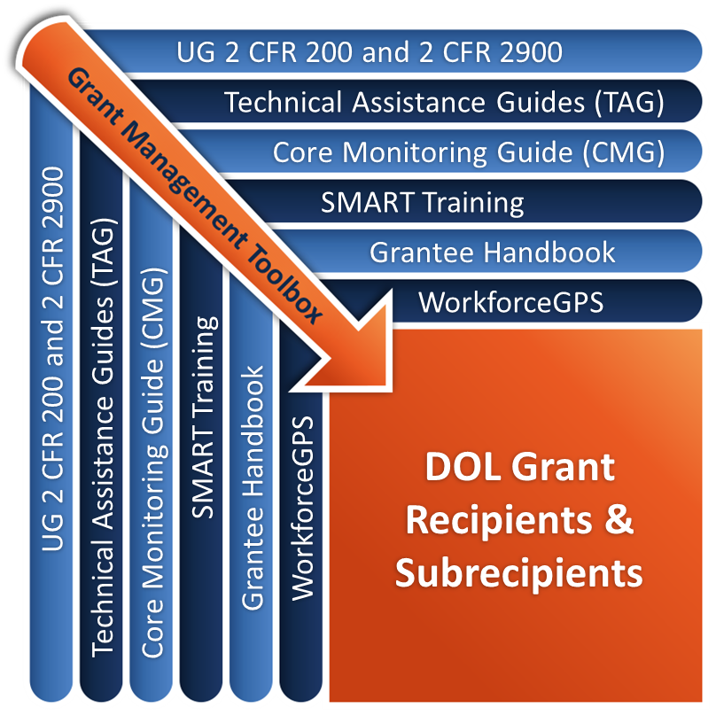
Grant Management Toolbox

Slide 3
Grant Management Toolbox References
SMART
SMART Training
Core Monitoring Guide
Technical Assistance Guides
ETA Grantee Handbook
WorkforceGPS Resources
CMG
TAG
Grantee Handbook
GPS

Slide 4
Module Overview
Basics
DOL financial reporting requirements
ETA 9130
Identify the data elements reported on the ETA 9130 Financial Report
Subrecipient Reporting
Identify the subrecipient reporting requirements
Common Issues
Avoid common mistakes and their consequences

Slide 5
Basics
DOL financial reporting requirements

Slide 6
Why We Need Financial Data
DOL uses data to report to Congress and other stakeholders (can influence future funding)
Track program performance against financial spending (identify potential technical assistance)
Helps avoid returning grant funds back to DOL

Slide 7
Tools For Accurate Financial Data
Accounting systems including charts of accounts to compile, identify and track financial transactions by classifications for reporting purposes
Reliable and knowledgeable staff to perform the monthly accounting process and produce the required financial reports
Policies and procedures. Internal controls to ensure a consistent process of compiling, identifying, tracking and reporting financial transactions

Slide 8
Authorization of ETA 9130
Uniform Guidance 2 CFR Part 200
Financial Management 2 CFR 200.302(b)(2) requires accurate, current, complete disclosure of financial results
Financial Reporting 2 CFR 200.327 requires no less frequently than annually nor more frequently than quarterly per terms and conditions of Federal award, except in unusual circumstances
DOL Exception 2 CFR 2900.14 Financial reporting
Recipient must develop accrual information through best estimates based on an analysis of the documentation at hand

Slide 9
ETA Guidance on Financial Reporting
Training & Employment Guidance Letter (TEGL) 2-16: Revised ETA-9130 Financial Report, Instructions, and Additional Guidance
Published July 14, 2016
Financial Reporting Process
Password and PIN Assignments
Report Submission
Reporting Requirements
Changes to Reporting Requirements

Slide 10
Basic Reporting Requirements
Basis
Accrual
Frequency
Quarterly and cumulative
Due 45 days after quarter end
QE Mar 31, Due May 15
QE Jun 30, Due Aug 14
QE Sep 30, Due Nov 14
QE Dec 31, Due Feb 14
Transmission method
ETA on-line reporting system

Slide 11
ETA 9130 Report : Final vs. Closeout Reports
Final report
Due no later than 45 calendar days after the reporting period
in which the grant period of performance expires
or all funds, Federal AND recipient share, are expended
WHICHEVER comes first
Closeout report
Must be submitted no later than 90 calendar days after the expiration of the grant regardless of whether funds are fully expended prior to the POP expiration date.

Slide 12
Reporting Periods, Due Dates and Cumulative Data
Each report must be complete and accurate for all levels where funds are expended through the last day of the quarterly report period.
Ensure that data is reported by subrecipients and submitted to DOL by the due date.
DOL financial reports are cumulative until the end of the life of the allotments or the period of performance for the DOL awards.

Slide 13
Online Reporting System
Follow instructions in the Notice of Award
Provide requested reporting contact information
An e-mail is sent to primary contact with password and PIN
System is user-friendly and provides guidance to assist user in completing the ETA 9130 form
System edits – hard and soft
http://www.doleta.gov/grants/pdf/FSR_eform.pdf

Slide 14
Password and PINs
Uses for Each
Password issued to access system and enter data
PIN issued to certify data
Instructions link provides information on how to use system
http://www.doleta.gov/grants/pdf/FSR_eform.pdf

Slide 15
ETA-9130 Requirements
Identify the data elements reported on the ETA 9130 Financial Report
Identify the different ETA 9130 versions and sections

Slide 16
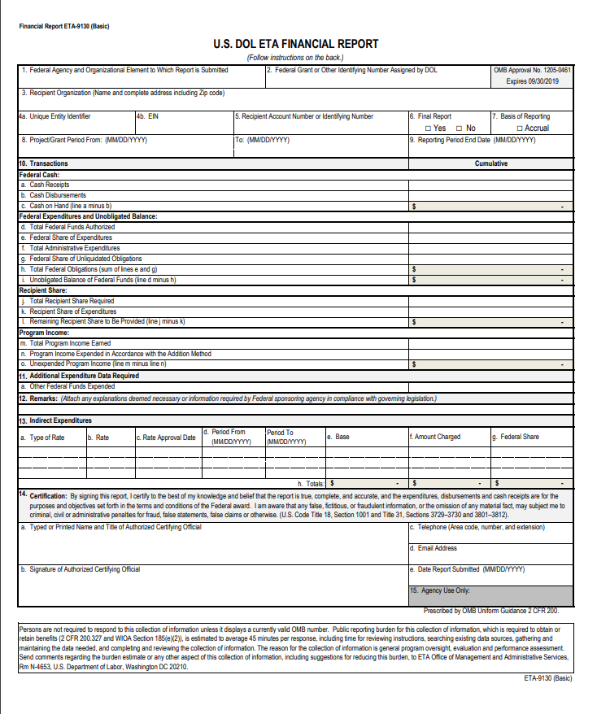
The ETA-9130 Financial Report
The ETA 9130 has 14 versions:
Basic 9130 plus 13 program-specific versions
Every funding source requires its own report
Basic ETA 9130
http://www.doleta.gov/grants/financial_reporting.cfm

Slide 17
9130 Versions
Basic ETA 9130 (Discretionary)
WIOA - Local Youth
WIOA - Local Adult
WIOA - Local Dislocated Worker
WIOA - Statewide Youth
WIOA - Statewide Adult
WIOA - Statewide Dislocated Worker
WIOA - Statewide Rapid Response
National Dislocated Worker Grants
Employment Services & Unemployment Insurance
National Farmworker Jobs Program
Senior Community Service Employment Program
Indian & Native American Program
Trade Adjustment Assistance Program

Slide 18
Sections of the ETA 9130
Basic Information
Federal Cash Section (10a-10c)(1-9)
Federal Expenditures and Unobligated Balance (10d-10i)
Recipient Share (10j-10l)
Program Income (10m-10o)
Additional Expenditure Data Required (11)
Remarks (12)
Indirect Expenditures (13a-13g)
Certification (14)

Slide 19
ETA-9130 Report Basic Information
Sections 1-9
Federal Agency
Federal Grant Number
Recipient Organization
Unique Entity Identifier / EIN
Recipient Account Number
Final Report
Basis of Reporting
Project Grant Period
Reporting End Date

Slide 20
Federal Cash
10a: Cash Receipts
What did you draw down from the PMS as of the report quarter end date?
Data pre-entered for non-formula; data must be entered for WIOA formula programs
10b: Cash Disbursements
What cash has been disbursed?
Of cash drawn down from PMS, how much disbursed for grant activities?
10c: Cash on Hand
Automatic calculation
Excess cash requirements apply, explain in Remarks

Slide 21
Cash – Keep in Mind
Cash disbursements (line 10b) cannot be greater than cash receipts (line 10a)
Generally cash disbursements (line 10 b cannot be greater than federal share of expenditures (line 10e)
What if too much cash is drawn?
Immediate needs
Returning funds to PMS or after grant has closed - ETA-ARTeam@dol.gov
Must address any and all issues with explanation in Section 12 Remarks

Slide 22
Cash – Issues
What documentation is used to determine how much to draw down from PMS?
Accruals beyond immediate cash needs
Use grant funds to pay for other activities
Must deposit funds in an interest bearing account

Slide 23
Federal Expenditures and Unobligated Balance
Lines 10d through 10i
10d. Federal funds authorized
10e. Federal Share of Expenditures
10f. Administrative Expenditures
10g. Unliquidated obligations
10h. Total Federal obligations
10i. Unobligated Balance

Slide 24
10e Federal Share of Expenditures
Line 10e includes actual cash paid out plus the value of all goods / services received but not yet paid.
Cannot exceed 10d (Federal funds) – hard edit
Will usually be greater than 10b
Net of Refunds, Rebates and Credits
If less than prior reported cumulative amount
Soft Edit, Caution, Remarks must include explanations

Slide 25
Expenditures – Keep in Mind
Examples of accruals:
Salaries
Goods received but invoices not paid
Goods or services received; not yet invoiced
NOT Accruals:
Orders placed but not yet received
Obligations
Encumbrances
Accruals can be estimations
If accruals for estimates are actually recorded in the accounting system as accruals, they must be reversed in the following reporting period to avoid over reporting of expenditures

Slide 26
Expenditures – Issues
All accruals not included
Grantee do not include accruals they do not have invoices for
Pass through entities do not collect and / or include the accruals of subrecipients
Grantees not including expenditures for full reporting period

Slide 27
10f Administrative Expenditures
Not every program uses same definition
WIOA definition
TAA
SCSEP
Not all grants have same limits
Includes direct and indirect administrative costs

Slide 28
10g Federal Share Unliquidated Obligations
Unliquidated Obligations
The sum/value of undelivered services/goods under a legal binding agreement
The amount of obligations for which an accrued expenditure (line 10e) has not yet been incurred

Slide 29
Unliquidated Obligations – Keep in Mind
NOT Unliquidated Obligations
Projected staff salaries
Future rents (except termination fee)
Budget items not yet expended
Need to update regularly as over-obligating can lead to returning funds to DOL

Slide 30
Recipient Share
10j. Total Recipient Share Required
10k. Recipient Share of Expenditures
10l. Remaining Recipient Share to be Provided

Slide 31
Recipient Share - Keep in Mind
Required Match
Must be reported in the period expended
Leveraged Resources
Grantees are encouraged to report leveraged resources (amounts greater than required match if there is a match requirement)
Lack of Documentation
In-kind contributions need to be supported by documentation
Stand-In Costs
Recipient cannot use stand-in costs to address disallowed costs unless they report these costs in the period in which they occur on line 10k

Slide 32
Program Income
10m. Total Program Income Earned
10n. Program Income expended
10o. Unexpended program income
Program Income must always be SPENT FIRST before requesting new grant funds from PMS

Slide 33
Program Income – Keep in Mind
Often Not Reported Correctly
What You Need to Watch Out For
The definition of program income is at 2 CFR 200.80
Direct grantees must include program income earned and expended by subrecipients

Slide 34
Program Income – Keep in Mind (cont.)
Program income examples:
Interest from interest bearing accounts
Rental of space
Program income exceptions:
Government revenues
Income earned after end of grant period
Donations
Profits of commercial organizations
Matching funds
YouthBuild proceeds from the sale of buildings constructed or renovated
Sale of property
Royalties

Slide 35
Additional Expenditure Data Requirements
11a: Other Federal funds expended: Found on all reporting forms
11b-11g: Required items vary by program
Examples
Real property proceeds expended (WIOA, ES, UI)
Local Youth

Slide 36
Section 12 Remarks
Enter Information for Items Requiring Explanations
Excess cash on hand
Reduction in cumulative expenditures
Decrease in disbursements
UI Supplemental Budget Request detail
Other significant expenditure adjustments (e.g., FIFO adjustments, prior period changes)

Slide 37
Section 13 Indirect Expenditures
13. Indirect Expenditures
Type of Rate
Rate
Rate Approval Date
Period
Base
Amount Charged
Federal Share
Totals

Slide 38
Section 14 Certification
Certification done by entering PIN
Same as affixing a signature of authorized Certifying Official

Slide 39
Knowledge Check 1 – Questions
True or False?
If the accounting system is on a cash basis, accrual reporting is not required.
ETA 9130 Report line 10.b, Cash Disbursements should always equal or exceed line 10.e, Federal Share of Accrued Expenditures.
Examples of accruals include salaries, goods received but invoices not paid, and goods or services received but not yet invoiced.
Interest income earned on title I WIOA and Wagner-Peyser funds must be included as program income on the ETA 9130 report.

Slide 40
Knowledge Check 1 – Answers
If the accounting system is on a cash basis, accrual reporting is not required. False
ETA 9130 Report line 10.b, Cash Disbursements should always equal or exceed line 10.e, Federal Share of Accrued Expenditures. False
Examples of accruals include salaries, goods received but invoices not paid, and goods or services received but not yet invoiced. True
Interest income earned on title I WIOA and Wagner-Peyser funds must be included as program income on the ETA 9130 report. True

Slide 41
Subrecipient Reporting
Identify the subrecipient reporting requirements

Slide 42
Lack of Familiarity with ETA Grants
What do I need to worry about?
My subrecipient is new to ETA grants, but has plenty of experience handling grants from other Federal agencies
I am sure they know how to fill out these reports

Slide 43
Reminders for Subrecipient Reporting
Each entity with subrecipients is responsible for collecting/monitoring all required DOL reporting elements
Direct grant recipient may impose different forms, shorter due dates, more frequent reporting requirements on subrecipients
Monthly reporting better for managing subawards
Certain data often missed/not collected – make sure report formats reflect required elements

Slide 44
Subrecipient Reporting Considerations
Start with the reports you must prepare for ETA
Timing – Frequency and due dates
Quarterly
Due 45 days after the end of the quarter
When would you need data from your subrecipients to meet your reporting deadlines?
Data items
Information required on the ETA 9130
Other data: by budget category, unique requirements?
Other reporting requirements
Accruals

Slide 45
Timing Issues
How often do I need financial information to manage the program?
Questions to Ask
Is quarterly reporting sufficient?
Is there time to take appropriate corrective actions?
Budget realignments
Other modifications
Implement corrective action plans
Make other corrections
How are reports transmitted?

Slide 46
Timing Issues – Subrecipients
When do I need to receive subrecipient reports?
How many subrecipients?
How long to compile data?
What if reports are late?
What if reports are missing?
Process for obtaining estimates
Is monthly reporting a better option?

Slide 47
Data Items
What information do I need?
Same data as on Federal reports?
More?
Less?
What data would allow me to effectively manage?

Slide 48
Other Data Items
What is required on the Federal reports?
Cash
Obligations
Program income – earned and spent
Recipients share
Leverages Resources
Other Federal funds
Do I have another way to get this?

Slide 49
Data Items – Cost Item Breakouts
What about these items?
Costs by activities?
Costs by budget line items?
What is in the subagreement?
Line item restrictions?
Prior approval requirements?

Slide 50
Reporting Requirements
Reporting expenditures on the accrual basis
Adhering to the requirements for program income
Allocating costs to funding sources and cost categories/objectives

Slide 51
Knowledge Check 2 – Questions
True or False?
Recipients must submit financial reports not later than 45 days after the end of the reporting period.
In designing subrecipient reporting forms the PTE should include information it needs for reporting to DOL.
PTEs should consider having subrecipients report more frequently than quarterly.
Accrual reporting is required for the PTE but not for subrecipients.

Slide 52
Knowledge Check 2 – Answers
Recipients must submit financial reports not later than 45 days after the end of the reporting period. True
In designing subrecipient reporting forms the PTE should include information it needs for reporting to DOL. True
PTEs should consider having subrecipients report more frequently than quarterly. True
Accrual reporting is required for the PTE but not for subrecipients. False

Slide 53
Common Reporting Issues
Avoid common mistakes and their consequences

Slide 54
Common Reporting Issues and Mistakes
Recipients and subrecipients not reporting on accrual basis
Cash disbursements exceed expenditures
Inaccurate reporting at subrecipient levels, which results in inaccurate reporting by direct recipients
Important data items not collected from subrecipients
Administrative expenses exceeding limit
Classifying administrative expenses as program costs
Not meeting minimum limits for Work Experience or Out of School Youth.
Calculating/reporting indirect costs on basis other than that prescribed in negotiated rate agreement
Inconsistent reporting
Underreporting of program expenditures
Late reporting

Slide 55
Solutions for Reporting Issue
Develop instructions and format for subrecipient reporting
Spell out the reporting requirements to your subrecipients
Provide definitions and explanations of each reporting item on your reporting format

Slide 56
Module Review
Accurate financial reporting from all levels where funds are expended requires understanding of the rules, definitions and reporting elements
Financial data reported each quarter can impact future funding levels and other budget decisions
Authorized individual entering PIN is certifying that report is accurate, complete and complies with reporting requirements
Accurate and complete financial reporting by subrecipients is critical to a direct grantee’s own reporting accuracy

Slide 57
Core Monitoring Guide – Objective 3.b Accounting System and Financial Reporting
Indicator 3.b.1: Basis of Reporting
Is there a policy in place that ensures accounts are reporting on an accrual basis?
Indicator 3.b.2: Financial Reporting
Does the grant recipient have procedures in place to ensure that it obligates and expends the funds within the period of availability and within the period of performance specified in the Grant Agreement or grant modification?
Indicator 3.b.3: Subrecipient’s Financial Reporting
If the subrecipient uses estimated accrual data, does the PTE understand the basis of the estimate and verifies if reasonable?
Indicator 3.b.4: Performance Reports
How does the grant recipient ensure spending in accordance with its performance? Will funds be exhausted prior to meeting performance goals? If so, how with the grant recipient address this?
CMG

Slide 58
SMART Checklist
Financial Reporting
Develop and update procedures that track obligations, accrued expenditures, and disbursements to include the data elements identified at 2 CFR 200.302.
Develop a process to track accrual data in the accounting system or separately as required by DOL, including subsequent liquidation or reconciliation of accrual data.
Install a process to collect and summarize financial data from subrecipients in order to meet DOL financial reporting deadlines.
Develop or update procedures that properly track match, leverage resources, program income, and indirect costs to ensure timely collection and accurate submission on the required financial report (ETA-9130).

Slide 59
SMART Checklist (cont.)
Install processes to periodically monitor and provide complete disclosure of the financial results of the award.
Test and install measures that allow the accounting system/software to generate the necessary financial reports and financial statements needed for a Comprehensive Annual Financial Report (CAFR), Single Audit, Cost Allocation Plan, and/or Indirect Cost Rate proposal.
Develop and update procedures that track obligations, accrued expenditures, and disbursements to include the data elements identified at 2 CFR 200.302.
TAG

Slide 60
ETA and Uniform Guidance Resources
Core Monitoring Guide
Objective 3.b: Accounting System and Financial Reporting
Grant & Financial Management Technical Assistance Guide
Chapter 11: Financial Reporting
TEGL 2-16: Revised ETA-9130 Financial Report, Instructions, and Additional Guidance
ETA 9130 Form Instructions and various forms
Uniform Administrative Requirements, Cost Principles, and Audit Requirements for Federal Awards 2 CFR Part 200
2 CFR 200.80
2 CFR 200.302
2 CFR 200.327
Department of Labor Exceptions 2 CFR Part 2900
2 CFR 2900.14
SMART
CMG
TAG
Grantee Handbook
GPS

Slide 61
Web Resources
What is the best way to find your local American Job Center (AJC)?
See DOL’s Service Locator
Want More Information?
DOLETA.gov/Grants
Funding Opportunities
How to Apply
Manage Your Awarded Grant
Resources and Information
ETA Grantee Handbook
Annual Grant Terms Template
Core Monitoring Guide
Technical Assistance Guides
Uniform Guidance Quick Reference Sheet
Want More Training?
Workforce GPS’s Grants Application and Management Community of Practice
Financial Reporting
Subrecipient Management and Oversight
Indirect Cost Rates
Policies and Procedures
Procurement and Performance-Based Contracts
Capital Assets and More
WorkforceGPS
SMART
CMG
TAG
Grantee Handbook
GPS

Slide 62
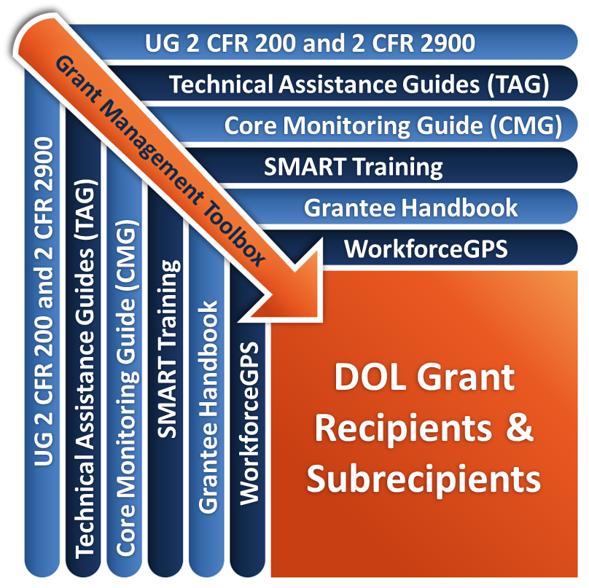
Remember the Grant Management Toolbox!

Slide 63
Questions?

Slide 64
Please complete your evaluations.

