Slide 1
The Role “Credit” Plays in the Employment of People with Disabilities
Webinar Date: April 8, 2014
Presented by: Sarah Chenven & Carolyn Schulte, Credit Builders Alliance (CBA)
U.S. Department of Labor
Employment and Training Administration

Slide 2
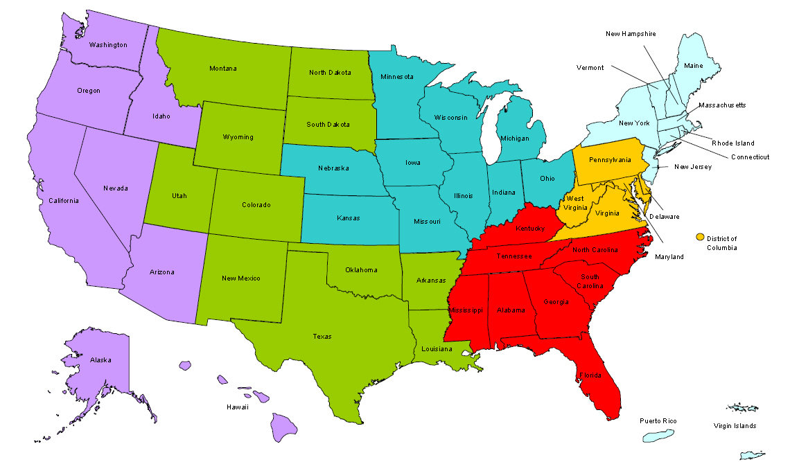
Where are you?
Enter your location in the Chat window – lower left of screen
Notes:
\

Slide 3


Moderators
Moderator: Randee Chafkin
Title: Workforce Development Specialist
Organization: Employment and Training Administration
Presenter: Miranda Kennedy
Title: Director of Training for DEI, NDI Technical Assistance Team
Organization: National Disability Institute
#
3

Slide 4


Disability Employment Initiative
Training and Technical Assistance to DEI Projects on Asset Development Strategies is provided under U.S. DOLETA contract with NDI Consulting, Inc. and the National Disability Institute (NDI).
Evaluation of the impact of the DEI Projects implementation and outcomes related to Asset Development Strategies is provided under U.S. DOL ODEP contract with Social Dynamics and its partners.

Slide 5

Learning Objectives
Upon completion of this training, DEI grantees (and members of the public workforce system) will have the following:
Information on what credit is and how it is established.
Information on the ways that credit can directly impact employment.
Strategies for educating and supporting job seekers with disabilities and/or multiple challenges to employment in establishing and/or rebuilding credit.

Slide 6
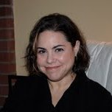

Presenters
Presenter: Sarah Chenven
Title: Director of Programs and Strategic Initiatives
Organization: Credit Builders Alliance
Presenter: Carolyn Schulte
Title: Programs and Strategic Initiatives Coordinator
Organization: Credit Builders Alliance
#
6

Slide 7
Agenda
Why Credit Building?
What is Credit Building?
5-Steps to Helping Job Seekers Build Credit (Including Job Seekers’ Rights on Employment Credit Checks)
Resources

Slide 8
Presenters
Presenter: Carolyn Schulte
Title: Programs and Strategic Initiatives Coordinator
Organization: Credit Builders Alliance
#
8

Slide 9

Introduction
Definitions
A CREDIT HISTORY is a record of transactions involving the use of credit. If the customer does not have a credit history they will not have a credit report.
A CREDIT REPORT is a record of the customer’s credit history.
A CREDIT SCORE is number that summarizes the individual’s credit risk. It is used by lenders to assess the odds that they will become delinquent in repaying their debt within the next two years, and is based on a snapshot of their credit report at a particular point in time.
.
GOOD CREDIT
513
824
780
657
456
Notes:
9

Slide 10

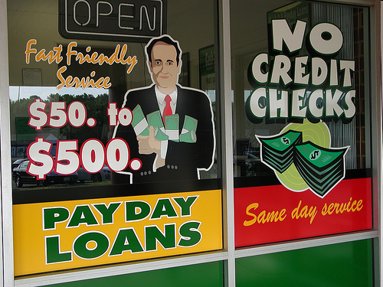
Why Credit Building?
Two Tiered System
Without access, assets & savings a job seeker cannot achieve or maintain financial stability or security
Paid in Full each month =
30 day 0% loan
400%+ APR; cycle of debt
Notes:
10

Slide 11
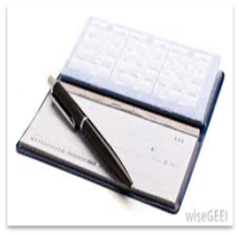
Why Credit Building?
Credit Matters
Good Credit = ACCESS
How we store our
money
The cost of household/ personal needs
How we get around
Access to and what we
pay for credit
Where we live

Slide 12
Potential Savings each month = $67 over 5 years = $4,020
Why Credit Building?
Credit Matters
Good Credit=SAVINGS
$10,000 auto loan, 5 year term
Score | Interest Rate | Monthly Payment
500 | 17% | $249.00
620 | 11% | $217.00
720 | 3% | $182.00
Source: www.myfico.com

Slide 13

Why Credit Building?
Credit Matters
Good Credit = OPPORTUNITY
In many states, credit history can still affect employment opportunities

Slide 14
Employment and Credit
Employers pull credit reports
To check for fraud and dishonesty
To verify application information
To assess accountability and responsibility
To mitigate risk

Slide 15
Employment and Credit
What does credit have to do with employment?
Financial Stress impact productivity
Researchers have estimated that 10 to 15% of the workforce is affected by financial problems to the extent that they negatively affect job productivity.

Slide 16
Employment and Credit
Employment ≠ Financial Security
A job is not a silver bullet
Workforce development professionals need a toolbox full of tools, including credit building

Slide 17
Employment and Credit
A new job may require…
A car
A new apartment or home
A corporate credit card
All of these will likely require a credit check!

Slide 18
Employment and Credit
RESUME
Financial
^
Credit Reports =

Slide 19
Why Credit Building?
Job Catch-22
I have no experience.
I can't get a job because

Slide 20
Why Credit Building?
Credit Catch-22
I have bad/no credit because
I can't get credit because

Slide 21

What is Credit Building?
Defining Credit Building
Credit Repair = fixing negative history
Credit Counseling = dealing with current crisis
Notes:
21

Slide 22
What is Credit Building?
How it Works
ON-TIME payments
REPORTED to a credit bureau
EVERY month
BUILDS credit
=
ACTIVE TRADE LINES

Slide 23
What is Credit Building?
How it Works
WHAT IS AN ACTIVE TRADE LINE?
An Active Installment (loan):
  Has a Balance
  Has a monthly payment
  Is not closed
An Active Revolving (credit card):
  Doesn’t need to have balance or payment
  A payment has been made in the past 6 months (date of last activity)

Slide 24
What is Credit Building?
More on Active Trade Lines…
A collection/charge-off can never be an active line of credit
An open line of credit is not the same thing as an active line of credit
Just because it doesn’t say closed/paid doesn’t mean it’s active
A loan paid off is no longer active
A student loan in deferment is not active, but has the potential to be active

Slide 25
What is Credit Building?
Best Practice
3 ACTIVE trade lines
MIX of installment and revolving
6 months

Slide 26
Benefits of Credit Building
For Job Seekers
Credit building…
Empowers individuals to make and maintain positive behavior changes
Connects job seekers to responsible financial institutions and products that support savings, credit, and budgeting needs
Saves money and can make the difference between negative and positive cash flow

Slide 27


CBA Credit-Builder 5-Step©
1. Consider the Goal
2. Know the Score
3. Get the Good Stuff Going
4. Deal with Debt
5. Leverage Success
Notes:
27

Slide 28
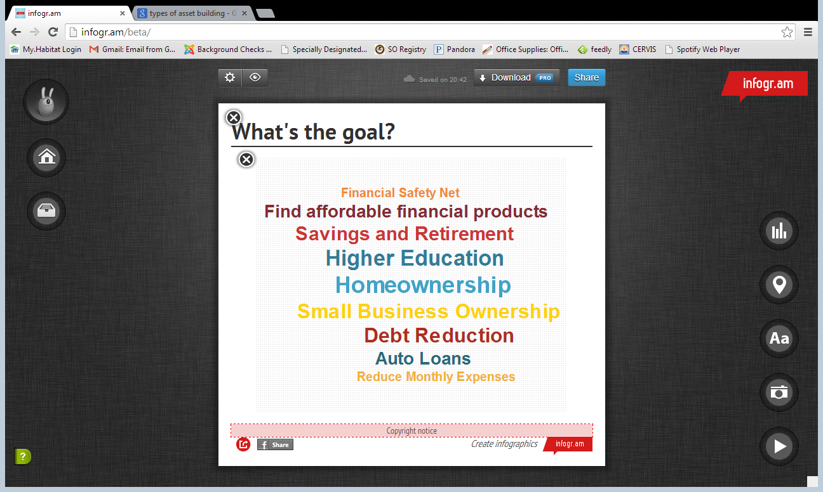

CBA Credit-Builder 5-Step©
Step 1: Consider the Goal
Help job seekers articulate SMART short-, medium- and long-term goals
Connect the importance of good credit to these goals.
Notes:
28

Slide 29
Presenters
Presenter: Sarah Chenven
Title: Director of Programs and Strategic Initiatives
Organization: Credit Builders Alliance
#
29

Slide 30

Credit Building in Action
Introducing Sal
In June 2010 Sal was approved for a power chair through Medicare.
Unfortunately, Medicare didn’t cover the accessories or ramps that he needed to use the chair outside his apartment to be able to more easily get to his new job at a local hospital.
“I suddenly realized that my business and personal funds were low and that I lacked the appropriate credit history or score to get a loan or a credit card. I wouldn't be able to use the chair at all outside of my apartment because of a large stair about 8 feet outside my door. I needed only approximately $350, but that small amount seemed like a gigantic hurdle at the time.”

Slide 31

CBA Credit-Builder 5-Step©
Step 2: Know the Score
Review credit report to determine need and readiness for credit building.
Is there one? Active trade lines or none? A lot of debt or accounts in collections? Have they gone through bankruptcy or are they at risk of garnishment?
Notes:
31

Slide 32
POLL
Do you pull credit reports or help your customers pull them?
  Yes
  No
  Don’t Know

Slide 33
POLL
Do you work with partners, for example, the centers for independent living that pull credit reports?
  Yes
  No
  Don’t know

Slide 34
Know the Score
And Report!
Know the Report!
A credit report typically contains:
Personal Identifying Information
Name
Credit History
Open trade lines
Public Records
Bankruptcies
Inquiries
List of creditors and other authorized parties that have requested and received a copy of the credit report in the last 24 months
Address
Social Security Number
Derogatory items such as accounts in collections
Foreclosures
Judgments
Date of Birth
Liens
Active trade lines
Notes:
34

Slide 35
Know the Score
Statutes of Limitation
Closed Accounts in Good Standing
10yrs from date of closure
Charge Off/Collections
7yrs from date of charge off
Bankruptcy
10 (Ch. 7) or 7 (Ch. 13) yrs from date of entry for relief
Civil Judgment
7yrs from date of entry
Foreclosure
7yrs
Tax Liens
7 yrs from paid date or no limit if unpaid
Open Accounts in Good Standing
Indefinitely
Inquiries
2yrs
Late or missed payments
7yrs from date of 1st delinquency

Slide 36
Know the Score
Know Job Seekers’ Rights
Employer must get job seekers’ permission before asking for a report
Employers who use credit for employment must abide by Fair Credit Reporting Act (FCRA)
Employers cannot get a credit score
Account numbers are not listed – just the source, type of account and payment history
Job Seeker’s age or year of birth is not listed

Slide 37
Know the Score
Know Job Seekers’ Rights
If you know a employer is going to pull credit:
Do not be the last to look at your report
  Pull from annualcreditreport.com
Correct any errors
If you have blemished credit be honest with HR or Hiring Manager, it will be better if it’s coming from you vs. the report.

Slide 38
Know the Score
Know Job Seekers’ Rights
If a job seeker doesn’t get the job because of info on credit report, employer has legal obligations. Employers:
  Must show job seeker the report
  Must tell job seeker how to get a copy (the report is free if within 60 days)
  Must tell job seeker that report used to make the decision, notice is separate and should include the company that provided the report
  If job seeker denied a job because of the report, he/she must receive “A Summary of your Rights Under the FCRA”
  If an employer says not to apply based on criminal record – this is discrimination. Contact the Equal Employment Opportunity Commission (EEOC)
  If employer doesn’t comply with the FCRA, report them to Federal Trade Commission (FTC) or Consumer Financial Protection Bureau (CFPB).

Slide 39
Credit Building in Action
Re-Introducing Sal
In June 2010 Sal was approved for a power chair through Medicare.
Unfortunately, Medicare didn’t cover the accessories or ramps that he needed to use the chair outside his apartment to be able to more easily get to his new job at a local hospital.
“I suddenly realized that my business and personal funds were low and that I lacked the appropriate credit history or score to get a loan or a credit card. I wouldn't be able to use the chair at all outside of my apartment because of a large stair about 8 feet outside my door. I needed only approximately $350, but that small amount seemed like a gigantic hurdle at the time.”

Slide 40
Credit Building in Action
Sal’s Credit Report
Open Trade Lines
Credit Card with 23.99% APR with a $500 credit limit open for 3 years. | $460 balance Uses every month to cover any relatively small additional expenses | Has made a few late payments over the last six months but now current in good standing | Can only make minimum monthly payment of $95/mo.
In Collections
ABC Bank | $2,300 | Charged Off 4 years ago | Two payments made a last year
Credit Score: 599 Inquiries in last year: 3

Slide 41

CBA Credit-Builder 5-Step©
Step 3: Get the Good Stuff Going
Offer & report your own products!
Refer to traditional products and financial institutions
Partner with nonprofit lenders
Notes:
41

Slide 42
Get the Good Stuff Going
A Good Product…
Accessible to your job seekers
Flexible & Affordable
Potential for graduation
BUILDS CREDIT!

Slide 43
POLL
Do you offer emergency loans?
Yes, and we do report the loans
Yes, but we don’t report the loans
No
Don’t know

Slide 44
POLL
Do you refer job seekers to outside financial products?
Yes, and we know those products are being reported
Yes, but we don’t know if those products are being reported
No
Don’t know

Slide 45
Benefits of Credit Building
Offer & Report Emergency Loans Directly
Job seekers are entitled to a lifetime of good credit and credit options:
By offering emergency loans to job seekers who cannot access conventional credit, you are meeting one of their CURRENT needs. By reporting loan repayments, you are helping them with their CURRENT needs and their FUTURE needs.

Slide 46
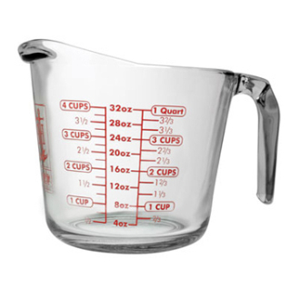

Get the Good Stuff Going
Financial Capability
Education
Product
Every monthly payment is a teachable moment!
Financial Capability

Slide 47
Credit Building in Action
Re-Introducing Sal’s Credit Report
Open Trade Lines
Credit Card with 23.99% APR with a $500 credit limit open for 3 years. | $460 balance Uses every month to cover any relatively small additional expenses | Has made a few late payments over the last six months but now current in good standing | Can only make minimum monthly payment of $95/mo.
In Collections
ABC Bank | $2,300 | Charged Off 4 years ago | Two payments made a last year
Credit Score: 599 Inquiries in last year: 3

Slide 48
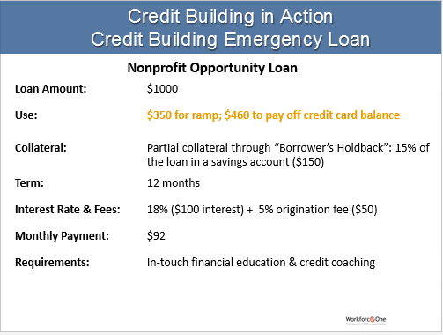
Credit Building in Action
Credit Building Emergency Loan
Nonprofit Opportunity Loan
Loan Amount: $1000
Use: $350 for ramp; $460 to pay off credit card balance
Collateral: Partial collateral through “Borrower’s Holdback”: 15% of the loan in a savings account ($150)
Term: 12 months
Interest Rate & Fees: 18% ($100 interest) + 5% origination fee ($50)
Monthly Payment: $92
Requirements: In-touch financial education & credit coaching

Slide 49
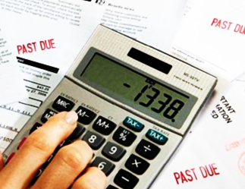
CBA Credit-Builder 5-Step©
Step 4: Deal with Debt
Help identify the best way to pay down existing debt and which to tackle first
Assess accounts in collections. Which ones may fall off their report soon (make sure they understand debt collection rules and their rights in your state). Can they negotiate lump sum settlements?`
Notes:
49

Slide 50
Deal with Debt
Step 4: Deal with Debt
Debt management ALONE is not a Credit Building strategy

Slide 51

Deal with Debt
Take Action: Disputes
Is there debt on the credit report that they do not recognize?
Help job seekers understand the information on the report and dispute errors:
With the credit bureaus
Directly with the creditor
Error
“One in four consumers identified errors on their credit reports that might affect their credit scores”

Slide 52

Deal with Debt
Take Action: Pay Down Debt
Goal: no more than 30% credit utilization on open debt
Job Seekers may need to navigate competing priorities when making decisions about paying off debt including:
        Get anything that’s delinquent back on track before it goes to collections
        Decrease revolving credit utilization rate
        Pay off highest interest rate
        Pay off smallest balances

Slide 53
Deal with Debt:
Take Action: Collections 101
Goal: Settle in one lump sum!
Collections have most significant negative impact on a score when first reported … then they age.
Removing a collection account (i.e. medical collection) will improve the score! If it is not theirs – dispute it!
Paying off a collection account still leaves negative account info on report until it ages off (do not confuse with state debt collection statute of limitations)
Paying off a collection account can have a NEGATIVE impact if it makes Date of Last Activity more recent. Settle rather than create payment plans if possible.
Collection activity and collection agents cannot update the Date of First Delinquency!

Slide 54
Credit Building in Action
Sal’s Credit Report: Before Loan
Open Trade Lines
Credit Card with 23.99% APR with a $500 credit limit open for 3 years. | $460 balance Uses every month to cover any relatively small additional expenses | Has made a few late payments over the last six months but now current in good standing | Can only make minimum monthly payment of $95/mo.
In Collections
ABC Bank | $2,300 | Charged Off 4 years ago | Two payments made a last year
Credit Score: 599 Inquiries in last year: 3

Slide 55
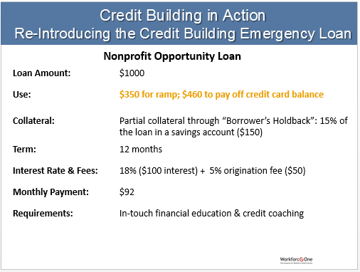
Credit Building in Action
Re-Introducing the Credit Building Emergency Loan
Nonprofit Opportunity Loan
Loan Amount: $1000
Use: $350 for ramp; $460 to pay off credit card balance
Collateral: Partial collateral through “Borrower’s Holdback”: 15% of the loan in a savings account ($150)
Term: 12 months
Interest Rate & Fees: 18% ($100 interest) + 5% origination fee ($50)
Monthly Payment: $92
Requirements: In-touch financial education & credit coaching

Slide 56
Credit Building in Action
Sal’s Credit Report After Loan
Open Trade Lines
Credit Card with 23.99% APR with a $500 credit limit open for 3 years. | $0 balance Uses every month to cover one small additional expenses | Pays off balance every month | Never pays interest
Nonprofit Loan | $522 (principle + interest) balance | Makes on-time payments of $92/mo. | TTL interest anticipated: $100
ABC Bank | $2,300 | Charged Off 4 years ago | Negotiating Settlement for ½ the balance
In Collections
Credit Score: 635 (36 point increase!)
Inquiries in last year: 0

Slide 57
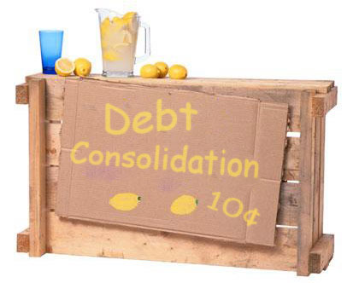
Deal with Debt:
Debt Management Companies
Can’t legally do anything you can do for free
Can’t legally collect fee before delivering the promised service
Can’t legally advise you to lie about your accounts or about your identifying information

Slide 58
Presenters
Presenter: Carolyn Schulte
Title: Programs and Strategic Initiatives Coordinator
Organization: Credit Builders Alliance
#
58

Slide 59
CBA Credit-Builder 5-Step©
Leverage Success
Established credit history and improved scores
Access to affordable financial products, housing, and employment opportunities
Increased savings and financial stability
Achieve financial security
Notes:
59

Slide 60
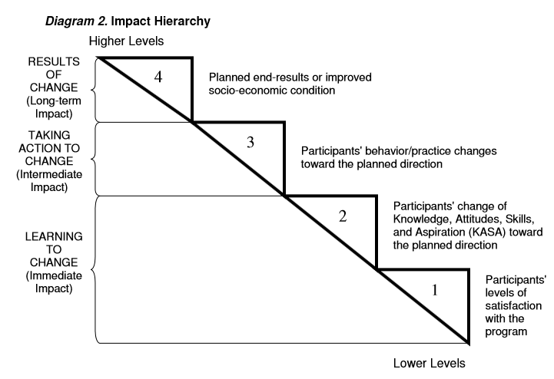
Leverage Success
Tracking Outcomes
What difference?
Financial behavior change can be measured by indicators found on a job seeker’s credit report
How well
NEFE Impact Hierarchy
Notes:
60

Slide 61
Presenters
Presenter: Sarah Chenven
Title: Director of Programs and Strategic Initiatives
Organization: Credit Builders Alliance
#
61

Slide 62
Credit Building in Action
Sal’s Success Story
Increased Score
Refinanced Credit Card Interest Rate
Obtained Small Business Loan
Increased Income

Slide 63
Summary
Credit is ubiquitous
Think about it as an asset to build and not just a barrier
Focus on underlying consumer behavior (not just score) as reflected on credit reports and the rest will follow
Take the credit building approach over the debt management approach, if possible:
  3 active accounts (ideally a mix of product types)
  On-time payments
  Paying off collections alone is not credit building
Offer Job Center Customers a pathway for building and leveraging good credit

Slide 64
FINAL WORD FROM RANDEE
Moderator: Randee Chafkin
Title: Workforce Development Specialist
Organization: Employment and Training Administration
#
64

Slide 65
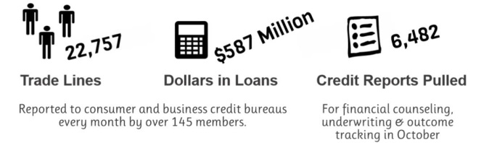
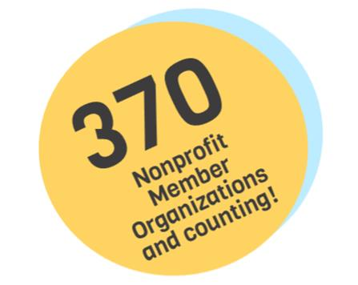
CBA’s Credit Builder Platform
CBA Business Reporter
CBA Access
CBA Reporter
Contact CBA at reporter@creditbuildersalliance.org

Slide 66

Resources
  Workforce Development & Credit Tip Sheet
  Glossary of Terms for Practitioners & Consumers
  Visit CBA’s website for links to additional training resources:
  http://creditbuildersalliance.org/training-resource-links

Slide 67

Please enter your questions in the Chat Room!

Slide 68

Speakers’ Contact Information
Speakers: Sarah Chenven &
Carolyn Schulte
Title: Programs & Strategic Initiatives Team
Organization: Credit Builders Alliance
Email: programs@creditbuildersalliance.org
Telephone: 202-888-7585

Slide 69
Thank You!
Find resources for workforce system success at:
www.workforce3one.org

