Slide 1
Engaging Older Workers in the Public Workforce System
January 22, 2014
U.S. Department of Labor, Employment and Training Administration with NGA, NASWA, and NAWB

Slide 2
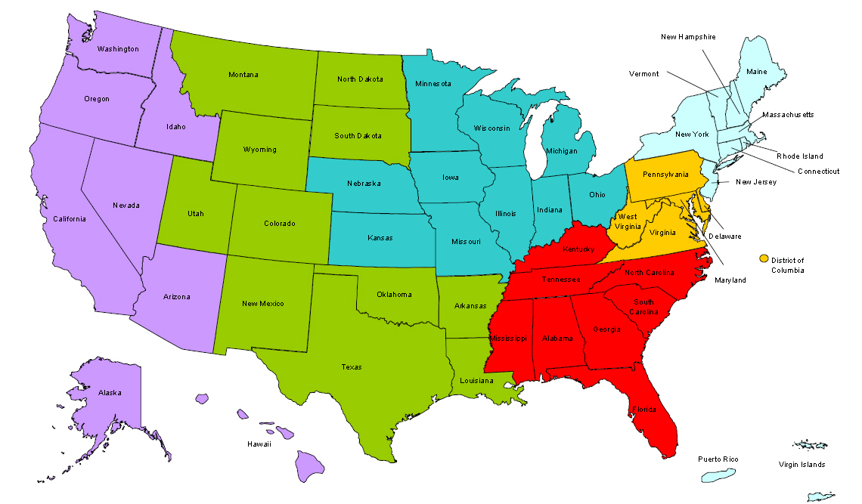
Where are you?
Enter your location in the chat window – lower left of screen

Slide 3
Polling Question
I think older workers are people who have the following…
Long-term work experience
Are age 40 or older
Are not yet eligible for Social Security (62) or Medicare (65)
The desire to work
All of the above

Slide 4
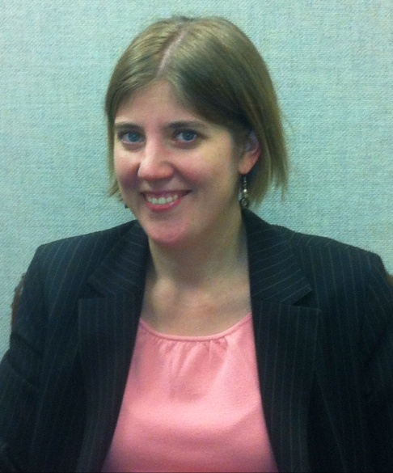
Moderator
Kim Vitelli
Chief, Division of National Programs, Tools & Technical Assistance ETA Office of Workforce Investment

Slide 5
Today’s Webinar
Older workers and the workforce
Strategies and tactics used by WIBs
Questions for speakers
Discussion

Slide 6
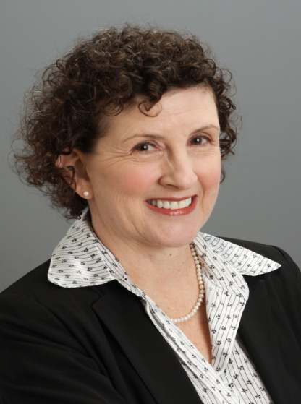
Partners
Martin Simon
Program Director, National Governors Association
Terri Bergman
Director of Research & Programs, National Association of Workforce Boards

Slide 7
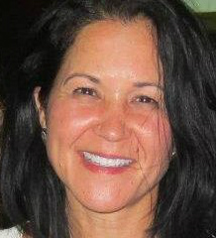
Partners
Yvette Chocolaad
Director of Employment & Training, National Association of State Workforce Agencies

Slide 8
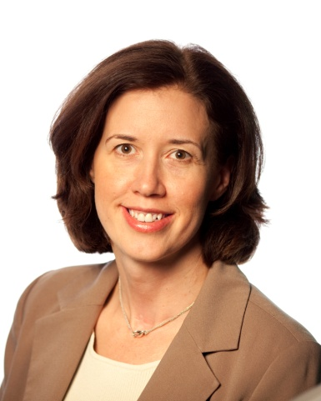
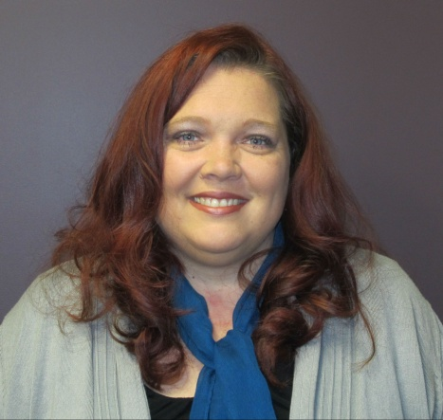
Presenters
Lori Strauss
Program Manager, AARP Foundation
Kelly Folks
Assistant Division Manager, Arapahoe/Douglas Works!

Slide 9
The Changing Landscape of Work
63
24
45
32
58

Slide 10
Historical First!
Four generations together in the workplace:
World War II
Baby Boomers
Generation Xers
Millennials

Slide 11
World War II Generation (born 1945 and before)

Slide 12
Baby Boom Generation (born 1946 – 1964)

Slide 13
Who Are Older Workers?
True or False?
The Age Discrimination in Employment Act (ADEA) only forbids age discrimination against people who are age 55 or older.

Slide 14
Age Distribution by Median Age

Slide 15
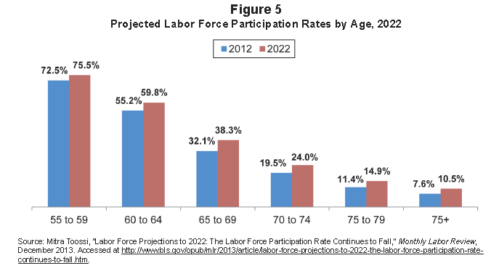
Projected Labor Force Participation Rates
Source: December Employment Report. AARP Public Policy Institute

Slide 16
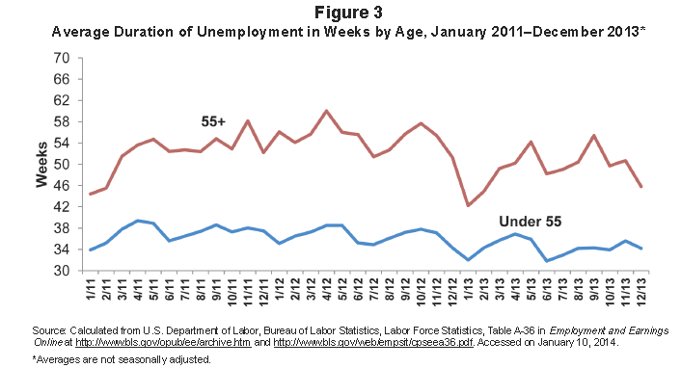
Average Duration of Unemployment by Age
Source: December Employment Report. AARP Public Policy Institute

Slide 17
America’s Workforce Investment System
Mission:
(1) To be customer-focused, (2) to help Americans access the tools they need to manage their careers through information and high-quality services, and (3) to help U.S. companies find skilled workers.

Slide 18
Median Age by State

Slide 19
Median Age by County

Slide 20
Why Focus on Older Workers?

Slide 21
Role of Workforce Boards
Identify and convene local employers who are struggling to keep employees and fill positions due to a lack of “soft skills”

Slide 22
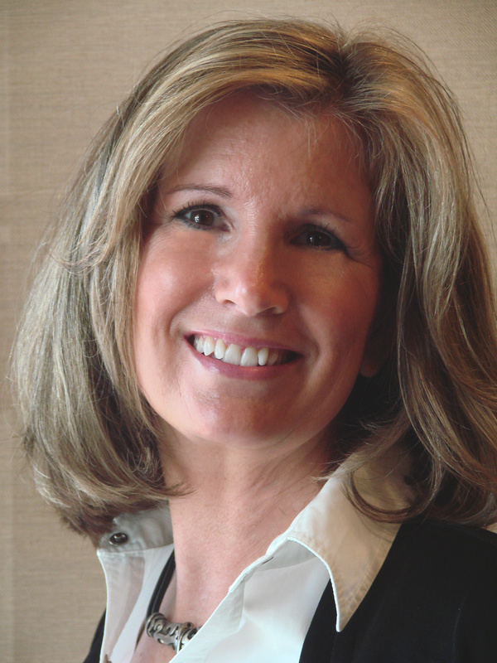
Why Workforce Boards Focus on Older Workers: Desirable Workforce for Employers
Older workers have assets that employers need – such as a strong work ethic, reliability, good judgment, and strong interpersonal and communication skills.

Slide 23
Why Workforce Boards Focus on Older Workers: To Better Engage the Audience in Core Services

Slide 24
Generations at Work Principles: For Employer Customers
Position older job candidates as “prime talent”
Provide high-quality job candidate referrals
Correct employer misconceptions using research, data, and new messaging
Skills training linked to available jobs
Focus on finding the right fit for employers and older job candidates

Slide 25
Generations at Work Principles: For Job Candidate Customers
Message to older workers and job candidates: You are good providers and the backbone of your communities. We will help you get back on track.
Help them target hot jobs, update their personal marketing tools and network strategies
Create an older worker resource center
Focus on building new skills (especially technology)

Slide 26
Generations at Work Principles: For Job Candidate Customers
Train your staff in team case management
Include financial capability and emotional support services
Offer navigators and coaching
Integrate Senior Community Service Employment Program (SCSEP) services into AJCs to serve 55+ workers with multiple barriers to employment

Slide 27
Questions for the Speakers?
Please enter your questions in the chat room!

Slide 28
Discussion

Slide 29
Protocol for Serving Older Workers

Slide 30
Resources
Protocol for Serving Older Workers (2005)
GAO report: “Unemployed Older Workers”
Evaluation of the Aging Worker Initiative
Arapahoe/Douglas Works! workforce outlook resources

Slide 31
Presenters’ Contact Information
Kelly Folks
Assistant Division Manager
Arapahoe/Douglas Works!
kfolks@arapahoegov.com
Lori Strauss
Program Manager
AARP Foundation
lstrauss@aarp.org
Kim Vitelli
Employment and Training Administration
vitelli.kimberly@dol.gov

Slide 32
Presenters’ Contact Information
Martin Simon
Program Director
National Governors Association
msimon@nga.org
Yvette Chocolaad
Director of Employment and Training
National Association of State Workforce Agencies
ychocolaad@naswa.org
Terri Bergman
Director of Programs and Research
National Association of Workforce Boards
bergmant@nawb.org

Slide 33
Thank You!
Find resources for workforce system success at
www.workforce3one.org

