Slide 1
Introduction:
Integrated Resource Team (IRT) Model
Webinar Date: 3/17/14
Presented by: Miranda Kennedy and Brian Ingram with NDI Technical Assistance Team
U.S. Department of Labor
Employment and Training Administration

Slide 2
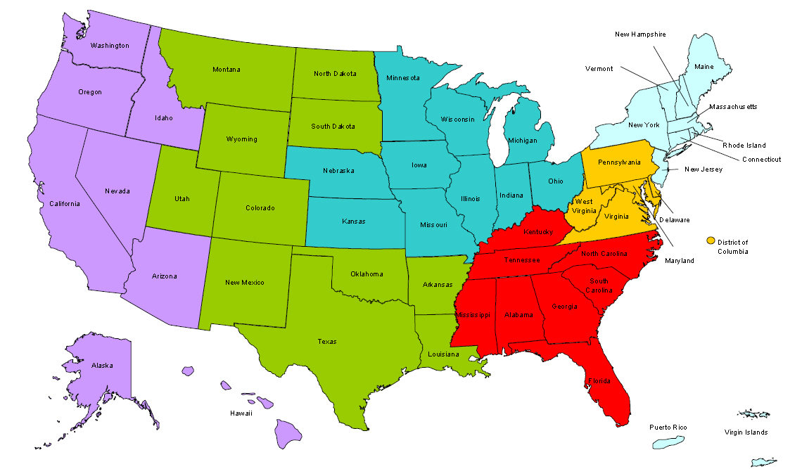
Where are you?
Enter your location in the Chat window – lower left of screen

Slide 3


Moderators
Moderator: Randee Chafkin
Title: Workforce Development Specialist
Organization: Employment and Training Administration
Moderator: Miranda Kennedy
Title: Director of Training for DEI, NDI Technical Assistance Team
Organization: National Disability Institute
#
3

Slide 4


Disability Employment Initiative
The DEI is focused on improving the accessibility, capacity, and accountability of America’s Job Centers to serve customers with disabilities resulting in education and career pathways that lead to unsubsidized employment and economic self-sufficiency.
Training and Technical Assistance to DEI Projects is provided under U.S. DOLETA contract with NDI Consulting, Inc. and the National Disability Institute (NDI).
Evaluation of the impact of the DEI Projects implementation and outcomes will be provided under U.S. DOL ODEP contract with Social Dynamics and its partners.

Slide 5
Learning Objectives
Upon completion of the Introduction to the IRT training, DEI grantees will know the following:
Why the IRT was developed and the purpose that it serves
How an IRT is defined
How to Coordinate an IRT
The Role of the DRC in relation to the IRT
Strategies and Resources to Support the IRT

Slide 6

Presenters
Presenter: Miranda Kennedy
Title: IRT Subject Matter Expert, NDI Technical Assistance Team
Organization: National Disability Institute
Presenter: Brian Ingram
Title: IRT Subject Matter Expert, NDI Technical Assistance Team
Organization: National Disability Institute
#
6

Slide 7
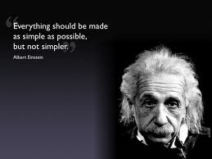
Agenda
Background on IRT Model
Defining an IRT
Coordination of an IRT
IRT & Role of DRCs
IRT Examples
IRT Resources
Next Steps
Q&A

Slide 8

Background on
IRT Models

Slide 9

Background on the IRT Model
The Disability Program Navigator (DPN) Initiative
Disability Program Navigators (DPNs)
Resource Gaps

Slide 10
Background on the IRT Model
Navigators engaged in significant resource mapping,
Navigators developed an understanding of the ‘big picture’.
Navigators helped to increase cross-agency communication ,

Slide 11
DEI Vision of the IRT
Improve coordination and collaboration.
Build effective community partnerships
“IRTs are organized around an individual jobseeker with a disability who experiences multiple challenges to employment and who has been enrolled in WIA intensive and/or training services (or is attempting to attain enrollment in these services).
The concept from the IRT has now evolved to specifically refer to job seekers with disabilities who are currently enrolled and/or to be enrolled in WIA intensive and training services.”
From the Round 3 SGA – Page 9 (http://www.dei-ideas.org/chapter2-3/Nov_2012/RoundThreeDEISGA_4_16_2012.pdf)

Slide 12
DEFINING
An
Integrated Resource Team (IRT)

Slide 13

What is an IRT?
An IRT is initiated on behalf of an individual with a disability who is experiencing multiple challenges in reaching an employment goal
It addresses that one individual’s specific needs in relation to attaining this goal.

Slide 14
What an IRT is and is NOT…
  An IRT is an approach used for an INDIVIDUAL job seeker.
  An IRT is NOT an interagency committee consisting of various disability/community agencies that focus on systems collaboration.
  The main purpose of an IRT is EMPLOYMENT.
  The main purpose of an IRT is NOT resource mapping or to assist an individual to learn about various agency resources.
  Customers who engage in the IRT approach under the DEI should be eligible and enrolled in some level of WIA services,
  such as Wagner-Peyser/WIA core or preferably WIA Intensive training services.
  Point to Remember: An IRT that has been initiated with a Job Center customer by a DRC is NOT an IRT under the DEI unless other workforce staff in addition to the DRC are at the table.

Slide 15
What is the difference between and IRT and Active Resource Coordination?
  Active Resource Coordination is the process of identifying needed resources and appropriate and prioritized action steps to address specific, targeted barriers to employment experienced by an individual entering the Job Center’s WIA customer flow.
  Active Resource Coordination always takes place PRIOR to an Integrated Resource Team (IRT) being put in place. Although active resource coordination may take place without resulting in an IRT.
  So you can have Active Resource Coordination without and IRT, but you CANNOT have an IRT without first having done some Active Resource Coordination!

Slide 16

Who Participates on an IRT?
An IRT may consist of members from a wide variety of community programs and service providers, including:
  The Workforce Investment system
  Mental Health
  Vocational Rehabilitation
  Independent Living Center
  Programs for Deaf & Hard-of-Hearing
  Commission for the Blind
  Community Work Incentives Coordinator
  Supported Employment Specialist
  Housing Provider
  TANF
  Advocates /Friends of Job Seeker

Slide 17
Goal of Introducing the IRT Model
To enhance cross-agency collaboration and communication to better leverage available resources in a seamless way for an individual jobseeker with a disability.
To increase enrollments in available workforce investment programs and enhance knowledge of available career options.
To help the Workforce system and partner agencies see the benefit of resource collaboration.

Slide 18
COORDINATION of an
Integrated Resource Team (IRT)

Slide 19
Coordination of an IRT: Customer Assessment
Consider the following questions when deciding whether or not to propose the IRT approach with a job seeker:
The Employment Goal
  Are there resources beyond those available in your system that are critical to your customer’s success in attaining his/her employment goal?
The Customer
  What other system(s) is your customer currently accessing?
  What services might your customer be eligible for that are relevant in attaining their employment goal?

Slide 20

DEI and WIA Customer Flow
The Job of the DRC is not to develop a new service delivery system for customers with disability within WIA, but instead is to make the one that currently exists accessible to them.
This is why access is the focus of this project and why each of the service delivery components were identified, because they had helped the systems that developed them increase access to the WIA service flow.

Slide 21
Coordination of an IRT: Customer Assessment
Before approaching partners, a customer should be engaged in your system and positioned to access resources.
For example:
  The customer should be determined eligible and enrolled in your system’s services, such as Job Center Intensive or WIA services.
  The customer should have determined an employment goal that allows for the application of your system’s resources.
  The customer should be consulted and agree to all contacts with other partners, i.e. have a clear understanding of the IRT approach.

Slide 22
Coordination of an IRT: Approaching Partners
After other service providers have been identified as potentially meeting resource/support needs, the job seeker may make initial contact independently or with support:
  Introduction
  Eligibility
  Establish Partnership
  Tracking Progress

Slide 23
Coordination of an IRT: Negotiating Shared Resource Plans
Whenever possible, a face-to-face meeting should be arranged with partners within a One-Stop Career Center.
Reach consensus around three key parameters:
  A common employment goal
  Lines of communication (established Prior to the need)
  A sequence of services

Slide 24
Integrated Resource Team (IRT)
and the role of the
Disability Resource Coordinator (DRC)

Slide 25
IRTs & the Role of a DRC
The Disability Resource Coordinator (DRC) may initially help to build understanding within the workforce system about the benefits of the IRT model.
DRCs may also take on an active role in assisting customers with resource coordination, which may involve:
  Helping a customer to create a goal specific resource plan.
  Directly assisting a customer to convene, and negotiate with, multiple service providers to create an employment plan that accesses needed resources from multiple systems.
  Directly assisting a customer to implement and monitor the employment plan, and making adjustments as needed.

Slide 26
IRTs & the Role of a DRC
DRCs may then move into more of a facilitator role by:
  Helping Job Center staff to explain the benefits of utilizing the IRT approach to jobseekers
  Working with Job Center staff and jobseekers to identify and reach out to other providers who may serve as part of an IRT.
  Facilitating and/or leading the first IRT meeting

Slide 27
SAMPLE
Integrated Resource Team (IRT)
FLOW CHART

Slide 28
Sample DEI/WIA flow (Detail)
DRC provides support to Customer and Staff around Access to all Center Services
Customer begins mandatory suite of core services
DRC Provides *ARC
Customer attends WIA enrollment meeting
DRC Assists with IRT Meeting
Customer implements IEP
Placement
Customer attends center orientation
Customer begins job search using core services only
Customer attends Job search workshop
Customer attends resume workshop
Customer attends interviewing workshop
DRC provides support to Customer and Staff around Access to all Center Services
Key Code
Customer Decision –
Customer Activity –
DEI Support -
*ARC = Active Resource Coordination

Slide 29
Integrated Resource Team (IRT)
EXAMPLES
(Case Studies)

Slide 30
IRT Example - Sara
Sara, a job seeker who is Deaf and non-verbal came into the Job Center looking for assistance in finding work.
Sara was a young mother in the process of getting divorced, which qualified her as a Displaced Worker under WIA.
Her eligibility for Vocational Rehabilitation services had been established by a prior plan with them years ago.

Slide 31
IRT Example – Sara (cont.)
The plan developed by Sara and her WIA counselor was for Sara to capitalize on her love and positive past experience volunteering with animals and her local area’s high demand for professional dog-grooming services.
A local training program on the Center’s training provider list offered certification as a professional dog-groomer.
However, the WIA program did not have the funds and/or ability to pay for the accommodations that Sara would require (ASL Interpreter during class Lectures) and also pay for the expensive training program.
IRT members were identified (DRC, VR Counselor, WIA Case Manager, and now a representative from the Training Program) and met with Sara to discuss her support & accommodation needs throughout training and employment placement.

Slide 32
IRT Example – Sara (cont.)
Contributions from Sara’s IRT members:
  The DRC was pulled in and consulted the Job Accommodation Network (JAN) to help develop a training communication strategy that maximized and blended limited funding, resources and reasonable accommodations.
  The Job Center provided access to UbiDuo on loan (*Note: Job Center also paid for the training program & coordinated the IRT)
  The Vocational Rehabilitation program provided ASL interpreting for the first two weeks of the training program, which were more lecture intensive.
  The Training Provider agreed to ongoing communication via e-mail to consult with the IRT regarding any issues.
  Sara agreed to update the WIA Case Manager weekly by e-mail.

Slide 33
IRT Example – Sara (cont.)
Sara performed at the top of her class in her training program.
The Training Provider personally recommended her to a local employer and gave information about the types of effective accommodations around communication (e.g. written notes, e-mail, and UbiDuo) and referenced The Job Accommodation Network (JAN) for future needs.
The Training Provider (who was now a member of the IRT) and Sara communicated the placement with the WIA Case Manager & Vocational Rehabilitation.

Slide 34
IRT Example – Sara (cont.)
Sara continued to update the WIA Case Manager bi-weekly as part of the retention strategy put in place by the IRT.
6 months into her employment, Sara began experiencing carpal tunnel symptoms from overuse of her arms caused by things such as lifting wet dogs all day long. This was threatening her ability to work, AND her ability to communicate via ASL/UbiDuo/E-mail, etc…
Sara and her WIA Case Manager reconvened her IRT and consulted with JAN.
JAN recommended ergonomic dog grooming equipment.
Vocational Rehabilitation re-opened her case so that they could purchase the equipment and she could retain her employment.
SARA MADE ALL OF HER WIA OUTCOMES & WAS A SUCCESSFUL CLOSURE FOR BOTH WIA & VR!!!

Slide 35
IRT Example: Mark
Mark is a Job center customer who participates in career exploration and identifies an employment goal of medical coder.
He discloses a disability to his WIA Case Manager and together, they contact his Vocational Rehabilitation (VR) counselor.
With permission, the VR Counselor then contacts Mark’s housing program, which may be impacted by work earnings.
Mark, his WIA Case Manager and VR Counselor arrange to meet at the Job Center and together call his Housing Counselor to include in their discussion on Mark’s shared employment plan.
At this initial meeting, it is determined that the Independent Living Center (ILC) should be brought onto the team, since they offer travel training, which has been identified as a resource need by Mark.

Slide 36
IRT Example: Mark (cont.)
Mark and all partners agree to work together towards his
employment goal .
  WIA agrees to pay for medical billing and coding training.
  VR agrees to fund a job developer to locate an employer, and to the possibility of offering an OJT if needed.
  VR also agrees to pay for accommodating technology for Mark to use both for training and on the job.
  The housing provider agrees to extend housing support through the training period and to assist Mark in developing a plan of transition into permanent housing once he gains earned income.
  The ILC agrees to provide travel training upon completion of Mark’s WIA training, throughout the interview process, and to/from the new place of employment.

Slide 37

Reminder…
JOIN US FOR TA OFFICE HOURS
Thursday, April 24th from 3pm – 4pm ET
https://ndi-conf1.webex.com/ndi-conf1/j.php?ED=25128223&UID=493947542&RT=MiMxMQ%3D%3D
Comprehensive Breakdown of the IRT Approach Thursday, May 22nd from 3pm to 4pm ET
This webinar will cover:
    Change in Definition of an IRT – New Language in SGA
    Step-by-step coordination of an IRT
    Includes in-depth information on IRT Supports:
        Active Resource Coordination
        Resource Planning
        Strength-based Assessment
        More Case Studies of IRTs

Slide 38

Resources
http://www.dei-ideas.org/chapter2-1/page2a_irt.cfm
  IRT FAQs
  IRT Promising Practice Brief
  IRT Video
  http://www.dei-ideas.org/chapter2-3/Nov_2012/RoundThreeDEISGA_4_16_2012.pdf
  The Round 4 SGA provides the most up to date definition of the IRT

Slide 39
Summary
In today’s presentation we covered the following:
Background of the IRT model, including how and why it was developed
The definition of an IRT and how it is distinct from the other service delivery components
The initiation and coordination of an IRT
The role of the DRC within the IRT
IRT Examples
IRT Resources

Slide 40
FINAL WORD FROM RANDEE
Moderator: Randee Chafkin
Title: Workforce Development Specialist
Organization: Employment and Training Administration
#
40

Slide 41

Open Chat
What are your thoughts/questions about The Integrated Resource Team (IRT)?

Slide 42

Please enter your questions in the Chat Room!

Slide 43

Speakers’ Contact Information
Speaker: Miranda Kennedy
Title: IRT Subject Matter Expert
Organization: National Disability Institute
Email: mkennedy@ndi-inc.org
Telephone: 720-890-3990
Speaker: Brian Ingram
Title: IRT Subject Matter Expert
Organization: National Disability Institute
Email: bingram@ndi-inc.org
Telephone: 503-913-3169

Slide 44
Thank You!
Find resources for workforce system success at:
www.workforce3one.org

