Slide 1
Integrated Resource Team (IRT) Part 2: Comprehensive Breakdown of the IRT Approach
Webinar Date: 5/22/14
Presented by: DJ Ralston and Brian Ingram with NDI Technical Assistance Team
U.S. Department of Labor
Employment and Training Administration

Slide 2
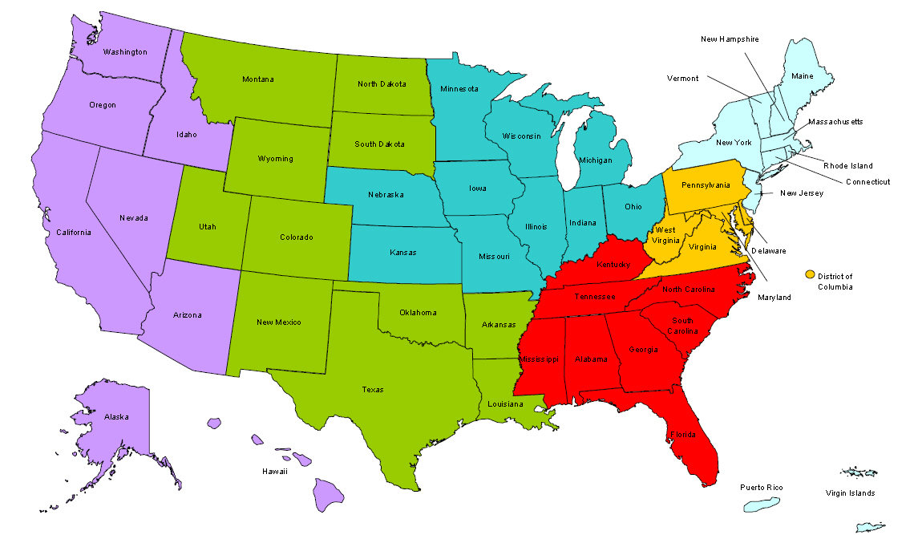
Where are you?
Enter your location in the Chat window – lower left of screen

Slide 3


Moderators
Moderator: Randee Chafkin
Title: Workforce Development Specialist
Organization: Employment and Training Administration
Moderator: Miranda Kennedy
Title: Director of Training for DEI, NDI Technical Assistance Team
Organization: National Disability Institute
#
3

Slide 4


Disability Employment Initiative
The DEI is focused on improving the accessibility, capacity, and accountability of America’s Job Centers to serve customers with disabilities resulting in education and career pathways that lead to unsubsidized employment and economic self-sufficiency.
Training and Technical Assistance to DEI Projects is provided under U.S. DOLETA contract with NDI Consulting, Inc. and the National Disability Institute (NDI).
Evaluation of the impact of the DEI Projects implementation and outcomes will be provided under U.S. DOL ODEP contract with Social Dynamics and its partners.

Slide 5
Learning Objectives
Upon completion of the Comprehensive Breakdown of the IRT Approach training, DEI grantees will know the following:
How Career Exploration serves as an important step in the IRT process
The distinction between Active Resource Coordination and an IRT
How Active Resource Coordination creates the building block to convene an IRT.
How to convene an IRT Meeting including strategies for approaching partners
How the IRT works hand in hand with helping customers to become enrolled in WIA Intensive and/or Training services

Slide 6


Presenters
Presenter: DJ Ralston
Title: IRT Subject Matter Expert, NDI Technical Assistance Team
Organization: National Disability Institute
Presenter: Brian Ingram
Title: IRT Subject Matter Expert, NDI Technical Assistance Team
Organization: National Disability Institute
#
6

Slide 7
Agenda
IRT Review
Coordination of an IRT
  Career Exploration
  Active Resource Coordination
  IRT Meeting
    Approaching Partners
  WIA Access

Slide 8

IRT Part One Review

Slide 9

Background on the IRT Model
The Disability Program Navigator (DPN) Initiative
Disability Program Navigators (DPNs)
Resource Gaps

Slide 10

What is an IRT?
An IRT is initiated on behalf of an individual with a disability who is experiencing multiple challenges in reaching an employment goal
It addresses that one individual’s specific needs in relation to attaining this goal.

Slide 11
Goal of Introducing the IRT Model
To enhance cross-agency collaboration and communication to better leverage available resources in a seamless way for an individual jobseeker with a disability.
To increase enrollments in available workforce investment programs and enhance knowledge of available career options.
To help the Workforce system and partner agencies see the benefit of resource collaboration.

Slide 12
Goal of Introducing the IRT Model
The IRT model was developed in response to a need to increase access to WIA services for customers with Disability and /or multiple challenges to employment
It was included in the DEI because of it’s success in assisting these customers to access WIA intensive services

Slide 13
IRT Flow Chart
The IRT model is designed to provide support to a customer through the entirety of a plan
Planning
Career Exploration WIA Core Services
IRT Meeting (Consensus)
implementation
Lines of Communication
Sequence of Services
retention
Lines of Communication WIA Intensive Services
Sequence of Services
Active Resource Coordination
IRT Meeting(s) (implementation) WIA Intensive Services

Slide 14
COORDINATION of an IRT
Career Exploration

Slide 15

The Employment Goal
An IRT is driven by the needs of the customer it is built around as it relates to their chosen employment goal.
Supporting a customer as they develop and commit to an employment goal is the commencement point of the IRT process

Slide 16
The Employment Goal
The employment goal should be a very good match to a customer’s skills and interests
The employment goal needs to meet the long term needs of the customer
If the employment goal, is not substantial enough, or a good match, there is very little chance an IRT will be successful

Slide 17
Career Exploration
A focus on making the career exploration process more accessible can increase the accessibility of all levels of WIA services including enrollment in intensive services.
  Does your center have a career exploration process?
  Who is referred to this service, and why?
  Is this service considered part of the process associated with enrollment in WIA intensive services?
  How accessible is this process to customers with unique needs?

Slide 18
Career Exploration Activity
Suggested activity
A worthwhile activity for a DRC might be to personally attend a career exploration workshop/session/ or web based activity to directly observe:
If it is accessible to customers who do not have any or current work history
If it is accessible to customers who do not have any or traditional educational history
If it is accessible to customers who need the use of accommodating technology to access the outcome of the service
If it is accessible to customers who need the modification of existing procedures to access the outcome of the service

Slide 19
COORDINATION of an IRT
Active Resource Coordination

Slide 20
What is the difference between an IRT and Active Resource Coordination?
  Active Resource Coordination is the process of identifying needed resources and appropriate and prioritized action steps to address specific, targeted barriers to employment experienced by an individual entering the Job Center’s WIA customer flow.
  Active Resource Coordination always takes place PRIOR to an Integrated Resource Team (IRT) being put in place. Although active resource coordination may take place without resulting in an IRT.
  So you can have Active Resource Coordination without an IRT, but you CANNOT have an IRT without first having done some Active Resource Coordination!

Slide 21
Active Resource Coordination is:
Actively assisting a customer to identify, explore, and access available resources in a way that is specific to assisting a customer achieve their employment goal,
Positioning the customer in the WIA system prior to coordinating with other providers
Providing customers with targeted support around coordinating their resources beyond simple referral
Acknowledging that a customer often has the least amount of leverage when it comes to advocating for themselves within service delivery systems

Slide 22
Active Resource Coordination (ARC) vs. Simple referral
ARC differs from simple referral to resources (which is a legitimate WIA service) in a number of important ways:
ARC begins with an employment goal then makes referrals based on needs specific to attaining that goal.
In ARC referrals are made internally to WIA services before or at the same time referrals are made to other systems.
In ARC the WIA system makes an initial commitment to advocate for a customer as they engage in eligibility for additional services.
In ARC the WIA system makes an initial commitment to take the lead in convening multiple service providers for the purpose of resource coordination.

Slide 23
Active Resource Coordination (ARC) Challenges
The implementation of ARC can present some programmatic challenges to a WIA Program. These challenges focus on
The division of Core and Intensive activities
It is important to be aware of these possible issues and determine if they exist (and to what extent), and how they might be addressed.

Slide 24
Active Resource Coordination (ARC) Challenges
For Consideration
The DRC should investigate the division of services into WIA Core and Intensive services as it currently operates in their job centers to determine where the activities under the DEI’s definition of ARC fall.
If the activities fall under the definition of intensive services the DRC might consider using DEI resources to provide ARC to customers while the customer engages in core services as a strategy for leveraging enrollment into WIA intensive services.

Slide 25
ARC Challenges: Case Study
The Resource Planning Meeting
The state of Oregon was funded in round 2 of the DPN initiative and region 2 (Portland Metro Area) hired a Navigator in 2004. This Navigator covered the 5 centers in the region and immediately began working with WIA staff and attempting to increase access to WIA intensive services for customers with disability and/or multiple challenges to employment. Within a few months the Navigator began to notice consistent barriers to accessing WIA intensive services for the customers he was advocating for, they were:
The referral of customers with disability and/or multiple challenges to employment experiencing resource gaps to other providers and away from WIA
Lack of Access to the job centers Career Exploration Process
The perception that customers with Disability and/or multiple challenges to employment presented a risk to WIA performance measures due to their need for services and resources the center did not directly control

Slide 26
ARC Challenges: Case Study
To adress these issues the DPN developed a two tiered strategy.
A career exploration workshop
A one-on-one follow up Resource Planning Meeting

Slide 27
ARC Challenges: Case Study
The Resource Plan document would then function as the primary focus of subsequent ARC activities
Resource Plans:
  Have a stated employment goal
  Include services your system will provide
  Include possible partner services
  Include possible partner roles
  Identify pieces of the multi-partner plan puzzle

Slide 28
ARC Challenges: Case Study
Tips for writing a Resource Plan:
Make employment goals as specific as possible, state specific needs around hours benefits and wages, list longer, or shorter term goals in relation to the primary goal for example:
Sample Employment Goal:
Obtain a part time job in a warehouse to maintain housing while attending WIA funded welding certification program, upon certification obtain full time welding position at $17-$20 an hr. with medical benefits.
2) Frame all discussion of barriers to employment as a discussion of available resources, and frame all resource discussions as a discussion of how to attain employment goal.
3) The purpose of a resource planning session is not to list every possible benefit or service a customer may be eligible for, but to use these possible resources to address barriers to the stated employment goal.
4) Use the resource plan as a tool to give context to referrals and next steps you may suggest to the customer

Slide 29
COORDINATION of an
IRT Meeting

Slide 30
IRT Meeting
The purpose of an IRT meeting is to convene all the providers that have service commitments to a specific customer to share information about each provider’s service plan and then reach consensus around three key parameters:
A common Employment goal
Sequence of services
Lines of communication

Slide 31
IRT Meeting
Planning the meeting
Identify both the resource gaps and the services and resources needed to address them then make the appropriate contacts and referrals to the services that may meet those needs.
Ensure that all the necessary releases are signed and in place so that information can be shared
Identify a location for the meeting
Identify a time that works for all the attendees
Develop an agenda for the meeting

Slide 32

IRT Meeting
Approaching Partners

Slide 33
IRT Meeting
Pre-Partner Eligibility
Let the staff person who will be determining eligibility know you have referred the customer, and that the customer is also engaged with WIA services
Ask the staff person who will be determining eligibility if there is anything you can do to help your customer to complete the partner’s eligibility process
Let the staff person who will be determining eligibility know that you are interested in discussing the possibility of partnering with them if the customer is determined eligible for their services.
Try to track your customer’s progress through each of the provider’s eligibility processes and be willing to assist in communicating any issues or barriers your customer might be experiencing during this process to the providers themselves.

Slide 34
IRT Meeting
Post-Engagement
Ask questions concerning the specific services that are being delivered
Emphasize the benefits of partnering with your program that might be of great value to the customer
Try to uncover areas where you or the partner has some flexibility within the established plans

Slide 35
IRT Meeting
Facilitating the IRT Meeting/Negotiating Integrated Resource Teams
Set up an IRT meeting to discuss a joint employment goal and plan
At this meeting, present information gathered about customer’s goal choices, needs, and YOUR program’s resource commitments
Listen to the concerns of partners in relation to identify needs concerning their field of expertise
Reach consensus around:
  Shared employment goal
  Sequence of services
  Timeline of services

Slide 36
COORDINATION of an IRT
WIA Access

Slide 37
Sample DEI/WIA flow (Detail)
DRC provides support to Customer and Staff around Access to all Center Services
Customer begins mandatory suite of core services
DRC Provides *ARC
Customer attends WIA enrollment meeting
DRC Assists with IRT Meeting
Customer implements IEP
Placement
Customer attends center orientation
Customer begins job search using core services only
Customer attends Job search workshop
Customer attends resume workshop
Customer attends interviewing workshop
DRC provides support to Customer and Staff around Access to all Center Services
Key Code
Customer Decision –
Customer Activity –
DEI Support -
*ARC = Active Resource Coordination

Slide 38

Resources
http://www.dei-ideas.org/chapter2-1/page2a_irt.cfm
  IRT FAQs
  IRT Promising Practice Brief
  IRT Video
  http://www.dei-ideas.org/chapter2-3/Nov_2012/RoundThreeDEISGA_4_16_2012.pdf
  The Round 4 SGA provides the most up to date definition of the IRT

Slide 39
Summary
In today’s presentation we covered the following:
IRT Review
Coordination of an IRT
  Career Exploration
  Active Resource Coordination
  IRT Meeting
    Approaching Partners
  WIA Access

Slide 40
FINAL WORD FROM RANDEE
Moderator: Randee Chafkin
Title: Workforce Development Specialist
Organization: Employment and Training Administration
#
40

Slide 41

Open Chat
What are your thoughts/questions about The Integrated Resource Team (IRT)?

Slide 42

Please enter your questions in the Chat Room!

Slide 43

Speakers’ Contact Information
Speaker: DJ Ralston
Title: IRT Subject Matter Expert
Organization: National Disability Institute
Email: dralston@ndi-inc.org
Telephone: 740-398-5247
Speaker: Brian Ingram
Title: IRT Subject Matter Expert
Organization: National Disability Institute
Email: bingram@ndi-inc.org
Telephone: 503-913-3169

Slide 44
Thank You!
Find resources for workforce system success at:
www.workforce3one.org

