Slide 1
Jobs for Veterans State Grant (JVSG) Program Refocusing and Front-line American Job Center (AJC) Staff
May 8, 2015
U.S. Department of Labor
Employment and Training Administration
Veterans Employment and Trainging Services

Slide 2
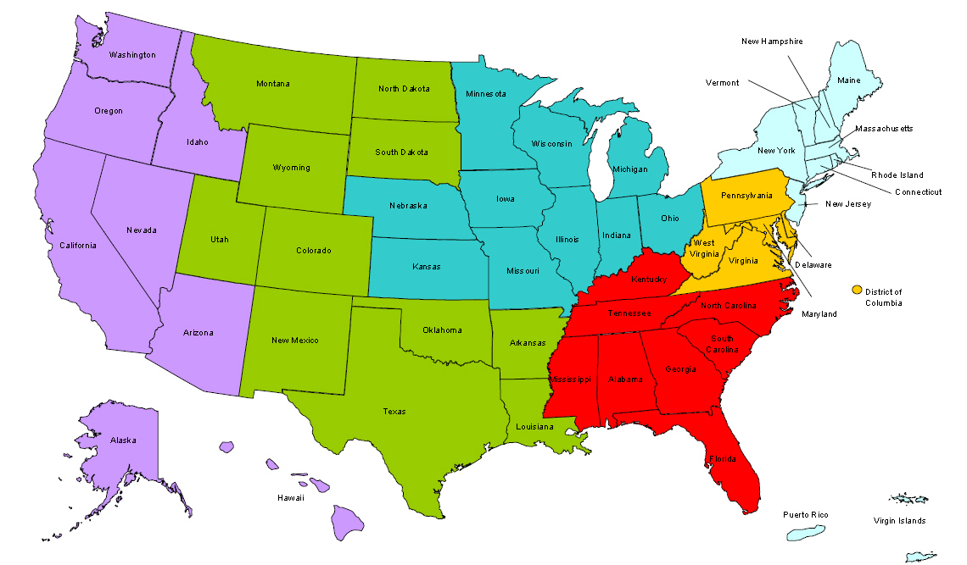
Where are you?
Enter your location in the Chat window – lower left of screen

Slide 3
Moderator
Kathy Tran
Division Chief
Office of Policy Development and Research,
Employment and Training Administration

Slide 4
Agenda
Background on JSVG refocusing initiative
Highlights of the major provisions in TEGL No. 19-13 and TEGL No. 20-13
Clarification about staff roles and responsibilities
Information about implementation timelines
Information about technical assistance resources
6. Questions

Slide 5
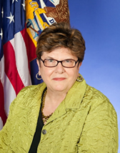
Presenters-Introductions
Terry Gerton
Deputy Assistant Secretary of Policy
Veterans Employment and Training Services
Gerri Fiala
Deputy Assistant Secretary
Employment and Training Administration

Slide 6
Presenter
Terry Gerton
Deputy Assistant Secretary of Policy
Veterans Employment and Training Services

Slide 7
Presenter
Gerri Fiala
Deputy Assistant Secretary
Employment and Training Administration

Slide 8
JVSG Refocusing Overview
JVSG refocusing is a joint VETS-ETA effort to best meet the employment needs of veterans at American Job Centers.
Establishes clear definition for Significant Barriers to Employment (SBE)
Clarifies roles and responsibilities of JVSG-funded staff
Emphasizes the requirement to provide intensive services to veterans with a SBE

Slide 9
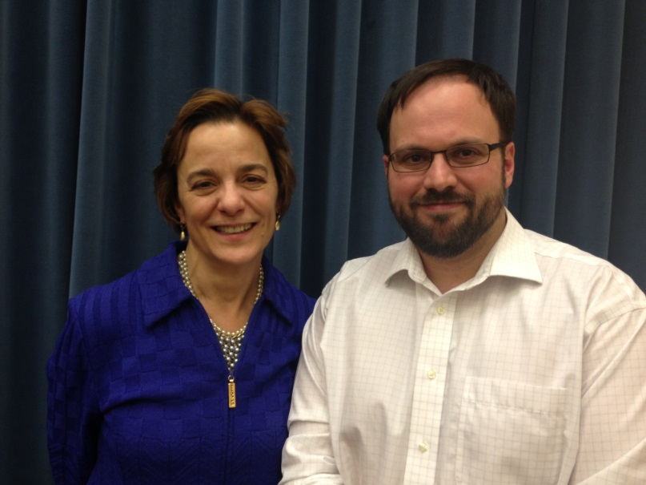
Presenters
Ruth Samardick
Director of National Programs
Veterans Employment and Training Services
Larry Burns
Chief of Adult Performance, Office of Workforce Investment
Employment and Training Administration

Slide 10
JVSG Refocusing Landscape
U.S. Department of Labor
DOL’s Veterans’ Employment & Training Service (VETS)
DOL’s Employment &Training Administration (ETA)
$/Guidance
$/Guidance
Performance Reporting
$/Guidance
State Workforce Agencies
American Job Centers
Jobs for Veterans State Grant (JVSG) Program
Wagner-Peyser (WP) Employment Services and WIA Training
Disabled Veterans’ Outreach Program (DVOP) Specialist
Local Veterans’ Employment Representative (LVER)
WP/WIA Staff

Slide 11
Refocusing Rationale
Ensure that veterans are receiving appropriate level of employment and training services
Ensure that DVOP specialists and LVER staff are performing their statutorily-mandated responsibilities

Slide 12
Workforce System Staff
Who needs to know about JVSG Refocusing?
State workforce administrators
JVSG staff
Wagner-Peyser Employment Service staff
WIA Adult and Dislocated Worker staff
American Job Center partner program staff
Veteran Service Organizations
Others

Slide 13
Polling Question
Do you have a full-time LVER in your AJC?
-- Yes
-- No

Slide 14
Polling Question
Do you have a full-time DVOP in your AJC?
-- Yes
-- No

Slide 15
What does refocusing mean?
Refocusing ensures that three key components of
veteran services at American Job Centers are adhered to:
Roles
Within the JVSG program, Disabled Veterans’ Outreach Program (DVOP) specialists and Local Veterans’ Employment Representatives (LVERs) are performing their statutorily-mandated roles
Referral
Veterans and eligible spouses are referred to the employment program that best meets their needs
Responsibility
DVOP specialists must provide increasing rates of intensive services to mitigate veterans’ significant barriers to employment

Slide 16
Roles
Statutorily-Mandated Responsibilities
DVOP Specialists
LVER Staff
are to provide intensive services to veterans with significant barriers to employment*
conduct employer outreach and job development in the local community, on behalf of all American Job Center veterans
.
are not to provide services to any other population.
are not to provide direct services to participants
*or other populations as specified by the Secretary

Slide 17
SBE categories
An eligible veteran or eligible spouse is determined to have a SBE if he or she attests to belonging to at least one of the six criteria below:
A special disabled or disabled veteran, as those terms are defined in 38 U.S.C § 4211(1) and (3); Special disabled and disabled veterans are those:
who are entitled to compensation (or who but for the receipt of military retired pay would be entitled to compensation) under laws administered by the Secretary of Veterans’ Affairs; or,
were discharged or released from active duty because of a service-connected disability;
Homeless, as defined in Section 103(a) of the Stewart B. McKinney Homeless Assistance Act (42 U.S.C. 11302(a));
A recently-separated service member, as defined in 38 U.S.C § 4211(6), who at any point in the previous 12 months has been unemployed for 27 or more consecutive weeks;
An offender, as defined by WIA Section 101(27), who has been released from incarceration within the last 12 months;
Lacking a high school diploma or equivalent certificate; or
Low-income (as defined by WIA at Sec. 101(25)(B)).

Slide 18
Serving Veterans at American Job Centers
Veterans seeking American Job Center (AJC) Services
(1.3 million participants)
The majority of veterans will be served by other AJC programs, where all veterans receive priority of service and post-9/11 Era veterans are entitled to intensive services.
Total Veteran population
(~21.2 million)
How many veterans meet the SBE definition?
Of the 1.3 million veterans seeking AJC services annually, DOL used demographic data from a similar employment program, the Workforce Investment Act training program, to estimate that 32.1%, or approximately 417,000 veterans, would meet the proposed definition of SBE.
Veterans meeting DOL’s SBE Definition
(~417,000 participants)
DVOP Specialists’ maximum capacity*
(~328,000 participants)

Slide 19
Polling Question
Currently, who does your intake process for veterans?
Wagner-Peyser staff
WIA Case Manger
LVER
DVOP
Other

Slide 20
Referral
The Basics
AJCs will need to establish intake processes to identify veterans with an SBE.
e.g., SBE categories can be part of a self-attestation check list
DVOP specialists and LVERs cannot conduct intake or assess veterans to determine if they have an SBE.
Some SBE categories are already existing data elements (i.e., homelessness, disability status)
While documentation is preferred, many applicants will qualify through self-attestation

Slide 21
Responsibility
DVOP Specialists providing Intensive Services
DVOP Specialists are required to provide intensive services to veterans with significant barriers to employment.
Intensive services assist veterans in mitigating their barriers and transitioning into the civilian workforce
Intensive service rates have increased from 20% to nearly 40% in the last five years.
VETS has set aggressive targets to increase intensive services to 90% by PY 2016.

Slide 22
Responsibility
Other DVOP Duties
In the event that a DVOP does not receive new referrals for services, he or she must:
Conduct case management for current veterans
Completing case notes and documentation requirements
Contacting participants to assess progress and provide additional services
Coordinating with the LVER or AJC business team to match veterans with job opportunities
Conduct activities to recruit veterans with SBE

Slide 23
Responsibility
DVOP Specialists
For those AJCs without a full- or part-time DVOP specialist, veterans with a SBE should be referred to another workforce program to meet his or her needs.
The veteran should be informed that he or she will still be able to receive intensive services from other programs within the AJC on a priority basis.
For those AJCs with part-time DVOP specialists, veterans with a SBE should also be offered the option of an appointment with the part-time DVOP specialist as soon as possible.

Slide 24
Responsibility
LVER staff duties
LVERs should be an integrated member of the Business Services Team at the AJC.
If there is no LVER on site at the AJC, then the Business Services Team would include veterans in their standard outreach activities.
LVERs should coordinate with AJC staff, including Wagner-Peyser, WIA, and DVOP specialists, to communicate employer outreach efforts and job openings that are available to veteran customers.

Slide 25
Examples of Integrated AJC Intake and Assessment Promising Practices
As you implement JSVG refocusing, we will provide ongoing technical assistance.
There are some effective integrated intake and assessment promising practices currently being implemented in the AJCs for customers with disabilities-these can easily be modified for veterans.

Slide 26
Performance Measurement
Referral from Wagner-Peyser to JVSG
VETS will track the percentage of AJC jobseekers who are veterans that are referred to JVSG.
(VETS 200C Cell C1 divided by ETA 9002B Cell A(4)1)
VETS and ETA anticipate no more than one-third of veterans will meet the SBE definition
SBE Categories
There is currently no single field that identifies all veterans with a SBE

Slide 27
Performance Measurement
DVOP Services
VETS will track the number and percentage of services to nonveterans
(VETS 200A and 200C Cell A1 less Cell C1)
Direction: Decreasing
LVER services to participants
VETS will track the number and percentage of participants served by LVER staff
(VETS 200B Cell C1 divided by VETS 200 C Cell C1)
Direction: Decreasing

Slide 28
Performance Measurement
DVOP Intensive Services
VETS will closely monitor the rate of intensive services by DVOP specialists
(VETS 200A Cell C11 divided by Cell C8)
Direction: Increasing
Entered Employment Rate (EER)
VETS will track both the EER and the EER following intensive services
(VETS 200A Cells C17 and C20 divided by Cells C18 and 21, respectively)

Slide 29
Performance Measurement
New LVER performance measures are being considered
Working to develop measures that connect LVER staff members’ work in conducting outreach and job development opportunities with the outcomes of veterans served by the AJC.
Alignment with other DOL priorities and initiatives

Slide 30
Effects of Refocusing Across Programs
JVSG will serve fewer veterans and provide them with higher rates of intensive services
Wagner-Peyser/WIA’s workload of veteran clients will increase with fewer referrals to JVSG
Veterans will receive priority of service
DOL recognizes there are resource limitations with current funding and will provide technical assistance to the workforce system.

Slide 31
Additional Changes Beyond Refocusing
DVOP specialists may also provide services to the following populations:
As specified by the Secretary
Veterans, ages 18-24
As specified in the FY 2014 Omnibus Appropriation
Transitioning service members in need of intensive services
Wounded Warriors in military treatment facilities and their family caregivers.

Slide 32
Federal Monitoring
ETA and VETS will update monitoring tools and guidance
to ensure an appropriate intake process has been established to identify veterans with a SBE
to review the proportion of veterans referred to DVOP specialists
to ensure strong linkages between the AJC business team and the LVER.

Slide 33
What this means for the Gold Card?
Post 9/11-era veterans with a SBE will be referred to DVOP specialists.
Post 9/11-era veterans without a SBE are eligible for intensive services from an AJC partner program.

Slide 34
Other
Are there restrictions limiting a 50% JVSG funded and 50% Wagner-Peyser funded position?
There are no restrictions. However, states must be able to differentiate both funding and performance outcomes for each program.

Slide 35
Reminder…
Take the training “Preparing Veterans for Meaningful Careers,” offered by the National Veterans Training Institute on this topic: http://www.nvti.ucdenver.edu/home/homePage.htm

Slide 36
Resources
AJC frontline staff training on NVTI (http://www.nvti.ucdenver.edu)
The Veterans Priority Resource Page (https://veterans.workforce3one.org )
Information on promising practices of integrated AJC intake and assessment:
https://disability.workforce3one.org/page/tag/1001411964704199127
https://disability.workforce3one.org/page/tag/1001326836216639830
TEGLS, FAQs and Fact Sheet (Available on NVTI and Workforce3One Web site)

Slide 37
Questions

Slide 38
Follow-up Questions
DOL Regional Staff
www.veterans.workforce3one.org
Vet.priority@dol.gov

Slide 39
Thank You!
Find resources for workforce system success at:
www.workforce3one.org

