Slide 1
Participant Placement Strategies
Webinar Date: May 8th, 2014
U.S. Department of Labor
Employment and Training Administration

Slide 2
Here’s what you can expect to get out of this webinar!
Learn first-hand accounts of ways peers have overcome challenges and turned them into success stories
Identify ways you can apply successful innovations to your own practice
Recognize key ways to establish an effective partnership
Understand the value of employer engagement and building this into your system

Slide 3
Agenda
Introductions
Presentation by Patricia Dombrowski
Presentation by Dr. Gillian Gabelmann
Question & Answer Period
Closing Remarks
Please join us on May 14th at 3:00pm EDT for a Follow up Teleconference. We’ll answer Q&A from this webinar in a more interactive exchange.

Slide 4
Moderators
Charlotte Harris
Workforce Analyst
Department of Labor
Annette Summers
President
Giuffrida Associates

Slide 5
Presenters
Presenter: Patricia Dombrowski
Health eWorkforce Consortium
Bellevue College
Presenter: Dr. Gillian Gabelmann
TRAC-7
Washburn Institute of Technology

Slide 6
Presenter
Presenter:
Patricia Dombrowski
Health eWorkforce Consortium
Bellevue College

Slide 7
9-College
Consortium
Veterans
Focused
HEALTH eworkforce COnsortium
Health IT Workforce Development
Funded by the Department of Labor,
Employment and Training Administration,
Grant #TC-23745-12-60-A-53

Slide 8
Participant
Placement
Strategies
big umbrella
+
big hat

Slide 9
think big – for the student
cut your losses
find the value proposition
BEST PRACTICES SO FAR

Slide 10
please contact me…we'd love to learn from you
patricia.dombrowski@bellevuecollege.edu
Health eWorkforce Consortium

Slide 11
Polling Question
How challenging has it been for your TAACCCT project to establish effective participant placement strategies?
Very Challenging
Somewhat Challenging
Not very Challenging

Slide 12
Presenter
Presenter:
Dr. Gillian Gabelmann
TRAC-7
Washburn Institute of Technology

Slide 13
Technical Re/Training to Achieve Credentials
Kansas Round 1 TAACCCT grant Consortium Members:
Washburn University – Lead
Cloud County Community College – Agri-Biotechnology
Dodge City Community College –Electrical Power Technician
Flint Hills Tech College - Power Plant Technology
Garden City Community College – Food Science
Highland Community College – Risk Management
Salina Area Tech College – Environmental Technology
Washburn Institute of Technology – Advanced Systems Technology
Dr. Gillian Gabelmann - TRAC-7 Principal Investigator and Associate Dean, Washburn Institute of Technology Gillian.Gabelmann@washburn.edu 785.228.6302

Slide 14
Challenges to Placement
Breaking the stereotypes of technical education that potential employers hold.
Students lack motivation and/or understanding & confidence
Students who will not apply for a job unless the qualifications and requirements perfectly fit them.
Students not willing to consider
moving.

Slide 15
Successes
Employer Engagement
Coop program – internships –
OJT
State emphasis on Technical
Education
Individual student services
Showing students how to apply for a job – mechanics & documents
Stressing the importance of the job search process
Sending out applicable jobs on a weekly basis to our students

Slide 16
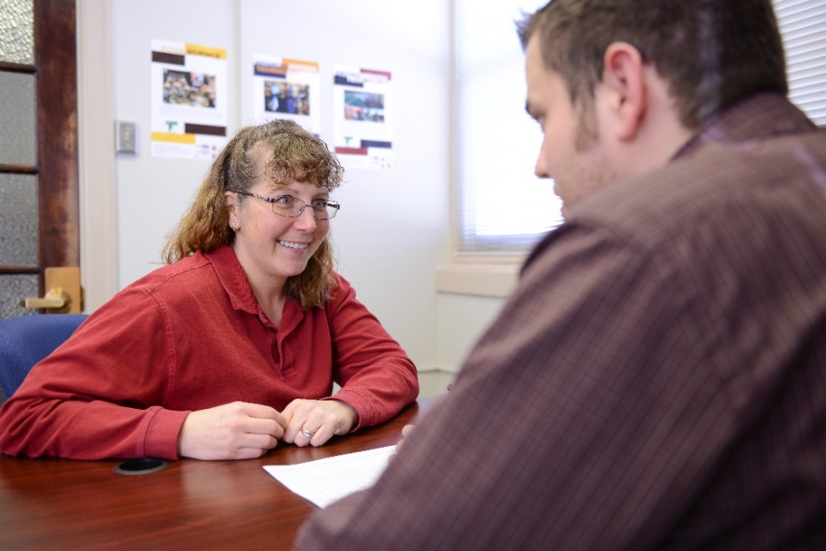
Advice
Individual contact
Intrusive advising
Be patient and treat every student with respect – be positive
Every student is an opportunity and every college staff member who comes in contact with that student has the opportunity to make a positive impact on their lives.

Slide 17
Polling Question
Some of the barriers we discovered for placing participants into employment include:
Poor relationships with the local workforce systems
Project training programs are too long
Employer partnerships didn’t work out
None, really

Slide 18
Please enter your questions in the Chat Room!

Slide 19
Reminder…
Follow up Teleconference will be held on
May 14th from 3:00pm to 4:00 pm EDT
Conference Call-In: 1-877-710-0658
Access Code: 4807419

Slide 20
Speakers’ Contact Information
Speaker: Patricia Dombrowski
Title: Executive Director
Organization: Bellevue College
Email: patricia.dombrowski@bellevuecollege.edu
Telephone: 425-564-3164
Speaker: Gillian Gabelmann
Title: Principal Investigator and Associate Dean
Organization: Washburn Institute of Technology
Email: gillian.gabelmann@washburn.edu
Telephone: 785-228-6302

Slide 21
Look for upcoming Webinars in this series!
SAVE
DATE
the
Performance Management
May 15th 3:00pm-4:00pm EDT
Success Coaches/ TAA Navigators
May 29th 3:00pm-4:00pm EDT

Slide 22
Thank You!
Find resources for workforce system success at:
www.workforce3one.org

