Slide 1
Performance Management
Webinar Date: May 15th, 2014
U.S. Department of Labor
Employment and Training Administration

Slide 2
Moderators
Kristen Milstead
Workforce Analyst
Department of Labor
Annette Summers
President
Giuffrida Associates

Slide 3

Here’s what you can expect to get out of this webinar!
Learn first-hand accounts of ways peers have overcome challenges and turned them into success stories
Identify ways you can apply successful innovations to your own practice
Recognize key ways to implement performance management practices
Understand the value of performance management and building this into your system

Slide 4

Agenda
Introductions
Presentation by Dawn Busick
Presentation by Robert Pimentel
Question & Answer Period
Closing Remarks
  Please join us on May 21st at 3:00pm EDT for a Follow up Teleconference. We’ll answer Q&A from this webinar in a more interactive exchange.

Slide 5
Presenters
Presenter: Dawn Busick
Health & MoManufacturing WINs
St. Louis Community College
Presenter: Robert Pimentel
C6 Project
West Hills College

Slide 6
Presenter
Presenter:
Dawn Busick
MoHealth & MoManufacturingWINs

Slide 7
What is MoWINs?
Missouri’s Workforce Innovation Networks
MoHealthWINs: $20 million 13 college consortium
    Fiscal Agent: Ozarks Technical College
    Administrative Coordination: Missouri Community College Association
MoManufacturingWINs: $15 Million 9 college consortium
    Fiscal Agent: St. Louis Community College
    Administrative Coordination: Missouri Community College Association

Slide 8

Challenges & Successes
Communication
Empower Grant Staff and Faculty
Leverage Volunteer Army
Implement New Processes
Accountability: Conduct Site Visits
Gather data
Celebrate Results

Slide 9
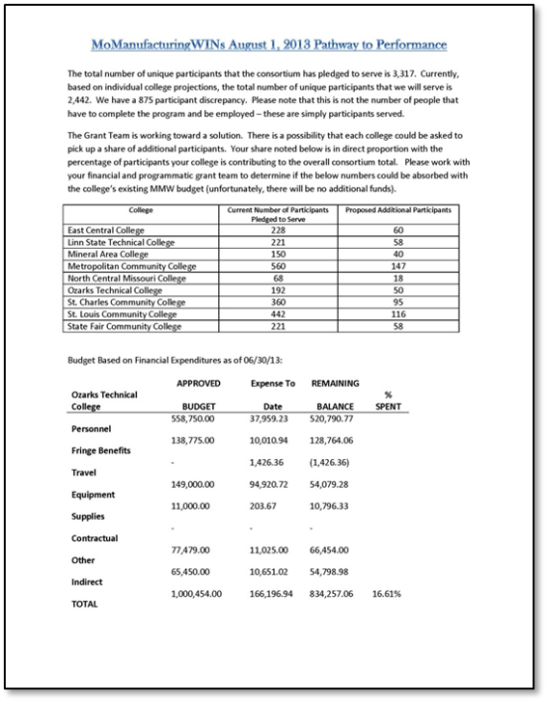
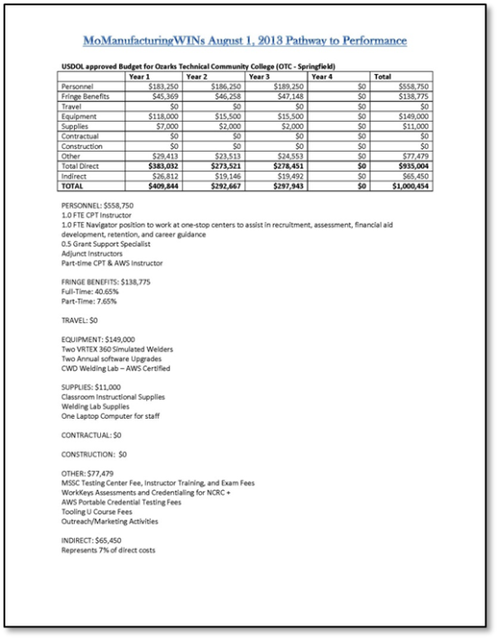
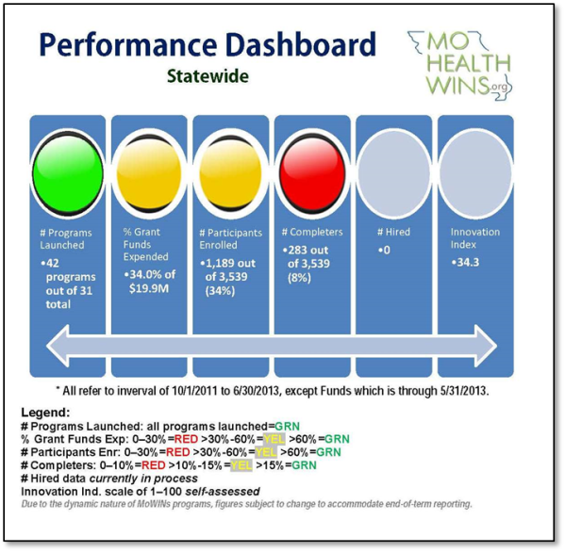
My Advice to You:
  Performance Management is something I do WITH my co-grantees,
  not TO my co-grantees!
  Empower them with Data Tools
  so they can OWN it!

Slide 10
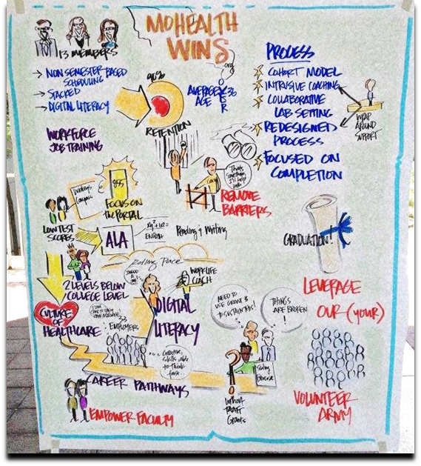
Happy to Assist… Anytime!
http://mccatoday.org/mohealthwins/technicalassistance/
Ms. Dawn Busick, Grants Director
dawn.busick@mccatoday.org
Missouri Community College Association
573-634-8787

Slide 11

Polling Question
How challenging has it been for your TAACCCT project to establish effective participant tracking strategies?
Very Challenging
Somewhat Challenging
Not very Challenging
I have not yet established a strategy for tracking participants

Slide 12
Presenter
Presenter:
Robert Pimentel
C6 Project

Slide 13
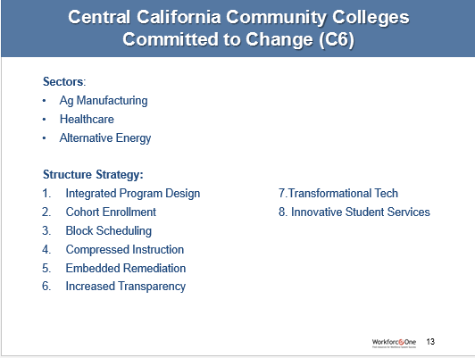

Slide 14
Challenges vs Success
Challenges:
  Faculty Challenges
    Change
    Curriculum (nursing, manufacturing)
    Job Placement Efforts
  Success
    Change
    Basic Skills
    Open Educational Resources

Slide 15
Advice
Continue to work with faculty members to ensure success
Make sure you have the support of high level administrators
Engage industry and make changes based on their recommendations
Track your students and reporting information since the beginning

Slide 16
Contact Information
Robert Pimentel
Director C6 Projects
(559) 934-2793
RobertPimentel@whccd.edu
www.westhillscollege.com

Slide 17
Polling Question
The participant tracking process established through my TAACCCT project accurately reflects the work of our grant while capturing all of the DOL required reporting outcomes.
Yes
No
N/A

Slide 18

Please enter your questions in the Chat Room!

Slide 19

Reminder…
Follow up Teleconference will be held on
May 21st from 3:00pm to 4:00 pm EDT
Conference Call-In: 1-877-710-0658
Access Code:4807419

Slide 20

Speakers’ Contact Information
Speaker: Dawn Busick
Title: Project Director
Organization: St. Louis Community College
Email: dawn.busick@mcctoday.org
Speaker: Robert Pimentel
Title: Director of C6 Projects
Organization: West Hills College
Email: RobertPimentel@whccd.edu

Slide 21
Look for upcoming events in this series!
SAVE
DATE
the
Webinar
Success Coaches/ TAA Navigators
May 29th 3:00pm-4:00pm EDT
Register now by clicking here!
Stand-Alone Teleconferences
Student Retention
May 28th 3:00pm-4:00pm EDT
Staff Turnover
June 11th 3:00pm-4:00pm EDT
Collecting Participant Wage Data
June 18th 3:00pm-4:00pm EDT
Consortium Management
June 25th 3:00pm-4:00pm EDT

Slide 22
Thank You!
Find resources for workforce system success at:
www.workforce3one.org

