Slide 1
Seeking Champions for State Short Time Compensation Programs
Webinar Date: December 6, 2013
Presented by:
U.S. Department of Labor
Employment and Training Administration

Slide 2
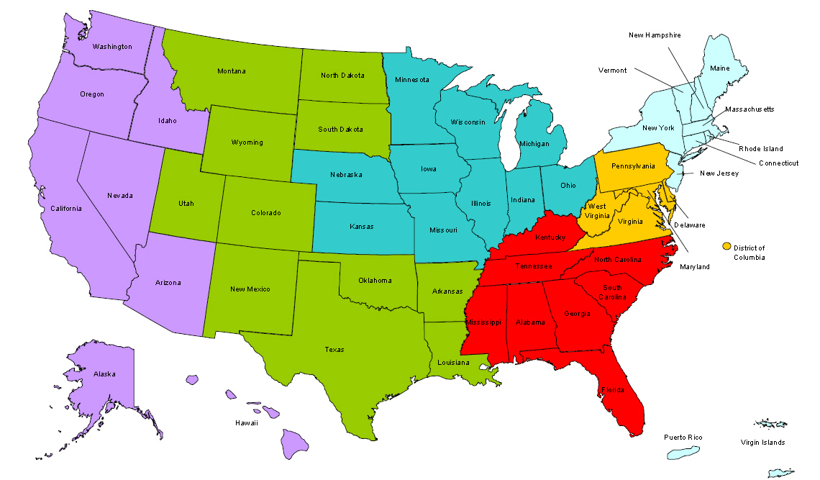
Where are you?
Enter your location in the Chat window – lower left of screen

Slide 3
UDOL/ETA Presenters
Gay Gilbert, Administrator
Unemployment Insurance
U.S. Department of Labor
Suzanne Simonetta, Chief
UI Legislation
U.S. Department of Labor
Lidia Fiore
UI Program Specialist/ UI Operations
U.S. Department of Labor

Slide 4
State Presenters
Stephen Geskey, Director
Federal & State Policies and Procedures
Michigan Department of Licensing & Regulatory Affairs
Kathy Catanzaro
Chief - Unemployment Insurance Special Programs
Rhode Island Department of Labor & Training

Slide 5
Goals for the Webinar
Encourage UI Stakeholders to become Champions of the Short Time Compensation Program in Their State.
Educate Participants on STC and Its Value
Promote DOL’s New Website as an Implementation Tool in support of State Adoption of STC program.

Slide 6
Secretary Perez Promotes STC
Secretary of Labor
Thomas E. Perez

Slide 7
How does STC work?
Employers can reduce hours of work for a specific group(s) of employees rather than laying off some employees while others continue to work regular hours
Employees receive a portion of their unemployment benefits while working reduced hours
The program preserves employees’ jobs and employers’ trained workforce during business slowdowns
Example: Instead of laying off 5 workers, an employer reduces the schedules of 25 workers by 20%

Slide 8
Who is using Shared Work?

Slide 9
State of Washington 2012 Voluntary Employer Survey Results
98% of employers would apply for the program again
99% would recommend the program to other business owners
93% said they saved jobs due to the program
68% said the program assisted them in surviving the recession

Slide 10
It’s a WIN for Employers
Retains skilled workers
Helps employers maintain quality services/products to customers
Skilled, trained workforce available when business demand increases
Avoids the time and expense of hiring and training new employees
Employee morale is maintained
For some employers, the UI tax rate may be lower than if employees were totally unemployed

Slide 11
It’s a WIN for Workers
Workers keep their jobs and continue to earn wages.
Employees receive a portion of unemployment benefits. Example:
8 hours = 20% reduction
20% x $270 WBA = $54.00
The employee receives $54.00 of unemployment benefits + 32 hours of wages earned.
Retain their health insurance and retirement benefits.
Employees maintain job skills.

Slide 12
It’s a WIN for States
STC is a valuable layoff aversion strategy, particularly during economic downturns.
It’s good for the state’s economy because it saves jobs.
States have an opportunity NOW to take advantage of Federal financial incentives to get a strong STC program up and running.

Slide 13
Financial Incentives Available NOW
Federal Government providing $ for operating the program through the Middle Class Tax Relief & Job Creation Act of 2012:
STC Benefit Reimbursement through August 22, 2015 (if state law conforms).
Grant funding to implement or improve an STC program and promote the program & enroll employers. Application deadline December 31, 2014.

Slide 14
Federal Benefit Reimbursement
States have the flexibility to non-charge employers (or not require employers to reimburse) the amount of the STC benefits that are reimbursed, depending upon the state’s STC law.
No reimbursement for STC benefits for seasonal, temporary, or intermittent employees.
Due to sequestration, reimbursement of STC benefits is 92.8% for FY2014.- still a substantial incentive and boost to state’s trust fund.

Slide 15
State STC Law
Voluntary for states to operate program.
28 States with STC laws:
Arizona, Arkansas, California, Colorado, Connecticut, Florida, Iowa, Kansas, Louisiana, Maine, Maryland, Massachusetts, Michigan*, Minnesota, Missouri, New Hampshire, New Jersey*, New York, Ohio*, Oklahoma, Oregon, Pennsylvania, Rhode Island, Texas, Vermont, Washington, Wisconsin* & District of Columbia State
* States with new STC laws not yet operational.
State laws effective after February 22, 2012 must conform to federal law to operate the program.

Slide 16
STC Legislation
STC requirements under 3306(v), FUTA:
Employer participation is voluntary.
Employer reduces employee hours in lieu of layoffs.
Work week reduction is at least 10% and no more than 60%.
Employees receive a pro-rata share of their UI benefits for reduced work hours.
Employees continue to be available to STC employer for full work hours (thereby meeting work availability and work search requirements).

Slide 17
STC Legislation
STC requirements under 3306(v), FUTA (continued):
Eligible employees may participate in training (employer-sponsored or State-approved WIA funded training).
Employers must continue to provide health and retirement benefits.
Employers must submit an STC plan for state approval, which includes certain information.
Plans must be consistent with employer obligations under applicable Federal and state laws.
Other STC state statute provisions may be approved by the Secretary of Labor.

Slide 18
STC Legislation
States have great flexibility to customize their STC programs to meet their unique needs.
Guidance has been issued about legal requirements (links to guidance provided on STC website).
More guidance is forthcoming.
The 2014 session of state legislatures is the last chance to enact laws that would make states eligible to receive an STC grant.
Staff is available to provide customized TA to states seeking to modify existing or establish new STC programs.

Slide 19
Introducing New STC Website https://stc.workforce3one.org
Champions for STC will find:
Information on the benefits of the program
Model legislative language
Program implementation information from current STC states
Outreach strategies to engage businesses
More information on available financial incentives
And much more!

Slide 20
Home Page

Slide 21
State STC Programs Work!

Slide 22
STC Guidance & Model Legislation

Slide 23
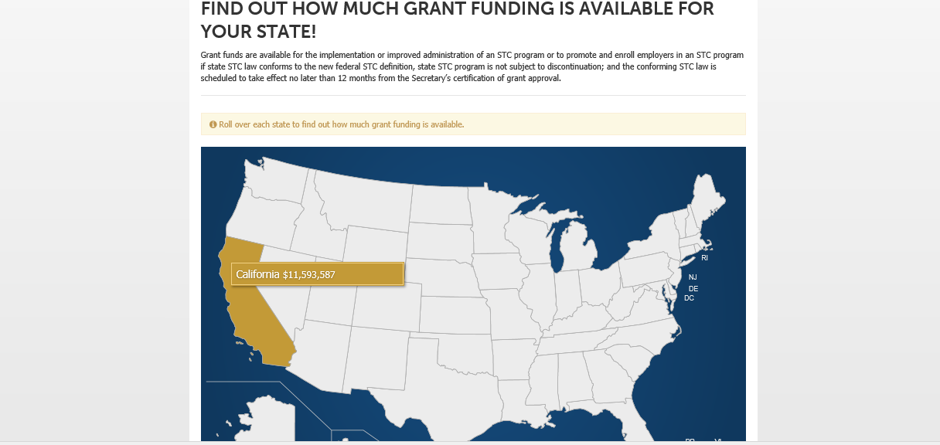
Grant Funding

Slide 24
USDOL/ETA Technical Assistance
USDOL is available to provide technical assistance to support all aspects of adopting and implementing an STC program from drafting legislation to program implementation.

Slide 25
How Can You Help?
Go to the new website and learn more about the STC program and how it can benefit your state
Reach out to your state’s UI agency
Talk to your peers and reach out to other stakeholders
Be a personal champion to implement this important program in your state

Slide 26
Michigan’s Experience
Executive Support
Stakeholder Support
Programmatic . . . Implementing It
Strategic Hook . . . Selling It
Purely Voluntary
Leverage federal funding (grants and federal reimbursement)
Policy . . . Marrying STC with state strategic goals and policy
Compliance: send draft bills in for conformity and compliance review;
Federal Flexibility allows states to build around germane state issues, concerns, and risks

Slide 27
Rhode Island’s Experience
Rhode Island’s WorkShare Program
Helping Rhode Island Employers Weather the Storm
Presenter: Kathy Catanzaro, Chief – UI Special Programs

Slide 28
Rhode Island’s WorkShare
RI’s WorkShare statistics over time
WorkShare challenges during tough economic times
RI’s conforming amendments
RI’s proposed WorkShare automation project as part of modernization effort

Slide 29
Rhode Island: WorkShare Initial Claims
2001 | 10,803
2002 | 8,370
2003 | 7,832
2004 | 4,452
2005 | 5,006
2006 | 5,618
2007 | 6,451
2008 | 10,546
2009 | 27,372
2010 | 12,099
2011 | 3,612
2012 | 2,299
2013 | 1683

Slide 30
Rhode Island: Workshare Number of Payments

Slide 31
Rhode Island: WorkShare Total $ Paid
2001 | $3,134,600
2002 | $3,367,102
2003 | $3,372,889
2004 | $1,954,908
2005 | $2,044,110
2006 | $2,005,135
2007 | $2,138,166
2008 | $4,680,686
2009 | $18,665,226
2010 | $10,642,743
2011 | $6,830,723
2012 | $4,947,891
2013 | $1,993,047

Slide 32
Rhode Island: WorkShare Layoffs Averted
1992 | 2,173
1993 | 1,400
1994 | 1,474
1995 | 2,228
1996 | 2,033
1997 | 2,140
1998 | 1,773
1999 | 1,656
2000 | 1,408
2001 | 3,998
2002 | 2,602
2003 | 1,801
2004 | 1,017
2005 | 1,165
2006 | 1,288
2007 | 1,472
2008 | 2,934
2009 | 6,618
2010 | 2,933
2011 | 963
2012 | 625
2013 | 454

Slide 33
Rhode Island: WorkShare Employers Participating
2007 | 180
2008 | 283
2009 | 612
2010 | 479
2011 | 235
2012 | 278
2013 | 171

Slide 34
Rhode Island: WorkShare Challenges During the Economic Downturn
Staffing issues during peak UI periods.
Significant increase in employer participation during worst economic crisis.
Employers requesting more flexibility in modification of plans to meet their own demands.

Slide 35
Rhode Island: WorkShare Challenges During the Economic Downturn
Need for more extensive monitoring of WorkShare plans to ensure compliance.
Need for more employer interaction to help them keep their doors open.

Slide 36
Rhode Island’s WorkShare Conforming Amendments
Prior statute:
required a 30 hour minimum work week prior to participating in the WorkShare program – removed this restriction to allow part-time employees as well.
did not allow public employers, i.e. municipalities, state agencies, federal agencies. Struck the word “private” from the definition of eligible employers.
specified WorkShare was to be utilized in lieu of “temporary” layoffs. This requirement was stricken so that the program could be used in lieu of temporary or permanent layoff situations.

Slide 37
Rhode Island’s WorkShare Conforming Amendments
Prior Statute:
did not specifically disqualify an employer from WorkShare if fringe benefits were reduced while participating. Language was added to specify under what conditions fringe benefits can be affected.
did not specifically disqualify temporary workers, although by policy, RI did not allow this situation. Temporary work is now specified as not allowable under WorkShare.

Slide 38
Rhode Island’s WorkShare Conforming Amendments
New Sections:
Two new sections were added to require employers to:
describe the manner in which employees will be notified with notice (where feasible),
an estimate of the number of layoffs participation will avert, and
an attestation that the terms of the plan will conform with employers’ obligations to federal and state laws.

Slide 39
Rhode Island’s WorkShare Conforming Amendments
New Sections
New language was required in order to allow non-charging of WorkShare benefits during any period of Federal STC reimbursement.
New section added to allow participation in training, whether employer-sponsored or WIA.

Slide 40
Rhode Island: WorkShare Automation Project
Online applications:
Employer application – Will be one of the options available in the employers’ Tax Self-Service menu.
Employer weekly certification – employer may submit with no change from last week for each unit, or make adjustments.
NEW: Claimant weekly certification – must match information submitted by employer.

Slide 41
Rhode Island: WorkShare Automation Project
System will:
track modifications to plan.
create work items where potential issues exist.
allow reports for compliance with State statute, i.e. extended use, layoffs while participating, etc.
provide dashboard reporting on numbers of participating employers, payments, initial claims, averted layoffs, etc.

Slide 42
Ask the State Panel or USDOL Questions

Slide 43
Contact Information
You can contact us at:
Stc.Inquiries@dol.gov

Slide 44
Thank You!
Find resources for workforce system success at:
www.workforce3one.org

