Slide 1
Short-Time Compensation
Model Legislation & Conformity Requirements
January 24, 2013 1:00 pm ET

Slide 2
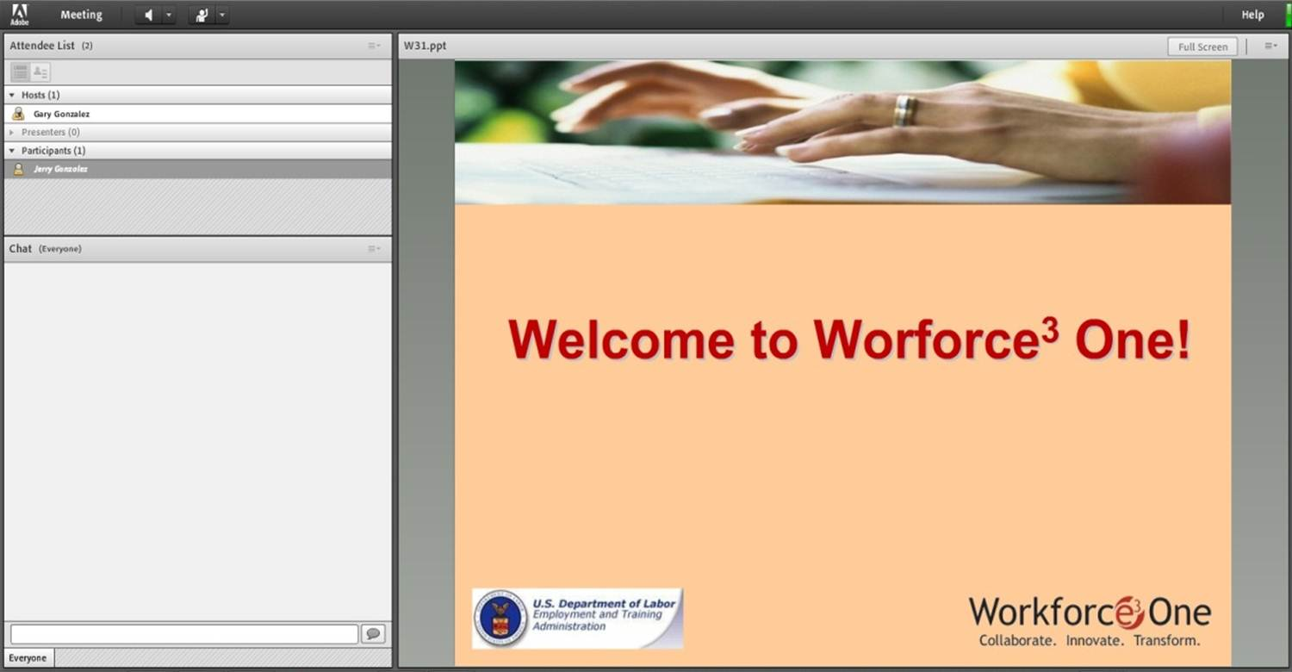






Welcome to Workforce³ One!

Slide 3
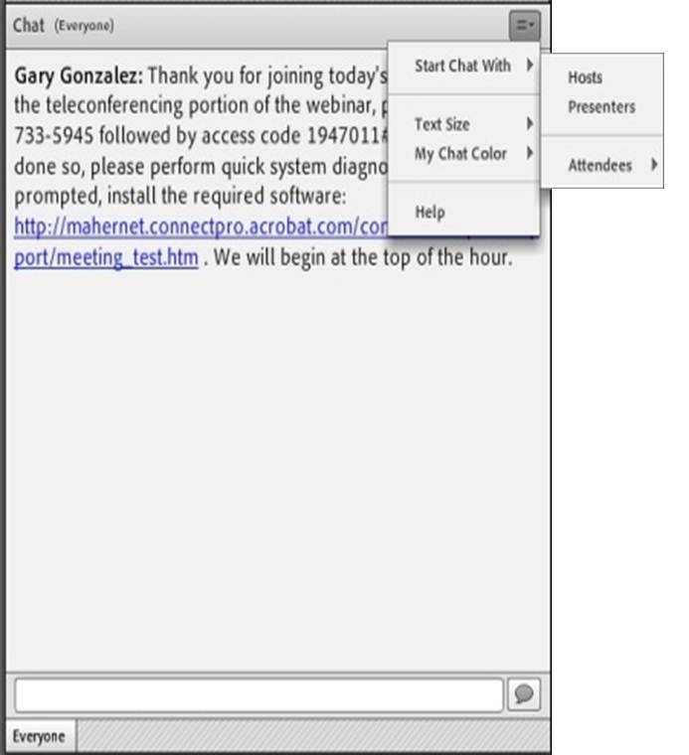
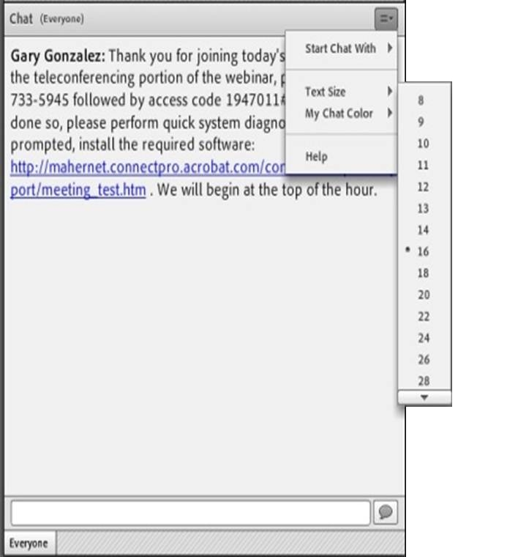
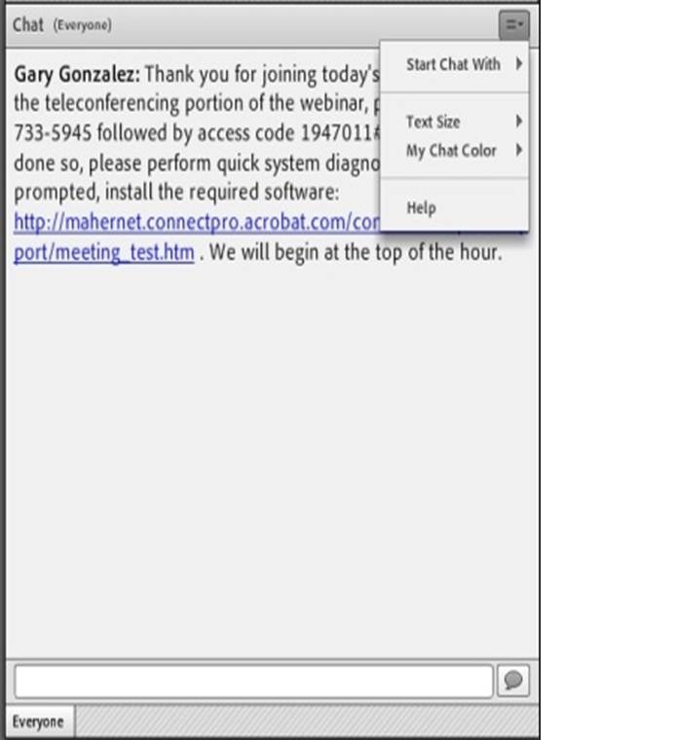
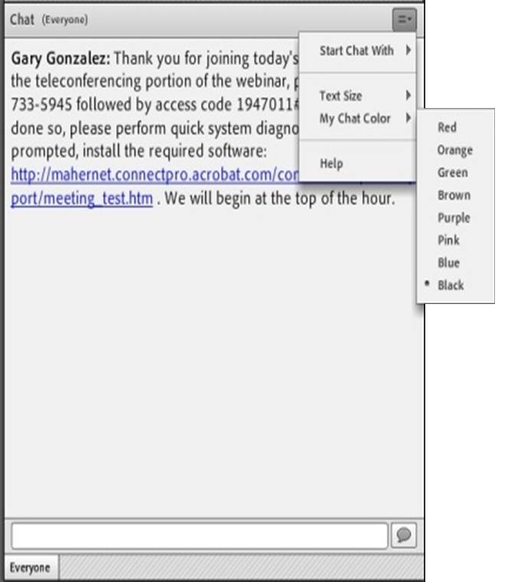
Submitting Questions:
Open Chat
Drop-Down Menu
To submit a question, type the question in the text field and press your Enter/Return key.
  Please enter the name to whom the question is directed.
To send questions only to the presenters, select Presenters from the drop-down menu before pressing your Enter/Return key.
Change Text Size and Chat Color…
Text Field

Slide 4
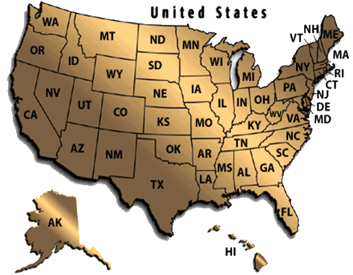
Practice
In the Chat Room, please type the name of your organization, your location, and how many people are attending with you today.

Slide 5
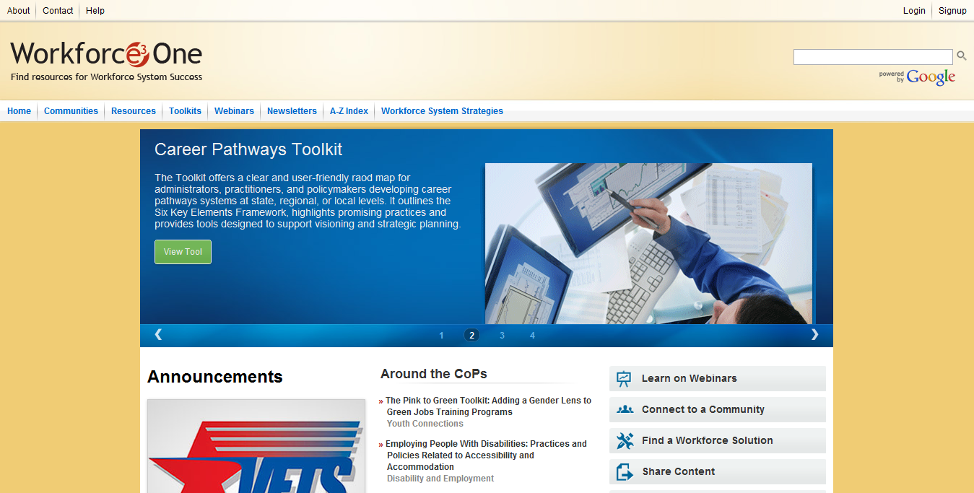
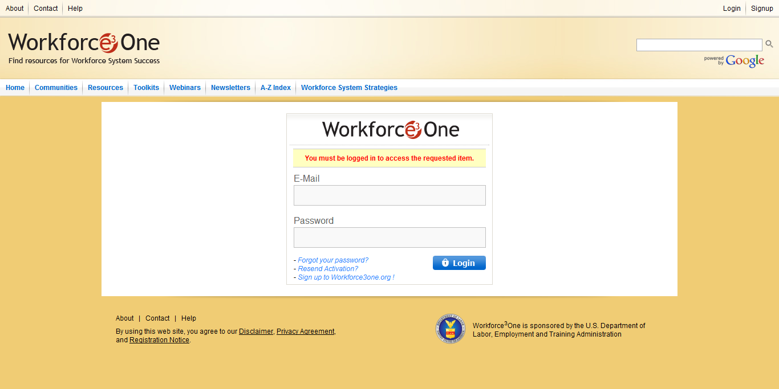
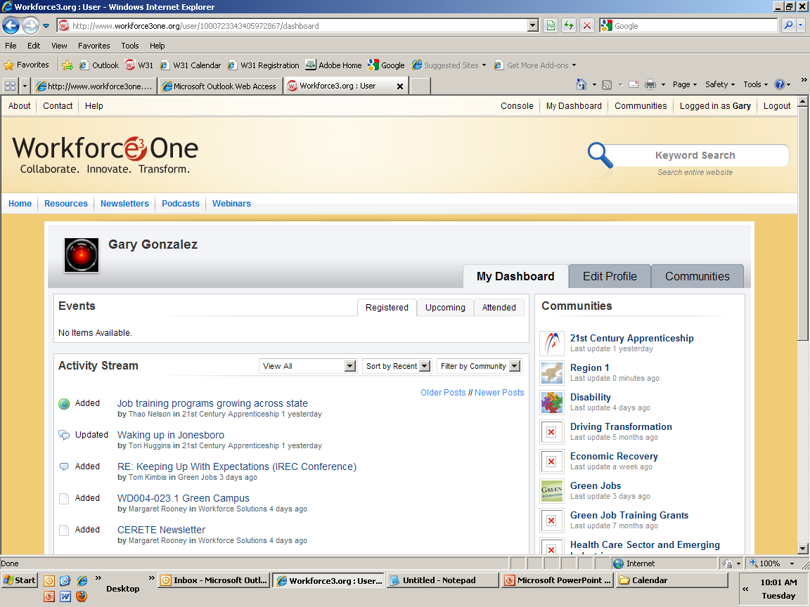
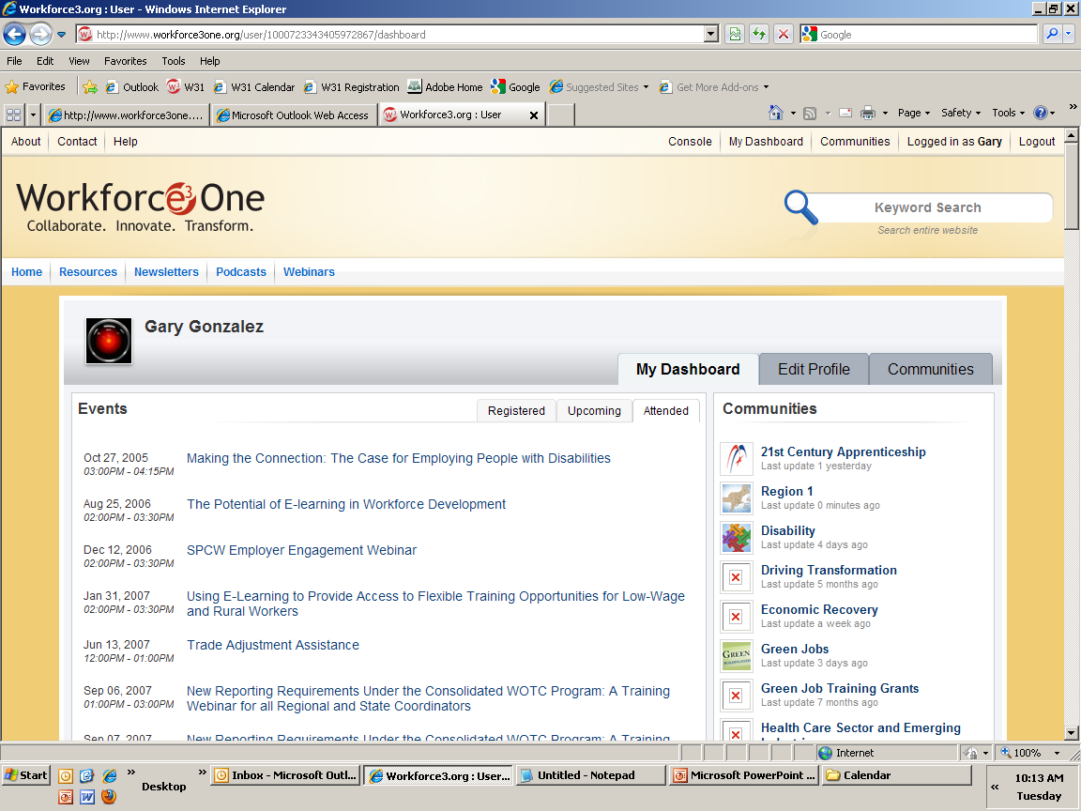



Access to Webinar Resources
WEBINAR RESOURCES:
Recordings and transcripts are available within 2 business days after the event.

Slide 6
Presenters
Gay Gilbert, Administrator, Unemployment Insurance
Suzanne Simonetta, Chief,
Division of Legislation

Slide 7
Purpose of Webinar
Describe model legislation provided to states for use in implementing the provisions in Subtitle D of Title II of the Middle Class Tax Relief and Job Creation Act of 2012 (P.L. 112-96) on short-time compensation.
Provide additional guidance to the state agencies about the new definition of short-time compensation in Federal unemployment compensation law.

Slide 8
Webinar Agenda
Overview of the STC provisions in P.L. 112-96
Discussion of the Model Language
Approval of Additional Provisions not included in Model Language.
State Specific Technical Assistance

Slide 9
What is Short-Time Compensation?
Short-Time Compensation
STC (also known as worksharing or shared work) preserves employee’s jobs and employers’ trained workforce during disruptions to a firm’s regular business activity by reducing the hours of work for an entire group of affected employees rather than laying off some employees while others continue to work full time.

Slide 10
What is Short-Time Compensation?
Short-Time Compensation
Employees benefit by maintaining their jobs and skills while experiencing a smaller cut to their weekly income.
Employers benefit by keeping their trained and experienced workforce who will be immediately available when demand for their services increases.

Slide 11
Background
  UIPL No. 22-12, Short-Time Compensation Provisions in the Middle Class Tax Relief and Job Creation Act of 2012 (“Act”), issued June 18, 2012
The “Act” enacted on February 22, 2012 contains the Layoff Prevention Act of 2012 (Subtitle D), which does the following:
  Modifies the STC definition; adds 3306(v), FUTA
  Provides 100% Federal Reimbursement for state STC programs
  Allows states to operate a Federal STC program
  Provides STC grants to eligible states
  Directs the Secretary of Labor to develop STC model legislation
  Requires a report on implementation of these new STC provisions

Slide 12
Temporary Reimbursement of Eligible Short-Time Compensation Costs
  Up to 156 weeks of Federal 100% reimbursement of eligible STC costs paid under state law conforming to 3306(v), FUTA, until 8/22/15.
  States administering an STC program on 2/22/12 whose laws do not conform to Section 3306(v), FUTA, are eligible for 100% Federal reimbursement during the 2 ½ year period ending on 8/22/14 (up to 130 weeks).
    Enactment of conforming legislation during this period permits reimbursement of a total of 156 weeks until 8/22/15.

Slide 13
Short-Time
Compensation Grants
Types of Grants
There are two grants available to states:
  a grant to implement or improve a state STC program, and
  a grant to promote and enroll employers in the STC program.
States may apply for one or both of the grants

Slide 14
Short-Time
Compensation Grants Cont.
STC Grant Requirements
STC law must conform to Section 3306(v), FUTA
STC program may not be subject to discontinuation
Application Deadline: December 31, 2014

Slide 15
Definition of Short-Time Compensation
The term “Short-Time Compensation” is defined in new subsection (v) of Section 3306, FUTA, which became effective on February 22, 2012.
States are not required to enact an STC program into law; however, states may not operate an STC program that does not conform to the new definition in 3306(v), FUTA.
States currently operating an STC program are provided a transition period of two years and six months (or until August 22, 2014) in order for laws to conform to the new definition and requirements.

Slide 16
Provisions of Section
3306(v), FUTA
3306(v), FUTA, contains nine specific requirements that define an STC program.
3306(v)(10), FUTA, provides authority for the Secretary of Labor to approve additional provisions of state STC laws.

Slide 17
Section 3306(v), FUTA
A new modified definition of STC is provided in new subsection (v) of Section 3306, FUTA, under which:
Employer participation is voluntary.
Employer reduces employee hours in lieu of layoffs.
The reduction is at least 10% and not more than 60% and employees are not disqualified from UI.
Employees receive a pro-rata share of benefits they would have received if totally unemployed.
Employees meet work availability and work search requirements, by being available for their workweek as required by the State agency.

Slide 18
Section 3306(v), FUTA
Eligible employees may participate in training, either employer-sponsored or funded under the WIA if approved by State agency.
New Elements in the Definition:
Requires employers to continue to provide health and retirement benefits.
State agencies shall require the employer to submit a written plan describing how the requirements of 3306(v), FUTA will be implemented, with an estimate of the number of layoffs that would have occurred.
Plan must be consistent with employer obligations under applicable Federal and State laws.
Upon approval by the Secretary, only such other provisions of State law that are determined appropriate for purposes of STC.

Slide 19
Model Legislation
What is it?
Limited to what is necessary to conform to the new definition of an STC program.
Based on the 1983 model language; however, updated and revised to assist states in enacting conforming legislation that meets the definition in Section 3306(v), FUTA.
Consist of:
  8 pages of text
  15 pages of commentary
  3 pages of pre-approved provisions for 3306(v)(10), FUTA

Slide 20
Model Legislation
Common issues in current state STC laws:
In lieu of layoffs – many state laws provide a reduction in lieu of “temporary” layoffs.
Many states limit STC plan participation only to full-time employees.
Reduction in hours – some states provide for a reduction of at least 10% but provide no maximum.
Almost all states are silent on employer sponsored training and WIA funded training.

Slide 21
Model Legislation
Common issues in current state STC laws:
Maintenance of health and retirement benefits – Many state STC laws only require that the plan specify how benefits will be affected and do not prohibit their reduction while the plan is in effect.
Many state STC laws provide for notice to union members in an affected unit through a collective bargaining agent but do not require a description for how notice will be provided to the affected unit when there is no collective bargaining agent involved.

Slide 22
Model Legislation
Common issues in current state STC laws:
Layoff aversion estimate – Many states do not require employers to provide it.
Almost all states need to add a provision that requires employers to certify that participation in the plan is consistent with the employer’s obligation under state and federal law.

Slide 23
Pre-Approved Additional Provisions
State laws may contain other provisions for an STC program in addition to the provisions necessary to conform to the new definition of 3306(v), FUTA. The U.S. Department of Labor pre-approved five concerning:
The size of the affected unit provided the size selected is not so large as to limit effective participation in STC;
A requirement that, if the affected unit is covered under a collective bargaining agreement, the bargaining agent must agree to the plan;
Employer assurance that it will not hire new employees in the affected unit during the term of the STC plan;

Slide 24
Pre-Approved Additional
Provisions Cont.
Limitations on STC participation of workers in affected unit based on their tenure;
A limitation that the STC plan is being implemented to avoid layoffs of a certain minimum percentage of workers in the affected unit;
A prohibition against STC plan participation by employers who are delinquent in the payment of contributions, penalties, or interest.

Slide 25
3306(v)(10), FUTA Approval
Section 3306(v)(10), FUTA, provides flexibility to states to receive approval by the Secretary of Labor of other provisions if they are appropriate for an STC program.
We strongly encourage states to consult with the U.S. Department of Labor before enacting any optional provisions other than those identified in the model legislation.
All additional provisions must be consistent with how an STC program is defined in Section 3306(v)(1) through (9), FUTA.

Slide 26
3306(v)(10), FUTA Approval
An authorized representative of the state must request, in writing, that the Department of Labor approve any additional provision(s) as appropriate for an STC program.
Request must include:
  A citation where the state proposes to codify the additional provision in its law;
  A description of the provision;
  A detailed rationale as to why the state considers the provision appropriate for an STC program; and
  A request that the U.S. Department of Labor approve the provision.

Slide 27
State Specific
Technical Assistance
The U.S. Department of Labor is:
Developing an STC Implementation Toolkit that will include: policies, procedures, and messaging strategies – launched in early 2013.
Collecting best practices from current STC programs – STC testimonials (employers and claimants).
Developing content for an STC Virtual Institute to be led by a team of federal and state STC experts.

Slide 28
State Specific
Technical Assistance
Please contact your Regional Offices/National Office support for law changes, questions, and information sharing.
Best practices via Unemployment Insurance Community of Practice.

Slide 29

Question and Answer Period
Please enter your questions into the Chat Room!

Slide 30
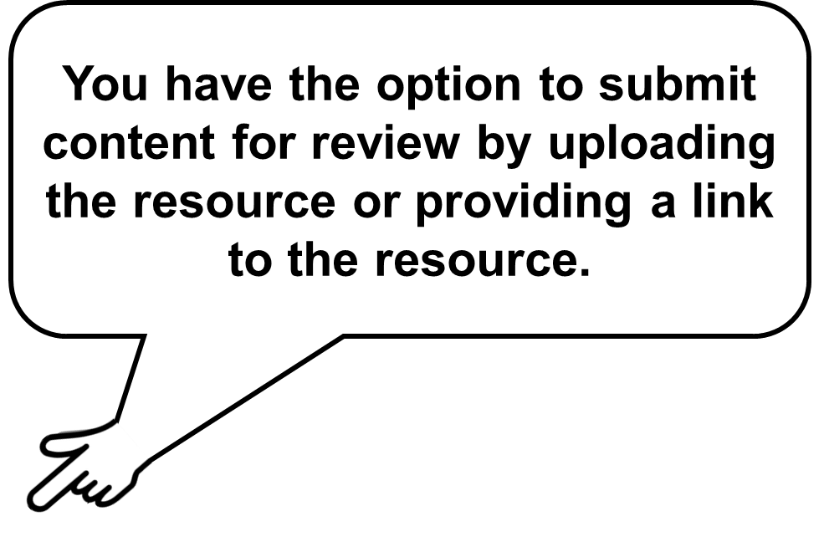
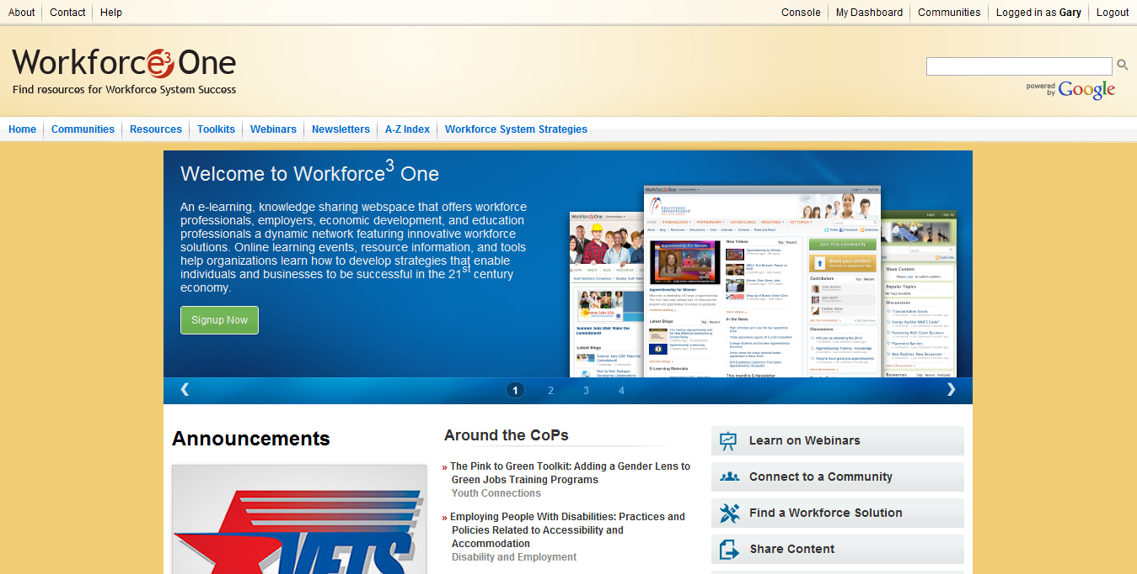
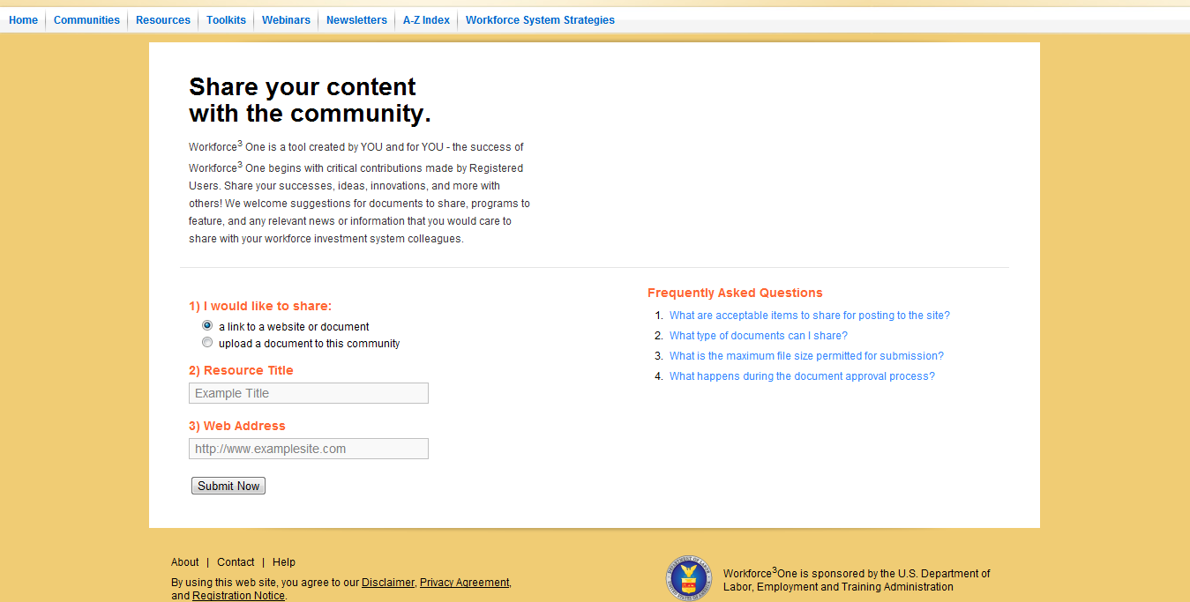
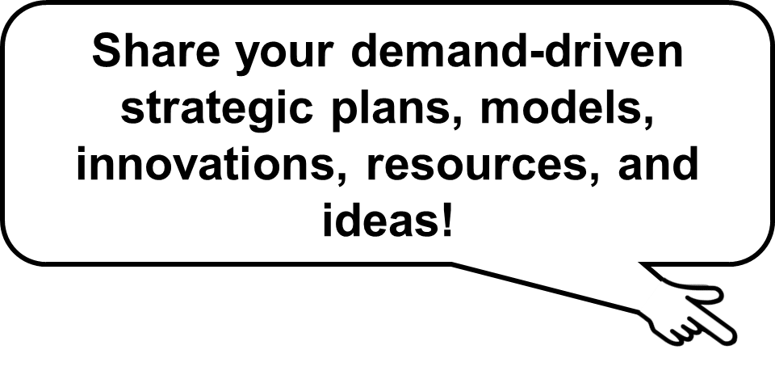
Share Your Ideas with Your Peers!

Slide 31
Access to Webinar Resources
WEBINAR RESOURCES:
Recordings and transcripts are available within 2 business days after the event.

Slide 32
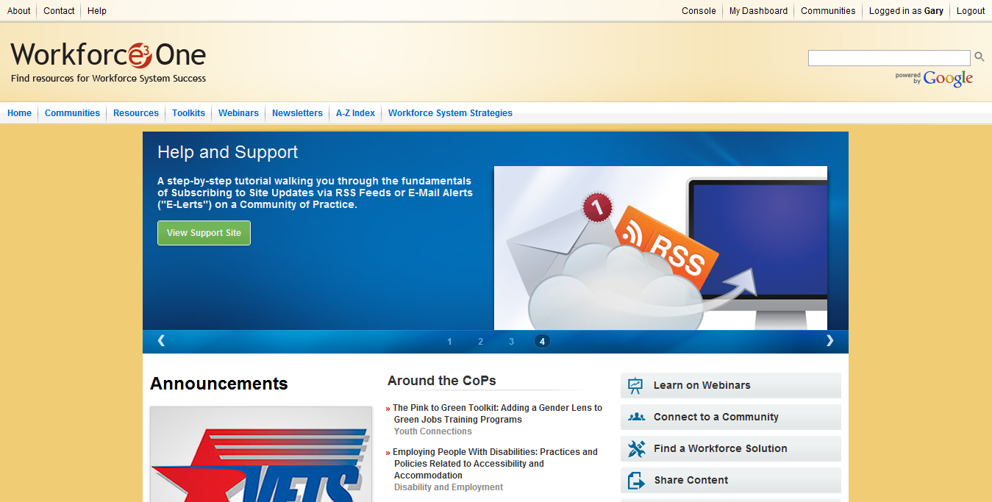
Stay Informed, Get Connected!

Slide 33
For more information about the Workforce Investment System:
  Visit www.careeronestop.org
  Call 1-877-US2-JOBS
THANKS!
www.workforce3one.org

