Slide 1
Using Labor Market Information in Service Delivery for National Farmworker Jobs Program Grantees
Webinar Date: Wednesday, April 24th, 2013
Presented by:
Office of Workforce Investment
Employment and Training Administration
U.S. Department of Labor

Slide 2
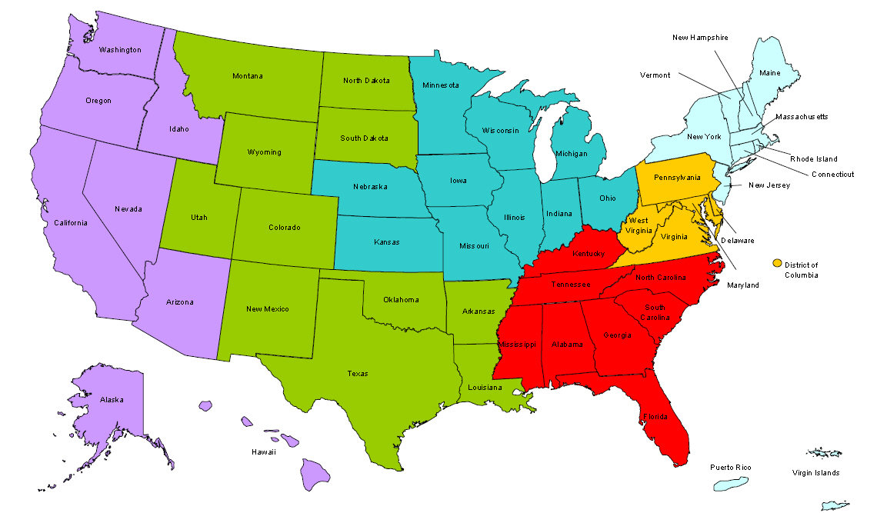
Where are you?
Enter your location in the Chat window – lower left of screen

Slide 3

Here’s what you can expect in this webinar:
Learn where to access LMI
Find out what LMI means on the local, state, and national levels
How to use LMI to help NFJP participants find in-demand jobs
How to engage local businesses and develop relationships

Slide 4

Agenda
Welcome
ETA Labor Market Information (LMI) team presents: “LMI You Can Use!”
Proteus Inc. discusses how to use LMI to enhance program outcomes
Questions/Answers
Conclusion

Slide 5
Target Audience
What is your primary role with the NFJP?
[Please choose all that apply]
  Case Manager
  Outreach
  Job Development/Placement
  Administrative
  Director/Manager
  Federal Program Officer or State LMI Team
  Other [Please type your role into the chat]

Slide 6
Moderator/Presenters
Moderator: Amy Young
Unit Chief, Specialty National Programs
U.S. Department of Labor, Employment &Training Administration
Presenter: Anthony Dais
Labor Market Information Team Leader
U.S. Department of Labor, Employment & Training Administration
Presenter: Frank Gallo
Workforce Analyst
U.S. Department of Labor, Employment & Training Administration
Presenter: Daniel Ramirez
Area Manager
Proteus, Inc.

Slide 7
LMI Presentation Outline
1. What’s LMI, and who produces it?
2. Avoiding mistakes, & understanding key terms
3. Best sources for state & local LMI
4. Best rural and farmworker data sources
Pay
Benefits
Employment
5. Which jobs are growing, which aren’t?
Layoffs
Job vacancies
Hours
Projections
Safety
6. Which growing jobs are “good” jobs?
7. How much education and training are required?
my Skills, my Future
My Next Move
8. KEY E-TOOLS TO FIND DATA & INFO
Occupational Outlook Handbook
State-specific tools
US.jobs

Slide 8
What Is LMI, and Who Produces It?
Labor market information (LMI) and workforce information — roughly synonymous — are data and other information (such as job openings) about employment and unemployment, compensation, and education and skills.
Almost all LMI is produced by a few government and private sector entities.
  At the Federal level, principally the U.S. Bureau of Labor Statistics (BLS); Census Bureau; Employment and Training Administration; and National Center for Education Statistics.
  At the state-level, state LMI offices.
  In the private sector, Help-Wanted OnLine (HWOL) and other vendors that analyze online data or private databases.

Slide 9
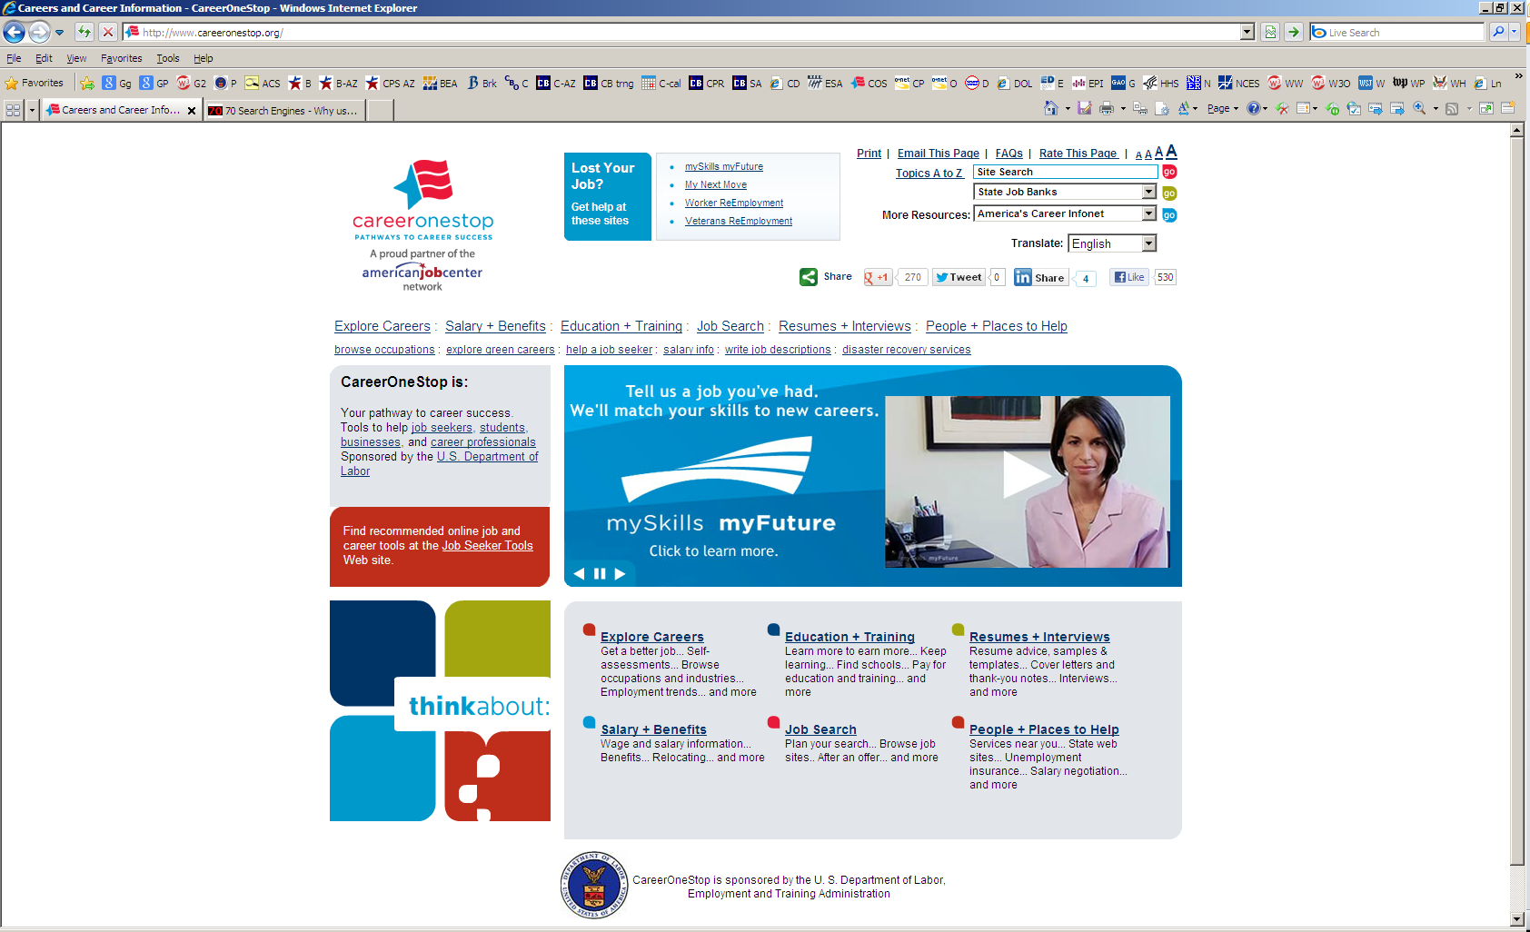
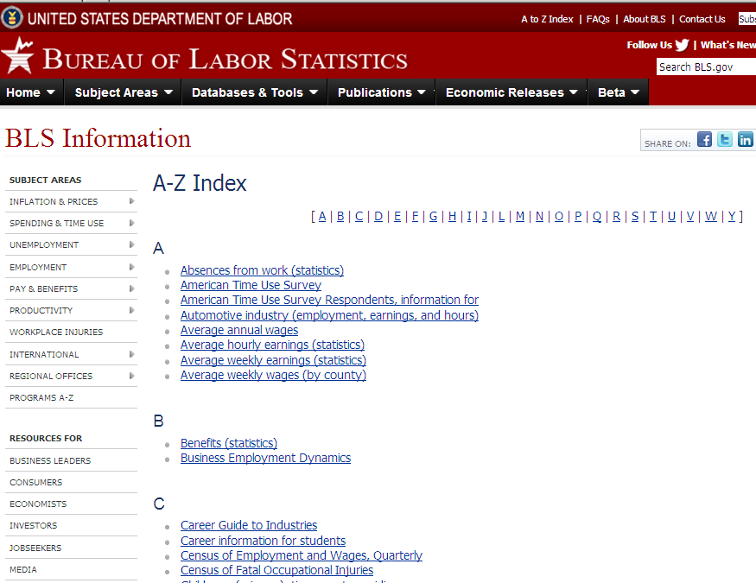
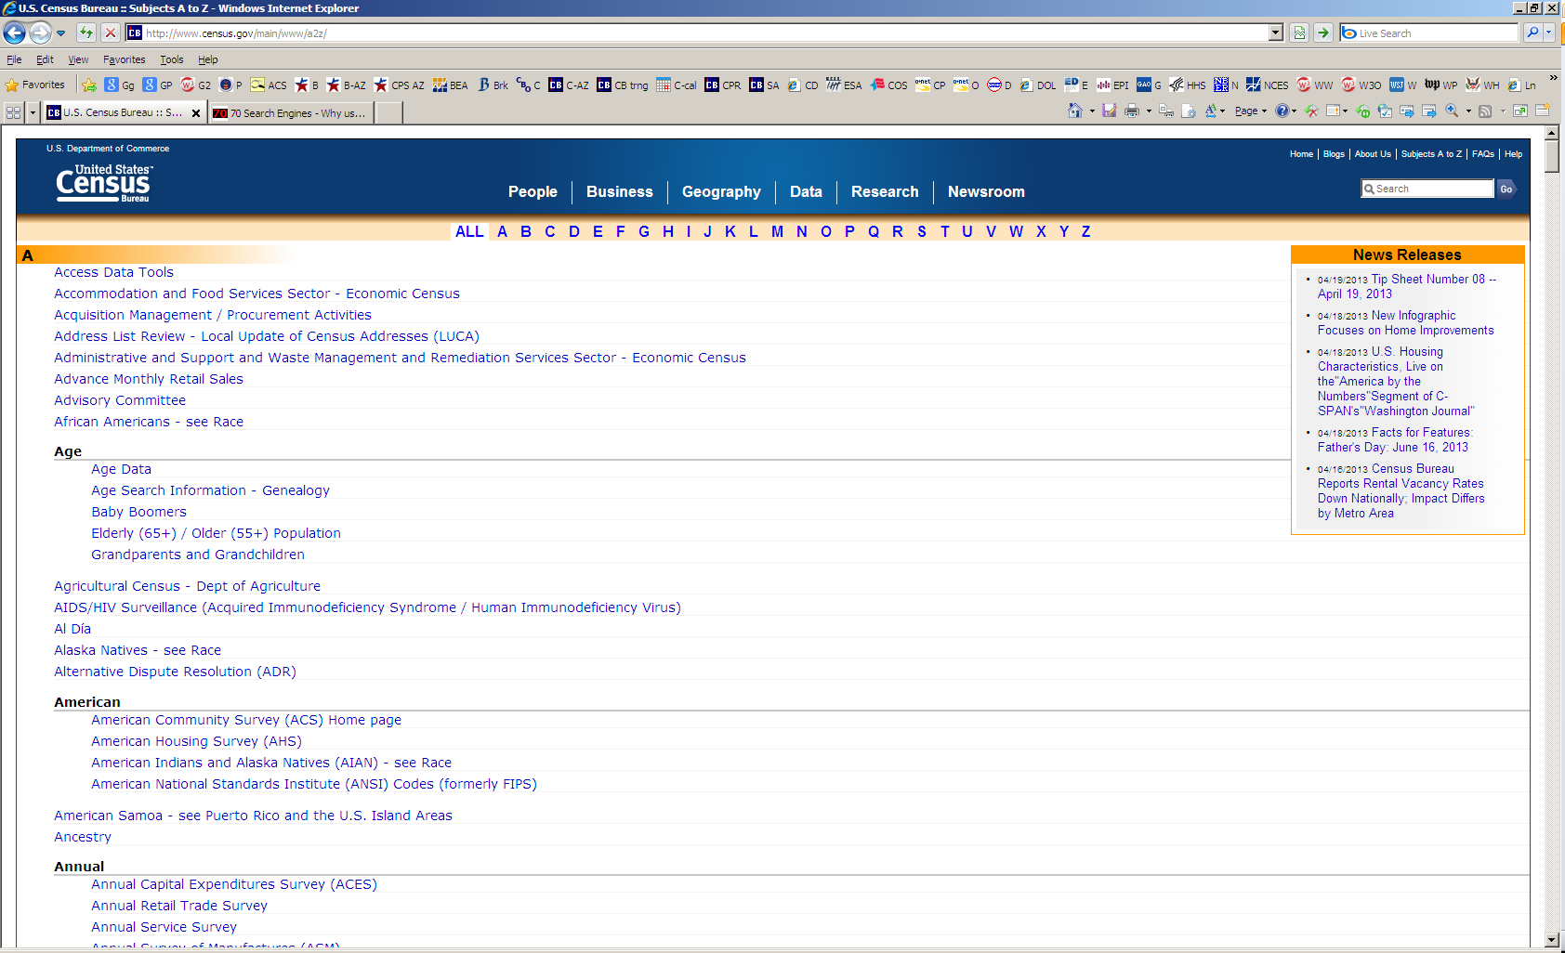
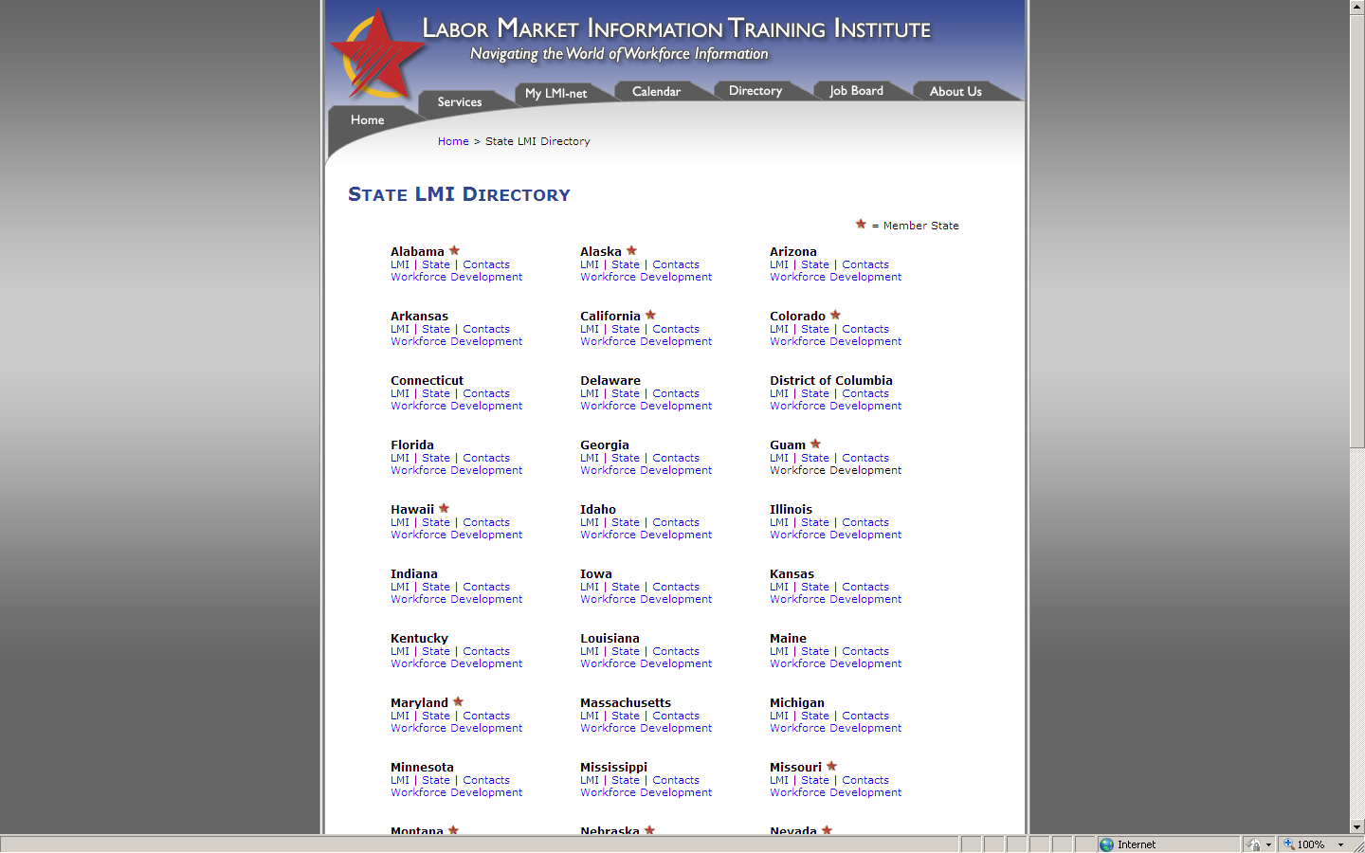
ETA, BLS, Census, and State LMI Web Sites

Slide 10
Avoiding Common Mistakes
Unemployment and joblessness are not synonyms — only job hunters are “unemployed.” See ETA’s Unemployment Data Podcast.
Isolated numbers have little meaning outside their historical and geographic context.
Raw numbers are typically less useful than the appropriate percentage.
It’s often possible to obtain the same type of data from different sources, but you should be very careful about comparing numbers from different sources. E.g., self-employed and agricultural workers are included in some sources but not in others.
Except in recessions, labor market changes and problems develop gradually. Despite common claims, few workforce developments are new.

Slide 11
Understanding Some Key Terms
“Industries” describe what employers or businesses do, while “occupations” group individuals by the work they perform. See ETA’s Industry Data Podcast.
BLS and state employment projections are not forecasts — although many private sector firms issue forecasts. Instead, BLS assumes full employment in the projected year. See ETA’s Employment Projections Podcast.
Wages, earnings and compensation, respectively, describe progressively broader categories of income. Benefits are non-monetary forms of compensation. See “Key Definitions” in ETA’s Guide to State and Local Workforce Data.

Slide 12
Basic Sources for State and Local Data
ETA’s workforce data site, the Labor Market Information WIN-WIN Network Community of Practice, has resources available nowhere else on the Internet.
3 Web sites list state LMI offices: LMI Training Institute Directory; ETA’s state LMI directory; and BLS’ state LMI contact list.
ETA’s Guide to State and Local Workforce Data comprehensively covers quality government and private sector sources.
BLS has 3 geographic Web sites: a) BLS Geographic Information, b) BLS Geographic Guide and c) BLS Statistics by Geography

Slide 13
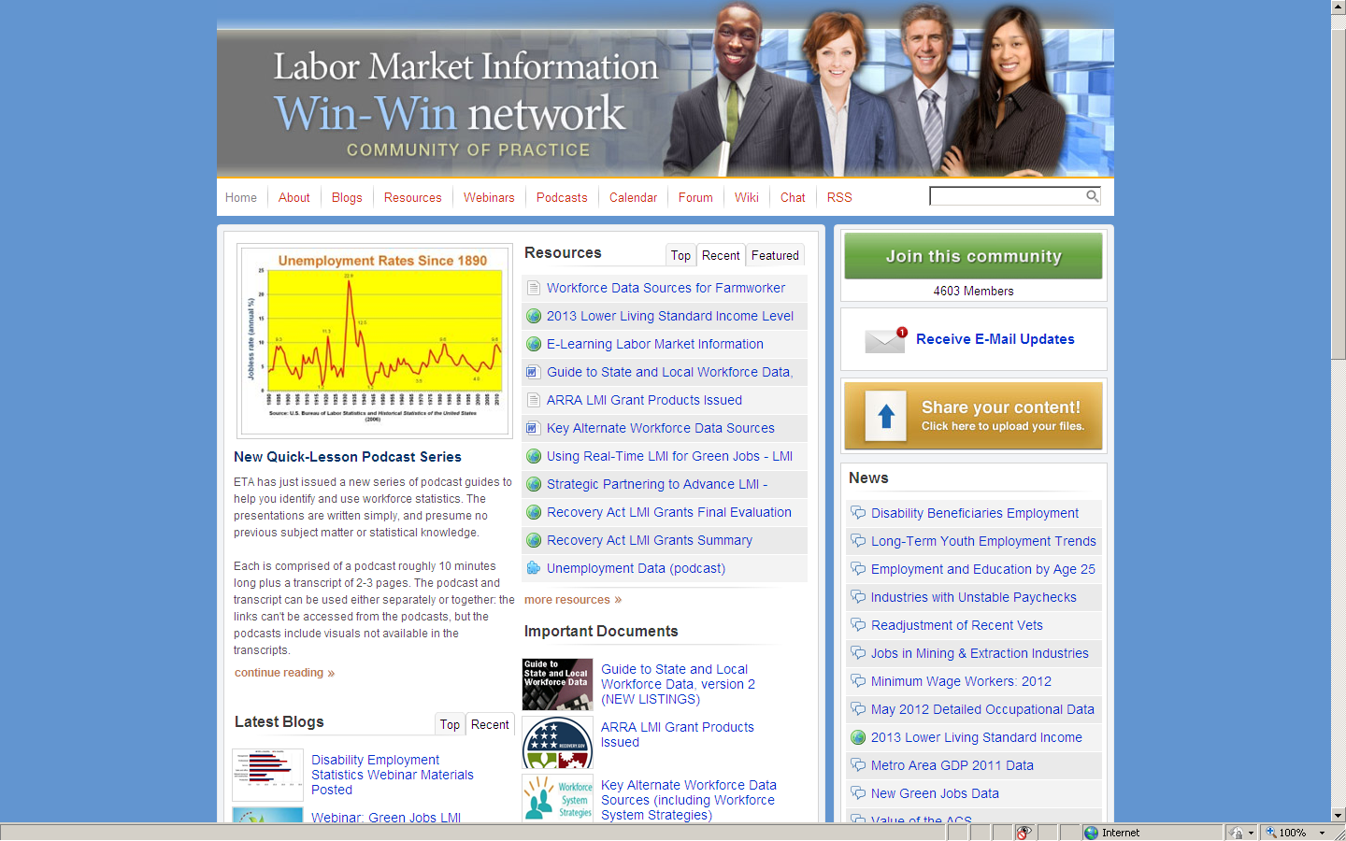

https://winwin.workforce3one.org/

Slide 14
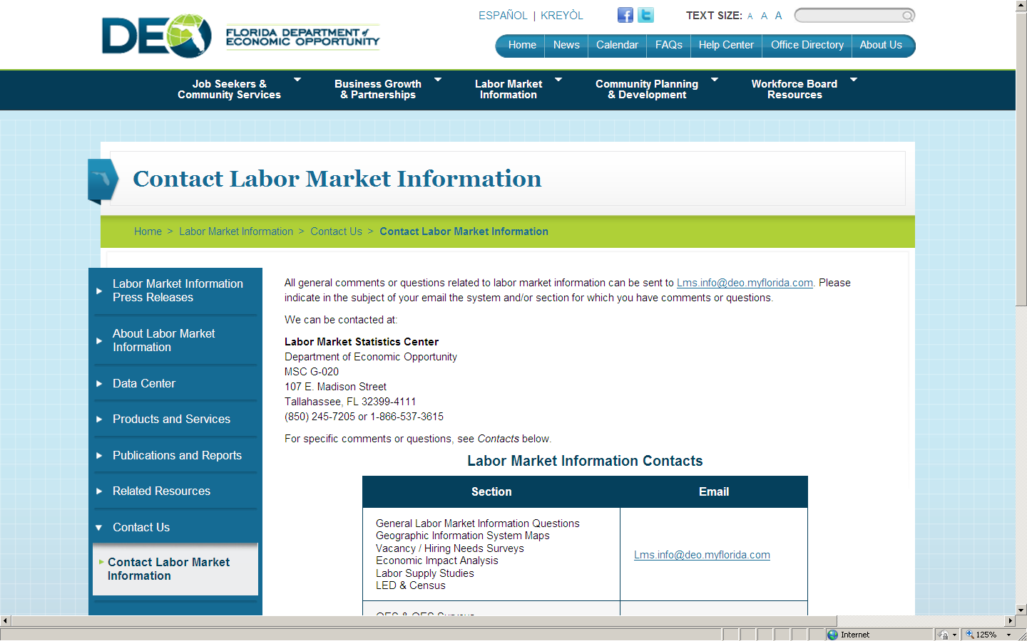
Florida’s LMI Web site

Slide 15
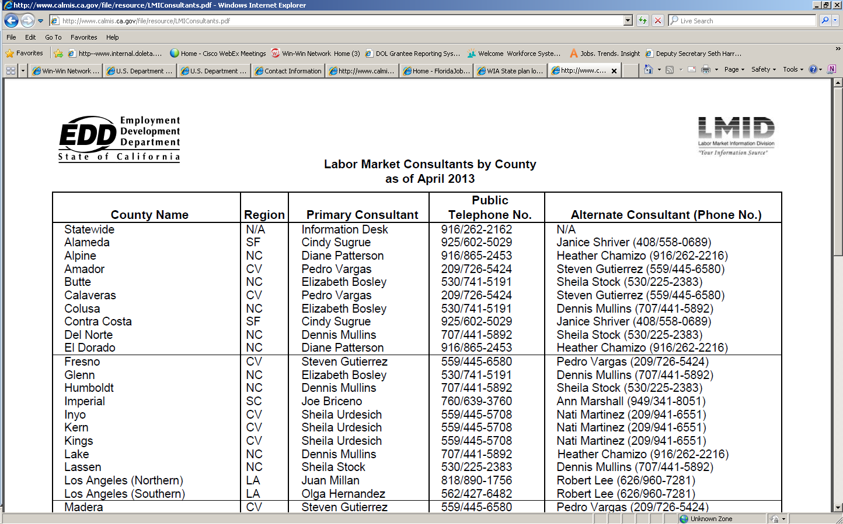
California’s Directory of LMI Experts, by County

Slide 16
Guide to State and Local Workforce Data
ETA’s Guide includes these features.
Organization by topic, with direct data links wherever possible.
How many states and localities each source provides data for.
Identifies sources with the most recent and geographically-detailed data, and with demographic data — see the key on the Contents page.
Essential background information, including when the data series began, how often it’s published, and links for FAQ’s and contact information.

Slide 17
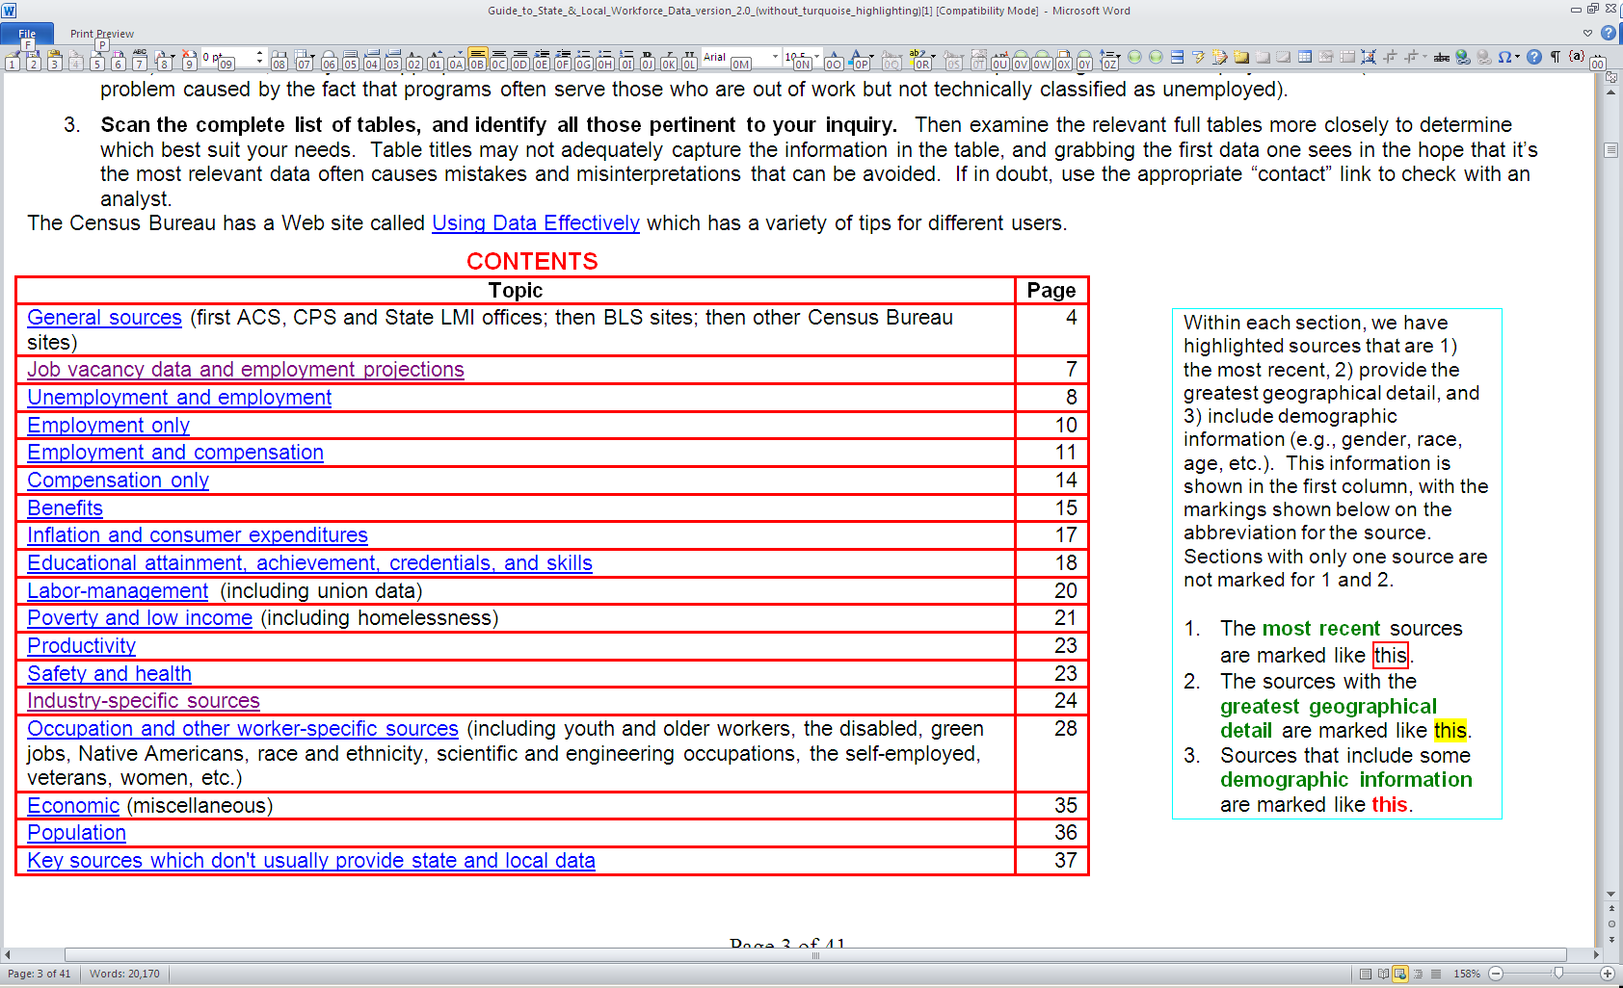
Guide to State and Local Workforce Data Contents

Slide 18
Best Rural Data Sources
Generally, the dividing line between plentiful and scarce data is whether a locality is within a Metropolitan Statistical Area (MSA) — see map on the next slide.
However, BLS’ Occupational Employment Statistics (OES) program has data on more than 170 non-metro areas, and the Bureau’s Local Area Unemployment Statistics program covers some 7,300 localities.
The Agriculture Dept.’s (USDA) Atlas of Rural and Small-Town America consolidates various data in one place.
The Census Bureau’s American Community Survey covers the smallest localities, but only by combining 5 years of data.

Slide 19
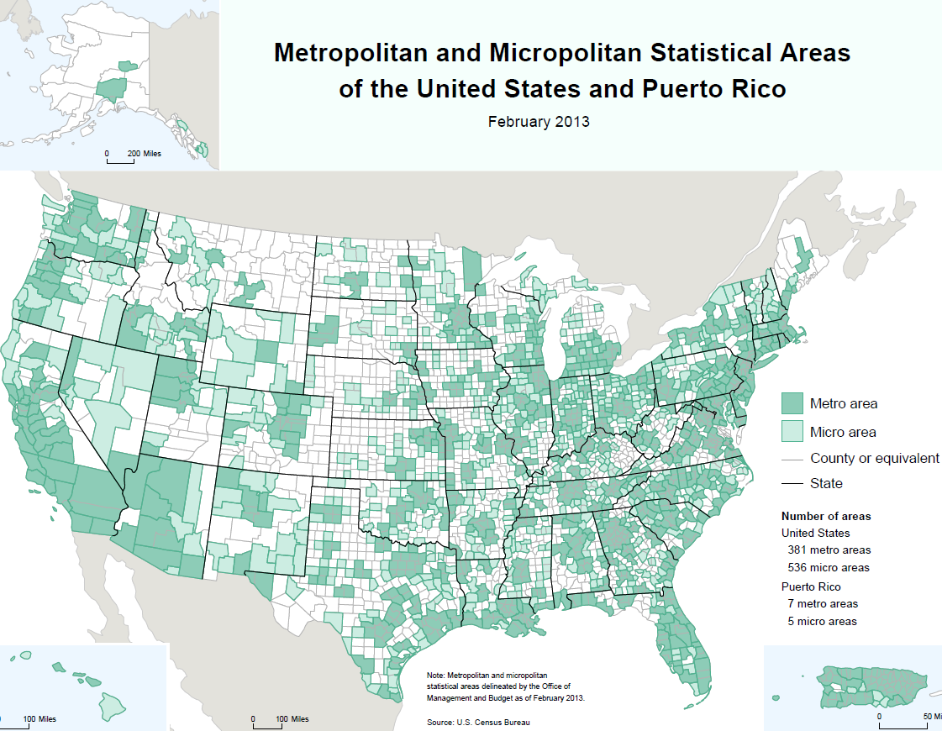

Slide 20
Best Farmworker Data Sources
ETA’s Guide to State and Local Workforce Data provides a one-stop location for farmworker data, in the “Industry-Specific Sources” section (see next slide). In order of relevance, these are
  ETA’s National Agricultural Workers Survey (NAWS), which provides a wealth of data on employment and other topics for migrant and seasonal farmworkers.
  USDA’s Farm Labor Survey.
  The Census Bureau’s Census of Agriculture.

Slide 21
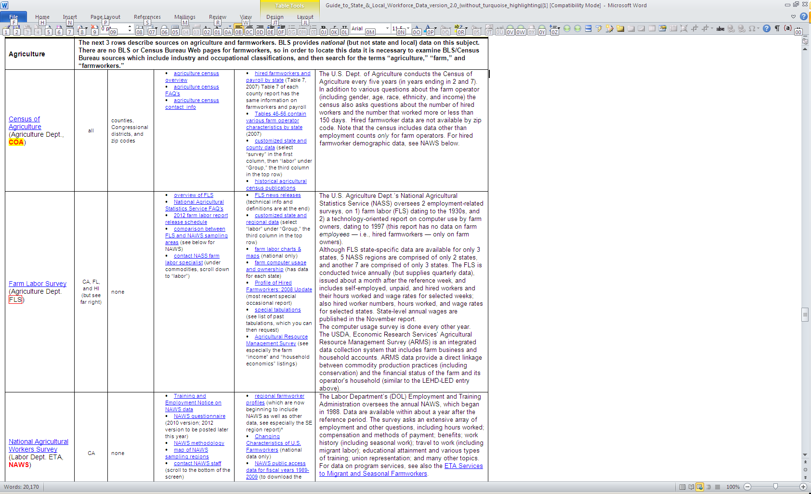
Governmental farmworker data sources

Slide 22
TASK 1: Which Jobs Are Growing?
3 types of sources are worth checking, each with strengths and weaknesses — examining all 3 supplies the surest foundation for decision-making.
Examine recent BLS trends for industries and occupations, with ETA’s Using E-Tools to Identify Growing Industries and Using E-Tools to Identify Occupations (with step-by-step instructions).
Review job vacancy sources to track job openings and the ratio of unemployed job seekers per opening. BLS JOLTS tracks industry openings, and HWOL tracks occupational openings.
Analyze projections: industry and/or occupational projections for the short- (usually 2 years) or long-term (10 years) future.

Slide 23
Source 1: Industry and Occupational Employment Trends
Advantages
This provides the most concrete evidence available.
Industry data are available on a monthly basis, with only a short time lag.
Disadvantages
Detailed occupational data are only available annually, and to analyze historical trends only every fourth year can be used (because the sample combines 3 years).
Obtaining these data requires more work than for other sources. Two steps are necessary to analyze industry data, then an analysis of occupations within the industries you target.

Slide 24
Source 2: Job vacancies
There are 2 main sources of job vacancy (or job openings) data: BLS JOLTS and the private sector Conference Board’s HWOL.
JOLTS supplies industry job vacancy data, but only nationally and for 4 regions (Northeast, South, Midwest, and West). JOLTS also tabulates total employment, hires, quits, layoffs & discharges, and other separations.
Help-Wanted OnLine consolidates data for online job vacancies only, by occupation, for the nation, states, and 52 MSAs. More geographically-detailed data are available in real time, for a fee.
About a fifth of the states have their own job vacancy surveys.

Slide 25
Job Vacancies: Pro’s and Con’s
Advantages
Counts documented job openings, the best possible measure of employer demand for specific types of work.
Can be matched with BLS unemployment data, to calculate the ratio of unemployed job seekers per job opening.
Insight into the extent and persistence of skill shortages.
Disadvantages
JOLTS sample is too small to present state or local data, and jobs aren’t classified by occupation.
HWOL only counts Internet job openings, and includes some duplicative counts of online jobs. Because private sector data are proprietary, little is known about its underlying quality, in contrast to governmental surveys.
Because unemployed individuals frequently obtain jobs in different industries and occupations, industry- and occupation-specific ratios of unemployed job seekers per job opening aren’t definitive measures of supply and demand.

Slide 26
Source 3: Employment Projections
BLS issues 10-year national projections every 2 years for industries and occupations (shortly thereafter ETA holds a Projections Webinar). For a simply written overview with useful charts, see Charting the Projections.
ETA funds state and local projections, requiring, for both industries and occupations: 1) statewide and local 10-year long-term projections (every 2 years), and 2) statewide 2-year short-term projections (each year).
Obtain state projections through two principal methods: ETA’s Internet Links for State and Local Employment Projections, or Projections Central (for long-term occupational projections only). These sites offer alternative methods to get data, and one or both may best suit your needs.

Slide 27
What does “high growth” mean?
Although commonly used, there’s no standard definition of “high growth.”
The national average employment growth rate between 2010 and 202 is projected to be 14.3%. Percentages at or below that shouldn’t be characterized as evidence of high growth.
Most analysts measure growth by the 1) growth rate, 2) number of projected jobs, or some combination of the two. Some ETA sites use the term “bright outlook” to describe occupations that “will grow rapidly” (in percentage terms), have “large numbers of openings,” or are “new and emerging” (for which data are typically scarce).
Because workers change occupations (or retire), the number of job openings is always far higher than the number of projected new jobs (nearly 3 times as much).

Slide 28

http://www.projectionscentral.com/

Slide 29
Sample Projections Central Table, for Nebraska
Nebraska 2008-2018 High Growth Occupations
STFIPS | AreaName | OccupationCode | OccupationName | BYear | Base | PYear | Proj | Change | PercentChange
31 | Nebraska | 00-0000 | Total, All Occupations | 2008 | 1,092,450 | 2018 | 1,203,300 | 110,840 | 10
31 | Nebraska | 53-3032 | Truck Drivers, Heavy and Tractor-Trailer | 2008 | 31,090 | 2018 | 37,730 | 6,640 | 21
31 | Nebraska | 29-1111 | Registered Nurses | 2008 | 21,220 | 2018 | 26,320 | 5,100 | 24
31 | Nebraska | 43-4051 | Customer Service Representatives | 2008 | 18,860 | 2018 | 22,840 | 3,990 | 21
31 | Nebraska | 35-3021 | Combined Food Preparation and Serving Workers, Including Fast Food | 2008 | 19,520 | 2018 | 22,910 | 3,390 | 17
31 | Nebraska | 41-2031 | Retail Salespersons | 2008 | 30,720 | 2018 | 33,530 | 2,810 | 9
31 | Nebraska | 31-1012 | Nursing Aides, Orderlies, and Attendants | 2008 | 14,900 | 2018 | 17,460 | 2,560 | 17
31 | Nebraska | 43-9061 | Office Clerks, General | 2008 | 17,120 | 2018 | 19,180 | 2,060 | 12
31 | Nebraska | 43-3031 | Bookkeeping, Accounting, and Auditing Clerks | 2008 | 19,420 | 2018 | 21,460 | 2,040 | 10

Slide 30
Nebraska Projections Central Table:
Selected Declining Occupations
Nebraska 2008-2018 Declining Occupations
STFIPS | Name | Code | Occupation | BYear | Base Occ | PYear | Proj | Change | %Change
31 | Nebraska | 45-2092 | Farmworkers and Laborers, Crop, Nursery, and Greenhouse | 2008 | 28,750 | 2018 | 24,730 | -4,010 | -14
31 | Nebraska |  | Farm, Ranch, and Other Agricultural Managers | 2008 | 12,470 | 2018 | 11,690 | -780 | -6
31 | Nebraska | 41-9041 | Telemarketers | 2008 | 5,560 | 2018 | 4,840 | -720 | -12
31 | Nebraska | 43-4151 | Order Clerks | 2008 | 4,360 | 2018 | 3,780 | -580 | -13
31 | Nebraska | 45-2093 | Farmworkers, Farm and Ranch Animals | 2008 | 4,650 | 2018 | 4,140 | -510 | -11
31 | Nebraska | 53-7064 | Packers and Packagers, Hand | 2008 | 5,760 | 2018 | 5,400 | -370 | -6
31 | Nebraska | 43-4071 | File Clerks | 2008 | 1,340 | 2018 | 1,020 | -320 | -24

Slide 31
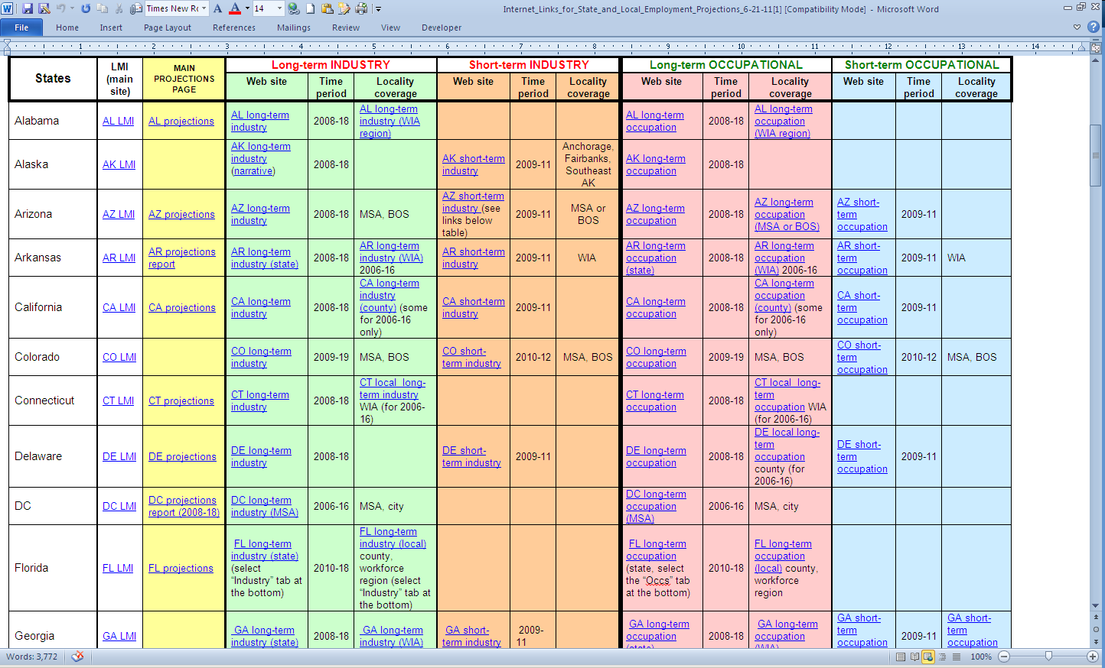
Internet Links for State and Local Employment Projections

Slide 32
Projections: Pro’s and Con’s
Advantages
Projections are the only governmental employment data that estimates future trends.
In existence for more than a half century, projections are familiar to and trusted by the workforce investment system. Job vacancy data only cover the last dozen years.
Disadvantages
Projections assume full employment in the projected year, but the base year incorporates actual data — recessions especially can create misleading impressions unless users understand this.
Although some analysts use employment projections to draw conclusions about future skill shortages, BLS characterizes this as an inappropriate use of projections.

Slide 33
TASK 2: Which growing jobs are “good”?
There’s no standard definition of “good” jobs, but most people look for high wages and steady pay, career opportunities, a good benefit package, regular hours, low risk of layoffs, safe working conditions and a good work environment.
Best source for this information is BLS’ Occupational Outlook Handbook.
BLS’ Occupational Employment Statistics (OES) supplies mean annual and hourly wages, and the annual wages at the 10th, 25th, 50th (median), 75th, and 90th percentiles.
  Be careful not to confuse the mean and median.
  Caution about OES wage data: BLS calculates the annual wage by multiplying hourly wages by 2,080 — yearly hours for those who work full-time, year-round. For occupations characterized by part-time work, irregular hours and/or layoffs, the OES annual wage will be misleading.
For alternative compensation sources, and data on benefits, unemployment and layoffs, and occupational safety and health, see ETA’s Guide to State and Local Workforce Data.

Slide 34
TASK 3: What education and training are required?
In 2012 BLS introduced new categories defining what individuals typically need to enter occupations and attain competency, a major improvement over the previous BLS system. It incorporates 3 factors.
Typical educational attainment most workers need to enter the occupation (using 8 levels, from less than a high school diploma to a doctoral or professional degree (e.g., doctor or lawyer).
Prerequisite work experience, or work experience that commonly can be substituted for educational attainment in the occupation (using 4 levels, from none to more than 5 years).
On-the-job training (OJT), typically post-hiring but also including internships/residencies, and apprenticeships, using the last two mentioned plus 4 more categories: none, short-term OJT (under a month), moderate OJT (1-12 months), and long-term OJT (more than a year).

Slide 35
Using BLS’ Education and Training System
There are two easy ways to obtain the information:
  Education, on-the-job training, and work experience for all projected occupations (everything in one table — see the next slide); and
  BLS Occupational Outlook Handbook, using the drop-down choices under the “Select Occupations By” heading at the top of the screen (see also ETA’s Webinar on the Handbook).
All major national sources of education and training prerequisites use this BLS information, and most of the states are likely to adopt it as well for their own projections and other analyses.

Slide 36
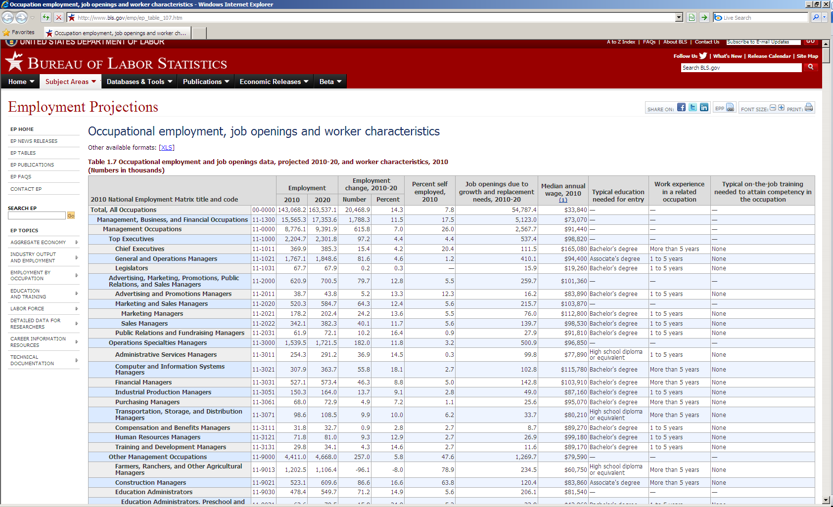
BLS Table for Education, Training, & Other Data

Slide 37
E-Tools to Get Data and Identify Job Postings
ETA, BLS, and other governmental entities have created E-Tools that consolidate occupational data and/or online job ads. You can sometimes save considerable research time by using multi-purpose E-Tools rather than the primary sources.
ETA has compiled a guide called, “Workforce Data, Job Openings and Other Information Available from Selected Federal Multi-Purpose E-Tools,” which outlines what information is available from each source.
Here are some of the most popular E-Tools for this purpose (several are highlighted in the following slides, while others have already been described).
ETA | BLS or Census Bureau | Other Governmental E-Tools
My Skills, my Future | BLS Occupational Outlook Handbook | State-specific employment projections
My Next Move or O*NET Online | BLS Occupational Employment Statistics | State job banks
Projections Central | Census Bureau’s American Community Survey (using AmericanFactFinder) | US.jobs

Slide 38
E-Tools Rely on a Few Common Sources
You should be aware that despite the plethora of E-Tools, virtually all draw upon a few basic sources:
BLS’ OES for employment numbers and wages
Employment projections from BLS (national) and/or ETA (state and local)
Education and training prerequisites from the BLS classification system
Job vacancy data from HWOL or Wanted Analytics
Skills data from ETA’s O*NET
Job openings often from the National Association of State Workforce Agencies’ US.Jobs Web site

Slide 39

Source 1 : BLS Occupational Outlook Handbook
http://bls.gov/ooh/

Slide 40
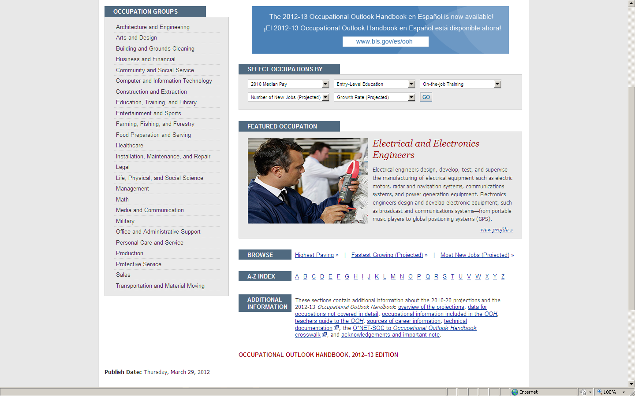

Slide 41
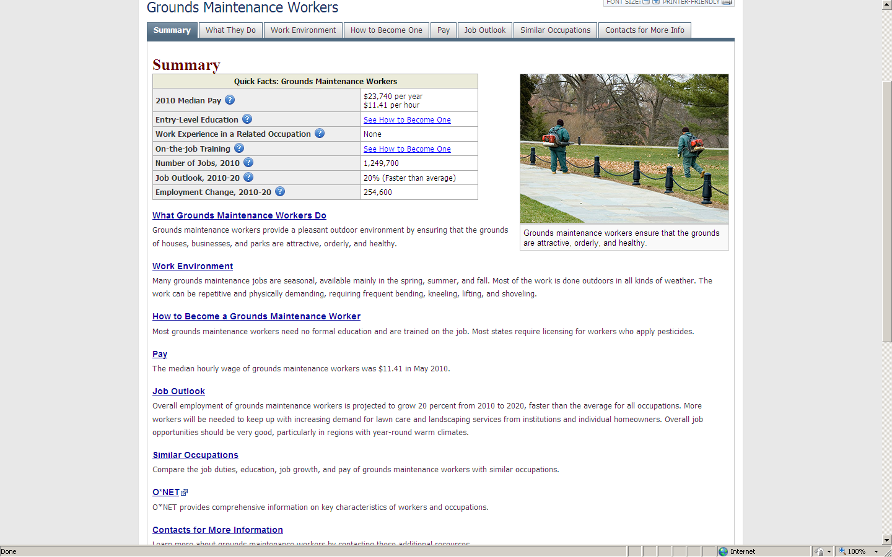

Slide 42
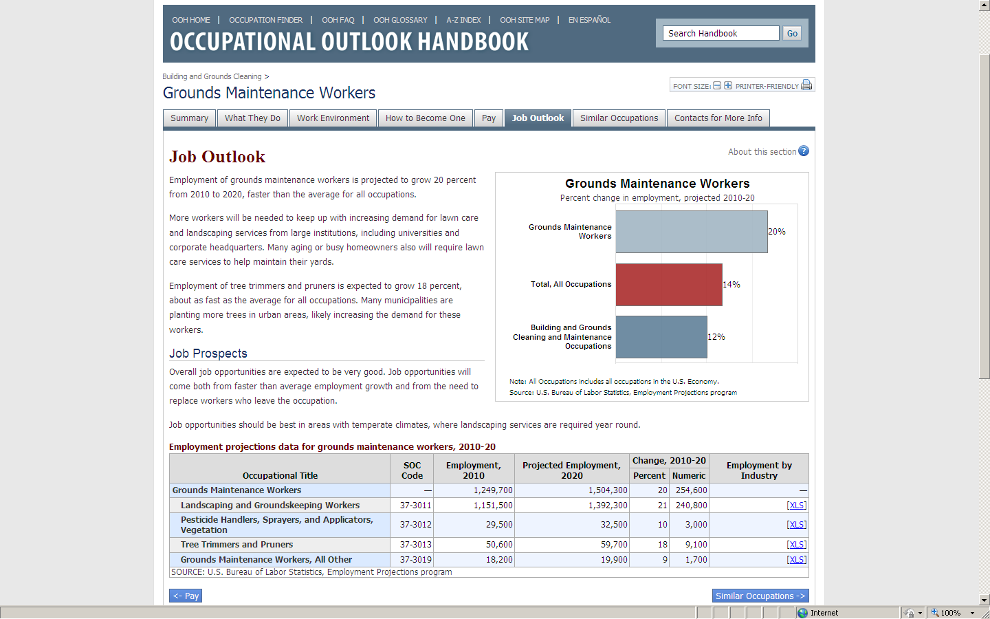

Slide 43
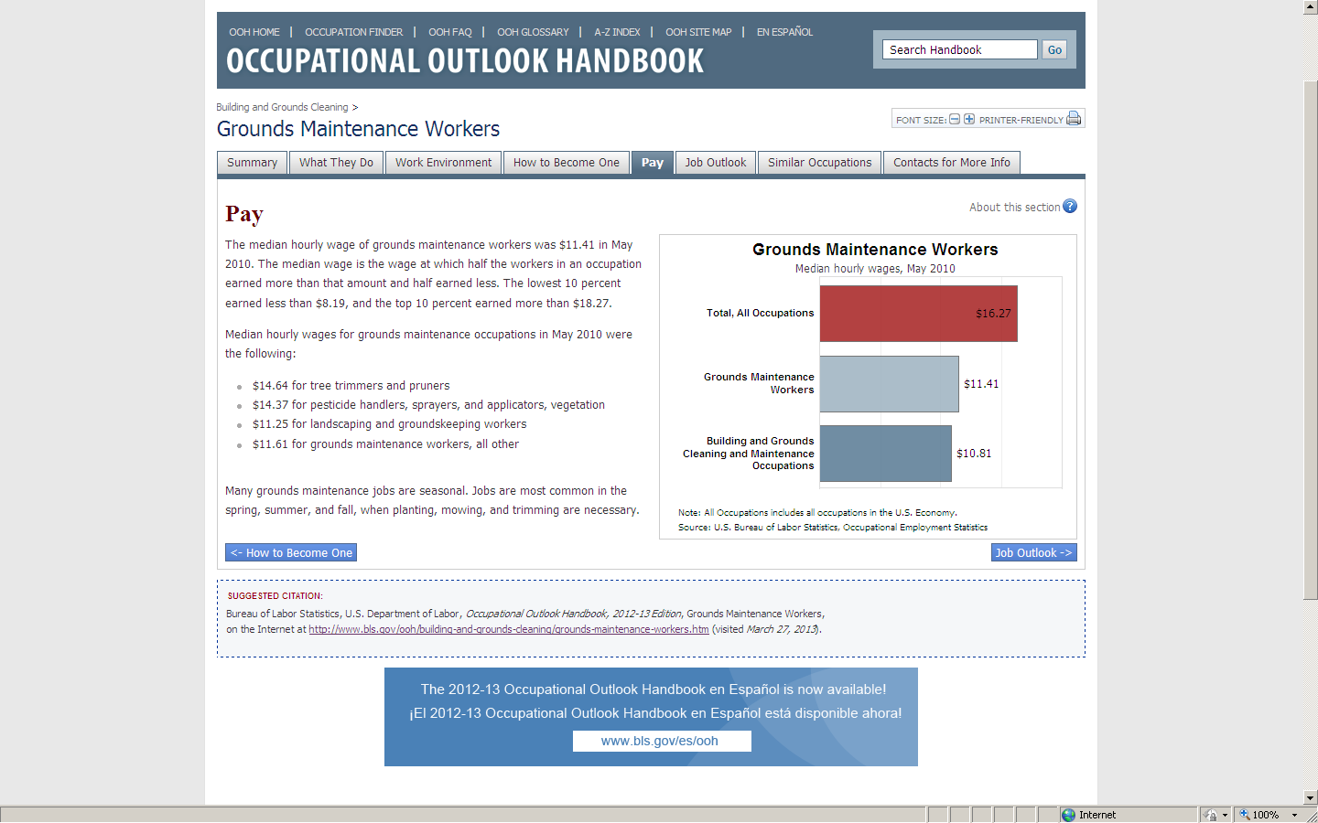

Slide 44
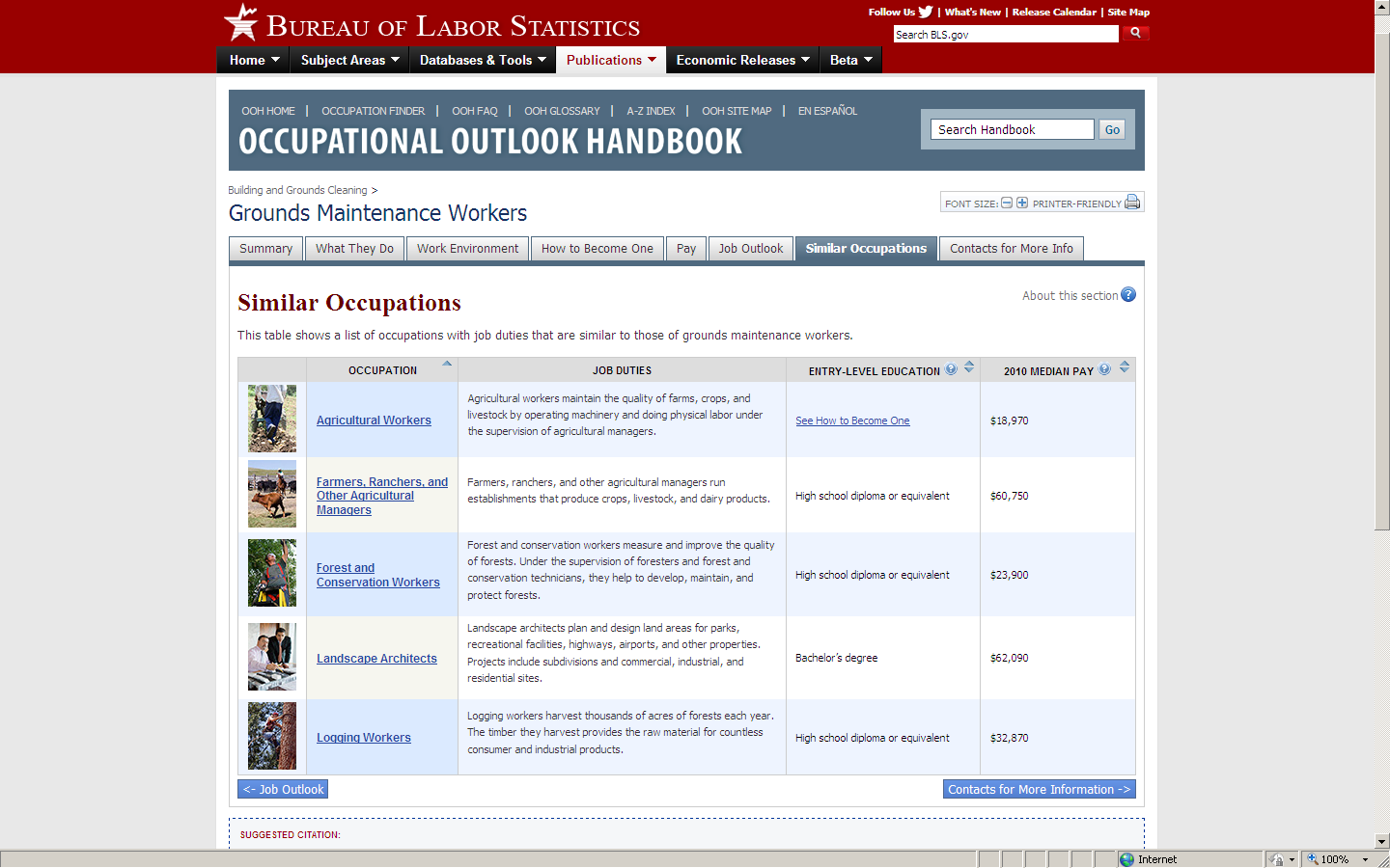

Slide 45
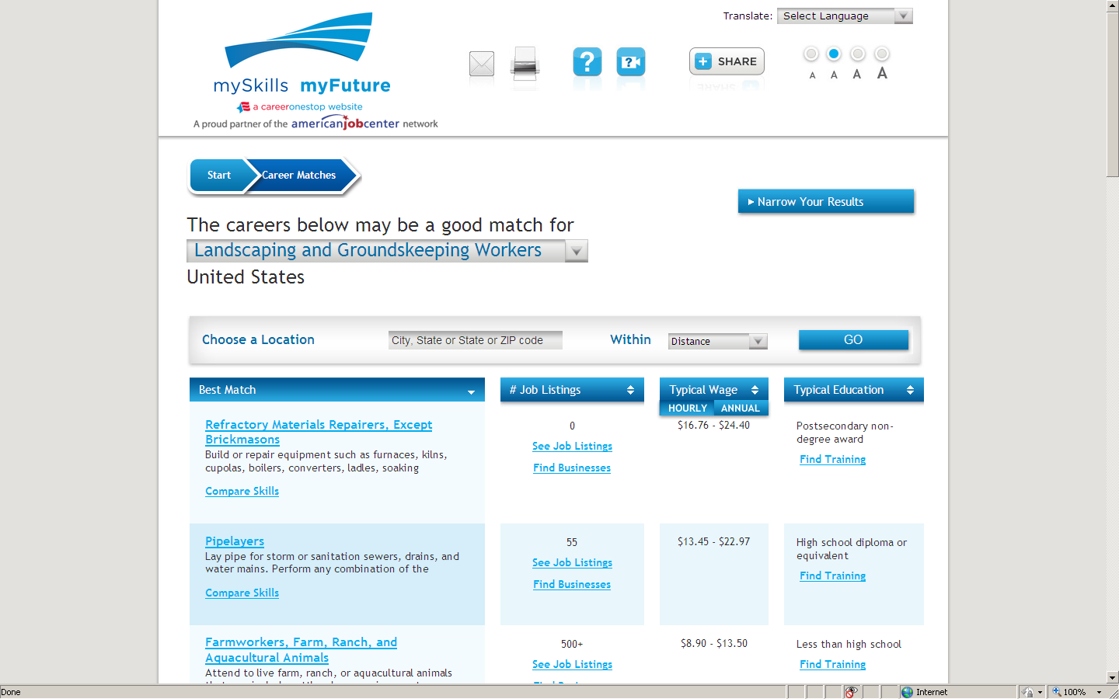
Source 2 : ETA’s my Skills, my Future
www.myskillsmyfuture.org

Slide 46
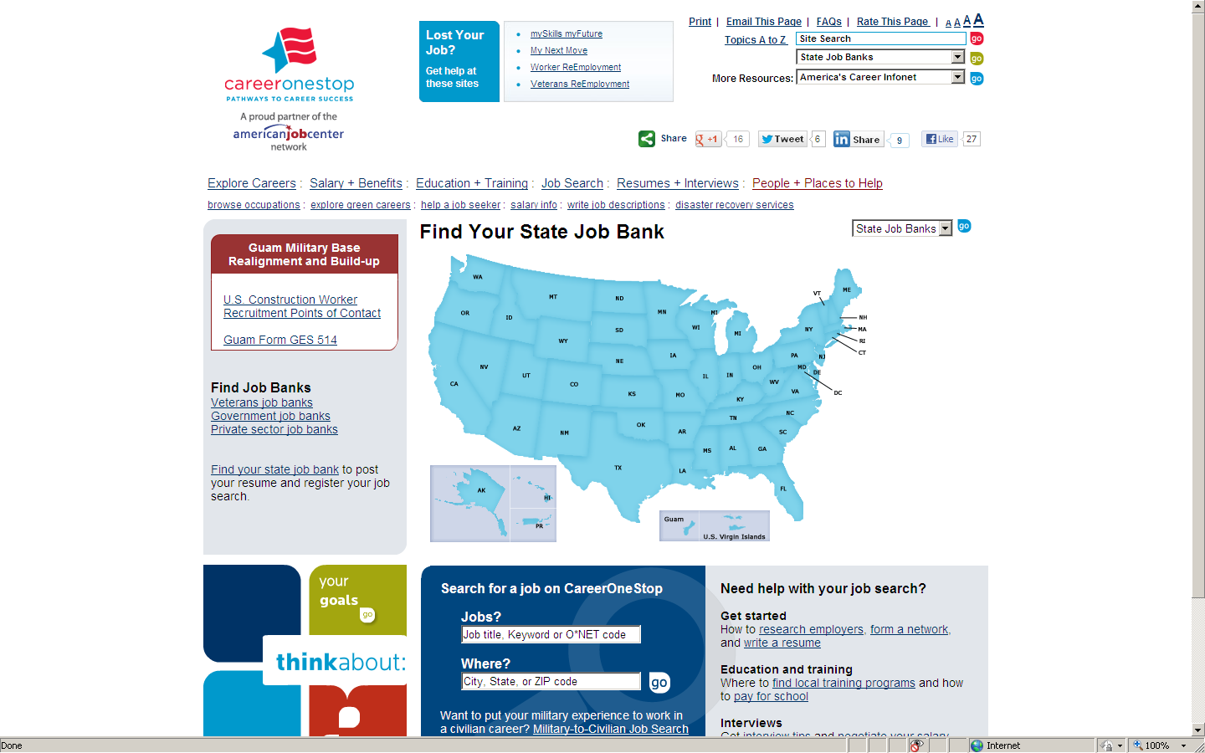
Source 3: State Job Banks
http://www.jobbankinfo.org

Slide 47
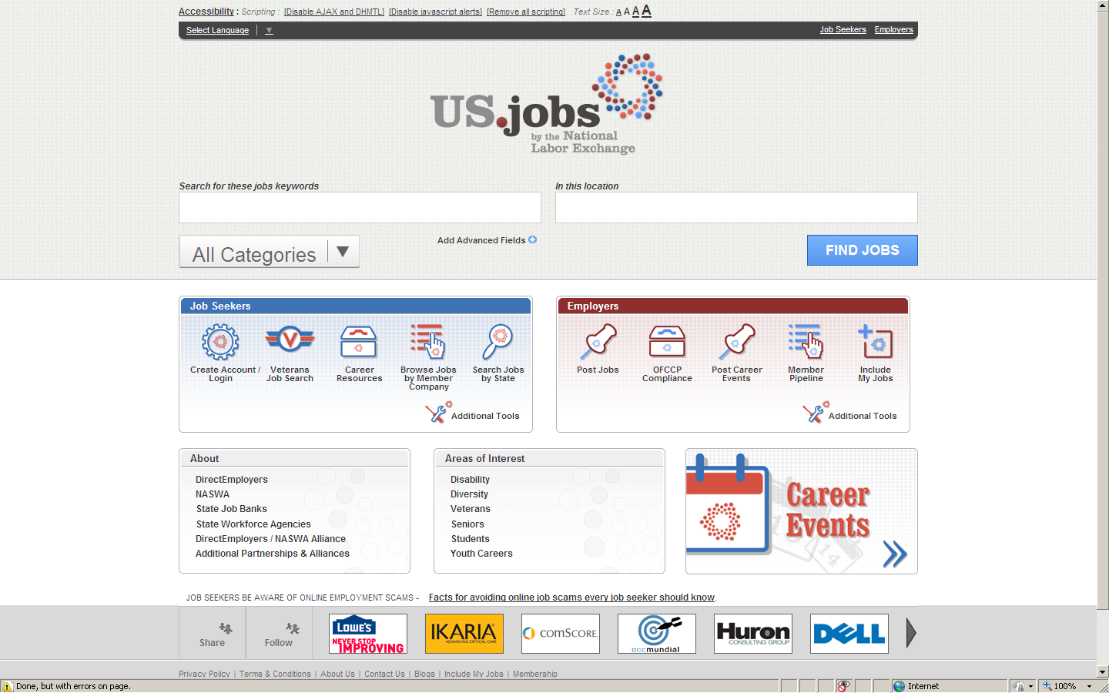
Source 4: NASWA’s US.jobs
www.US.jobs

Slide 48


Labor Market Information (LMI)
Data Harvesting
Presented by:
Dan Ramirez

Slide 49
Proteus Uses LMI for the Following Purposes
Identify high demand occupations (national versus local)
Assess trends on specific occupations (increase versus decrease)
Identify industry changes (growth jobs or decline jobs)
Staff better educated on local job market and are able to better inform participants which lead to placements
LMI is used to forecast occupations for the new DOL proposal
LMI leads to NFJP common measure attainment

Slide 50
Proteus Obtains LMI from Various sources
Employment Development Department (website)
  Site details occupations by state, county, & city
Economic Development Corporations – (website & annual meetings)
  Identify high growth jobs by industry
  Assess industry patterns by sales gross, permits for new corporate relocation to areas, & corporate land acquisitions for expansions
  Provide names of companies coming into the region and forecast number of potential hires by occupation
Other LMI sources used include, but are not limited to, the following:
  Chamber of commerce data, farm bureau data, webinars, industry conferences, city council meetings, board of supervisor meetings, local newspapers, WIB meetings, & industry periodicals

Slide 51
From the LMI data, Proteus is able to
Complete the Following:
Identify growing jobs via ONET codes within the service delivery area
Proteus is then able to develop strategies on how best to place (farmworkers) in those jobs.
  Strategies include: finding training vendors to offer the vocational training for customers, invest in prerequisite trainings like Adult Basic Education (ABE) or GED or ESL
  If Proteus cannot find vocational training vendor(s) to provide training, then Proteus researches training for in house via completing feasibility study.
  Examples of in-house trainings are: truck driver, forklift, office
  automation, weatherization, and solar training.

Slide 52
Labor Market Information Analysis
Important to track your program placement data in order to match LMI predictions. Proteus uses POSSE system. Have the ability to identify customer placement ONET Codes. This helps us assess what jobs are growing or decreasing by industry. Able to identify trends with the use of POSSE reports. (Important to have a good MIS system)
LMI is tracked quarterly and annually via POSSE
LMI helps Proteus identify growing jobs which maximizes placements:
  Predict “time” a customer is trained and then become job placed
  Identify placement wages (averages)
  Proteus focuses on jobs that offer upward career ladder opportunities

Slide 53

Proteus focuses on jobs that are transferable and offer relocation opportunities to other regions.
Proteus is able to target specific “companies/corporations” within the high growth industry:
  LMI data details new companies in the area, Proteus staff work immediately to build relationships in order to gather job orders or industry employment knowledge (new software requirements, skills needed, or other)
  Proteus staff educates companies on advantages of hiring from Proteus by offering (WEX, OJT, job-skill upgrade trainings, participant supportive services)
  Proteus fosters business relationships by inviting them to
  participate on Proteus employer advisory councils
  and employer forums

Slide 54
Employer Forums
The intent is to foster positive business relationships with high growth employers by industry for job placement purposes. The benefits of the employer forums are:
  Proteus learns of hiring needs of employer(s)
  Proteus learns of changes in industry first hand (skills needed, legislation, wages, other)
  Proteus participants receive industry information on (skills requirements for jobs, education levels needed, guest speakers share job personal experiences thus better prepares Proteus participants)
  Clients often are interviewed and sometimes hired at the employer forum
  Industry employers are able to network with other employers in same industry

Slide 55
Using LMI data Proteus is able to identify industry Outcomes –
by looking at the projected job openings:
Areas of expected growth | New Jobs | Net Replacements | Combined Total
Fresno County Education Services, Health Care, and Social Assistance sector will generate an estimated 4,600 jobs. An additional 2,800 new jobs are estimated for Professional Business Services. 1,900 new jobs are projected in the Government Sector. The transportation, warehousing, and utilities sectors will also experience growth. | 23,900 new jobs from industry growth | 90,100 job openings from Net Replacements | Combined total of 114,000 job openings in Fresno County
Tulare County The Government sector will generate 2900 new jobs. Education Services, Health Care, and Social Assistance sector will generate an estimated 1900 jobs. Retail Trade 1,100 jobs, and Leisure and Hospitality sector generate 1,100 jobs. The Manufacturing sector is projected to have a decrease of 800 jobs. | Approximately 12,800 new jobs from industry growth | Over 37,900 job openings from Net Replacements | Combined total of nearly 50,700 job openings
“Proteus will utilize current data to assure those industries projected to have openings are prioritized and that our education services are parallel to the needs of both, potential employers and workers.”

Slide 56
Audience Poll
How often to you look at your local LMI data?
Weekly
Monthly
Every few months
Almost Never

Slide 57

Please enter your questions in the Chat Room!

Slide 58

Speakers’ Contact Information
Speaker: Frank Gallo
Title: Workforce Analyst
Organization: US Department of Labor, Employment and Training Administration
Email: gallo.frank@dol.gov
Telephone: 202-693-3755
Speaker: Anthony Dais
Title: Labor Market Information Team Leader
Organization: US Department of Labor, Employment and Training Administration
Email:dais.anthony@dol.gov
Telephone: 202-693-2784
Speaker: Dan Ramirez
Title: Area Manager
Organization: Proteus, Inc.
Email: danr@proteusinc.org
Telephone: 559-627-0100

Slide 59
Thank You!
Find resources for workforce system success at:
www.workforce3one.org

