Slide 1
Webinar Title
Webinar Date: (Enter date)
Presented by:
(Enter office name)
U.S. Department of Labor
Employment and Training Administration

Slide 2
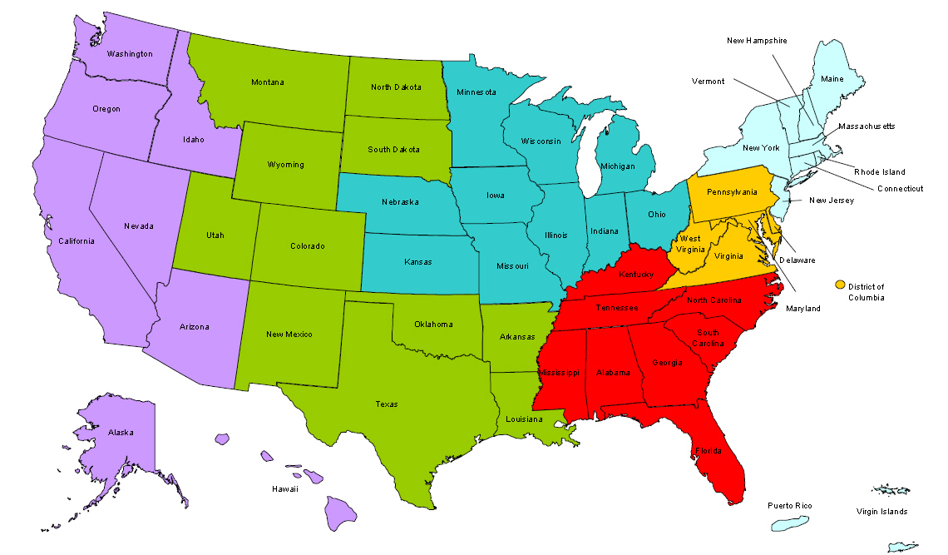
Where are you?
Enter your location in the Chat window – lower left of screen
Notes:
In the Chat Room, please type the name of the your organization, your location, and how many people are attending with you today.

Slide 3
Here’s what you can expect to get out of this webinar!
Value add one
Value add two
Etc…
List some of the valuable things that your audience will gain from attending your webinar and delete this text box.
Notes:
Video clip of what to expect in the webinar room. (instead of the 5 tech slides)

Slide 4
Agenda
Enter Agenda items below and delete this text box. This is different than the previous slide as it outlines the event in broad strokes. Delete this text box.
Item 1…
Item 2…
Item 3…
Item 4…
Item 5…
Etc…
Notes:
Agenda/Objective
Agenda/Objective 1
Agenda/Objective 2

Slide 5
Moderator
Moderator: (enter name)
Title:
Organization:
This is an Image Placeholder. We suggest including an image as it helps to build rapport with the audience. Delete this text box. If no image is to be used, delete the image placeholder.

Slide 6
Presenters
Presenter: (enter name)
Title:
Organization:
If you have more then two presenters, consider putting those presenters on another slide. A good rule of thumb: have only 2 presenters on each “Presenters” slide to reduce clutter. Just copy this slide and paste it after this slide. We suggest including an image as it helps to build rapport with the audience. Delete this text box. If no image is to be used, delete the image placeholder/s.
Presenter: (enter name)
Title:
Organization:

Slide 7
Presenter
Presenter: (enter name)
Title:
Organization:
Whenever there is a handoff from speaker to speaker, include a transition slide such as this so that the audience knows who is speaking. To add transition slides, copy this slide and place it wherever necessary. Delete this text box. If no image is to be used, delete the image placeholder. Delete this slide if not needed.

Slide 8
Content Heading
(Enter content here)
Try to be concise and avoid cluttering the slides. A helpful method to follow is to have only 1-4 concepts/ideas/bullets per slide. This might lengthen the number of slides, but the content will be more digestible than having lots of information on one slide. Delete this text box when you are ready to populate the slide.

Slide 9
Content Heading
If you are re-using content from a past presentation, place your bullets/talking points in the speaker notes area. On the slide, include a quality graphic that speaks to your content.
If you must keep your bullets on the slide, try to make the text as succinct as possible and keep the bullets to 1-4 per slide.
Delete this text box when you are ready to populate the slide.
(Enter content here)

Slide 10
Content Heading
(Enter content here)
You can include graphics that help underscore your point. Visit the graphics archive here: L:\01 - ETA Offices\OWI\DNPTTA\Technical Assistance Unit\Webinar Materials .Graphics are only to be used for Workforce3 One related webinars.
Delete this text box when you are ready to populate the slide.

Slide 11
Content Heading
(Enter content here)
If you don’t find any suitable images in the graphics archive, visit http://www.istockphoto.com and send the image url to Gary Gonzalez at gonzalez.gary@dol.gov so that he can download the image. Graphics are to be used for Workforce3 One related webinars.
Delete this text box when you are ready to populate the slide.

Slide 12
Open Chat
Enter discussion question/topic here
To make your events more engaging and dynamic, schedule some discussion breaks so that the audience can engage subject matter experts and each other. These text based discussions would last approximately 3-5 minutes and can be used to brainstorm, share best practices or solicit feedback. Delete this text box. Delete this slide if not needed.
Notes:
2nd POLL – using chat feature
OPTION 2 POLLING
NOTE – the chat box will remain open for the duration of the Webinar, and the questions will weave into the webinar as we go – no question is a dumb question – so please feel free!
(Click to next slide)

Slide 13
Polling Question
(Enter polling question here)
Choose the answer that best reflects you (or your group):
Option 1
Option 2
Option 3
Option 4
Etc…
To make your events more engaging and dynamic, include a poll every few slides (generally every 4-6 slides) as knowledge checks or to assess assumed knowledge. To add another polling slide, copy this slide and paste it where you’d like the next slide to appear. Delete this text box. Delete this slide if not needed.

Slide 14
Reminder…
(Enter content here)
If you need to remind your audience about something that is upcoming, use this slide to highlight the reminder. Delete this text box. Delete this slide if not needed.

Slide 15
Resources
Resource Name
Link 1
Resource Name
Link 2
Resource Name:
Link 3
Resource Name:
Link 4
Provide links to any resources referenced or resources you’d like your audience to access. If you have more than 4 resources, copy this slide and paste it after this slide. Delete this text box. Delete this slide if not needed.
Notes:
Handouts URL will be provided in the Webinar Room

Slide 16
Please enter your questions in the Chat Room!
Notes:
Please enter your questions into the Chat Room!

Slide 17
Speakers’ Contact Information
Speaker: (Enter name)
Title:
Organization:
Email:
Telephone:
Speaker: (Enter name)
Title:
Organization:
Email:
Telephone:
Input Speakers’ contact information for your audience. If you have more than three speakers, copy this slide and past it after this slide. Delete this text box. Delete this slide if not needed.
Speaker: (Enter name)
Title:
Organization:
Email:
Telephone:

Slide 18
Look for upcoming Webinars in this series!
If this webinar is one in a series, let your audience know about the next event and if available, include the registration link, and dates/times. Delete this text box. Delete this slide if not needed.
(Enter next Webinar date here)
Notes:
If this webinar is being held as a series, include on this slide:
Webinar registration links for prospective registrants
Webinar dates/times
Inform prospective registrants of any preparatory actions that must be performed before attending webinar series (documents to be reviewed and/or completed before session begins, etc…)

Slide 19
www.workforce3one.org

