Slide 1
Universal Design:
A Customer Centered Approach

Slide 2
What is Universal and Customer Centered Design?
Universal Design is a strategy for making products, environments, operational systems and services welcoming and usable to the most diverse range of people possible.
We can achieve universal design through applying Customer Centered Design which is applying a set of methods to gain a deeper understanding of the needs of the customers we are serving.

Slide 3
Universal Design Overview
In Universal Design thinking, we are not targeting one group, but rather designing our facility, and services for the average user, with a broad range of abilities, reading levels, learning styles, and culture.
The key principles of universal design are
  Simplicity
  Flexibility
  Ease of Access
  Efficiency

Slide 4
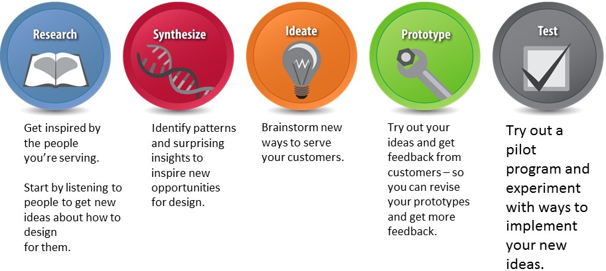
The Customer Centered
Design Process
Try out a pilot program and experiment with ways to implement your new ideas

Slide 5
Additional Resources
The following additional resources are available:
  Webcasts Applying the Customer Centered Design Principles:
    1) WorkSource Spokane, Washington – (14:22)
    2) Greater Lowell Workforce, Massachusetts – (10:43)
  Resource Page - Universal and Customer Centered Design Resources with Additional Links

