Slide 1
Procurement and Contract Administration
SMART 3.0 Training
June 2019

Slide 2
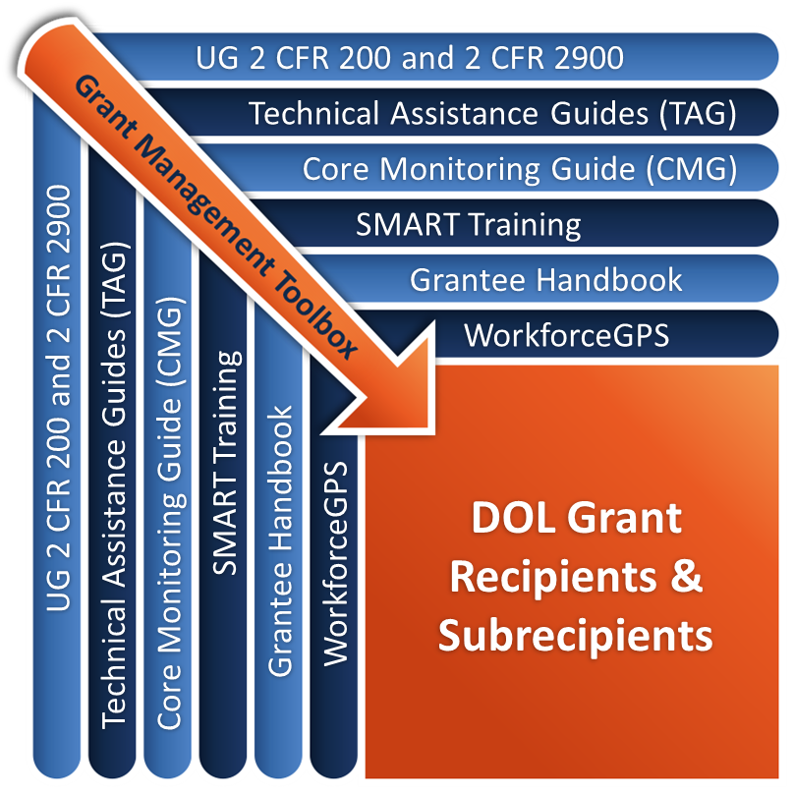
Grant Management Toolbox

Slide 3
Grant Management Toolbox References
SMART Training
Core Monitoring Guide
Technical Assistance Guides
ETA Grantee Handbook
WorkforceGPS Resources
SMART
CMG
TAG
Grantee Handbook
GPS

Slide 4
Module Overview
Laws, Rules, and Guidance
Applicability of Procurement Standards
General Procurement Standards
Conflict of Interest
Procurement Methods
Procurement Process - 5 Phases
Contract Elements

Slide 5
Law, Regulations & Guidance
Uniform Guidance Procurement Standards
2 CFR 200.317-200.326
Workforce Innovation and Opportunity Act
WIOA Sec. 121(d) and 183 (a)(3)
20 CFR 683.200(c)(4) and 20 CFR 678.600-635
Competitive Selection of One-Stop Operators TEGL
TEGL No. 15-16
FAQ’s
Uniform Guidance FAQs
WIOA One-Stop Operator Competition FAQs

Slide 6
Applicability of Procurement Standards
Applicability to grants and cooperative agreements
Contractor vs. subrecipient
State vs. other non-Federal entities
Profit provisions

Slide 7
Applicability
All portions of guidance apply to grants and cooperative agreements
Applies to non-Federal entities that receive a grant, an agreement, or subaward
States must follow the same polices and procedures it uses for procurements from its non-Federal funds

Slide 8
Contracts
Contract
Does not include subawards
Legal instrument used to purchase property or services needed either to carry out a project, program or for the entities own use and consumption.
Contractor
Entity that receives a contract
Replaces the term “vendor”

Slide 9
Subawards
Subaward - Award provided by a pass-through entity (a non-Federal entity that provides a subaward to a subrecipient to carry out part of a Federal program) to a subrecipient
Subrecipient
Non-Federal entity that receives a subaward from a pass-through entity to carry out part of a Federal program

Slide 10
Subrecipient vs. Contractor
Subrecipient
Contractor
Determines who is eligible to receive what Federal assistance
Performance is measured by whether objectives of Federal program are met
Has responsibility for programmatic decision making
Responsible for adhering to applicable Federal program requirements
Uses Federal funds to carry out a program for a public purpose
Funded by a subaward
Provides similar goods or services to many different purchasers
Provides the goods and services within normal business operations
Provides goods or services that are ancillary to the operation of the Federal program
Not subject to the compliance requirements of the Federal program
Provides goods and services for the non-Federal entity’s own use, creating a procurement relationship
Funded by a procurement contract

Slide 11
Selection of Subrecipients
What guides the selection of subrecipients when a competitive procurement process is not required?
Internal Controls System 2 CFR 200.303
Written procedures
Conflict of interest provisions
Service provider’s track record 2 CFR 200.331(b)
Past record of performance
Cost principles: reasonable costs
Past record of compliance
Audit and monitoring results
Non-Federal entities must have a written method for conducting technical evaluations of the proposals and for selecting recipients 2 CFR 200.320(d)(3)
ETA recommends using a competitive procurement process when feasible

Slide 12
Procurement for Property and Services
Property
Supplies, equipment, building space, leases,
Curricula, and/or Intangible property
Services
Auditing services, consultation services, professional services,
IT services, training, temporary or HR staffing, and/or
Renovation or repairs of leased or owned real property

Slide 13
Applicability
States must follow the same policies and procedures that it uses for procurement with non-Federal funds 20 CFR 678.605(b) and 2 CFR 200.317
Other non-Federal entities must adhere to Uniform Guidance Procurement Standards at 2 CFR 200.318-326

Slide 14
For-profit entities
WIOA specifically allows for non-Federal entities to enter into contracts and subawards with for-profit entities, for example:
One-stop operators
Service providers
Eligible training providers
May earn a profit
Fair and reasonable profit negotiated as separate item of cost

Slide 15
Profit – Allowable?
Uniform Guidance
For all other programs, 2 CFR 200.400(g) prohibits earning and retaining profit on Federal financial assistance unless expressly authorized by the terms and conditions of the Federal award.
WIOA
At 20 CFR 683.295 and programs authorized by WIOA under secs. 121(d), 122(a), and 134(b) allows awardees of Federal financial assistance, such as one-stop operators, service providers, or Eligible Training Providers, to earn profit. The pass-through entity must follow 2 CFR 200.323 to assess reasonableness.

Slide 16
For-Profit One-Stop Operators
Entities selected and serving as one-stop operators are subrecipients of a Federal award and thus are required to follow the Uniform Guidance (2 CFR part 200) and DOL’s exception (2 CFR part 2900)
In 20 CFR 683.295(a)(2), ETA requires for-profit entities that are one-stop operators to follow 2 CFR 200.323 on earning and negotiating a profit.
The entity conducting the competition must ensure that the entity’s charges for profit are reasonable and fair.

Slide 17
Profit or Incentive
Negotiate as a separate element from price
When there is no price competition
In all cases where cost analysis is performed
Profit considerations
Complexity of work performed
Risk borne by contractor
Contractor’s investment
Amount of subcontracting
Quality of past performance
Industry profit rate in surrounding area for similar work
Federal Acquisition Regulations (FAR) suggests less than 10 percent
Department of Health and Human Services (HHS) limits profit to 8 percent
CMG Indicator 2.d.4: Cost or Price Analysis
CMG

Slide 18
Profit or Incentive (cont.)
Governmental Entities
Awards with must be on a cost reimbursement basis,
Profit is not allowable under those agreements.
Non-profit organizations
Revenue in excess of costs
Must be treated as program income and used for allowable purposes under the award.
May not be retained by the organization as profit.

Slide 19
Knowledge Check 1 – Questions
True or False?
UG procurement standards apply to both contracts and subawards.
A contract is a legal instrument used to purchase goods or services needed to carry out the project or program.
All non-Federal entities must follow the UG procurement standards at 2 CFR 200.318-326.
Non-Federal entities must negotiate profit with for-profit One-stop operators as a separate item of cost when there is no price competition or when cost analysis is required.

Slide 20
Knowledge Check 1 – Answers
UG procurement standards apply to both contracts and subawards. False
A contract is a legal instrument used to purchase goods or services needed to carry out the project or program. True
All non-Federal entities must follow the UG procurement standards at 2CFR 200.318-326. False
Non-Federal entities must negotiate profit with for-profit One-stop operators as a separate item of cost when there is no price competition or when cost analysis is required. True

Slide 21
General Procurement Standards
Written procurement policies and procedures
Full and open competition
Prohibitions
Transparency and responsibilities
Recordkeeping
Special Conditions

Slide 22
General Procurement Standards Written Policies and Procedures
Non-Federal entities are required to have the following written procurement policies and procedures in place.
Contract administration system 2 CFR 200.318(b)
Including procedures to ensure that sufficient records are maintained
A written code of conduct for employees engaged in the award and administration of contracts 2 CFR 200.318(c)(1-2)
Procedures that avoid purchase of unnecessary or duplicate items, including analysis of lease versus purchase alternatives 2 CFR 200.318(d)
A process that promotes the use of intergovernmental agreements 2 CFR 200.318(e)
A process to ensure that purchases are made only to responsible contractors with the ability to perform successfully

Slide 23
General Procurement Standards Written Policies and Procedures (cont.)
Documentation of each of the significant steps followed in making an award.
Mandatory disclosure of violations
A settlement process whereby recipients and subrecipients are solely responsible for the settlement of all procurement actions, including those related to source evaluation, protests, claims, and disputes
Protest procedures to handle disputes related to both award and administration of contracts
Small, minority, women’s, and labor surplus businesses: For procurement actions, the Uniform Guidance requires that all necessary affirmative steps be taken to assure that small, minority, women’s, and labor surplus area businesses are used whenever possible 2 CFR 200.321

Slide 24
Small, Minority, Women’s, Labor Surplus Area Businesses
Must take all necessary affirmative steps to assure that small, minority, women’s and labor surplus area firms are used whenever possible, to include:
Placing qualified businesses on solicitation lists
Soliciting them whenever they are potential sources
Dividing total requirements into smaller tasks or quantities when economically feasible
Establishing delivery schedules to encourage their participation
Using services of SBA and MBDA of Dept. of Commerce
Requiring prime contractor to take these same steps

Slide 25
General Procurement Standards
KEEP IN MIND – Written Procurement and Purchasing Policies and Procedures must:
Be sound, efficient, fair, and cost-effective
Identify the different procurement methods
Identify the phases or stages of a procurement process
Outline history and recordkeeping requirements
Define individuals with authority to initiate and approve actions
Outline ethical practices

Slide 26
General Procurement Standards Full and Open Competition Restrictions
Placing unreasonable requirements on firms in order for them to qualify to do business
Requiring unnecessary experience and excessive bonding
Noncompetitive pricing practices between firms or between affiliated companies
Noncompetitive contracts to consultants that are on retainer contracts
Organizational conflicts of interest
Specifying only a ‘‘brand name’’ product instead of allowing ‘‘an equal’’ product
Any arbitrary action in the procurement process

Slide 27
General Procurement Standards Full and Open Competition
To the extent practicable, the non-Federal entity must distribute micro-purchases equitably among qualified suppliers.
For small purchase procedures price or rate quotations must be obtained from an adequate number of qualified sources.
Written procedures must allow for sufficient time for all phases of the procurement process to be carried out in a manner that does not unduly restrict competition.

Slide 28
General Procurement Standards Prohibited Restrictions
Geographic preferences;
Offerors and bidders may come from different zip codes and cities outside of the local area.
However, one-stop operator must be located in the local area in order to carry out its functions and responsibilities as an operator.
Outdated pre-qualified lists;
Pre-qualified lists are a result of a competitive procurement process. Review and updates to this list must be done frequently.
Noncompetitive pricing practices;
Non-Federal entities cannot issue an RFP or IFB with no, or zero, funds

Slide 29
General Procurement Standards Transparency and Responsibility
Sunshine Provisions
Requirement to make all information available to the public, auditors, and Federal reviewers. WIOA secs. 107(e) and 101(g)
Responsible Entities
Awards must be made only to responsible entities that possess the ability to successfully perform under the terms and conditions of the proposed procurement.
Consideration must be given to the entity’s integrity, compliance with public policy, record of past performance, and financial and technical resources. 2 CFR 200.318(h)
Entities must not be debarred, suspended, or otherwise excluded from or made ineligible for participation in Federal assistance programs or activities. 2 CFR 200.213

Slide 30
General Procurement Standards Recordkeeping
Documentation must be retained for all phases of the competitive procurement process.
The Uniform Guidance at 2 CFR 200.318(i) requires the maintenance of records sufficient to detail the history of procurement.
In the case of the one-stop operator, WIOA regulations at 20 CFR 678.605(d) require entities conducting the competition to prepare written documentation explaining the determination concerning the nature of the competitive process followed in the selection of the one-stop operator
Local or State Boards have to document carefully the decision to select or not select a proposal.

Slide 31
General Procurement Standards Recordkeeping (cont.)
Documentation is key to ensure that the procurement process is transparent and objective.
Standards for documentation are high if the procurement results in a sole source selection.
Procurement history file should contain, at a minimum:
All proposals/ bids received
Ratings of those proposals
Rationale for the method of procurement
Selection of agreement or contract type
Selection or rejection of proposals/bids
Appeals and disputes
And the basis for the contract price

Slide 32
Special Considerations – Applicable to WIOA Procurements and Agreements
General Requirements
The local workforce investment plan must contain a description of the competitive process used to award grants and contracts under all programs funded under WIOA title I.
The procurement requirements addressed in this presentation do not apply to the identification of Eligible Training Providers.

Slide 33
Special Considerations – Applicable to WIOA Procurements and Agreements (cont.)
WIOA Youth Service Providers
When subrecipients or contractors are chosen to provide WIOA youth program services, they must be selected on a competitive basis. (ETA also encourages the use of competitive procurement processes to select all service providers.)
One-Stop Operators
Local WDBs are required by WIOA to use a competitive process for the selection of one-stop operators for the system.
Local WDBs must support continuous improvement through the evaluation of one-stop operator performance.
Re-competition of one-stop operators every four years is required.
In situations in which the outcome of the competitive selection process is the selection of the Local WDB itself as the one-stop operator, the Governor and CEO must approve the selection.

Slide 34
Knowledge Check 2 – Questions
True or False?
All procurements should be conducted to promote full and open competition.
Local WDBs are required by WIOA to use a competitive process for the selection of one-stop operators and youth service providers.
ETA encourages the use of competitive procurement processes for the selection of all service providers.
Non-Federal entities may award sole-source contracts to consultants that are on retainer contracts.

Slide 35
Knowledge Check 2 – Answers
All procurements should be conducted to promote full and open competition. True
Local WDBs are required by WIOA to use a competitive process for the selection of one-stop operators and youth service providers. True
ETA encourages the use of competitive procurement processes for the selection of all service providers. True
Non-Federal entities may award sole-source contracts to consultants that are on retainer contracts. False

Slide 36
Conflict of Interest
Conflict of Interest – WIOA
Conflict of Interest – Uniform Guidance

Slide 37
Conflict of Interest - WIOA
20 CFR 683.200(c)(5)
In addition to the requirements at 2 CFR 200.318 which address codes of conduct and conflict of interest the following applies:
(i) A State WDB member, Local WDB member, or WDB standing committee member must neither cast a vote on, nor participate in any decision-making capacity, on the provision of services by such member (or any organization which that member directly represents), nor on any matter which would provide any direct financial benefit to that member of that member’s immediate family.”

Slide 38
Conflict of Interest – WIOA (cont.)
20 CFR 683.200 (c)(5)
ii) Neither membership on the State WDB, the Local WDB, or a WDB standing committee, nor the receipt of WIOA funds to provide training and related services, by itself, violates these conflict of interest provisions.
(iii) In accordance with the requirements of 2 CFR 200.112, recipients of Federal awards must disclose in writing any potential conflict of interest to the Department. Subrecipients must disclose in writing any potential conflict of interest to the recipient of grant funds.

Slide 39
Conflict of Interest – Uniform Guidance
Written standards of conduct to:
Address conflict of interest, and
Governing the performance of its employees engaged in the selection, award and administration of contracts 2 CFR 200.318

Slide 40
Conflict of Interest – Uniform Guidance (first type)
No employee, officer, or agent must participate in the selection, award, or administration of a contract supported by a Federal award if he or she has a real or apparent conflict of interest.

Slide 41
Conflict of Interest – Uniform Guidance (second type)
Organizational conflict of interest 2 CFR 200.318(c)(2)
Occurs because of relationships with a parent company, affiliate, or subsidiary organization, the non-Federal entity is unable or appears to be unable to be impartial in conducting a procurement action involving a related organization
If the non-Federal entity has a parent, affiliate, or subsidiary organization that is not a state, local government, or Indian tribe, the non- Federal entity must maintain written standards of conduct covering organizational conflicts of interest.

Slide 42
Conflict of Interest – Uniform Guidance (Competition)
Contractors that develop or draft specifications, requirements, statements of work, and invitations for bids or requests for proposals must be excluded from competing for such procurements 2 CFR 200.319

Slide 43
Procurement Methods
Micro-Purchase
Small Purchase
Sealed Bids
Competitive Proposals
Noncompetitive Proposals

Slide 44
Methods of Procurement – Overview
2 CFR 200.320 Methods of procurement to be followed
Micro-purchase (< $10,000 effective Oct. 1, 2018)
Small Purchase procedures (purchases between $10* and $250k* effective Oct. 1, 2018)
Sealed bids (<$250k)
Competitive Proposals (requests for proposals) and Sealed Bids (formal advertising such as IFBs)
Non-Competitive Proposals (Sole Source)
Professional or Qualifications Based Services
*Subject to change. Thresholds are set by the Federal Acquisition Regulations (FAR) at 48 CFR Subpart 2.1 and 41 U.S.C 1908
** note that the threshold for micro-purchase and Simplified Acquisition thresholds have been updated, refer to link of ETA memo indicating this change.

Slide 45
Micro-Purchases
Acquisition of supplies or services not exceeding $10,000 (adjusted for inflation - see Federal Acquisition Regulation at 48 CFR Subpart 2.1) in the aggregate.
May be awarded without soliciting competitive quotations if price is reasonable.
Distribute equitably among qualified suppliers to extent practicable.

Slide 46
Small Purchases
Informal procurement methods for securing services, supplies or other property.
Cost is less than the Simplified Acquisition Threshold (SAT)
Adjusted for inflation at FAR at 48 CFR 2.1
Currently $250,000 (increased from $150,000)
Price or rate quotations must be obtained from an adequate number of qualified sources.

Slide 47
Sealed Bids
Sealed Bids (formal advertising)
Bids publicly solicited.
Firm fixed price contract is awarded.
Successful bid conforms to all material terms and conditions of the invitation for bids
And is lowest in price
Preferred method for procuring construction.

Slide 48
Competitive Proposals
Requirements
Publicize Request for Proposals (RFPs) and identify all evaluation factors
Solicit from an adequate number of qualified sources
Written method for evaluating and selecting proposals
Contract awarded to responsible firm
Whose proposal is most advantageous
Price and other factors considered

Slide 49
Competitive Proposals Qualifications-based Procurement
Architectural/engineering (A/E) professional services.
Qualifications evaluated and most qualified selected.
Subject to negotiation of fair and reasonable compensation.

Slide 50
Non-Competitive Proposals
Sole-Source Selection:
Non-federal entities may select a contractor through sole source selection if one or more of the following conditions apply 2 CFR 200.320(f):
The item or service is available only from a single source
Public exigency or emergency
The Federal awarding agency expressly authorizes noncompetitive proposals in response to a written request
After solicitation of a number of sources, competition is determined inadequate

Slide 51
Knowledge Check 3 – Questions
True or False?
Non-Federal entities must have a written code of conduct for both personal and organizational conflicts of interest.
The threshold for micro-purchase is $10,000.
The Simplified Acquisition Threshold for small purchase is between $10,001 and $150,000.
Non-federal entities may select a contractor through sole-source selection in case of public exigency or emergency.

Slide 52
Knowledge Check 3 – Answers
Non-Federal entities must have a written code of conduct for both personal and organizational conflicts of interest. True
The threshold for micro-purchase is $10,000. True
The Simplified Acquisition Threshold for small purchase is between $10,001 and $150,000. False
Non-Federal entities may select a contractor through sole-source selection in case of public exigency or emergency. True

Slide 53
Competitive Procurement Process Phases
Planning Phase
Release and Evaluation Phase
Negotiation and Selection Phase
Implementation Phase
Closeout Phase

Slide 54
Phase 1: Planning
Identify need and specify all parameters to be negotiated
Conduct market research
Establish parameters for timeframes and monies
Identify procurement method
Develop requirements
Develop procurement solicitation (e.g., RFP or IFB)
Develop factors for evaluation/ scoring
Identify panel and signatory authority

Slide 55
Phase 2: Release and Evaluation
Publicize procurement solicitation
Prepare proposals/bids
Host bidders conference
Collect Proposals/Bids
Score or evaluate proposals

Slide 56
Phase 2: Release and Evaluation (cont.)
KEEP IN MIND - Awards must be made only to responsible entities that possess the ability to successfully perform under the terms and conditions of the proposed procurement.
When selecting the contractor, consider the following 2 CFR 200.318(h):
Integrity
Compliance with public policy
Record of past performance
Financial stability
Financial and technical resources
Entities must not be debarred, suspended or otherwise excluded from or made ineligible for participation in Federal programs/activities 2 CFR 200.213.

Slide 57
Phase 3: Negotiation and Selection
Negotiate performance levels
Negotiate fair and reasonable profit, if applicable
Negotiate payment details and frequency
Negotiate duration of contract, MOU or agreement and modification process
Obtain applicable authorized approval
Make offer and obtain acceptance
Execute contract, agreement, or MOU*

Slide 58
Phase 4: Implementation
Conduct oversight and monitoring
Use of monitoring tool/guide
Contract administration
Ensure timely invoices and payments
Ensure contractors submit invoice timely to ensure accurate financial reporting
Establish procedures to pay invoices timely to take advantage of any discounts for timely payment
Monitor performance in accordance with performance and service deliverables
Evaluate and approve contract or MOU modifications

Slide 59
Phase 5: Closeout
Reconcile costs and payments
Includes advances
Reconcile performance goals with actual performance
Ensure participant and financial records are secured and retained
Safeguard personally identifiable information (PII)
Record retention requirements apply
Prepare closeout documents

Slide 60
Essential and Additional Elements of a Contract, Agreement or MOU

Slide 61
Essential Elements
Offer: A conditional promise made by the offeror to the offeree giving the offeree the ability to accept.
Acceptance: An unconditional agreement with the terms of the offer.
Consideration: the giving of something of value in return for something of value.
Authorized officials and purpose: Persons authorized to enter into and sign legally binding agreements and must be on record as the signatory official. Signatures of both the offeror/bidder and offeree must be contained as part of the written contract. The purpose of the contract should be legal and authorized, and contract performance must occur during an authorized period of time.

Slide 62
Additional Elements
A contract should be well organized and easily understood and should include:
Essential terms and conditions required by Federal and State/local statutes
Statement of Work (SOW)
Specific period of performance
Schedule/timetable of deliverables
Payment terms
Written contract (signed by both parties)

Slide 63
Essential Terms and Conditions
Either required by the State, local area, or the Federal agency as National, State, or local policy requirements
Identify that the other party is a subrecipient of Federal funds
Include terms that adhere to requirements found in:
WIOA
Uniform Guidance 2 CFR part 200
OMB’s approved exceptions for DOL 2 CFR part 2900
Grant terms and conditions

Slide 64
Statement of Work (SOW)
The “heart of the agreement/contract/MOU”
The SOW specifies the services to be performed. Should identify:
“What” they must do
Schedule of deliverables, records to be maintained, and reports to be submitted
“When” – Period of performance, hours of operation, payment terms
“Where” - Identify grant performance locations
“How” – Budget and performance measures to reach satisfactory levels
“Who” - Participants to be served

Slide 65
Specific Period of Performance
The SOW specifies the period of performance or the start and end dates of the contract.
Holds the contractor accountable for deadlines.

Slide 66
Schedule of Deliverables
May include an itemized list of program deliverables expected to be delivered.
Coordinate with other service providers and partner programs.
Having a schedule/timetable for delivery of services/products holds the contractor accountable for performance.

Slide 67
Payment Terms
Outlines:
Type – advance or reimbursement
Frequency
Submission of supporting documentation
Other payment-related information

Slide 68
Written Contracts (signed by both parties)
Signatures of the offeror and offeree must be contained as part of the written contract.
Having written contracts prevents any misunderstanding as to the contract purpose, price, deliverables, period of performance, essential terms and conditions, method of billing and payment, etc.
If authorized personnel for modifications/amendments to the contract are different than personnel who signed the original contract, those individuals need to be identified in the contract as well.

Slide 69
Module Summary
States must follow their own procurement procedures, whereas, all other non-Federal entities follow the Uniform Guidance procurement procedures at 2 CFR 200.317-326.
For-profit entities are included in the definition of non-Federal entities for DOL programs by DOL exception 2 CFR 2900.2.
Uniform Guidance procurement standards apply to contracts, however pass-through entities are encourage to use procurement standards when selecting subrecipients.
With the exception of one-stop operators, it is required to competitive procure these entities
Procurement history files must be retained to ensure that the files are complete and contain the necessary disclosures, signatures, dates, and performance metrics.

Slide 70
Core Monitoring Guide – Objective 2.d Procurement and Contract Administration
Indicator 2.d.1: Procurement Standards
Does the grant recipient conduct procurement activities in a manner that promotes full and open competition and is not restrictive of competition?
Indicator 2.d.2: Competition
What is the grant recipient’s process for procurement activities?
Indicator 2.d.3: Methods of Procurement
For the purchase of goods and/or services, did the grant recipient appropriately use one of the procurement methods outlined above?
Indicator 2.d.4: Cost or Price Analysis
Are the amounts paid consistent with the terms of the agreement?
Indicator 2.d.5: Contract Administration
Does the grant recipient have a boilerplate contract or subrecipient format?
CMG

Slide 71
SMART Checklist
Procurement, Contracts, and Leases
For States only, ensure that it follows the same policies and procedures that it uses for procurement with non-Federal funds are used for Federal funds. For all other grant recipients, update documented policies and procedures to conform to applicable Federal laws and the procurement standards identified in the Uniform Guidance.
Incorporate or develop policies on the expanded (real, apparent, and organizational) conflict of interest requirements found in the Uniform Guidance.
Update or develop policies that are reflective of the methods of procurement contained in the Uniform Guidance and the requirements of the program that would include: a) micro-purchases; b) small purchases; c) sealed bids/ formal advertising; d) procurement by competitive proposals; e) noncompetitive purchases (sole source); and f) professional and/or qualifications-based services.
Update cost or price analysis on all procurement action in excess of the Simplified Acquisition Threshold, include contract modifications. The method and degrees of analysis are dependent on the procurement situation and must include independent estimates prior to receiving bids or proposals.

Slide 72
SMART Checklist (cont.)
Update contract template (boilerplate) to ensure that it contains the essential elements and requirements of the grant, including the contract provisions found in the Uniform Guidance.
Create or update policies on the procurement history file to ensure that the five (5) phases of a competitive procurement are recorded.
Ensure that all contracts, agreements and MOUs that are considered legal binding agreements contain the essential elements of a contract.
Train staff to properly distinguish or determine awards or agreements made between subrecipients versus contractors.
Routinely examine and update conflict of interest of financial disclosure forms on file of persons involved in the procurement process.
TAG

Slide 73
ETA and Uniform Guidance Resources
Core Monitoring Guide
Objective 2.d Procurement and Contract Administration
Grant & Financial Management Technical Assistance Guide
Chapter 6: Procurement, Contracts, and Leases
TEGL 15-16: Competitive Selection of One-Stop Operators
Department of Labor Exceptions 2 CFR Part 2900
Uniform Administrative Requirements, Cost Principles, and Audit Requirements for Federal Awards 2 CFR Part 200
2 CFR 200.90
2 CFR 200.112
2 CFR 200.213
2 CFR 200.317-326
2 CFR 200.400
WIOA One-Stop Operator Description 20 CFR 678.600-635
WIOA Administrative Provisions 20 CFR 683.200
SMART
CMG
TAG
Grantee Handbook
GPS

Slide 74
Web Resources
What is the best way to find your local American Job Center (AJC)?
See DOL’s Service Locator
Want More Information?
DOLETA.gov/Grants
Funding Opportunities
How to Apply
Manage Your Awarded Grant
Resources and Information
ETA Grantee Handbook
Annual Grant Terms Template
Core Monitoring Guide
Technical Assistance Guides
Uniform Guidance Quick Reference Sheet
Want More Training?
Workforce GPS’s Grants Application and Management Community of Practice
Financial Reporting
Subrecipient Management and Oversight
Indirect Cost Rates
Policies and Procedures
Procurement and Performance-Based Contracts
Capital Assets and More
WorkforceGPS
SMART
CMG
TAG
Grantee Handbook
GPS

Slide 75
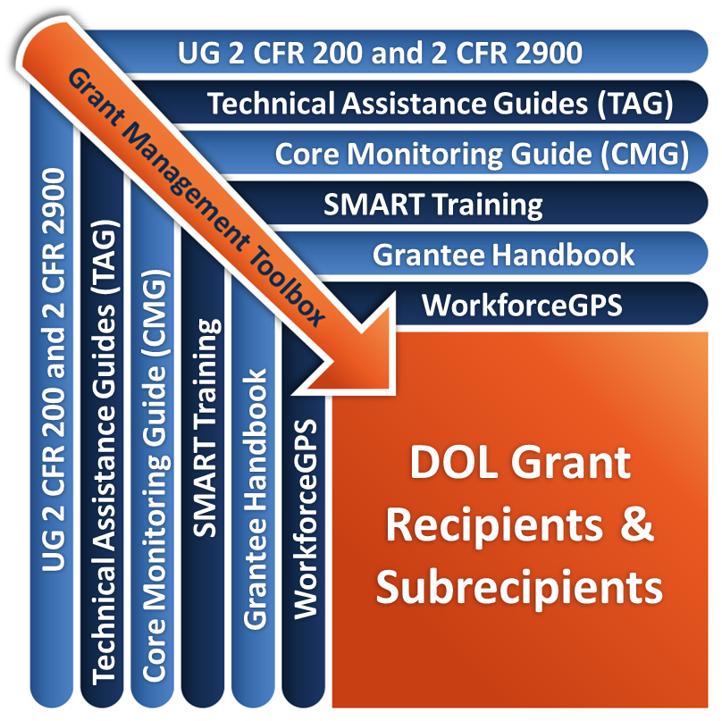
Remember the Grant Management Toolbox!

Slide 76
Questions?

Slide 77
Please complete your evaluations.

