Slide 1
Trade Adjustment Assistance Community College and Career Training (TAACCCT)
Grantee Orientation
October 25, 2011
3:00 pm Eastern Time

Slide 2
Presenters
Jen Troke, Program Manager, Division of Strategic Investments
Megan Baird, Workforce Analyst, Division of Strategic Investments
Sarah Sunderlin, Workforce Analyst, Division of Strategic Investments
Donna Kelly, Grant Officer, Office of Grants Management
Kristen Milstead, Workforce Analyst, Division of Strategic Investments

Slide 3
Today’s Agenda
Welcome to ETA!
Share webpage, TA and communication strategies
Explain the role of the National Office and Regional Offices
Explore the grant package
Provide information on reporting and performance for these grants

Slide 4
Program Overview
$500 million in FY11 grant funds to expand and improve the ability of eligible institutions to deliver education and career training programs – capacity building grants
Awards to institutions of higher education and consortia of two or more individual eligible institutions
  Includes public, proprietary, or other non-profit educational institutions
Period of performance is 36 months
  Includes implementation and start-up, program development and enhancement, and grant close-out

Slide 5
Four Program Priorities
Accelerate Progress for Low-Skilled and Other Workers
Improve Retention and Achievement Rates to Reduce Time to Completion
Build Programs That Meet Industry Needs, Including Developing Career Pathways
Strengthen Online and Technology-Enabled Learning

Slide 6
TAACCCT Grantees

Slide 7
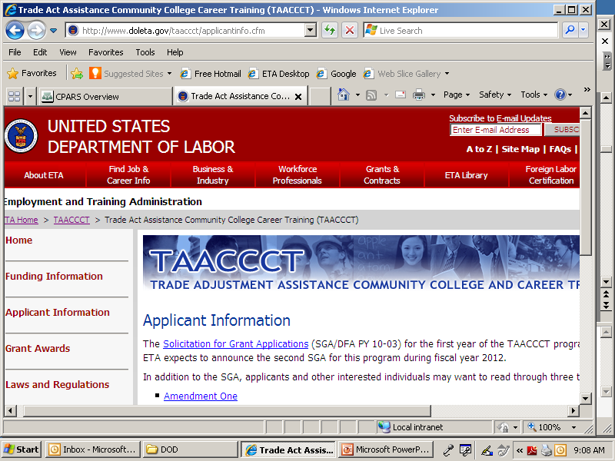
Quick Peek at the TAACCCT Webpage
The main TAACCCT grant program page is available at www.doleta.gov/taaccct
  One-Pagers
  SGA and Amendments
    Redacted copy of Technical proposal due to ETA by November 1, 2011

Slide 8
Technical Assistance
You will participate in an initial orientation on October 25 *That’s now!
Participate in a series of trainings related to financial and administrative management, and performance reporting are now scheduled through October and November
New TA and training planned for remainder of 2011 and early 2012 is in development!

Slide 9
Team Communications & Support
Main Point of Contact (POC) Needed
  Responsible for sharing notices with consortium and subs
Send POC contact information to: taaccct@dol.gov
Bi-weekly newsletter with important updates – Help us name the newsletter!

Slide 10
ETA Regional Offices

Slide 11

Update Point of Contact
Any time the main point of contact for your grant changes, please remember to alert your Federal Project Officer (FPO) and National Office staff
FPOs and the National Office regularly send out email blasts to grantees
Please make sure your email system does not confuse our communication as spam.

Slide 12
National Office Role
The National Program Office has several functions:
  Supports Federal Project Officers (FPOs)
  Provides Technical Assistance
  Creates peer learning opportunities
  Coordinates product submissions and dissemination
  Periodically requests additional information about your grant

Slide 13
DOL/ETA Grants Officer
The Grants Officer performs official grant duties:
  Maintains official grant documents such as modifications, no-cost extensions, and other relevant documents
  Approves all purchases over $5,000

Slide 14
Donna Kelly
Grant Officer
Office of Grants Management

Slide 15

The Grant Award
Grant Award Letter
Grant Agreement - Notification of Award Obligation
Application for Federal Assistance SF-424
Administrative Costs
Solicitation
Part I - Statement of Work
Part II - Budget Information – SF424a
Part III - Assurances /Certifications
Part IV - Special Clauses and Conditions

Slide 16

Grant Award Letter
Acknowledgements of Award
Payment Management System
  Information and forms on www.doleta.gov/grants under Payment Information
ETA’s on-line Grantee Fiscal Reporting System – SF 9130
  Information to access system on www.doleta.gov/grants under Financial Reporting
Passwords/PINs are sent separately after supplying the necessary information
Once you receive this please DO NOT LOSE IT!

Slide 17
Grant Agreement
Notification of Award Obligation
Project Title – Trade Adjustment Assistance Community College and Career Training Grant Program (TAACCCT)
Grant Awardees' Identifying Information
DOL Identifying Information
  Agreement # TC-2XXXX-11-60-A-XX
Period of Performance
Award Amount
Regulations and Cost Principles
Signatures

Slide 18
Notification of Award Obligation
Regulations & Cost Principles
Code of Federal Regulations (CFR) can be found at:
http://www.gpoaccess.gov/cfr/index.html
  Uniformed Administrative Requirements
    29 CFR Part 95 - Institutions for Higher Education
    29 CFR Part 97 - State/Local Governments and Indian Tribes
  Cost Principles
    2 CFR 220 (OMB Circular A-21) – Educational Institutions
    2 CFR 225 (OMB Circular A-87) – State/Local Government, Indian Tribes
    2 CFR 230 (OMB Circular A-122) – Non-profit Organizations
  Other Requirements (As Applicable)

Slide 19
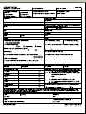
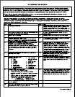
Application for Federal Assistance
SF-424
Submitted by grant applicant
Incorporated in grant packet

Slide 20
Statement of Work
Grantee’s original proposal
  Includes Technical Proposal, and required attachments
Budget

Slide 21
Special Clauses and Conditions
Special Clauses
  Budget Line Item Flexibility
  Indirect Cost Rate and Cost Allocation Plan
Special Conditions
  Federal Project Officer
  Equipment
  Program Income
  Intellectual Property Rights
  Evaluation
  Reports
    Quarterly Financial and Performance Reports

Slide 22
State-Designated Eligible Institutions
17 states
Implementation Plan within 60 days
  States will work with the DOL’s Performance Excellence Center

Slide 23
Kristen Milstead
Workforce Analyst
Division of Strategic Investments

Slide 24

The Value of Reporting
Reporting successes of high profile programs to Congress, Administration, OMB, GAO, etc.
Demonstrating Grant Outcomes to investors and partners
Illustrating Return on Investment (ROI) to employer partners
Building additional strategic partnerships and leveraging resources
Sustainability of the project and partnership
Continuously improving program to meet the needs of participants

Slide 25
Reporting
TAACCCT grantees are required to submit quarterly and annual program reports to ETA in order to comply with the reporting and record keeping requirements of the grant
These reports are:
  Quarterly Progress Reports
  Annual Performance Reports
  Quarterly Financial Report (ETA-9130 Form)

Slide 26
Quarterly Progress Report
Each grantee must submit a Quarterly Progress Report (QPR) containing updates on the progress and implementation measures specified in each grant
  Due no later than 45 days after the end of a quarter

Slide 27
Annual Performance Report
Each grantee must submit an Annual Performance Report (APR) that reflects the longer-term outcomes of program participants and a comparison cohort
  The APR contains two tables
    Table 1: aggregate year-by-year information on all participants
    Table 2: cumulative information on participant and comparison cohorts only
  Due annually, based on the grant start date (first annual report is due November 14, 2012 and covers the period of 10/1/2011-9/30/2012)

Slide 28
Quarterly Financial Report
Each grantee must submit a Quarterly Financial Report (ETA-9130 Form)
  Due no later than 45 days after the end of a quarter

Slide 29
Final Performance and Outcomes Report
The last Quarterly Progress and Annual Performance Reports will serve as the grant’s Final Performance and Outcomes Report

Slide 30
Key Milestones
Grant Start Date:
  October 1, 2011
1st quarterly progress report:
  Due February 14, 2012
1st quarterly financial report:
  Due February 14, 2012
1st annual performance report due:
  Due November 14, 2012
Grant End date:
  September 30, 2014

Slide 31
Immediate Next Steps
Grants Management 101 Part A and B
  PART A: Live Webinar on October 26 @ 2:00 pm ET
  PART B: Live Webinar on November 2 @ 2:00 pm ET
Financial Management
  Live Webinar on November 9 @ 2:00 pm ET
Performance Reporting Overview and Quarterly Progress Reporting Training:
  To be made available after November 9
Partners, MOUs, and Subcontracts
  Live Webinar on November 16 @ 2:00 pm ET
Performance Reporting: Participant and Comparison Cohort Training
  To be made available after November 16

Slide 32
THANKS!
www.workforce3one.org

