Slide 1


Employer Engagement: 20 Strategies
ARRA Grantees Technical Assistance Webinar
Tuesday, November 8
2:00 – 3:00 pm ET

Slide 2


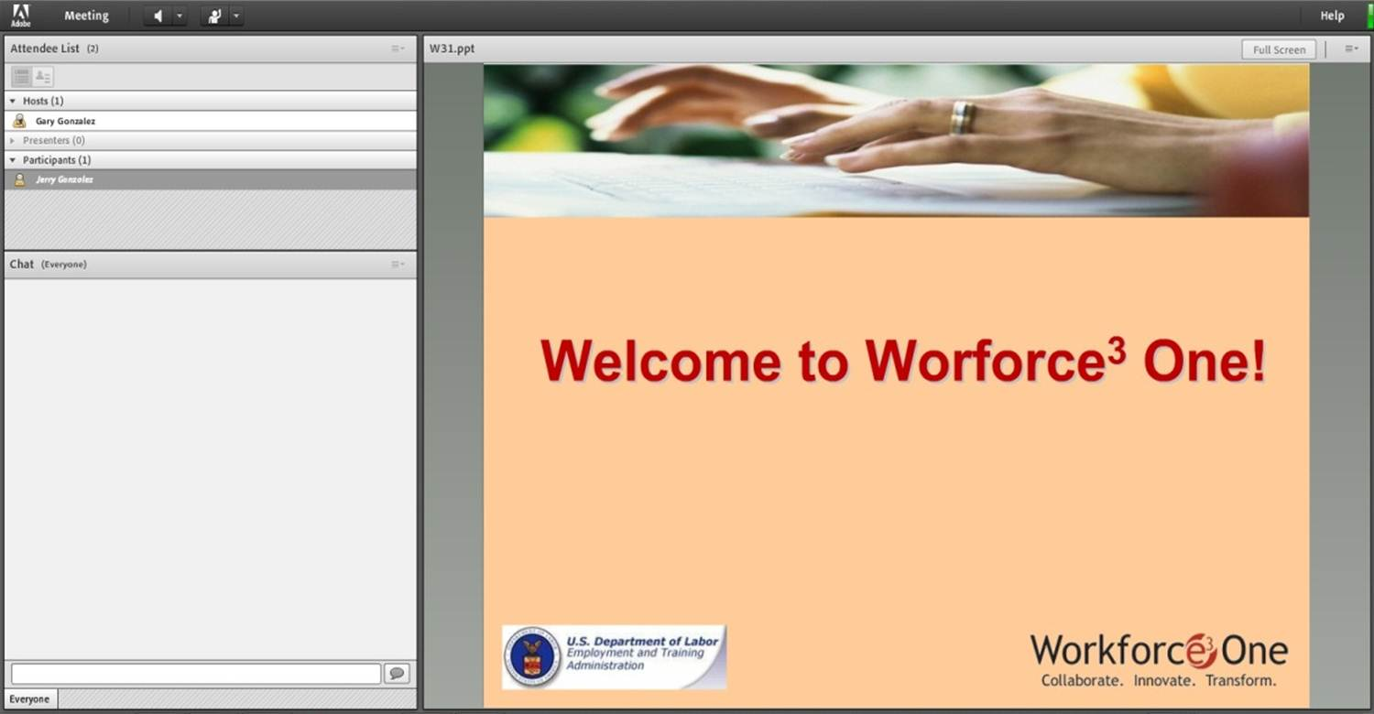

Welcome to Workforce³ One!

Slide 3
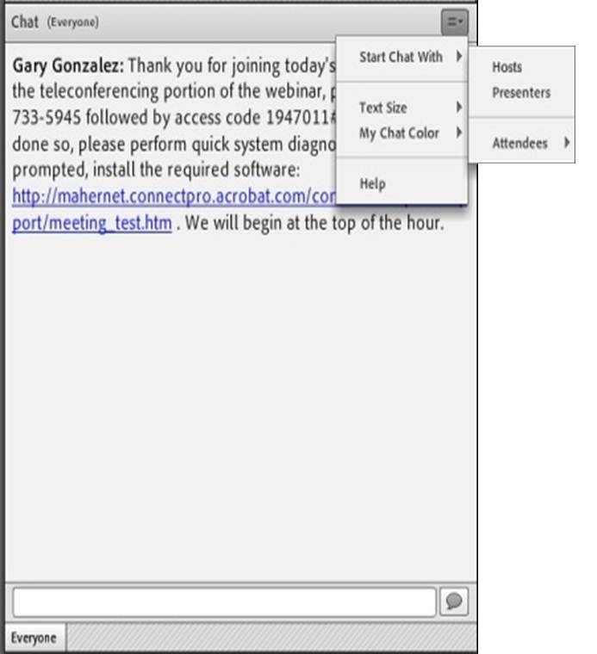
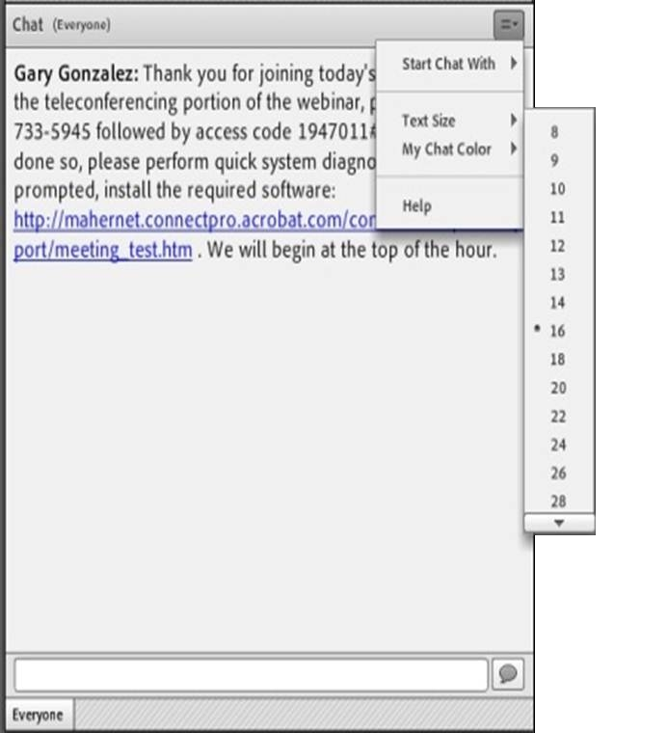
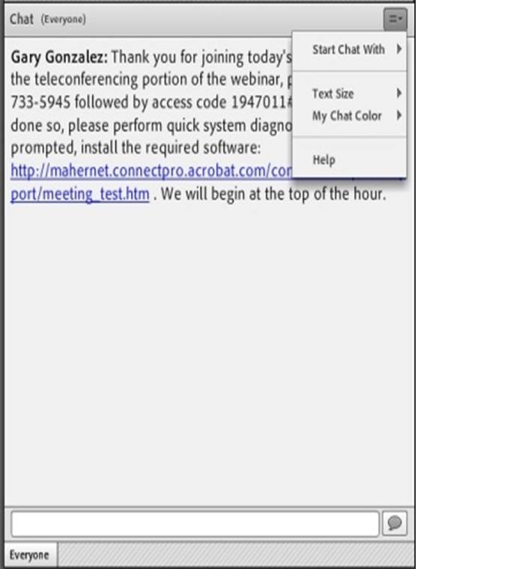
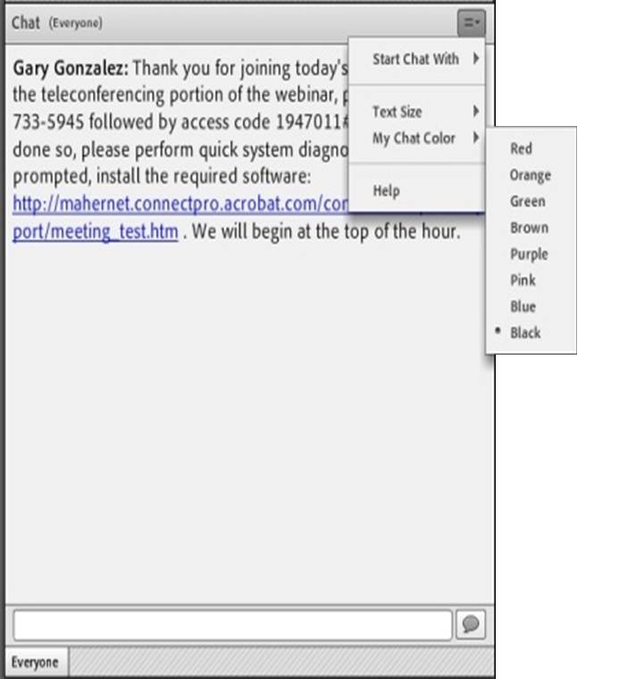
Submitting Questions: Open Chat
Drop-Down Menu
To submit a question, type the question in the text field and press your Enter/Return key.
  Please enter the name to whom the question is directed.
To send questions only to the presenters, select Presenters from the drop-down menu before pressing your Enter/Return key.
Change Text Size and Chat Color…
Text Field

Slide 4
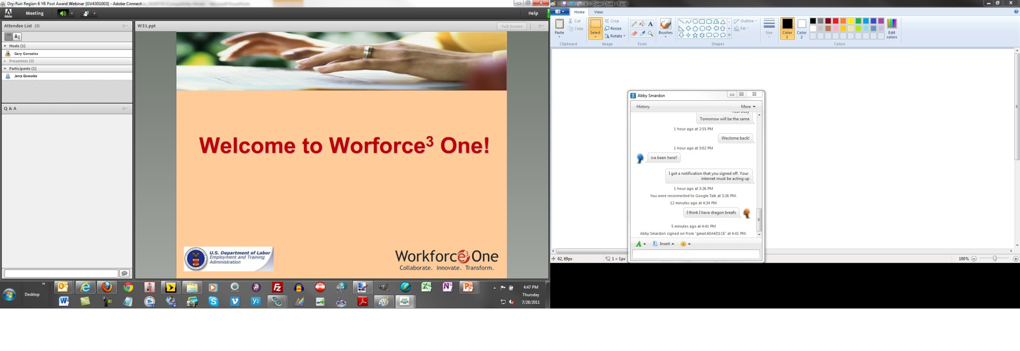

Submitting Questions: Closed Chat
To submit a question, type the question in the text field and press your Enter/Return key.
  Please enter the name to whom the question is directed.
Your name and your question will appear on your screen, indicating successful submission.
Questions are directly transmitted to presenters—no other participants will see your questions.
Text Field
Gary, where can I find today’s PPT?

Slide 5
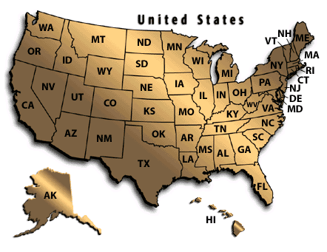
Practice
In the Chat Room, please type the name of your organization, your location, and how many people are attending with you today.

Slide 6
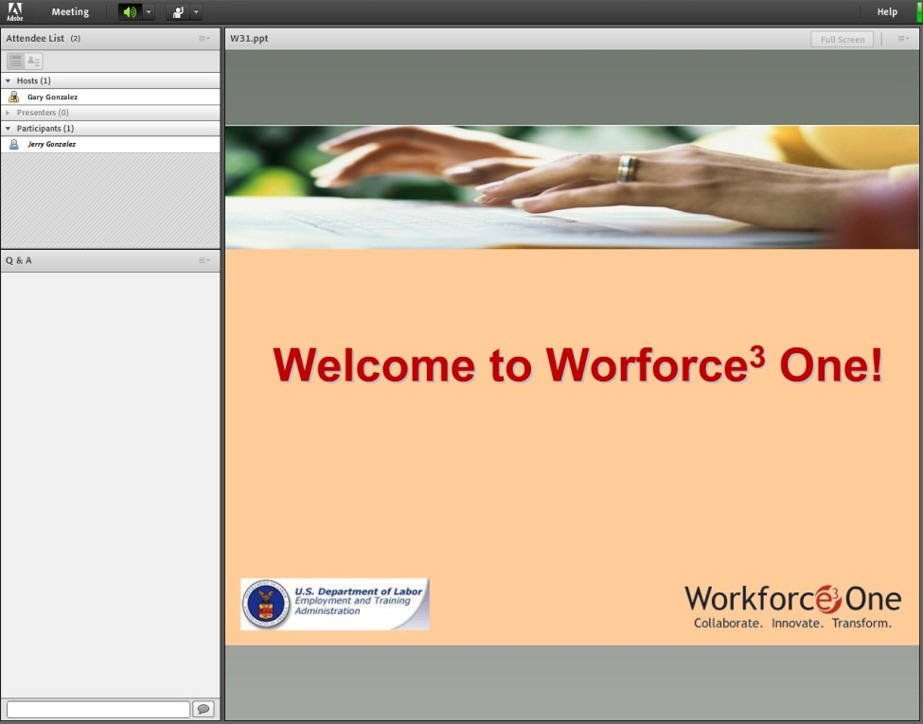
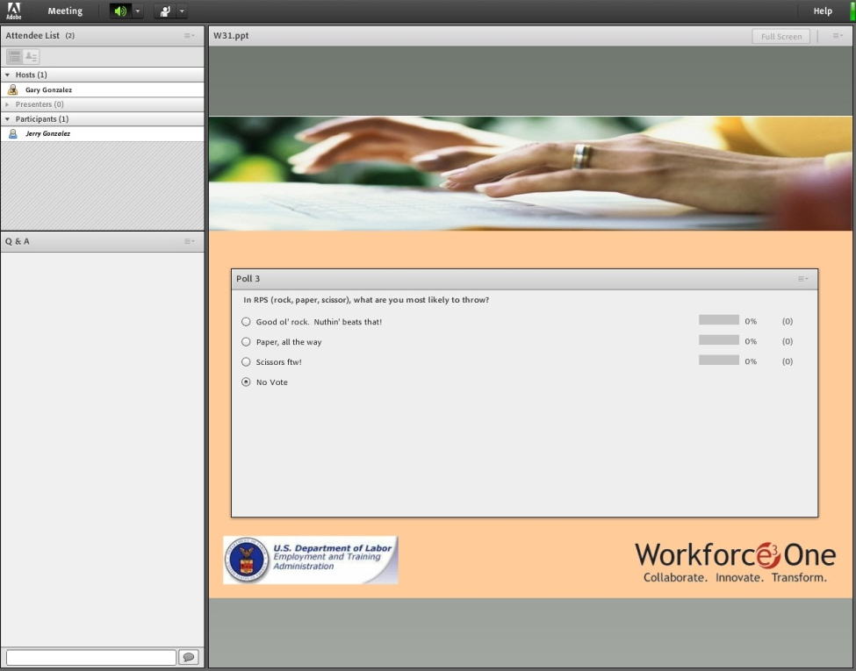


How To Participate in a Poll

Slide 7
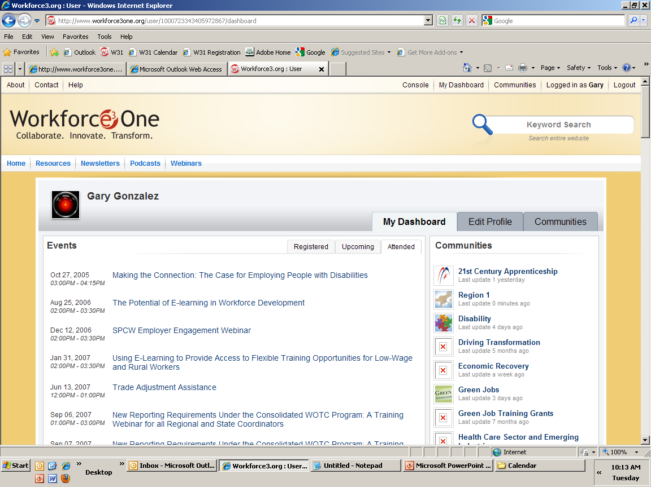
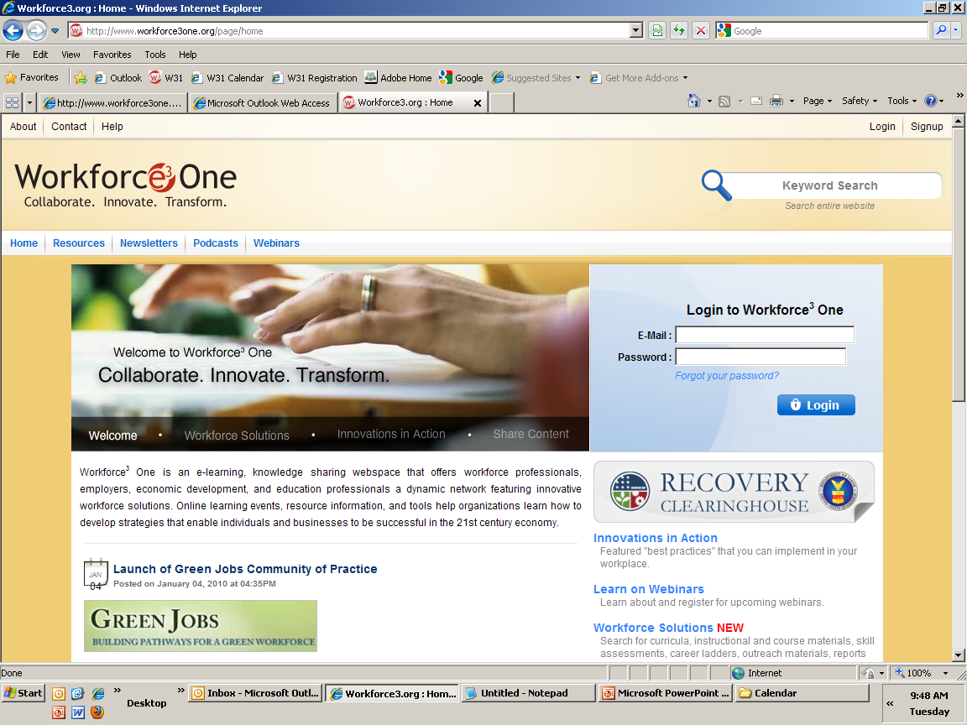
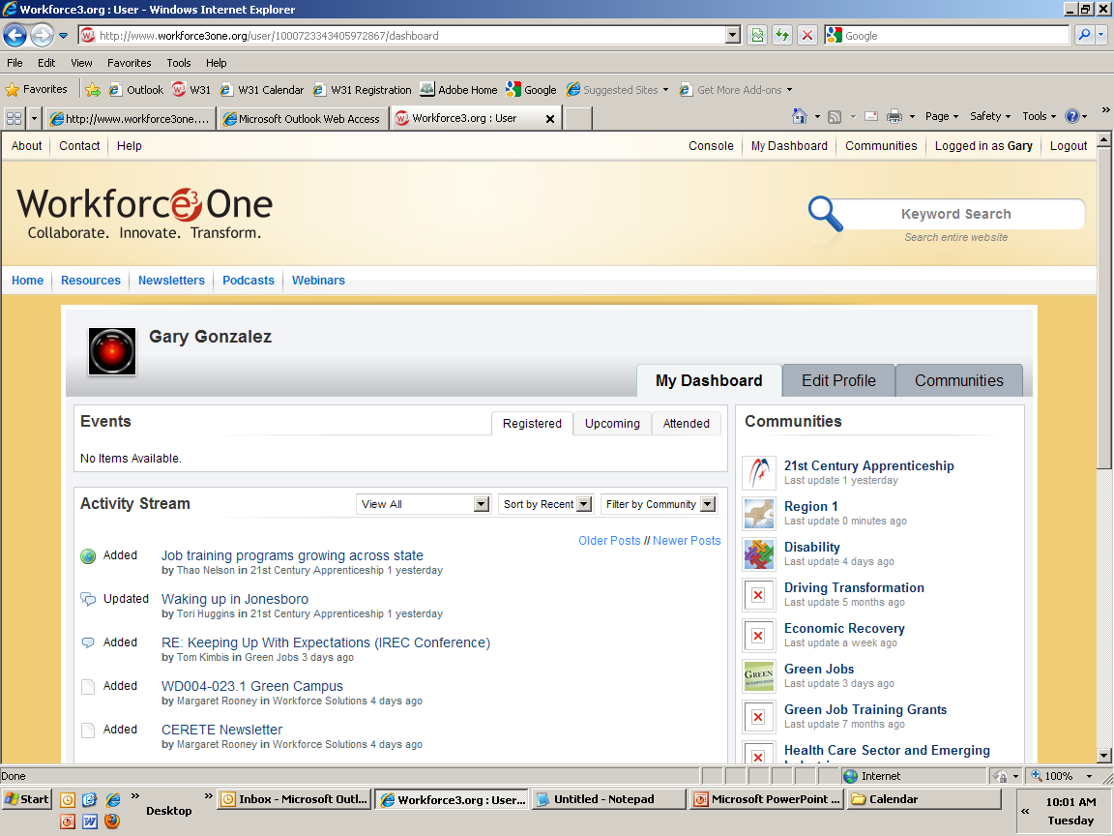



Access to Webinar Resources
WEBINAR RESOURCES:
Recordings and transcripts are available within 2 business days after the event.

Slide 8

Welcome to Today’s Webinar –
Part I: Employer Engagement
20 Strategies to Better Engage Employers
Don’t Miss Part II: Employer Engagement
Finding the Hidden Jobs in your Region
November 16th, 12:30 Eastern (tentative)

Slide 9
Please Welcome Our Speakers!
Stewart Knox, Executive Director, Northern Rural Training and Employment Consortium – Chico, CA
Sean Sypolt, Administrator, Private Industry Council of Westmoreland/Fayette County, Greensburg, PA

Slide 10

Today’s Objectives
To provide a menu of 20 concrete, tangible strategies to better engage employers;
To showcase two of your peers and highlight how they facilitate networking across employers, use data to engage employers on an ongoing basis, and use training to support economic growth; and
To provoke new thinking about how you engage employers, and to discuss what works.

Slide 11

Let’s Get Started

Slide 12
20 Employer Engagement Strategies (1-6)
Mix it up: surveys, focus groups, 1-on-1 meetings, group meetings, presentations (Connecticut SESP)
Find your “employer champions” – Which employers keep coming back? Use them to recruit additional companies, and bring them with you to new meet-and-greets. (Cincinnati State Technical & Community College, West Hills Community College)
Engage company volunteers to conduct mock interviews as part of participant training. Employers love it, tell other employers about it, and even hire! (Columbus State Community College)
Engage employers together, not just individually. They learn a lot from each other, recognize that value, and keep coming back. (Columbus State Community College, Westmoreland-LaFayette PIC, Northern Rural Training & Employment Consortium)
Start with actual job descriptions, but then do a sit-down with employers to really find out what they need, and to establish credibility. (Workplace, Inc.)
Cross-check, combine and leverage your employer lists with your partners’. (Southwest Housing Solutions Corporation)

Slide 13

Which of these will you try out, or do more of, going forward? [Select All That Apply]
Mix it up
Find your employer Champions
Engage company volunteers in mock interviews
Engage employers together
Start with job descriptions
Cross check and leverage employer lists

Slide 14
20 Employer Engagement Strategies (continued)
Make meetings matter: 1) Opportunities to learn about their own industry; 2) Concrete sharing about non-training topics (finance, technology); 3) Focused conversation about skills needs and trainees ready for hire (Colorado SESP, Southwest Housing Solutions Corporation)
Be creative with how you build awareness of your programs: job fairs, postcards, personal calls, billboards, free conferences or summits, yard signs, newspaper ads, short videos played at large sporting events! (Kansas SESP, NC SESP, Westmoreland-Lafayette PIC)
Use Industry experts or partners with strong industry backgrounds to help translate business needs to education and training partners (Columbus State CC)

Slide 15
20 Employer Engagement Strategies (continued)
Significantly increase level of understanding by program staff of the industry of focus: what makes companies grow? What policies affect this industry? What are persistent skill gaps, and why? (Massachusetts SESP)
Find the hidden jobs: pull city permits, first source agreements, city/county public works opportunities. (Goodwill Industries International, West Hills Community College)
Make your services seamless, single vision, non-bureaucratic: employers don’t need to know what program or funding stream is in use. (NorTEC)
Assess demand accurately and regularly by using good data and checking in with employers about its validity. Follow-up: Are new hires accurately trained? (NorTec)

Slide 16
Which of these will you try out, or do more of, going forward? [Select All That Apply]
Make meetings matter
Be creative with building awareness
Use Industry Experts
Increase staff’s understanding of the industry of focus
Find the hidden jobs
Make services seamless
Assess demand accurately and regularly

Slide 17
20 Employer Engagement Strategies
(continued)
Use your Advisory Committee members more: They’re not just names, filled seats, or grant requirements. They’re employers themselves and networkers. (North Carolina SESP)
Create a strong employer network that is a forum for sharing, a time for joint policy strategizing, a place for practical problem solving. (Westmoreland-LaFayette PIC)
Offer something unexpected and extra that employers need via your program or a referral to a partner’s, like grant writing services. (Workplace Inc.)

Slide 18
20 Employer Engagement Strategies
(continued)
Be clear about roles and responsibilities of partners so employers don’t experience mixed messages, gaps or duplication. (West Hills CC and Austin Joint Apprenticeship Training Committee)
Provide space and equipment: sometimes employers have the best training, but need a place to conduct it. (Austin JATC)
Keep engagement industry-specific: When you share about your services, put it in the context of the employer audience (Westmoreland-Lafayette PIC)
Go to them, get out of the office, listen more, sell less. (Workplace Inc., North Carolina SESP, Eastern Maine Development Corporation)

Slide 19
Which of these will you try out, or do more of, going forward? [Select All That Apply]
Use Advisory Committee members better
Create strong employer networks
Offer something unexpected and extra
Be clear about roles/responsibilities across partners
Provide space and equipment
Keep engagement industry-specific
Go to them, get out of the office

Slide 20

Let’s Talk – What stood out that you think you might try?
Use the Chat Box or Raise Your Hand!

Slide 21

Let’s Welcome . . .
Stewart Knox, Executive Director, Northern Rural
Training and Employment Consortium – Chico, CA
Pathways out of Poverty Grantee

Slide 22
Some ideas to ponder from NorTEC . . .
“NorTEC carefully tracks grant funding and eligibility criteria, but to its customers, the programs are a single menu of services, avoiding confusion by customers about funding streams.”
“Making sure that demand is there is a balancing act. LMI data is used as focal points for employer meetings, and data validity is confirmed or corrected by employers’ input. NorTEC follows up with employers and trainees after placement to make sure they constantly tweak and improve training based on employer needs.”
“The employer engagement system has evolved beyond verification of data and placing people into jobs. It has evolved to partnering with economic development, universities, community colleges, and employer groups to focus on jobs and business creation, and how NorTEC can support the workforce development implications. NorTEC has become a regional convener of this conversation.”

Slide 23

5 Minute Q&A – Raise Your Hand or Use the Chat Box!

Slide 24
Let’s Welcome . . .
Sean Sypolt, Administrator, Private Industry Council of Westmoreland/Fayette County, Greensburg, PA
Pathways Out of Poverty Grantee

Slide 25
Let’s look at Westmoreland-LaFayette PIC . .
“The Green Alliance Committee includes elected officials, economic council members across 4 counties, local colleges and industry partners. Because employers find value in the training and the Network, they bring other employers to the table. There are now 40 companies involved.”
“The value of the Committee is in the connections made, sharing information and resources, and building trust. Everyone stays on the same page, forms policy strategies together. It’s become a forum for practical problem solving.”
“The Committee has spurred a regional network of energy efficiency suppliers and vendors. Companies recruit other companies as the sector’s success spreads by word of mouth. It has led to local companies contracting with local companies, rather than going out of state for supply chain needs. Companies from out-of-state have started to visit to be closer to this strong industry network.”

Slide 26

5 Minute Q&A – Raise Your Hand or Use the Chat Box!

Slide 27

What did we miss?
What questions are you still sitting with?
What did you take away from this?

Slide 28

That’s a Wrap for Today
Thanks!!
Don’t Forget about the Next Webinar:
Employer Engagement Part II: Finding the Hidden Jobs in your Region
November 16th, 12:30 Eastern (tentative)
www.workforce3one.org

Slide 29
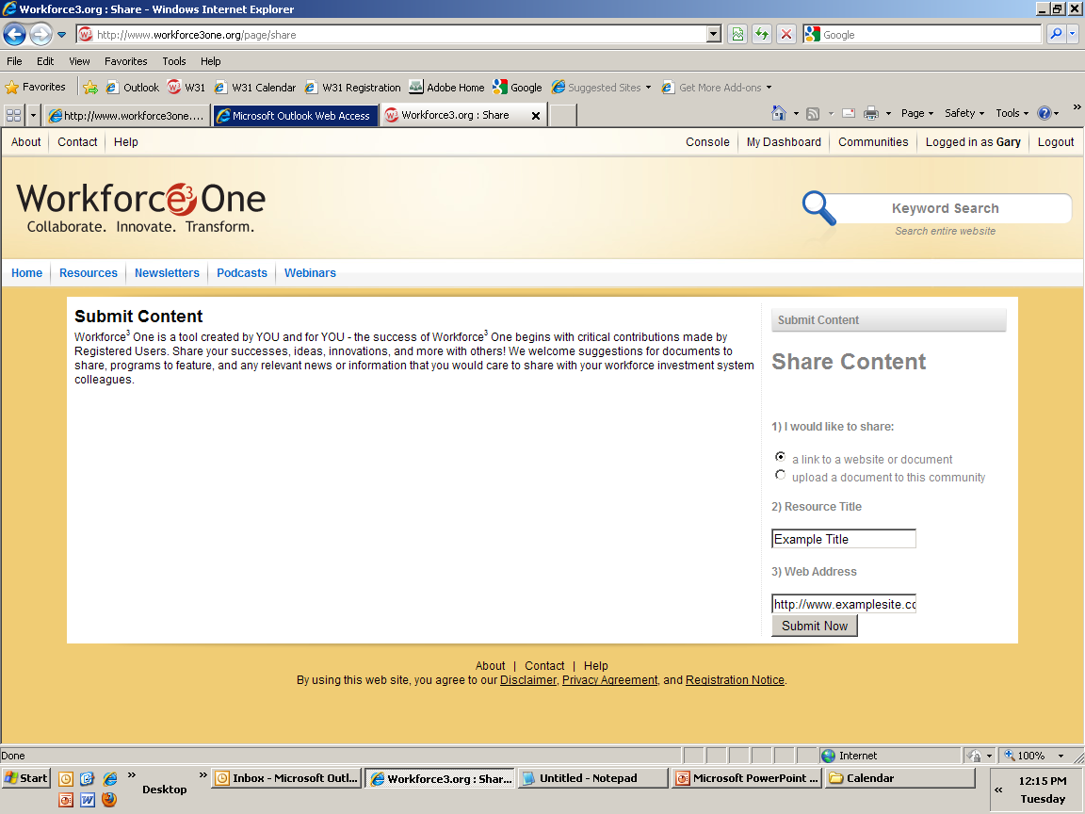
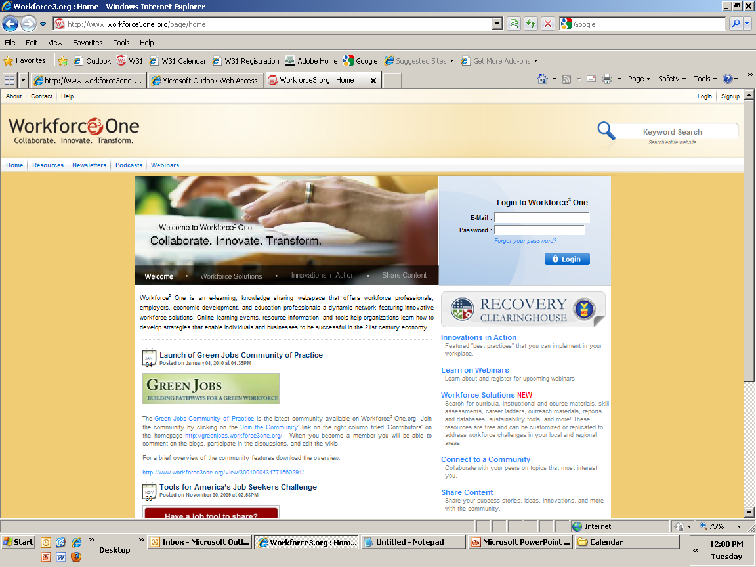


Share Your Ideas with Your Peers!
You have the option to submit content for review by uploading the resource or providing a link to the resource.
Share your demand-driven
strategic plans, models,
innovations, resources, and ideas!

Slide 30
Access to Webinar Resources
WEBINAR RESOURCES:
Recordings and transcripts are available within 2 business days after the event.

Slide 31
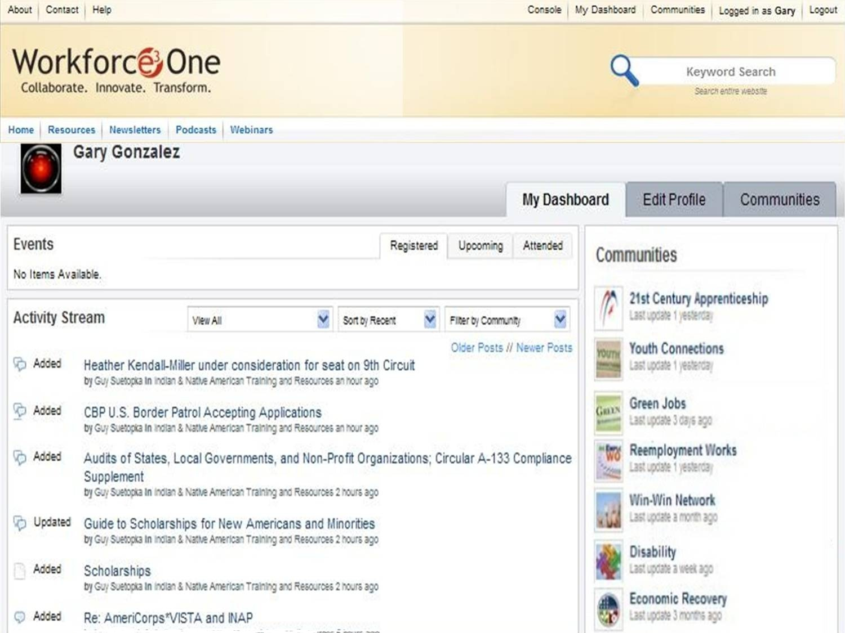
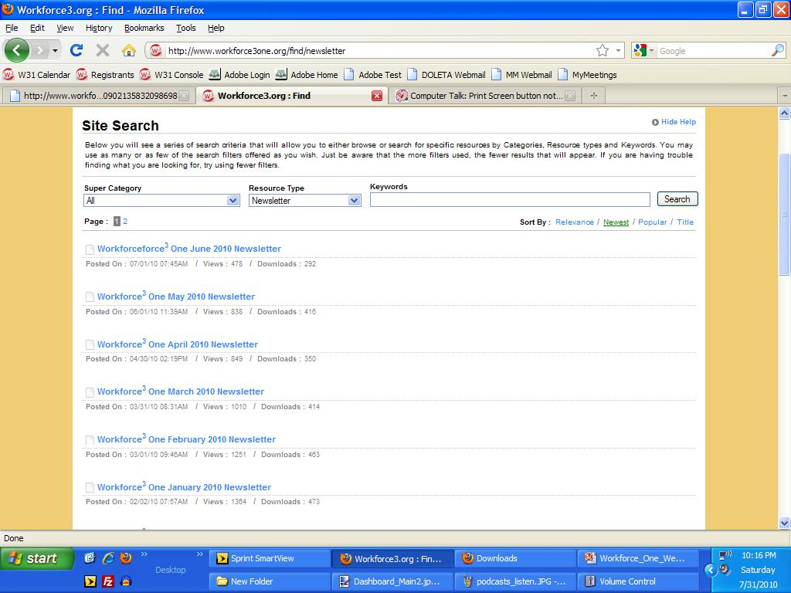
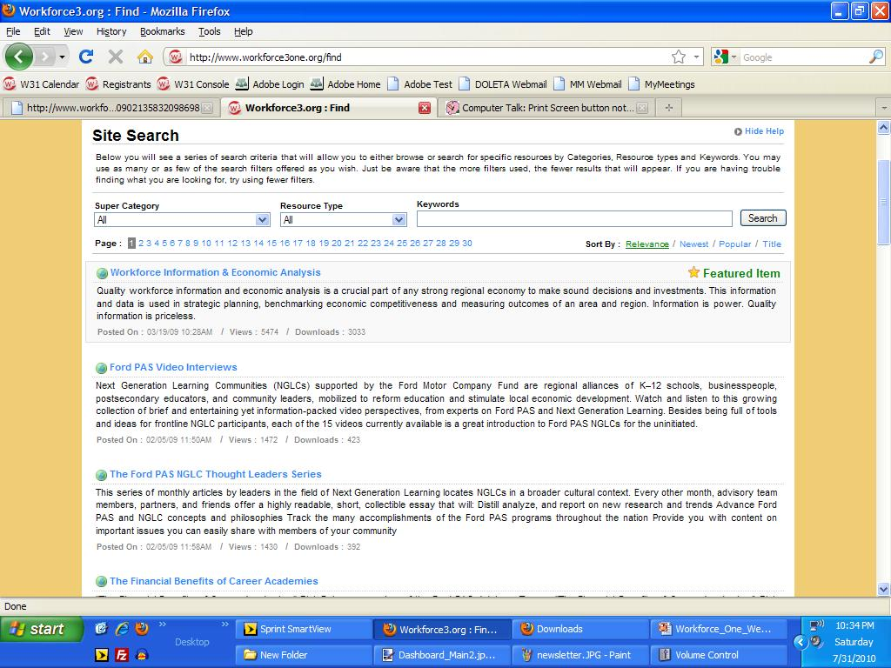
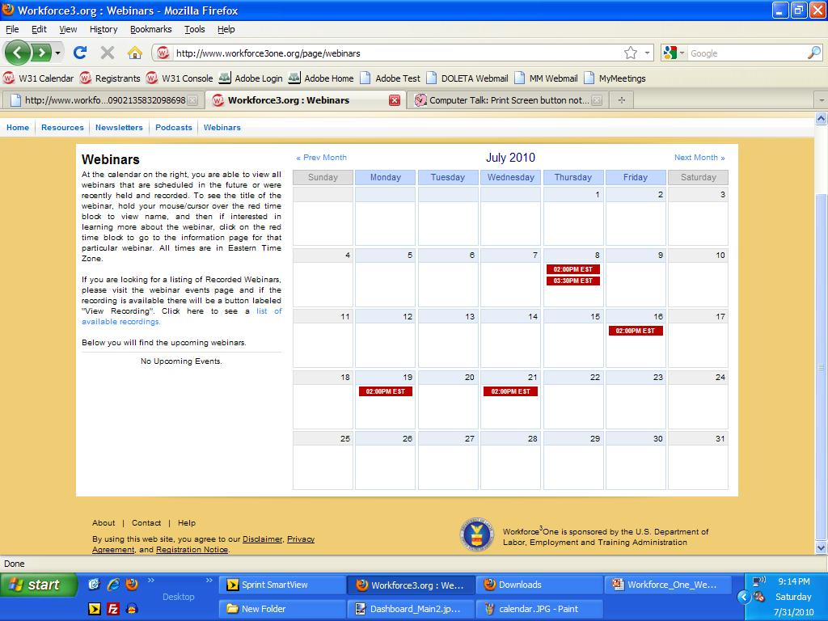
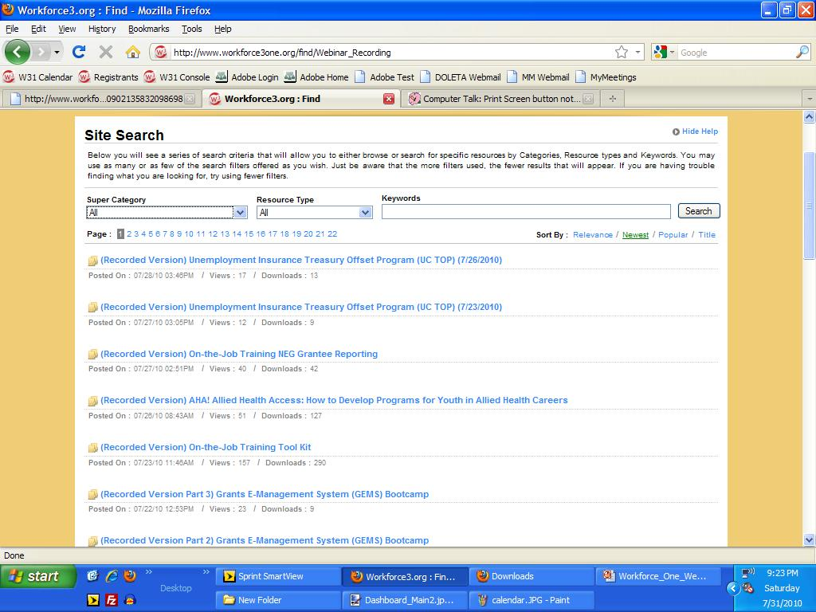
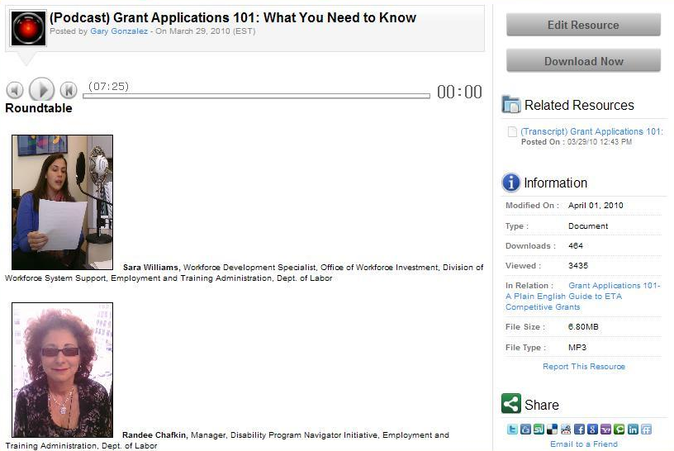
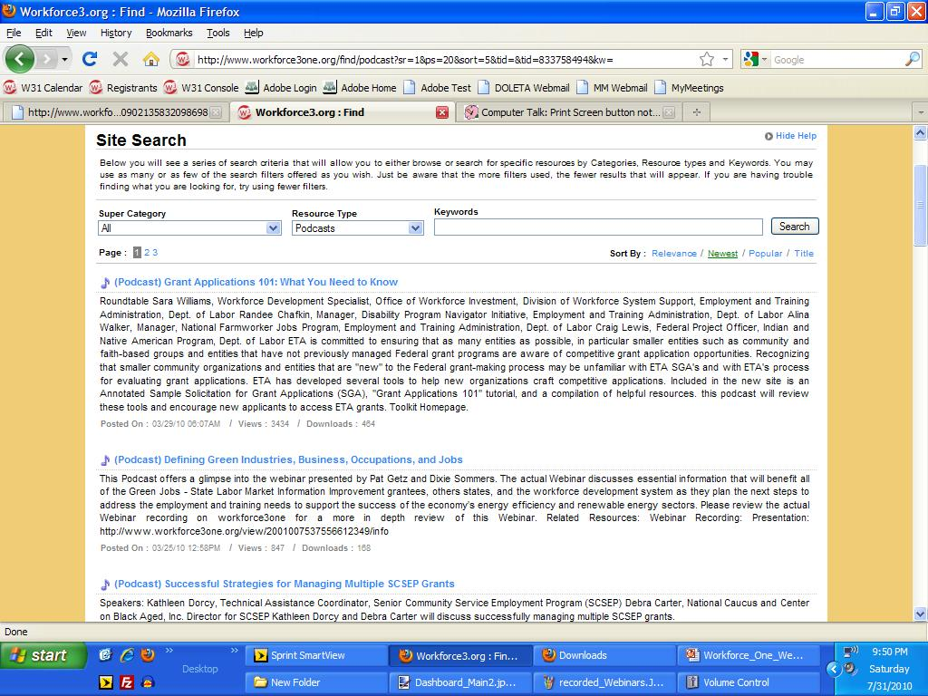
Stay Informed, Get Connected!

Slide 32
For more information about the Workforce Investment System:
  Visit www.careeronestop.org
  Call 1-877-US2-JOBS
THANKS!
www.workforce3one.org

