Slide 1


Pay for Success
Wednesday, February 22, 1:30 EST

Slide 2
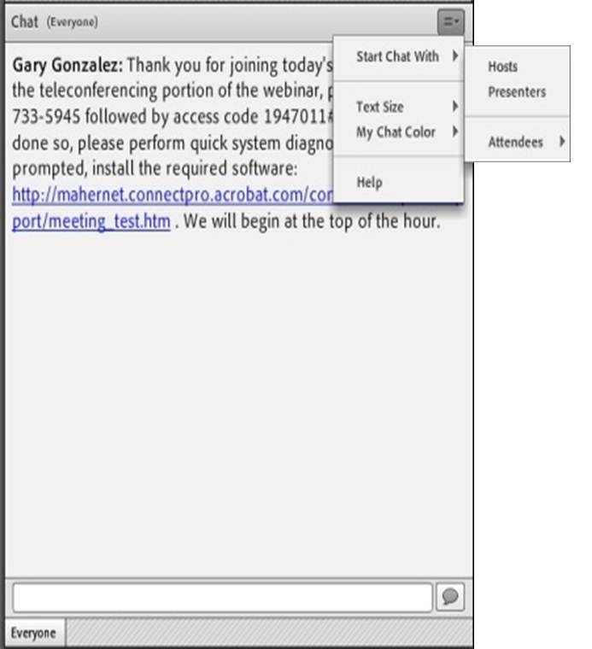
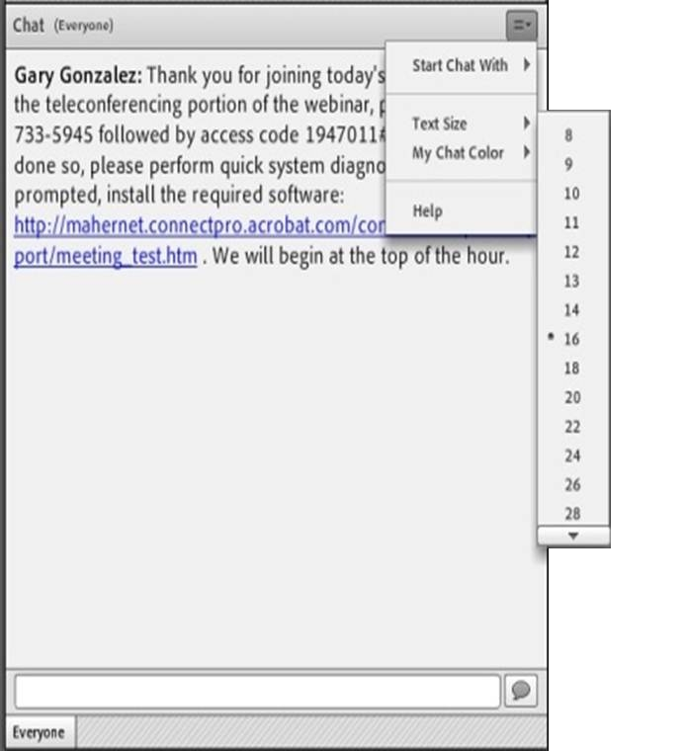
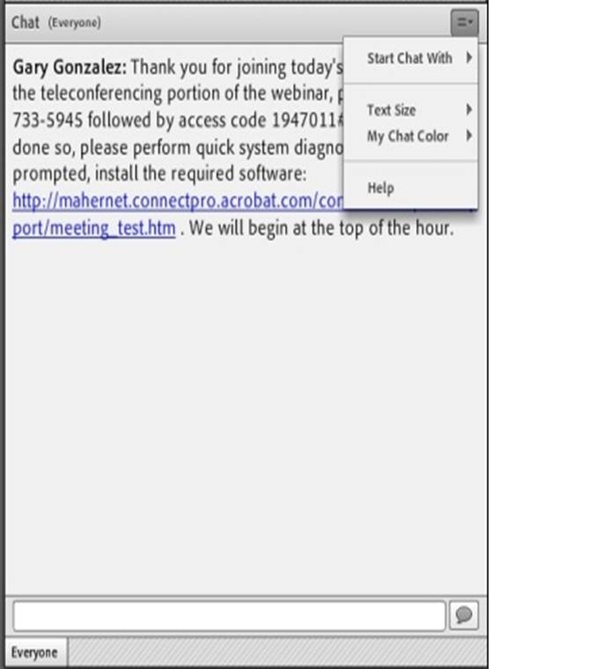
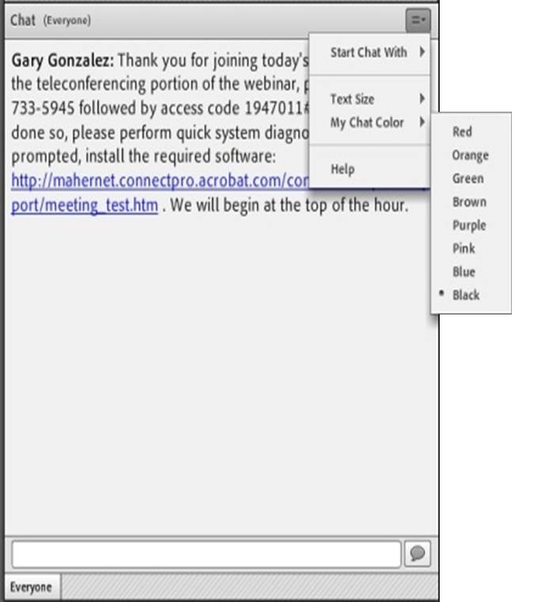

Submitting Questions: Open Chat
Drop-Down Menu
To submit a question, type the question in the text field and press your Enter/Return key.
  Please enter the name to whom the question is directed.
To send questions only to the presenters, select Presenters from the drop-down menu before pressing your Enter/Return key.
Change Text Size and Chat Color…
Text Field

Slide 3


Submitting Questions: Closed Chat
To submit a question, type the question in the text field and press your Enter/Return key.
  Please enter the name to whom the question is directed.
Your name and your question will appear on your screen, indicating successful submission.
Questions are directly transmitted to presenters—no other participants will see your questions.
Text Field
Gary, where can I find today’s PPT?

Slide 4

Practice
In the Chat Room, please type the name of your organization, your location, and how many people are attending with you today.

Slide 5
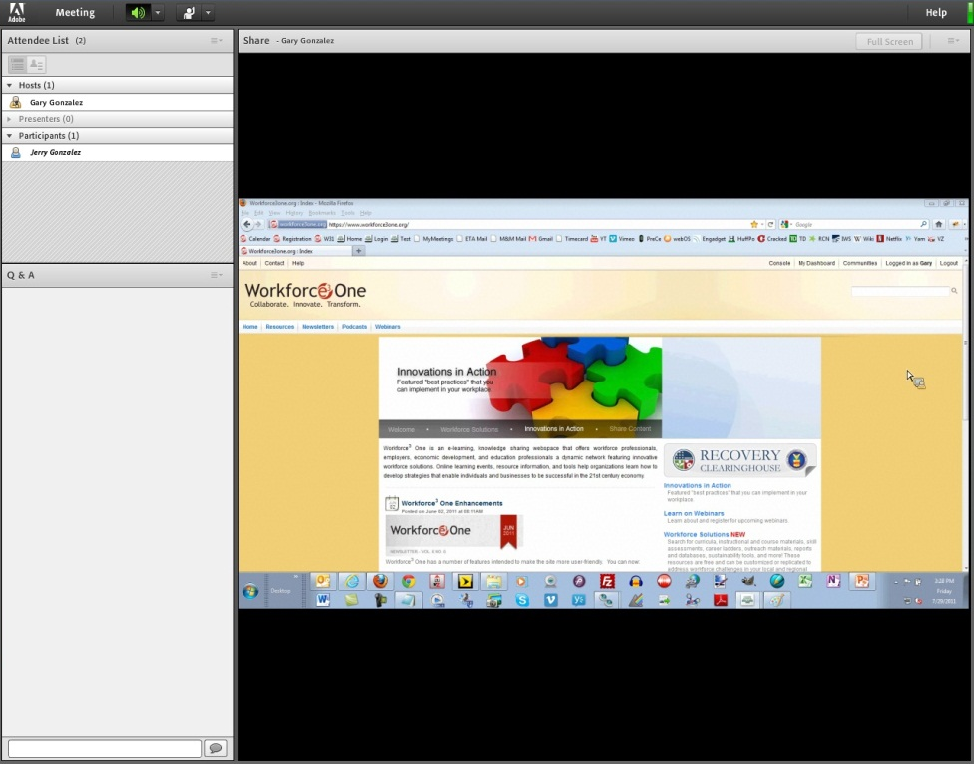
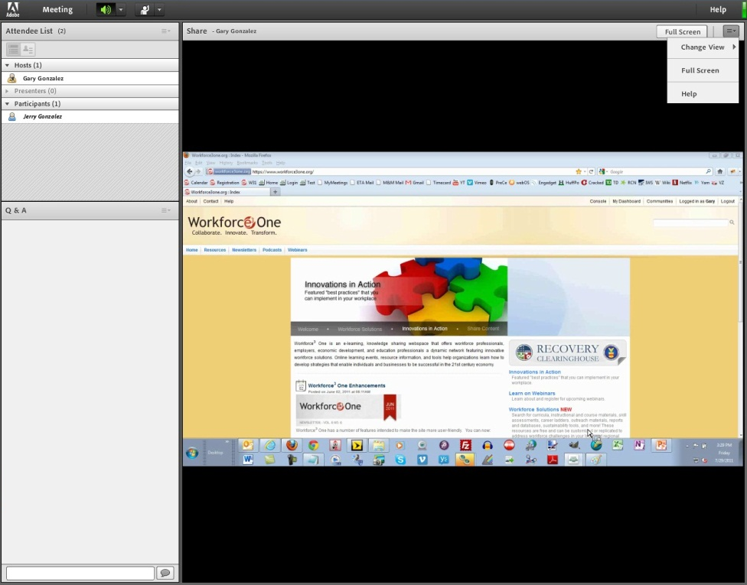

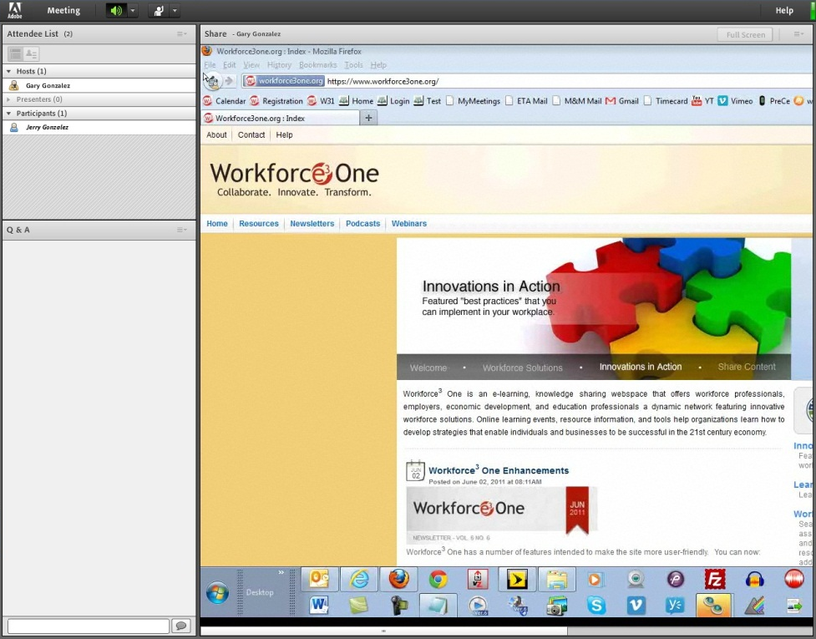

Screen Sharing

Slide 6




How To Participate in a Poll

Slide 7
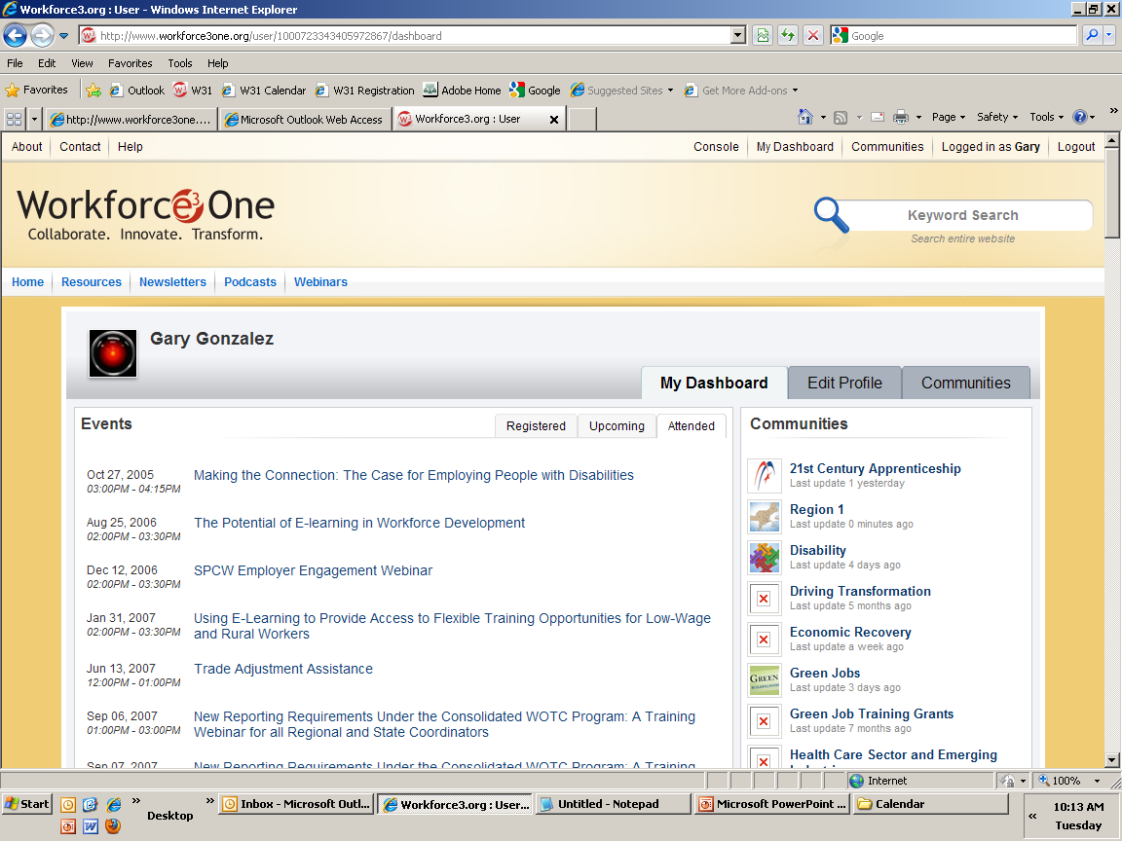
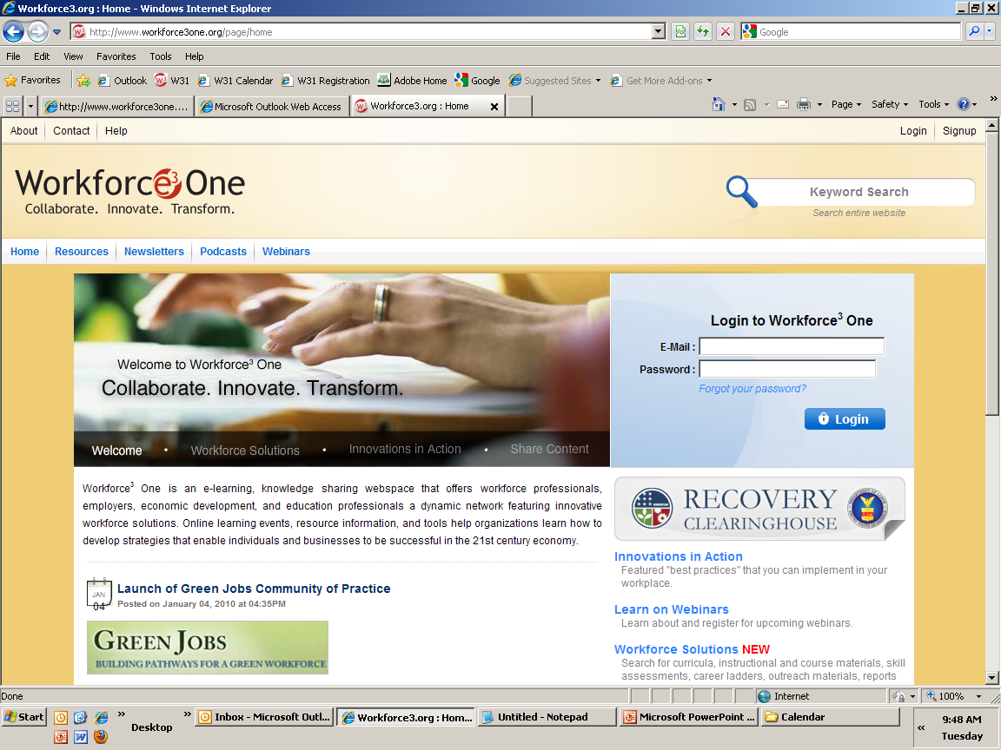
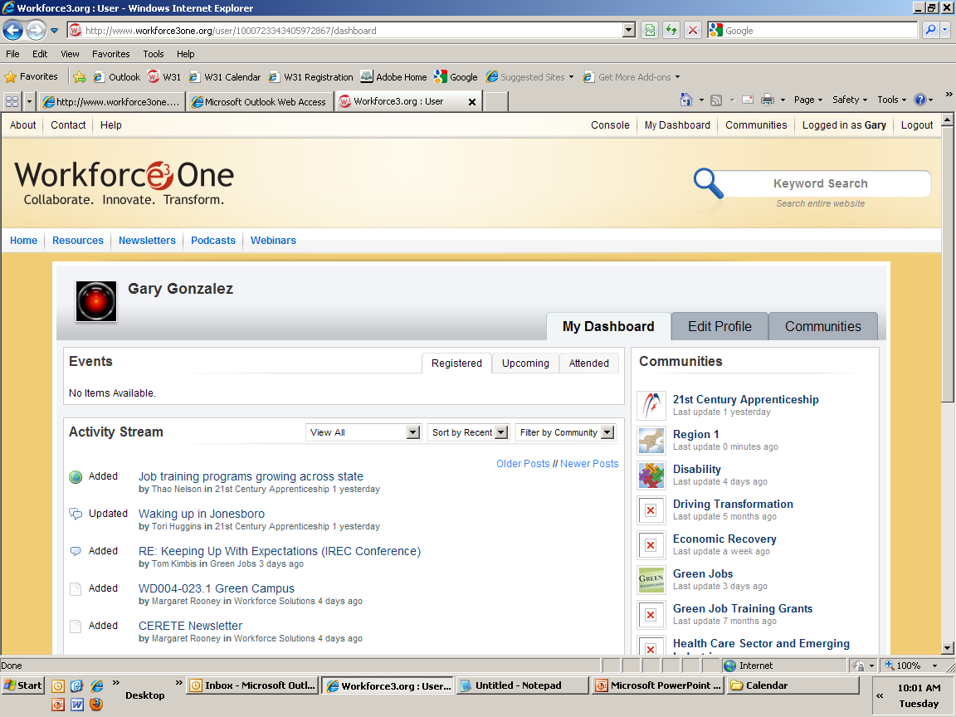



Access to Webinar Resources
WEBINAR RESOURCES:
Recordings and transcripts are available within 2 business days after the event.

Slide 8

Featured Speakers
Presenters
Jane Oates, Assistant Secretary
Employment and Training Administration
Gary Glickman, Office of Financial Management
Office of Management and Budget
Moderator
Amanda Ahlstrand, Acting Administrator
Office of Workforce Investment, ETA

Slide 9
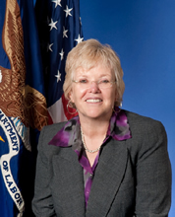
Jane Oates
Assistant Secretary
Employment and Training Administration

Slide 10
Agenda/Objectives
Share information about the Pay for Success model
Identify potential workforce development outcomes and target populations suited to the PFS financing model.
Obtain feedback on what resources can best help you form PFS partnerships
Assess your interest in the model

Slide 11
Gary Glickman
Office of Management and Budget

Slide 12

Pay for Success
A New Funding Model
Pay for Success promotes rapid adoption of evidence-based practice by providing financial incentives and flexibility to achieve the best outcomes for hard-to-serve populations.
Model being tested in Peterborough, U.K.

Slide 13
Pay for Success
Benefits of the Model
Opportunity to leverage new financing to invest in preventative services
Focus on identifying and achieving outcomes
Incentivizes performance and limits taxpayer risk

Slide 14
Pay for Success
2012 federal grant opportunities
Two Federal grant opportunities in 2012
Department of Justice’s Second Chance Act grants
Department of Labor’s Pay for Success grants under the Workforce Innovation Fund

Slide 15
Pay for Success
White House Listening Session
October, 2012 White House Listening Session
Co-hosted with the Nonprofit Finance Fund
Details of the convening and additional background on Pay for Success available at www.payforsuccess.org

Slide 16
Moderator
Amanda Ahlstrand
Acting Administrator
Office of Workforce Investment

Slide 17
Challenges of the Status Quo
One-year budget cycles make it difficult to finance long-term, preventative measures
Hard to blend funding streams
Governments wary of putting taxpayer dollars at risk for new, unproven, or experimental interventions

Slide 18
Benefits of Pay for Success
  Provides flexible non-government investment for integrated interventions that are not constrained by programmatic funding silos
Creates incentives for improved outcomes, cost savings, and efficiency gains
Allows for more rapid learning about which approaches and strategies work
Accelerates the adoption of proven, new solutions

Slide 19
Under Pay for Success, the public sector pays for outcomes only after they have been achieved.

Slide 20
Pay for Success Partnership:
The Government Agency
Identifies workforce issue and target population
Identifies and contracts with an intermediary based on achievement of specific outcomes
State/Local/Tribal Government Agency

Slide 21
Pay for Success Partnership:
The Intermediary
Investors
  Contracts with service providers to achieve outcomes
  Can change service delivery methods and providers, and
  Raises funds from investors
Intermediary
Lead Contractor
Service Providers
SP
SP
SP
At-Risk Population

Slide 22
Pay for Success Partnership:
The Investors
Investors
  Agree to fund the operational and service delivery costs of the intermediary and service provider(s) throughout the lifetime of the proposed project.
Intermediary
Upfront funding
SP
SP
SP
At-Risk Population

Slide 23

Pay for Success Partnership:
The Validator
Investors
  Verifies and validates whether outcome targets are met.
Intermediary
Upfront funding
SP
SP
SP
Validator
O3
O2
O1
Outcomes
At-Risk Population

Slide 24
Pay for Success Partnership:
The Service Providers
  Contracted by the intermediary to administer the programs and interventions designed by the intermediary
Investors
Intermediary
Upfront funding
SP
SP
SP
O3
Validator
O2
O1
At-Risk Population

Slide 25
The Players in the Pay for Success Partnership
Federal Government
Payment
for Outcomes
Investors
Payment
for Outcomes
Intermediary
State/Local/Tribal Government Agency
Payment
for Outcomes
Upfront funding
SP
SP
SP
Validator
O3
O2
O1
At-Risk Population

Slide 26
Key Features of the Pay for Success Model
A clear, measurable problem to be solved and a target population
Are you able to isolate a particular program area and client population that are not achieving optimal outcomes?
Is there evidence or historical precedent that a different or new approach would have better results?
Can you clearly articulate and quantify the improved resulting outcomes that you would like to see?
Can you specify a monetary value that you would pay to obtain those results and explain the basis for it?

Slide 27
Key Features of the Pay for Success Model
A way to evaluate progress in solving the problem
Can you identify data that would be required to evaluate whether outcomes are being achieved for a target population and a comparison group?
Do you or a service provider collect this data or could you organize your systems so that the data could be collected and analyzed?
If you see hurdles to collecting and using the needed data, are there mechanisms to overcome these hurdles?

Slide 28
Key Features of the Pay for Success Model
A way measure actual savings to the that would result from the improved outcomes
Can you quantify the direct and/or indirect costs associated with this problem?
Could you measure savings that would actually accrue to a different program or programs than the one that is supporting the intervention?

Slide 29

Audience Question
What is your level of experience or familiarity with the Pay for Success concept?
  I am actively planning to get involved with PFS
  I have some familiarity
  I am hearing about PFS for the first time today

Slide 30
Resources
For more information, visit
www.doleta.gov/workforce_innovation
www.payforsuccess.org

Slide 31
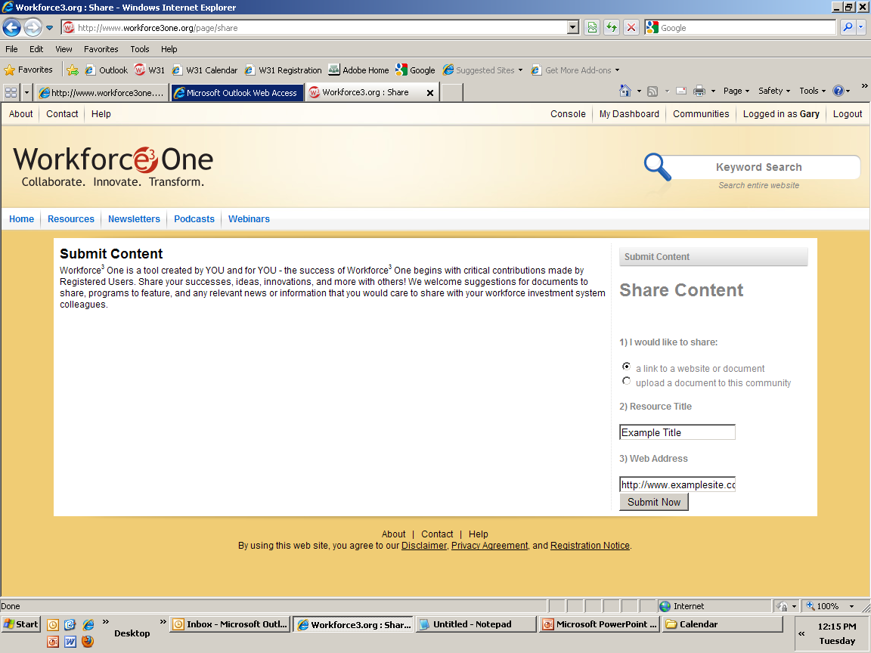
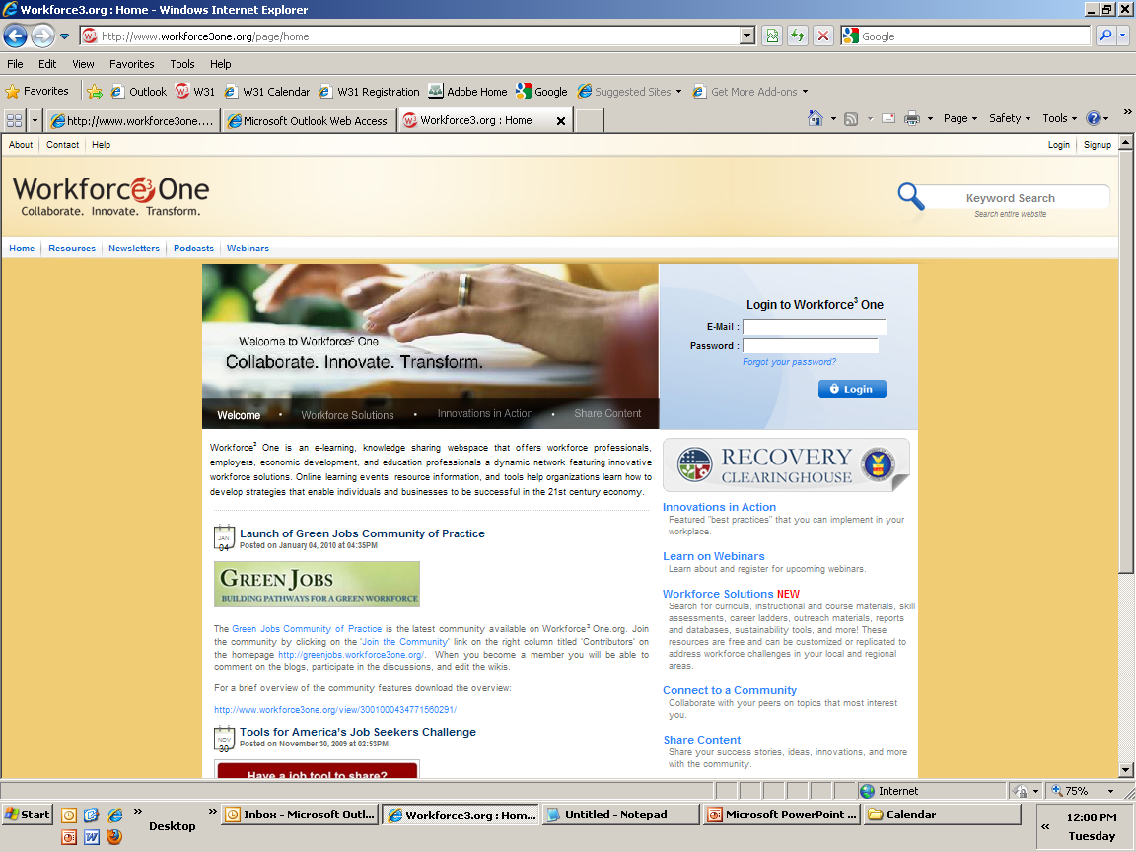


Share Your Ideas with Your Peers!
You have the option to submit content for review by uploading the resource or providing a link to the resource.
Share your demand-driven
strategic plans, models,
innovations, resources, and ideas!

Slide 32
Access to Webinar Resources
WEBINAR RESOURCES:
Recordings and transcripts are available within 2 business days after the event.

Slide 33
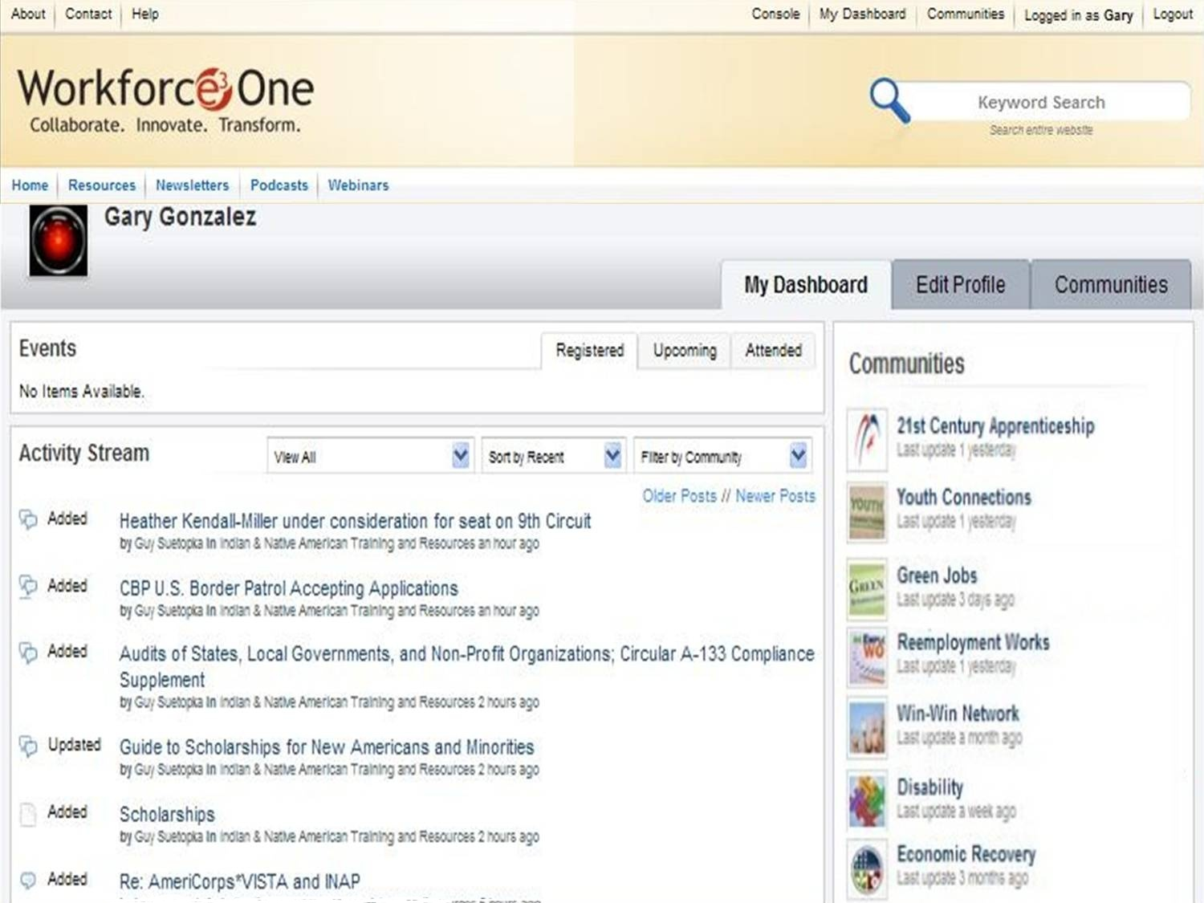
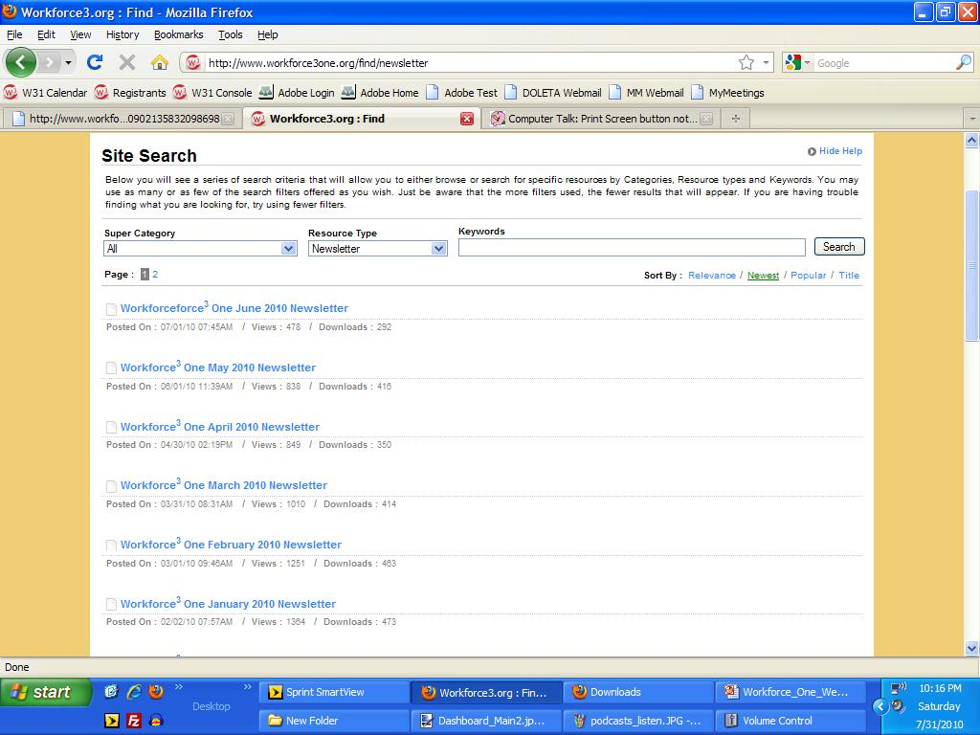
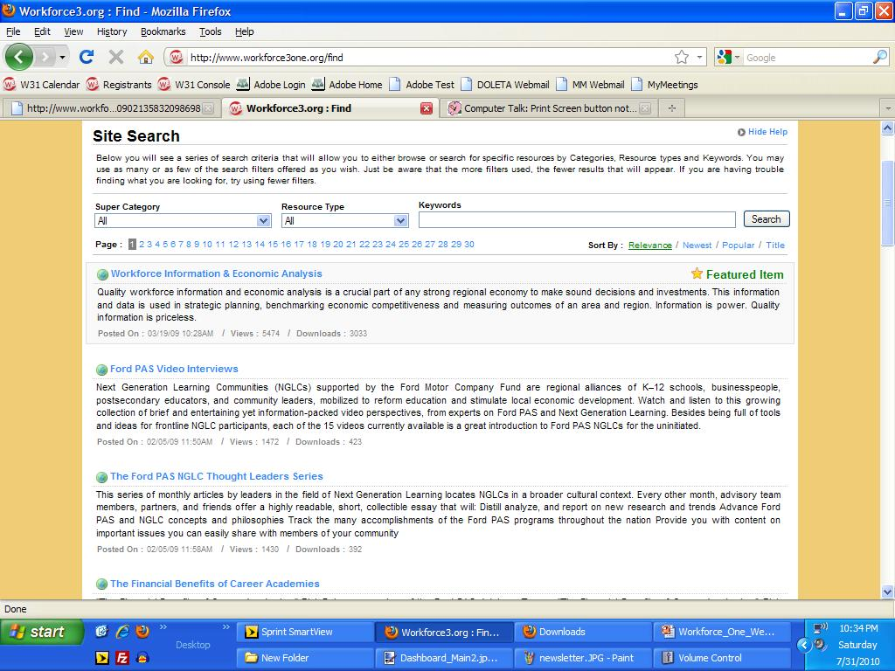
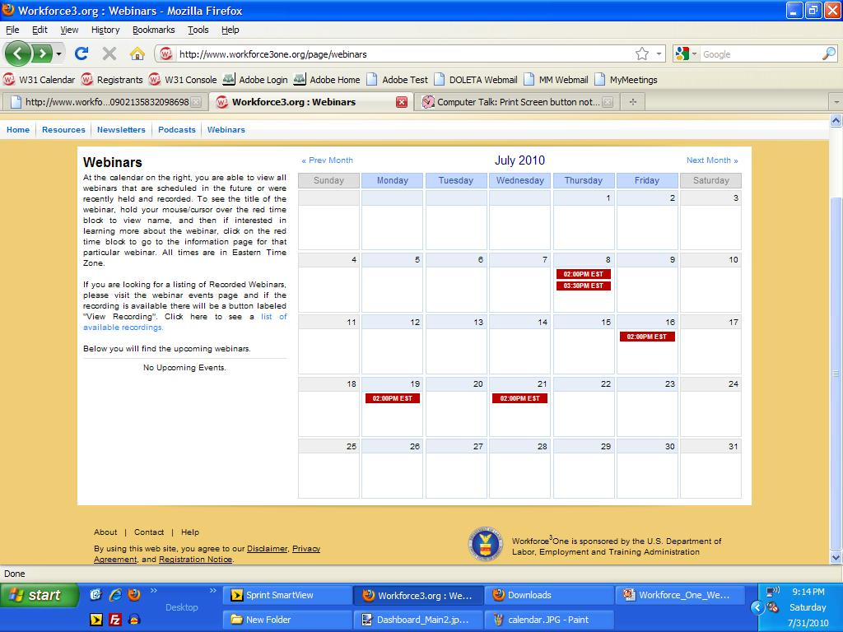
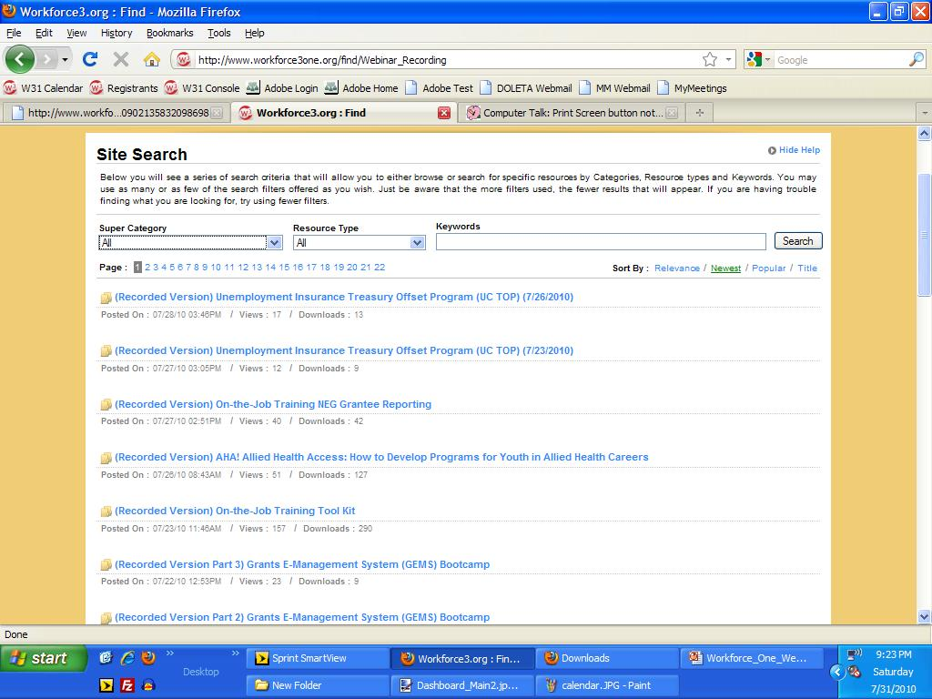
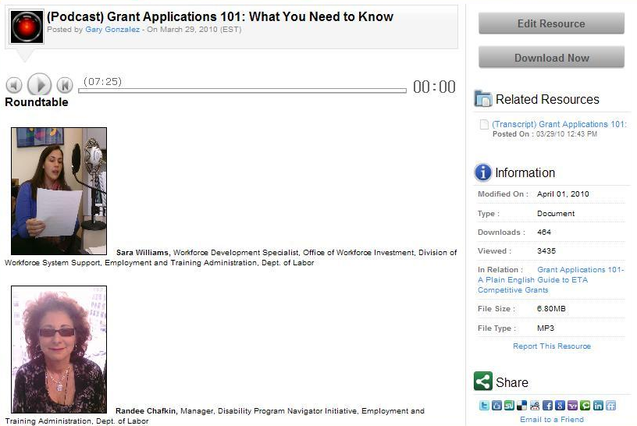
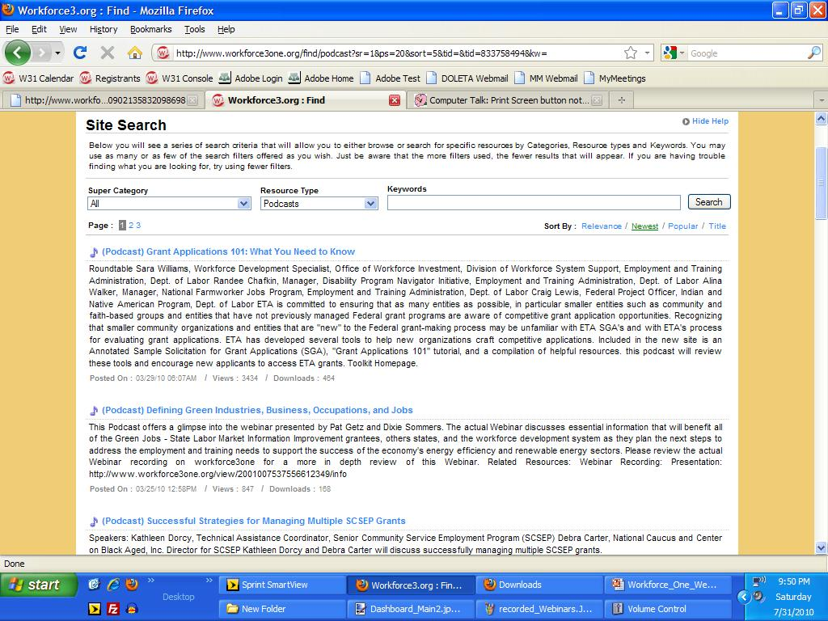
Stay Informed, Get Connected!

Slide 34
For more information about the Workforce Investment System:
  Visit www.careeronestop.org
  Call 1-877-US2-JOBS
THANKS!
www.workforce3one.org

