Slide 1


National Farmworker Jobs Program:
Case Management for Higher Performance Outcomes
Wednesday, July 25th, 2:00-3:00pm EST

Slide 2
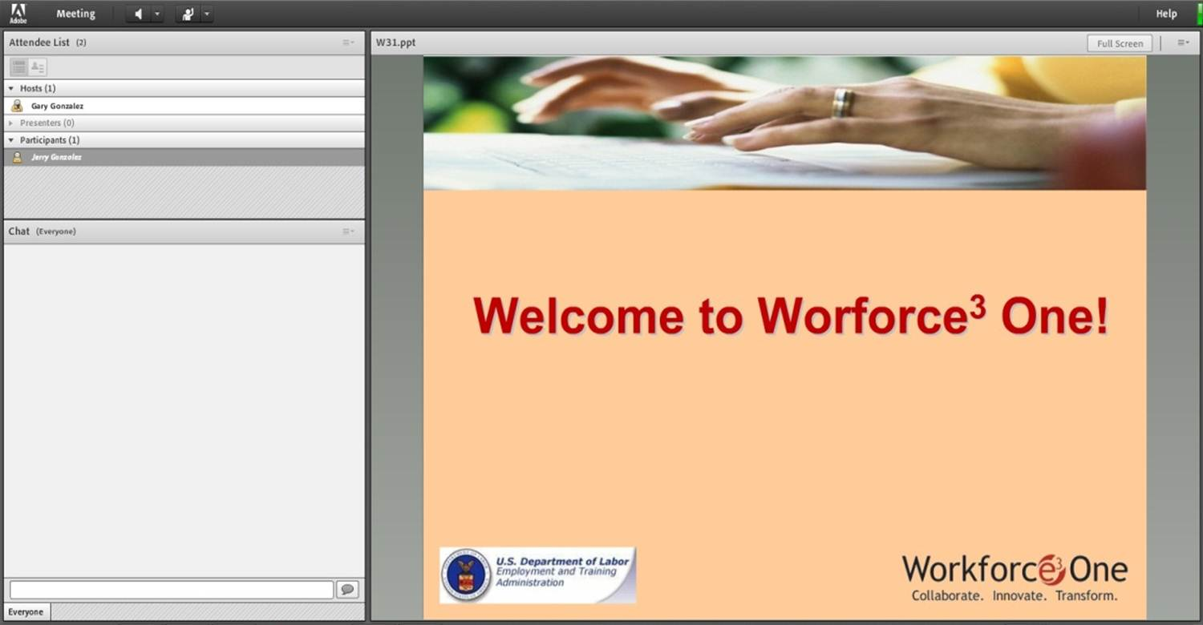




Welcome to Workforce³ One!

Slide 3
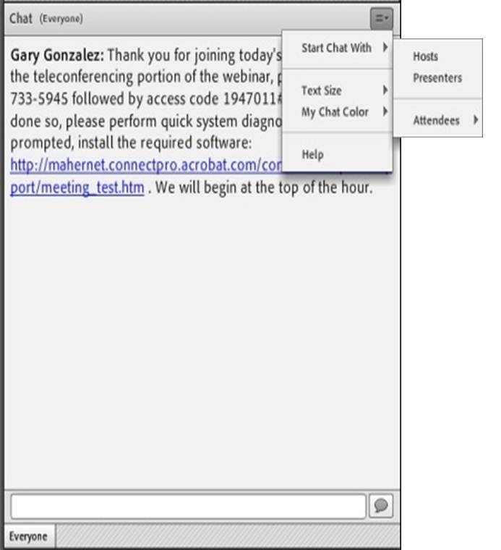
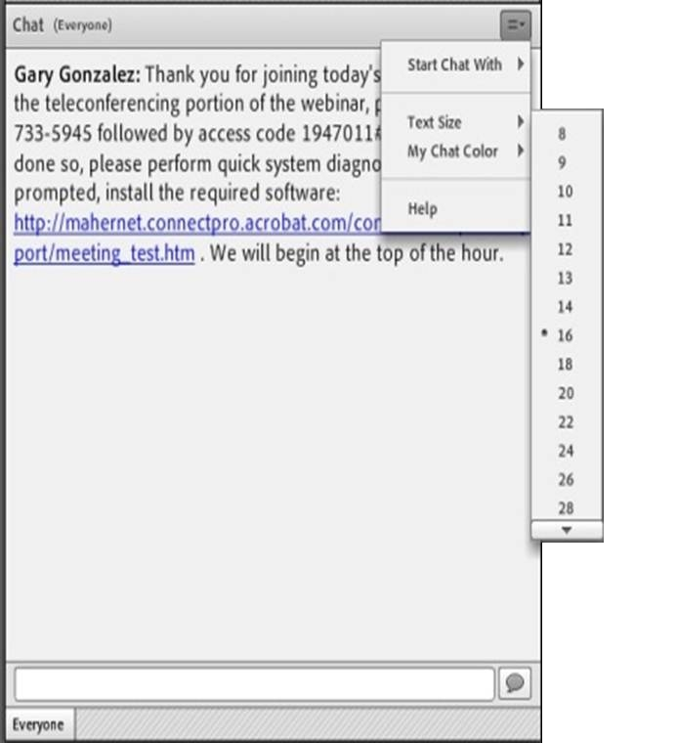
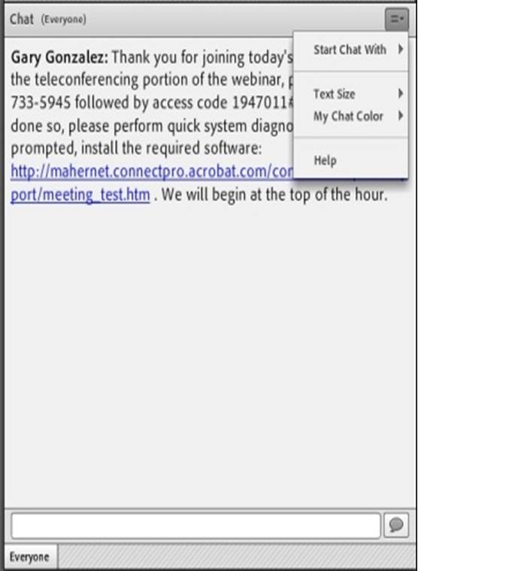
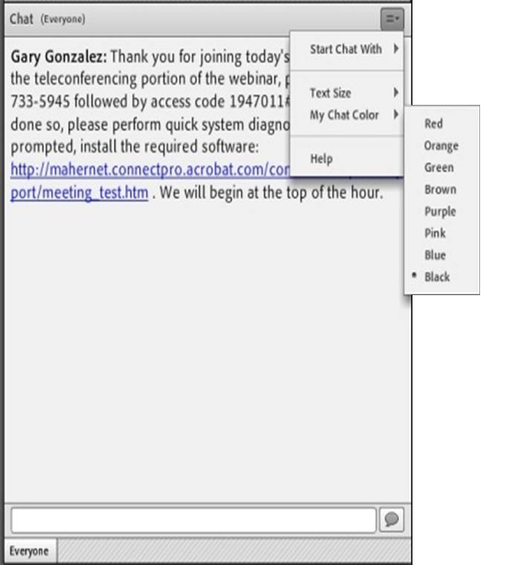
Submitting Questions: Open Chat
Drop-Down Menu
To submit a question, type the question in the text field and press your Enter/Return key.
  Please enter the name to whom the question is directed.
To send questions only to the presenters, select Presenters from the drop-down menu before pressing your Enter/Return key.
Change Text Size and Chat Color…
Text Field

Slide 4
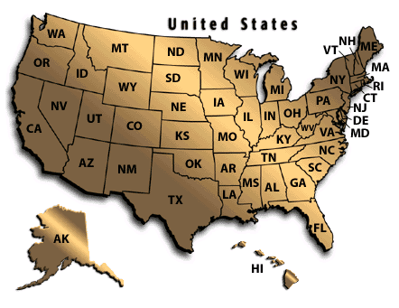
Practice
In the Chat Room, please type the name of your organization, your location, and how many people are attending with you today.

Slide 5
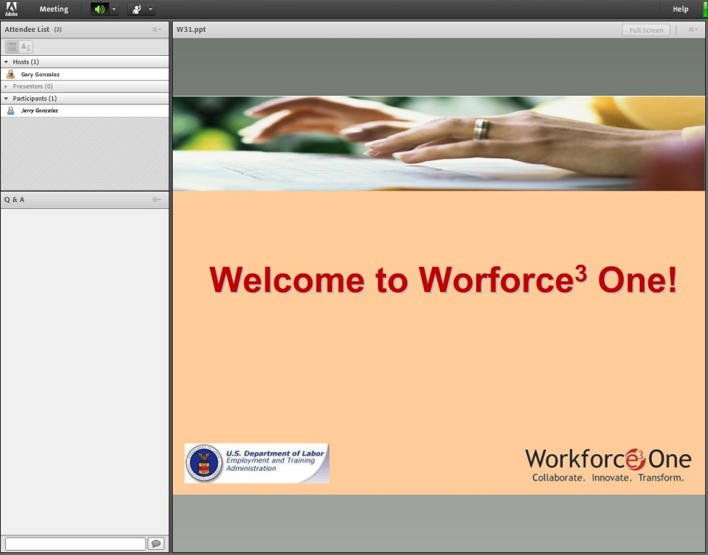
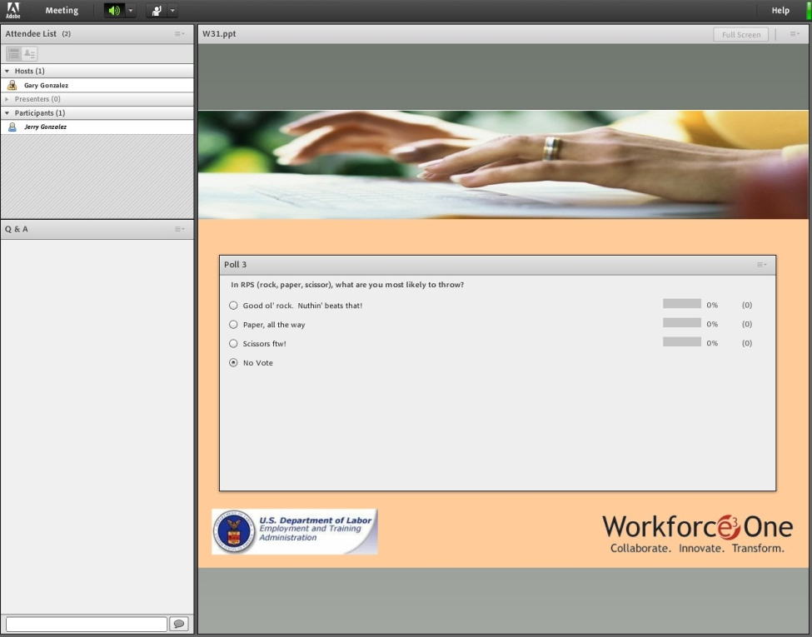


How To Participate in a Poll

Slide 6
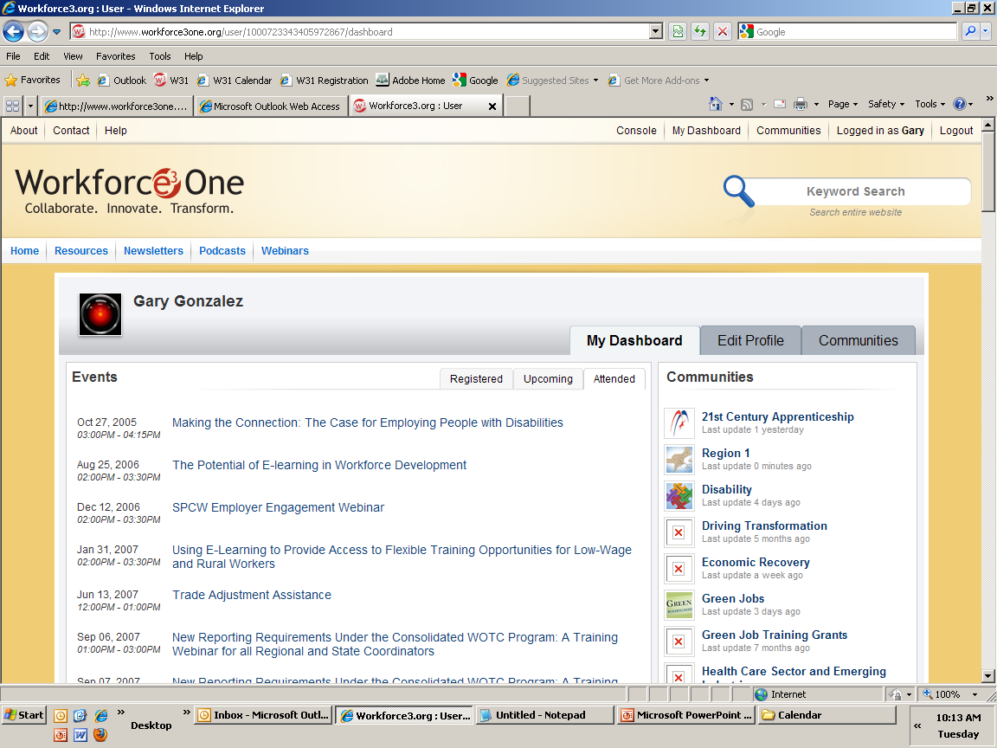
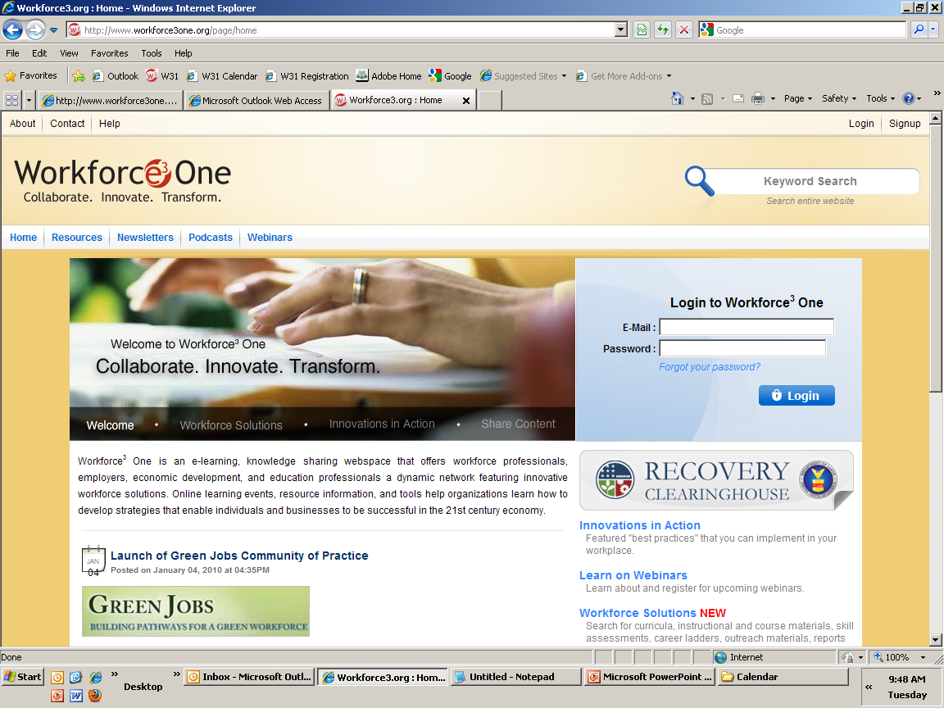
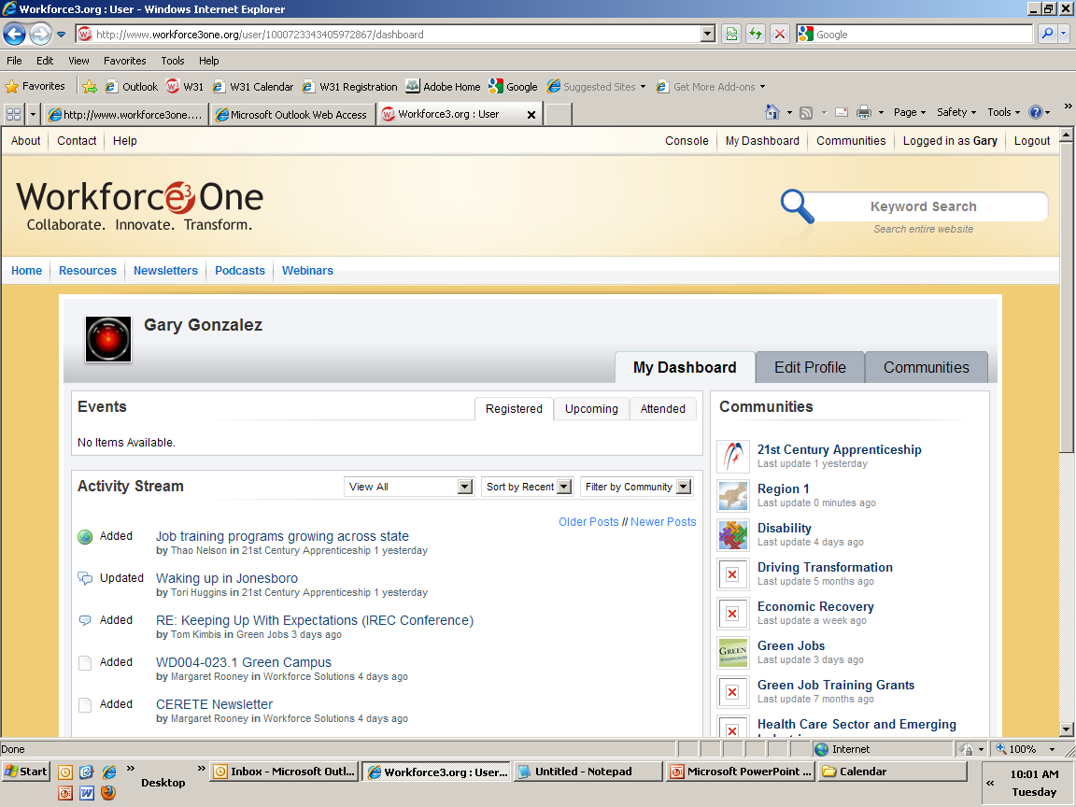



Access to Webinar Resources
WEBINAR RESOURCES:
Recordings and transcripts are available within 2 business days after the event.

Slide 7
Welcome
Amy Young
Unit Chief, Specialty National Programs Office of Workforce Investment Employment and Training Administration

Slide 8

Participant Poll
How long have you worked with the NFJP?
  Less than 1 year
  1-5 years
  5-10 years
  10-15 years
  Over 15 years

Slide 9

Featured Speakers
Presenters
Jeanna Vaughn, Director, Workforce Development, Association of Farmworker Opportunity Programs
Christopher Huh, Program Manager, Eastern Maine Development Corporation
Sylvia Salazar Murphy, Client Service Representative, Motivation Education & Training, Inc.

Slide 10
Participant Poll
What is your primary role with the NFJP? [Please choose all that apply]
  Case Manager
  Outreach
  Job Development/Placement
  Administrative
  Director/Manager
  Other [Please type your role into the chat]

Slide 11
Presenter
Case Management with Farmworkers:
Christopher Huh
Program Manager,
Eastern Maine Development Corporation

Slide 12

Intro & Overview
The NFJP in Maine
Staff:
Chris Huh, Program Manager and Career Advisor (Eastern and Central)
Wendy Lord, Career Advisor (Northern Maine)
NFJP Eastern Maine Development Corporation

Slide 13
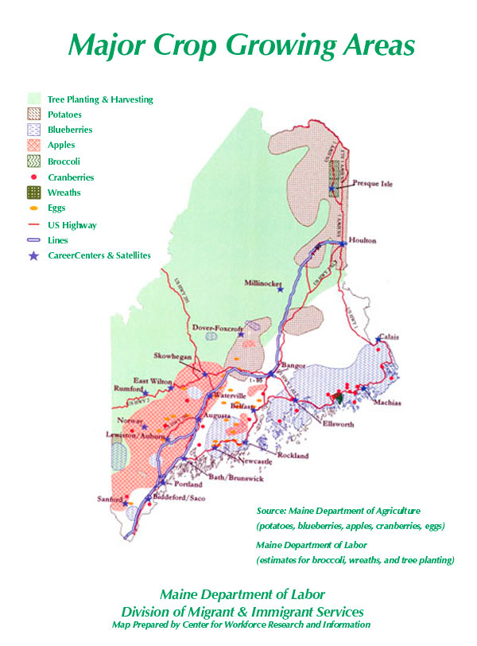
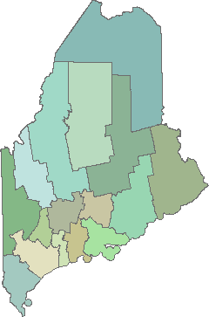
Intro & Overview
Service Area

Slide 14
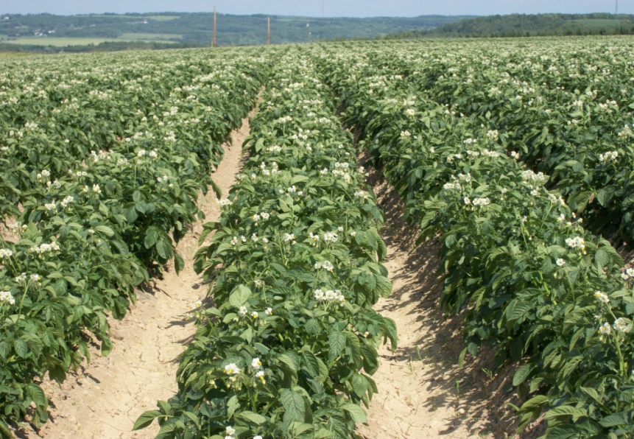
Intro & Overview
Maine’s Farmworker Population
Primarily works in potato, blueberry, dairy, broccoli, apple production, and on small diversified vegetable and livestock farms
Migrant workers (largely Latino, Haitian), as well as Seasonal. Most recent DOL 7-Qtr report shows 51% Seasonal and 48% Migrant for NFJP in Maine
NFJP Eastern Maine Development Corporation

Slide 15

Overview
Significant Barriers
Geographic isolation
Language (Spanish, Creole)
Poverty (low educational attainment, unemployment rates in target counties: Washington 10.2%, Piscataquis 10.3%, Somerset 9.9%, Aroostook 10.9%)
Goal: 165/year
NFJP Eastern Maine Development Corporation

Slide 16
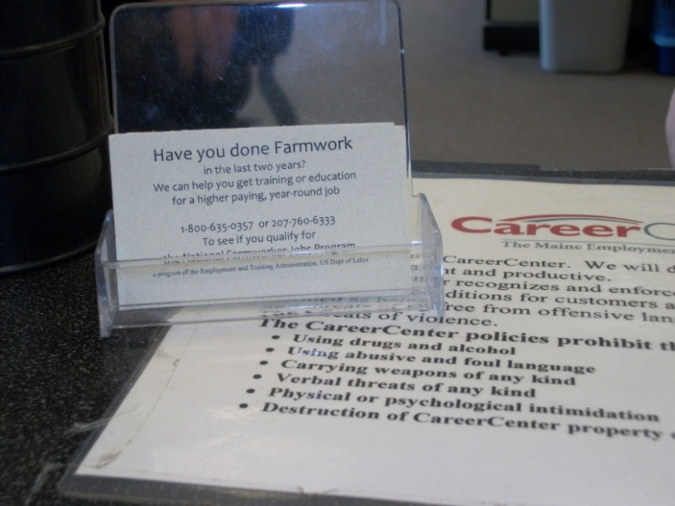
Outreach
Relationship Building
Adult Education
  Migrant Services (e.g. Maine Migrant Health Program; HEP; Health Council)
  One-Stop Partners:
  WIA Adult and Youth Programs
  Bureau of Employment Services
  Vocational Rehabilitation
  Youth Programs ( Job Corps, schools, Upward Bound)
NFJP Eastern Maine Development Corporation

Slide 17
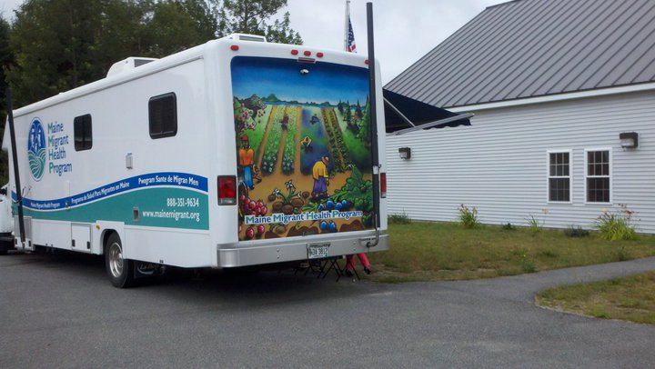
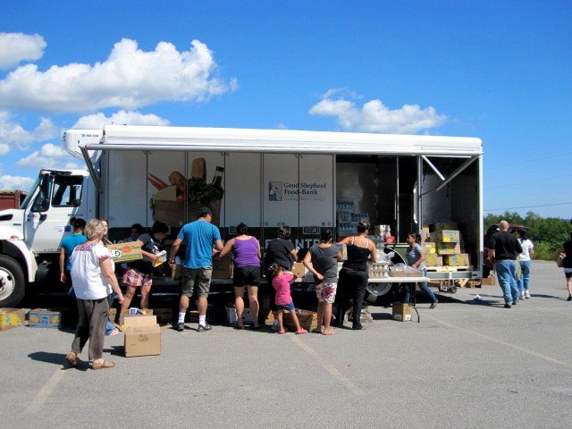
Outreach
Go to Where the Farmworkers Are!
‘Raker Center’ Model
10+ agencies set up temporary (~4 week) seasonal service center during blueberry harvest
Accessible to farmworkers, located in blueberry barrens
Photo credit: Luz Serrano, Maine Migrant Health Program
Photo credit: Luz Serrano, Maine Migrant Health Program

Slide 18
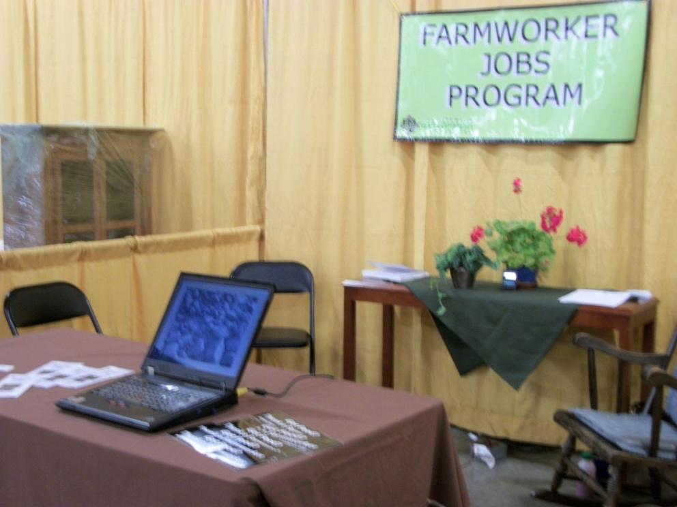
Outreach
Opportunities
Attend meetings with growers, employers (job fairs, Chamber meetings), and training providers (college fairs/orientations)
Presentations/Speaking engagements (financial aid workshops, Upward Bound, youth groups, summer camps, high schools, etc.)
NFJP Eastern Maine Development Corporation

Slide 19

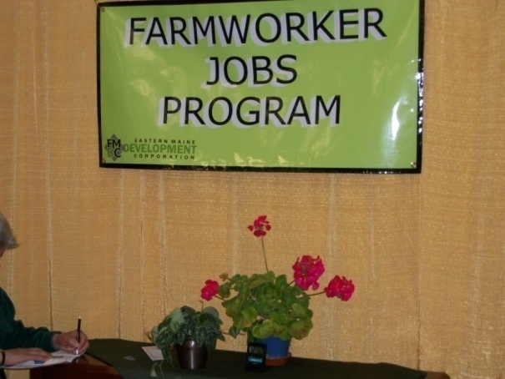
Outreach
Agricultural Community and Growers
Agricultural Fairs
Farm Days
Trade Shows
NFJP Eastern Maine Development Corporation

Slide 20
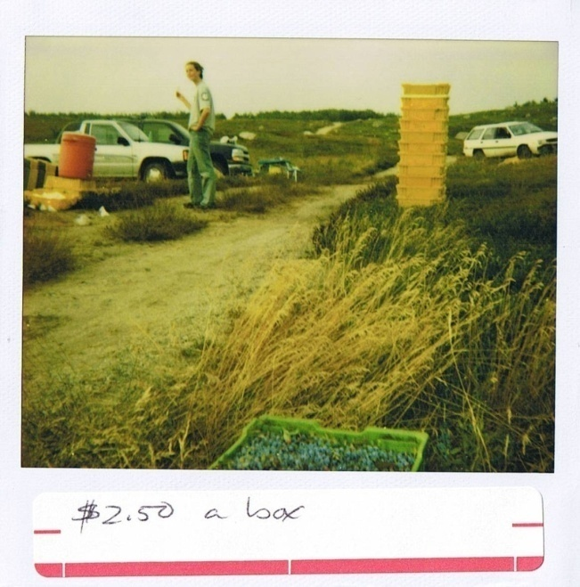
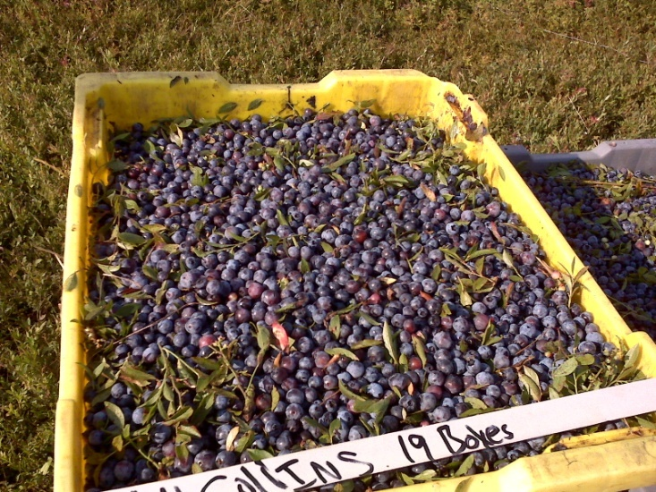
Outreach
Know Your Agricultural Economy
Changes facing large and small scale farmers
Increase in organic/local
Understand local crops/calendar
Attend local government meetings (Cooperative Extension, Crop Boards, etc.)
TV-radio Ag Reports
NFJP Eastern Maine Development Corporation

Slide 21
Assessment
Formal
Interviewing, Needs Assessments
Basic Skills: CASAS Reading and Math
O*NET activities: Interest Inventory, Transferable Skills; www.mynextmove.org
Labor Market Information
  Maine Center for Workforce and Information: http://www.maine.gov/labor/cwri/ for High Growth, In-Demand occupations
Past Educational Experience, Transferable Skills

Slide 22
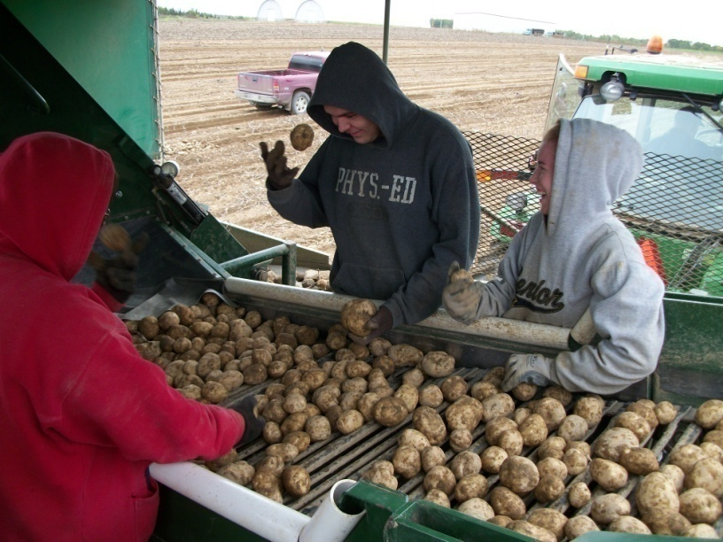
Assessment
Informal
Actively Listen: Take Time to Talk
Create Relaxed Setting for Meeting Participants
Be Flexible. Meet in Participant’s Comfort Zone, Accommodate Work/Family Schedule
NFJP Eastern Maine Development Corporation

Slide 23
Developing an Effective IEP
Individualized Service Strategy
General Characteristics
Participant-Centered “I will not work harder than you do at your success. Your life is yours; you will have whatever you make of it.” - Wendy Lord, EMDC Career Advisor
Involves Co-enrollment, Leveraging of Resources
Up-dated and Reviewed Regularly
Goal is Employability: “If you want to be an opera singer, learn to type” - Barbara Bagri, opera singer / school teacher . In other words, pursue your dreams, but you’ll need to eat.

Slide 24
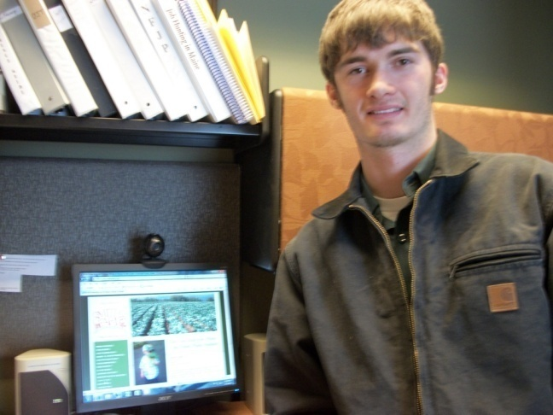
Developing an Effective IEP
Individualized Service Strategy
Basic Components:
Assessments Completed and Results Evaluated (CASAS, O* NET), Basic Skills (ESL, Math, etc.)
Goal with LMI Wage Attached
Degree Planning, OJT plan
Blake, NFJP Participant, Electrician

Slide 25
Developing an Effective IEP
Individualized Service Strategy
Basic Components (continued):
Co-enrollment Commitments (WIA, etc.)
Financial Aid Awards
Other Considerations: Health, Transportation, Child Care, etc.
Time Frame for Goal Attainment
Scheduled Review

Slide 26
Developing an Effective IEP
Individualized Service Strategy
Challenges Encountered:
Length of Time for Degree Completion
Geographic Distance from Training Providers
Co-enrollment: Benefits and Challenges

Slide 27

Rapport with Participants
Practices:
Sharing Stories to Develop Rapport with Participant: “If participant feels that you have somehow been where they are, that will be a good relationship!”
Develop Trust
Build Relationship
NFJP Eastern Maine Development Corporation

Slide 28
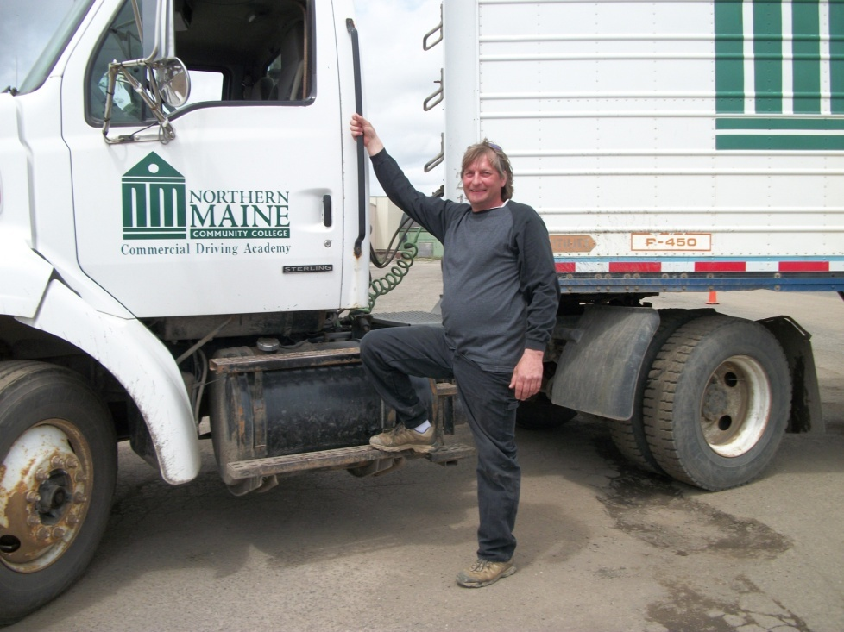
Rapport with Participants
Practices:
Attend Graduations of your Participants, Send Cards
90-Day Status Update
Low/no Cost Activities: Workshops, Resumes, Informational Interviews, Job Leads
Co-enrollment
NFJP Eastern Maine Development Corporation

Slide 29
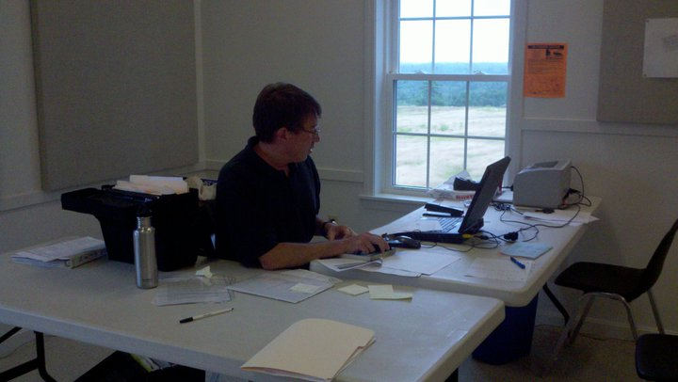
Rapport with Participants
New Practices
Social Media (Facebook, Blogs, etc.)
Poll: Has Your Program Successfully used Social Networking (Facebook, etc.) in Outreach and or to Connect with Participants?
  Yes, it is a Regular Practice
  Sometimes/Just Starting To Use It
  Never
NFJP, Eastern Maine Development Corporation

Slide 30
Presenter
Job Search and Placement:
Sylvia Salazar Murphy
Client Service Representative, Motivation Education & Training, Inc.

Slide 31
Overview
The NFJP in Texas
M.E.T. Texas Field Offices
Crystal City - Mr. Frailan Sendejo
Eagle Pass - Ms. Hilda Robles
Endinburg & Weslaco STC - Ms. Carmen Salinas
El Paso - Mr. John Ballejo
Fabens - Mr. Saul Portillo
Harlingen - Ms. Sylvia Salazar Murphy
Laredo - Mr. Lauro Garcia
Mission - Mr. Ruben Femat
Plainview - Ms. Irene Favila
Weslaco One Stop - Ms. Ramona Solis
For addresses and phone numbers refer to:
www.metinc.org

Slide 32
Overview
Crops
Plains: cotton, sorghum, corn, pumpkin, wheat, alfalfa, cucumbers, onions, peanuts, watermelon
Winter Garden Area : spinach, red beets, watermelon, melons, potatoes
Far West: lettuce, pecans, peppers, onions, melons, cabbage, alfalfa, cotton, corn, pumpkin, squash, wheat
Rio Grande Valley: cotton, sorghum, grain, greens, carrots, melons, cabbage, citrus, strawberries

Slide 33
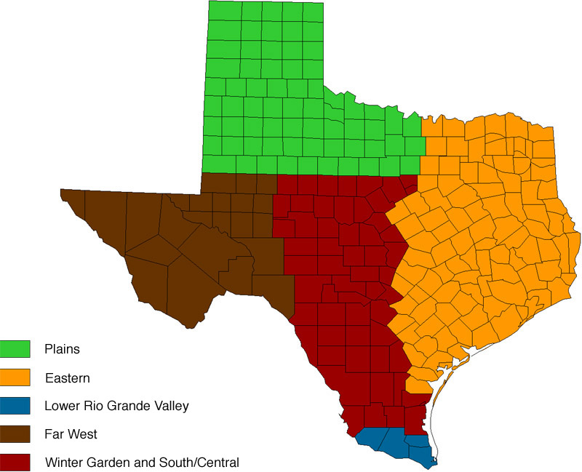
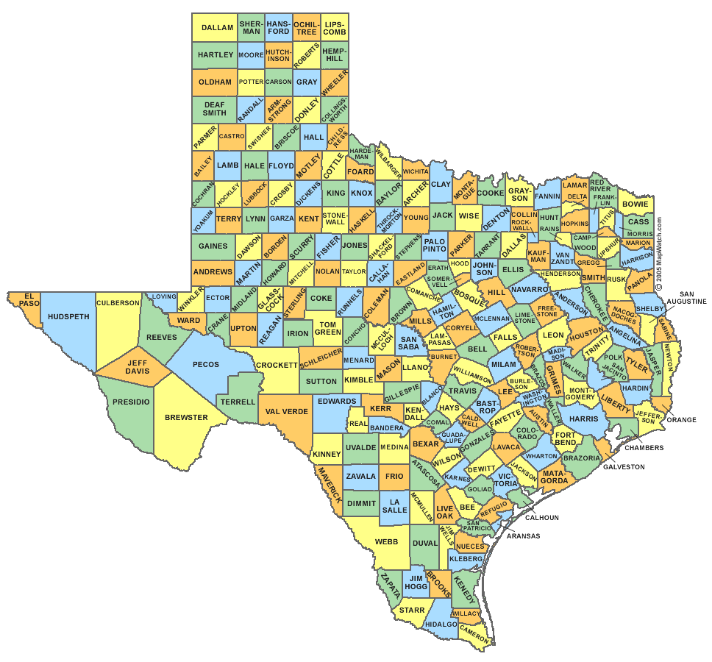
Overview
Production Regions of Texas
Counties of Texas

Slide 34
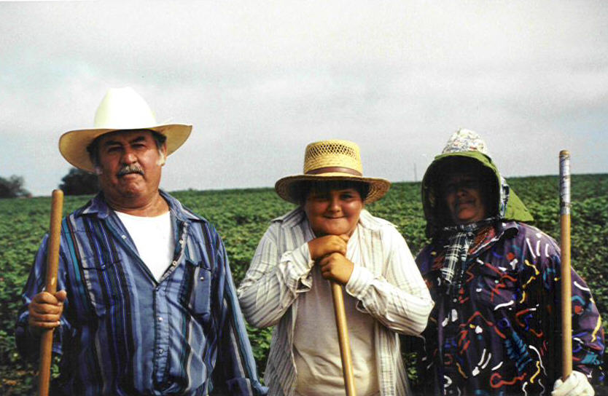
Overview
Farmworker Population
Migrant worker - 42.1%
Seasonal Worker - 57.9%
Majority of our Farmworkers are Hispanic (96.4%)
*Texas Unemployment Rate is 7.0% as of June 2012

Slide 35
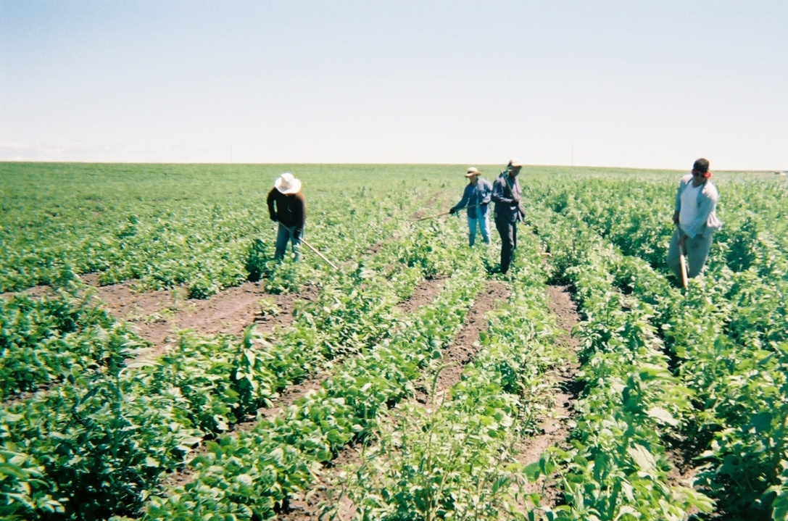
Overview
Significant Barriers
Language Skills
Lack of Education
Migrant
Transportation
Poverty

Slide 36

Job Search and Placement
Starting the Job Search Phase
Client’s last day of training does not end the responsibility of the case manager
Always keep focus on the client’s Individual Employment Plan (IEP)
Keep an open dialogue with the client at all times
Understand your client’s strengths and weaknesses

Slide 37
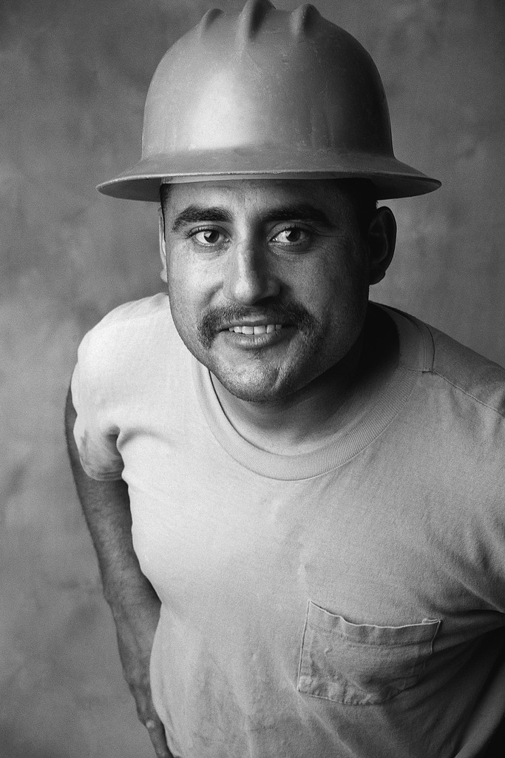
Job Search and Placement
Client’s Barriers to Employment
By acknowledging the strengths and weaknesses of our clients, we will assist them to become successful employees in their training fields
Case managers must teach and encourage clients to always emphasize their employment strengths(i.e. resume)
Clients must be reminded that there are opportunities to remove or overcome their employment barriers

Slide 38

Job Search and Placement
Employment and Placement:
Know the diverse job titles for the trainings in which clients are enrolled
Be familiar with local workforce partners

Slide 39

Job Search and Placement
Diversity in Employment
Keep an open mind for different job titles for more client opportunities for success
Research the varies job titles associated with the training titles (i.e. Labor Market Index and O*net)
Present the different occupations or job titles to the client

Slide 40

Job Search and Placement
Local Workforce Partners
Be familiar with workforce monthly calendar (i.e. job readiness classes and update client’s profile)
Know your local employment search engines (i.e. staffing agencies)

Slide 41
Job Search and Placement
Useful Resources in Local Area:
  www.indeed.com
  www.workintexas.com (Texas Workforce Commission site)
  www.southtexasjobs.com (local site powered by Monster.com)
  What are Your Local Resources?

Slide 42

Question and Answer Period
Please enter your questions into the Chat Room!

Slide 43
Speakers’ Contact Information
Amy Young, ETA
Website: www.doleta.gov/msfw
E-mail: young.amy@dol.gov
Phone: 202-693-2758
Christopher Huh, EMDC
Website: www.emdc.org
E-mail: CHuh@emdc.org
Phone: 207-610-1521
Sylvia Salazar Murphy, MET
Website: www.metinc.org
Email: harlingen@metinc.org
Phone: 956-364-4984
Jeanna Vaughn, AFOP
Website: www.afop.org
E-mail: vaughn@afop.org
Phone: 202-828-6006 ext. 109

Slide 44
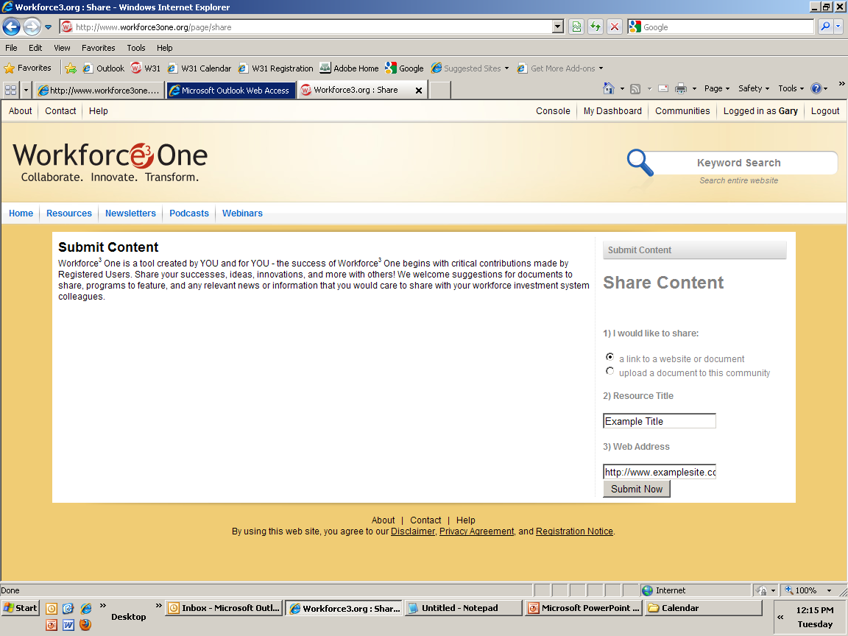
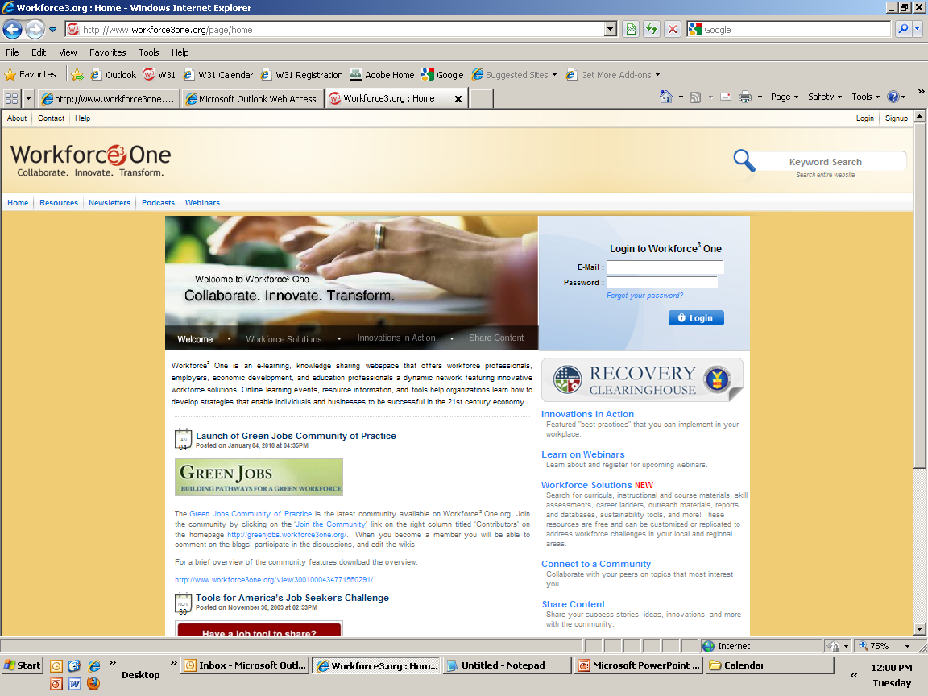


Share Your Ideas with Your Peers!
You have the option to submit content for review by uploading the resource or providing a link to the resource.
Share your demand-driven
strategic plans, models,
innovations, resources, and ideas!

Slide 45
Access to Webinar Resources
WEBINAR RESOURCES:
Recordings and transcripts are available within 2 business days after the event.

Slide 46
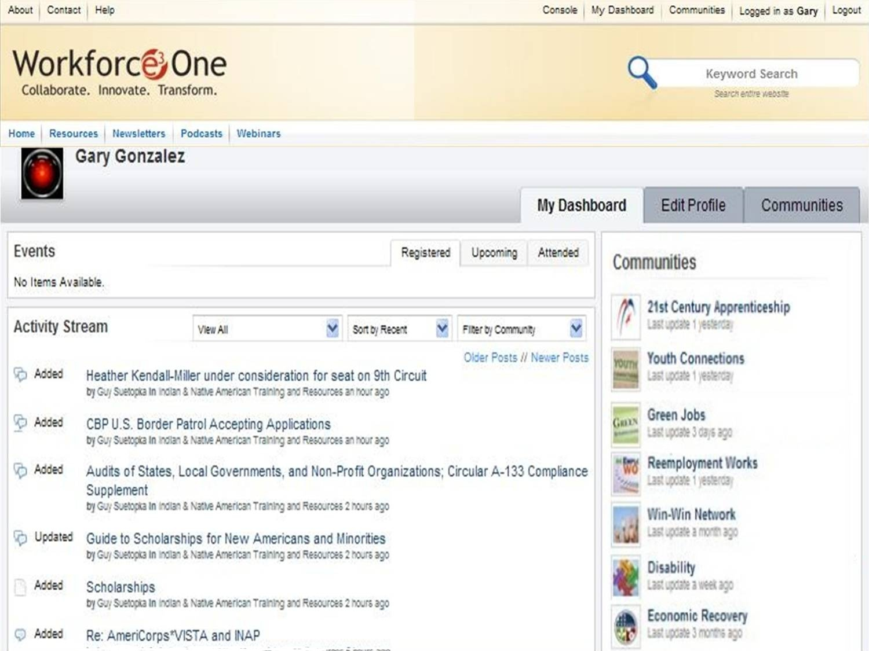
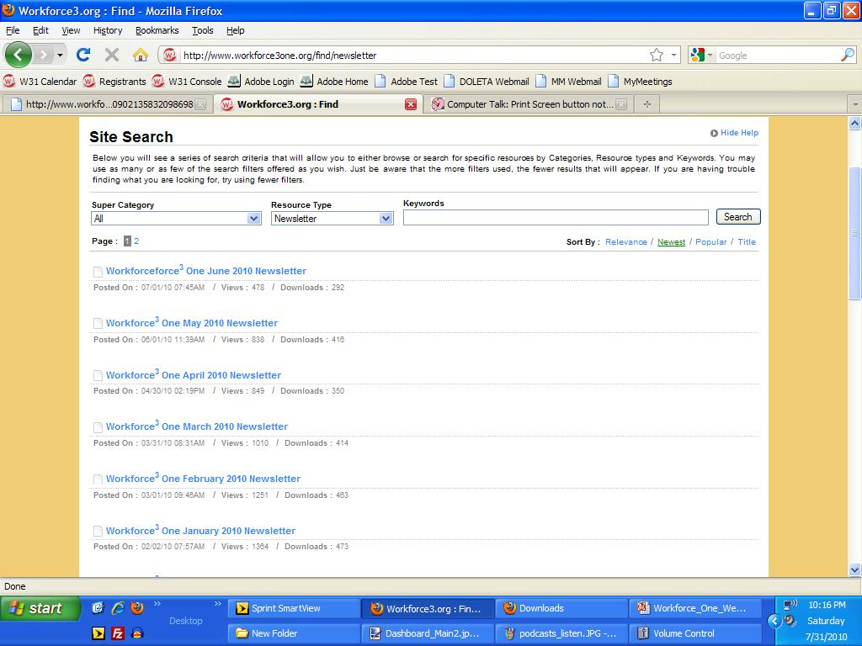
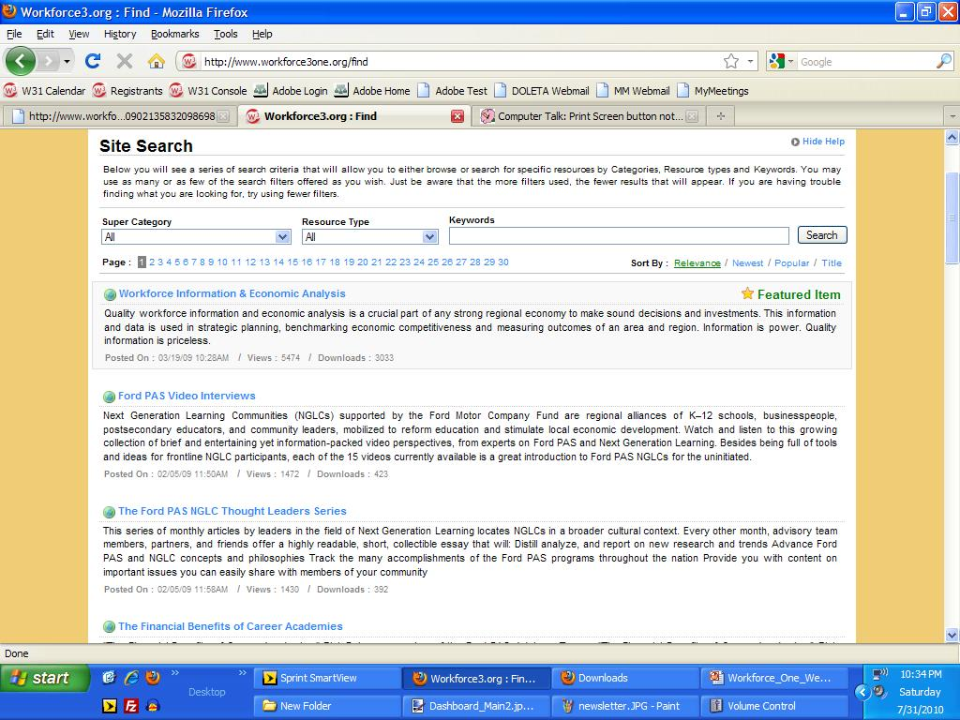
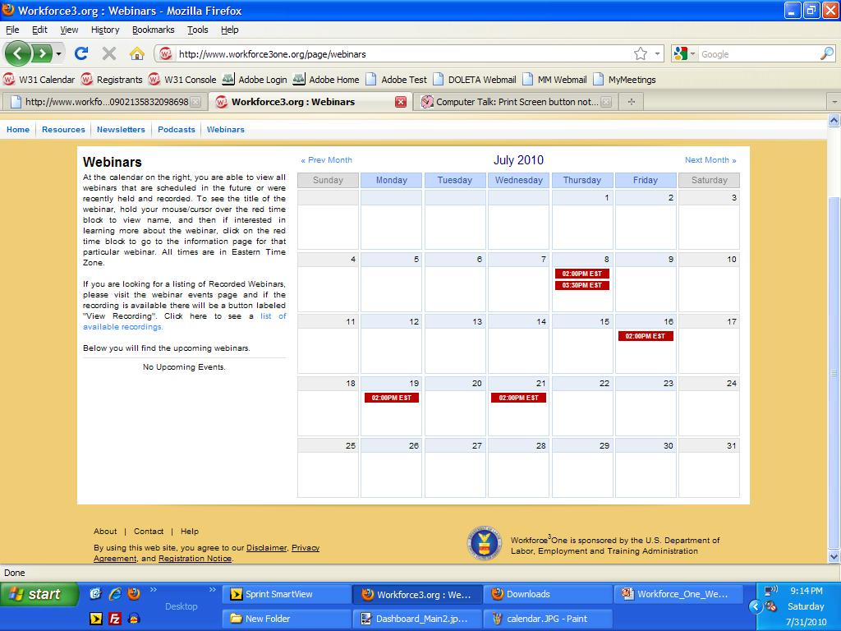
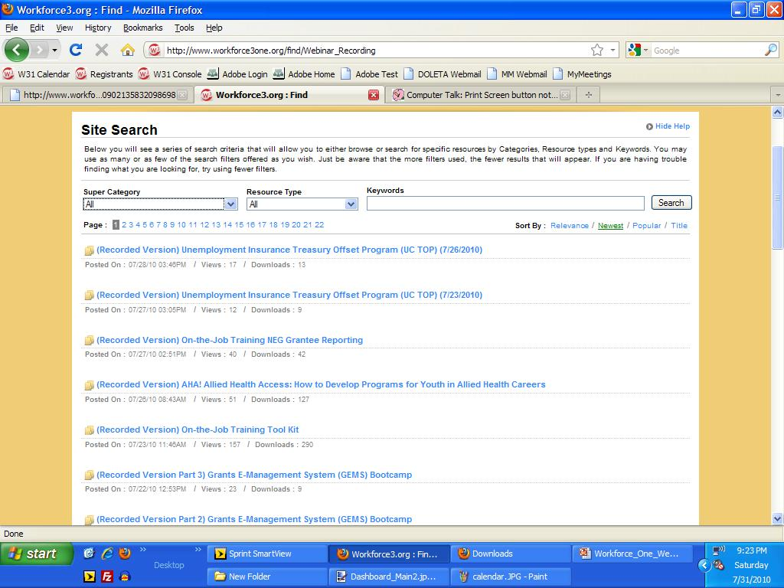
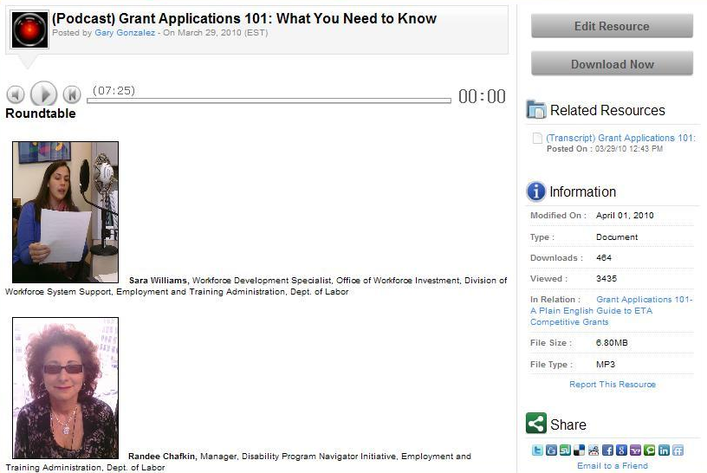
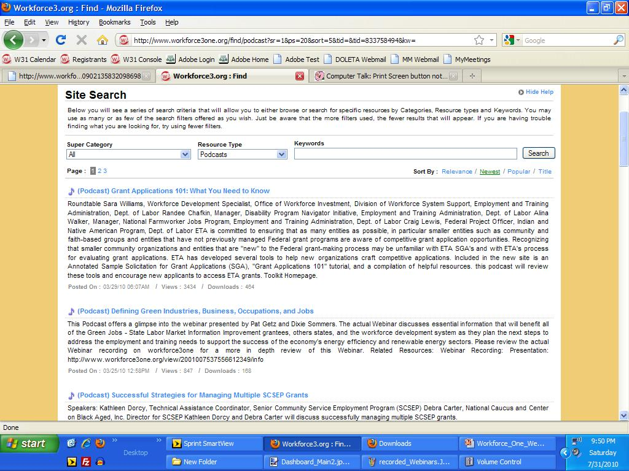
Stay Informed, Get Connected!

Slide 47
For more information about the Workforce Investment System:
  Visit www.careeronestop.org
  Call 1-877-US2-JOBS
THANKS!
www.workforce3one.org

