Slide 1
Agricultural Upgrades: New Opportunities in Agricultural Careers for Farmworkers
Webinar Date: July 25, 2013
Presented by:
Office of Workforce Investment
U.S. Department of Labor
Employment and Training Administration

Slide 2
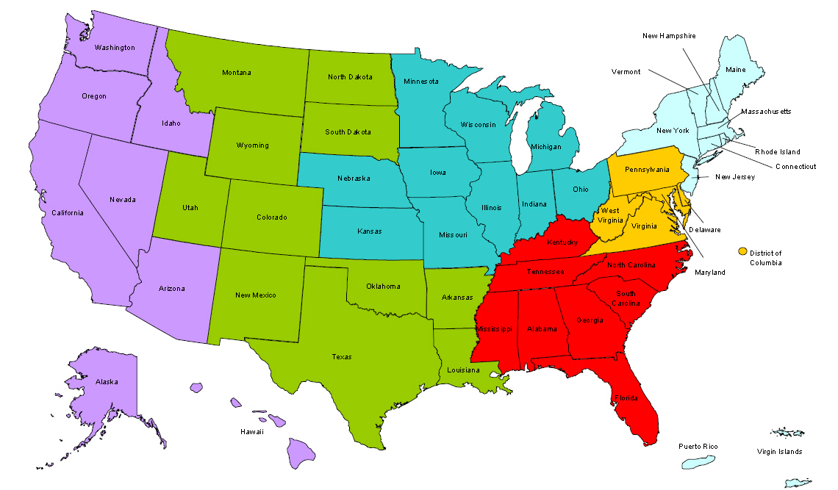
Where are you?
Enter your location in the Chat window – lower left of screen

Slide 3
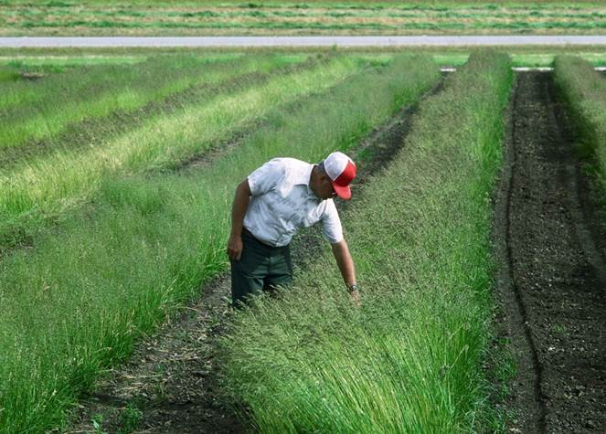
Welcome!
Our focus today:
Explore career ladders within the agricultural industry.
ETA Resources:
How to find industry jobs and identify the skills needed for success
NFJP Grantees:
Learn about strategies for agricultural skills upgrades that benefit employers and NFJP participants.

Slide 4
Polling Question Title
Did you attend or watch our last webinar on Labor Market Information? If you answer Yes, let us know in the chat which LMI resources you’ve used so far!
Choose the answer that best reflects you (or your group):
Yes
No

Slide 5
Moderators/Presenter
Moderator: Amy Young
Title: Unit Chief, Special National Programs
Organization: Employment and Training Administration
Presenter: Pam Frugoli
Title: O*NET/Competency Assessment Team
Organization: Employment and Training Administration

Slide 6
Presenters
Presenter: Patricia Stovall
Title: Sr. Director, Training & Employment Programs
Organization: PathStone Corporation
Presenter: Barbara B. Coleman
Title: State Director, Training and Employment Programs
Organization: Telamon-South Carolina

Slide 7
Polling Question Title
Do you currently have a formal “agricultural upgrade” program? If your answer is Yes- type the jobs you train for in the chat.
Choose the answer that best reflects you (or your group):
Yes, we have a formal program
We don’t have a formal program but we do some skills upgrades in Ag.
Not yet!

Slide 8
Potential Career Pathways in Farm Work
Pam Frugoli
O*NET/Competency Assessment Team Lead
USDOL Employment and Training Administration

Slide 9
Farmworkers, plus other agricultural occupations to consider

Slide 10
Industry and Occupation
There are agricultural industries and agricultural occupations
Although they do overlap, they do not include exactly the same workers
Industry groups similar types of business establishments
Occupation group workers by the type of work they perform
An accountant employed by a agricultural firm would be a agriculture industry employee, but does not work in an agricultural occupation

Slide 11
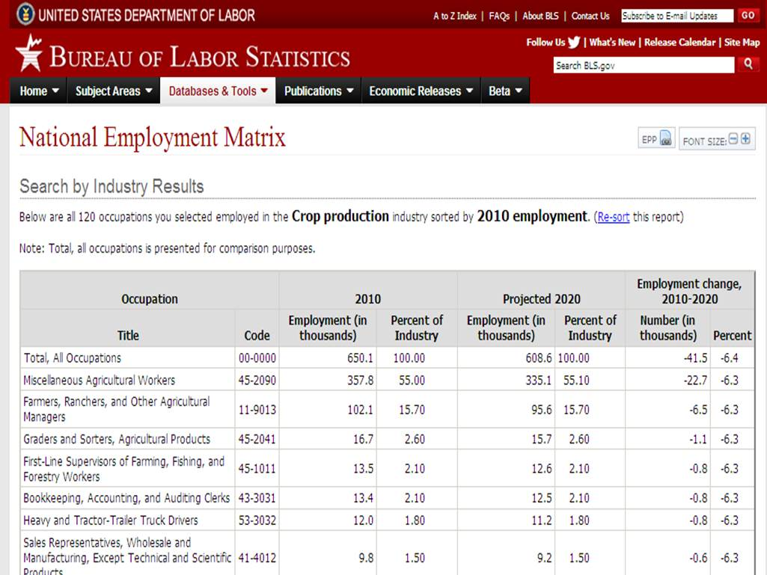
Industry staffing pattern for Crop Production

Slide 12
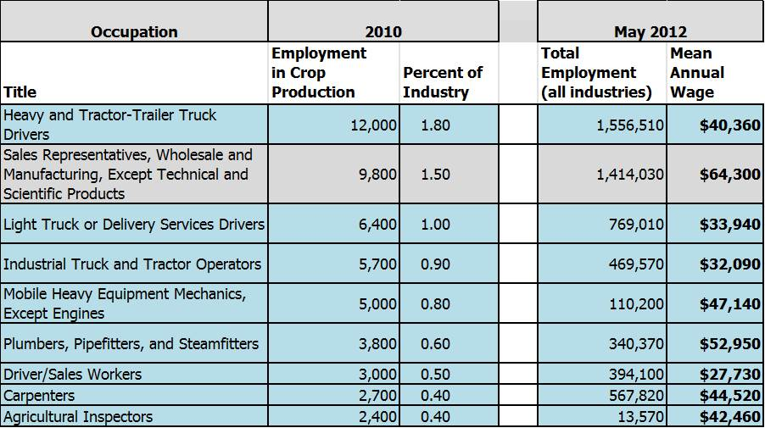
Other occupations to consider in the crop production industry

Slide 13
Where can you go to find more information about these careers?

Slide 16
Agricultural Equipment Operators
Also called:
Tractor Operator
Equipment Operator
Farm Hand
Farm Laborer
What they do:
Drive and control farm equipment to till soil and to plant, cultivate, and harvest crops. May perform tasks, such as crop baling or hay bucking. May operate stationary equipment to perform post-harvest tasks, such as husking, shelling, threshing, and ginning.
On the job, you would:
Adjust, repair, and service farm machinery and notify supervisors when machinery malfunctions.
Observe and listen to machinery operation to detect equipment malfunctions.
Irrigate soil, using portable pipes or ditch systems, and maintain ditches or pipes and pumps.

Slide 17
Agricultural Equipment Operators

Slide 18
Farm Equipment Mechanics & Service Technicians
Also called:
Mechanic
Service Technician
Tractor Mechanic
Agricultural Technician
What they do:
Diagnose, adjust, repair, or overhaul farm machinery and vehicles, such as tractors, harvesters, dairy equipment, and irrigation systems.
On the job, you would:
Record details of repairs made and parts used.
Reassemble machines and equipment following repair; test operation; and make adjustments as necessary.
Maintain, repair, and overhaul farm machinery and vehicles, such as tractors, harvesters, and irrigation systems.

Slide 19
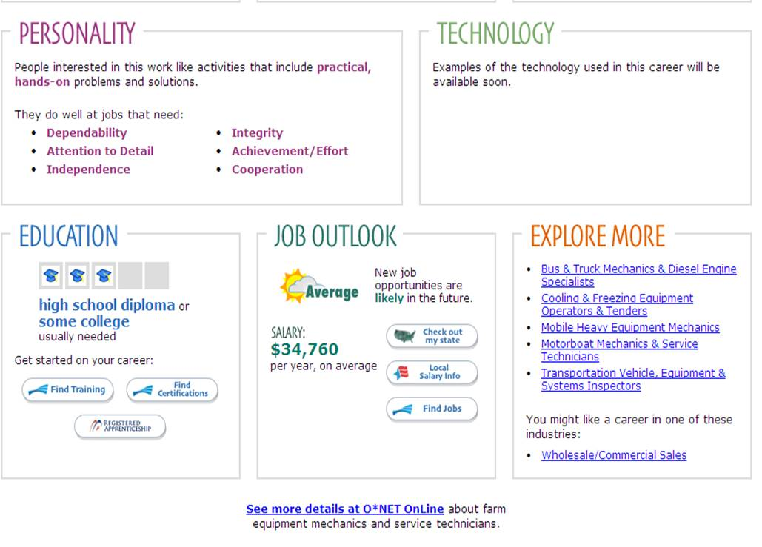
Farm Equipment Mechanics and Service Technicians Outlook and where they are employed

Slide 20
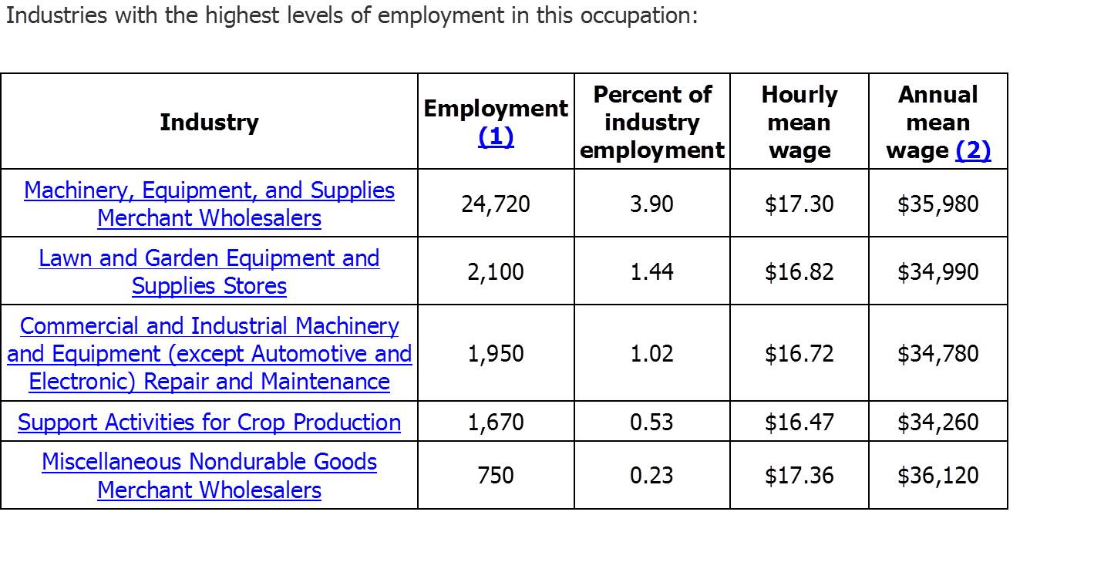
Farm Equipment Mechanics
http://www.bls.gov/oes/current/oes_stru.htm

Slide 21
Agricultural Inspectors
Also called:
Seed and Fertilizer Specialist, Grain Inspector, Meat and Poultry Inspector, Plant Protection Specialist
On the job, you would:
Inspect agricultural commodities or related operations, as well as fish or logging operations, for compliance with laws and regulations governing health, quality, and safety.
Inspect or test horticultural products or livestock to detect harmful diseases, chemical residues, or infestations and to determine the quality of products or animals.
Verify that transportation and handling procedures meet regulatory requirements.

Slide 22
Agricultural Inspectors

Slide 23
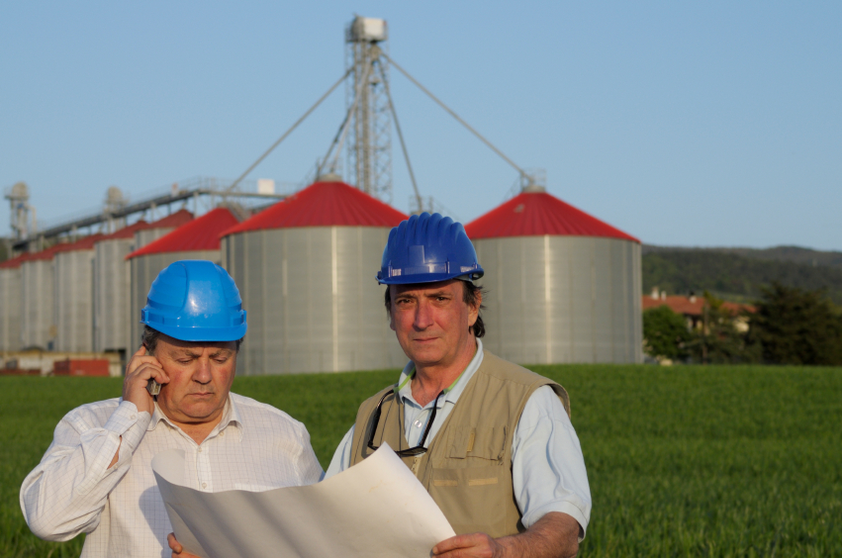
Farm & Home Management Advisors
Also called:
Extension Agent
Agricultural Extension Educator
Extension Educator
Family and Consumer Sciences Extension Agent
What they do:
Advise, instruct, and assist individuals and families engaged in agriculture, agricultural-related processes, or home economics activities
Instruct and train in product development, sales, and the use of machinery and equipment to promote general welfare
Includes county agricultural agents, feed and farm management advisors, home economists, and extension service advisors.
On the job, you would:
Collaborate with producers in order to diagnose and prevent management and production problems
Conduct classes or deliver lectures on subjects such as nutrition, home management, and farming techniques.

Slide 24
Farm and Home Management Advisors

Slide 25
USDA Cooperative Extension Service
http://www.nifa.usda.gov/Extension/index.html
Cooperative Extension Service offices are conveniently located in courthouses, post offices, or other local government buildings Extension Services
E-Extension
Local Extension Offices
State and National Partners

Slide 26
Buyers & Purchasing Agents, Farm Products
What they do:
Purchase farm products either for further processing or resale. Includes tree farm contractors, grain brokers and market operators, grain buyers, and tobacco buyers.
On the job, you would:
Purchase, for further processing or for resale, farm products such as milk, grains, or Christmas trees.
Negotiate contracts with farmers for the production or purchase of farm products.
Arrange for processing or resale of purchased products.

Slide 27
Buyers & Purchasing Agents, Farm Products
Sample of reported job titles:
Grain Merchandiser
Grain Buyer
Farm Marketer
Grain Division Manager
Grain Origination Specialist
Tobacco Buyer
Almonds Grower Representative
Buyer
Procurement Manager
Purchasing Agent

Slide 28
Outlook for Buyers, Farm Products

Slide 29
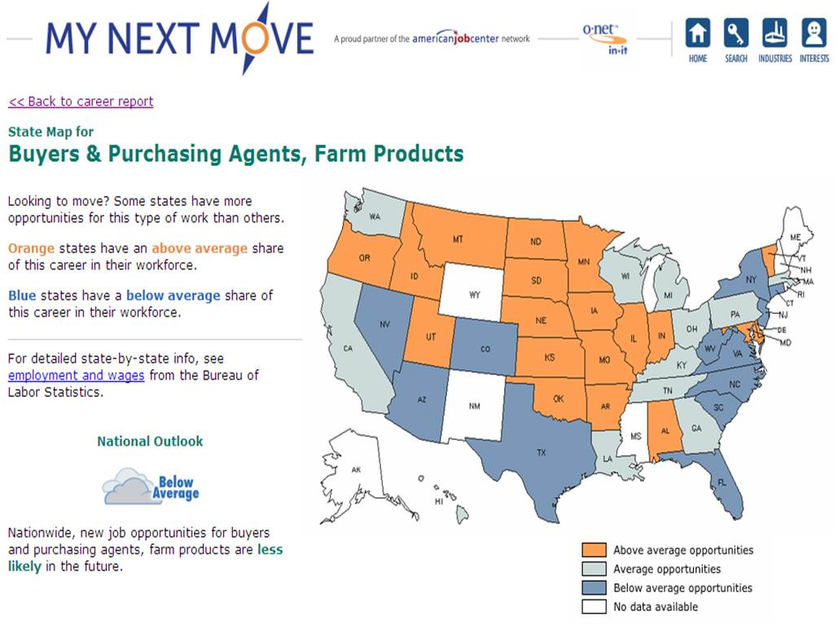

Slide 30
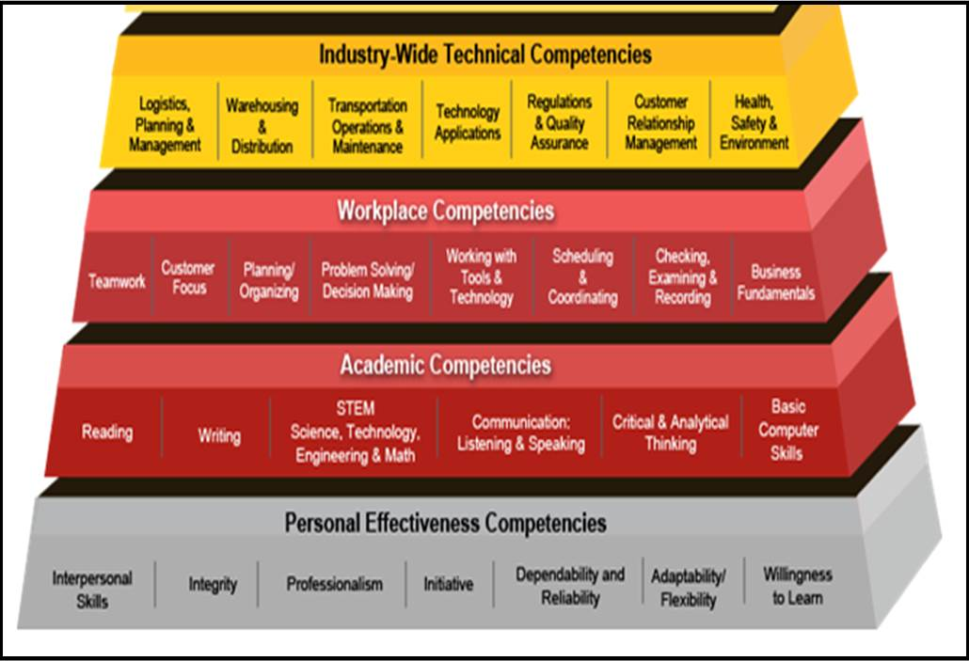
Competency model for Transportation, Distribution, and Logistics
www.CareerOneStop.org/CompetencyModel

Slide 31
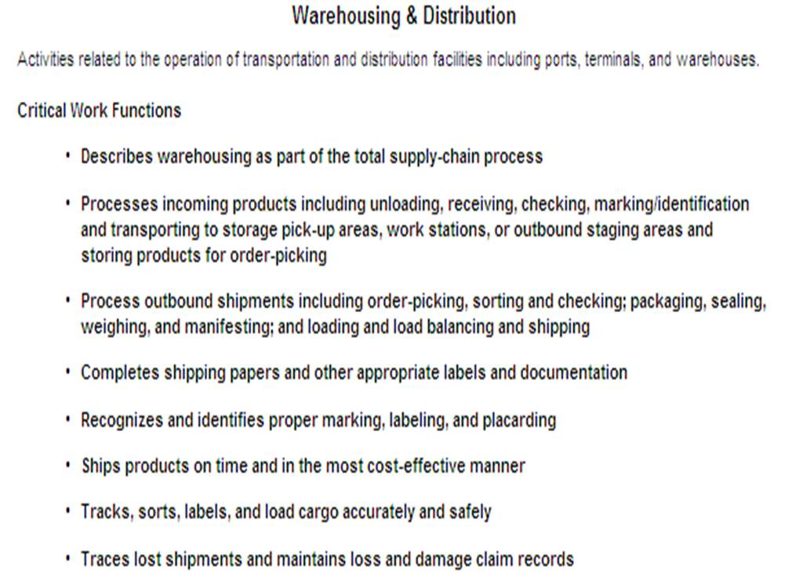
Specific competencies and related resources such as apprenticeship and certifications

Slide 32
Thanks!
Pam Frugoli O*NET/Competency Assessment Team Lead USDOL Employment and Training Administration
http://www.onetonline.org/
http://www.mynextmove.org/
http://www.miproximopaso.org/

Slide 33
AGRICULTURAL UPGRADES In South Carolina
TELAMON CORPORATION
Barbara Coleman
State Director, Training and Employment Programs
Telamon-South Carolina

Slide 34
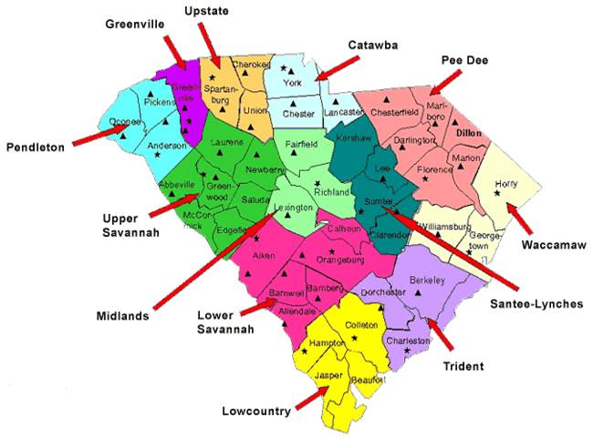
TELAMON-SOUTH CAROLINA OFFICE LOCATIONS

Slide 35
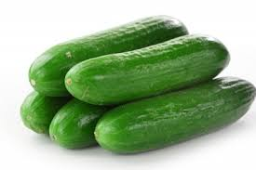

Slide 36
FARMWORKERS…

Slide 37
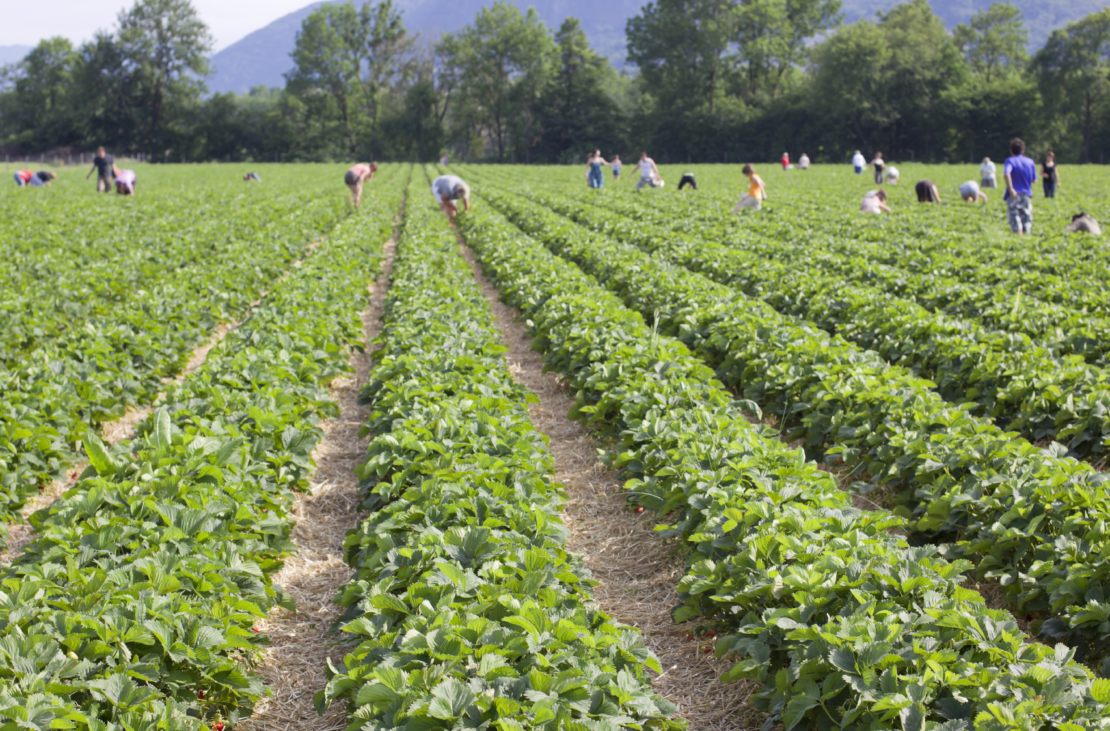
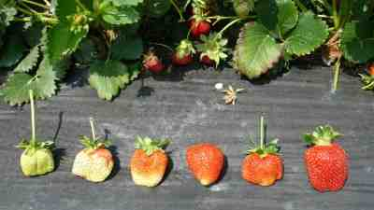
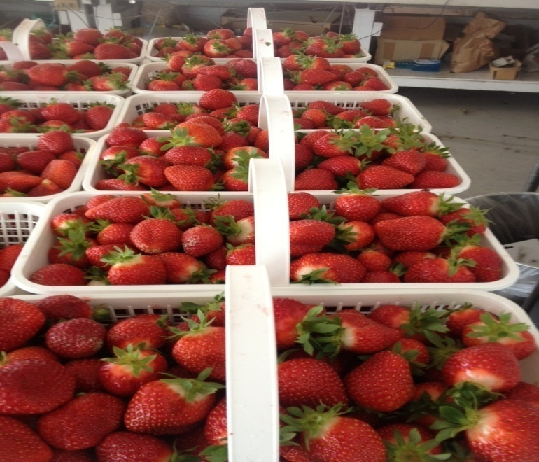
STRAWBERRIES

Slide 38
PEACHES, APPLES, & TOMATOES

Slide 39
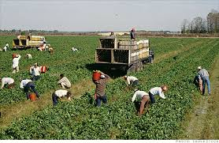

Slide 40
Mechanization

Slide 41
H2A LEGISLATION
COSTLY TO SMALL FARMERS
THREATENED BY LARGER FARMERS

Slide 42
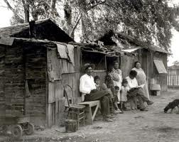
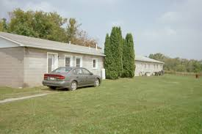
DOL Housing Funds
REPAIR OF MIGRANT HOUSING

Slide 43
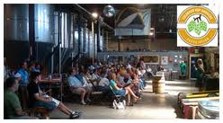
Grower’s Association Meeting

Slide 44
Training Used to Affect Agricultural Upgrades
ON THE JOB TRAINING
SAFETY TRAINING
ENGLISH AS A SECOND LANGUAGE

Slide 45
Our Programs…
ON THE JOB TRAINING
DEFRAYS EXTRAORDINARY COST OF TRAINING
ENCOURAGES AN INVESTMENT FROM GROWER
PROMISE OF HIRE AT THE END OF CONTRACT

Slide 46
Our Programs…
SAFETY TRAINING
ADMINISTERED DURING JOB READINESS
WORKER GAINS KNOWLEDGE ON HOW TO WORK SAFELY AND HEALTHY

Slide 47
Our Programs…
SKILLED TRAINING
FORK LIFT TRAINING
NATIONAL CERTIFICATION
PORTABLE
INCREASES LONG TERM EMPLOYMENT
OFFERED BY FARMER
CAN OCCUR THROUGH CLASSROOM TRAINING

Slide 48
ESL
In-house developed training designed to teach functional workplace English
Dispels the fear of a structured environment
Encourages further study at a more structured setting
Instills confidence on the job
Improves workplace opportunities

Slide 49
English as a Second Language

Slide 51
Our Programs…
LABORER
$10/HR
LEARNED TO OPERATE TRACTORS AND TRACTOR DRAWN MACHINERY
REPAIR FARM BUILDINGS, FENCES AND OTHER STRUCTURES
LEARNED HOW TO CONTROL WEEDS BY SLASHING, ROTARY
HOEING OR CHEMNICAL SPRAYING

Slide 52
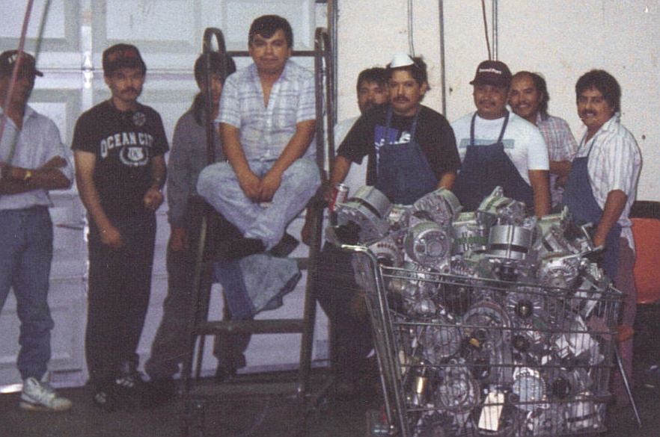
On-the-Job Training

Slide 53
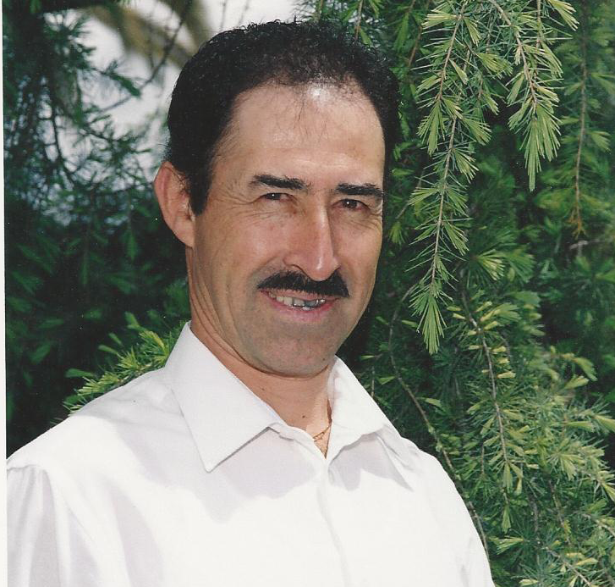
Adolfo Chavez

Slide 54
Our Programs…
MECHANIC’S ASSISTANT
$10-$13/HR
YEAR ROUND SKILL EXTENDED EMPLOYMENT
MINOR REHAB
Learned how to disassemble broken/defective equipment
Replace/install machinery parts and instruments
Learned how to operate and use sundry tools
Lubricate vehicles, machinery; dismantle and put back together

Slide 55
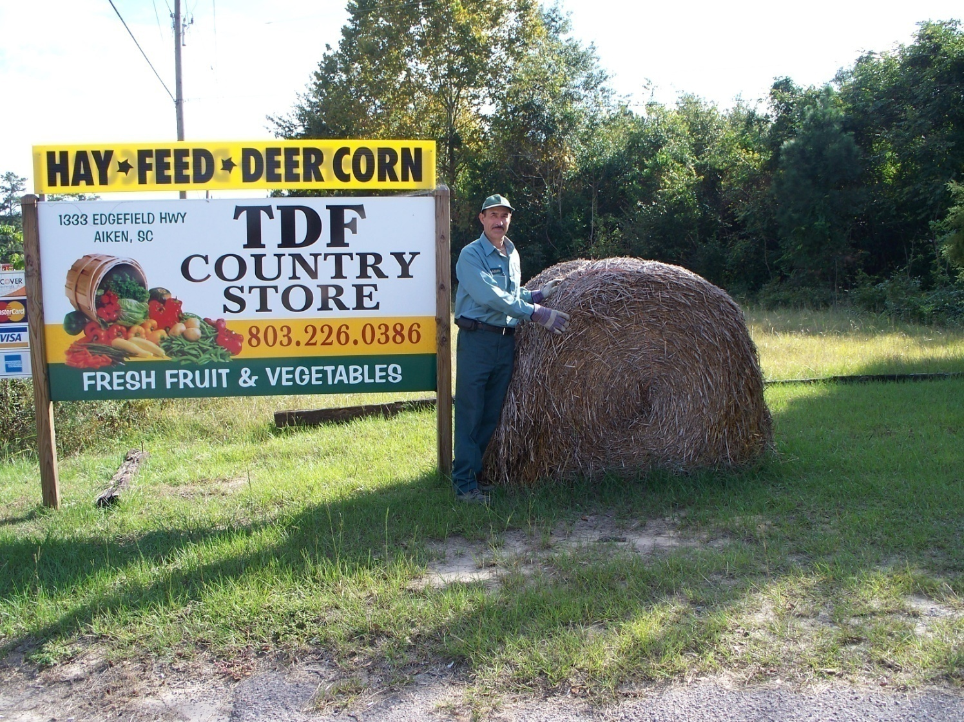

Slide 56
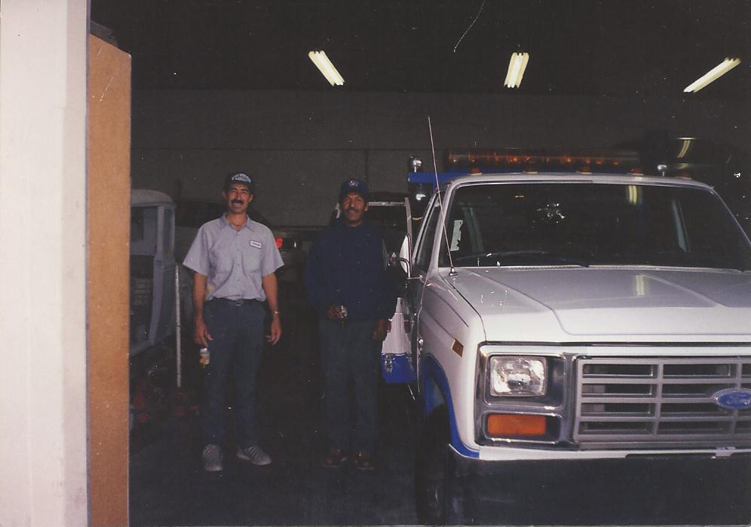

Slide 57
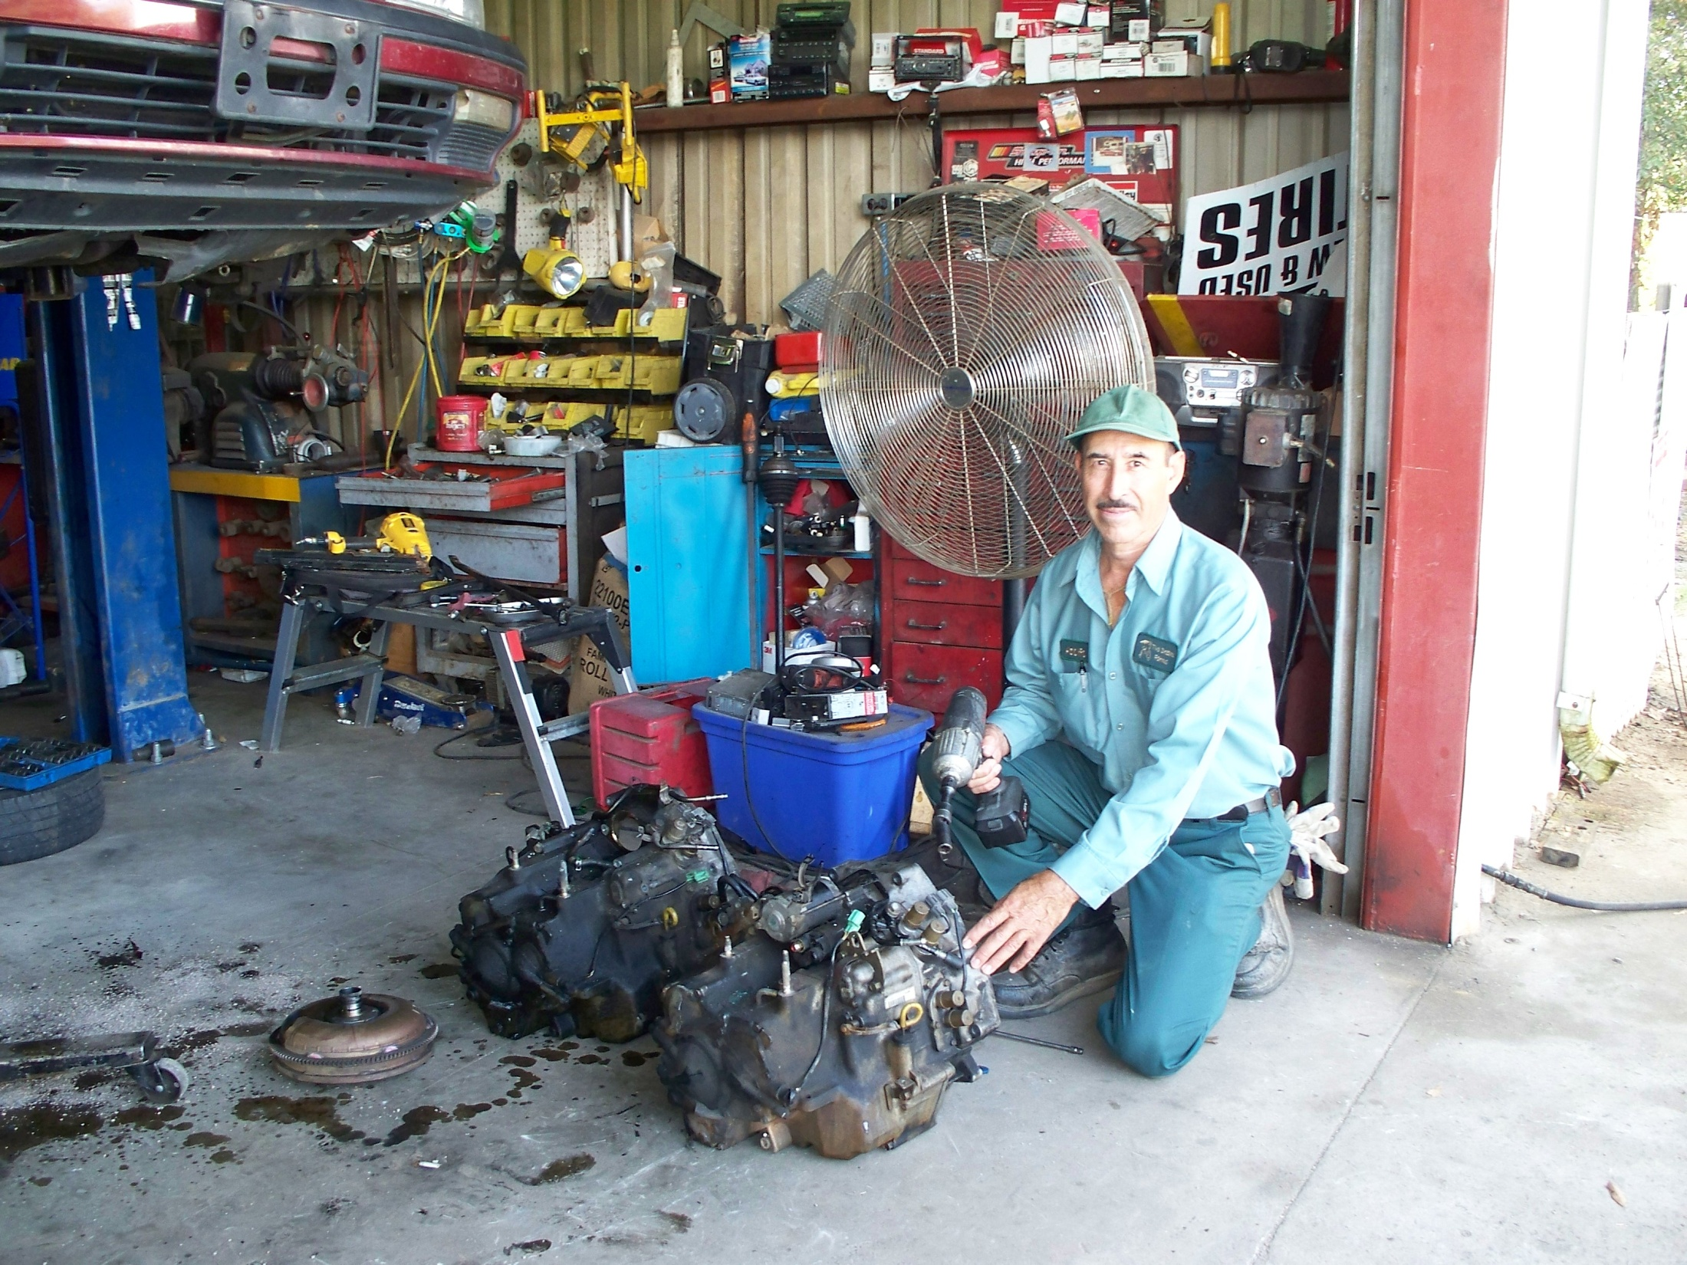

Slide 58
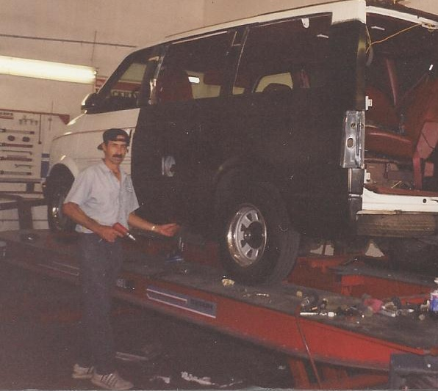

Slide 59
CHALLENGES
HARD SELL
FARMWORKERS OFTEN OVERLOOKED
FOR SKILLED POSITIONS
DEMAND FOR HIGHER WAGES
INCREASED MOBILITY

Slide 60
THAT’S ALL FOLKS!
Barbara Coleman
State Director, Training and Employment Programs
Telamon-South Carolina

Slide 61
PathStone Training and Employment Programs
Agriculture Skills Upgrades
Patricia Stovall
Sr. Director, Training & Employment Programs
PathStone Corporation

Slide 62
The Purpose of Ag Upgrades
Understanding the Benefits……
Who
What
When
Where
Why
Of…. Ag Upgrades

Slide 63
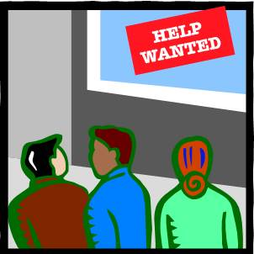
The Who in Ag Upgrades
“ WHO Benefits“
Your Target Population
Ag Employers, Farmworkers
And
Your Program

Slide 64
What ….is the Benefit of Ag Upgrades
Builds Relationships with Ag Employers and Your Program
Word of Mouth Advertising – Growers and Farmworkers get to see WIIFM and they Tell Others
Growers get skilled labor force with certifications
Farmworkers gain transferable skills with certifications
Your program does what it is supposed to do… Provide training to the under-skilled farmworkers.. Train for Employment!

Slide 65
Present the Opportunity on Outreach ….. WHEN?
The Most Convenient Time to Reach Those You Serve!
Time of Day is Key

Slide 66
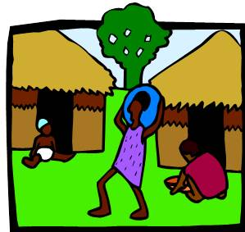
Where…..
Plan WHERE You Go!
Reach Out Where Potential Growers and Participants..
Live – Camps, Housing, Apartment Complexes
Work – Farms, Volunteer sites,
Play – Parks, Ball Fields, Churches, Bingo

Slide 67
The Why in Ag Upgrades
To Develop Relationship and Benefits to the Agriculture Industry.
Recruit participants for Your Program
Educate the Community About Available Services
Provide Information About Our Agency
Without Growers and Participants Our Programs .. Would Not Exist

Slide 68
TRAINING FOR JOBS
Training for Jobs with Transferrable Skills
Agriculture Skills Upgrades in jobs like:
Fork Lift Operator
CDL – Commercial Drivers License
Heavy Equipment – Tractor Operator
Pesticides Application
All come with certifications or licenses!

Slide 69
Do’s In Ag Upgrades
DO ….Be Prepared …
ID Badge
Business Cards
Logs/Pens
Brochures, Forms

Slide 70
DON’T …
Go Alone
Be Pushy or Overly Persistent
Forget to get Phone Numbers (more than 1)…

Slide 71
Agriculture Skills Upgrades Benefit Everyone… Plan your Expected Outcome!
IF YOU FAIL TO PLAN
YOU PLAN TO FAIL
Success
is in Your Hands !!

Slide 72
Resources
O*NET OnLine http://www.onetonline.org/
My Next Move http://www.mynextmove.org/
Mi Proximo Paso http://www.miproximopaso.org/
USDA Cooperative Extension Service http://www.nifa.usda.gov/Extension/index.html
Competency Models www.CareerOneStop.org/CompetencyModel
BLS Occupation Profiles: http://www.bls.gov/oes/current/oes_stru.htm

Slide 73
Please enter your questions in the Chat Room!

Slide 74
Speakers’ Contact Information
Speaker: Pam Frugoli
Title: O*NET/Competency Assessment Team
Organization: Employment and Training Administration
Email: frugoli.pam@dol.gov
Speaker: Patricia Stovall
Title: Senior Director, Training & Employment Programs
Organization: PathStone Corporation
Email: pstovall@pathstone.org
Speaker: Barbara B. Coleman
Title: State Director, Training and Employment Programs
Organization: Telamon-South Carolina
Email: bcoleman@telamon.org

Slide 75
Thank You!
Find resources for workforce system success at:
www.workforce3one.org

