Slide 1
Overview of the Disability Employment Initiative
Webinar Date: December 17, 2013
Presented by: Randee Chafkin, national DEI Program Office and Laura Gleneck, NDI Technical Assistance Team
U.S. Department of Labor
Employment and Training Administration

Slide 2
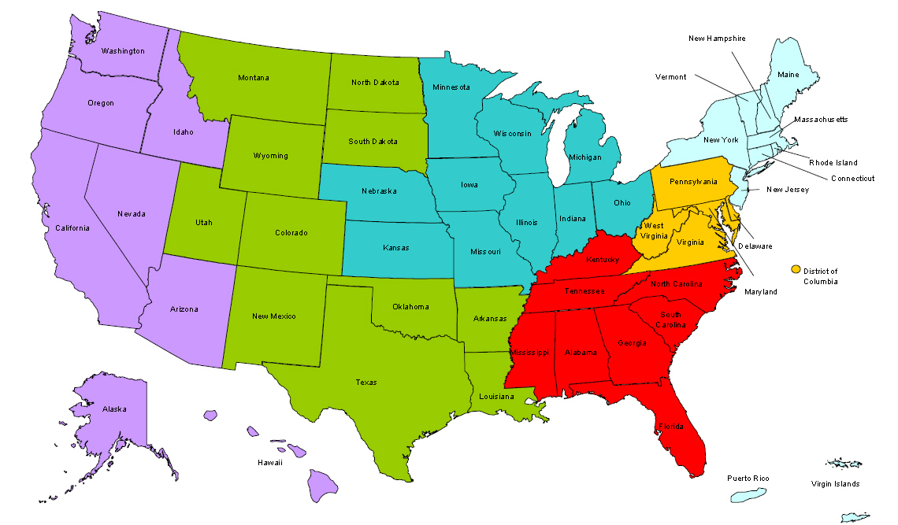
Where are you?
Enter your location in the Chat window – lower left of screen

Slide 3
Moderators
Moderator: Randee Chafkin
Title: Workforce Development Specialist
Organization: Employment and Training Administration
Moderator: Miranda Kennedy
Title: Director of Training for DEI, NDI Technical Assistance Team
Organization: National Disability Institute

Slide 4
Disability Employment Initiative
According to Congress:
“These funds…will improve the accessibility and accountability of the public workforce development system for individuals with disabilities.
The Committee further expects these funds to continue promising practices implemented by disability program navigators, including effective deployment of staff in selected States to:
improve coordination and collaboration among employment and training and asset development programs carried out at a State and local level, including the Ticket to Work program
and build effective community partnerships that leverage public and private resources to better serve individuals with disabilities.”

Slide 5
Here’s what you can expect in this webinar
Upon completion of this training, DEI grantees will have the following:
General information on the DEI and how it is being implemented at the national, state and local levels.
Knowledge of project roles and functions within the DEI.
Resources on Disability and Employment.

Slide 6
Presenters
Presenter: Randee Chafkin
Title: Workforce Development Specialist
Organization: Employment and Training Administration
Presenter: Laura Gleneck
Title: Program Manager for DEI, NDI Technical Assistance Team
Organization: National Disability Institute

Slide 7
Agenda
The need for a Disability Employment Initiative (DEI)
Background on previous related ETA and ODEP Initiatives
DEI Goals and Objectives
DEI Required Project Components
DEI Strategic Service Delivery Components
Defining National DEI Roles
DEI National Program Office (ETA & ODEP)
Federal Project Officers (FPOs)
DEI Contractors:
Training and Technical Assistance
Evaluation
Next Steps
Questions and Answers

Slide 8
DEI Background and Need
DEI is jointly funded and administered by the U.S. Department of Labor’s (DOL) Employment and Training Administration (ETA) and Office of Disability Employment Policy (ODEP).
Training and Technical Assistance is provided under contract with NDI Consulting, Inc. and its subcontractor, the National Disability Institute (NDI), forming the NDI Technical Assistance Team (NDI team) to help build system capacity.
Evaluation is provided under contract with Social Dynamics, LLC in partnership with Altarum Institute; Berkeley Policy Associates, Inc.; and Mathematica Policy Research, Inc. forming the DEI Evaluation team.

Slide 9
Why is there a need for the DEI?
Goal of Department of Labor’s
Good Jobs for ALL…
To promote a public workforce system that is coordinated, integrated, and effective for the widest range of jobseekers and responsive to business customers’ needs…
By improving the accessibility, capacity, and accountability of the One-Stop Career Center system to serve customers with disabilities resulting in education and career pathways that lead to unsubsidized employment and economic self-sufficiency.

Slide 10
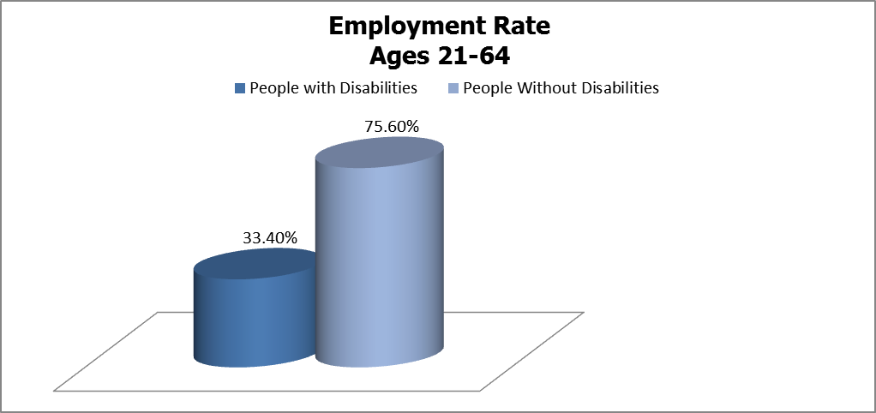
Disability Statistics – Working-age Adults
In 2011, 10.5 percent of working-age (21-64 years of age) individuals reported a disability.
The poverty rate of working-age people with disabilities was 27.8 percent compared to 12.4 percent for their peers without disabilities.
The employment rate was only 33.4 percent versus 75.6 percent, representing a gap of 42.2 percent.

Slide 11
Disability Statistics – Working-age Adults, cont.
34.5 percent only had a high school diploma or equivalent, and only 12.5 percent had a Bachelor’s degree or more compared to 31.2 percent of peers without disabilities.
From 2002 to 2009, the percentage of Wagner-Peyser participants identifying as having a disability varied from 2.3 percent in 2002 to 2.7 percent in 2009 with a slight increase in between.
It is important to note that this and other disability data may not fully reflect the use of Job Center services by people with disabilities, as it does not include individuals with non-apparent disabilities who have declined to identify that they have a disability, or customers with disabilities not identified for other reasons.
Erickson, W., Lee, C., & von Schrader, S. (2012). 2011 Disability Status Report: United States. Ithaca, NY: Cornell University Employment and Disability Institute(EDI).
Hoff, D., & Smith, F.A. (2011). Job Seekers with Disabilities at One-Stop Career Centers: An Examination of Registration for Wagner- Peyser Funded Employment Services. DataNote Series, Data Note 32. Boston, MA: University of Massachusetts Boston, Institute for Community Inclusion.

Slide 12
Disability Statistics – Working-age Adults, cont.
According to a 2010 report, although small in number relative to all Job Center users, working-age SSA beneficiaries (SSI and SSDI) using Job Center services were large in number and represented a large share of the beneficiaries in each state pursuing employment.
For SSA beneficiary Job Center customers, the report found that:
The number was similar to or much greater than the number participating in the SSA-funded Ticket to Work program.
SSA beneficiaries who used Job Center services achieved positive employment outcomes.
The Job Center system is an important resource used by a substantial share of SSA beneficiaries who are seeking employment.
Source: Livermore, G., and S. Coleman. “Use of One-Stops by Social Security Disability Beneficiaries in Four States Implementing Disability Program Navigator Initiatives.” Washington, DC: Mathematica Policy Research, 2010..

Slide 13
Statistics

Slide 14
Disability Statistics - Youth
High school graduation rates for students with disabilities and other at-risk student populations continue to be below the national average. Graduation is least likely among students with intellectual disabilities, emotional/behavioral disabilities, and learning disabilities.
The public workforce system IS already serving youth with disabilities. In PY 2012, WIA youth programs served 15.1% ages 14-18 and 8.6% ages 19-21, who self-identified as having a disability.

Slide 15
Disability Statistics – Youth, cont.
It has been documented that the numbers of youth with disabilities being served by the public workforce system is much larger than reported.
Youth, like adults, do not want to self-identify as a person with a disability and/or may not have been diagnosed as having a disability; this is especially true for youth with non-visible disabilities (e.g., learning disabilities, mental health disabilities, etc.).
Sources:
National Center for Education Statistics. (n.d.). The condition of education. Washington, DC: U.S. Department of Education. Retrieved from http://nces.ed.gov/programs/coe/
Chapman, C., Laird, J., Ifill, N., and KewalRamani, A. (2011). Trends in High School Dropout and Completion Rates in the United States: 1972–2009 (NCES 2012-006). U.S. Department of Education. Washington, DC: National Center for Education Statistics. Retrieved [date] from http://nces.ed.gov/pubsearch.
PY 2012 WIASRD Data. Available at http://www.doleta.gov/performance/

Slide 16
ETA and ODEP Initiatives
Previous ETA and ODEP grants to improve employment outcomes of youth and adults with disabilities:
ETA Systems Change Models
Work Incentive Grant (WIG) Projects
Disability Program Navigator (DPN) initiative
ODEP Employment Service Models
Customized Employment Grants (CEG)
Workforce Action (Olmstead) Grants
START-UP Initiative
State Intermediary Youth Grants
Guideposts for Success

Slide 17
ETA Work Incentives Grant Projects
Four rounds of 2-year grants awarded to 113 grantees (states, non-profit organizations, and/or local workforce investment areas) from October 2000 - June 2006.
WIG Grantees charged with improving employment outcomes through policy development and systems change activities by:
Enhancing the American Job Center Network and providing comprehensive services to multiple programs for which job seekers with disabilities are eligible; and
Improving the American Job Centers’ physical and programmatic access to job seekers with disabilities and other challenges.
Identified employing a “Navigator” type position was instrumental to enhancing the American Job Center Network in better serving all job seekers, particularly job seekers with disabilities.

Slide 18
ETA Disability Program Navigator (DPN) Initiative
Established with Social Security Administration to better inform beneficiaries/other job seekers with disabilities about work support programs at American Job Centers to help achieve a more seamless, comprehensive and integrated service delivery system.
Four rounds of project from 2003 - 2009 across fifty-one states and territories . At the height of the DPN Initiative, there were approximately 550 Navigator positions nationwide.
The DPN was charged with building the capacity of the American Job Centers to effectively serve job seekers with disabilities.
DPN transformative models included: 1) Deploying dedicated staff experts; 2) Conducting outreach and marketing to disability community; 3) Improving Job Center access; 4) Establishing Integrated Resource Teams-- individual level and Interagency Action Committees--systems level; 5) Building and sustaining partnerships; 6) Connecting with other initiatives; 7) Leveraging of funds and resources; 8) Increasing knowledge and comfort level of Job Center staff; and 9) Meeting the needs of employers.

Slide 19
ODEP Customized Employment Grants
Funded development and research work from 2001 – 2006 on Customized Employment in the American Job Centers to 26 grants nationwide.
CEG Grantees were charged with increasing the capacity of service-delivery systems to effectively serve people with disabilities and other ‘‘hard-to-serve’’ populations through individualized employment and placement services.
Key findings included: 1) Partnership and collaboration were key to systems change; 2) Universal design was fundamental to improving access to programs and services; 3) Leveraging expertise and resources maximizes outcomes; 4) Asset development strategies enhance economic advantages; 5) Access to flexible dollars; and 6) Customized approach shows promise for improving employment outcomes.

Slide 20
ODEP Workforce Action Grants
Funded 6 grants from 2002-2003 for periods of time ranging from three to five years.
The Working for Freedom, Opportunity, and Real Choice Through Community Employment (WorkFORCE) Action grants continued ODEP’s development and documentation of programs that address the capability of individuals transitioning from segregated environments, such as nursing homes and institutions, to successfully participate in community employment through utilization of customized strategies.
The grants began or expanded the delivery and implementation of customized community employment opportunities for individuals with disabilities so that they may live, work, and fully participate in their communities.

Slide 21
ODEP START-UP Initiative
To further promote self-employment as an employment outcome for individuals with disabilities, in 2007, ODEP funded Self-Employment Technical Assistance, Resources, & Training (START-UP / USA), a partnership between Virginia Commonwealth University and Griffin-Hammis and Associates, LLC to:
provide technical assistance and disseminates resources nationally to individuals interested in pursuing self-employment.
START-UP USA provides assistance to three sub-national projects: START-UP / Alaska, START-UP / Florida, and START-UP / New York:
generate data and information to validate systems capacity-building strategies and systems change models for successfully increasing self-employment opportunities for individuals with disabilities.
The information generated through these model programs are disseminated nationally for replication through technical assistance and support
The START-UP initiative resulted in the establishment of a range of businesses by individuals with disabilities.

Slide 22
ODEP State Intermediary Youth Grants
Youth transition model awarded to 8 states in 2003.
Assisted states, under the leadership of the State Workforce Investment Board, in the design, implementation, and evaluation of systems changes needed to improve transition outcomes for youth with disabilities at the local level.
Focused on closing the substantial gap between education and employment outcomes for youth with disabilities and those of their peers without disabilities.

Slide 23
ODEP Guideposts for Success
Research from the State Intermediary Youth Groups unveiled the five Guideposts for Success that include:
School-Based Preparatory Experiences
Career Preparation & Work-Based Learning Experiences
Youth Development & Leadership
Connecting Activities
Family Involvement & Supports

Slide 24
DEI Goals
The goal of the Disability Employment Initiative (DEI) is to:
improve coordination and collaboration among employment and training and asset development programs implemented at state and local levels, including the Ticket to Work Program, and
build effective community partnerships that leverage public and private resources to better serve individuals with disabilities and improve employment outcomes.

Slide 25
DEI Objectives and Outcomes
The DEI is designed to:
Improve education, training, and employment opportunities and outcomes of youth and adults with disabilities who are unemployed, underemployed and/or receiving Social Security disability benefits; and
Help these individuals with disabilities find a path into the middle class through exemplary and model service delivery by the public workforce system.
The desired outcome of the DEI is to:
Lead to the increased enrollment of customers with disabilities in WIA intensive and training services and other relevant DOL programs.

Slide 26
DEI Outcomes: Data from Ticket to Work and WIASRD
Through the DEI, DOL is creating systemic change within the public workforce system by providing tools and strategies to promote the economic self-sufficiency of job seekers with disabilities.
Under the DEI, the numbers come in two formats through:
Ticket to Work Program, and
The workforce system’s performance outcomes

Slide 27
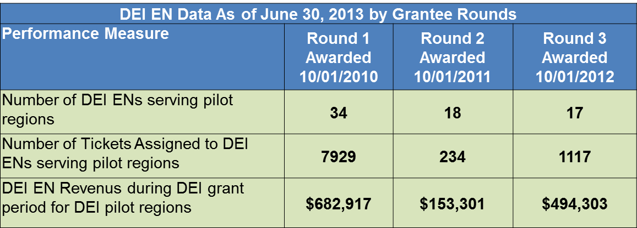
Workforce Employment Networks (ENs)
The comprehensive nature of the American Job Center makes it a natural service provider as an EN.
Job Centers are employment support providers that can help Social Security disability beneficiaries return to work.
Participation as an EN provides an additional revenue source to leverage funding to maximize services for customers with disabilities.

Slide 28
Workforce Performance Outcomes: DEI Pilot Sites
Often people with disabilities and/or multiple challenges to employment are not given an opportunity to be considered for enrollment in WIA intensive/training services due to concerns that they may not meet workforce performance measures.
The data on these charts represents positive impacts on performance outcomes from 2012.

Slide 29
DEI Grantees
Since 2010, there have been four rounds of funded grantees covering a total of 26 states:
Round one in Program Year 2010 at $22 million: Alaska, Arkansas (youth), Delaware (youth), Illinois, Kansas, Maine, New Jersey (youth), New York and Virginia.
Round two in Program Year 2011 at $21 million: California, Hawaii, Ohio, South Dakota (youth), Tennessee, Washington, and Wisconsin.
Round three in Program Year 2012 at $21 million: Florida, Indiana, Iowa, Louisiana, Massachusetts, Minnesota (youth) and Rhode Island.
Round four in Program Year 2013 at $18 million: Alabama (youth), Alaska, Connecticut, Idaho (youth), Illinois, Maine, New York, and Virginia.

Slide 30
DEI Map

Slide 31
DEI Components
Required Project Components:
Overarching DEI Elements
Responsibilities of the DEI Project Lead
Responsibilities of the State and Local Level
Strategic Service Delivery Components

Slide 32
DEI Required Project Components
Overarching DEI Elements:
Disability Resource Coordinator - Local WIBs that participate in the DEI cooperative agreement must commit to hiring a new, or designating an existing, full-time staff person(s), as the disability resource coordinator(s) to implement the strategic approach.
Participation in SSA’s Ticket to Work Program as an Employment Network (EN) – The DEI requires that either the state workforce agency and/or LWIB: 1) already operate as an EN; or 2) stipulate their commitment to apply for EN status to SSA within 60 days of identification of participating pilot sites.
Strategic Service Delivery Components – All DEI grantees are required to use partnerships and collaboration plus identify at least two of the other six strategic components. as significant elements of their service delivery approach.

Slide 33
DEI Required Project Components
Responsibilities of the DEI Project Lead:
Coordinating with the local DEI project Workforce Investment Boards/implementing sites to ensure issues and challenges are addressed and common goals are achieved.
Representing the state in administrative communications and facilitating state and local DEI participation in training and technical assistance activities.
Establishing and coordinating partnerships, via both formal and informal mechanisms, with other state level agencies.
Coordinating implementation of Ticket to Work administrative activities.
Facilitating implementation of additional data collection and process evaluation requirements.

Slide 34
DEI Required Project Components
Responsibilities of the State AND Local Level:
Assisting local implementing sites in determining the method and process for hiring/supervising DRC positions.
Continuous review and upgrade of Job Center Physical, Programmatic, and Communications accessibility.
Participation in SSA’s Ticket to Work Program as an Employment Network.
Implementing efforts to sustain DRC positions and promising practices into state policy and procedures.
Participating in DOL’s data collection and evaluation activities.

Slide 35
What is a DRC?
It’s time for a 30-Second Training!!!

Slide 36
DEI Strategic Service Delivery Components
All DEI projects must consider Partnerships and Collaboration as a strategic component and select from the following strategic components to serve adult or youth with disabilities:
Integrated Resource Teams coordinate services and leverage funding to meet the needs of a job seeker with a disability.
Blending and Braiding Funds /Leveraging Resources from multiple sources to contribute to education, training and/or employment goals.
Customized Employment individualizes the relationship between job seekers and businesses to meet the needs of both.
Self-Employment is an employment alternative for individuals seeking flexibility in a new or better career.
Guideposts for Success are key educational and career development interventions for all youth, including youth with disabilities.
Asset Development Strategies represent various approaches to enhance long-term economic self-sufficiency.

Slide 37
Round 1 Grantees Strategic Service Delivery Components

Slide 38
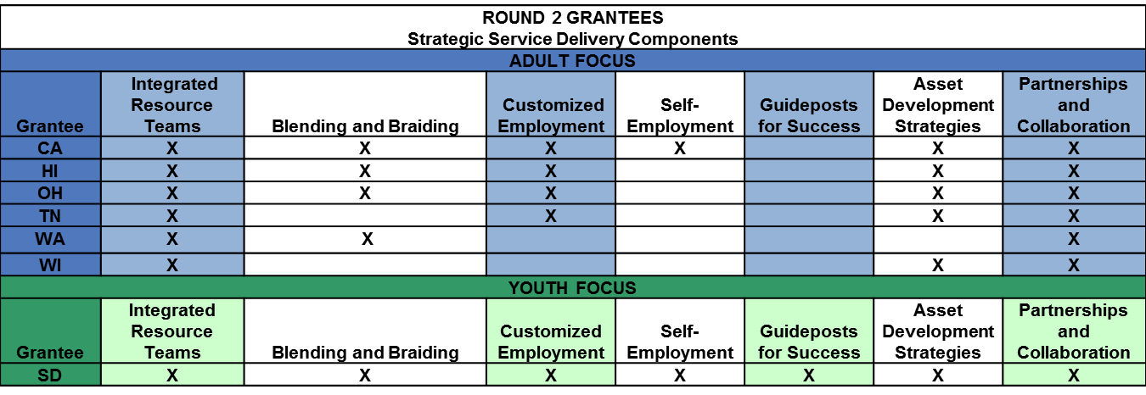
Round 2 Grantees Strategic Service Delivery Components

Slide 39
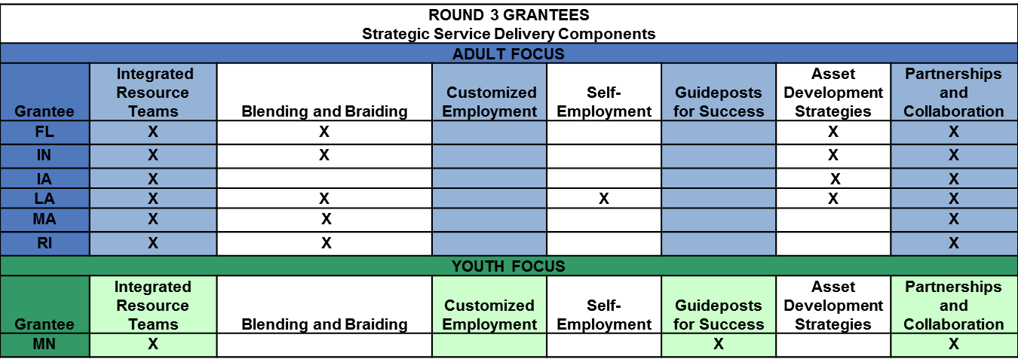
Round 3 Grantees Strategic Service Delivery Components

Slide 40
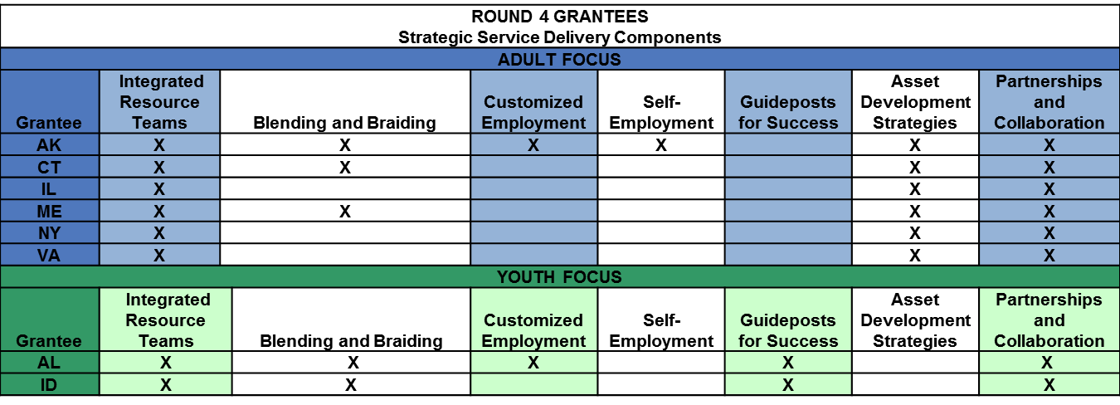
Round 4 Grantees Strategic Service Delivery Components

Slide 41
Defining DEI National Roles
National DEI Program Office
ETA
ODEP
ETA Federal Project Officers
Contractors
NDI Team
DEI Evaluation Team

Slide 42
Defining Roles: National DEI Program Office
ETA Support on behalf of the DEI Grantees
Develops and issues Solicitation for Grant Applications, provides programmatic and support guidance, and issues grant planning instructions.
Establishes performance measures associated with the Government Performance and Results Act.
Provides policy clarification, program technical assistance, and guidance to Grantees, Federal Project Officers and the NDI team.
Coordinates with the DEI evaluation team.

Slide 43
Defining Roles: National DEI Program Office
ETA Support on behalf of the Workforce Development System – to address the needs of persons with disabilities and multiple challenges to employment:
Develops and implements workforce disability policy and program initiatives to address structural, programmatic, and systemic employment challenges.
Provides technical assistance (including the dissemination of promising practices) on promoting positive education, training, and employment outcomes, as well as expanding the capacity to serve these populations.

Slide 44
Defining Roles: ODEP
ETA is jointly funding and administrating the DEI in collaboration with the Office of Disability Employment Policy (ODEP).
ODEP provides national leadership on disability employment policy by:
developing and influencing the use of evidence-based disability employment policies and practices,
building collaborative partnerships, and
delivering authoritative and credible data on employment of people with disabilities.

Slide 45
Defining Roles: ETA Federal Project Officers
Regional Federal Project Officers (FPOs) serve as the Grant Officer’s technical representative to the DEI cooperative agreement.
FPOs conduct desk and on-site monitoring of the grant and are the primary federal contact with the grantee.
Grant modification requests are submitted to FPOs when changes involve budget realignment or adjustments to the statement of work.

Slide 46
Defining Roles: NDI Team
The DEI training and technical assistance provider under contract with ETA:
Develops, disseminates and shares information of a technical assistance nature and should serve as the primary contact for these types of needs.
Provides technical assistance to grantees on the execution of the DRC position role and responsibilities.
Works in coordination with the national DEI Program Office to develop and present trainings and resource materials targeted to grantees.

Slide 47
Defining Roles: DEI Evaluation Team
The Social Dynamics evaluation team under contract with ODEP:
Will conduct an independent evaluation utilizing quantitative and qualitative data from grantees.
Working with the National DEI Program Office and grantees, the DEI evaluation team will:
collect data,
implement a process evaluation tool, and
conduct site visits to document grantee progress and to develop case studies.

Slide 48
Good Jobs For All
The goal of the Department of Labor (DOL) is to promote a public workforce system that is coordinated, integrated, and effective for the widest range of jobseekers and responsive to business customers’ needs.
If customers with disability and/or multiple challenges to employment encounter access barriers within the Job Center that preemptively refer them out of WIA services entirely, or steer them into core services only, it makes it unlikely that they will be considered for participation in DOL national initiatives, including discretionary grants, which are usually accessed for customers enrolled in intensive services.
Through the DEI, grantees can help jobseekers with disability and/or multiple challenges to employment achieve programmatic access.

Slide 49
Summary
In today’s presentation we covered the following:
The need for The Disability Employment Initiative (DEI).
The DEI builds upon previous DOL grants to improve employment outcomes of individuals with disabilities:
ETA systems change models
ODEP employment service models
Congress helped to define the DEI goals and objectives
How projects will achieve the DEI goals and objectives:
Required project components
Strategic service delivery components
Roles of the DEI national partners
Universal Access

Slide 50
Next Steps
DEI Project Lead
If your DRCs are not on board/hired yet, have them access the archive of today’s presentation once they are in place. Training Archives are available at: http://www.dei-ideas.org/chapter1/page1a_archives.cfm
Provide your DRCs with a copy of your state’s DEI Project grant application.
Make sure your DRCs are on the DEI Listserv to get information on future DEI Orientation and Other trainings. Submit new DRC’s contact information to Laura Gleneck at lgleneck@ndi-inc.org.
Disability Resource Coordinators (DRCs)
Ask your DEI Project Lead for a copy of your state’s DEI Project grant application in order to gain a better understanding of the specifics and goals for which you will be responsible.
Be on the lookout for notices of upcoming trainings via the DEI Project Listserv and attend trainings in the DEI Orientation Series starting in January 2014.

Slide 51
Additional Resources
DEI Technical Assistance Project
http://www.dei-ideas.org/
Disability and Employment Community of Practice provides disability and employment resources for the public workforce system, including promising practices to promote the positive employment outcomes of persons with disabilities. http://disability.workforce3one.org
For background information on the DEI including the DEI National Vision PowerPoint Presentation, access:
https://disability.workforce3one.org/page/tag/dei_project
ODEP http://www.dol.gov/odep/

Slide 52
Please enter your questions in the Chat Room!

Slide 53
Speakers’ Contact Information
Speaker: Randee Chafkin
Title: Workforce Development Specialist
Organization: Employment and Training Administration
Email: chafkin.randee@dol.gov
Telephone: (202) 693-2723
Speaker: Laura Gleneck
Title: Program Manager
Organization: National Disability Institute
Email: lgleneck@ndi-inc.org
Telephone: (781) 899-0139

Slide 54
Look for upcoming Webinars in this series!
SAVE
DATE
the
January 30th at 3pm EST

Slide 55
Thank You!
Find resources for workforce system success at:
www.workforce3one.org

