Slide 1

H2P and NAWB Summit
Building a Resilient Healthcare Workforce by Creating and Enhancing
Workforce System-Community College Strategic Partnerships
March 29, 2014
“This workforce solution was funded by a grant awarded under the Trade Adjustment Assistance Community College and Career Training Grants as implemented by the U.S. Department of Labor’s Employment and Training Administration”

Slide 2
The Vision:
“The H2P Consortium will dramatically improve health professions training via career pathways and the development of core curriculum and core credentials with employer participation and validation.”
“Individually we Innovate
Collectively we Transform”

Slide 3
National Imperatives & Trends: Healthcare Education and Employment
Bureau of Labor Statistics estimates unmet demand of 300,000 associate degree graduates
GNP for healthcare spiraling out of control
Healthcare demands for service will continue to increase
Supply of trained professionals will not meet demand at current pace
Time to training is increasing: degree creep
Community College retention/graduation statistics - < 25%

Slide 4
IS THERE A SOLUTION??
General Agreement: Solution to the Dilemma can be found in Strategic Partnerships between:
  Workforce
  Employer
  Job Seeker

Slide 5
However: What Educators say about Employers…
We invite them and ask what they need, but they don’t talk. They just sit.
They want things done immediately.
They just don’t understand:
  What our accreditation requires
  How few resources (ie: money) we have
  Our internal processes
-CAEL, 2014
72% of education leaders say
newly educated workers are
ready for work.
42% of employers think these
same workers are ready for
work.
-Bersin Study reported in
CLO Magazine 3.22.13

Slide 6
However: What Employers say about education…
Takes way too long to get things finished
They ask for our advice after the courses are already developed
We tell them what we think, but we never know what they do with it
-CAEL, 2014
96% of college and
University chief academic
officers were confident
in their ability to prepare
students for workforce
success.
11% of business leaders
strongly agree that today’s
graduates have the skills
and competencies their
businesses need.
-Chronicle of Higher Education, 2.26.14

Slide 7
AND JOB SEEKERS/NEWLY EMPLOYED ARE JUST CONFUSED!
I did exactly what I was supposed to do why don’t I have a job?
This job is not what I am prepared for.
They have unrealistic expectations of me…

Slide 8
The 8 H2P Strategies - Building Blocks to Reform Healthcare Training
Prior Learning Assessment and Career Guidance→
Contextualized Education→
Competency-based Core Curriculum→
Industry Recognized Stackable Credentials→
Enhanced Retention Support→
Training programs for Incumbent Health Professions Workers→
Enhanced Data and Accountability Systems→
Galvanizing a National Movement to Improve Health Professions Training

Slide 9


Improving Student Outcomes
Prior Learning Assessment and Career Guidance→
Virtual Career Network
Work keys, Fit and Talent
Pre-Assessment Tutoring
Enhanced Retention Support→
Intrusive Advising by College and Employer personnel

Slide 10
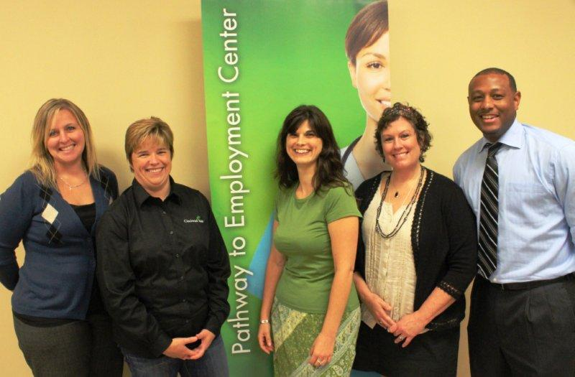
H2P Colleges
Implementing the Pathway Model
ACT Work Keys Assessments, including National Career Readiness Certificate (NCRC). Nationally recognized, evidenced based portable credential.
  NCRC – over 3,000 credentials earned by participants with silver being predominant.
Intrusive Academic Advising, Preadmission, program of study and employment support and services.
  Over 4700 new students served since Spring 12
  Retention Rate – 88% as of 12.31.13
Prior Learning Assessments completed with participants.
  363 students granted 1223.5 credit hours, representing @400 classes avoided

Slide 11
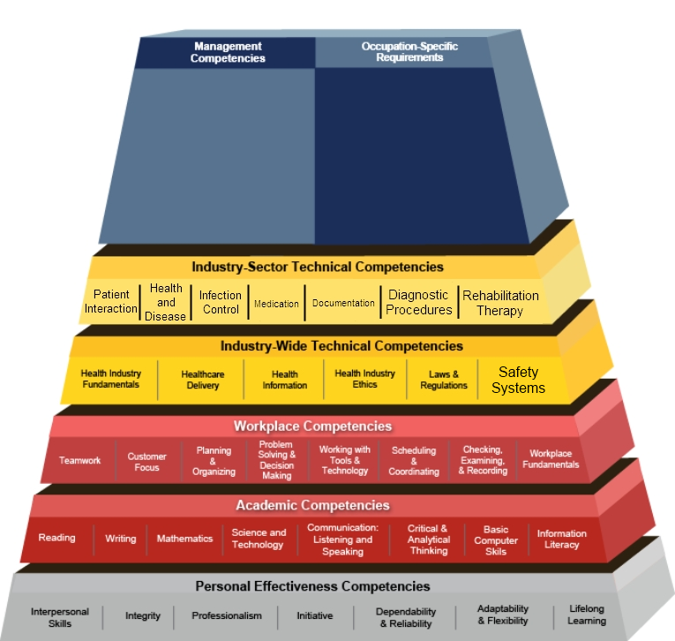
Improving Student Outcomes via Implementation of Pathway Model
Contextualized Education→
  Integration of Core Content
  Employer validated
  Decrease time, increase retention
Competency Based Core Curriculum→
            Assures basic knowledge
            Reduces Repetition/Costs
            Employer validated
            Exposure to Healthcare Team
Decreasing time to completion =
increased credential attainment
= acceleration to labor market

Slide 12

Enhancing Employer/WIB Relationships
Industry Recognized Stackable Credentials→
  Community College/Community Collaboration
  Creating Jobs that meet industry needs
  Building skill sets through credentials
Training programs for Incumbent Health Professions Workers →
  School at Work
  Grow Your Own

Slide 13

Why Incumbent Training Programs Matter
≅13% less turnover for participant groups
10-20%↑ Top Box -Employee Satisfaction
$113,946 annual cost savings
50% pay increase
Evaluation scores – 3.96 for cohorts

Slide 14
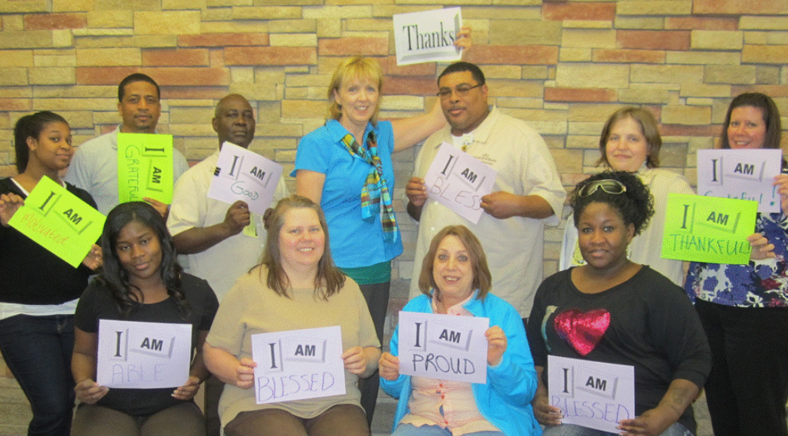
School at Work Programs Making a Difference for Employees

Slide 15
Role of Workforce Investment Boards (WIB’s)
400 Employers evaluated which workforce issues are an “important” strategic challenge for them:
Need to build talent & leadership: 94%
Missing skills for promotion: 87%
Hard to find well-qualified applicants: 85%
College for America - 2014
All 9 Community Colleges are required to engage with their local and State WIB’s.
Assisting with identifying Target Populations: TAA Workers, Displaced Workers and Veterans
Provide guidance and input on design of education pathways
Source for Labor Market Information and Trends relevant to planning education pathways to employment
Providing UI Wage Records to understand employment outcomes of graduates
Create opportunities to convene key industry and community stakeholders to improve pathways for employment

Slide 16
Best Practices: WIB/H2P Collaboration
Anoka-Ramsey Community College – Greater Minneapolis
  Contractual relationship between WIB and College for on-site WIB personnel to provide intake and assessments for H2P participants.
Cincinnati State Technical and Community College
  Launched Pathway to Employment Center and
  co-located with WIB to provide direct integration of
  services, funded with combination of grant, College,
  city and county funds.
Owens Community College – Toledo, OH
  Lucas County WIB “The Source” provides ACT-National Career Readiness Certificate (NCRC), College certificates and training on-site at the WIB.
Pine Technical College - Pine, MN
  Strong relationship with WIB
  Employment and Training Center on-site providing direct TANF services.
The majority of future employment opportunities will require the kind of degrees and training most commonly offered by community colleges.
- Georgetown University’s Center on Education and the Workforce

Slide 17

Best Practices: Employer Partnerships
Cincinnati State Technical and Community College
  Health Careers Collaborative of Greater Cincinnati -serves to create incumbent worker training, stackable credentials and inform regional training needs.
El Centro Community College – Dallas TX
  “Grow Your Own” incumbent worker training programs with several regional healthcare systems
Jefferson Community and Technical College - Louisville KY
  “Grow Your Own” incumbent worker training programs with regional health care systems
  Stackable credentials developed based on employer needs.

Slide 18



The H2P Health Career Training Transformation
From: Education Silos based upon Courses and Curriculum→
To: Meaningful Programs of Study identified and validated by the Workforce Community → Leading to high demand Health Care Jobs

