Slide 1
Reemployment and Eligibility Assessments (REA) Innovations in Maine and Rhode Island
Webinar Date: August 28, 2014
Presented by:
Office of Unemployment Insurance
U.S. Department of Labor
Employment and Training Administration

Slide 2
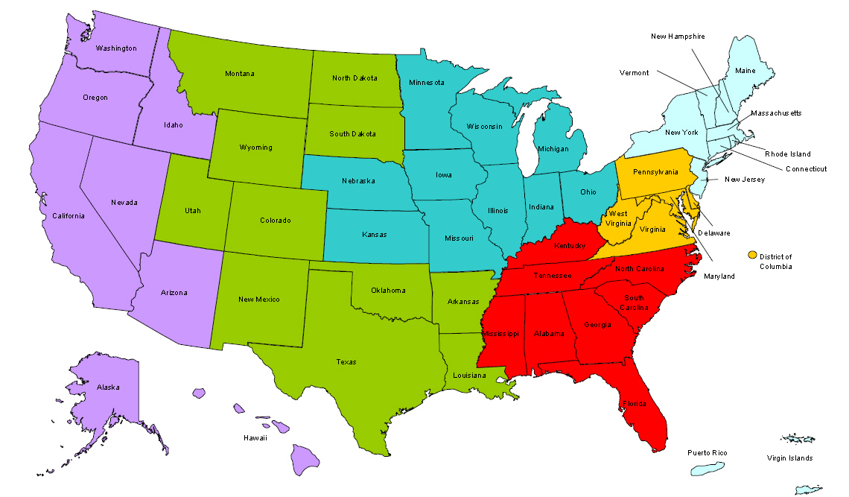
Where are you?
Enter your location in the Chat window – lower left of screen
Notes:
In the Chat Room, please type the name of the your organization, your location, and how many people are attending with you today.

Slide 3
Moderator
Moderator: Diane Wood
Title: UI Program Specialist
Organization: Office of Unemployment Insurance

Slide 4
Here’s what you can expect to get out of this webinar!
Tips on Scheduling Group Orientation Sessions
Ideas to keep claimants active during their time in the office
Tips on getting correct data that reflects the positive results of the program
Notes:
Video clip of what to expect in the webinar room. (instead of the 5 tech slides)

Slide 5
REAs in Rhode Island
Presenter: Kathy Catanzaro
Title: Chief – UI Special Programs
Organization: Rhode Island Department of Labor and Training
Presenter: Hector Rivera
Title: Chief – Workforce Development
Organization: Rhode Island Department of Labor and Training

Slide 6
Rhode Island Agenda
The Selection Process
Creating the Comparison Group
Reporting Challenges
REA Program Delivery
REA Outcomes

Slide 7
The Selection Process:
Rhode Island uses the profiling score to build the weekly REA selection list.
Individuals with lower scores (less likely to exhaust benefits) are assigned to the REA selection list. Those with higher scores (more likely to exhaust) are assigned to the WPRS (Worker Profiling) selection list.
After all first UI payments are processed, selection lists are created each Tuesday, and populated into a selection option in our UI claims system.

Slide 8
The Selection Process (cont’d)
REA selection lists are assigned by local office according to zip code, and are separately accessible to REA counselors by local office.
Each Tuesday, counselors select the required number of REA participants for their offices. Appointments are scheduled two weeks out from the selection date.
REA appointment letters are auto-generated the following day based on these selections. Modifications were made to the appointment letter to reinforce that participation is mandatory, and that failure to report WILL result in interruption of UI benefits.

Slide 9
Creating the Comparison Group
Creating a comparison group was a challenge for Rhode Island for several years.
In 2009, it was decided that the group would be comprised of individuals who have similar profiling scores to REA participants. At that time, the number of individuals in the comparison group equaled those in the treatment group.
Currently, our control group is equal to 20% of the treatment group, and is created at the same time the REA selection group is created.

Slide 10
REA – Reporting Challenges
Reporting to Reemployment Services or Training
Difficult to identify if participant was referred or reported
Met with regional and national offices to develop ways to differentiate in reporting
Developed process to identify individuals in WIA training programs through quarterly automated program interface (API) with vendor
Implemented use of scan card to track participants reporting to reemployment services/workshops, etc.

Slide 11
REA – Reporting Challenges
REA-detected Adjudication Issues
Difficult to identify REA-detected issues as opposed to non REA-detected
Developed system to flag REA-detected issues during the adjudication process so that only those were counted on the 9128
Resulting overpayments were identified in the same manner.

Slide 12
REA – Reporting Challenges
Unable to produce a 9129 for several years
Difficult to program method to create control group
Difficult to extract outcome data for comparison group
IT devised system to create control group at the same time the selection group for treatment is created
Built programming to extract outcomes from our claims and overpayment systems to accurately report issues, outcomes, overpayments, etc.

Slide 13
REA – Program Delivery
Immediately following the orientation, participants meet with counselor “one-on-one”.
Participants get ERP and Individual Reemployment Plan during the orientation, which they begin working on and then discuss them one-on-one with counselor
UI eligibility is reviewed
Individualized Labor Market Information
Individualized Employment plan
Assessment
Work search requirements explained
Scheduled appointment for 30-day follow-up.

Slide 14
REA – Program Delivery
REA selected individuals are required to attend orientation.
Each local office conducts at least three REA group orientations per week.
Providence, Woonsocket, Wakefield, West Warwick
Participants receive packet of various documents, including UI responsibilities, WD available services, etc.
Slide presentation followed by Q and A

Slide 15
REA – What’s in the Packet?
Eligibility Review Form
EmployRI users Quick Reference Users’ Guide – Register, Create Resume, My Skills
Weekly Job Search Report
Sample of Weekly Job Search Report
netWORKri Available Services
Job Search Web Sites
O*Net Online Instructions
Resource Room Policies
Reemployment Plan of Action/Appointment Worksheet
USAJOBS Flyer
Instructions to Create Virtual Recruiter
UI Fraud Flyer

Slide 16
REA – While you are waiting. . .
How participants fill the time between the orientation and the one-on-one. They are encouraged to use computers to begin the items that will be verified at 30-day follow-up. Can look at job postings; calendar of events/workshops and schedule those.
Complete Eligibility Review form
Review documents in REA packet
Review job recruitment information
Sign up for workshops
Network with the rest of the group
Conduct a work search on EmployRI using available computer stations
Start the process to create their virtual recruiters, skills check offs, and resume posting so as to meet those requirements.

Slide 17
REA Requirements for 30-day Follow-up Appointment
REA counselor reviews job search activities including:
required # of job searches conducted, Must present record of work search for four weeks.
Resume posted in EmployRI,
Virtual Recruiter created, and
Skills check-off completed.
Must have registered for any service referred to by counselor at initial one-on-one.
If claimant does not report for 30-day Follow-up, REA issue detection notice is forwarded to UI for failure-to-report.
If work search is inadequate for any of the four weeks, REA issue detection notice is forwarded to UI failure to meet work search requirement.

Slide 18
REA Requirements for 30-day Follow-up; New for PY 2014
Resume Creation and Posting
Job Seekers may create resumes in EmployRI utilizing three options; they can follow a step-by-step process to create a resume from scratch, utilize a copy and paste method, or import an existing resume that is a Word Document or Pdf.
Creation and posting of the resume will allow the job seeker to conduct job searches that will identify job openings that match their resumes.
The customer can apply for jobs and send employers their resumes directly.
Employers can locate and contact candidates whose resumes match their hiring needs/requirements.

Slide 19
REA Requirements for 30-day Follow-up; New for PY 2014
Virtual Recruiter
The Virtual Recruiter is an automated job search tool that will notify the job seeker that jobs exist that meet their interests and requirements
It can be set to run on a daily, weekly, or monthly basis
Automatic notification to the job seeker is done by an internal message within EmployRI, an email sent to the job seeker, or both.
Employers can create Virtual Recruiters that will notify them that job seekers meeting their requirements exist in EmployRI.

Slide 20
REA Requirements for 30-day Follow-up; New for PY 2014
Skills Check-off
Completing the skills check off allows the job seeker to compile a list of job skills and personal skills to find occupations best suited for them and match their interests and work values to find suitable employment.
Job seekers can search for jobs posted by employers that are in need of their skills.
The job search results list the skills required by the employer versus the skills possessed by the job seeker.
The job seeker is shown what skills that they are lacking, and is provided with a link for training options that are available to remediate that skills gap, such as the Workforce Investment Act (WIA) Eligible Training Provider List (ETPL).
Employers may search for individuals whose job skills match a required job skill set by a pre-determined match ratio (usually 70%, 50%, or 25%).

Slide 21
REA – Tracking Services
All netWORKri customers are issued a scan card the first time they report to the office. Customers swipe their scan cards each time they:
Report to utilize resource area
Report for workshops
Report for initial REA or other orientation
Report for in-house job fairs

Slide 22
REA Outcomes - Period ending 3/31/13
Comparison REA Difference
Average Duration 16.18 15.35 -0.83
Benefits per Claimant $5,439 $5,149 -$290
Percent Exhausting 40.4% 32.1% -8.3%
Percent Reemp 22.4% 38.4% 16.1%

Slide 23
What the Comparison Shows
In every quarter at least as far back as first quarter 2011, more REA participants become reemployed than those in the comparison group.
Of individuals who return to work among both groups, REA participants return to work in less weeks than those in the comparison group.
More potential issues and overpayments are detected through the REA process than without.
THE BOTTOM LINE: Overall, REA participants have less financial impact on the UI Trust Fund than those in the comparison group.

Slide 24
REAs in Maine
Presenter: Gaetane Johnson
Title: Reemployment Services Program Manager
Organization: Maine Department of Labor

Slide 25
Agenda
1. Successful Strategies for scheduling Pre-&-Post Labs and Group sessions
2. Value Added time spent in REA Pre- and-Post Labs
3. Interactive Group Workshops include “Live” website demonstrations

Slide 26
Successful Strategies for scheduling Pre-&-Post Labs and Group sessions
The personal touch- Increases REA participation
The “invitation” letter and courtesy calls.
Although less prominent than the Mandatory reporting requirement segment of the Law, the REA selection letter includes some positive information about our CareerCenters, and specifically the REA program, helping participants receiving these services become reemployed sooner than those who are not selected for an REA.

Slide 27
Reporting of successful strategies Report for period ending 6/30/2013

Slide 28
Successful Strategies for scheduling Pre-&-Post Labs and Group sessions
Our initial REA selection takes place with claim week 5.
We refer to this as REA Level I. Maine has up to two additional subsequent REA Levels (REA II & REA III) per participant.
A review of the participants Structured Work Search Plan/IEP and update as well as completion of the Eligibility and Assessment Questionnaire will occur for everyone regardless of which level of participation and activity they are in.

Slide 29
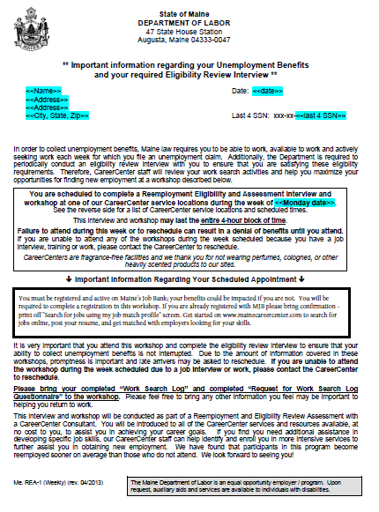
Successful Strategies for scheduling Pre-&-Post Labs and Group sessions
An embedded Notification paragraph within the REA selection letter delivers a CareerCenter message.
This paragraph is a boxed area within the letter where we can place dedicated messages and updated information.
Notification paragraph
You must be registered and active on Maine’s Job Bank; your benefits could be impacted if you are not. You will be required to complete a registration in this workshop. If you are already registered with MJB please bring confirmation –print off “Search for jobs using my job match profile” screen. Get started on www.mainecareercenter.com to search for jobs online, post your resume, and get matched with employers looking for your skills.

Slide 30
Successful Strategies for scheduling Pre-&-Post Labs and Group sessions
We rotate different “default” paragraphs pertaining general information when there are not any particular messages to post. The most widely used default paragraph messages carry the importance of being registered and active in Maine’s Job Bank.
Maine sends out the Work Search Log and Work Search Questionnaire with their claim, and the REA selection letter reminds them to bring that completed documentation with them to the session.

Slide 31
Successful Strategies for scheduling Pre-&-Post Labs and Group sessions
Courtesy Reminder Calls- increase attendance and our first connection and opportunity for intervention.
After receiving, and researching participants on the weekly list, we contact each customer to remind them of the REA.
REA staff use the reminder calls as a tool to strategically schedule selected participants into our Pre- and Post- Lab sessions.

Slide 32
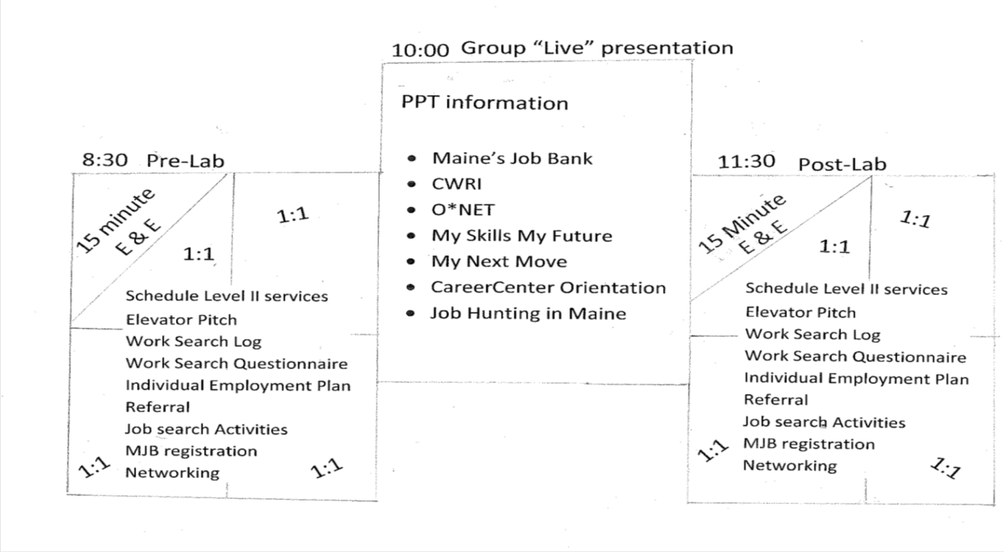
Successful Strategies for scheduling Pre-&-Post Labs and Group sessions
The reminder call scheduling strategy allows approximately ½ the selected participants to attend the Pre-lab portion of this format and ½ attending the Post-lab portion - thus keeping the 1:1 numbers manageable within the contained REA workshop.
We begin the Pre-lab in the following format:

Slide 33
Value Added time spent in REA Pre-and-Post Labs
REA Pre- and Post-Lab Format
We piloted this format model while delivering our REA-EUC program. The REA-U staff’s flexibility and performance was phenomenal and the pilot model was well received and working for our customers.
During Lab time, participants are accommodated in the workshop room engaged in job search activities, completion of paperwork and provided laptop access for hands-on experience to job seekers using Maine’s Job Bank and the internet.

Slide 34
Value Added time spent in REA Pre-and-Post Labs
E&E- Expectation & Explanation
Extremely important to use the E&E instruction time explicitly indicating the use of this time and ground rules for this activity. The lab allows valuable time with work search activity tools, and resources.
We spend about 15 minutes of E&E talking about resources available in the room and tools to use and ask that everyone participate in a positive manner.

Slide 35
Value Added time spent in REA Pre-and-Post Labs
Provide a handout with a list of activities to do while waiting for individual One-on-one.
Individual Employment Plan- Discuss goals and strategies resulting in success and provide examples for development.
Register for Maine’s Job Bank-update and activate your profile and print out documentation.
Opportunity to Check e-mail and possible job referrals.

Slide 36
Value Added time spent in REA Pre-and-Post Labs
Elevator Pitch or speech- template and how-to information.
Check out job search activities and related materials.
Browse job boards.
Research companies.
Complete online applications or complete a “Master Application.”

Slide 37
Value Added time spent in REA Pre-and-Post Labs
Explore CareerCenter website for Job fairs and recruitments.
Sign up for additional CareerCenter workshops.
Networking.
Job search video.
Browse “Job Hunting in Maine” publication.
Prepare questions for your 1:1 session.

Slide 38
Value Added time spent in REA Pre-and-Post Labs
Sign up in REA Counselor calendar for additional help or services.
Consider your “Referral” –everyone must have a “next step.”
The expectation is that everyone will be busy doing something related to searching for work. Lab time is considered a part of participating in the REA session for completion credit. The lab time was developed for participants to show they are actively looking for work. Be prepared to discuss how you spent your lab time.

Slide 39
Value Added time spent in REA Pre-and-Post Labs
One-on-One, in person Eligibility Review interviews.
Staff provide both reemployment services and a UI Eligibility review.
Participants are asked how they spent their time during the lab opportunity.
Staff are trained on how to conduct a UI eligibility review to Include Work Search Questionnaire, Work Search Log.
Review the IEP and discuss an appropriate referral for individual participant.
Apprise the participant of the appropriate UI process and expectations.

Slide 40
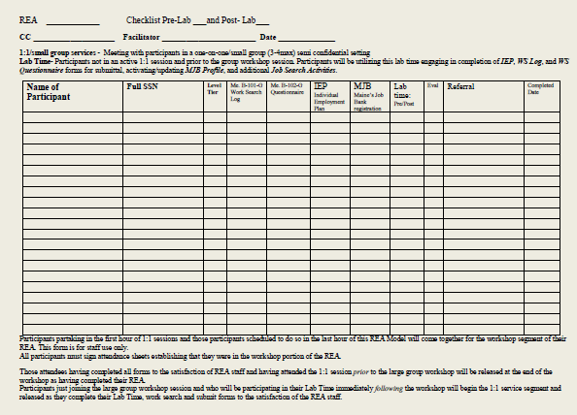
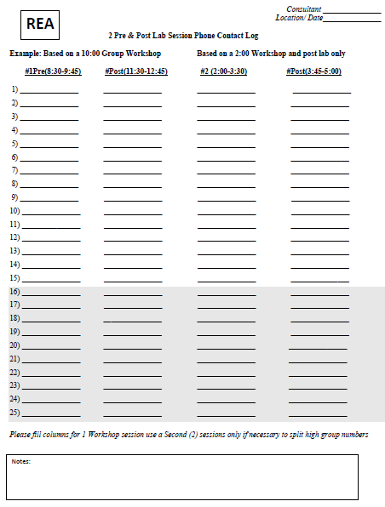
Value Added time spent in REA Pre-and-Post Labs
We use the “REA Activity Log” form, created for staff to organize and track participant’s individual submittal of forms during the Pre-&Post labs.
This form is used to schedule participants during our reminder phone calls
Activity Log Checklist for Pre-&Post Labs

Slide 41
Value Added time spent in REA Pre-and-Post Labs
Components of an REA must include the following:
1:1 session-
Referral-A referral to additional services or next step for participant. This may be an internal referral to additional CareerCenter services or an external referral to services and resources provided by a partner or agency.
Individual Employment Plan-
IEP must be completed with a copy for local files. The IEP indicates the participant’s referral or “next step” in job search.

Slide 42
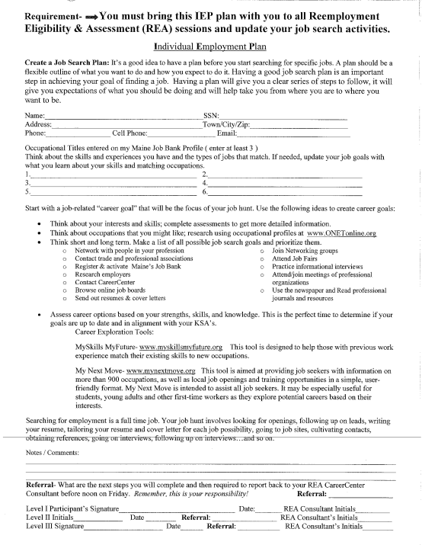
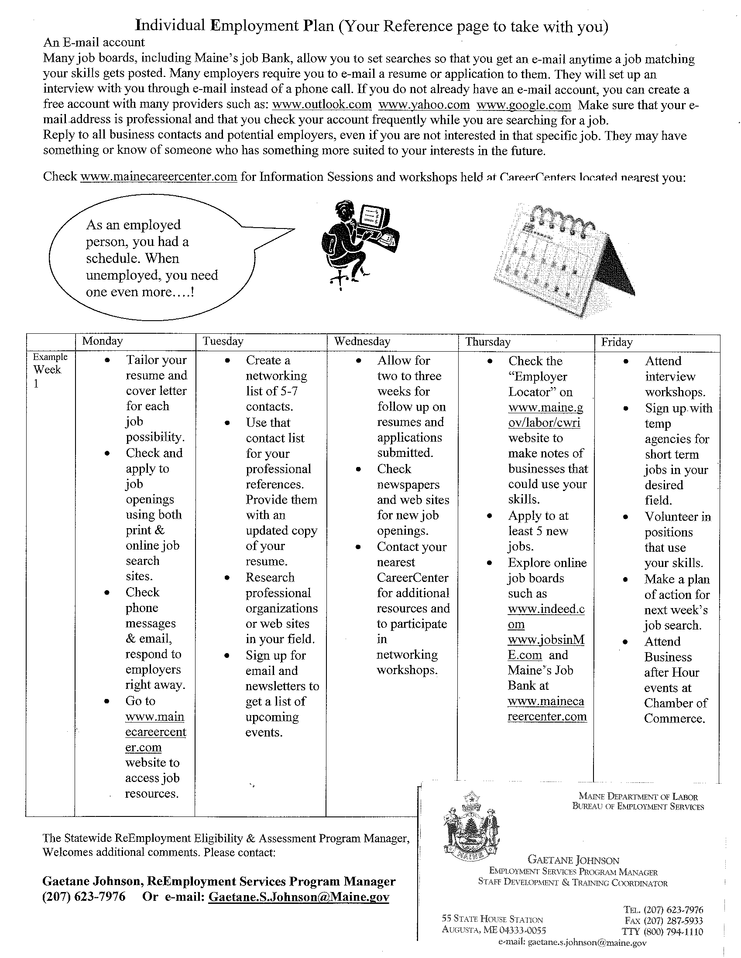
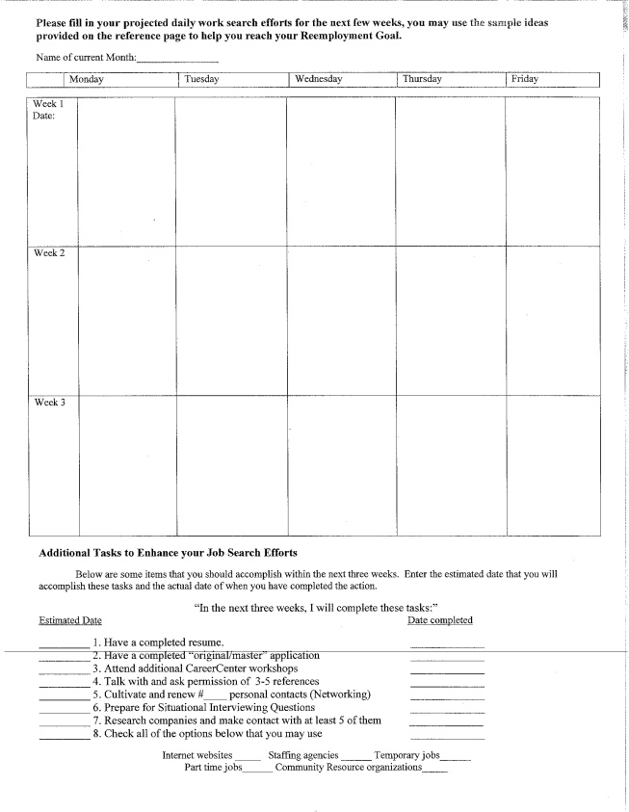
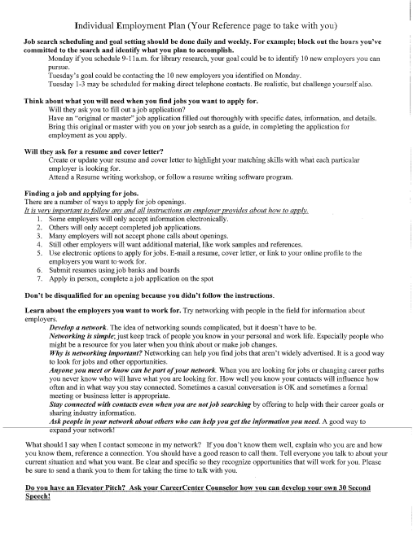
Individual Employment Plan
Start your plan TODAY, take it with you and work on it every day, when you come back for more help, bring it with you!
Place your contact info or business card here

Slide 43
Individual Employment plan
Your Employment Plan tells us how you search for work.
It is a snapshot in time, and MUST be completed with as accurate information as you can provide today.
This tool should be used as a guide going forward on how you plan to succeed in re-entering the workforce.
The activities listed will help you to remember to use alternative methods of job search.

Slide 44
Value Added time spent in REA Pre-and-Post Labs
Work Search Log-content and information on this form are discussed during the 1:1 meeting. A review of the individual’s adherence to Maine’s UI job search and able and availability benefit eligibility requirement.
Work Search Questionnaire- questions and comment on this form are discussed during the 1:1 meeting.
Group orientation
The Eligibility Review Interview (ERI) process includes an evaluation of the participant’s reemployment efforts.
The ERI serves to protect the Program integrity and focuses on the participant’s responsibilities for receiving benefits.

Slide 45
Interactive Group Workshops include “Live” website demonstrations
Our group sessions disseminate information using live and interactive internet site access and demonstrations for participants with information covering:
CareerCenter orientation www.mainecareercenter.com
CWRI http://www.maine.gov/labor/cwri/jobseekers.html
Maine’s Job Bank http://www.mainecareercenter.com/
Job Hunting in Maine http://www.mainecareercenter.com/docs/Job_Hunting_in%20_ME.pdf

Slide 46
Interactive Group Workshops include “Live” website demonstrations
Resource familiarity and tools such as; networking, job boards, master applications, and discussions covering tips and strategies on conducting a successful job search.
Elevator Pitch -A description of your skills and career goals. Job seekers use this as a networking tool to briefly market themselves to potential employers.
What do
you do?
What can
you do for me?
Why should I
hire you?
How can I
contact you?
Who are you?
Use these steps to answer 5 questions towards your own elevator pitch…you already have the answers to the first and last step.

Slide 47
Interactive Group Workshops include “Live” website demonstrations
We utilize career exploration tools from USDOL as well as our own.
O*NET www.onetonline.org
My Next Move www.mynextmove.org
My Skills-My Future www.myskillsmyfuture.org
Relate… sequence… correlate… be sure to explain the relationship between the live sites and the information directing the consistent language and relevancy between the sites and the job seeker.

Slide 48
Interactive Group Workshops include “Live” website demonstrations
The group workshop session is approximately an hour and half dissemination of required REA Program information Participants from both Labs are scheduled together for the group session of the workshop.
Those participants having completed all forms to the satisfaction of REA staff and having attended the Pre-Lab session PRIOR to the group workshop are released at the end of the PowerPoint portion of the workshop.
Participants just joining the large group workshop and who will be participating in their Post-Lab immediately FOLLOWING the PowerPoint will begin the Post-Lab segment and may leave once they complete their full lab activities, and submit completed forms to the satisfaction of the REA staff. (The Post-Lab is the repeated format of the Pre-Lab)

Slide 49
Interactive Group Workshops include “Live” website demonstrations
Evaluations- Critiquing our intent to be a “Value added” existence
We use survey evaluations to create and tweak our intervention development.
Giving the ability to participants to “voice” their need, comments, and opinions.
REA format is a working product that changes slightly as needed
The Pre- and Post-lab provide valuable 1:1 time for real discussion and informed referrals.
Growing into our current model.

Slide 50
Interactive Group Workshops include “Live” website demonstrations
Database Interface- REAp Process Flow Tracking
Provide daily updated metrics from REA activities associated with Career Centers to REA coordinators and other pertinent BUC and BES managers
Provide REA reporting with tracking and control and documentation capability
Support more timely REA program data to enable better management decision making
Create efficient and accurate REA productivity tracking and comparisons
Create automatic update and scheduling for Fact Finding and adjudication
1:1 - Viable information and critical UI intervention

Slide 51
Interactive Group Workshops include “Live” website demonstrations
Closing statement
The research we do, and the resources we uncover and pass on to the REA participant, are great stuff. There are many good things included in REA sessions, and it is difficult for customers to absorb all that we deliver in one session. New and pertinent information is available every day. And, even though we present our workshops to include all the newest information, we grow in our delivery by what we see and learn ourselves each day.
This program is a great help to many people and we see it in every session we hold. My appreciation and respect goes out to the REA team in our CareerCenters and the BUC for their consistent hard work and compassion.

Slide 52
Please enter your questions in the Chat Room!
Notes:
Please enter your questions into the Chat Room!

Slide 53
Speakers’ Contact Information
Speaker: Kathy Catanzaro
Title: Chief – UI Special Programs
Organization: Rhode Island Department of Labor and Training
Email: Kathy. Catanzaro@dlt.ri.gov Catanzaro
Speaker: Hector Rivera
Title: Chief – Workforce Development
Organization: Rhode Island Department of Labor and Training
Email: Hector.Rivera@dlt.ri.gov
Speaker: Gaetane Johnson
Title: Reemployment Services Program Manager
Organization: Maine Department of Labor
Email: Gaetane.S.Johnson@Maine.gov

Slide 54
Speakers’ Contact Information
Moderator: Diane Wood
Title: UI Program Specialists
Organization: US Department of Labor
Email: Wood.diane@dol.gov

Slide 55
Thank You!
Find resources for workforce system success at:
www.workforce3one.org

