Slide 1

December 18, 2014
Presented by U.S Department of Labor
Employment and Training Administration and
Jobs for the Future
Announcing New Technical Assistance Resources
For Trade Adjustment Act Community College Career Training (TAACCCT) Program Grantees

Slide 2
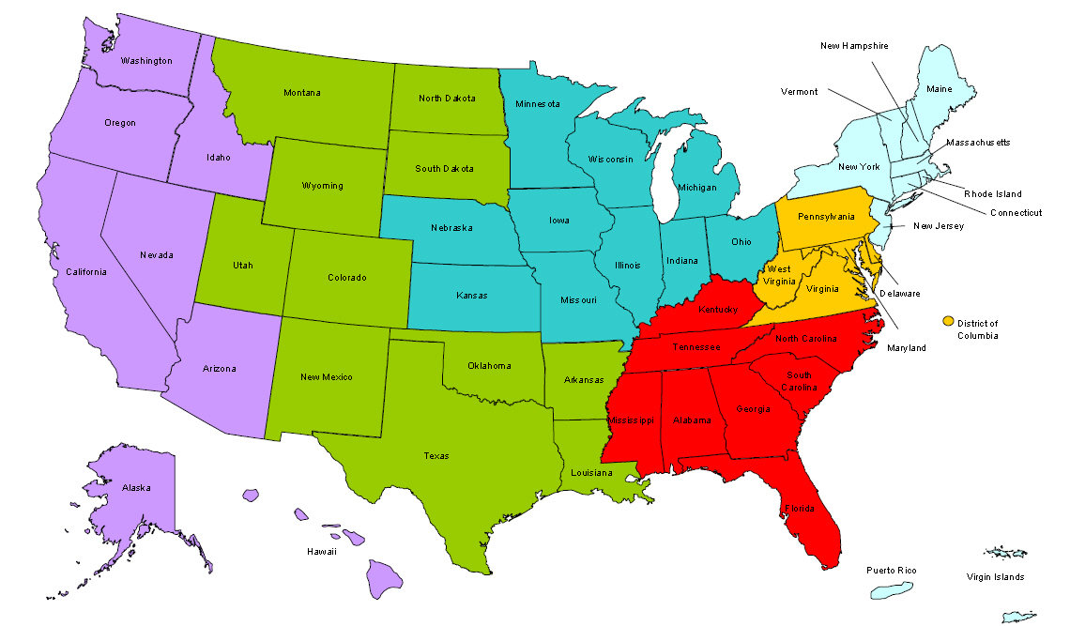
Where are you?
Enter your location in the Chat window – lower left of screen

Slide 3
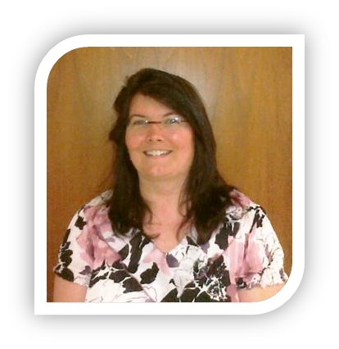
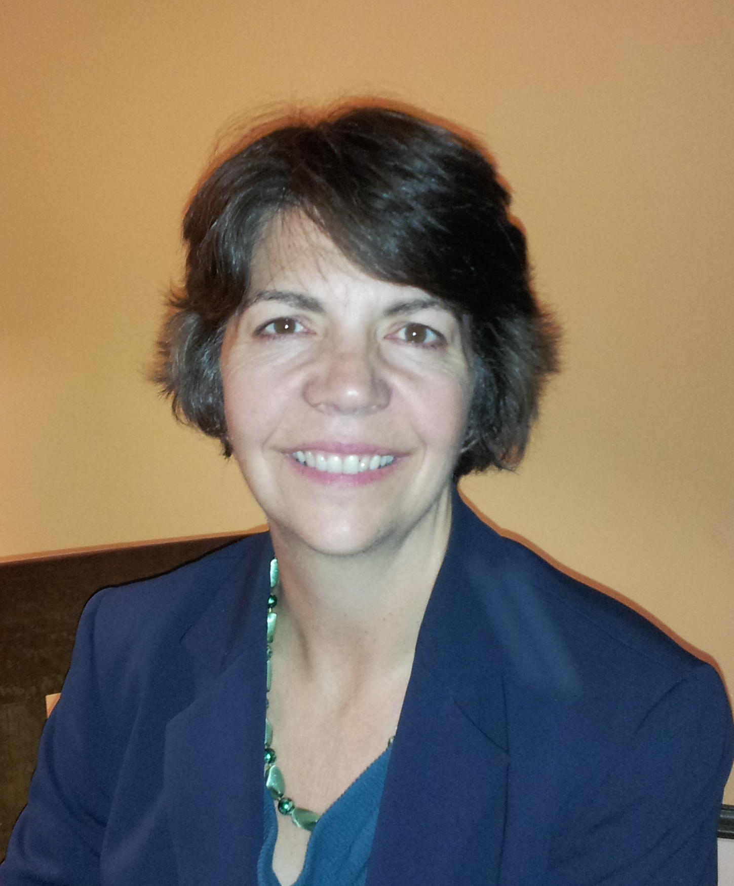

Presenters
Robin Fernkas, Director
Division of Strategic Investments
DOLETA
Jennifer Freeman, Program Director
TAACCCT Learning Network
Jobs for the Future

Slide 4

Here’s what you can expect to get out of this webinar
Hear about new technical assistance offerings
Provide input & feedback
3. Learn about upcoming events

Slide 5
Agenda
Introduction to the TAACCCT Learning Network and Services
The Technical Assistance Team
TAACCCT Learning Network Events
Q&A
Wrap-up & Next Steps

Slide 6

Role of the TAACCCT Learning Network
National Office (Division of Strategic Investments and Office of Grants Management) and Regional office (Federal Project Officers)
Guidance on TAACCCT program policy, Federal rules and regulations
Program and fiscal compliance
Performance reporting
Improving outcomes through strong program designs
Grant and consortium management assistance
Peer sharing and replication

Slide 7
TAACCCT Technical Assistance
U.S. Department of Labor
(National)
Jobs for the Future
CalState/Merlot
Maher&Maher and AACC
Other Providers of TA to TAACCCT Grantees:
Creative Commons
CAST
NSF/ATE Centers

Slide 8
TAACCCT Learning Network Offerings
Virtual Group Exchanges
Individualized Assistance
In-Person Convenings
Tools & Resources

Slide 9
TAACCCT Learning Network Offerings
Virtual Group Exchanges
Webinars: key topics & challenges based on input from grantees
Conference Calls: individualized or group calls to go deeper into key topics & challenges
Peer-to-Peer Network: opportunities to hear from peers via calls, webinars, chats

Slide 10

Polling Question
Q. Which of these subject areas for webinars and calls would be most helpful to your project?
Put your 1st choice1 - 7, plus a word
in the chat box, and tell us which Round you are from
Consortium/Grants Management
Career Pathway Development
Technology Enabled Teaching and Learning
Alignment with Industry and the WF System
Sustaining your Impact
Managing Change
0ther (specify)

Slide 11
TAACCCT Learning Network Offerings
Individualized Assistance
Weekly Electronic chats where you can engage with the TLN team. www.workforce3one.org
Get your questions answered by the TLN team or other subject matter experts by sending questions to TAACCCT@dol.gov
Peer-to-Peer mentoring opportunities with between grantees

Slide 12

Let’s Talk!
What issue does your grant/consortium need some help with RIGHT NOW?
Who most needs that help? -- grant managers, faculty, administrators, student advisors, etc.

Slide 13

Polling Question
Q. Does your project have a strong practice that you could share with other grantees?
Q. If you represent a consortium, do you have strong practices related to consortium management that you could share with others?
If so, enter “yes” in the chat box along with your TAACCCT project name

Slide 14
TAACCCT Learning Network Offerings
In-Person Convenings
Annual convenings for all grantees to engage with peers, and share and learn best practices
TLN presence at outside conferences/convenings that grantees attend throughout the year. May include: conference sessions, pre-conferences, networking opportunities

Slide 15

TAACCCT Learning Network Offerings
Tools & Resources
TAACCCT Resource Page that will be continually updated
Monthly Newsletter featuring grantees, resources, upcoming events, etc.
Toolkits developed to support your work and assess your progress
Case Studies that highlight best and promising practices

Slide 16
Upcoming Events
Round 4 Grants Management Webinars
In-Person Convenings
Round 4 Convening, late spring 2015
TLN Annual Convening, fall 2015
Topical Webinars
Employer Engagement, Jan. 20, 3:30 – 4:30 EST
Round 2 “The Final Stretch”, late February, TBD
Financial Management, Live Q &A; January 6, 3 – 4 EST
Performance Reporting, Live Q&A; January 21, 3 – 4 EST
Fiscal Reporting; Feb 6, 3 – 4 EST
Finding and Using OER, TBD
Universal Design in Curriculum, TBD

Slide 17

Open Discussion

Slide 18
Thank You!
Find resources for workforce system success at:
www.workforce3one.org
Send your specific questions to taaccct@dol.gov

