Slide 1
DEI Orientation Part 2: DEI Strategic Service Delivery Components & the DEI Development Framework Tool
Webinar Date: January 30th 2014
Presented by: Laura Gleneck and Miranda Kennedy with NDI Technical Assistance Team
U.S. Department of Labor
Employment and Training Administration

Slide 2
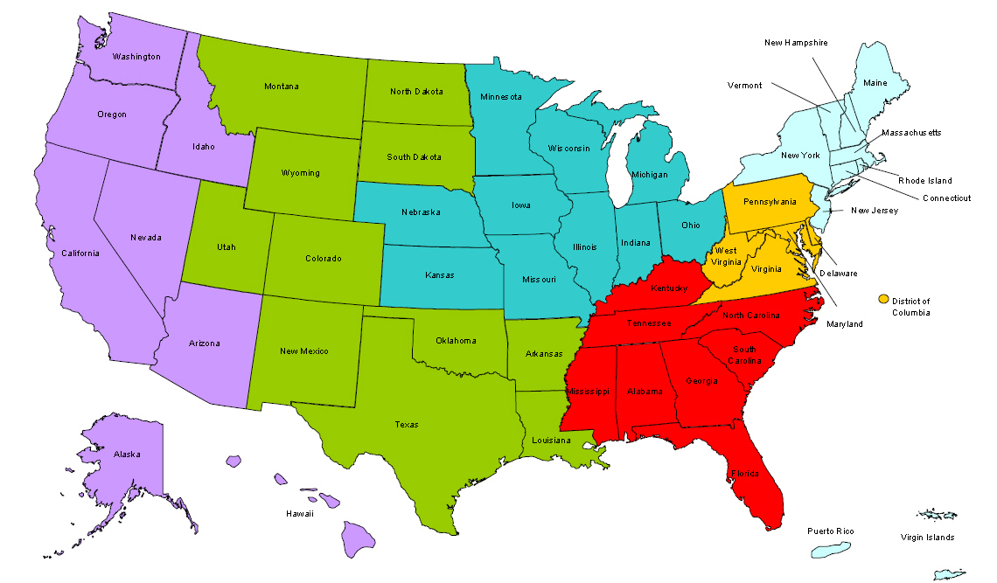
Where are you?
Enter your location in the Chat window – lower left of screen
Notes:
In the Chat Room, please type the name of the your organization, your location, and how many people are attending with you today.

Slide 3
Moderator
Moderator: Randee Chafkin
Title: Workforce Development Specialist
Organization: Employment and Training Administration
#
3

Slide 4
Disability Employment Initiative
Training and Technical Assistance to DEI Projects is provided under U.S. DOLETA contract with NDI Consulting, Inc. and the National Disability Institute (NDI).
Evaluation of the impact of the DEI Projects implementation and outcomes will be provided under U.S. DOL ODEP contract with Social Dynamics and its partners.
Notes:
Randee

Slide 5
Learning Objectives
Upon completion of this training, DEI grantees will have the following:
An "overview" of the 7 DEI Strategic Service Delivery Components
Understanding of the purpose and relevance of the DEI Development Framework as it relates to state level DEI Projects and local DEI Pilot Sites
Information on upcoming trainings and technical assistance support related to these service delivery components
Notes:
Randee
Upon completion of this training, DEI grantees will have the following:
An "overview" of the 7 Strategic Service Delivery Components
Understanding of the purpose and relevance of the DEI Development Framework as it relates to state level DEI Projects and local DEI Pilot Sites
Ability to effectively utilize the DEI Development Framework to:
Asses the current stage of development of the state DEI Project across all categories at any point in the project
Chart a course for future activities from any starting point within each strategic service delivery component
Clearly identify successful implementation outcomes to serve as ultimate outcome goals for the state DEI Project
Information on upcoming trainings and technical assistance support related to these service delivery components

Slide 6
Presenters
Presenter: Laura Gleneck
Title: Program Manager for DEI, NDI Technical Assistance Team
Organization: National Disability Institute
Presenter: Miranda Kennedy
Title: Director of Training for DEI, NDI Technical Assistance Team
Organization: National Disability Institute
#
6
Notes:
Randee

Slide 7
Agenda
30-Second Training Introducing your NDI TA Team
Creation, background and purpose of DEI Development Framework
Use of DEI Development Framework Tool by State and Local DEI staff
Overview of the DEI Development Framework Worksheet
Training and Technical Assistance Support
Notes:
Miranda

Slide 8
It’s time to meet your Technical Assistance Team
Let’s do a 30-Second Training!
Notes:
Miranda
Go to NDI TA Team Intro 30-Second Training. Miranda will facilitate. Brian will post poll’s w/ names of NDI TA Team members. Randee will read the content of the TA Team members slides explaining who they are, etc…

Slide 9
The Creation of the DEI Development Framework
Notes:
Laura

Slide 10
DEI Strategic Service Delivery Components
DOL Requires that all applicants implement the first component, Partnerships and Collaboration, as part of their service delivery approach for the adult or youth population they plan to serve. In addition, an applicant must identify at least two of the other six strategic service delivery components listed below to include in their service delivery approach. Note however that applicants focusing on a youth population must choose the Youth Guideposts for Success components as one of their two additional strategies.
DEI Strategic Service Delivery Components:
Integrated Resource Teams (IRTs)
Integrating Resources and Services, Blending and Braiding Funds, and Leveraging Resources
Customized Employment
Self-Employment
Youth Guideposts for Success
Asset Development Strategies
Notes:
Laura

Slide 11
Background: The Creation of the DEI Benchmarks & Outcomes
Strategic Service Delivery Components
Developed in response to requests and feedback from both the evaluation team and grantees on guidance around implementation of the DEI service delivery strategies and grantee progress.
Similarities between this tool and the Maturity Model that was created under the Disability Program Navigator (DPN) initiative.
Designed to serve as a continuum to assess implementation status of the DEI and identify priorities for development.
A framework to achieve outcomes in each of the strategic service delivery areas.
Notes:
Laura

Slide 12
Why was the DEI Development Framework Tool and Worksheet developed?
To help define the activities and outcomes associated with those activities that projects will need to engage in order to deliver each of the DEI strategic service delivery components that they committed to implementing in their grant application.
To help states and local areas assess their baseline and see where they need to go (some might be pleased with having already covered many basics, etc…)
To help state and local areas identify any areas they have not addressed and tag those for support from TA, state level leadership, national level, etc…
To provide a framework and guide, within which each project is encouraged to be innovative and tailor activities to meet the needs of the local area, etc…
Notes:
Laura

Slide 13
Why was the DEI Development Framework Tool and Worksheet developed? (cont.)
It is NOT to limit projects to only those activities identified in the framework.
This framework is NOT to be used to evaluate staff or program performance.
The framework is a tool to assess the implementation level of the DEI.
Notes:
Laura

Slide 14
DEI Development Framework Tool
“The secret of getting ahead is getting started. The secret of getting started is breaking your complex overwhelming tasks into manageable tasks, and then starting on the first one.” – Mark Twain
Notes:
Miranda

Slide 15
What is the “DEI Development Framework Tool”?
The Development Framework of DEI Implementation is designed to provide states and local workforce investment areas that are serving as DEI pilot (implementing) sites with a developmental tool to:
assess implementation status of the DEI and
identify priorities for development.
This tool serves as an approved framework to help projects develop in terms of achieving outcomes in each of the 7 service delivery areas.
There are three focus areas within each service delivery component to assess priorities for growth and improvement of implementation:
Beginner (disability expertise)
Intermediate (problem solving); and
Advanced (policies and practices)
Within each focus area, key outcome indicators have been highlighted.
Notes:
Miranda
A framework which isolates the attributes of development along a continuum and describes more fully how the implementation cycle can help determine the progress of any state’s initiative at a given time. It can help states plan the progression for growing and expanding their state DEI project beyond grant funds. It can help evaluators assess the effectiveness of various implementation efforts.
The following three pivotal factors can be used to gauge the development of DEI implementation of the strategic service delivery components of a grantee’s service delivery approach to serve the youth or adult population:
The degree and distribution of disability expertise related to employment;
The level of problem solving in which the DRC and/or the DEI pilot site staff and DEI Project state level leadership is primarily engaged; and
The sustainability of promising practices into state policies and procedures.
The DEI Framework tool, which begins on the next page, includes the three focus areas (Disability Expertise, Problem-Solving, and Policies and Practices) for each of the seven strategic service delivery components. These have been further clarified in the tool as being designated as Beginner, Intermediate and Advanced. For each area key outcome indicators have been identified.
All of the activities under each specific Strategic Service Delivery Component in this Framework tool are connected to one another. The goal is to look first under the Beginner Column and then move on to activities under the other columns (e.g., Intermediate and then Advanced).

Slide 16
Prior to DEI Development: DEI Project Start-Up
During project start-up and initial implementation, grantees have been focused on three core areas:
Working with DOL and the DEI evaluation team on the lottery rules used to select the local workforce investment boards (WIBs) that will participate in the DEI grant project.
The State workforce agency or local WIB: 1) already operate as an Employment Network (EN) under the Ticket to Work and Work Incentives Improvement Act; or 2) committed to apply for EN status to the Social Security Administration (SSA) within 60 days of pilot site selection.
Developed the process for hiring and supervising local level full-time Disability Resource Coordinator (DRC) positions to implement the state’s DEI project strategic approach OR assisting the designated local WIBs in this process.
Notes:
Miranda

Slide 17
DEI Development Framework Tool
Let’s check out the Tool!
Notes:
Miranda

Slide 18
Upcoming Trainings
The NDI team will be providing ongoing additional trainings on DEI Strategic Service delivery Components
For example on the IRT Strategic Service Delivery Element these trainings are currently archived on the DEI password protected website Training Archives page, and will be updated and presented again during 2014.
Introduction to the Integrated Resource Team (IRT) Model
Will provide a basic overview of the IRT approach
Comprehensive Breakdown of the Integrated Resource Team (IRT) Approach
Will build upon the first training by providing a comprehensive in-depth breakdown of the IRT model from start to finish.
Be sure and take note of all available DEI trainings through the NDI training notices distributed monthly via the DEI listserv!
Notes:
Laura

Slide 19
Technical Assistance Support
Your designated TA Liaison can provided the following supports:
Coordinate/Facilitate/Present on these topics on your DEI Project’s monthly call and/or on ad hoc calls with your project as needed
Provide one-on-one support, engage in problem-solving, and provide resources to individual DRCs and local areas via phone and e-mail to:
Present information and address challenges during site-visits with project
Connect state and local level DEI grantees with experts and peers as appropriate
NDI General support on DEI Strategic Service Delivery Components DEI password protected website
Training Archives page:
http://www.dei-ideas.org/chapter1/page01a_webinar_private.cfm
Notes:
Laura

Slide 20
Summary
On today’s training we provided:
An introduction to your NDI TA Team
Information on the creation, background and purpose of the DEI Development Framework
Information on how state and local DEI staff can use the DEI Development Framework Tool and Worksheet
A Walk-Through and Overview of the DEI Development Framework Worksheet
Information on Training and Technical Assistance Support
Notes:
Randee

Slide 21
Open Chat
What are your thoughts/questions about the DEI Development Framework Tool?
Notes:
2nd POLL – using chat feature
OPTION 2 POLLING
NOTE – the chat box will remain open for the duration of the Webinar, and the questions will weave into the webinar as we go – no question is a dumb question – so please feel free!
(Click to next slide)

Slide 22
Please enter your questions in the Chat Room!
Notes:
Please enter your questions into the Chat Room!

Slide 23
Speakers’ Contact Information
Speaker: Miranda Kennedy
Title: Director of Training
Organization: National Disability Institute
Email: mkennedy@ndi-inc.org
Telephone: 720-890-3990
Speaker: Laura Gleneck
Title: Program Manager
Organization: National Disability Institute
Email: lgleneck@ndi-inc.org
Telephone: 781-899-0139

Slide 24
Thank You!
Find resources for workforce system success at:
www.workforce3one.org

