Slide 1
Integrating Effective Mentoring Strategies and Services into Youth Services
Webinar Date: June 9, 2014
Presented by: Office of Policy Development and Research
U.S. Department of Labor
Employment and Training Administration

Slide 2
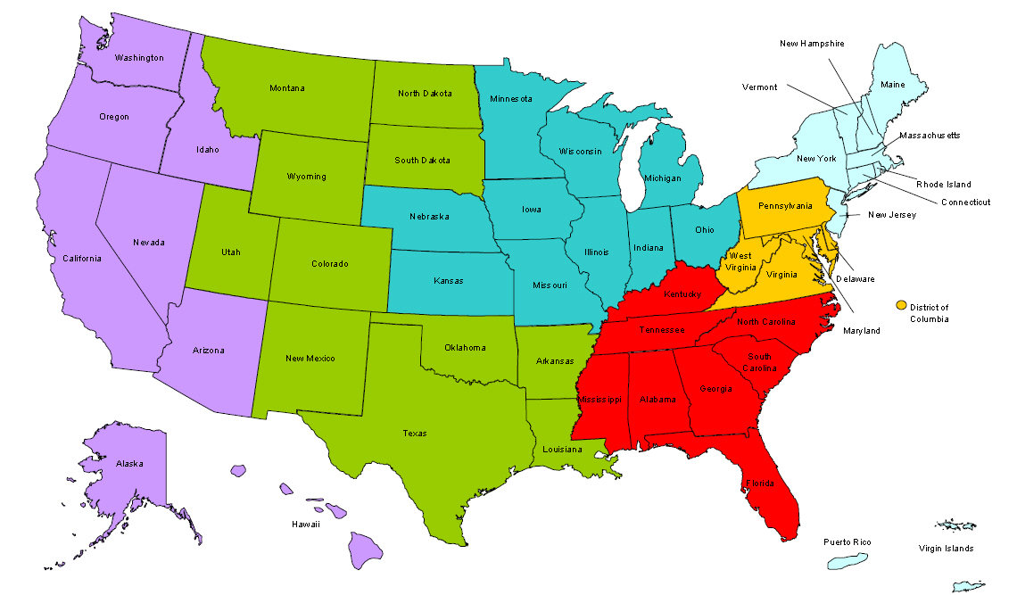
Where are you?
Enter your location in the Chat window – lower left of screen

Slide 3

Moderator
Gloria Salas-Kos
Office of Policy Development and Research
Employment and Training Administration
U.S. Department of Labor

Slide 4
Integrating Effective Mentoring Strategies and Services into Youth Services
Poll Question: What is the biggest challenge to setting up mentoring as a service within your organization?
  Initiating a new program
  Identifying and recruiting mentors
  Training staff and mentors to understand youth culture
  Establishing and retaining long-term and quality mentoring relationships

Slide 5

Here’s what you can expect to get out of this webinar!
Background information about programs with mentoring services
Mentoring strategies examples used for new and existing programs
Mentoring and other program resources available through Workforce 3One and MENTOR
Interactive discussion!

Slide 6
Agenda
Introduction
Workforce Investment Act Youth Activities
Mentoring as a New Service
  Core Components of Effectiveness
  Lessons Learned
Strengthening Mentor Services
  Partnerships and Collaboration
  Sustaining Mentoring Relationships
  Effective Mentor/Mentee Engagement Strategies
Creating Quality and Expanding Mentor Relationships
Open Chat

Slide 7
INTRODUCTION
Young Parents Demonstration Project
  Mentoring Youth and Young Parents: A Guidebook for Programs Helping Youth and Young Parents Navigate a Pathway to Self-Sufficiency
  Training and Employment Notice (TEN) 28-13 -- Release and Availability of a Report, “Mentoring Youth and Young Parents: A Guidebook for Programs Helping Youth and Young Parents Navigate a Pathway to Self-Sufficiency”
  Strengthening mentoring services for eligible youth and tying the resources together

Slide 8


Presenters
Maisha Meminger
Division of Youth Services
Office of Workforce Investment
Employment and Training Administration
Diana Hernandez
Workforce Development Director
Youth Programs
AltaMed Health Services Corporation

Slide 9

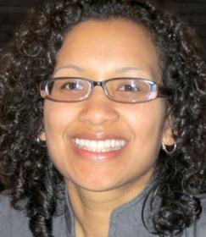
Presenters
Kerri Pruitt
Executive Director
The Dannon Project
Tammy Tai
Chief Program Officer
MENTOR

Slide 10
Strengthen Mentoring As a Service
Maisha Meminger
Division of Youth Services
Office of Workforce Investment
Employment and Training Administration

Slide 11
Division of Youth Services
Our Office’s primary responsibilities:
Coordinating all youth-related workforce activities;
Providing leadership, policy direction, program administration, technical assistance and guidance; and
Supporting activities for youth programs authorized under the Workforce Investment Act (WIA) of 1998

Slide 12
WIA Youth Program
14-21 year old, low-income youth, with one of the following barriers:
  Basic skills deficient
  School dropout
  Homeless, runaway, or foster child
  Pregnant or parent
  Offender
  Individual who requires additional assistance to complete an education program or secure and hold employment

Slide 13
Services under the WIA Youth Program
Academic
  Tutoring, study skills training, and dropout prevention activities
  Alternative secondary school offerings
Vocational
  Work experience, summer employment
  Occupational skills training
  Leadership development activities
Support
  Supportive services
  Mentoring
  Follow-up services
  Comprehensive guidance and counseling

Slide 14
Integrating Effective Mentoring Strategies and Services into Youth Services
Training and Employment Guidance Letter No. 5-12: Workforce Investment Act (WIA) Youth Program Guidance for Program Year (PY) 2012
Increasing the quantity and quality of mentoring services available for WIA Youth
Identifying existing mentoring programs and connect WIA youth to those services
Partnering with organizations to serve older or out-of-school youth

Slide 15
Mentoring as a New Service
Diana Hernandez
Workforce Development Director
Youth Programs
AltaMed Health Services Corporation

Slide 16
Mentoring as a New Service for Existing Youth Programs
Largest independent Federally Qualified Community Health Center in the U.S. delivering more than 855,000 annual patient Comprehensive Services from Birth through Seniors years
Youth Programs: case management, pregnancy prevention, health and parenting education, academic and career services.
Serve 1,700 pregnant/parenting teens la county

Slide 17
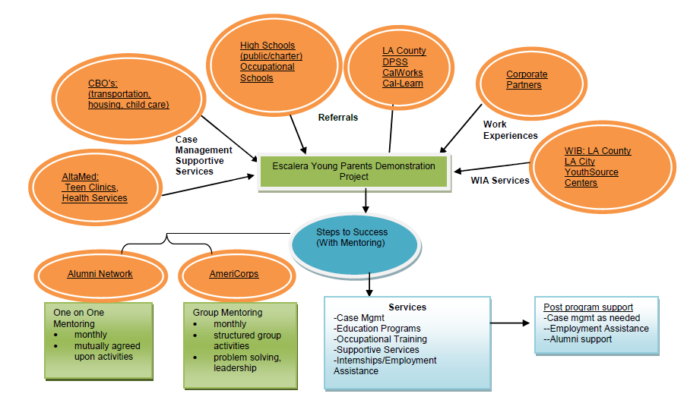
Defining AltaMed’s Mentoring Strategies and Services for the Escalera Young Parents Program

Slide 18
Program Management and Capacity-building
Staffing
Mentor Training (10 hours)
  Coordinator
    Mentor Recruitment
    Matching
    Training
    Mentor Recognition
  AmeriCorps Members
    Group Mentors
  Program Alumni
    One-to-One Mentors
  Overview of the project and their role;
  Description of what mentoring is and is not;
  Qualities of a good mentor; obligations, goals and expectations;
  Characteristics of youth in the program and special needs;
  The mentoring relationship and setting appropriate boundaries;
  Program rules;
  Relationship development and maintenance;
  Ethical issues that may arise;
  Mentoring Resources

Slide 19
Mentor Engagement and Activities
Group Mentoring
One-to-One
  Structured Activities
    Leadership Skills
    Career Development
    Conflict Resolution
    Health And Wellness
    Parenting Skills
  2 hour Monthly Meetings
    In Person
  Peer Support
    Mutually agreed upon activities
    Cultural Outings
    Recreational
    Career Guidance
    Homework Assistance
  4 hours Monthly
    In Person
    Phone
    e-mail
    text message

Slide 20
Challenges and Lessons Learned
Lessons Learned
  Provide resources to support mentoring activities
    Transportation, child care, activity options
  Mentor Retention
    Acknowledgement
    Continued Training
    Engaging different audiences; age, professional levels
  Leverage community partnerships and organizational strengths
    AltaMed employees as mentors

Slide 21
Strengthening Mentor Services through Enhancements
Kerri Pruitt
Executive Director
The Dannon Project

Slide 22
YPD + Partnerships and Collaborations =
YPD Success
  Dannon Project assessed existing partnerships and used assessment build new sustainable collaborations.
    Existing partnerships collaborations
    New and sustainable collaborations
      Childcare
      Employment
      Recruitment efforts
      Mentors positively affecting the overall outcome of the program.

Slide 23
Assessing Services to Enhance Mentoring for Young Parents
Dannon Project’s relationship with the Department of Human Resources (TANF)
  Children of TANF Jobs Program participants received priority in child care while parents enrolled in YPD
  Recruitment partner
  Post YPD outcomes: career placement for YPD participants, and no longer on TANF
Create an action plan
Identify key stakeholders and partners
Involve stakeholders and partners in the action planning

Slide 24
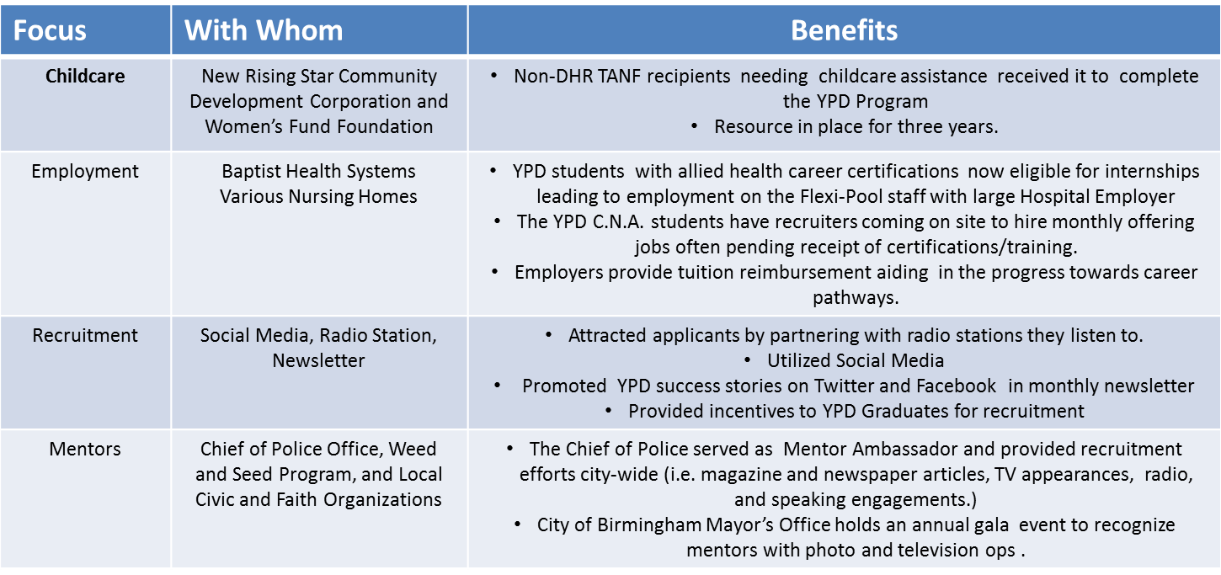
Action Plan: With Focus on Partners and Benefits

Slide 25
Sustaining Mentoring Relationships
Matching
  Assess interests (etc.) of mentor and mentees
  Group activities
Time Commitment
  Schedule and number of hours
Incentives
  Mutually beneficial
Agreements

Slide 26
Effective Mentor/Mentee Engagement Strategies
Group Events
  Offering group mentoring first helped to pave the successful way to individual mentoring relationships
    Mentor Coordinator plans group events –
      With topical discussions, training, food (provided by Jack’s Restaurant), and FUN!
      Participants bring their children as well to places like the park, zoo, etc.
      This method allows mentees and mentors to get to know each other better.
Individual Activities
  Matches decide how they wanted to spend their 3 hours per month during the group events.
  Use time to communicate and interact one-to-one (i.e. text, phone calls, job references, assisting with job interviews, tutoring, church and program attendance)

Slide 27
Creating Quality and Expanding Mentor Relationships
Tammy Tai
Chief Program Officer
MENTOR

Slide 28
MENTOR’s Mission
Fuel the quality and quantity of mentoring relationships for America’s young people and to close the mentoring gap.
For nearly 25 years, MENTOR and its growing network of affiliate Mentoring Partnerships have served the mentoring field by providing a public voice, developing and delivering resources to mentoring programs nationwide and promoting quality for mentoring through standards, cutting-edge research and state of the art tools.

Slide 29
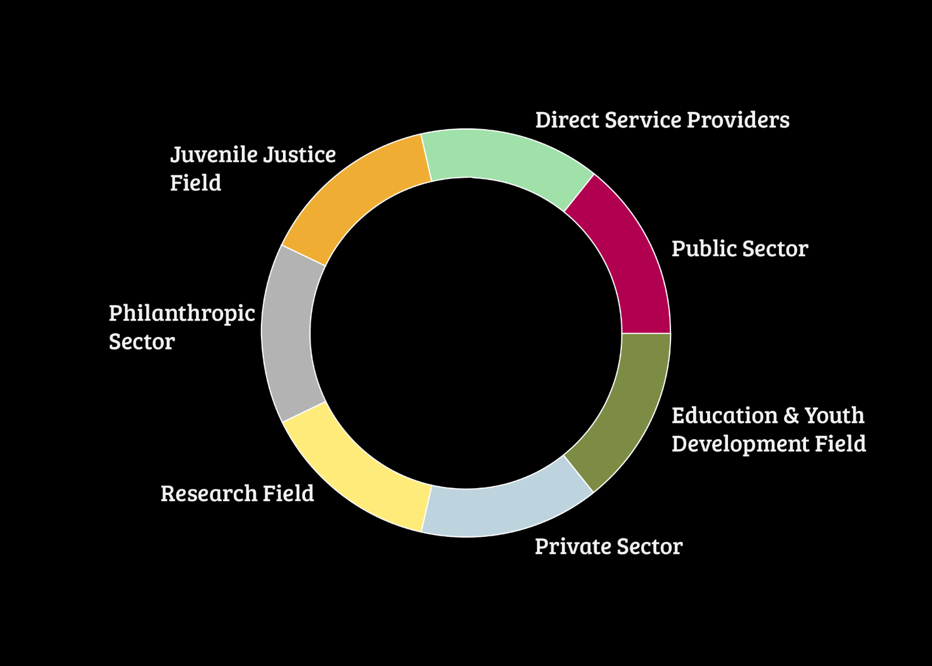



Slide 30
Unifying Champion
Unite a coalition to drive advocacy for federal funding for mentoring ($80 million in FY14)
Lead annual public awareness campaign National Mentoring Month (est. 2002)
Direct the Corporate Mentoring Challenge to increase private sector engagement in youth mentoring
Convene 1,000 attendees at the National Mentoring Summit
Provide thought leadership through innovative research
30

Slide 31
Ensuring Quality. Building Capacity.
Instituted nationally recognized standards – The Elements of Effective Practice for Mentoring ™
Operate the only national database for volunteer mentoring opportunities
Establishing a National Quality Mentoring System
Support network of affiliate Mentoring Partnerships that serve as local capacity builders / movement leaders
Developing the National Mentoring Resource Center in collaboration with the Office of Juvenile Justice and Delinquency Prevention
31

Slide 32
Engage with MENTOR
Connect with an affiliate Mentoring Partnership in your area
Attend the 2015 National Mentoring Summit
Access free mentoring resources on mentoring.org
Attend a monthly webinar
Register in or search the Volunteer Referral Service (VRS)
Sign up to receive the MENTOR Minute
Adopt MentorCore as your program’s database
Connect on social media - follow us on Twitter and like the MENTOR Facebook page
32

Slide 33

Please enter your questions in the Chat Room!

Slide 34
RESOURCES
Handouts
  Mentoring Youth and Young Parents Guidebook
  Mentoring/Employment Assessment Tool
  Action Plan Sample
Workforce3One
    Youth Connections
    Workforce System Strategies
  Find Youth Info
  MENTOR - www.mentoring.org

Slide 35

Presenters’ Contact Information
Gloria Salas-Kos
Office of Policy Development and Research, USDOL-ETA
Email: salas-kos.gloria@dol.gov
Telephone: 202-693-3596
Maisha Meminger
Office of Workforce Investment-Youth Services, USDOL-ETA
Email: meminger.maisha@dol.gov
Telephone: 202-693-3962
Diana Hernandez , Workforce Development Director
AltaMed Health Services, Inc.
Email: dihernandez@la.altamed.org
Telephone: 323-307-0111
Kerri Pruitt, Executive Director
The Dannon Project
Email: kerri@dannonproject.org
Telephone: 205-202-4072
Tammy Tai, Chief Program Officer
MENTOR
Email: ttai@mentor.org
Telephone: 617-303-4607

Slide 36
Thank You!
Find resources for workforce system success at:
www.workforce3one.org

