Slide 1
YouthBuild Webinar Series High School Equivalency Instruction in Action: ELA and Math Lessons that Support Student Success
November 4, 2014
Presented by:
Division of Youth Services – YouthBuild
U.S. Department of Labor
Employment and Training Administration

Slide 2
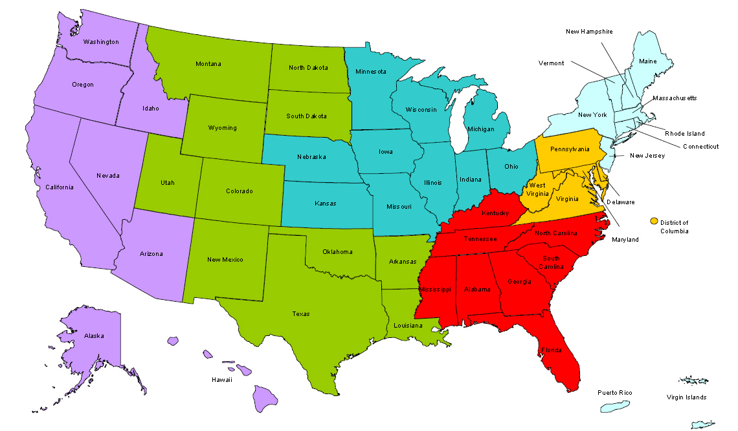
Where are you?
Enter your location in the Chat window – lower left of screen

Slide 3
Moderator
Toni Wilson
Workforce Analyst
U.S. Department of Labor

Slide 4
Question 1
Were you able to watch at least one of the webcasts in preparation for today’s webinar?
Yes
No
Some of the webcast

Slide 5
Question 2
Which breakout session do you choose to participate in?
Math
ELA

Slide 6
Here’s what you can expect in this webinar
Participants will receive recommendations on strategies for implementing quality ELA and math instruction to support students’ success on high school equivalency exams.
Participants will be able to network and peer share promising strategies.

Slide 7
Webinar Format
Content available to participants at registration via webcast
Overview of the content
Discussion
Links to resources provided at the end of the webinar

Slide 8
Discussion
Participate in open discussion with facilitators and peers. Phones will be un-muted.
Be courteous. Reduce extraneous noise for the best audio quality by muting your phone, if you are not speaking.
Choose the breakout room based on the number shown on your screen.

Slide 9
Presenter
Connie Rivera
Math Teacher
Capital City YouthBuild
Hartford, Connecticut

Slide 10
A Discovery Approach
With a discovery approach,
students construct rules and discover formulas on their own through carefully structured activities.

Slide 11
Lessons that Discover Rules and Formulas
Student-Centered
Scaffolded
Exercises
Pursue How and Why

Slide 12
Lead Students to a Conclusion
1 + 2 + 3 + 4 + 5 + 6 + 7 + 8 + 9 =

Slide 13
Add Mentally
10
10
1 + 2 + 3 + 4 + 5 + 6 + 7 + 8 + 9 =
10
10

Slide 14
Presenter
Rebecca Dezan
Education Manager
ReSOURCE YouthBuild, Burlington, VT

Slide 15
Shifting Instruction: The Context
GED 2014 / CCSS
Instructional Shifts Require:
- Informational Texts
- Depth over Breadth (Close Reading)
- Complex Texts
- Text-Dependent Questions
- Academic Vocabulary
- Writing from Sources

Slide 16
Strategy #1: Selecting Texts
“Chunk” larger texts into manageable pieces.
Scaffold complexity.
Model annotation and reading strategies

Slide 17
ReSOURCE YouthBuild
Current Events- Education
A View of What’s Missing From the Classroom
Jane L. Levere
The New York Times
The Advertising Council and the United States Army, hoping to lower absenteeism in schools across the country, are introducing a public service campaign this week aimed at helping parents keep track of their children’s absences.
As many as 7.5 million students miss nearly a month of school each year, according to the Ad Council, which noted that chronic absenteeism- defined as missing 10 percent, or 18 days, or more of school for any reason- is a critical warning sign that a student will fall behind and risk not graduating from high school.
The new campaign focuses on chronic absenteeism because “we know without a doubt” that it is a “proven early indicator of the potential of dropping out,” said Priscilla Natkins, an executive vice president of the Ad Council. “We believe that by communicating with parents a very pointed message about absenteeism, we can actually change behavior and have a real impact on graduation rates.”
She said parents’ misconceptions about the importance of attendance include the belief that attendance matters only in high school, that excused absences will not hurt a child’s academic performance and that an occasional absence will not make a difference.

Slide 18
Strategy #2: Close Reading
Three Complete Readings of a Text
1st Reading- Instructor Reading- Model Fluency
2nd Reading- Thinking Out Loud
Model Strategies Out Loud
Fluent Reading - Inference
Questioning - Connection
Visualization - Monitoring
3rd Reading – Student Silent Reading

Slide 19
Close Reading Recommendations
Develop Routines and Processes for Close Reading
Model Fluency
Explicitly Teach Annotation
Instruct and Model Specific Reading Strategies

Slide 20
Strategy #3: Shifting Instruction: Text Dependent Questions
Shift from Reflection to Evidence-Based Conversation about Text
“Where did you see…”
“Take me to a place where…”
“How did the author use…”
“Connect a place in this article to the article we read yesterday…”
“Is there a line that shows…”
“Where is the argument for…”

Slide 21
Text-Dependent Questions
Who is being targeted by this Ad campaign?
2. How does the article define chronic absenteeism?
3. What is the purpose of the campaign? Why are the having it?
4. Why are parents keeping children out of school?
5. In your experience, does missing school matter? Why? How?

Slide 22
Text – Dependent Questions: Student Response

Slide 23
Strategy #4: Shifting Instruction: Academic Vocabulary
Word Work
Absenteeism
Look up the definition of “absenteeism.” Put it in your own words to create a user-friendly definition. Develop a sentence, complete with a context clue, that will help a future student understand this vocabulary word.
Now, draw an illustration of the word “absenteeism” that incorporates its’ meaning. On the same paper, include your own definition, and your original sentence for inclusion on the word wall.
Chronic
Look up the definition of “chronic,” and find a definition that works in the context of this article (chronic absenteeism). Rewrite the definition in your words.
Develop a list of synonyms for the word “chronic.” What other words could you use that have the same meaning.

Slide 24
Academic Vocabulary: Student Example

Slide 25
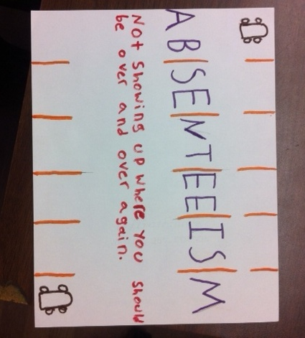
Academic Vocabulary: Student Examples

Slide 26
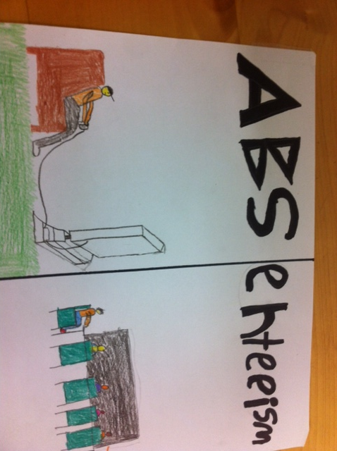
Academic Vocabulary: Student Examples

Slide 27
Strategy #5: Instructional Shifts: Increase Text Complexity
“The True Cost of High School Dropouts,” The New York Times
Only 21 states require students to attend high school until they graduate or turn 18. The proposal President Obama announced- to make such attendance compulsory in every state- is a step in the right direction, but it would not go far enough to reduce a dropout rate that imposes a heavy cost on the entire economy, not just on those who fail to obtain a diploma.
In 1970, the Unites States had the world’s highest rate of high school and college graduation. Today, according to the Organization for the Economic Cooperation and Development, we’ve slipped to No. 21 in high school completion and No. 15 in college completion, as other countries surpassed us in the quality of their primary and secondary education.
Only 7 of 10 ninth graders today will get high school diplomas. A decade after the No Child Left Behind law mandated efforts to reduce the racial gap, about 80 percent of white and Asian students graduate from high school, compared with only 55 percent of blacks and Hispanics.
Some Americans probably think that preventing 1.3 million students from dropping out of high school each year can’t be done- but in fact the costs of inaction are far greater.
If we could reduce the current number of dropout by just half, we would yield almost 700,000 new graduates a year, and it would more than pay for itself. Studies show that the typical high school graduate will obtain higher employment and earnings- an astonishing 50 percent to 100 percent increase in lifetime income- and will be less likely to draw on public money for health care and welfare and less likely to be involved in the criminal justice systems. Further, because of the increased income, the typical graduate will contribute more in tax revenues over his lifetime than if he’d dropped out.

Slide 28
Increase Text Complexity
Use appropriate scaffolds
Annotate together using a white board or projector. Students lead their own process.
Model Annotations to the text. Provide copies with annotations on them already.

Slide 29
Increase Cognitive Demand
ReSOURCE YouthBuild
Current Events: Education- September 2013
Word Work
What do the following words mean? Define it in your own words, make a list of synonyms (words that mean the same thing), and write a sentence with a context clue to help remember its meaning.
Compulsory
Surpassed
Mandated
Reduce
Yield
Obtain
Select one of the words from the above list and make an illustration of the definition that includes the word. How would you create a pictorial representation of the word that illustrates the meaning of the word?
Text-Dependent Questions
What is the Main Idea of this story?
What is the author of the article persuading the readers to believe?
What does the term “reduce the racial gap” in the third paragraph mean?
What does “draw on public money” in the fifth paragraph refer to?
As the title implies, what is “The True Cost of High School Dropouts?”

Slide 30
Increase Cognitive Demand: Student Examples

Slide 31
Increase Cognitive Demand: Student Examples

Slide 32
Increase Cognitive Demand: Student Examples

Slide 33
ELA Shifts
Instruction of texts should be deep, balanced and thorough.
Look for content and evidence in texts to develop questions that ask students to think abstractly and deeply.
Play with words- academic vocabulary building is key

Slide 34
Discussion
Participate in open discussion with facilitators and peers. Phones will be un-muted.
Be courteous. Reduce extraneous noise for the best audio quality by muting your phone, if you are not speaking.
Choose the breakout room based on the number shown on your screen.
It may take a few minutes for the room number to appear on your screen.

Slide 36
Report Back
What was discussed during the session?
What questions consistently surfaced?

Slide 37
Please enter your questions in the Chat Room!

Slide 38
Save the Date!
Data/MIS December 2 at 2:00 PM (EDT)
Construction (Registered Apprenticeship) January 6 at 2:00 PM (EDT)
Counseling and Case Management February 3 at 2:00 PM (EDT)

Slide 39
Contact Information
Connie Rivera
Math Teacher
Capital City YouthBuild; Hartford, CT
con2ward@aol.com
Rebecca Dezan
Education Manager
Resource YouthBuild; Burlington, VT
rdezab@resourcevt.org
Toni Wilson
Acting DOL YouthBuild Director
U.S. Department of Labor
Wilson.toni@dol.gov

Slide 40
Thank You!
Find resources for workforce system success at:
www.workforce3one.org

