Slide 1
H-1B Ready To Work New Grantee Orientation
Webinar Date: November 19, 2014
Presented by:
Office of Workforce Investment, Division of Strategic Investments
U.S. Department of Labor
Employment and Training Administration

Slide 2
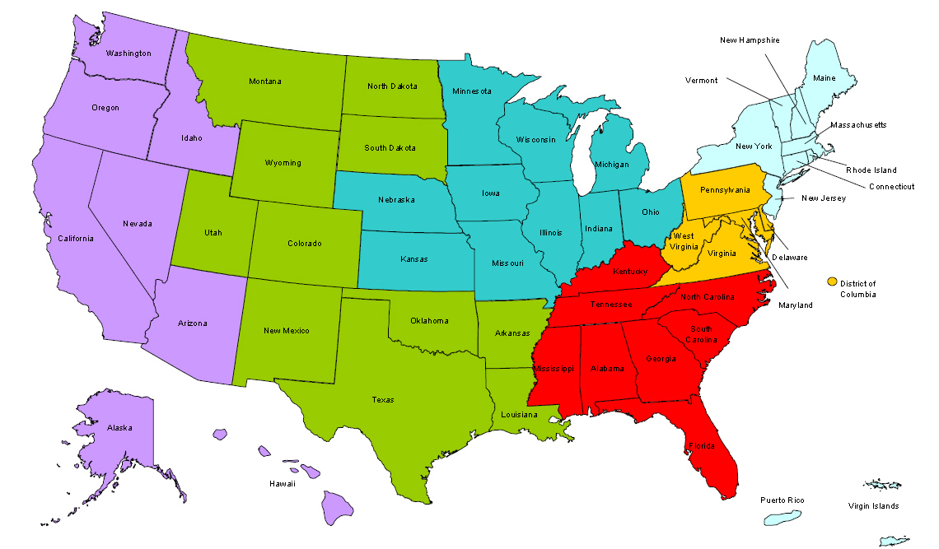
Where are you?
Enter your location in the Chat window – lower left of screen

Slide 3
Presenters
Robin Fernkas
Division Chief, Division of Strategic Investments
Melissa Smith
Program Manager, Division of Strategic Investments
Megan Baird
Workforce Analyst, Division of Strategic Investments
Steve Rietzke
Grant Officer, Office of Grants Management
Kia Mason
Grants Management Specialist, Office of Grants Management

Slide 4
Today’s Agenda
Welcome to ETA!
Introductions
Program Overview
Communication Plan
Reporting Requirements
Grant Package
Next Steps
Tips and Advice

Slide 5
Introductions
Employment and Training Administration (ETA)
National Office
Program Office – Division of Strategic Investments (DSI)
Grant Office – Office of Grants Management (OGM)
Chief Evaluation Office (CEO)
Office of Policy Development and research (OPDR)
Regional Office
Federal Project Officer (FPO)

Slide 6
National Office – Division of Strategic Investments (DSI)
The Program Office has several functions:
Supports Federal Project Officers (FPOs)
Provides Technical Assistance (“TA”)
Together with an external TA provider
Creates peer learning opportunities
Collects performance data
Reviews some grant modifications
Coordinates product submissions and dissemination
Periodically requests additional information about your grant

Slide 7
National Office – Technical Assistance Initiative
Technical Assistance Initiative
DOL is in process of procuring a TA provider (in addition to TA provided by the National and Regional Offices).
Functions include:
general technical assistance to all grantees on topics such as, recruiting LTU, employer engagement, job placement, etc.;
Customized technical assistance to specific grantees identified in need of one-on-one TA

Slide 8
National Office – Office of Grants Management (OGM)
The Grant Officer performs official grant duties:
Maintains official grant documents such as modifications, no-cost extensions, and other relevant documents
Approves all purchases over $5,000
ETA Grant Officer: Steve Rietzke
Ready To Work Specialist: Kia Mason
The Office of Grants Management (OGM) also provides guidance on policy issues and training on fiscal and administrative requirements.

Slide 9
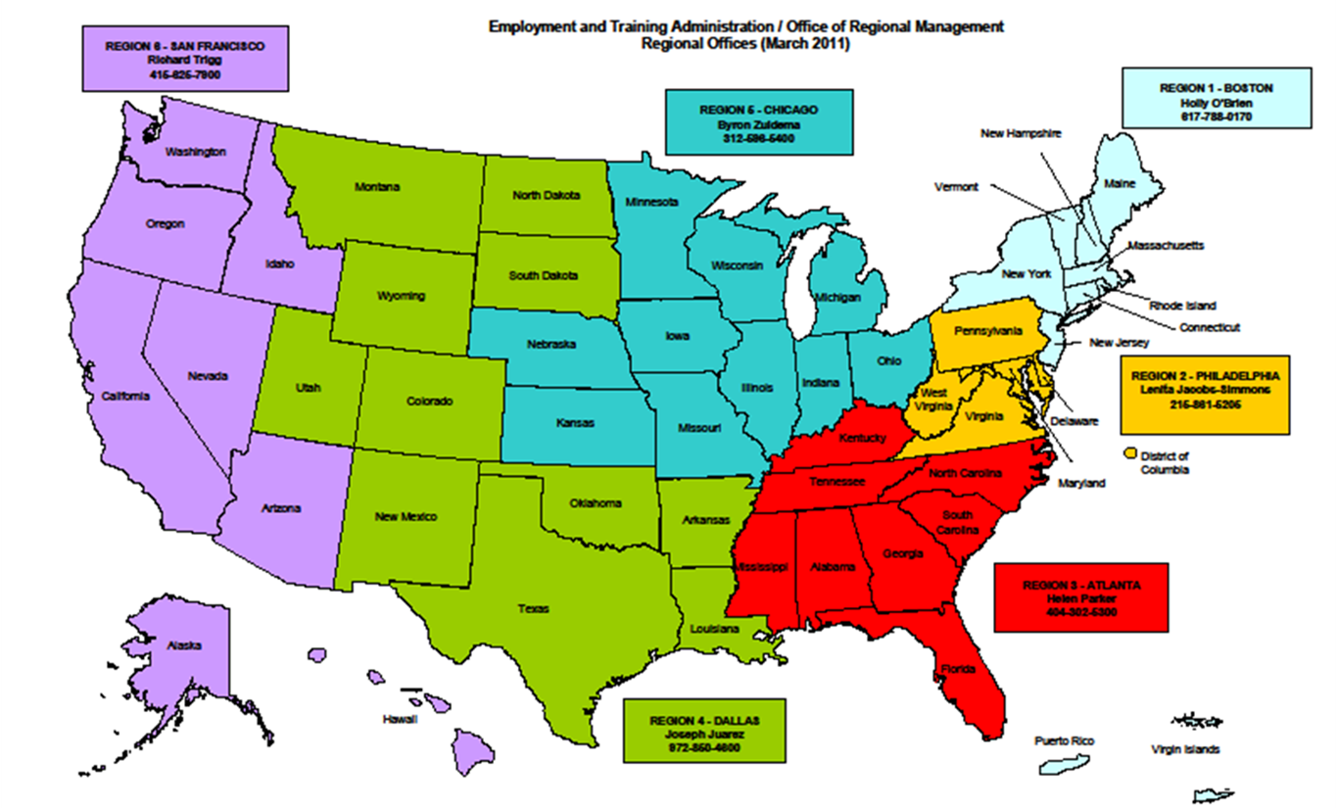
Regional Office Role

Slide 10
National Office – Office of Policy Development & Research/Chief Evaluation Office
Evaluating Successful RTW Strategies
Conduct the Ready To Work national evaluation
Oversight of Evaluation Contractors: Abt Associates and MEF Associates
Committed to producing strong evidence about what works
Next Steps:
We will be reaching out to grantees in the near future to tell you more about the evaluation and to learn more about your programs.

Slide 11
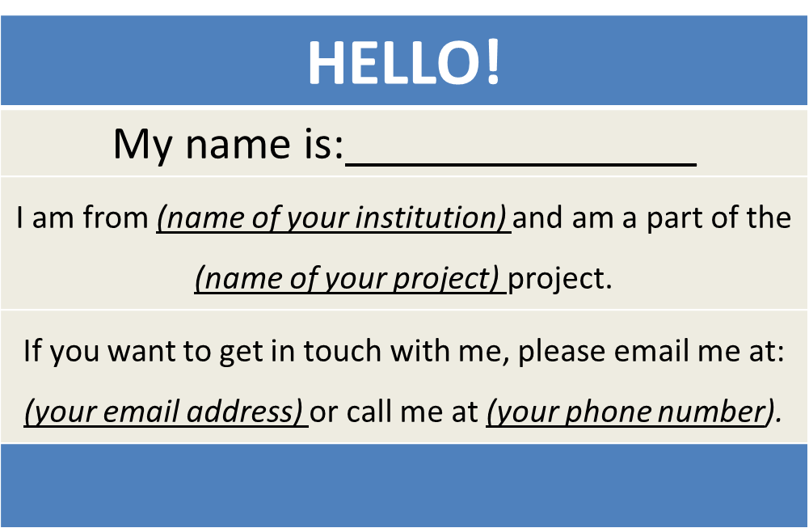
Ready To Work Grantees
Create a virtual name tag…

Slide 12
Grantee Polling Question
Is this your first ETA grant?
Choose the answer that best reflects you (or your group):
Yes
No

Slide 13
Melissa Smith Division of Strategic Investments ETA Office of Workforce Investments
Program Overview

Slide 14
Program Overview
Nearly $170 million in grant funds
To support development of workforce partnerships between employers, non-profit organizations, and America’s public workforce system;
To effectively recruit and serve long-term unemployed workers; and
To help place the long term unemployed in to skilled jobs with good wages.

Slide 15
Overview of Grantees
Awards to 23 public and private partnerships
Projects provide services in 20 states and PR
Includes 3 multi-state projects
Period of performance is 48 months
Grant start date: November 1, 2014
Grant end date: October 31, 2018

Slide 16
Overview of Grantees

Slide 17
Overview of Grantees

Slide 18
Target Populations
Long-term Unemployed Workers
Every project is serving at least 85% long-term unemployed workers
Unemployed Workers
Incumbent Workers
Within these populations:
9 projects are targeting veterans
11 projects are targeting lower-skilled workers that can benefit form training along a career pathways
19 projects are targeting shorter-term unemployed workers

Slide 19
Program Overview
Provide a range of interventions that lead to middle and high skilled employment
Incorporate strong up-front assessment component, allowing for a customization of services and training along one or more of the customized intervention tracks to employment:
Intensive coaching and other short-term, specialized services culminating in direct job placement into middle and high-skilled jobs.
Short-term training that may or may not result in an industry-recognized credential, but will lead to a skilled job.
Training along a career pathway that leads to an industry-recognized credential and employment in middle and high skilled jobs.

Slide 20
Program Overview
Training Strategies
OJT
Paid Work Experience
Paid Internships
Registered Apprenticeships
Classroom Training
Distance Learning
Technology-based Learning
Other Training Strategies
Activities and Service Strategies
Services and activities that support skill development, training retention, and reemployment
Financial counseling; mental health counseling; child and/or dependent care, etc.

Slide 21
Megan Baird Division of Strategic Investments ETA Office of Workforce Investments
Communication Plan

Slide 22
Communication Plan
From: ETA, To: You
Usually through your FPO for specific requests and information
RTW mailbox for general requests and information
Grantee Community of Practice: https://etagrantees.workforce3one.org
Click on “H-1B Technical Skills Training and Jobs Accelerator” link
ETA Website: www.doleta.gov/readytowork
From: You, To: ETA (National Office)
Contact your FPO first
Copy the RTW Mailbox: RTW@dol.gov, if appropriate
Remember
Include your grant number and lead grantee organization name
Describe your question/issue as specifically as possible
Please be patient!

Slide 23
Grantee Team Communications & Support
Main Point of Contact (POC)
Receives communication from ETA
Responsible for sharing information with project team and consortium members
Any time the main point of contact for your grant changes, please remember to alert your Federal Project Officer (FPO) and National Office staff
Note: Changing signature authority requires a formal grant modification

Slide 24
Ready To Work Webpage
Ready To Work webpage: www.doleta.gov/readytowork
SGA and Amendments
Abstracts
Resources

Slide 25
Ready To Work Webpage
Check out your fellow Ready To Work grantees !

Slide 26
Community of Practice
Ready To Work Community of Practice:
https://etagrantees.workforce3one.org – click on “H-1B Technical Skills Training and Jobs Accelerator Link” and “Ready To Work Grantees” folder
Resources
Technical Assistance Materials, training modules, FAQs
Ready To Work Grantee Orientation Series Posted!
https://etagrantees.workforce3one.org/page/resources/1001432150333279972

Slide 27
Communication Plan
Always contact your FPO first if you have questions!
If you… | Contact:
Are the grant lead | FPO
Are a member of a grant project | The lead for your grant
Have questions or difficulty accessing the performance reporting system | RTW@dol.gov with a copy to your FPO
Have questions or difficulty accessing the financial reporting system | EBSS.help@dov.gov, with a copy to your FPO and RTW@dol.gov
Have questions about evaluations | RTW@dol.gov with a copy to your FPO

Slide 28
Megan Baird Division of Strategic Investments ETA Office of Workforce Investments
Reporting Requirements

Slide 29
The Value of Reporting
Reporting successes of high profile programs to Congress, Administration, OMB, GAO, etc.
Demonstrating Grant Outcomes to investors and partners
Illustrating Return on Investment (ROI) to employer partners
Building additional strategic partnerships and leveraging resources
Sustainability of the project and partnership
Continuously improving program to meet the needs of participants

Slide 30
Reporting Requirements
Ready To Work grantees are required to submit reports Quarterly to ETA, including a final report
These reports are:
Quarterly Progress Reports (QPR)
Includes performance report
Includes narrative report
Quarterly Financial Report (ETA-9130)
Final Report

Slide 31
Quarterly Progress Report
Each grantee must submit a Quarterly Progress Report (QPR)
Due no later than 45 days after the end of a quarter
More information and training will be provided

Slide 32
Quarterly Progress Reports
Submitting QPRs to ETA
Web-based reporting system is still in development and is anticipated to be available in early 2015
In preparation, grantees should prepare to collect and track participant-level data on demographic information, services and training received, credential outcomes, and employment and employment retention information.
This includes providing participant SSNs, which will be used by ETA to track and report long-term employment outcome measures (ETA Common Measures)
Please ensure you follow PII protocol.
Stay tuned for training on performance reporting in January 2015!

Slide 33
Quarterly Financial Report
Each grantee must submit a Quarterly Financial Report (ETA 9130)
Due no later than 45 days after the end of a quarter
Financial reporting system different than performance reporting system
More information and training will be provided
Quarter End Dates | 9130 Due Date | Report Fiscal Activities Occurring
December 31, 2014 | February 14, 2015 | October 1 – December 31, 2014
March 31, 2015 | May 15, 2015 | January 1 – March 31, 2015
June 30, 2015 | August 14, 2015 | April 1 – June 30, 2015

Slide 34
Key Dates
Grant Start Date | November 1, 2014
1st QPR Due Date Performance report and narrative | February 14, 2015
1st ETA QFR Due Date Financial report (9130) | February 14, 2014
Grant End Date | October 31, 2018

Slide 35
Steve Rietzke and Kia Mason ETA Office of Grants Management
Grant Award Package

Slide 36
The Grant Award
Grant Award Letter
Grant Agreement -
Signature Page / Notice of Obligation (NOO)
Condition of Award Page
Terms and Conditions
Application for Federal Assistance
Budget
Statement of Work (SOW)
Indirect Cost Rate Agreement (if applicable)

Slide 37
Grant Award Letter
Acknowledgements of Award
Payment Management System
Information and forms on www.doleta.gov/grants under Payment Information
ETA’s on-line Grantee Fiscal Reporting System
ETA 9130
Information to access system on www.doleta.gov/grants under Financial Reporting
Passwords/PINs are sent separately after supplying the necessary information
Once you receive this please DO NOT LOSE IT!

Slide 38
Grant Agreement Notice of Award Obligation
Project Title – READY To Work Partnership Grant Program (Ready To Work)
Grant Awardees' Identifying Information
DOL Identifying Information
Agreement # HG-266XX-15-60-A-XX
Period of Performance
Award Amount
Regulations and Cost Principles
Signatures

Slide 39
Notice of Award Obligation Regulations & Cost Principles
Code of Federal Regulations (CFR) can be found at:
http://www.ecfr.gov/cgi-bin/ECFR?page=browse
Uniform Administrative Requirements
29 CFR Part 95 - Institutions for Higher Education
29 CFR Part 97 - State/Local Governments and Indian Tribes
Cost Principles
2 CFR 220 (OMB Circular A-21) – Educational Institutions
2 CFR 225 (OMB Circular A-87) – State/Local Government, Indian Tribes
2 CFR 230 (OMB Circular A-122) – Non-profit Organizations

Slide 40
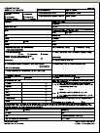
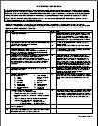
Grant Agreement Condition of Award & Terms and Conditions
Condition of Award
All have first 2 conditions with additional conditions as needed
Terms and Conditions
Order of Precedence
Solicitation for Grant Applications (SGA) and Amendments (incorporated by reference)

Slide 41
Grant Agreement Terms and Conditions
Indirect Cost Rates
FPO Contact Information
Equipment Requirements
Pre-Award Costs
Reporting Requirements
Consultant Fees
Publicity
Procurement
Audit Requirements
Intellectual Property

Slide 42
Grant Agreement Attachments
Attachment A: SF-424
Attachment B: SF-424A
Attachment C: Budget Narrative
Attachment D: Statement of Work
Attachment E: Indirect Cost Rate Agreement (if applicable)

Slide 43
Terms and Conditions – Equipment Purchases
Equipment purchases with a per unit acquisition cost of $5,000 or more, and a useful life of more than one year need prior approval from Grant Officer.
Submit a detailed equipment purchase list with descriptions of each item to your Federal Project Officer (FPO) for review. We encourage you to submit this request as early as possible in the period of performance, with as many planned pieces of equipment as possible.
Your FPO will review the items and submit the list for approval. A modification to your grant will be processed approving the equipment purchases.

Slide 44
Budget and Statement of Work
Budget Information
SF-424A
Budget Narrative
Grantee’s original proposal
Technical Proposal
Abstract
Documentation of Employer commitment
Documentation of Commitment to Participate in an Evaluation
Organization Chart
Performance Outcomes Table

Slide 45
Indirect Cost Rate Agreement
Only applicable to those claiming indirect costs
If grantee is claiming indirect costs but did not provide agreement, placed on 90-day temporary rate
Indirect cost spending limited to lesser of either 10% of total Personnel budget or total claimed indirect costs

Slide 46
SOW Review
Ready To Work grantees
Conditions detailing potential issues in your SOW are included in your grant package
Review of SOW, budgets, other attachments
45 days to respond
Assistance from FPO, DSI, and OGM
Review of Program Outcomes
Mathematical accuracy and benchmarks for years 1-4
45 days to respond
Assistance from FPO and DSI

Slide 47
Megan Baird Division of Strategic Investments ETA Office of Workforce Investments
Next Steps

Slide 48
Immediate Next Steps
Redacted Technical Proposals – due 11/15
If you have not already submitted, please do so
ASAP to RTW@dol.gov
Send updated point of contact information to RTW@dol.gov
Respond to SOW review, as appropriate
Get started on fiscal/admin online
training series!

Slide 49
Next Steps – Upcoming TA
Available Now!
Get Started Now on your Fiscal/Admin Online Training Series!
Title | Event Type | Link | Due Date
(1) Uniform Administrative Requirements | Online Training | Recorded Link: https://etareporting.workforce3one.org/view/4011200950256115537/info | Watch by December 17, 2014
(2) Cost Principles and Selected Items of Cost | Online Training | Recorded Link: https://etareporting.workforce3one.org/view/4011130552739025566/info | Watch by December 17, 2014
(3) Administrative Costs and Indirect Costs | Online Training | Recorded Link: https://www.workforce3one.org/view/4201120336293625358/info | Watch by December 17, 2014
(4) Fiscal Management Principles | Online Training | Recorded Link: https://etareporting.workforce3one.org/view/4011130549531844024/info | Watch by December 17, 2014

Slide 50
Next Steps – Upcoming TA (cont.)
Coming in January/February 2015!
Performance Reporting
Live Performance Reporting Overview and Quarterly Progress Report Training
Live QPR Reporting System Orientation and Q&A
Fiscal/Admin
Introduction to Financial Reporting (self-paced tutorial)
ETA 9130 Reporting for ETA Discretionary Grantees (self-paced tutorial)
Accrual Accounting (self-paced tutorial)
Reporting Obligations (self-paced tutorial)
Evaluation Orientation

Slide 51
Next Steps – Upcoming TA (cont.)
Check out upcoming TA events in the Ready To Work Training Plan – posted on the CoP and updated regularly!
https://etagrantees.workforce3one.org
Click on “H-1B Technical Skills Training and Jobs Accelerator”
“H-1B Ready To Work Grantees” has it’s own folder!
Start the fiscal/admin online training series now!

Slide 52
Grantee Polling Question
How do you feel after today’s webinar?
Choose the answer that best reflects you (or your group):
Geronimo!!!
Uh… Ready to what ?
A little overwhelmed, but excited!

Slide 53
Resources
Ready To Work webpage: www.doleta.gov/readytowork
Ready To Work CoP: http://etagrantees.workforce3one.org – click on the “H-1B technical Skills Training and Jobs Accelerator” link!
Your FPO!

Slide 54
Please enter your questions in the Chat Room!
Notes:
Please enter your questions into the Chat Room!

Slide 55
Thank You!
Find resources for workforce system success at:
www.workforce3one.org

