Slide 1
Partnerships that Deliver Results
The Workforce System and Registered Apprenticeship
Part 2
Webinar Date: November 20, 2014
Presented by:
Office of Apprenticeship
U.S. Department of Labor
Employment and Training Administration

Slide 2
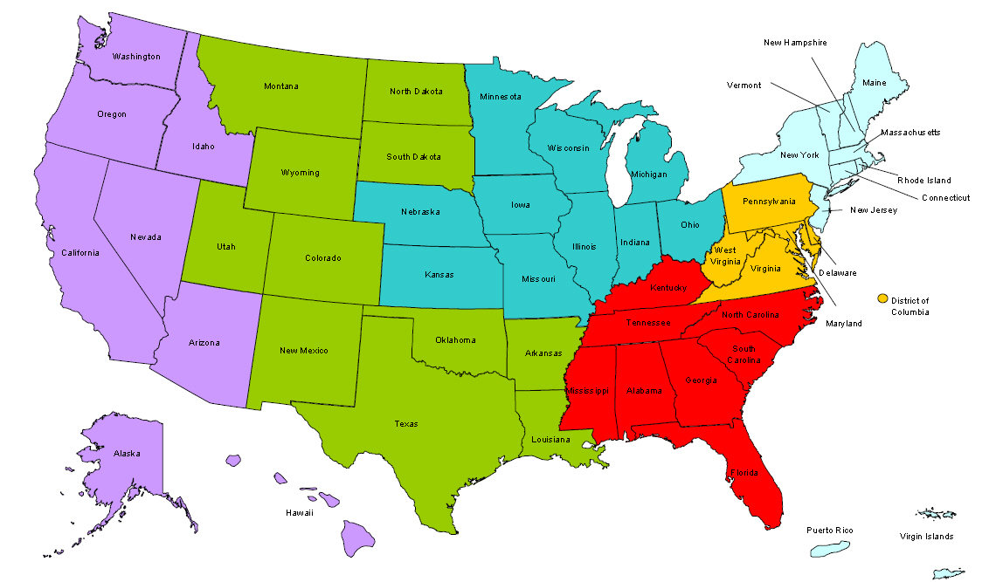
Where are you?
Enter your location in the Chat window – lower left of screen

Slide 3



Moderator/Speakers
John Ladd
Administrator, Office of Apprenticeship
Employment and Training Administration
Gerry Ghazi
President
Vermont HITEC, Inc
Rose Lucenti
Workforce Development Director
Vermont Department of Labor

Slide 4
Welcome to Part 2 of a two-part webinar series on using Registered Apprenticeship as an integral part of your workforce development strategy.
Part 2 (Today)
Part 1 (November 6)
1
1
Understand the Registered Apprenticeship model
Hear about successful partnerships from state and local speakers
Learn about a new toolkit with steps to help launch apprenticeship programs
Learn the basic components of Registered Apprenticeship
Hear about the benefits of partnering with Registered Apprenticeship
Learn how to connect with apprenticeship in your area
2
2
3
3
View Part 1 at:
https://www.workforce3one.org/view/5001423143986500443/info

Slide 5
Polling Question
What organization
do you represent?
State Workforce Agency or State Workforce Board
Local Workforce Agency or Local Workforce Board
American Job Center
State Registered Apprenticeship
Educational Institution
Business/Industry
Other (please enter in the chat)

Slide 6






Registered Apprenticeship has been a growing part of workforce development discussions.
…Train Americans with the
skills employers need, and
match them to good jobs
that need to be filled right
now. That means more
on-the-job training, and
more apprenticeships…
President Obama
2014 State of the Union Address
Vice President Biden (AACC Conference) on April 7, 2014 , announcing the launch of the RACC.

Slide 7
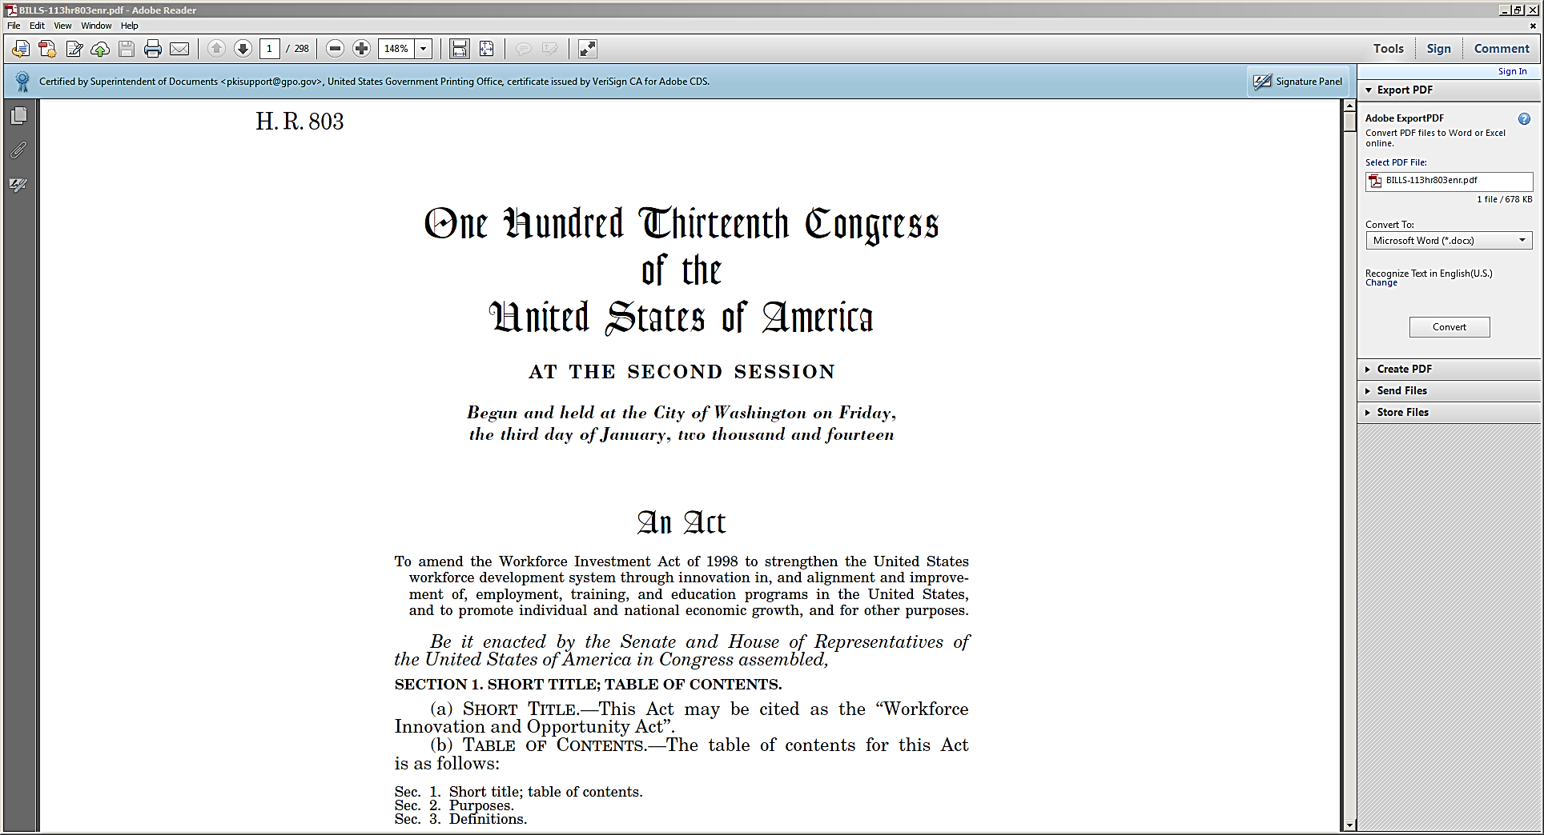

Within both WIA and WIOA, Registered Apprenticeship is a proven workforce strategy to explore and expand.

Slide 8

Registered Apprenticeship is a job-driven approach…
Checklist for Job-Driven Training
Work up-front with employers to determine local or regional hiring needs and designing training programs that are responsive to those needs.
Offer work-based learning opportunities with employers.
Measure and evaluate employment and earnings outcomes.
Promote a seamless progression from one educational stepping stone to another, and across work-based training and education…
Break down barriers to accessing job-driven training and hiring for any American who is willing to work, including access to supportive services and relevant guidance.
Create regional collaborations among American Job Centers, education institutions, labor, and non-profits.

Slide 9
…that is an integral part of WIOA!
an integral partner on workforce boards and in workforce planning
a key element in business engagement and industry sector strategies
a proven work-based learning model for job seekers
a strategy for increasing outcomes on performance measures
Registered
Apprenticeship

Slide 10
Think Registered Apprenticeship is as simple as five…four…three…two…one
5
5 Core Components: Employers, OJT, Related Instruction, Reward Skill Gains, National Credentials
4
4 Key Roles: Employers, Sponsors, Education Providers, Workforce System
3
3 Ways to Complete: Time-Based (Short as 1 year) | Competency-Based: No Time Limits | Hybrid
2
2 Ways to Register: U.S. DOL and State Apprenticeship Agencies
1
1 System with Nationally Recognized Credentials

Slide 11





5
Core Components of Registered Apprenticeship
Employer is the foundation for the RA program and must be directly involved and provider of OJT
Employer Involvement Is Integral
Structured On-the-Job Training with Mentoring
Minimum of 2,000 hours Structured and Supervised
Related Training and Instruction
144 hours recommended per year
Parallel | Front-loaded | Segmented Options
Rewards for Skill Gains
Increases in skills brings about increases in earnings
Nationally recognized credential showing job proficiency Sponsor certifies individual is fully competent for career
National Occupational Credential

Slide 12

The workforce system has a role to play in each
Registered Apprenticeship component.
Utilize RA apprenticeship
as a key business engagement strategy & incorporate in sector strategies
Employer Involvement
Use workforce funds
to help apprentices get on-the-job learning through a OJT contract
Structured
On-the-Job Training
Provide supportive services
to participants – or use training funds through ITAs or customized training
Related Training
and Instruction
Count apprentice wages
in the earnings performance measure
Rewards for Skill Gains
Count the RA national credential
in the new performance measure for credential attainment
National Credential

Slide 13

Traditional Registered Apprenticeship Model
Example shows a four year program; however, program length driven by industry needs (e.g. most construction programs).
Related Training and Instruction
Related Training and Instruction
Related Training and Instruction
Related Training and Instruction
Credential Issued
by US DOL
Reward Skill Gains
Reward Skill Gains
Reward Skill Gains
Reward Skill Gains
Structured OJT with Mentoring
Structured OJT with Mentoring
Structured OJT with Mentoring
Structured OJT with Mentoring
2,000 hours
2,000 hours
2,000 hours
2,000 hours
Year 1
Year 2
Year 3
Year 4

Slide 14
1 Year Apprenticeship Model
Example shows a one year program; however, program length driven by industry needs
Related Training and Instruction
144 hours min.
144 hours min.
Credential Issued
by US DOL
Reward Skill Gains
Structured OJT with Mentoring
2,000 hours
Year 1

Slide 15
Front-loaded Apprenticeship Model
Example shows a program with diminishing time spent in classroom training; however, all RTI could occur at the beginning of program.
Related Training and Instruction
Reward Skill Gains
Credential Issued
by US DOL
Reward Skill Gains
Structured OJT with Mentoring
Related Training and Instruction
Structured OJT with Mentoring
2,000 hours
2,000 hours
Initial Period
2nd Period
3rd Period

Slide 16


Pre-apprenticeship to Registered Apprenticeship Direct Entry Model
Quality Pre-Apprenticeship Programs have a partnership with an RA program to ensure direct entry with advanced credit upon completion of the pre-apprenticeship.
Related Training and Instruction
Related Training and Instruction
Pre-apprenticeship
Program
Reward Skill Gains
Reward Skill Gains
Credential Issued
by US DOL
RTI and/or OJT credit can be applied to RA program
Structured OJT with Mentoring
Structured OJT with Mentoring
2,000 hours
2,000 hours
Prior to Entry
Year 1
Year 2

Slide 17
Key Roles within Registered Apprenticeships
4
Employers (OJT)
Must have employer(s)
Must Drive Program Design / RTI
Provider of OJT/Work-Based Learning
Sponsors (Administrators)
Responsible for Administering the Program
Can be Employer, Consortia of Employers, Industry Associations, Joint Labor-Management Organizations, Educational or Training Providers, CBOs, or Other Workforce Intermediaries!
4
Public Workforce System
Provide basic skills/pre-apprenticeship
Provide training funds (through OJT contracts, ITAs, customized training)
Provide support services
Educational (RTI) Provider
Can be employer/industry based
Can be Joint Labor-Management Orgs
Community Colleges
Others

Slide 18
Single Employer Model
Employer provides OJT
Employer Serves as Sponsor
Employer Provides RTI
Employer Provides Services
Workforce
System

Slide 19
Multiple Employers and Intermediary Model
Lots of organizations can play an intermediary role.
Employer provides OJT
Serves as Sponsor
Provides RTI
Provides Services
Intermediary
Workforce
System
For example:
Industry
associations,
labor organizations,
community-based
organizations, etc.
Intermediary
Intermediary

Slide 20
Multiple Employers + Intermediary Model + Community College
Employer provides OJT
Serves as Sponsor
Provides RTI
Provides Services
Intermediary
Workforce
System
Education Provider
Intermediary

Slide 21
Multiple Employers and Multiple Intermediaries Model
Employers provide OJT
1 Serves as Sponsor
Provides RTI
2 Provide Services
Intermediary
Workforce
System
Education Provider
Intermediary

Slide 22
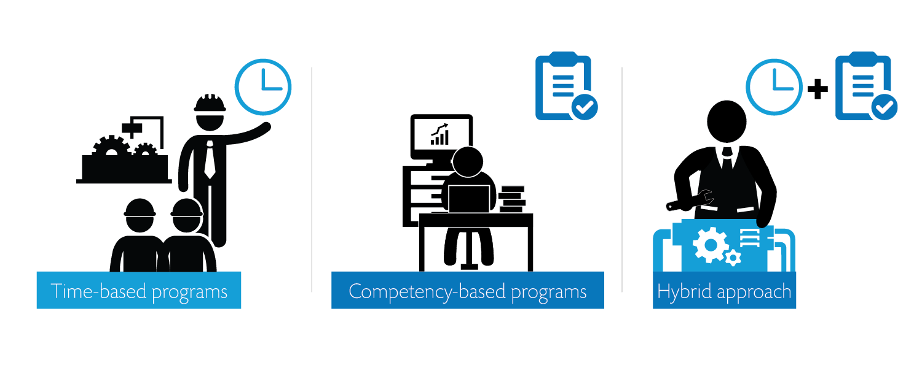
Ways to Complete a Registered Apprenticeship
3

☑


Slide 23
2
Ways to Register Apprenticeship Programs:
U.S. Department of Labor and State Apprenticeship Agencies
List of State Directors:
http://www.doleta.gov/oa/contactlist.cfm
DOL = 25 (FEDERAL)
SAA = 26 (STATE)

Slide 24

1
System with Nationally Recognized Credentials
All workers that graduate from a Registered Apprenticeship receive a national, industry-recognized, portable credential
The credential is a 100% guarantee to all employers that graduates from Registered Apprenticeship programs are fully qualified to do the job

Slide 25







Building Apprenticeship Programs:
A Quick-Start Action Toolkit http://www.doleta.gov/oa/employers/apprenticeship_toolkit.pdf
Provides helpful steps and resources to start an apprenticeship program, from exploring apprenticeship as a workforce strategy to launching a new program
Whether you’re a business or labor organization, an industry association or another kind of workforce intermediary, a community college or the public workforce system, we invite you to use this toolkit to...
1. Explore
apprenticeship as a strategy to meet your needs for skilled workers
2. Partner
with key players in your region to develop an apprenticeship
3. Build
the core components of your apprenticeship program
4. Register
your program to become part of the national Registered Apprenticeship network
5. Launch
your new Registered Apprenticeship program

Slide 26


Workforce System – Registered Apprenticeship:
A Partnership for Producing Results
Rose Lucenti
VT Dept of Labor
Gerry Ghazi
Vermont HITEC
Vermont HITEC
Vermont

Slide 27
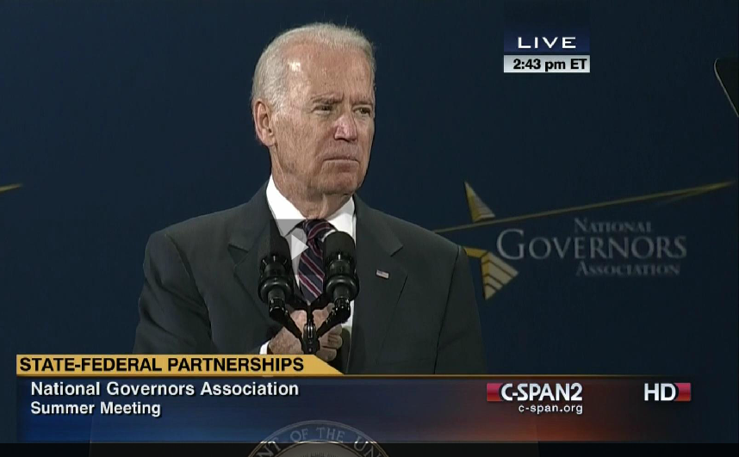



Vermont HITEC
“Vermont HITEC – what you done up there Gov[ernor] – it works.”

Slide 28
Who we are
Vermont HITEC (acts as an “Intermediary”)
Non-profit focused on workforce development
Intensive outreach, education & apprenticeship model
Customized curriculum to match job & career openings immediately to be filled
“Guaranteed” employment for graduates
14+ years experience implementing innovative apprenticeship model
Red = State Workforce System Linkage

Slide 29
Our Partners
Employer-Partners (Job Providers)
Departments of Labor
Departments of Economic Development
Federal & State Apprenticeship Divisions
Other Government & Nonprofit Agencies
Secondary and Post-secondary School
Unemployed and Underemployed (Job Seekers)

Slide 30
Vermont Department of Labor (VDOL)
All statewide workforce system activities under one Commissioner of Labor, with Divisions:
  Labor Market Information (LMI)
  Unemployment Insurance & Benefits
  State and Local Workforce Investment Board (WIB)
  Workforce Development (WIOA)
  American Job Centers (One-Stops)
  Veterans Services Outreach
  State Apprenticeship Council (SAC)

Slide 31
Our Guiding Principles
Start with jobs – end with jobs
Subject-matter does not matter
Passion for education and apprenticeship
Unlimited human potential
Apprentice-centered education and mentoring
Competency-based apprenticeship metrics
No previous experience required by apprentices
Pay it forward

Slide 32
Healthcare Apprenticeships
Certified Medical Transcriptionists
Certified Medical Coders
Certified Phlebotomists
Certified Medical Assistants
Certified Pharmacy Technicians
Licensed Nurse Assistants
Practice Support Specialists
Registration Representatives
Electronic Health Record Go-Live Support Analysts
Electronic Health Record Data Abstractors

Slide 33
Information Technology Apprenticeships
Software Developers (Java)
Web Developers
Development Programmers
Support Programmers
EDI Analysts / Programmers
Software Installation Consultants
IT Support Analysts
IT Account Managers

Slide 34
Advanced Manufacturing Apprenticeships
Computer Numerically Controlled
(CNC) Machine Operators and Machinists
Structural Steel Welders and Fitters

Slide 35
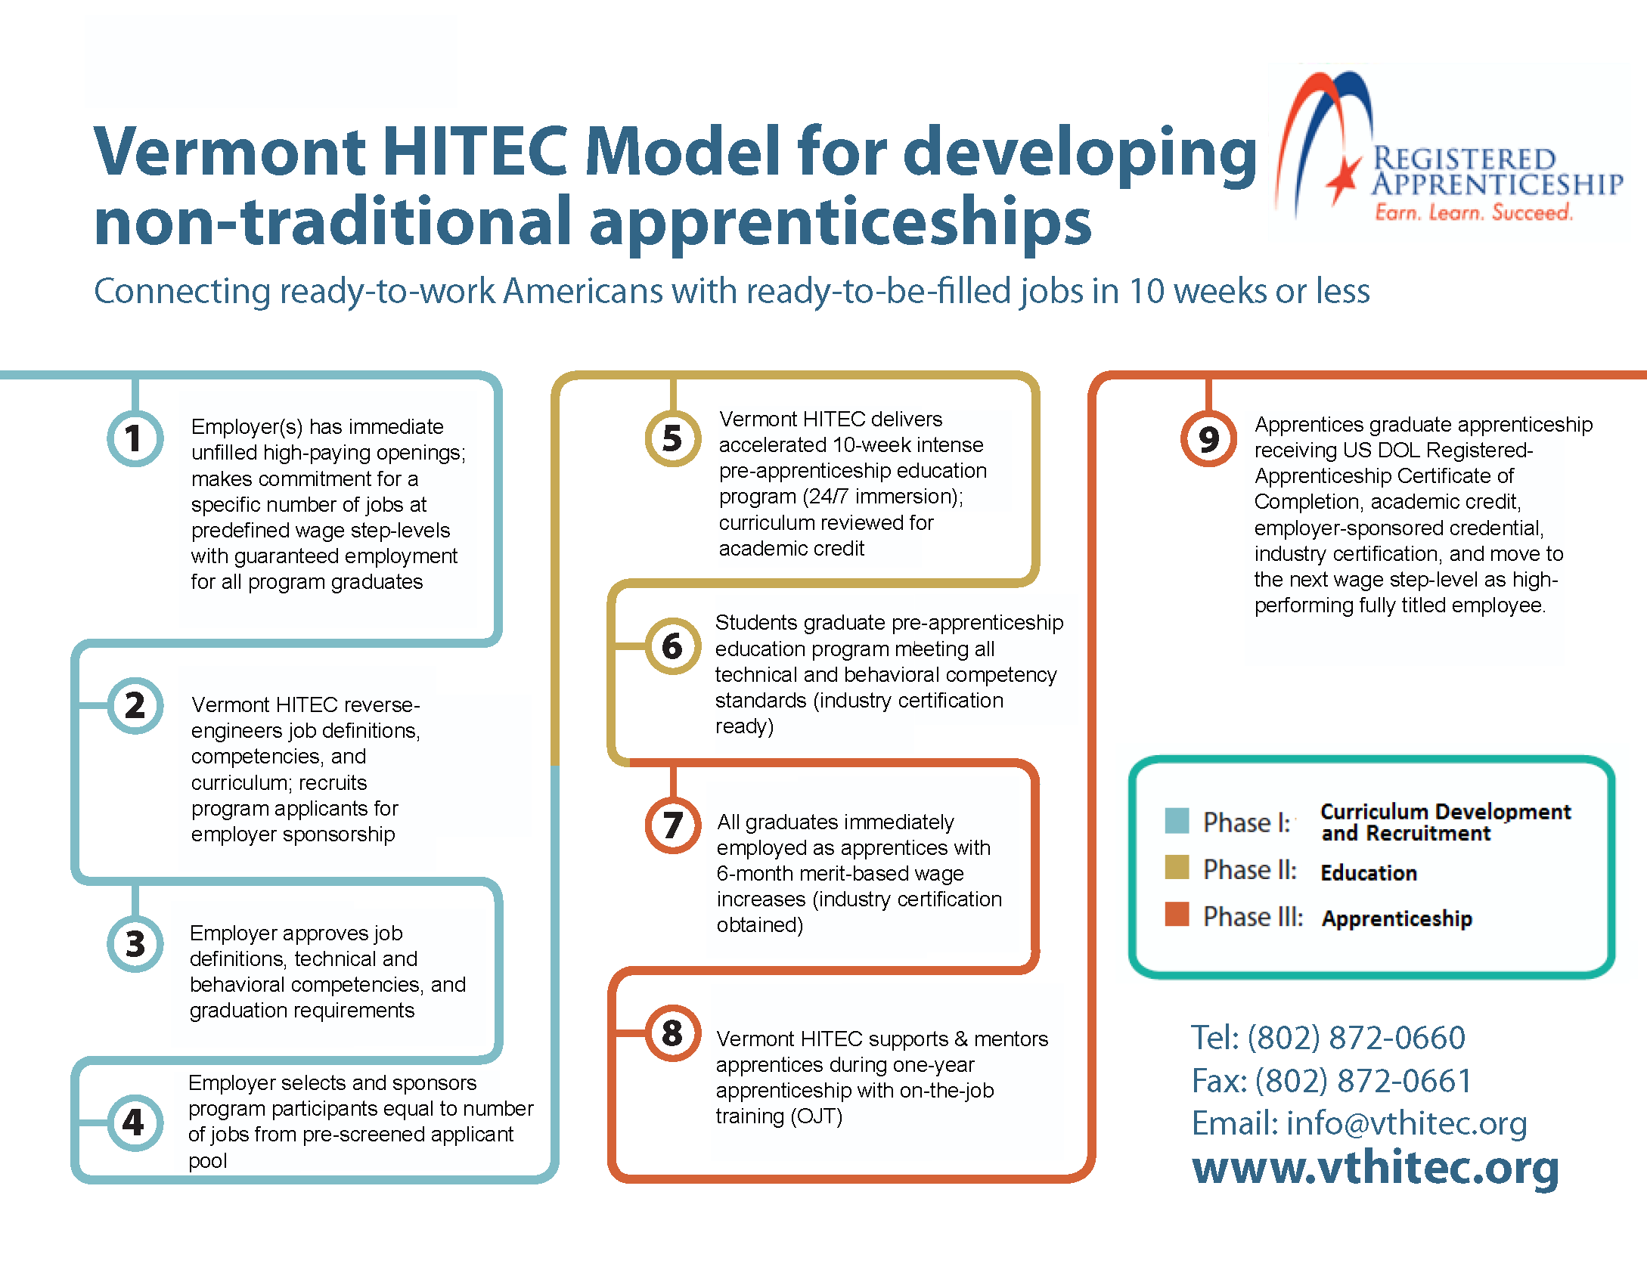

Slide 36

Phase I : Project Development
Project Development Process
  Identify immediate ready-to-fill job openings using LMI data
  Contact local and regional employers
  Secure commitment from employer(s) to guarantee jobs to successful graduates
  Secure commitment of state and federal funding

Slide 37

Phase I (a): Curriculum Development
Curriculum Development Process
  Become “employee” of employer-partner
  Perform all essential functions of position
  Reverse engineer curriculum
  Identify process improvements
  Validate apprenticeship competencies
  Submit for academic accreditation

Slide 38

Phase I (b): Outreach & Selection
Candidate Outreach Process
  TV and newspaper articles (Press Release)
  Radio, newspaper, social media ads
  Direct mailings through VDOL Job-link system
  Direct outreach through VDOL American Job Centers and WIOA case managers (Vets/Youth/DW)
  Direct mailings to long-term unemployed through VDOL UI system
  Direct placement on VDOL UI checks stubs

Slide 39

Phase I (b): Outreach & Selection
Candidate Selection Process
  Open “management” application website
  Mandatory orientation session
  Aptitude assessments
  Programmatic interviews
  Instructor interviews
  Employer interviews
  Selection criteria matrix

Slide 40

Phase II: Education
Total immersion learning (flipped classroom)
  8 to 10 weeks of academics
  8-9 hours course work each day / 5 days per week
  3-4 hours course work each night plus weekends
Online, lectures, lab/clinical work, rotations
Behavioral and technical competencies
Rigorous graduation requirements
National certification exams
Student support services

Slide 41

Phase III: Apprenticeship
Technical and behavior competencies
On-the-Job Training (OJT) support
Dedicated mentor for apprentices
Monthly apprentice evaluations
Performance-based merit increases
Student support services
Industry-recognized certification, academic credit
US DOL Certificate of Apprenticeship
Fully-titled employee

Slide 42
Apprentice Support Services
Extensive support services provided at every step of process
Numerous touch points
  VDOL American Job Centers office support
  VDOL UI reemployment services & case managers
  VDOL WIOA services and case managers
  VDOL Apprenticeship field representatives
  VSAC (grants for living stipends)
Apprentice-centered approach ensures success

Slide 43
Example: IT Apprenticeship
Software Interface Analysts for Allscripts, Inc. (30 positions)
  One-year apprenticeship: $35,000 -- $45,000 -- $55,000
  4298 visited website
  706 filled out applications
  400+ attended orientation session
  304+ participated in aptitude assessments
  140 participated in 1st round interviews with Vermont HITEC
  65 participated in 2nd round interviews with Allscripts
  30 selected and completed 8-week education program
  29 graduated, entered & completed apprenticeship
  29 became fully-titled Software Interface Analysts

Slide 44
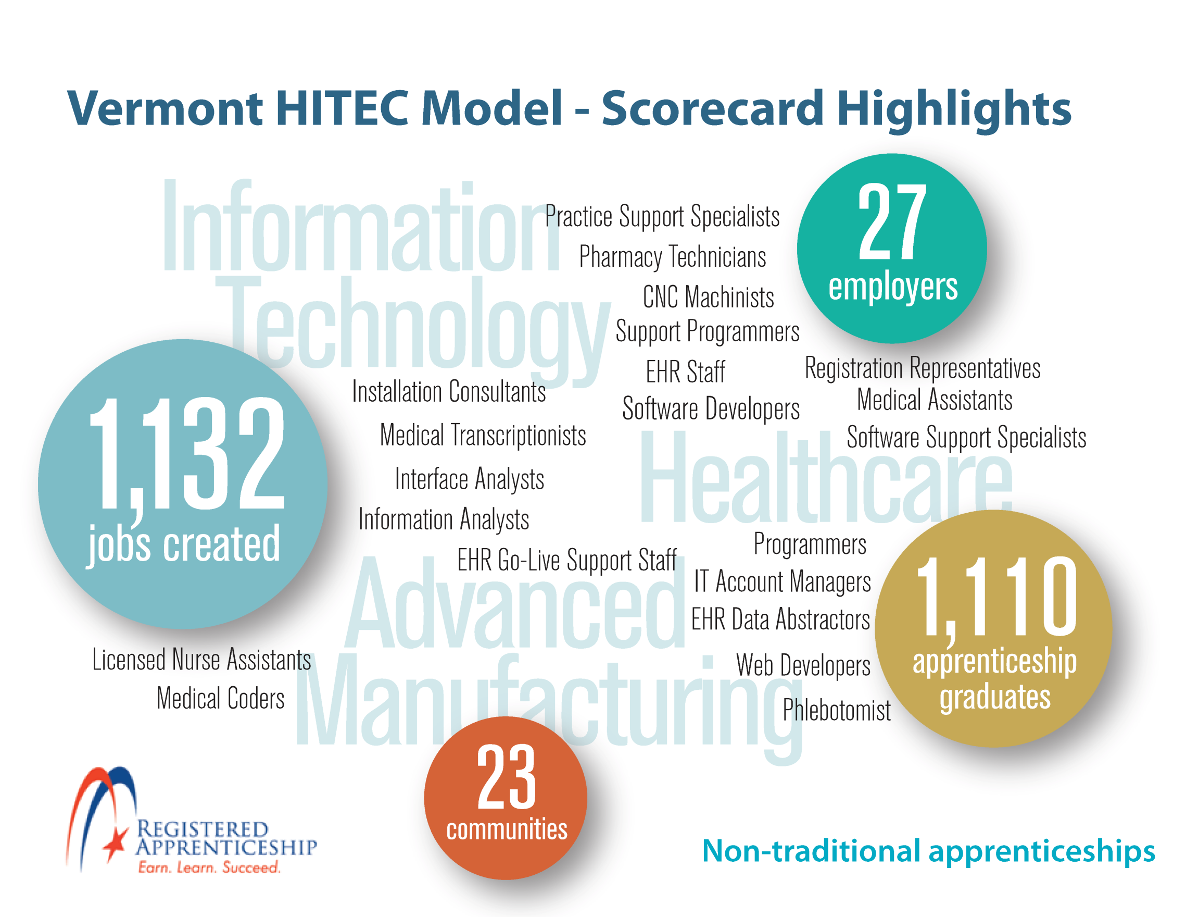

Slide 45

Please enter your questions in the Chat Room!

Slide 46
Resources
Building Apprenticeship Programs: A Quick-Start Toolkit
http://www.doleta.gov/oa/employers/apprenticeship_toolkit.pdf
U.S. Department of Labor – Apprenticeship Program Website
http://www.doleta.gov/oa/
21st Century Apprenticeship Community of Practice
https://21stcenturyapprenticeship.workforce3one.org/
American Apprenticeship Initiative
http://doleta.gov/oa/aag.cfm

Slide 47
Speakers’ Contact Information
Stephen Tucker
Gerry Ghazi
Title: President
Organization: Vermont HITEC, Inc.
Email: gerry.ghazi@vthitec.org
John Ladd
Title: Administrator, Office of Apprenticeship
Organization: Employment and Training Administration
Email: OA.Administrator@dol.gov
Rose Lucenti
Title: Workforce Development Director
Organization: Vermont Department of Labor
Email: Rose.Lucenti@state.vt.us

Slide 48
Thank You!
Find resources for workforce system success at:
www.workforce3one.org

