Slide 1
Workforce Innovation Fund Round 2 Virtual Grantee Orientation
Webinar Date: November 20, 2014
Presented by: Workforce Innovation Fund Team
U.S. Department of Labor
Employment and Training Administration

Slide 2
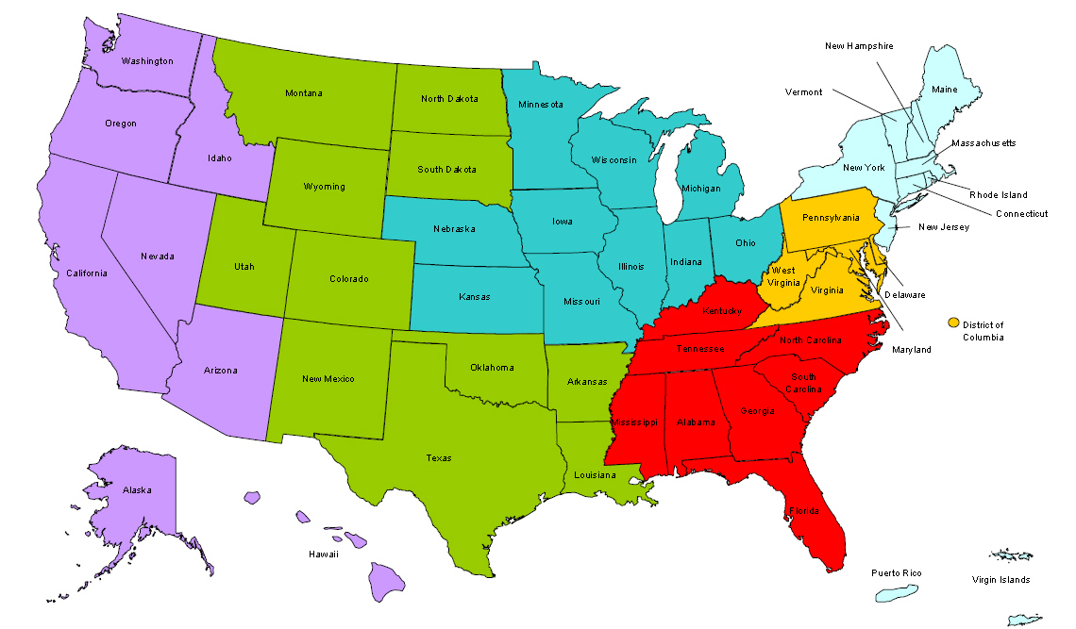
Where are you?
Enter your location in the Chat window – lower left of screen
Notes:
In the Chat Room, please type the name of the your organization, your location, and how many people are attending with you today.

Slide 3
Moderator
Wendy Havenstrite, Workforce Analyst
Adult Policy Unit, Division of WIA Adult Services and Workforce System
Workforce.Innovation@dol.gov
havenstrite.wendy@dol.gov
(202) 693-2618

Slide 4
Here’s what you can expect to get out of this webinar!
Understanding Roles and Responsibilities
Understanding Administrative and Fiscal grant requirements
Understanding Evaluation Component
Notes:
Video clip of what to expect in the webinar room. (instead of the 5 tech slides)

Slide 5
Agenda
Overview: Workforce Innovation Fund
Roles and Responsibilities
Grants Package
Administrative and Fiscal Requirements
Evaluation Plan Component
Next Steps
Notes:
Wendy
Review agenda

Slide 6
Presenters
Sara Williams, Grant Officer
Office of Grants Management
Eliza Kean, National Evaluation Coordinator
Abt Associates Inc.
WIF@abtassoc.com
Notes:
Wendy
Introduce Sara and Eliza from slide

Slide 7
Presenters
Robert Kight, Division Director
Division of WIA Adult Services and Workforce System,
Office of Workforce Investment
Wayne Gordon, Division Director
Division of Research and Evaluation,
Office of Policy Development and Research
Notes:
Wendy
Add: Joining us today are also two special guests Robert Kight, Director of the Division of WIA Adult Services and Workforce System, Office of Workforce Investment, and
Wayne Gordon, Director of the Division of Research and Evaluation, Office of Policy Development and Research
Turn over to Robert to explain the purpose of the Workforce Innovation Fund grants

Slide 8
Special Guests
Schedules permitting, we may be joined by our fantastic regional Federal Project Officers (FPOs):
Region 1: Tim Theberge Region 4: Roseana Smith
Region 2: Keith Hubert Region 5: Danielle Waddell
Region 3: Lovie Thompson Region 6: John Jacobs,
Tara Holt, and Krister Engdahl
Notes:
Wendy
Add: Joining us today are also two special guests Robert Kight, Director of the Division of WIA Adult Services and Workforce System, Office of Workforce Investment, and
Wayne Gordon, Director of the Division of Research and Evaluation, Office of Policy Development and Research
Turn over to Robert to explain the purpose of the Workforce Innovation Fund grants

Slide 9
Purpose of the WIF
Deliver services more efficiently and achieve better outcomes for the dual customer
Support cross program cooperation and system reforms to deliver client-centered services
Develop education, employment, and training services in partnership with specific employers or industry sectors
Build knowledge about effective practices through rigorous evaluation and translating “lessons learned” into the formula funded programs
Notes:
Robert
Read or paraphrase this first: Workforce Innovation Funds are not the same as WIA funds. They were authorized by the Full-Year Continuing Appropriations Act, 2011 (P.L. 112-10). They have their own appropriations and are only governed by WIA when we have chosen to align them with WIA. It was an initiative designed to strengthen public job training programs by: delivering employment and training services more efficiently and effectively, facilitating greater cooperation across workforce programs and funding streams, scaling best practices, and implementing rigorous evaluation techniques.
Then go over the slide, reading or paraphrasing.
Last, read or paraphrase this: I’ll turn this over to Sara Williams to give you more information about the specifics of your WIF grant. Sara?

Slide 10
Period of Performance
The period of performance for grants will be 60 months from the effective date of the grant, which will consist of:
12 months for planning and start-up;
36 months for technical grant performance; and
12 additional months to complete evaluation activities.
Notes:
Sara
Thanks Robert! Let’s get into the specifics of this great grant opportunity. We think these are among the most exciting grants we have ever awarded and we are so looking forward to working with you and watching you achieve great things!

Slide 11
Awardees
ETA funded 11 grantees in three project types
7 – Project Type A: New and Untested Ideas (up to $3M)
3 – Project Type B: Promising Ideas (up to 6M)
1 – Project Type C: Adapting or Scaling Proven Ideas (up to $12M)
Notes:
Sara

Slide 12
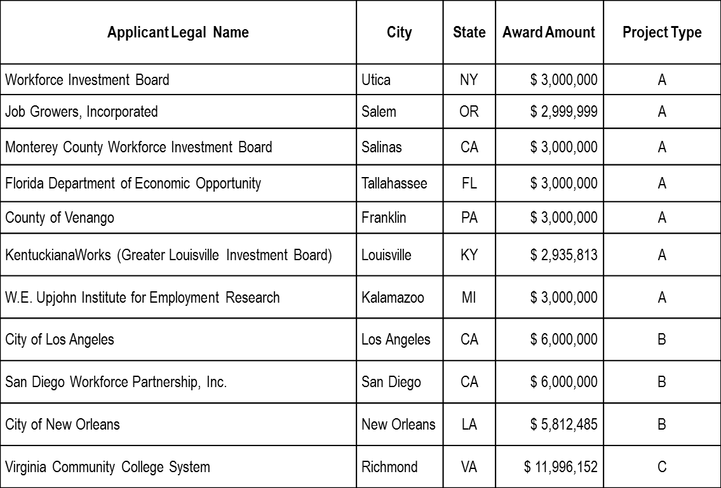
Awardees
Notes:
Sara
Wayne Gordon is going to tell you a little bit about some of the themes we are seeing emerging from our Round 1 WIF grantees.
Wayne?

Slide 13
Emerging Themes
Improving training outcomes by developing sector strategies and career pathways, especially to youth
Improving efficiency and efficacy of One-Stop service delivery through enhanced online resources and innovative, virtual service delivery
Reducing redundancies and improving participant outcomes by designing integrated management information systems and aligning policies and programs
Notes:
Wayne
Read or paraphrase explaining what we are beginning to see from our Round 1 grantees.

Slide 14
Roles and Responsibilities
National Office Leads
Sara Williams (Grant Officer)
Wendy Havenstrite (Technical Assistance)
Wayne Gordon (Evaluation)
Coordinating TA, evaluation, and grants management
Coordination with FPOs
Establishing policy guidance
Concurrence on some modifications of statements of work
Notes:
Wayne
Now we’ll talk a little bit about everyone’s roles and responsibilities.
Read from slide or paraphrase.

Slide 15
Roles and Responsibilities
Regional Office FPO
Primary contact
Responds to emergent requests and TA needs
Conducts monitoring and oversight
Grant modifications
Notes:
Wayne
FPOs are your first stop for all questions and concerns. Your FPOs will help guide you through the “roughest water” so if you haven’t yet talked to yours, reach out and do so. They are experts!

Slide 16
Roles and Responsibilities
Contractor Support
National Evaluation Coordinator
Technical Assistance Coordinator
Contractors submitted bids 11/14/14, in review, not yet selected
Notes:
Wayne
What other supports will ETA provide grantees?
Read or paraphrase slide
Sara is up next to tell you about her roles and responsibilities. Sara?

Slide 17
Roles and Responsibilities
Grant Officer
Grant modifications
Maintains official grant documents
Equipment prior approval
Notes:
Sara
What is the Grant Officer’s role?

Slide 18
The New DOL Grantee
ETA’s Expectations of You, a program that:
Is designed to focus on customer needs and to address those needs
Meets the requirements of Federal law and regulation
Is in compliance with Workforce Innovation Fund requirements, OMB Requirements and Generally Accepted Accounting Principles.
A high quality program that is backed up by a high quality evaluation
Notes:
Sara
And what is the grantee’s role?

Slide 19
Grant Award Package
Grant Award Letter
Grant Agreement - Notification of Award Obligation
Terms and Conditions
Application for Federal Assistance SF-424
Budget Information – SF-424A
Statement of Work
Project Narrative
Program Evaluation Plan
Evaluation Budget Narrative
Other Documents Required by the WIF SGA
Notes:
Sara
Grantees! You should have received your grant award package by email or UPS, and hopefully you have it with you now. If you have not received the award package, please check with your Grant Signatory and then, alert us with an email to workforce.innovation@dol.gov WIF grant award package in the Subject line.
The grant award package consists of the grant award letter and the actual grant package. This includes the notification of award obligation and the terms and conditions which includes Special Clauses and Conditions. The grant award package also includes attachments which are:
The application for federal assistance – that’s the SF-424
The Budget Information – SF424A and Budget Narrative
The Statement of Work; which includes the Project Narrative, Program Evaluation Plan and Evaluation Budget Narrative
As well as the other documents required by the WIF Solicitation for Grant Applications.

Slide 20
Grant Award Letter
Acknowledgements of Award
Payment Management System
Information and forms on www.doleta.gov/grants under Payment Information
ETA’s on-line Grantee Fiscal Reporting System – SF 9130
Information to access system on www.doleta.gov/grants under Financial Reporting
Passwords/PINs are sent separately after supplying the necessary information – Once you receive it please DO NOT LOSE IT!
Notes:
Sara
The grant award letter acknowledges your respective award and contains important information about the two systems that require a password and PIN. The first is the payment management system, which allows the draw down of funds. Information and forms on that can be found at www.doleta.gov/grants under “Payment Information”.
If you go to that same site and under “Financial Reporting” you will find information about the online grantee fiscal reporting system and the SF-9130. Your passwords and PINs are sent separately after you supply the necessary information. Once you receive it please do not lose it.

Slide 21
Notification of Award Obligation
Project title
Grant awardees' identifying information
DOL identifying information (for the first grants)
Period of performance
Award amount
Regulations and cost principles
Signatures
Notes:
Sara
In the grant agreement, the first page is the Notification of Award Obligation. This page was emailed to you and has the project title – which is the Workforce Innovation Fund (WIF) Grants– and it contains the grant recipient’s identifying information, which is the name of your organization, address, and EIN and DUNS number.
It also contains Department of Labor (DOL) identifying information. This is the agreement number. All WIF Grant agreement numbers should start with IF and then five-digit number. Please reference this number when you contact your Federal Project Officer or National Program Office when you have questions about your grant. The period of performance, award amount, regulations and cost principles, and signatures are also included in this document.

Slide 22
Terms and Conditions
Special Clauses and Conditions
Budget Line Item Flexibility
Indirect Cost Rate and Cost Allocation Plan
Transparency Information
Federal Project Officer
Equipment
Program Income
Intellectual Property Rights
Evaluation
Reports—Quarterly Financial and Performance Reports
Notes:
Sara
Right after the Notification of Award page are the WIF Terms and Conditions, which list the Special Clauses and Conditions for the grant award. The terms and conditions includes information on budget line item flexibility, your indirect cost rate, and cost allocation plan. If you need to claim indirect costs and have not submitted an indirect cost rate agreement, please send it to your FPO as soon as possible in order for a modification to be made to the grant. Grant Office
If you are claiming indirect costs and did not have an indirect cost rate, you were put on a 90-day temporary billing rate. As a result, please send the indirect cost rate agreement to your FPO. Or, if you do not have an indirect cost rate agreement, you need to start negotiating one as soon as possible. Information on cost negotiators can be found in this section of the grant award.
The Terms and Conditions also lists the contact information for your federal project officer – or FPO. There is also information on equipment, program income, intellectual property rights, the evaluation, and requirements for quarterly financial and performance reporting. If you have not reviewed the Terms and Conditions for the grant award, we urge you to do so immediately following this orientation.

Slide 23
Phase 1 and Phase 2 Funding
25% of award available for Phase 1
Process for requesting additional funds during Phase 1
Unlocked when you complete Phase 1 activities
Notes:
Sara
As you may recall from the solicitation, the Workforce Innovation Fund grants have two phases. You may only drawdown 25 percent of the total award amount from the HHS Payment Management System (PMS) to cover the costs of Phase I implementation. You may, however, request additional funds be made available for Phase I implementation with prior approval of the Grant Officer. You must work with your FPO to request approval to draw down funds.
All of your award will be unlocked when you complete all Phase 1 activities. Eliza Kean from the NEC will be discussing these requirements to complete Phase 1 in a few minutes.

Slide 24
Redaction in Action
All redaction requests or waivers have been received
Thank you!
They will be posted on Grant Program Information (GPI) site
http://www.dol.gov/dol/grants/
Notes:
Sara
Also, you may recall from the congratulatory letter and Solicitation, ETA is committed to conducting transparent grant award processes as a means of promoting and sharing innovative ideas. We have already published your Abstracts, and we have received redacted technical proposals from most of you at this point or the go ahead to publish your proposal as is.
We are working with the Freedom of Information Act (FOIA) coordinator here in the Department and may be in touch with a few of you with questions.
We hope to get all of the proposals posted within the next month. There is a lot of interest in these documents and they will be posted at our new Grant Program Information or GPI site. The documents can be viewed publicly at: http://www.dol.gov/dol/grants/
Now I’ll turn it over to Eliza

Slide 25
WIF Evaluation Goals
WIF goal is for projects to “be rigorously evaluated in order to build a body of knowledge about what works in workforce development.”
Notes:
Eliza
Turning to the evaluation component of WIF, I draw your attention to one of the primary goals of WIF as outlined in the SGA.

Slide 26
WIF Evaluation
Each grantee will perform an evaluation of its innovation.
The evaluation type must be appropriate to the innovation.
The evaluation design must be rigorous.
The evaluation must contribute to the same evidence base from which the innovation was designed.
The grantee must hire a third-party evaluator.
Abt, the National Evaluation Coordinator, will work with grantees’ evaluators to ensure consistent and high quality evaluations.
Notes:
Eliza
So what does that mean. Here we list how that goal is translated operationally for you, the WIF grantees.

Slide 27
WIF Evaluation Types
WIF funded three levels of projects, each with specific evaluation requirements:
Type A. New and Untested Ideas – pre-post outcomes evaluation design
Type B. Promising Ideas – Randomized Controlled Trial evaluation design
Type C. Adapting or Scaling Proven Ideas – Randomized Controlled Trial evaluation design
Notes:
Eliza

Slide 28
Evaluation Timeline
Phase I Requirements:
Procure third-party evaluators as soon as possible; submit copy of executed contract to WIF mailbox with a copy to your FPO
Grantees should include coordination with the NEC in the scopes of work for their third-party evaluators, and budget appropriately for the third-party evaluator
Submit Initial Evaluation Design Report to the NEC as early as possible, but no later than July 1, 2015.
Respond to comments and direction from DOL and the NEC to strengthen the evaluation design.
Submit Final Evaluation Design Report, final performance data template no later than September 1, 2015.
Notes:
Phase I Requirements:
Procure third-party evaluators as soon as possible; submit copy of executed contract to WIF mailbox with a copy to your FPO
Grantees should include coordination with the NEC in the scopes of work for their third-party evaluators, and budget appropriately for the third-party evaluator
Submit Initial Evaluation Design Report to the NEC as early as possible, but no later than July 1, 2015. NOTE THAT THIS IS DIFFERENT THAN THE TERMS OF YOUR AWARD BUT IS IN LINE WITH THE REQUIREMENTS OF THE SGA.
Respond to comments and direction from DOL and the NEC to strengthen the evaluation design.
Submit Final Evaluation Design Report, final performance data template no later than September 1, 2015.

Slide 29
NEC/Evaluation Resources
The NEC should be viewed as a Resource for the evaluators of your grants.
A Toolkit for grantees was published in May 2014 available at the ETA website.
A companion Toolkit will be published in the coming weeks specifically for the WIF evaluators
The NEC will work with the third-party evaluators and the WIF TA Provider to communicate with grantees for the remainder of the grant.
WIF NEC email address: WIF@abtassoc.com
Access to the WIF Evaluation SharePoint site will be provided by NEC staff

Slide 30
Evaluation Immediate Next Steps
Individual calls with the NEC to discuss:
Overall evaluation process
Evaluation documents included in applications (logic model, evaluation plan, evaluation budget)
Third-Party Evaluator Procurement and Expected Early Deliverables
Schedule and Next Steps
The NEC will work with the third-party evaluators after they are procured.

Slide 31
Next Steps
Email additional Points of Contact to FPO and Workforce.innovation@dol.gov and WIF@abtassoc.com
Procure third party evaluators and submit copy of executed contract to WIF mailbox
Plan for In-Person Grantee Meeting March 2015, TBD
Submit Initial Evaluation Design Report to the NEC no later than July 1, 2015.
Submit Final Evaluation Design Report, final performance data template, and final evaluation budget no later than September 1, 2015.
Notes:
Eliza
Turn over to Wendy

Slide 32
Resources
Financial, Administrative and Performance Training for Grantees:
http://etareporting.workforce3one.org
Introduction to Financial Reporting:
http://www.workforce3one.org/view/3000914758141611670
Financial Management Principles:
http://www.workforce3one.org/view/3000914831758578573
Introduction to Grant Applications and Forms:
http://www.workforce3one.org/view/3000914831964994677
Introduction to Procurement Requirements:
http://www.workforce3one.org/view/3000914833849989433
9130 Financial Form and Instructions:
http://www.doleta.gov/grants/docs/ETA-9130-straightSF269grants.pdf
Evaluation Toolkit for Grantees
http://www.doleta.gov/workforce_innovation/resources.cfm
Notes:
Wendy
Thanks Eliza, Robert, Sara and Wayne! Thank you to the FPOs who were able to join us, and thank you grantees for hanging in with us so far.
Save this slide! It will be a good reference to important information going forward.
This concludes the formal part of the presentation and now we can address some of the questions we have received.
Any questions not answered today will be collected and responses sent out to grantees.
Turn over to Gary

Slide 33
Please enter your questions in the Chat Room!
Notes:
Please enter your questions into the Chat Room!

Slide 34
Speakers’ Contact Information
Speaker: Wendy Havenstrite
Title: Office of Workforce Investment
Organization: Employment and Training Admin.
Email: Havenstrite.wendy@dol.gov
Telephone: 202-693-2618
Speaker: Wayne Gordon
Title: Director
Organization: Division of Research and Evaluation
Speaker: Sara Williams
Title: Grant Officer
Organization: Office of Grants Management

Slide 35
Speakers’ Contact Information
Speaker: Eliza Kean
Title: Senior Associate/Project Director
Organization: National Evaluation Coordinator
Email: WIF@abtassoc.com
Speaker: Robert Kight
Title: Director
Organization: Division of WIA Adult Services and Workforce System

Slide 36
Thank You!
Find resources for workforce system success at:
www.workforce3one.org

