Slide 1
New Grantee Orientation
Webinar Series
YouthBuild Grant Post Award Overview
September 9th, 2014; 2:00 - 3:30 PM (EDT)
Webinar Date: September 9, 2014
Presented by: Division of Youth Services-YouthBuild
U.S. Department of Labor
Employment and Training Administration

Slide 2
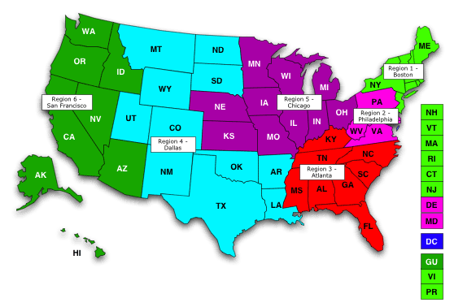
Where are you?
Enter your location in the Chat window – lower left of screen

Slide 3

Moderator
Toni Wilson
Workforce Analyst/National Liaison
U.S. Department of Labor

Slide 4
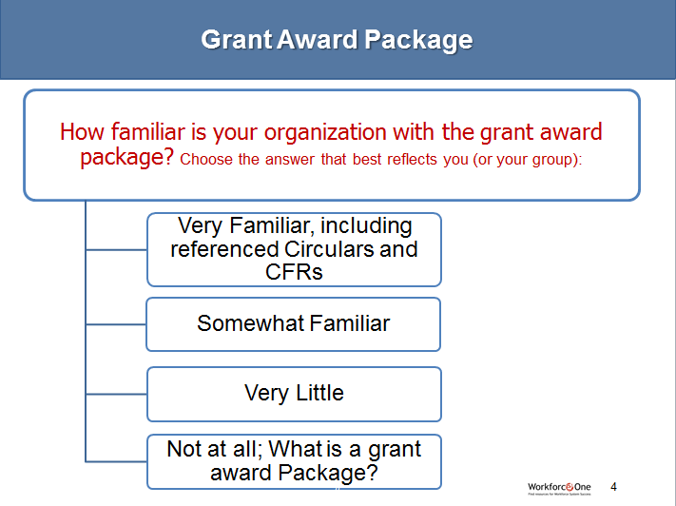
Grant Award Package
How familiar is your organization with the grant award package? Choose the answer that best reflects you (or your group):
Very Familiar, including referenced Circulars and CFRs
Somewhat Familiar
Very Little
Not at all; What is a grant award Package?

Slide 5


Presenters
Presenter: Dr. Jack MacLennan
Title: Federal Project Officer
Organization: Employment & Training Administration, Region 5
Presenter: Tiffani Thomas
Title: Federal Project Officer
Organization: Employment & Training Administration, Region 6

Slide 6

Grant Award Package Content
Notification of Obligation
Key References
Solicitation for Grant Applications
(SGA)
SF-424 Form
Statement of Work (SOW)
Budget (SF-424a)
Assurances and Certifications
Special Clauses and Conditions

Slide 7
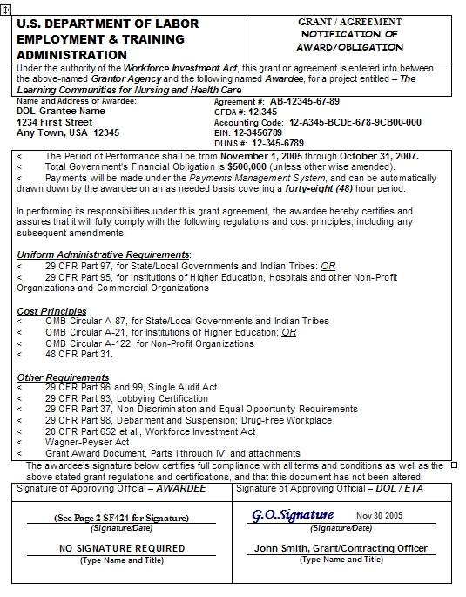
Notice of Obligation (Sample)

Slide 8

Key References
YouthBuild Transfer Act and Regulations
Payment management system (PMS) account
#9130 financial status report set-up
Important!

Slide 9
Solicitation for Grant Applications
The SGA is the main source about DOL’s expectations for the YouthBuild grants:
  Program design
  Participant eligibility
  Allowable expenses
  Performance and reporting requirements
  25 percent matching fund requirement
  OSHA safety compliance
  Affordable housing for low-income families

Slide 10
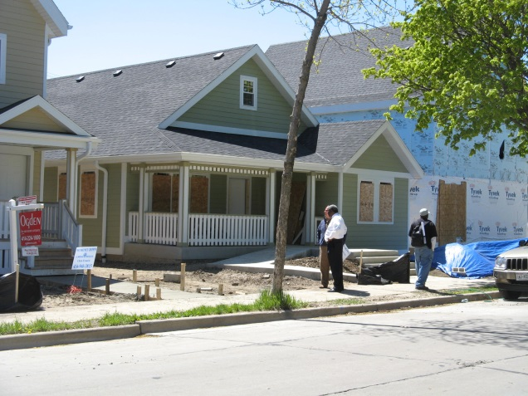
Grant Package - Statement of Work
The Statement of Work (SOW)
Includes the SF-424 application, technical proposal, SGA & supporting documents
Work site description and census Form
Covers the activities/results ETA gave you money to implement/achieve, and is binding.
MILWAUKEE

Slide 11
Worksite Description Form

Slide 12
Budget
Budget form SF-424a and justification
The amount ETA approved you to spend money on and to what extent
Is a binding commitment
Provides grantees limited flexibility
Changes beyond flexibility limits require ETA pre-approval

Slide 13
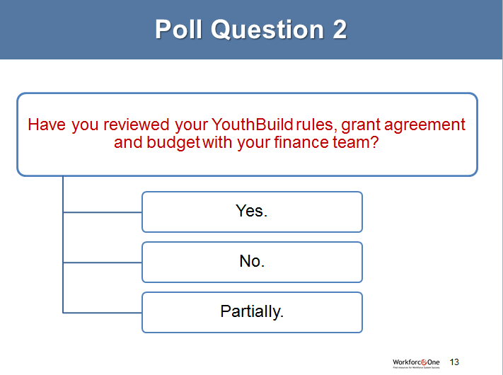
Poll Question 2
Have you reviewed your YouthBuild rules, grant agreement and budget with your finance team?
Yes.
No.
Partially.

Slide 14

Assurances & Certifications
By signing and accepting ETA funds, you “assure” and “certify” to ETA that you will comply with the all the standards and requirements of the grant.

Slide 15
Assurances Section
A FEW OF THE ASSURANCES:
The duly authorized representative of the applicant certifies that the applicant:
Has the legal authority and the managerial and financial capability to run a successful project.
Will give DOL access to and the right to examine all records, related to the grant
Will establish a proper accounting system
Will establish safeguards to prohibit employees constitutes or presents the appearance of personal or organizational conflict of interest, or personal gain.

Slide 16
Assurances (cont.)
Will initiate and complete the work within the applicable time frame after receipt of approval of the awarding agency.
Will comply with all Federal statutes relating to nondiscrimination.
Will comply with the Davis Bacon-Prevailing Wage Act if applicable.

Slide 17
Certification: Lobbying Activity
(SF LLL-A)

Slide 18
Special Clauses – Part 4
SPECIAL CLAUSES
Budget Flexibility
Workforce Investment Act (WIA) Citations including:
  Administrative Regulations
  Reporting Regulations
  Equal Opportunity Regulations
Indirect Costs or Cost Allocation Plan

Slide 19
Administrative Costs
There is a 10% limitation on administration costs under this grant.
Administrative costs include both
Administrative costs are different from Indirect costs.
See CFR 667.210(b)
.
direct and indirect costs.

Slide 20

Grant Package: Administrative Costs
Some examples are:
General administrative functions and coordination of functions:
  accounting
  audits
  budgeting
Oversight and monitoring
Travel costs incurred for official business in carrying out administrative activities
Information systems related to administrative functions
Awards vendors that are solely for the performance of administrative functions.
  Federal regulations defines administrative costs as allocable portion of necessary and allowable costs associated with the overall management and administration, which are not related to the direct provision of services.
                The cost of administration is defined in 20 CFR 667.220.

Slide 21
Special Conditions –Part 5
A FEW OF THE SPECIAL CONDITIONS
Federal Project Officer (FPO) is named here (not the Grant Officer)
Equipment approval
Reports—financial and progress
Publicity and announcements
Procurement
Drug-free workplace
Audits
Conference space approval

Slide 22
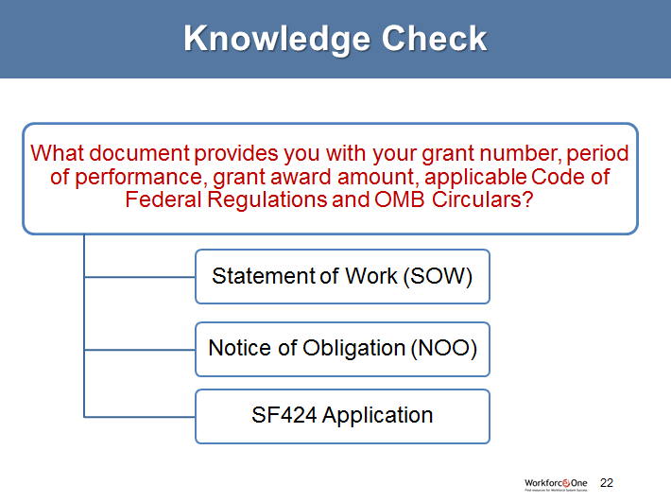
Knowledge Check
What document provides you with your grant number, period of performance, grant award amount, applicable Code of Federal Regulations and OMB Circulars?
Statement of Work (SOW)
Notice of Obligation (NOO)
SF424 Application

Slide 23

Unlocking the Grant Package
Read it, know what it says
Review the CFR, OMB and other references
Make sure program, fiscal and other relevant staff have it
Ask your FPO if you don’t understand an item
Refer to:
  http://www.dol.gov/dol/allcfr/cfr.htm
  http://www.gpoaccess.gov/cfr/index.html
  http://www.whitehouse.gov/omb/circulars_default/

Slide 24
Presenters
Presenter: Dr. Jack MacLennan
Title: Federal Project Officer
Organization: Employment & Training Administration, Region 5
Presenter: Tiffani Thomas
Title: Federal Project Officer
Organization: Employment & Training Administration, Region 6

Slide 25

Agenda
DOL YouthBuild Internal Structure
Quarterly Reports and Match Requirement
Eligibility Requirements and Selective Service
YouthBuild Program Design and Outcomes
YouthBuild Core Management Functions
OSHA Safety Requirements
DOL Monitoring Review

Slide 26


Grants Point-of-Contact and Resources
Grant Recipient
Office of Contracts & Grant Management
Grants/Contracts Administration
Assistant
Secretary
Federal Project Officer
Regional Office
Other National Offices
Program Offices When Needed
for Employment
and Training
GRANTS POC
& RESOURCES

Slide 27

FPO Roles and Responsibilities
Primary Point of contact to ETA
Front-line for the ETA Grant Office
Reviewer of grantee financial and performance reports
First point of contact for grant modifications
Responsible for monitoring reviews
Available to provide technical assistance
Not authorized to approve changes to the grant scope of work and/or budget

Slide 28



YouthBuild Technical Assistance Request Flowchart
Grantee
Submits Request for
Technical Assistance
Federal Project
Officer
(FPO)
Division of
Youth Services –
YouthBuild
Program Office
TA Provider –
YouthBuild
USA

Slide 29
YouthBuild Quarterly Reports
Quarterly Fiscal and Program Reports
  Fiscal Report (ETA-9130)
  Program Narrative Report
  Performance Report (QPR/ETA-9136)
  Each due 45 days after the end of each quarter
Final Report
  Due 90 days after the end of the performance period
        OR
  90 days after all funds are expended

Slide 30
Quarterly Report Due Dates
Quarterly Reports are due to DOL 45 days after the end of the quarter
Quarters | Quarterly Report Due Dates
Quarter 1 - January through March | May 15th
Quarter 2 - April through June | August 14th
Quarter 3 - July through September | November 15th
Quarter 4 - October through December | February 15th

Slide 31
Help Desk
Quarterly Financial Status Reports
  Submit through the Electronic Grant Reporting
  System
  - Help Desk: (202) 693-2682; E-grants-help@dol.gov
  - For EGRS PIN assistance, contact Shantay Logan (logan.shantay@dol.gov) or Avery Malone (malone.avery@dol.gov)
MIS Performance Reports
  Submit through YouthBuild MIS
  Help Desk: (866) 680-0855; missuport@youthbuild.org

Slide 32
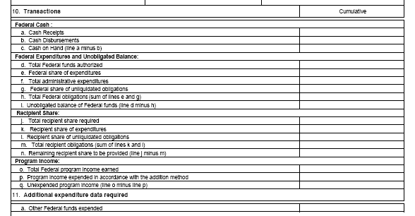
YOUTHBUILD MATCH REQUIREMENT
TEGL 5-10
25% Match Requirement
10j through 10n

Slide 33




YouthBuild Program Eligibility
YouthBuild Eligibility Requirements
Selective Service Requirement

Slide 34
YouthBuild Program Eligibility
YouthBuild Eligibility Requirements
Eligible Enrollees:
  Must be between 16 and 24 years of age; and
  A member of disadvantaged youth population; and
  Must be a school dropout or be enrolled in an alternative school (as part of a sequential service strategy).
  25% enrollment exemption: Basic Skills Deficient; or have been referred by a local secondary school for participation in the YouthBuild Program.

Slide 35
YouthBuild Program Eligibility
Definition of Disadvantaged Youth:
Member of low-income family
Youth in foster care (including youth aging out of foster care
Youth offender
An individual with a disability
A child of incarcerated parents
A migrant youth

Slide 36
YouthBuild Program Eligibility
25 percent enrollment exception
Up to (but not more than) 25 percent of participants in program may be youth who do not meet the education or target group criteria but are:
Basic Skills Deficient; or
  Have been referred by a local secondary school for participation in a YouthBuild leading to the attainment of a secondary school diploma.

Slide 37
YouthBuild Program Eligibility
YouthBuild Eligibility Guidelines and Source Documentation
Issue | Criteria | Most Common Documentation
Age | Youth is between the ages of 16 and 24 | Drivers license or Government Identification Card, School Records/School Identification Card, Birth Certificate, Hospital Birth Record, U.S. Passport or Naturalization Certificate
Low Income | Verify youth meets low-income guidelines (as referenced in 42 U.S.C. 1437a (b) through applicable income source | Income levels can be established through information contained within the following documents: Pay Stubs, Bank statement (direct deposit), Employer statement/contact, Parents tax return if under 18, Tax Return if over 18, emancipated or Public Assistance records/ receipt (TANF/Food Stamps), etc.
Youth in Foster Care or Aging Out | Verify youth is in the foster care system or aging out of the system | Court contact/documentation, Social Service contact/documentation, Medical Card or Verification of payment made on behalf of the youth
Youth is an individual with a disability | Verify disability (Define in Section 3 of the Americans with Disabilities Act of 1990 (42 U.S.C. 12102) | Social Security Administration Disability Records Statement, Academic records, Medical Records or Physician Statement
Child of Incarcerated parent | Verify youth is a child of an incarcerated parent | Court records or Applicant statement
Migrant Youth | Verify youth is a migrant youth or part of a family of migrant workers | Employer statement, wage records/family wage records, or work permits
Youth Offender | Verify youth is an offender or involved with the criminal justice system. | Court documentation, Resident of detention facility, group home, or restricted state run facility, Letter of parole/probation officer, Police records or Applicant Statement
School Drop-Out | Verify youth is no longer attending school | Letter documentation from the school stating the youth has dropped out, School Attendance Record, or Applicant Statement
25% Exemption: Basic Skills Deficient | Verify youth has a diploma/GED or other State-recognized equivalent and is basic skills deficient | Youth tests at or below the 8th grade level on a generally accepted standardized academic test (regardless of the attainment of diploma/GED), Testing indicates youth is unable to compute or solve problems, read, write, or speak English at a level necessary to function on the job
25% Exemption: Referred by a local secondary school | Youth has been referred by a local secondary school for participation in YouthBuild Program leading to attainment of a secondary school diploma | A referral from a high school guidance counselor/other academic professional

Slide 38
YouthBuild Program Eligibility
Selective Service Registration
Males between the ages of 18 – 25 must be registered for selective service in the DOL YouthBuild Management Information System.
Only those males in compliance with the registration requirements are eligible to participate in YouthBuild.
Males under age 26 who have not registered can do so through the Selective Service website ww.sss.gov/default.htm
Grant recipients must ensure enrollment and retain a copy of documentation.
.
TEN 44-10 Selective Service Registration for YouthBuild Participants
Issue | Most Common Documentation (Examples)
Selective Service | Selective Service Letter/Registration Letter, DD-214 Report of Transfer or Discharge from Military Service, Board/State Registration, Stamped Post Office of Registration, Internet verification/registration (www.sss.gov), Telephone Verification: (847) 688-6888

Slide 39




YOUTHBUILD PROGRAM DESIGN
YouthBuild Program Structure
  50% Educational Activities
  40% Vocational Activities in Construction or Construction Plus Vocational Activities in Other Industries
  10% Community and Public Facilities (Optional)
50% Education
40% Vocational
10% Community/Public

Slide 40
YouthBuild Performance Outcomes
YouthBuild Performance Outcomes | Documentation for Verification
Enrollment | DOL YouthBuild eligibility documentation, YouthBuild program enrollment form/application and/or enrollment verification from the DOL YouthBuild MIS system.
Recidivism | Documentation from juvenile or adult criminal justice system, documented phone call with court of probation representatives, or self-attestation at enrollment.
Literacy/Numeracy Gain | Pre and Post standardized assessment tests, i.e. CASAS, ABLE, TABE, TABE CLAS-E, BEST, Work Keys, SPL, and other U.S. Department of Education approved standardized assessment test, school records, and case notes.
Degree/Certification Attainment | GED certificate, HS diploma or Industry recognized certification in construction field (WIB certificates, Work readiness certificates and OSHA safety training certificates do not count as certifications towards measure).
Placement | Educational Placement – Requires post-secondary educational institutional or advanced level training program certification of enrollment, case notes verifying enrollment and report card reflecting completion of courses. Job Placement – Requires pay stubs, employer verification by phone or via a signed form that is case noted into MIS system or UI wage records. Military Placement – Documentation of military service i.e. DD214 or DD215 forms from the U.S. Department of Defense.
Retention | Educational Placement – Requires post-secondary educational institutional or advanced level training program certification of enrollment, case notes verifying enrollment, and report card reflecting completion of courses. Job Placement – Requires pay stubs, employer verification by phone or via a signed form that is case noted into MIS system, or UI wage records. Military Placement – Documentation of military service i.e. DD214 or DD215 forms from the U.S. Department of Defense.

Slide 41
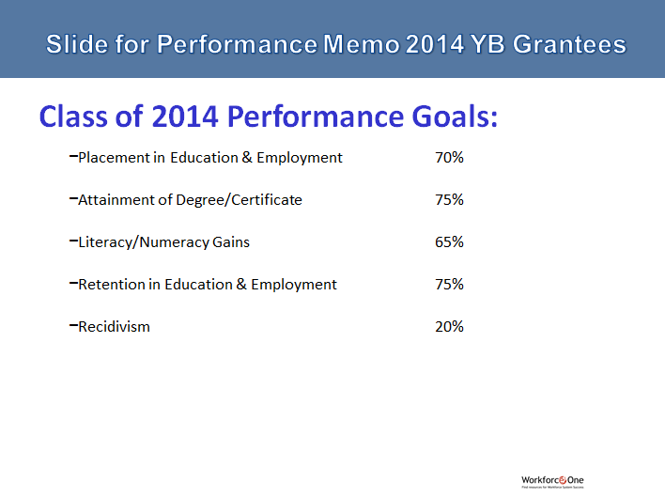
Slide for Performance Memo 2014 YB Grantees
Class of 2014 Performance Goals:
  Placement in Education & Employment 70%
  Attainment of Degree/Certificate 75%
  Literacy/Numeracy Gains 65%
  Retention in Education & Employment 75%
  Recidivism 20%

Slide 42
YouthBuild Core Management Functions
Grantees must develop written policies and procedures for YouthBuild core management functions.
YouthBuild Program Policies:
Outreach and Recruitment
Mental Toughness
Intake and Assessment
Eligibility and Enrollment
Attendance
Program Components
Termination and Suspension
Equal Opportunity/Non-discrimination
Grievance/Complaint Procedures
Sexual Harassment
Drug-Free Workplace
Construction Safety Plan
Case Management
Counseling and Referrals
Stipends and Incentives
Supportive Services
Exit and Follow-up
Sub-Recipient Monitoring

Slide 43

YouthBuild OSHA Requirements
YouthBuild programs must:
  Provide comprehensive construction safety training
  Demonstrate compliance with federal and state child labor laws and occupational safety health regulations
  Develop a written job-site specific safety plan and ensure a knowledgeable supervisor is on site that has the authority to enforce safety
  Provide necessary protective equipment
  Take measures to prevent injuries
  Report all illness and accidents to DOL using the OSHA 301 form

Slide 44

YouthBuild Standard Grant Modifications
Five standard modifications:
  Budget Realignment
  Statement of Work
  - Equipment Purchase
  Administrative
  Period of Performance

Slide 45
Grant Modification Procedures
Modification requests required for:
  Change in Partners/sub recipients as stated in the grant agreement;
  Increase or decrease in Personnel, Fringe Benefits, or Indirect Costs line items
  Any change exceeding 20% budget flexibility in all other line items
  Equipment purchase is any item with a per unit acquisition cost of $5,000 and useful life of more than 1 year. (Includes purchase of homes)
  Changes to the Scope of Work, such as adding a new construction worksite
  Period of Performance Extension

Slide 46
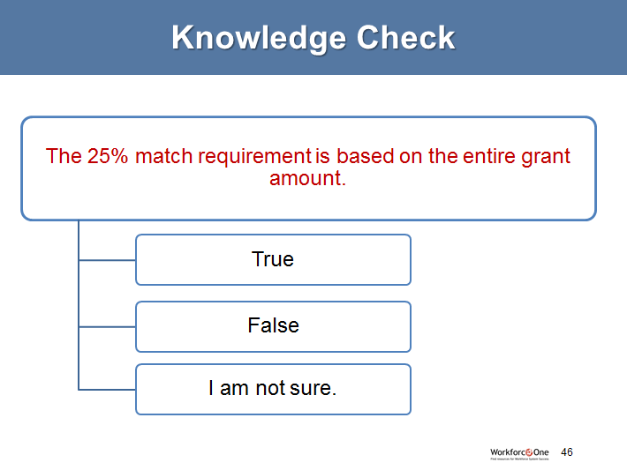
Knowledge Check
The 25% match requirement is based on the entire grant amount.
True
False
I am not sure.

Slide 47
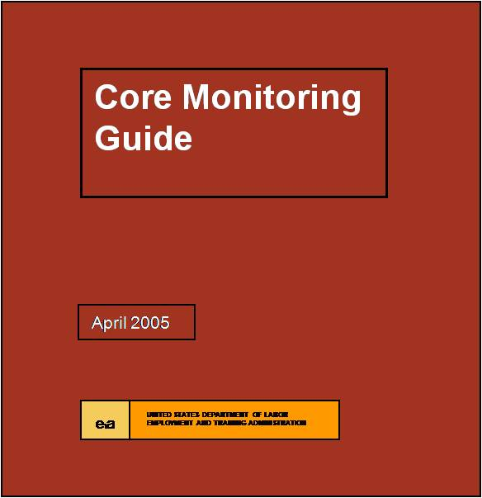
Monitoring Reviews
DOL ETA uniform guide for monitoring
  Five Core Activities
    Design and governance
    Program / Grant Management
    Systems
    Financial Management Systems
    Service/product Delivery
    Performance Accountability

Slide 48
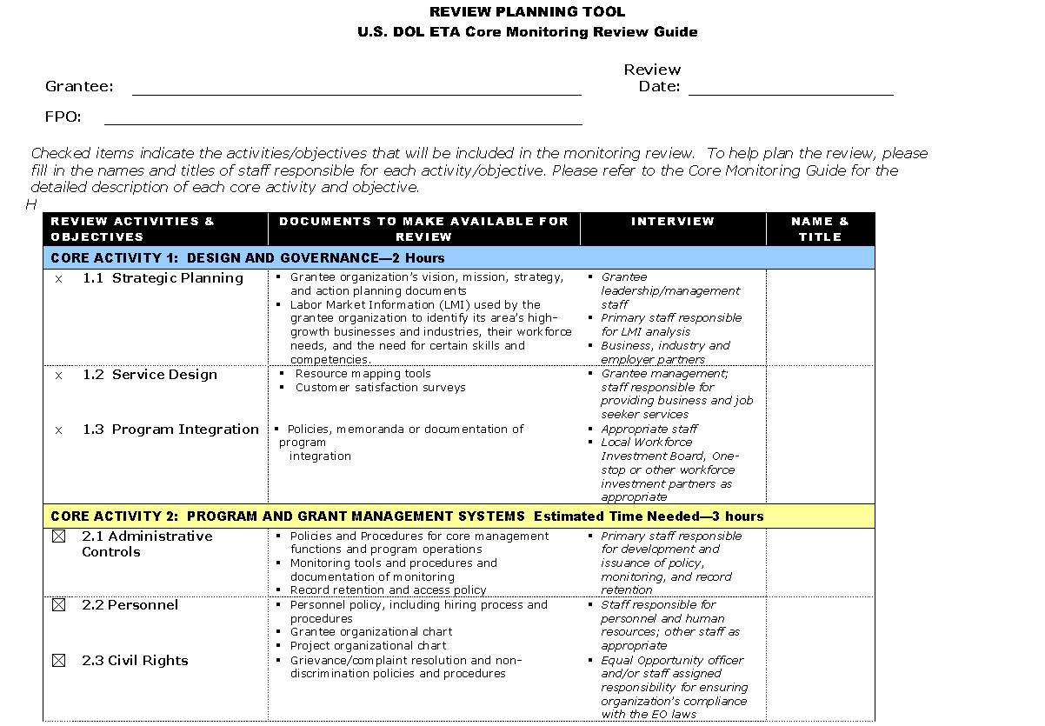
Monitoring Review Planning Tool

Slide 49
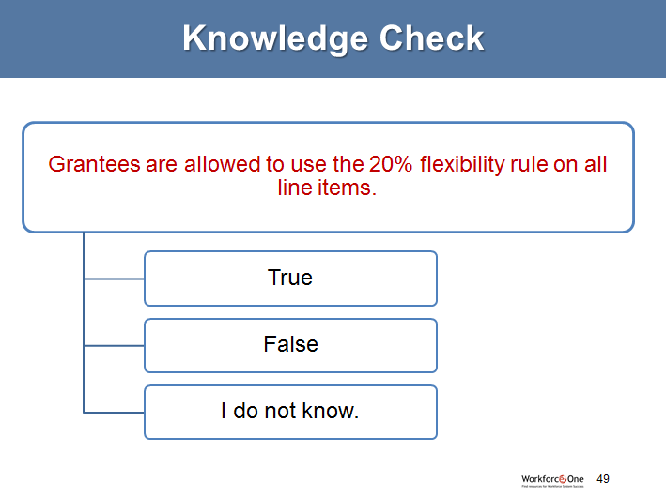
Knowledge Check
Grantees are allowed to use the 20% flexibility rule on all line items.
True
False
I do not know.

Slide 50

Please enter your questions in the Chat Room!

Slide 51

Resources
Community of Practice (CoP)
Code of Federal Regulations (CFR): http://www.dol.gov/dol/allcfr/cfr.htm
    Code of Federal Regulations (Annual Addition): http://www.gpoaccess.gov/cfr/index.html
    Code of Federal Regulations (Annual Addition): http://www.whitehouse.gov/omb/circulars_default

Slide 52

Speakers’ Contact Information
Speaker: JackMacLennan
Title: Federal Project Officer
Organization: ETA Region 5
Email: Maclennan.john@dol.gov
Telephone: 312-596-5494
Speaker: Tiffani Thomas
Title: Federal Project Officer
Organization: ETA Region 6
Email: Thomas.tiffani@dol.gov
Telephone: 415-625-7961
Moderator: Toni Wilson
Title: Workforce Analyst/National Liaison
Organization: DOL/ETA/OWI/DYS
Email: wilson.toni@dol.gov
Telephone:202-693-2922

Slide 53
Look for upcoming webinars!
Best Practices for Successful Work Site Management
SAVE
DATE
the
PRE NGO WEBINAR
September 16, 2014, 2pm EST

Slide 54
Look for upcoming webinars!
YOUTHBUILD WEBINAR SERIES
SAVE
DATE
the
(1st TUESDAY OF EVERY MONTH)

Slide 55
DON'T FORGET!
New Grantee Orientation
September 25-26, 2014
@ DOL in Washington DC

Slide 56
Thank You!
Find resources for workforce system success at:
www.workforce3one.org

