Slide 1
Disability Employment Initiative (DEI)
Workforce Employment Networks: Lessons Learned on Serving Ticketholders in the American Job Centers
Webinar Date: November 18, 2014
Presented by:
Mary Lynn ReVoir & Kevin Nickerson, NDI Technical Assistance Team
U.S. Department of Labor
Employment and Training Administration

Slide 2
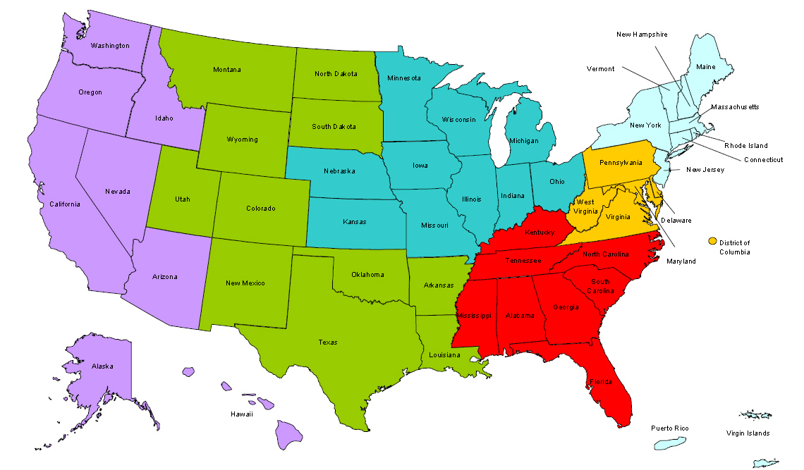
Where are you?
Enter your location in the Chat window – lower left of screen
Notes:
In the Chat Room, please type the name of the your organization, your location, and how many people are attending with you today.

Slide 3
Moderators
Moderator: Randee Chafkin
Title: Workforce Development Specialist
Organization: Employment and Training Administration
Moderator: Miranda Kennedy
Title: Director of Training for DEI, NDI Technical Assistance Team
Organization: National Disability Institute
#
3

Slide 4
Disability Employment Initiative
According to the SGA, DEI Projects at the state level and/or local level participating LWIBs are required to become Employment Networks (ENs) under Social Security Administration’s (SSA’s) Ticket to Work Program.
Training and Technical Assistance to DEI Projects in attaining Employment Network status and implementing effective EN operations is provided under U.S. DOLETA contract with NDI Consulting, Inc. and the National Disability Institute (NDI).
Evaluation of the impact of the DEI Projects implementation and outcomes as Employment Network will be provided under U.S. DOL ODEP contract with Social Dynamics.
#
4
Notes:
Video clip of what to expect in the webinar room. (instead of the 5 tech slides)
4

Slide 5
Learning Objectives
DEI grantees and participants and partners from the public
workforce system will:
Learn about key development and practices of DEI workforce Employments Networks leading to successful outcomes and
Become aware of challenges operating an EN and pitfalls to avoid
Be informed about performance trends of workforce Employment Networks and how to experience this success at the local AJC level
Hear about two case scenarios of real individuals who accessed AJC services leading to successful employment outcomes
#
5
Notes:
Miranda
5

Slide 6
Presenters
Presenter: Kevin Nickerson
Title: Ticket to Work Subject Matter Expert for DEI, NDI Technical Assistance Team
Organization: National Disability Institute
Presenter: Mary Lynn ReVoir
Title: Ticket Coordinator for DEI, NDI Technical Assistance Team
Organization: National Disability Institute

Slide 7
Agenda
Key development and practices of DEI workforce ENs leading to successful outcomes
Identified challenges when operating EN and pitfalls to avoid
Performance trends of workforce ENs
Guests from DEI regions share real case stories of those who accessed AJC services and how that led to successful employment outcomes
Time for Q & A
#
7
Notes:
Kevin
7

Slide 8
Key Developments and Practices Leading to Successful Outcomes
#
8
Notes:
8

Slide 9
Key Developments
Administration needs strong buy-in of the workforce Employment Network (EN)
Understand the EN represents the services and programs of the American Job Center
Establish procedures to create strong infrastructure
Arrange with IT department routine practice to check which AJC customers have a Ticket
Tapping into marketing / communications department to create professional marketing products (ongoing outreach necessary)
Notes:
It is critical to get the support of Job Center management and of the Workforce Investment Board. This is best accomplished through outcomes, but of course that takes time. We have found that sites that include key AJC staff and management in an ongoing dialogue about how the Ticket program operates, and why it helps to improve outcomes for customers that might be considered “hard to serve” have greater success.
Remember that the EN is not a representation of separate services offered by the Job Center, but is a way to coordinate services both within and outside of the Job Center. It is also important to note that successful Workforce ENs don’t rely solely on the DRC to provide supports to Ticket holders, but includes the support of multiple Job Center staff depending on individual needs.
Workforce ENs that have clearly outlined processes for Ticket holder services, and staff expectations, are really building a foundation for long-term operations. I’d like to give credit to Alaska for sharing with us their Procedures manual which clearly outlines their ticket operations for staff.
eData share is a technique by which ENs can sort lists of SSN’s to determine which customers are ticket eligible, and assignable. Making this a regular part of your strategy will help you in identifying individuals already registered with your Job Centers, making this audience the most likely to be interested in pursuing the goals associated with the Ticket program.
Ongoing marketing and outreach is critical in growing your EN. DEI projects that have employed this practice have experienced consistent growth in their Ticket program.

Slide 10
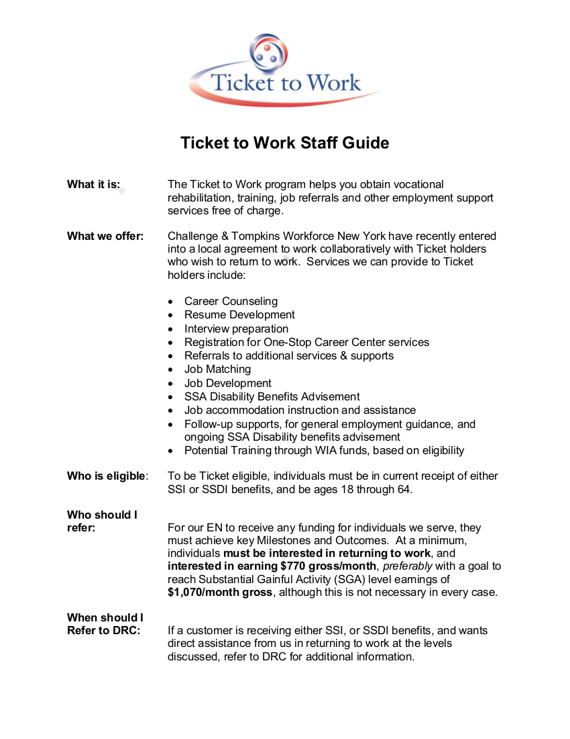
Example – Internal Basic Staff Guide
Provides basic information about services, eligibility, and referral process

Slide 11
Tap into the Job Center’s Management Information System (MIS)
Job Centers have a distinct advantage in tracking potential Ticket holders through registration for services captured in our MIS
Using this information, you can:
Query MIS for customers that have disclosed a disability
Use eData Share to determine which of these customers is Ticket eligible (Security Clearance is required to access eData Share through the Secure Provider Portal)
NOTE: eData Share can be used to sort ALL customers, or as stated, you can first sort out those who have disclosed
Tracking voluntary disability disclosure can assist in narrowing down customers that may be Ticket eligible, but not all customers will choose to disclose

Slide 12
Example of Marketing Flyer from the Alaska Round 4 DEI project
Notes:
Marketing example

Slide 13
The Ticket Life Cycle – An EN Perspective
Does Ticket holder fit our “EN Model”? Assessment of needs to initiate active resource coordination
Outreach – Ongoing community outreach to grow EN numbers
Assess
for Services
Serve
Ticket holder
Support
Ticket holder
Get Paid
Find
Ticket Holders
e-Pay, or Manual billing
Long-term follow up: Value added supports include financial planning, Accommodations, JD as needed, ongoing SSA benefits advisement
More than Job Matching services, Individualized JD. Employer networking assists in placement
Notes:
Kevin

Slide 14
Practices that lead to Positive Outcomes
Building expertise of Benefits Planning and Work Incentive guidance into EN business plan
Use of Integrated Resource Teams (IRTs) to assist customers with multiple barriers to employment
Strong partnerships with community agencies will help market your EN and increase referrals of Beneficiaries
Taking advantage of available resources and tools from OSM and DEI
Notes:
Representation of DEI service components.

Slide 15
Common Challenges Experienced by Workforce ENs and Pitfalls to Avoid
#
15
Notes:
ML starts
15

Slide 16
Challenges Operating an EN
Ticket program is complicated and it takes time to learn the nuances of the Ticket program.
The need for administrative tools to track and collect data.
The EN is a business operation and time will need to be devoted to outreach.
The design of the Ticket payment system causes a long delay in payments.
Notes:
Start up cost
Security clearance

Slide 17
Pitfalls to Avoid
Don’t put your EN on the back burner--- time is of the essence so start EN operations immediately upon receiving a contract from Social Security.
Don’t forget to inform internal AJC staff, representing all of the partner agencies, the AJC is an approved EN.
Don’t forget about the available technical assistance and join all training available, plus ask if available tools or resources
Notes:
Just because you are a youth program for EN need work with adults too.
Story of hx KN and ML past working as peer to peer

Slide 18
Performance Trends of Workforce ENs
#
18
Notes:
18

Slide 19
Recent report of Workforce EN Activity
*Used with permission from Ticket to Work Operations Support Manager

Slide 20
Recent report of Workforce EN Activity
 | All DEI ENs Trends by Month
Performance Measure | Qtr end 6/30/12 | Qtr end 12/31/2012 | Qtr end 6/30/2013 | Qtr end 12/31/13 | Qtr end 3/31/14 | Qtr end 6/30/14
Tickets Assigned to DEI | 304 | 513 | 1780 | 1590 | 2554 | 2903
Revenue for DEI | $473,448 | $666,838 | $2,373,404 | $1,927,104 | $3,505,582 | $4,057,353
*Information made available from data collected from Ticket to Work Operations Support Manager

Slide 21
Guest Presenters: Two Real Case Stories from DEI Projects
#
21
Notes:
21

Slide 22
Tennessee
Sharyn Hancock, Disability Resource Coordinator (DRC)
Workforce Essentials Clarksville, TN
Introducing Tyler : Computer Information Security

Slide 23
Tyler
30 yr old, just graduated from college with B.S. in Computer Information Security.
Never worked before, does not drive.
An individual who is visually-Impaired and who uses a Service Dog
Recipient of SSI benefits
Has a Ticket to Work

Slide 24
AJC Support for Tyler
Job Readiness training provided which included resume writing and interview skills.
Help with Transportation
Provided Paid Work Experience
Job Coach

Slide 25
Engaged DEI Service Components
Utilize Partnerships and Collaboration
Connected with our partners to find an employer (Ingram's Computer Services) willing to hire Tyler for his skills.
Enrolled in WIA Intensive and Training Services.
Ticket Assigned to local EN
Asset Development
Provided benefits planning services

Slide 26
Outcomes
Tyler worked for 3 months in Paid Work Experience.
He was hired to work part-time (10 hours week) but earns $40.00 per hours.
Current goal: additional education related to his current degree so he can help his employer grow the business.

Slide 27
New York
Shammi Carr, former Disability Resource Coordinator (DRC)
and Staffing Specialist Tompkins County
Introducing Tina: Registered Nurse

Slide 28
In the beginning…….
NY DEI Practice | Tina’s story
Ongoing beneficiary outreach events | Met Tina during July 2011 outreach event
All DRC’s certified as benefits and work incentive counselors (CWIC) | Assessment of SSA disability benefits and resource needs – Ticket supports chosen by Tina
AJC Integration | Part of process included registration at local career center
AJC Integration | Tina connected with workforce services, including resume development and SMART (Skills Matching for Referral Technology) for job leads

Slide 29
The journey continues…..
Job Development Efforts:
Met with Tina weekly for job search supports
Used a job log to track efforts
Discussed accommodation needs including which healthcare environment was more conducive (knowledge of Americans with Disabilities Act (ADA) provided great insights)
Landed job as a Registered Nurse (RN)!!

Slide 30
The journey doesn’t end yet….
NY DEI Practice | Tina’s story
Asset Development Strategies | Leveraged funds that United Way assisted in securing for an “Innovation Fund” as part of the Asset Coalition’s efforts to support Ticket holders. Funds used to purchased uniforms and RN renewal fees for Tina
Active Employment Network includes long-term supports focused on job retention and career advancement as well as job matching based on Ticket holder needs and interests | Tina has been working for over two years and is now thinking about advancement opportunities
Workforce integration – Use of staff resources | Tina was referred to Career Counselor for assistance with civil service opportunities
Diversity Recruitment | Disability Resource Coordinator (DRC) set up recruitment opportunity with local healthcare provider as next step for Tina

Slide 31
Overview - Best Practices
The use of the benefits advisor in the Ticket program
Can provide intensive and long-term supports
Enrollment in the public workforce system
Blending and braiding of funds for services/supports
Content specialist with accommodations
Diversity recruitment

Slide 32
Summary
In today’s presentation we covered the following:
Lessons learned: Key Developments and Practices result in desired outcomes
Common challenges of Workforce Employment Networks (ENs) and pitfalls to avoid
Current Performance Trends of Workforce ENs
Two successful case reports
32
Notes:
Miranda
32

Slide 33
FINAL WORD FROM RANDEE
Moderator: Randee Chafkin
Title: Workforce Development Specialist
Organization: Employment and Training Administration
#
33

Slide 34
Discussion & Feedback
Your thoughts or questions are welcomed…
#
34
Notes:
2nd POLL – using chat feature
OPTION 2 POLLING
NOTE – the chat box will remain open for the duration of the Webinar, and the questions will weave into the webinar as we go – no question is a dumb question – so please feel free!
(Click to next slide)
34

Slide 35
Please enter your questions in the Chat Room!
Notes:
Please enter your questions into the Chat Room!

Slide 36
Speakers’ Contact Information
Speaker: Kevin Nickerson
Title: DEI Ticket Subject Matter Expert
Organization: National Disability Institute
Email: knickerson@ndi-inc.org
Speaker: Mary Lynn ReVoir
Title: DEI Ticket Coordinator
Organization: National Disability Institute
Email: mlrevoir@ndi-inc.org
#
36
Notes:
36

Slide 37
Thank You!
Find resources for workforce system success at:
www.workforce3one.org

