Slide 1
Universal Design for Learning and Web Content Accessibility (WCAG 2.0):
Meeting your TAACCCT Requirements
Sam Catherine Johnston Ed.D.
Christina Bosch, M.A., M.Ed.
August 18, 2015

Slide 2
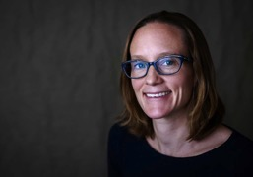
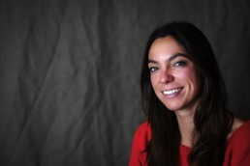
Presenters
Dr. Sam Johnston
Research Scientist
Christina A. Bosch
Instructional Designer/Research Associate

Slide 3
CAST is an education research and development nonprofit that works to expand learning opportunities for all individuals through
Universal Design for Learning (UDL).
We leverage the learning sciences and technology to create products, promote classroom practices, and inform policy.
We design for students at the margins from the outset. Innovations that are essential to some end up being beneficial to many.

Slide 4
TAACCCT LEARNING NETWORK
AT A GLANCE
U.S. Department of Labor, Employment & Training Administration
(National)
Jobs for the Future
CalState/Merlot
Maher & Maher
American Association of Community Colleges
U.S. National Science Foundation
ATE Centers
Other Non-Federal Providers of TA and Resources for TAACCCT Grantees:
Creative Commons
CAST
The Transformative Change Initiative

Slide 5
Overview
Define accessibility in the context of Universal Design for Learning (UDL)
Provide an overview of Universal Design for Learning
Show examples of UDL and accessibility best practices in postsecondary education
Tour UDL on Campus website and share resources on web accessibility relevant for OERs

Slide 6
Polling Question
How familiar are you with Universal Design for Learning (UDL)?
Very familiar- I use it all the time!
Somewhat familiar- I've heard of it, and use it sometimes.
Not too familiar- I've heard of it, but don't use it.
Not at all familiar- this is my first time hearing about it.

Slide 7
Polling Question
How familiar are you with accessibility guidelines (like WCAG 2.0?)
Very familiar- I use them all the time!
Somewhat familiar- I've heard of them, and use them sometimes.
Not too familiar- I've heard of them, but don't really use them.
Not at all familiar- this is my first time hearing about them!

Slide 8
Meeting your SGA Requirements
All online and technology-enabled content and courses developed under this SGA must incorporate the principles of universal design (see http://www.cast.org/udl/) in order to ensure that they are readily accessible to qualified individuals with disabilities. The content and courses must be in full compliance with the Americans with Disabilities Act and Sections 504 and 508 of the Rehabilitation Act of 1973, as amended, and the Web Content Accessibility Guidelines (WCAG) 2.0, Level AA (http://www.w3.org/TR/WCAG/)
Round 3 SGA, Round 4 SGA p. 34

Slide 9
Accessibility
“Accessible” means a person with a disability is afforded the opportunity to acquire the same information, engage in the same interactions, and enjoy the same services as a person without a disability in an equally effective and equally integrated manner, with substantially equivalent ease of use.
Office of Civil Rights Compliance Review No.11-11-6002
https://www2.ed.gov/about/offices/list/ocr/docs/investigations/11116002-b.pdf

Slide 10
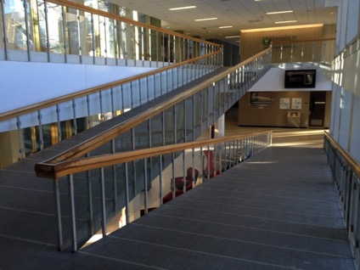
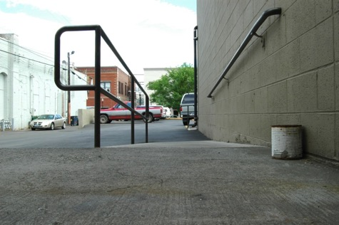

Accessibility built in – not added on
Arts Building University of Saskatchewan
Daryl Mitchell, February 14, 2014
https://www.flickr.com/photos/daryl_mitchell/
Ramp and Can
Sam Craig, June 18, 2009
https://www.flickr.com/photos/pirateyjoe/

Slide 11
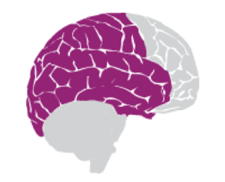




Three Learning Networks
Recognition
what
Strategic
how
Affective
why
Differentiate the ways that students can express what they know
Present information and content in different ways
Stimulate interest and motivation for learning

Slide 12
Accessibility
Making information meaningful
Independent, self-directed learner

Slide 13
Disability Related Civil Rights Laws
Section 504 of the Rehabilitation Act (1973)
  Prohibits discrimination on the basis of disability in programs and activities that receive federal funding
Title II of the Americans with Disabilities Act (1990)
  Prohibits discrimination on the basis of disability in all public entities, including public colleges and universities, regardless of whether they receive federal funding
Title III of the Americans with Disabilities Act
  Prohibits discrimination on the basis of disability in places of public accommodation, including private postsecondary institutions.

Slide 14
Protected Students
In order to be protected under Section 504, students must be considered “qualified”—i.e., they must be able to meet all academic and/or technical standards for admission or participation in the educational program or activity. In addition, they must have a “disability,” which means that they—
  have a physical or mental impairment that substantially limits one or more major life activities,
  have a record of such an impairment, or
  are regarded as having such an impairment.
“Major life activities” include seeing, hearing, learning, reading, concentrating, and thinking.

Slide 15
Web Content Accessibility Guidelines (WCAG 2.0)
Perceivable
  Information and user interface components must be presentable to users in ways they can perceive
Operable
  User interface components and navigation must be operable
Understandable
  Information and the operation of user interface must be understandable
Robust
  Content is robust enough that it can be interpreted reliably by a wide variety of user agents, including assistive technologies
  UDL On Campus Legal Obligations for Accessibility

Slide 16
Settlement agreement between the US Dept. of Justice and EDX Inc.
www.edx.org, its mobile applications, and the LMS conform with, at minimum, the Web Content Accessibility Guidelines (“WCAG”) 2.0 AA
Ensure compatibility with any accessibility features in course content (e.g, MathML)
Hire an accessibility consultant and conduct annual accessibility audits
Develop guidance and training for content providers

Slide 17
Polling Question
Which technologies in your environment are accessible (WCAG 2.0 compliant)?
Webcast and webconferencing software
Hardware & digital tools (e.g., polling devices, interactive projection boards, etc.)
Learning Management Systems
Specific Apps
Other

Slide 18
Higher Education Opportunity Act of 2008
Many learners who are not identified as having physical, sensory, and learning disabilities still may also struggle to learn due to diverse abilities and backgrounds, differing cultural and linguistic backgrounds, and other factors that affect perception, executive function, and engagement.
Even learners who are identified as “average” or “gifted” may not have their learning needs met due to poor curricular design.
For that reason, the Higher Education Opportunity Act of 2008 sets a higher standard, calling for instructional environments -- including materials, teaching methods, and assessments -- based on Universal Design for Learning (UDL).

Slide 19
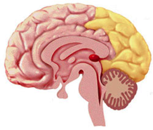
Principle 1: Multiple Means of Representation
Multimodal representation of materials via text, images, symbols, and audio
Options for perception - captioned and transcribed content
Prior knowledge influences interaction with content
Meaning-making is critical
Recognition

Slide 20
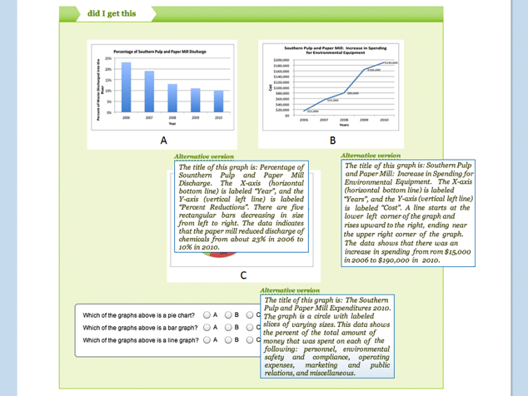
Provide Alternative Access to Media Content

Slide 21
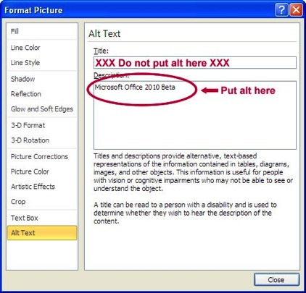
Provide Alternative Access to Media Content
Text equivalents of images convey the purpose of the image based on its context
  UDLonCampus Image Resource
Word 2010 Accessibility Checker: File > Info > Check for Issues > Check Accessibility.

Slide 22

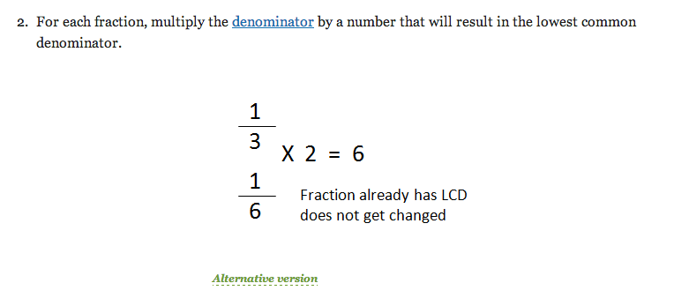
Provide Options for Language, Mathematical Expressions, and Symbols

Slide 23
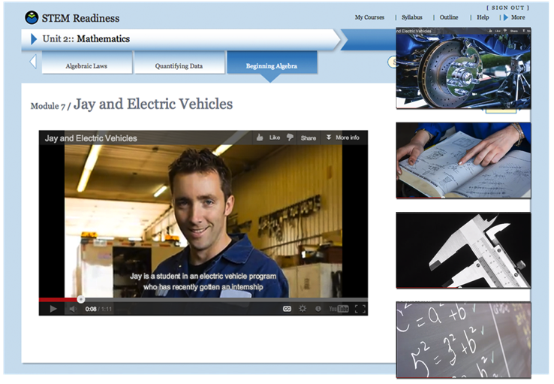
Provide Options for Comprehension

Slide 24
Polling Question
Can you share other examples of technologies or practices that offer accessible and flexible means of representation?

Slide 25
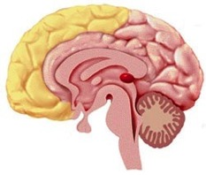
Principle 2: Multiple Means of Action and Expression
Content & activities should be available to assistive technologies that amplify, magnify or navigate curriculum
Vary methods of response -
digital tools offer greater flexibility for a wider range of learners
Support learning processes – set goals, plan, organize, strategize, progress monitoring
Strategic

Slide 26

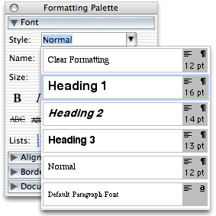
Create Meaningful Structure
Document headings help connect to content and support executive functions

Slide 27
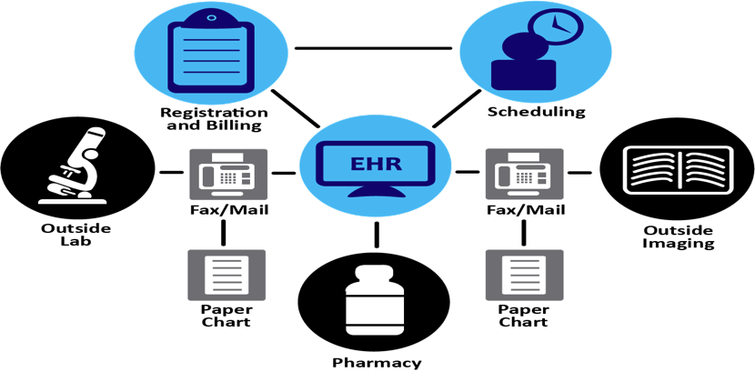
Create Meaningful Structure
Graphic organizers help connect to content and support executive functions

Slide 28
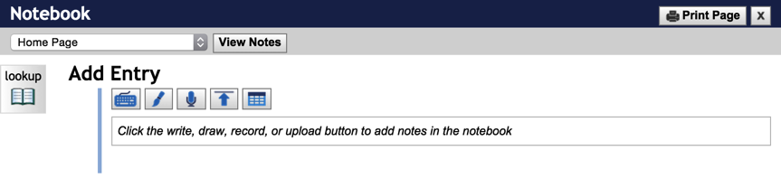
Vary methods of response

Slide 29
Enhance capacity for progress monitoring
College STAR (Supporting Transition, Access, and Retention: A UNC System Project Supporting Students with Learning Differences)
Tutors, trained in UDL, gave live and online recorded tutoring sessions and gave professor feedback on how UDL her/his course was
Program aided in retention of STEM courses with high enrollment and low course passage rates

Slide 30
Polling Question
Can you share other examples of technologies or practices that offer accessible and flexible means of action and expression?

Slide 31
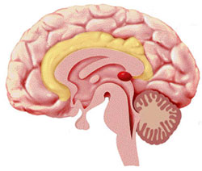
Principle 3: Multiple Means of Engagement
Self-assessment
Options for recruiting interest and for sustaining effort
Content is contextualized to their experience & interests
Learners are motivated – increased persistence & retention
Affective

Slide 32
Case method
Tell a story of the workplace that can be visualized
Richly model best practices in the workplace
Provide a step before learning-by-doing
Help learners problem-solve issues and learn from one another
Encourage reflection on work practices and allow learners to provide feedback or discuss work practices
Help learners to avoid a narrow view of a problem

Slide 33
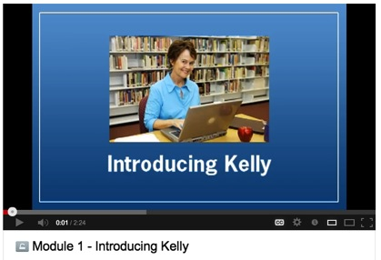
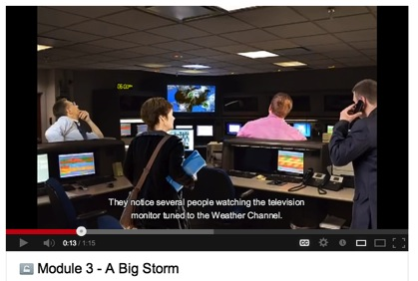
Options for recruiting interest
http://youtu.be/nFMRaG4p8mM
http://youtu.be/S0OOlThhU90
Present introductory story
Present contextualized challenges

Slide 34
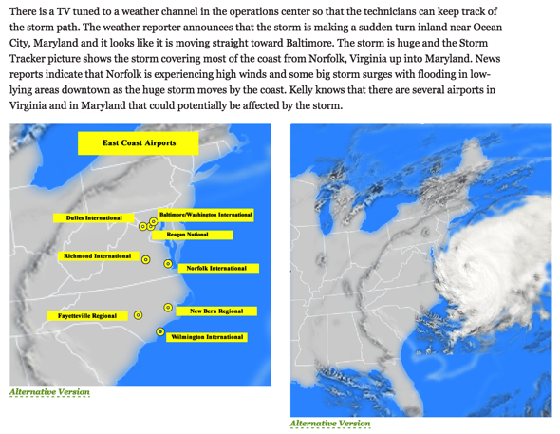
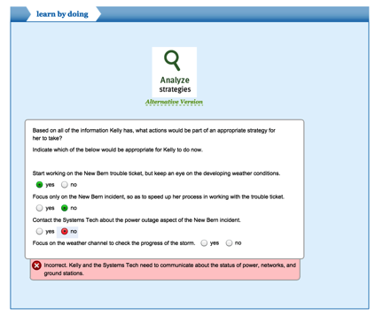
Options for sustaining effort and persistence

Slide 35
Polling Question
Can you share other examples of technologies or practices that offer accessible and flexible means of engagement?

Slide 36
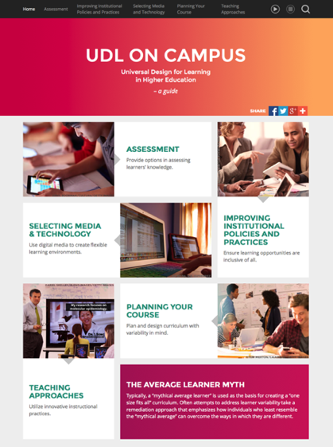
Visit www.udloncampus.cast.org
Institutional Policies & Practices:
Legal Obligations for Accessibility
Voluntary Product Accessibility Template
Equally Effective Alternate Access Plan (EEAAP)
Postsecondary Institutions with UDL Initiatives
Selecting Media and Technology:
Flexible Multimedia
Accessibility and OER
Webcasts and Webconfrences

Slide 37
Polling Question
Help us improve our site! Which of these is a priority for you?
Selecting accessible technology
Learning about how to create accessible learning materials
Providing options for assessment
Designing curriculum with UDL
Finding ways to vary engagement for learners
Other?

Slide 38
Conclusions
Grant managers, instructors and educational technology procurement staff need to be informed so that they can be equipped with tools to create and select meaningful accessible content.
Accessibility is the baseline and instructors and ed tech procurement staff should ensure that all of their educational technology and content is accessible.
Instructors should plan for learner variability. Universal Design for Learning (UDL) is a framework that emphasizes learner variability in the design of curriculum.
There are flexible multimedia tools that support the creation and selection of accessible learning content.

Slide 39
Accessibility Checks & Content Creation Resources
SkillsCommons Accessibility Requirement Guidelines:
SkillsCommons.org > Support > Accessibility
http://support.taaccct.org/ada-requirements/
Quick Check:http://webaim.org/standards/508/checklist
Detailed Review: http://projectone.cannect.org/
WCAG 2.0 Technical Details: http://www.w3.org/WAI/WCAG20/quickref/
WebAIM:
http://webaim.org/techniques/word/
http://webaim.org/techniques/powerpoint/
FLOE (Flexible Learning for Open Education) http://www.floeproject.org/
B.C. Open Textbook Authoring Guide http://opentextbc.ca/opentextbook/

Slide 40



Get in touch and give us feedback!
EMAIL: udloncampus@cast.org
@CAST_UDL
@UDL_OnCampus
UDL OnCampus
UDL OnCampus
Notes:
Connect with CAST:
CAST on Twitter: https://twitter.com/cast_udl
CAST on Facebook: https://www.facebook.com/CenterforAppliedSpecialTechnology
CAST on Google+: http://goo.gl/3q7Om
CAST on YouTube: http://www.youtube.com/user/UDLCAST
CAST on LinkedIn: http://www.linkedin.com/company/249511
Connect with the National Center on Universal Design for Learning:
UDL Center on Twitter: https://twitter.com/udl_center
UDL Center on Facebook: https://www.facebook.com/UDLCenter
UDL Center on Google+: http://goo.gl/poBrj
UDL Center on YouTube: http://www.youtube.com/user/UDLCenter
UDL Connect Ning: http://community.udlcenter.org/
Connect with the National Center on Accessible Instructional Materials:
AIM Center on Twitter: https://twitter.com/aim_center
AIM Center on Facebook: https://www.facebook.com/AIMCenter
AIM Center on Google+: http://goo.gl/JYjlM
AIM Center on YouTube: http://www.youtube.com/user/AIMNationalCenter

Slide 41
Sam johnston
sjohnston@cast.org
Christina bosch
cbosch@cast.org
TEL 617.728.4446 FAX 617.728.4857 info@jff.org
88 Broad Street, 8th Floor, Boston, MA 02110
122 C Street, NW, Suite 650, Washington, DC 20001
WWW.JFF.ORG

