Slide 1
OMB Uniform Guidance:
Overview
1

Slide 2

Why This Topic Is Needed
There are additional DOL exceptions to the Uniform Guidance, and many changes in Subpart A – Definitions.
.
There are a number of important changes in the Guidance that will impact your grants and how they are managed.
The Uniform Guidance is the first consolidation of Federal grant management requirements in many years.

Slide 3
Lesson Overview & Webinar Objectives
Recognize the structure and applicability of the Uniform Guidance
Uniform Guidance
Describe the layout of the Uniform Guidance and the DOL exceptions
Structure and DOL Exceptions
Major Changes
List the major changes brought about from the Uniform Guidance
Applicability and Implementation
Implementation options

Slide 4

Poll
I am fully aware of the various OMB Circulars that are impacted by the issuance of the Uniform Guidance.
(1-5 with 5 being the highest)

Slide 5
Poll
I understand the new structure of the Uniform Guidance.
(1-5 with 5 being the highest)

Slide 6
Poll
I know where to find additional resources to assist in my understanding of the Uniform Guidance.
(1-5 with 5 being the highest)

Slide 7
Poll
I understand the options available for implementation
(1-5 with 5 being the highest)

Slide 8
Genesis
Recognize the structure and applicability of the newly issued Uniform Guidance
Learning objectives for this section

Slide 9
How Did the Uniform Guidance
Come About?
Council on Financial Assistance Reform (COFAR)
Created on October 27, 2011
Composition
- 9 Federal awarding agencies
Published in Federal Register on
December 26, 2013

Slide 10
Why Develop the
Uniform Guidance?
Desire of recipients and subrecipients to get uniform guidance and avoid inadvertent audit findings
Reduce administrative burden and fraud, waste, and abuse
Need to leverage technology
Focus audits & monitoring on high risk areas

Slide 11
Before Uniform Guidance
Types of OMB Circulars
Uniform Guidance
8 Separate OMB Circulars
2 Administrative Requirements
3 Cost Principles
2 Audit Requirements
1 Circular covering the CFDA catalog
Application & Standards
1 Regulation
Applies to all entity types

Slide 12




After Uniform Guidance
2 CFR Part 200 & 2 CFR Part 2900
Administrative Requirements
Audit Requirements
Uniform
Guidance
Cost Principles
Acronyms, Definitions & Appendices

Slide 13

COFAR stands for the Council on Federal Awards and Regulations.
True or False

Slide 14
The Uniform Guidance consolidates requirements from 8 different OMB Circulars.
True or False

Slide 15
The sections of the Uniform Guidance contain consolidated requirements that apply separately to type of organization
True or False

Slide 16
Uniform Guidance Structure
& Major Definitions
Define DOL exceptions and technical corrections approved by OMB
Learning objectives for this section
Review key changes in definitions and noteworthy deletions

Slide 17
Structure (1 of 5)
2 CFR Part 200 and 2 CFR Part 2900
Acronyms & Definitions
  Subpart A: New and updated terms
General Provisions
  Subpart B: Effective dates
Pre-Federal Award Requirements
  Subpart C
  Appendix I : Full Text of Notice of Funding Opportunity

Slide 18
Structure (2 of 5)
2 CFR Part 200 and 2 CFR Part 2900
Post Federal Award Requirements
  Subpart D
  Appendix II : Contract Provisions
Cost Provisions
  Subpart E & 7 Appendices
Audit Requirements
  Subpart F & 2 Appendices

Slide 19
Structure (3 of 5)
2 CFR Part 200 and 2 CFR Part 2900
Cost Provisions: Subpart E & 7 Appendices
  Appendix III — Indirect (F&A) Costs Identification and Assignment, and Rate Determination for Institutions of Higher Education (IHEs)
    Appendix IV — Indirect (F&A) Costs Identification and Assignment, and Rate Determination for Nonprofit Organizations
    Appendix V — State/Local Government- wide Central Service Cost Allocation Plans
    Appendix VI — Public Assistance Cost Allocation Plans

Slide 20
Structure (4 of 5)
2 CFR Part 200 and 2 CFR Part 2900
Cost Provisions: Subpart E & 7 Appendices
    Appendix VII — State, Local Government, and Indian Tribe Indirect Cost Proposals
    Appendix VIII — Nonprofit Organizations Exempted From Subpart E — Cost Principles of Part 200
    Appendix IX to Part 200—Hospital Cost Principles

Slide 21
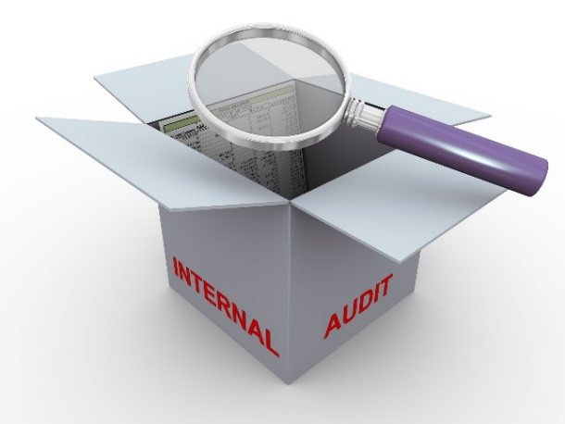
Structure (5 of 5)
2 CFR Part 200 and 2 CFR Part 2900
Audit Requirements
Subpart F & 2 Appendices
Appendix X — Data Collection Form (Form SF–SAC)
Appendix XI — Compliance Supplement
  2015 Edition released June 2015

Slide 22

Technical Corrections
          Federal Register published December 19, 2014
Procurement Standard
Modified Total Direct Costs
Unique Entity Identifier
Clarification on Payments
Cost Sharing or Matching
Prior Approvals
Program Income
Should vs. Must

Slide 23
DOL Exceptions
2 CFR Part 2900

Slide 24
Pre-Award Requirements Uniform Guidance
Subpart C
Learning objectives for this section
List the major changes brought about from the Uniform guidance

Slide 25

Major Changes:
Definitions
Subpart A of the Uniform Guidance
Consolidates, updates, and clarifies
Adds a number of new definitions
  Also renames or deletes a number of definitions
OMB Crosswalk between new and old definitions
  DOL Exceptions
  Budget
  Non-Federal entity
  Questioned costs
https://www.whitehouse.gov/omb/grants_docs

Slide 26

Major Changes:
Definitions and New Items
Conflict of Interest
Procurement Methods
Support for Indirect Cost rates
De Minimis Rate
Computing Devices
Improper Payments
COSO
Important
additions or changes

Slide 27

Major Changes:
New Definitions
200.8 Budget
  DOL clarification at 2 CFR 2900.1
200.23 Contractor
200.45 Fixed Amount Awards
200.61 Internal Controls

Slide 28

Major Changes:
New Definitions (2)
200.67 Micro-Purchase
200.68 Modified Total Direct Cost (MTDC)
200.69 Non-Federal Entity
200.79 PII and Protected PII
200.88 Simplified Acquisition Threshold
200.74 Pass-through Entity
200.92 Subaward

Slide 29
Major Changes:
Merit Review vs. Risk Assessment
Merit Review
Specifies the criteria that the Federal awarding agency will use to evaluate all grant applications
    Appendix I of the Uniform Guidance provides additional detail
Applies to ETA discretionary awards

Slide 30
Major Changes:
Merit Review vs. Risk Assessment
Risk Assessment Process
  Financial stability
  Quality of management systems
  History of performance
  Reports and Findings including Audits and Monitoring Reports
  Ability to effectively implement requirements
  FAPIIS and SAM—for debarment or Do Not Pay listing
  Conducted after the merit review but before Federal award is made
  Considers the following factors:
Applies to ETA discretionary awards

Slide 31
Major Changes:
Standards for Financial Systems
2 CFR 200.302 Financial systems must provide:
Identification of all Federal cash receipts and expenditures
Comparison of expenditures to budgets and performance
Written procedures for payments and allowability of costs
  States continue to follow their laws in expending federal awards

Slide 32
Internal Controls & Payments
Major Changes:
200.303 Internal Controls
200.305 Payments
  Must establish adequate internal controls using sound management practices that may include:
    Standards for Internal Control in the Federal Government (Green Book) or “Internal Control – Integrated Framework”
  Incorporates IPERA improper payments requirements
  Remittance of interest income of $500 annually
    WIA requirements continue until WIOA implementation
  DOL Exceptions 2900.6 and 2900.7
    Impose restrictions on advances depending on specific conditions
    Requires liquidation of existing advances before new request
200.304 Bonds
No change

Slide 33
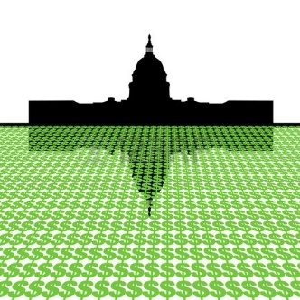
Cost Sharing or Match
Major Changes:
200.306 Cost Sharing
  Higher standards for documentation
  Must be verifiable through adequate records
  2900.8 DOL exceptions requires that contributions/funds received for match purposes be expended on program purposes.

Slide 34
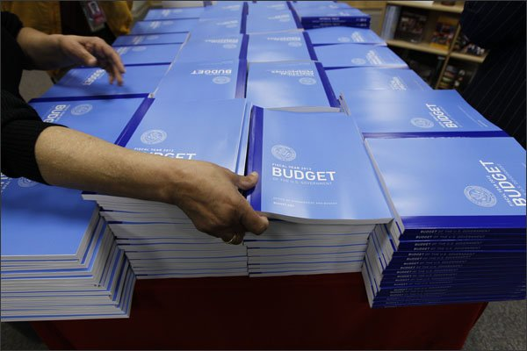
Major Changes:
Budget and Program Plans and
Period of Performance
2 CFR 200.308 & 200.309
Revision of budget and program plans
  If Federal award is over the Simplified Acquisition Threshold, prior approval is needed for any cumulative change that exceeds 10% of the total budget
  2900.9-12 - DOL Exceptions
    No blanket approval
    Submission 30 days before effective date
    Must be in writing
    Only approving official is the Grant Officer
Period of performance

Slide 35


Major Changes:
Property Standards
2 CFR 200.310 - 200.316
Facilities and Lease Agreements
Equipment
  Including information technology systems
Supplies
  Including computing devices
DOL Requires Creative Commons Licensing for intangible property
  2900.13

Slide 36
Major Changes:
Procurement Standards
2 CFR 200.317 to 200.326
New or expanded items
Micro-purchases
Conflict of Interest
States continue to follow state standards
Subrecipients of states follow the Uniform Guidance standards
Simplified acquisition threshold
Consultants

Slide 37
Major Changes:
Procurement Standards
2 CFR 200.317 to 200.326
New or expanded items
Micro-purchases
Conflict of Interest
States continue to follow state standards
Subrecipients of states follow the Uniform Guidance standards
Simplified acquisition threshold
Consultants

Slide 38
Major Changes:
Contractual Provisions
2 CFR 200.326
All contracts made must contain 10 possible contractual provisions at Appendix II
  Simplified acquisition threshold determines which provisions are applicable
December 19, 2014 Federal Register
  Contractual provisions from H to K are reordered, and the Energy Policy and Conservation Act (42 U.S. 6201) is removed

Slide 39
Major Changes:
Subrecipient Monitoring and Management
200.330 Subrecipient and Contractor Determination
Subrecipient
Determines eligibility
Contractor
Responsible for programmatic decision making
Characteristics substantially the same as before
Obtains goods and services for use of awardee
Changes term vendors to contractors
Affects audits, procurement and other requirements
Carries out a program for public purpose
Normal business operations and ancillary to Federal program

Slide 40
Major Changes:
Subrecipient Monitoring and Management
200.330 Subrecipient and Contractor Determination
Subrecipient
Determines eligibility
Contractor
Responsible for programmatic decision making
Characteristics substantially the same as before
Obtains goods and services for use of awardee
Changes term vendors to contractors
Affects audits, procurement and other requirements
Carries out a program for public purpose
Normal business operations and ancillary to Federal program

Slide 41

Major Changes:
Subrecipient Monitoring and Management
Ensure subawards appropriately identified
Evaluate risk of non-compliance
Monitor subaward activities
  Specified actions
Specify required information for each award
Include Federal Award Identification Number (FAIN) and DUNS numbers
Verify audit coverage as required
CFDA Number and dollar amount of each
Honor Indirect Cost Rates and de minimis rate

Slide 42

Major Changes:
Remedies for Non-Compliance
2 CFR 200.338 to 200.342
Remedies for non-compliance
  Expansion of enforcement actions
  Options to object, hearings and appeal
Termination
  Sets requirements for both termination for cause and for convenience
  Notification of termination requirements
Effects of Suspension or termination

Slide 43
Major Changes:
Cost Allocation and Indirect Costs
DOL clarification at 2900.17
  Adjustments or refunds and effect on IDC rates
200.413—Discussion of Direct Costs
200.418 – Distinctions
Use of Appendices

Slide 44
Major Changes:
De Minimis Rates
De Minimis Rate defined at 200.414(f)
Entity eligible to receive rate
Has costs classified as indirect costs
Entity has never received or does not currently have a negotiated indirect cost rate
May charge an indirect cost rate of 10% of modified total direct costs (MTDC)

Slide 45




Major Changes:
DOL Exceptions
2900.2
Non-Federal Entity
Applies to commercial & foreign entities
Multiple Provisions Concerning Budget
30 days, in writing, and no blanket approval
2900.5
Federal awarding agency review of merit of proposals
Findings outside of audits can be used during merit reviews and as questioned costs

Slide 46




Major Changes:
DOL Exceptions (2)
2900.7
Payment
Advances must be liquidated and additional restrictions can be imposed.
2900.14
Financial reporting
Expenditures must be reported on accrual basis
All obligations and/or accrued expenditures must be liquidated at closeout.
2900.15
Closeout
Promote through free and open use of content on Creative Commons.
2900.13
Intangible property

Slide 47



Major Changes:
DOL Exceptions (3)
2900.17
Adjustment of negotiated IDC rates
Indirect Cost Rates may need to be renegotiated
2900.18 Contingency provisions
Retention of records related to contingencies
Subpart F – Audit Requirements (2900.20-.22)
Audit resolution and management decisions
Clearly defined steps

Slide 48
The Uniform Guidance is divided into 6 subparts.
True or False

Slide 49
Subpart B contains all the definitions.
True or False

Slide 50
The simplified acquisition threshold is currently $150,000.
True or False

Slide 51
Internal Controls are now defined as a system of oversight.
True or False

Slide 52
Uniform Guidance
Applicability and Implementation
Learning objectives for this section
Discuss available implementation options for DOL-ETA recipients and their subrecipients

Slide 53

Implementation
  Training Employment Guidance Letter TEGL 15-14
:
All new grant awards or grant modifications released on or after December 26, 2014 MUST adhere to the Uniform Guidance
Options A and B require grant modification
Formula
Discretionary
Formula recipients may request authorization to apply the Uniform Guidance to existing or old grant awards
  Discretionary recipients may request authorization to apply the Uniform Guidance to existing grant awards

Slide 54
Implementation (2)
  Training Employment Guidance Letter TEGL 15-14
Option A
  Submit modification request in writing to your Federal Project Officer
  Include a list of grants (by grant number) for which the Uniform Guidance will be applicable
Option B
  Uniform Guidance applies to all new grant awards or funding released on or after December 26, 2014
  Previously awarded funds must follow terms of their grant agreement

Slide 55

Implementation (3)
  Training Employment Guidance Letter TEGL 15-14
To Modify or Not to Modify? That is the question.
The choice is yours
  DOL encourages you give this question serious consideration.
  Reasons to Modify Your Grant
    Consistency
      Internal Controls
      Staff Training
      Risk of Audit Findings
  Reasons to Not Modify Your Grant
    Shorter Transition Period

Slide 56

Grace Period
for Procurement Standards
PROCUREMENT STANDARDS
December 19, 2014 Federal Register
  Provides additional detail
  Effective date for implementation is revised
    200.110
  Allows a grace period of one fiscal year to implement 200.317 through 200.336
56

Slide 57
Grace Period
for Audit Requirements
For fiscal years beginning on or after December 26, 2014
2015 Compliance Supplement
  Released July 2015
  Streamlined the audit objectives and procedures for the 14 types of compliance requirements
57

Slide 58
New Dollar Threshold
A Single Audit or program-specific audit is required when a non-Federal entity expends $750,000
or more in Federal awards in a fiscal year [2 CFR 200.501(a)]
Must make records available for audit or review by the Federal agency, its pass-through agency, and/or GAO
Basis for determining Federal awards has been expanded to include accrued costs, disbursements to subrecipients [200.502]
Federal Agency or Inspectors General (OIG) may require audits to meet regulatory or statutory requirements
Alternatives: program-specific, limited scope, or agreed-upon procedures
  Expend less than $750,000 -- exempt for that fiscal year

Slide 59
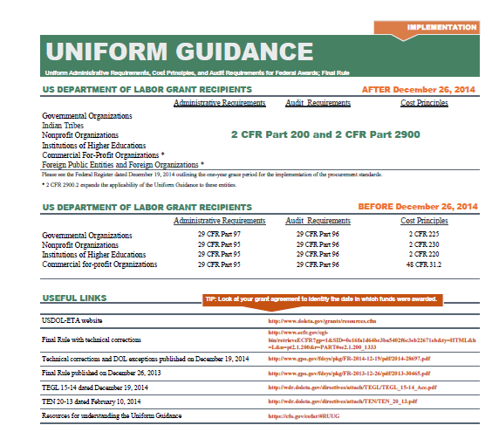
Resources

Slide 60
Key Concepts
Look to both Federal Registers
December 26, 2013
December 19, 2014
Share information with subrecipients
Be aware of requirements for the awarding of grants

Slide 61
Need Help?
For specific guidance related to the DOL Exceptions or grants
Contact your ETA Regional Office

Slide 62
Poll
I am fully aware of the various OMB Circulars that are impacted by the issuance of the Uniform Guidance.
(1-5 with 5 being the highest)

Slide 63
Poll
I understand the new structure of the Uniform Guidance.
(1-5 with 5 being the highest)

Slide 64
Poll
I know where to find additional resources to assist in my understanding of the Uniform Guidance.
(1-5 with 5 being the highest)

Slide 65
Poll
I understand the options available for implementation
(1-5 with 5 being the highest)

Slide 66

SMART
“There is no ignorance, there is knowledge.”
-The Jedi Code
Thank You!

