Slide 1
Using and Communicating Data to Drive
High Performing Sector Strategies
Webinar Date: February 4, 2015
Presented by:
U.S. Department of Labor
Employment and Training Administration

Slide 2
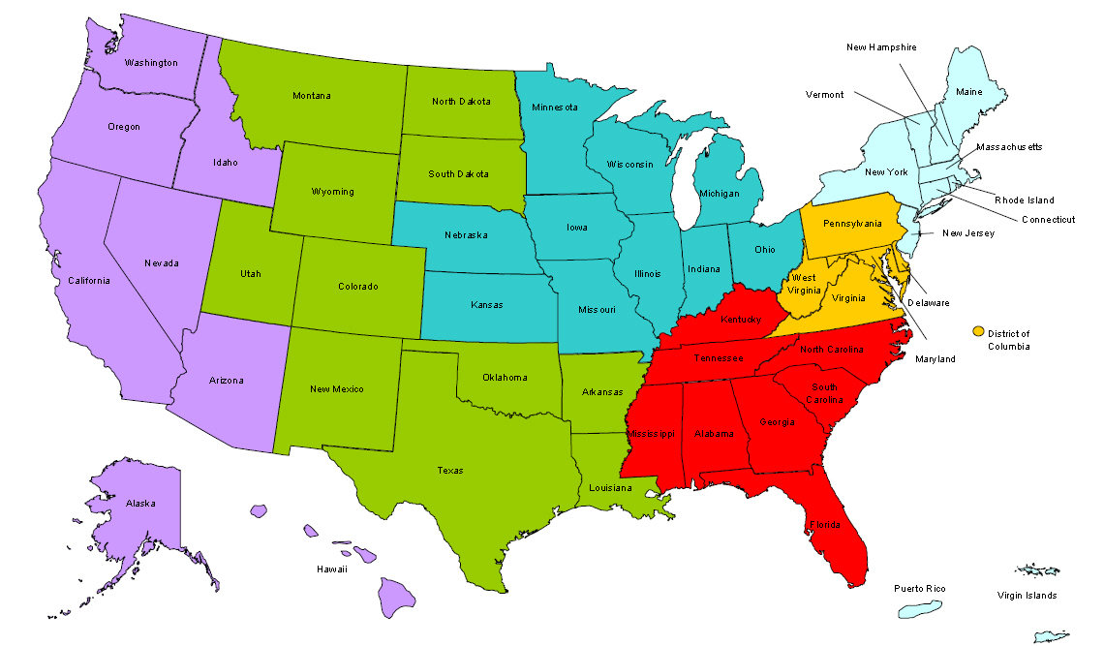
Where are you?
Enter your location in the Chat window – lower left of screen

Slide 3

Moderator
Moderator: Diane Walton
Title: Project Lead
Organization: Employment and Training Administration (San Francisco)

Slide 4

ETA Sector Strategies TA Initiative
Goal – to increase the number of states and regions actively engaged in sector strategies work

Slide 5





Sector Strategies Initiative Partners

Slide 6

Polling Question
How familiar are you with using data/labor market information to make decisions about target sectors and regional workforce needs?
Ready to start
Novice (use traditional LMI practices)
Practicing (using traditional and Real Time LMI)
Using it all the time (have been using innovative techniques for years)

Slide 7

Here’s What You Can Expect to Get Out of This Webinar!
Learn more about what LMI sources are most helpful and where to access information.
Learn how to tell a compelling story using labor market data to employers and other partners.
Hear best practices and lessons learned from practitioners at the state level about data use.

Slide 8

Agenda
Introduction
Importance and Understanding of Using LMI
Best Practices: KentuckianaWorks
Q&A

Slide 9

Presenters
Presenter: Mary Wright
Title: Senior Program Director, Demand Side Engagement and Analytics
Organization: Jobs for the Future

Slide 10


Presenters
Presenter: Cindy Read
Title: Deputy Director
Organization: KentuckianaWorks (the Greater Louisville Workforce Investment Board)
Presenter: Eric Burnette
Title: Workforce Intelligence and Communications Coordinator
Organization: KentuckianaWorks (the Greater Louisville Workforce Investment Board)

Slide 11
Labor Market Analysis –
Critical to Sector Strategies
11

Slide 12

About Jobs for the Future
Our Mission:
JFF works to ensure that all lower-income young people and workers have the skills and credentials needed to succeed in our economy.
Our Vision:
The promise of education and economic mobility in America is achieved for everyone.
Our Goals:
  Preparing for College and Career: All young people graduate high school on a clear path to college completion and career success
  Earning Postsecondary Credentials: All students gain the skills they need to earn postsecondary credentials with high labor market value
  Advancing Careers and Economic Growth: All workers obtain the education and training required to move into family-supporting careers with clear paths for advancement

Slide 13
Demand Side Engagement and Analytics
LABOR MARKET DATA
ANALYTICAL FRAMEWORK
TRAINING
USING DATA TO MAKE BETTER DECISIONS

Slide 14


Slide 15
Quandary of Change
Would you believe:
100% of all changes evaluated as successful had a good technical solution or approach
Over 98% of all changes evaluated as unsuccessful also had a good technical solution or approach

Slide 16
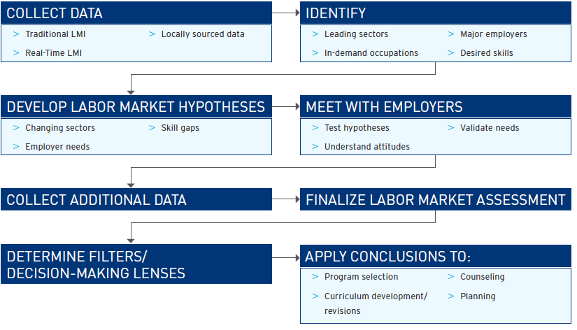
Understanding the Labor Market Through Data
16

Slide 17
The Needed Pieces
Local Drivers
Traditional LMI
Local Drivers
Traditional LMI
Staff Expertise
Real Time LMI
Staff Expertise
Real Time LMI
Employer Demands
Employer Demands
Institutional Priorities
Course Description

Slide 18
Labor Market Information Overview
 | Benefits | Limitations
Traditional LMI | Reliable and robust | Looks backward to forecast; lacks current labor market perspective (time lag)
 | Consistent and documented methodologies | Static/not dynamic
 | Regional comparisons | Lacks data on current demand/employers’ requirements
 | Public, no-cost distribution | Does not effectively capture emerging occupations/skills requirements/certifications
Real-time LMI | Reveals new and emerging trends in occupational definitions | Duplication errors (though this difficulty is quickly becoming obsolete with more sophisticated algorithms)
 | Offers insights into the skills and certifications sought by regional employers | Certain trades (construction, manufacturing) do not necessarily use online job postings.
 | Identifies early indications of market shifts; data is collected regularly | Online job ads can be vague
 | Tracks hiring demand | Not every job posting represents an actual vacancy
 | Current and Continuously updated | Proprietary/Cost

Slide 19
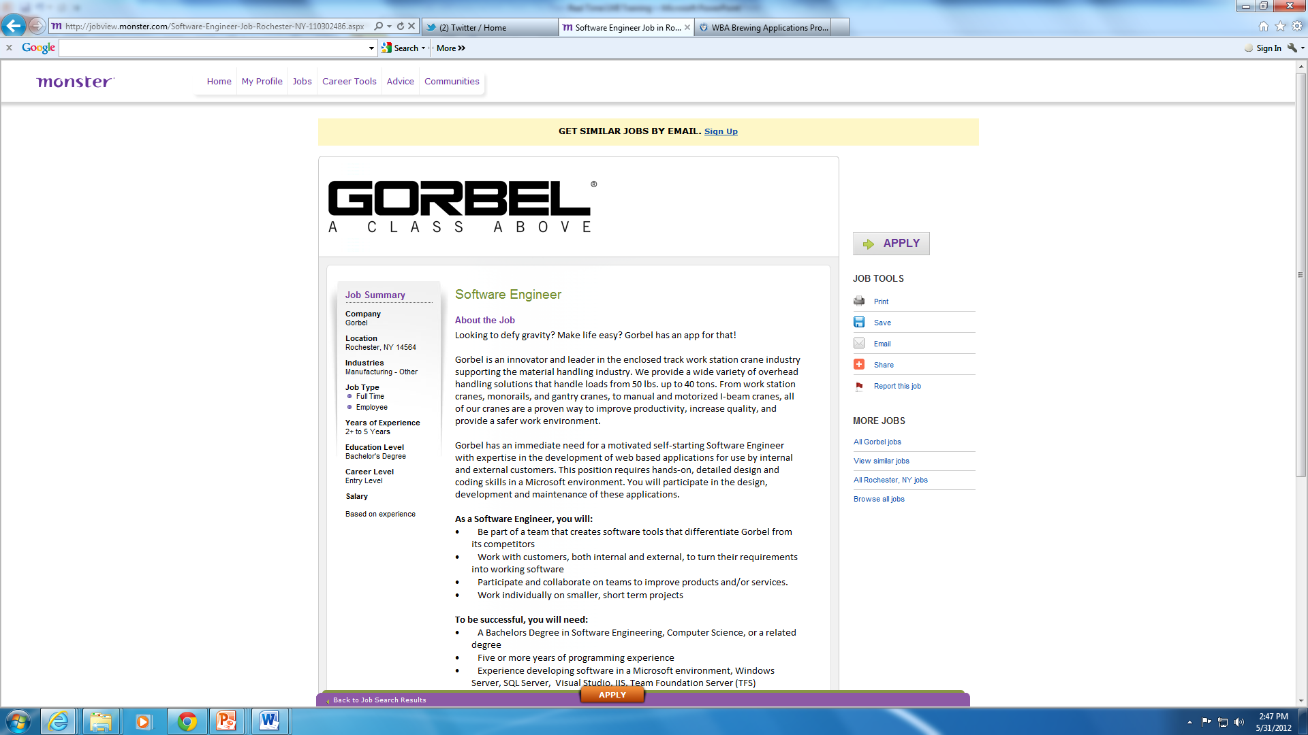
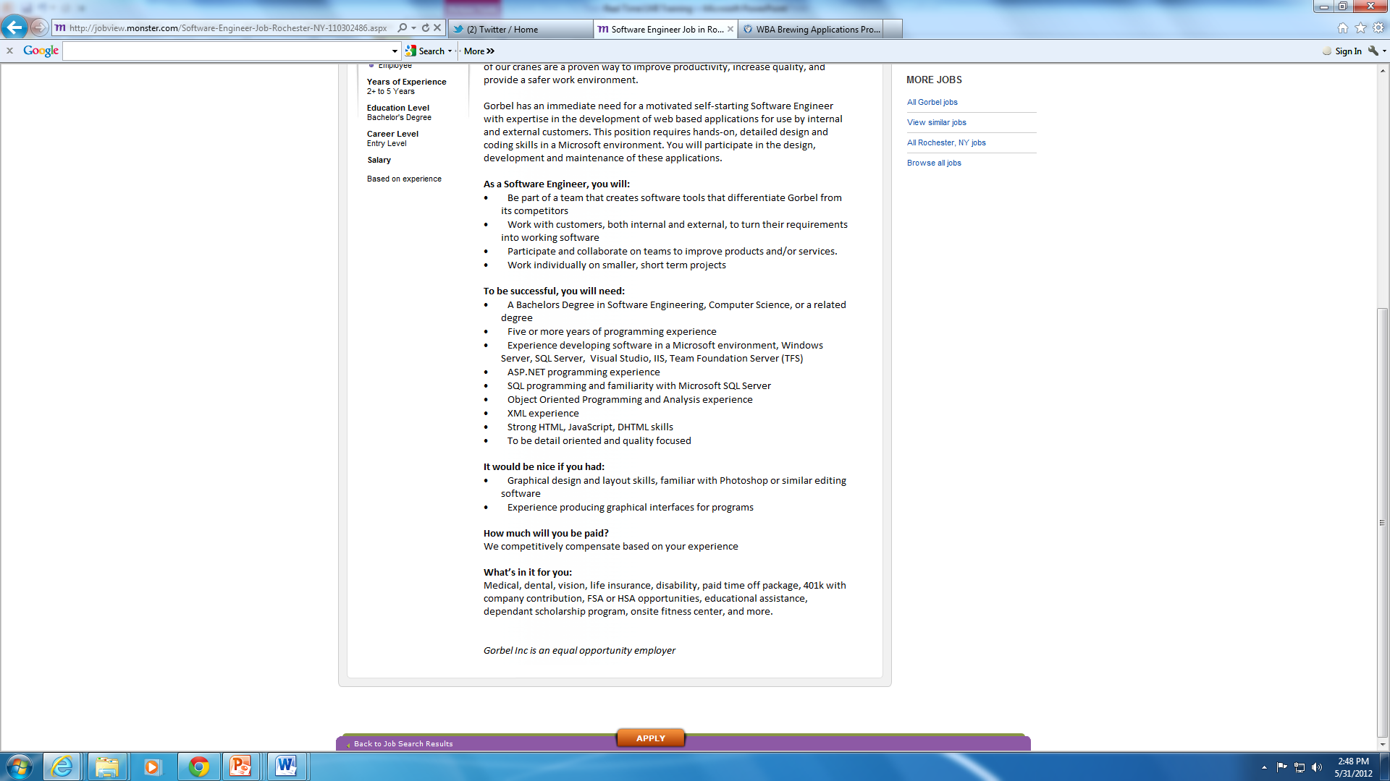
What’s in a Job Advertisement?
Company name and location
Job Title: Software Engineer
SOC: Software developers and programmers(15-1130)
Education and experience
Industry: Manufacturing (NAICS 31-33)
Specific skills
Benefits
Job tasks
http://jobview.monster.com/Software-Engineer-Job-Rochester-NY-110302486.aspx

Slide 20
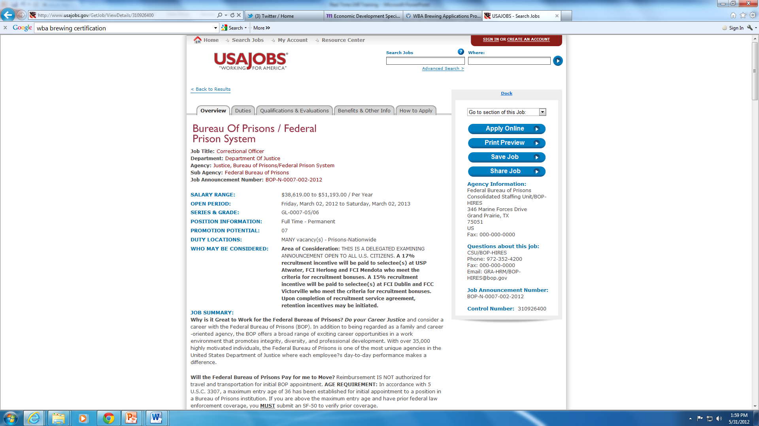
Not All Jobs Advertisements are Clear Cut
How many is MANY?!
Where?!
http://www.usajobs.gov/GetJob/ViewDetails/310926400

Slide 21
Top Ten Occupations
Occupations by 8-digit O*NET Code. Based upon 156,291 total postings. Location: DFW MSA
Source: Burning Glass Labor/ Insight from January 1, 2014 to December 31, 2014.

Slide 22
Top Five Industries
Industries by 3-digit NAICS code. Based upon 156,291 total postings. Note: 49% of records excluded because they do not include an industry. Location: DFW MSA
Source: Burning Glass Labor/ Insight from January 1, 2014 to December 31, 2014.

Slide 23
Requested Educational Requirements
Note: This report provides information on both the preferred and required education levels listed in job postings. For this reason, a job posting may be counted in more than one of the educational categories shown. Based upon 156,291 total postings. 45% of records excluded because they do not include and educational level. Location: DFW MSA
Source: Burning Glass Labor/ Insight from January 1, 2014 to December 31, 2014.

Slide 24
Top Ten Certifications in Greatest Demand
Based upon 156,291 total postings. Note: 71% of records excluded because they do not include a certification.
Location: DFW MSA
Source: Burning Glass Labor/ Insight from January 1, 2014 to December 31, 2014.

Slide 25
Top Ten Specialized Skills in Demand
Based upon 156,291 total postings. Location: DFW MSA
Source: Burning Glass Labor/ Insight from January 1, 2014 to December 31, 2014.

Slide 26
Top Ten Baseline Skills in Demand
Based upon 156,291 total postings. Location: DFW MSA
Source: Burning Glass Labor/ Insight from January 1, 2014 to December 31, 2014.

Slide 27
Top Five Employers with the Most Job Postings
Based upon 156,291 total postings. Location: DFW MSA
Source: Burning Glass Labor/ Insight from January 1, 2014 to December 31, 2014.

Slide 28
Defining Skill Demand
Tools & Tech
Database interface & query is number 1 tool. Office suite type tools are expected. No specific applications consistent.
Knowledge
Customer Service and Personal Service, Clerical and English Language are clearly most consistently demanded
Skills
Communication in all forms (listening, speaking, reading) reinforced. Customer service, organizational skills and Office proficiency
Abilities
Oral Comprehension, Oral Expression, Written Expression, Speech Recognition, Speech Clarity
Activities
Using a computer, access information and communicate results with supervisors, peers, subordinates

Slide 29
Curriculum Analysis Worksheet

Slide 30
Curricular Outcome Recommendations
COMMUNICATE PROFESSIONALLY AND EFFECTIVELY
Demonstrate the ability to create and receive written and oral communications reflecting the maturity of though and ability to analyze and synthesize information.
Understand the ways organizations and individuals communicate and apply them appropriately.
Understand the role of context in communicating appropriately with diverse audiences in business situations.
ACQUIRE PROFESSIONAL BEHAVIORS AND DEVELOP EFFECTIVE SELF-MANAGEMENT, TEAMWORK AND LEADERSHIP SKILLS
4. Demonstrate the ability to work effectively in teams.
5. Demonstrate professional workplace behaviors and planning skills.
6. Demonstrate effective organizational, time management and planning skills.
Understand different leadership styles and models.
8. Understand group processes, conflict, power, and politics in organizations.
DEVELOP CRITICAL THINKING, ANALYTICAL, AND PROBLEM SOLVING SKILLS
Demonstrate the ability to identify and evaluate relevant information for decision-making.
Demonstrate the ability to use flexible, creative, critical thinking methods to analyze and solve complex problems in environments characterized by change and uncertainty.

Slide 31
Change in Program Offerings
Business Management
Accounting
Business Administration
Management & Marketing

Slide 32
Employer Engagement Processes
Pre-engagement
Establishing the partnership
Systematizing
Monitoring & Evaluation
Retention

Slide 33
Types of Employer Engagement
Advising Provide feedback on curricula and insight into hiring needs
Capacity Building Provide speakers, internships, or in-kind donations
Convening Develop of sectoral partnerships between employers and colleges
Leading Develop multi-employer, multi-college partnerships
Co-designing Develop curricula and pathways

Slide 34
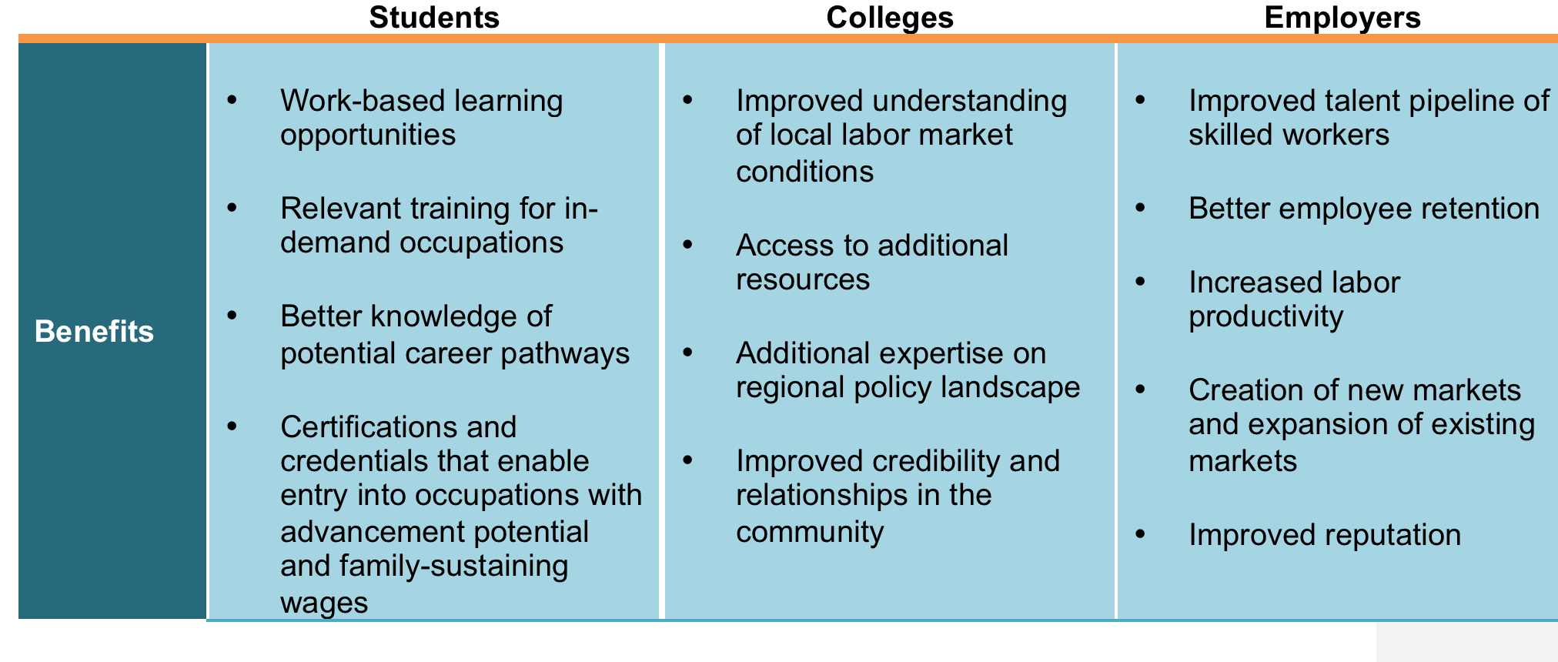
Stakeholder Benefits of Employer Engagement

Slide 35
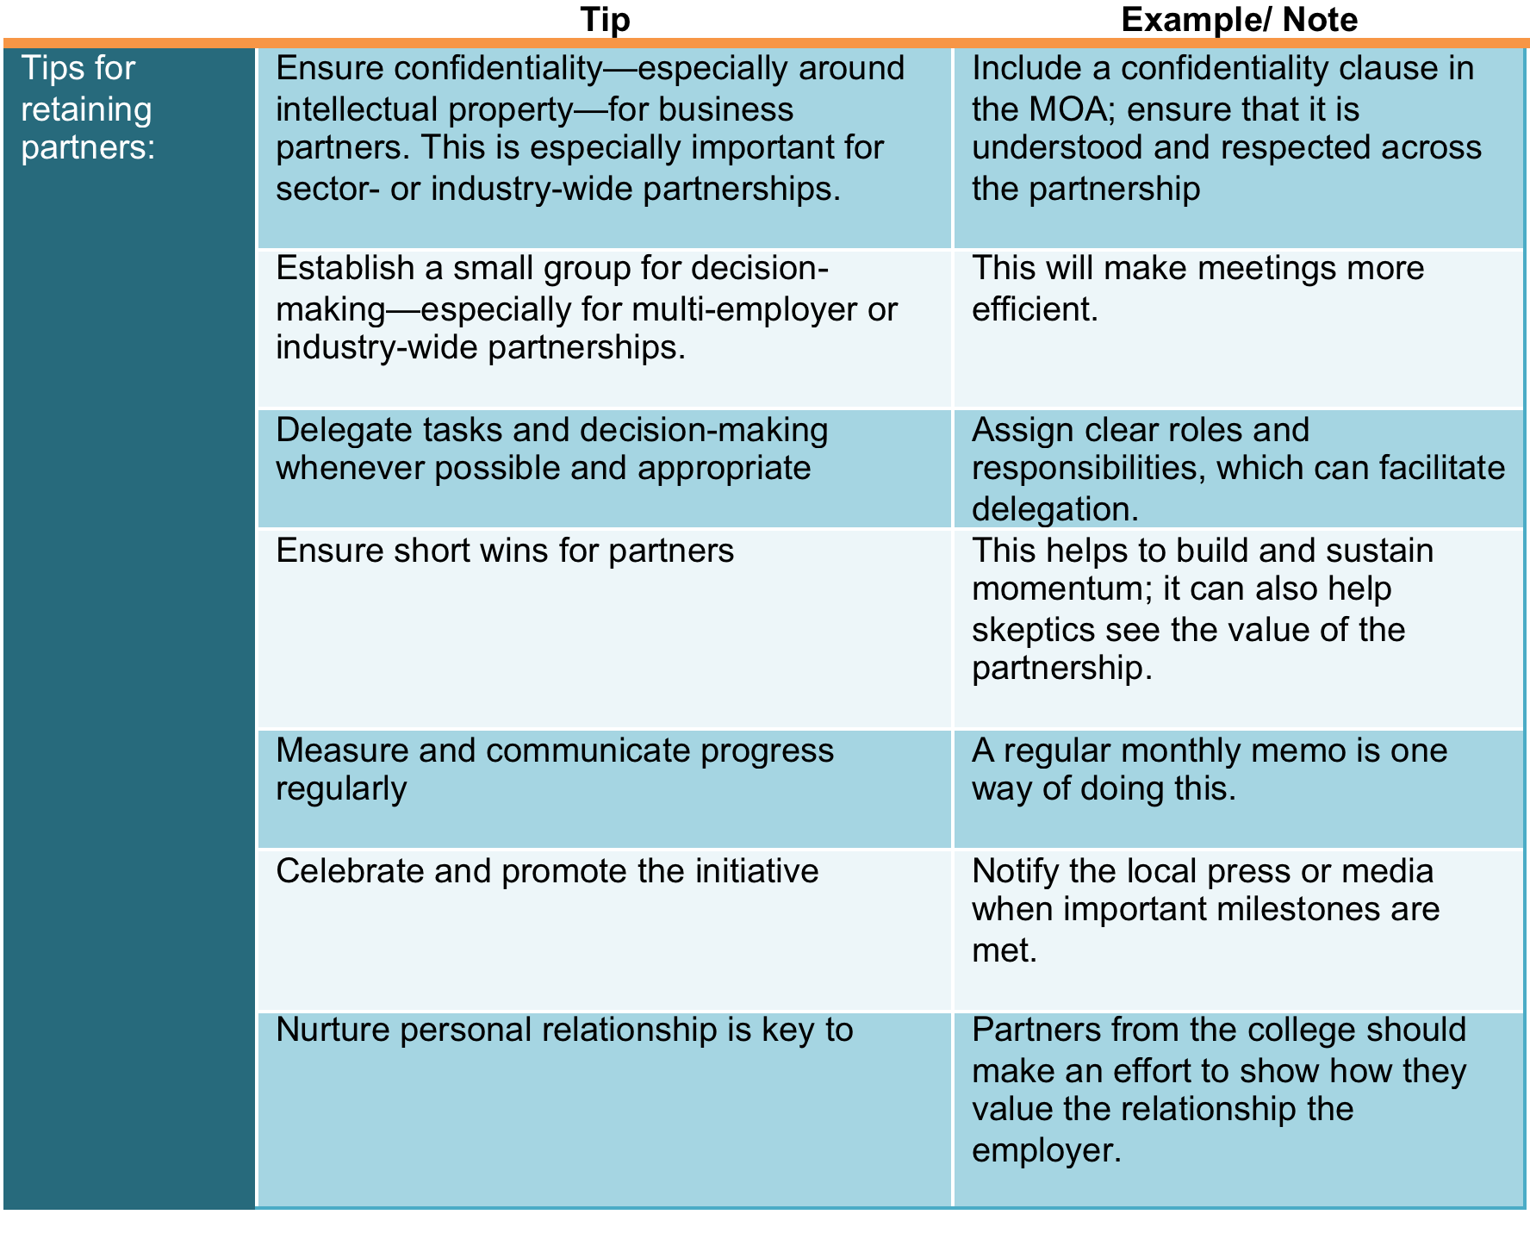
Partner Retention in Employer Engagement Initiatives

Slide 36
Engaging Employers
ANALYZE DATA TO DETERMINE SKILLS AND CREDENTIALS
VALIDATE CONCLUSIONS THROUGH MEETINGS WITH EMPLOYERS
DEVELOP JOINT PLANS TO MEET EMPLOYER/STUDENT NEEDS

Slide 37
Mary v. L. wright
Senior Program Director
mwright@jff.org
TEL 617.728.4446 FAX 617.728.4857 info@jff.org
88 Broad Street, 8th Floor, Boston, MA 02110
122 C Street, NW, Suite 650, Washington, DC 20001
WWW.JFF.ORG

Slide 38
Presenters
Presenter: Cindy Read
Title: Deputy Director
Organization: KentuckianaWorks (the Greater Louisville Workforce Investment Board)
Presenter: Eric Burnette
Title: Workforce Intelligence and Communications Coordinator
Organization: KentuckianaWorks (the Greater Louisville Workforce Investment Board)

Slide 39


HOW ONE WIB IS USING LMI TO GUIDE SECTOR-FOCUSED WORK
ERIC BURNETTE
WORKFORCE INTELLIGENCE & COMMUNICATIONS
&
CINDY READ
DEPUTY DIRECTOR
KENTUCKIANAWORKS
LOUISVILLE, KY

Slide 40
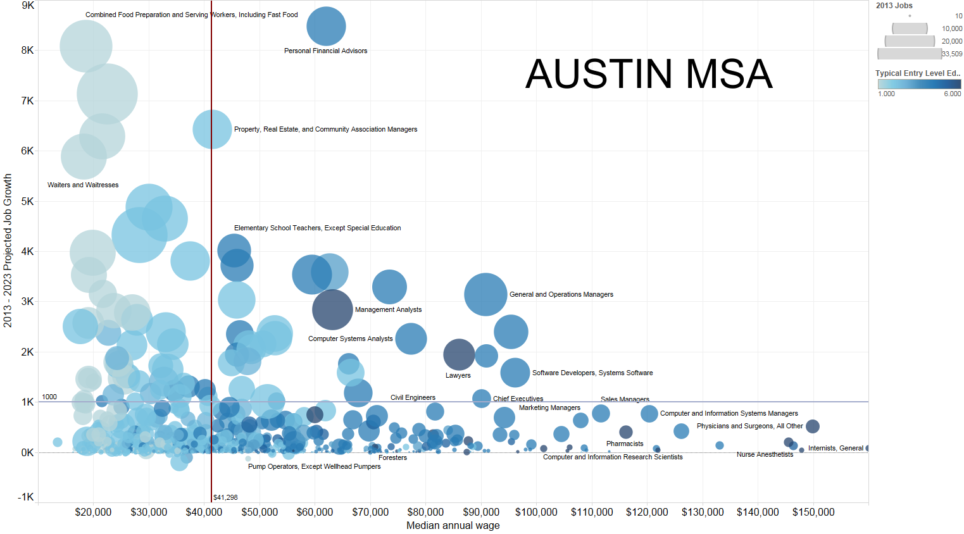

Slide 41
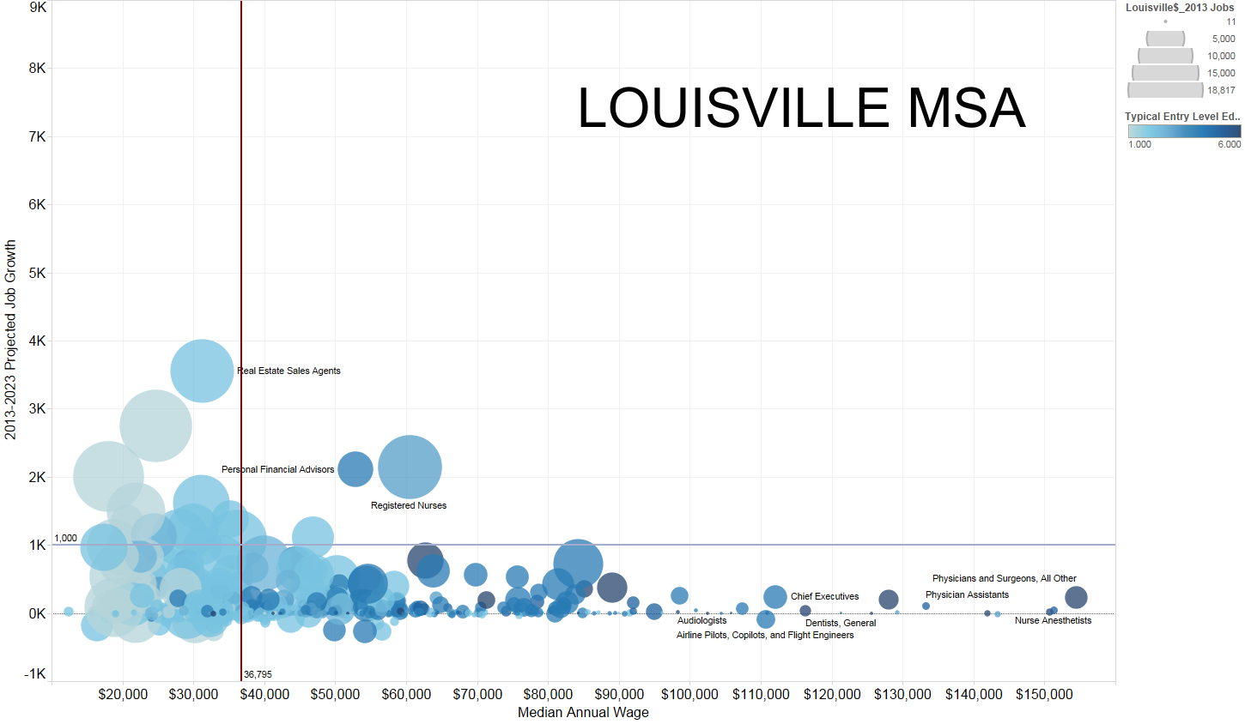

Slide 43
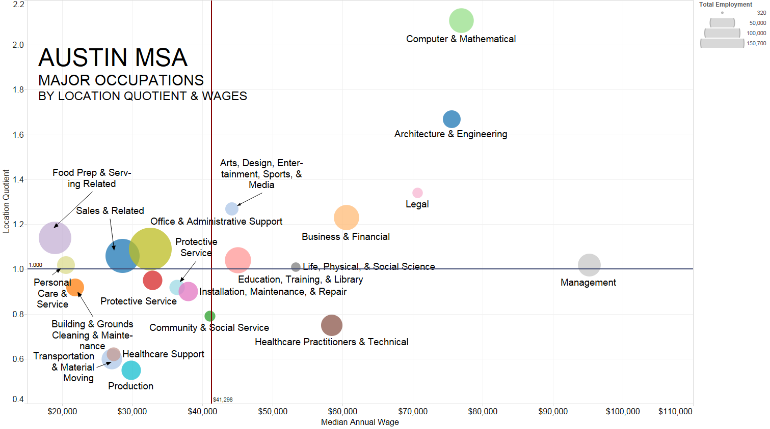
Overrepresented & High-paying
Underrepresented & High-paying

Slide 44
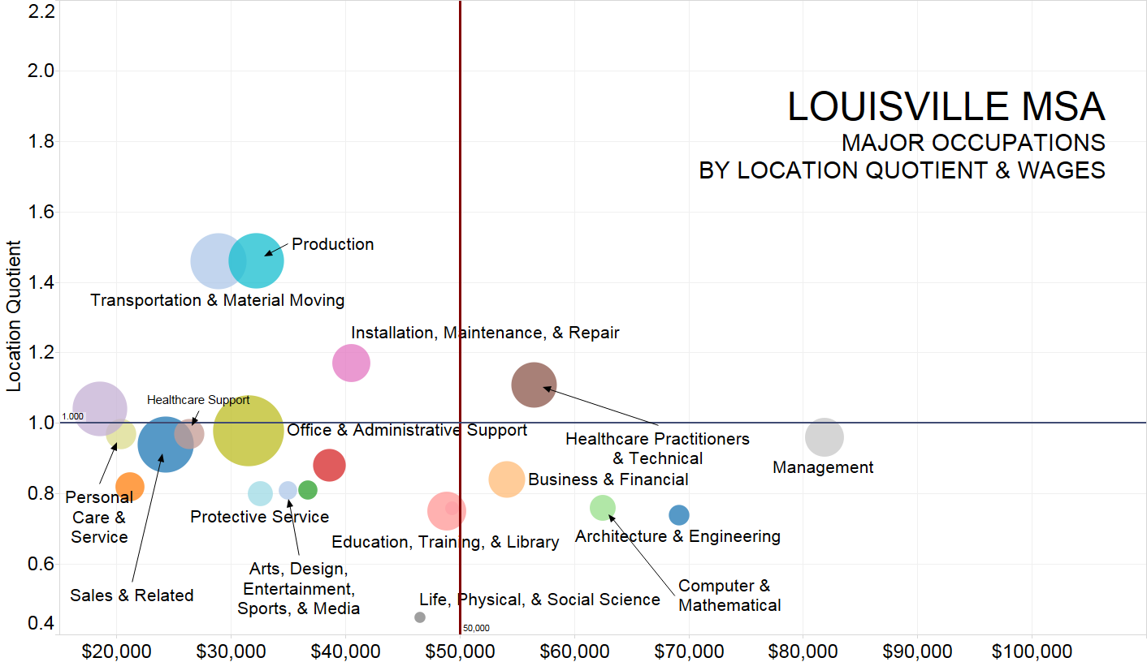
Overrepresented & High-paying
Underrepresented & High-paying
Source: EMSI Analyst

Slide 45
Acute Healthcare
8%
50,696 jobs
Longterm Healthcare
3%
17,907 jobs
HEALTHCARE AS PERCENTAGE OF TOTAL JOBS
LOUISVILLE MSA
Source: EMSI Analyst

Slide 46
HEALTHCARE AS PERCENTAGE OF PROJECTED 2013-2023
JOB GROWTH
LOUISVILLE MSA
Acute Healthcare
16%
12,058 jobs
Longterm Healthcare
6%
4,294 jobs
All Other Industries
78%
17,907 jobs
Source: EMSI Analyst

Slide 47
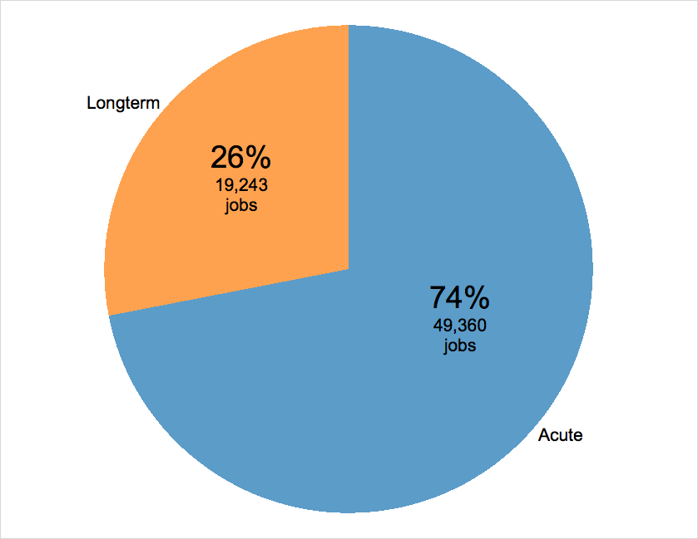
LONGTERM VS ACUTE
HEALTHCARE BY INDUSTRY
LOUISVILLE MSA
Source: EMSI Analyst

Slide 48
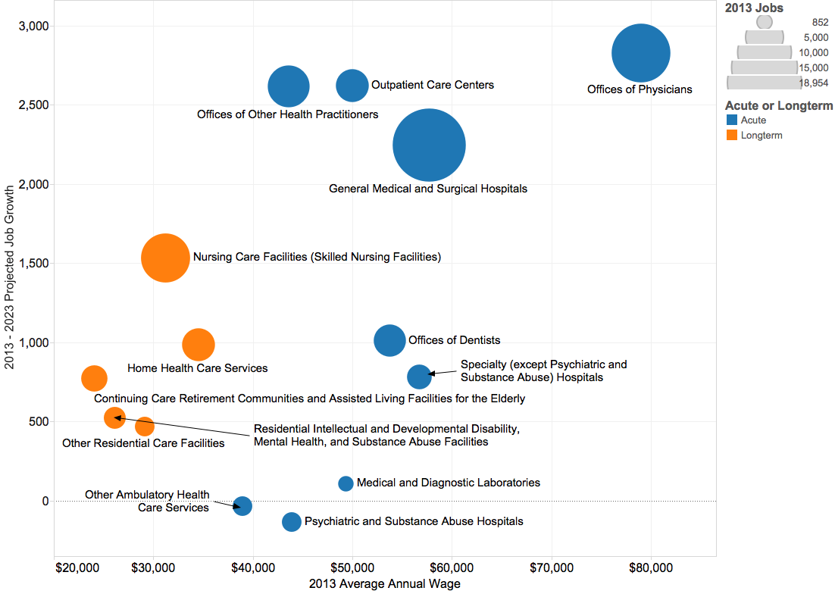
ACUTE vs LONGTERM
HEALTHCARE BY INDUSTRY
LOUISVILLE MSA
Source: EMSI Analyst

Slide 49
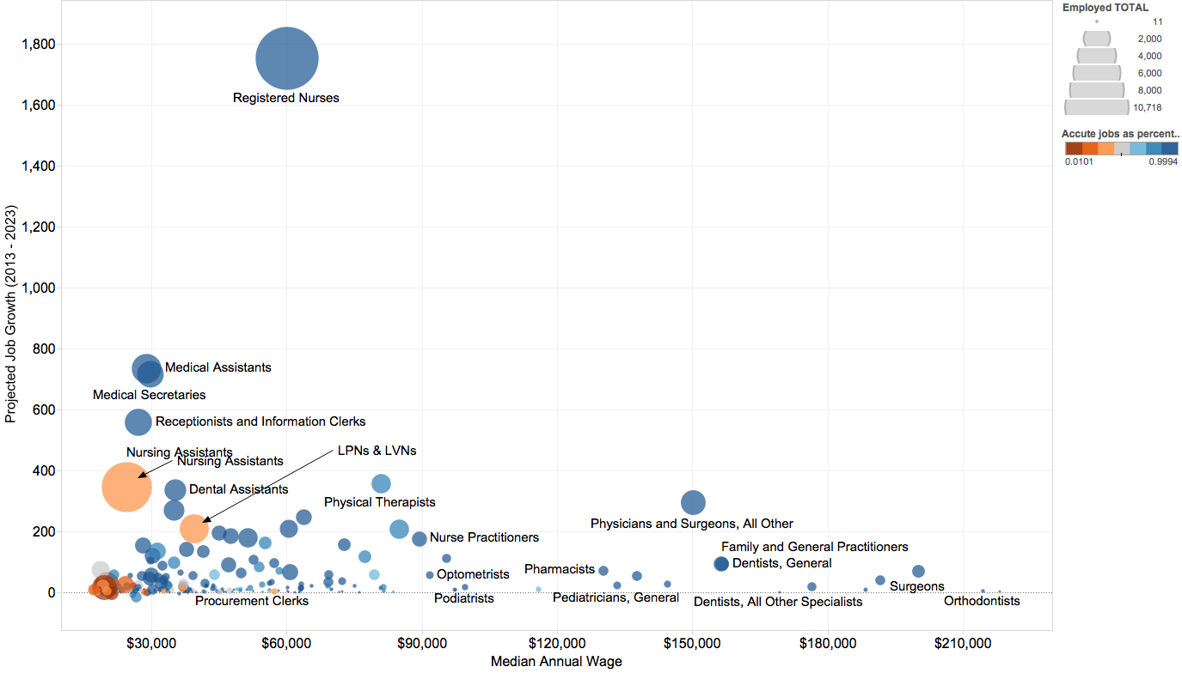
ACUTE vs LONGTERM
HEALTHCARE BY OCCUPATION
LOUISVILLE MSA
Source: EMSI Analyst

Slide 50
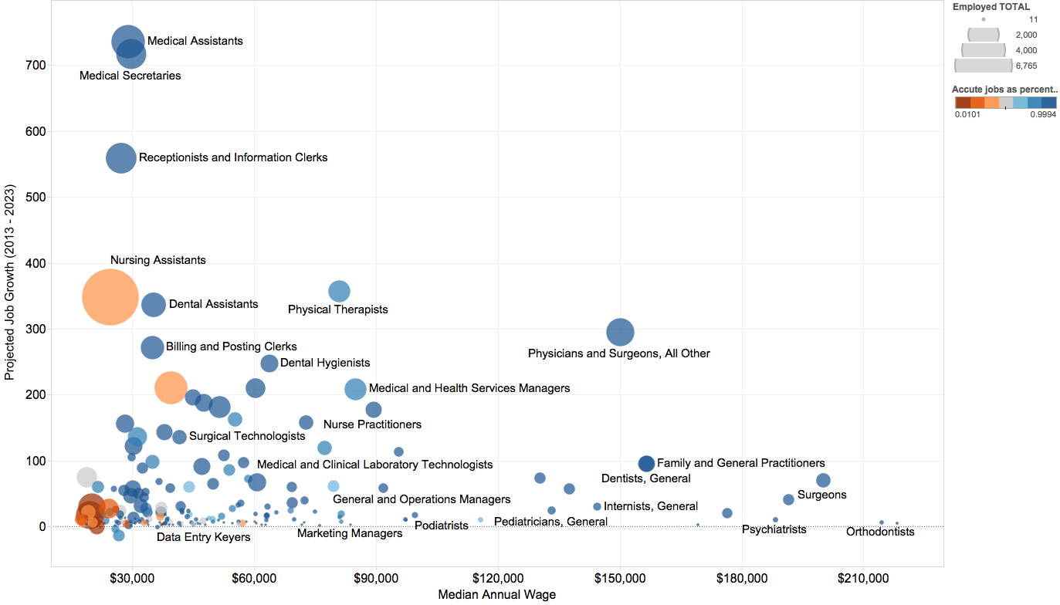
ACUTE vs LONGTERM
HEALTHCARE BY OCCUPATION
(WITHOUT REGISTERED NURSES)
LOUISVILLE MSA
Source: EMSI Analyst

Slide 51
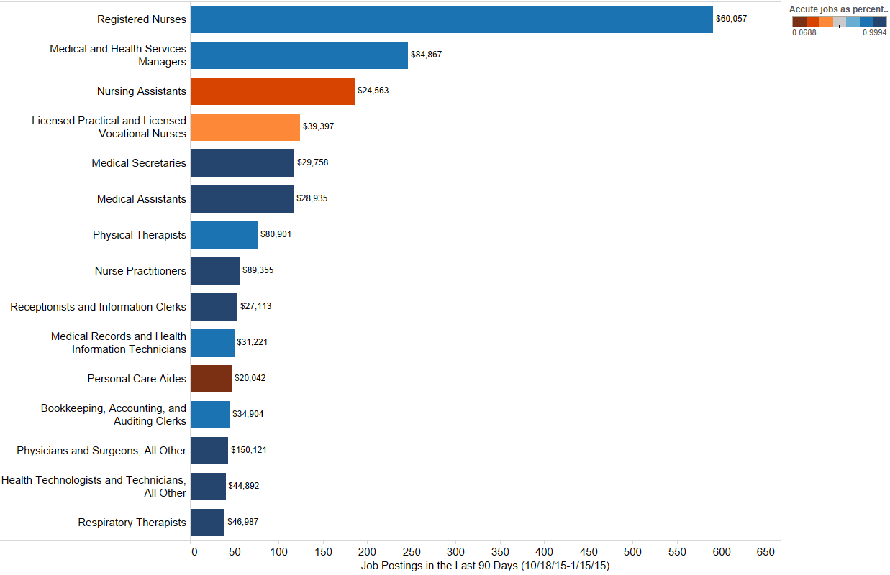
HEALTHCARE JOBS BY TOP JOB POSTINGS
LOUISVILLE MSA
Source: Burning Glass

Slide 52
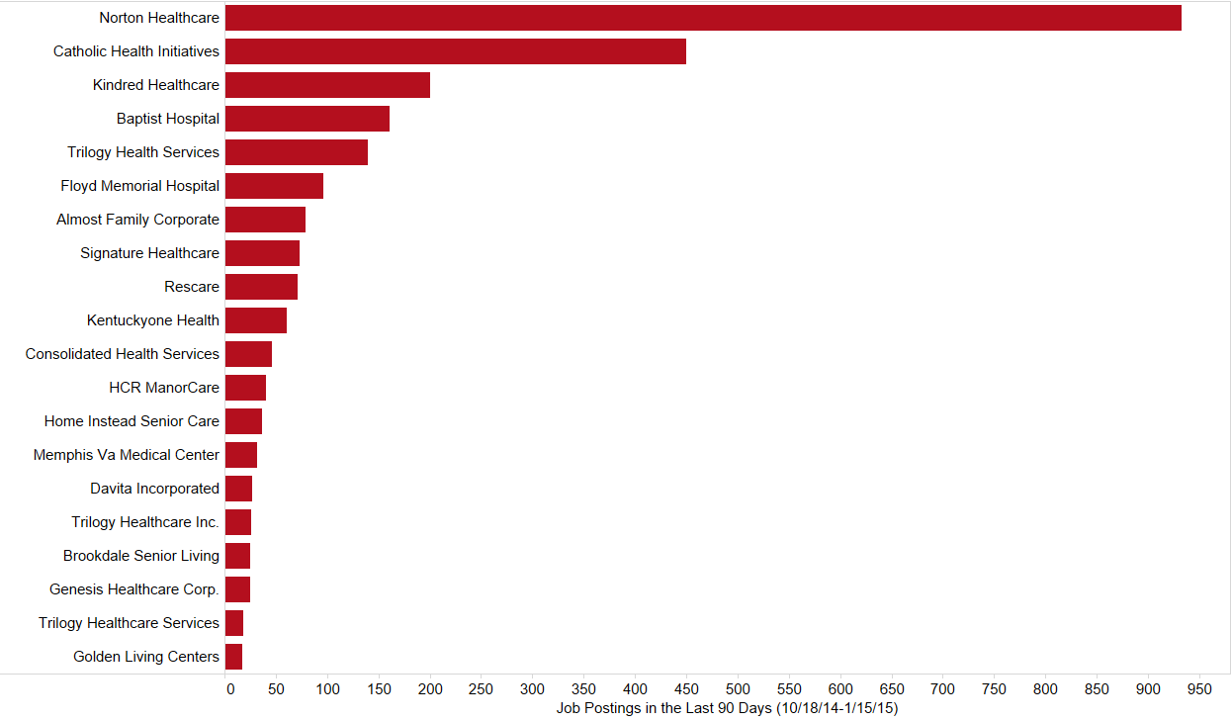
HEALTHCARE JOBS BY TOP EMPLOYERS
LOUISVILLE MSA
Source: Burning Glass

Slide 53
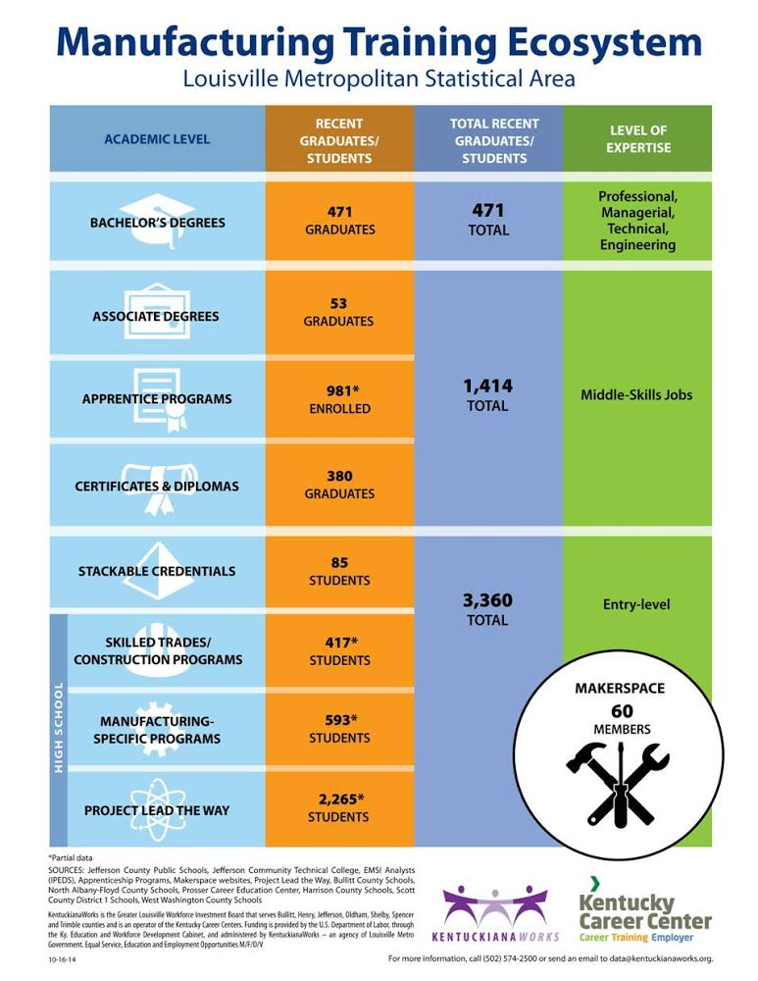

Slide 54
ADVANCED MANUFACTURING JOB POSTINGS IN THE LAST 90 DAYS
LOUISVILLE MSA

Slide 55

http://kentuckianaworks.org/Portals/2/KCC-Quarterly-Report-Q32014.pdf

Slide 56
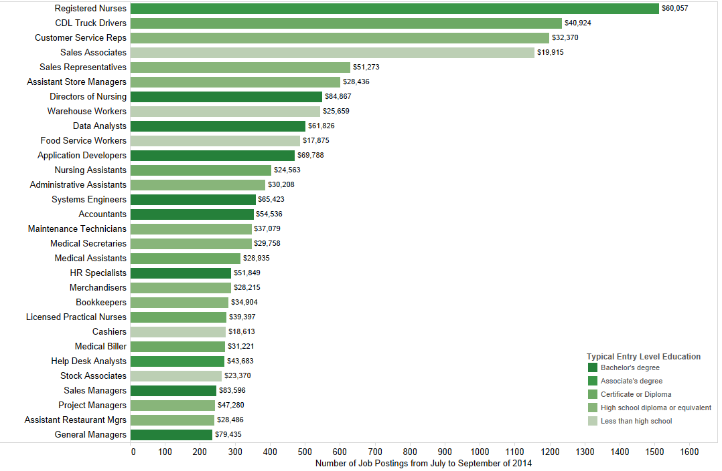
LOUISVILLE MSA
TOP 30 JOBS, JULY-SEPT. 2014
Source: Burning Glass
Source: Burning Glass/Labor Insight

Slide 57
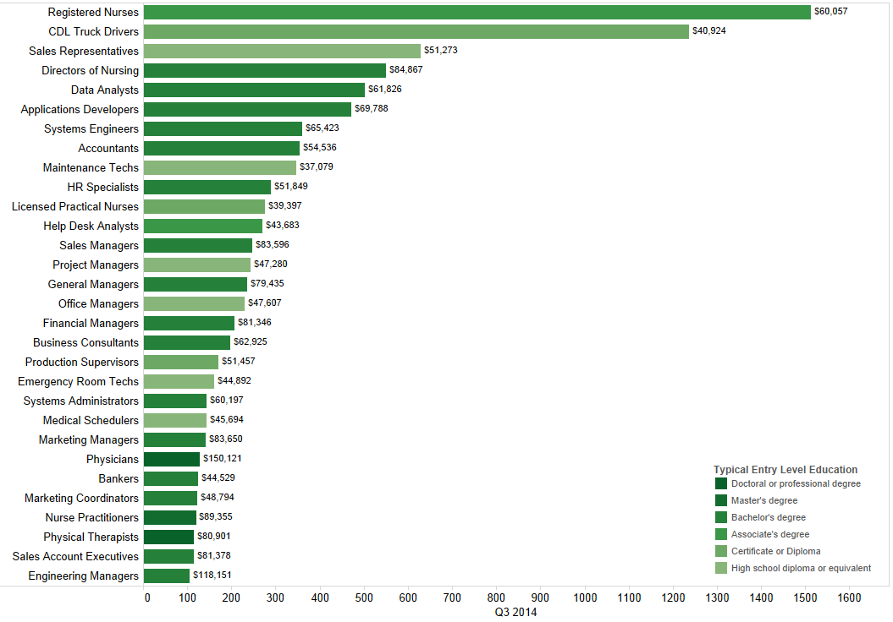
LOUISVILLE MSA
TOP 30 JOBS
ABOVE A LIVING WAGE ($36,795)
JULY-SEPT. 2014
Source: Burning Glass
Source: Burning Glass/Labor Insight

Slide 58
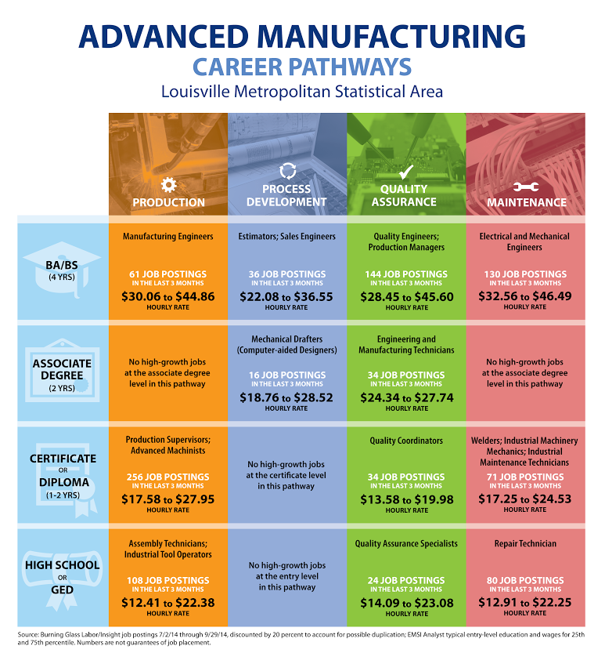
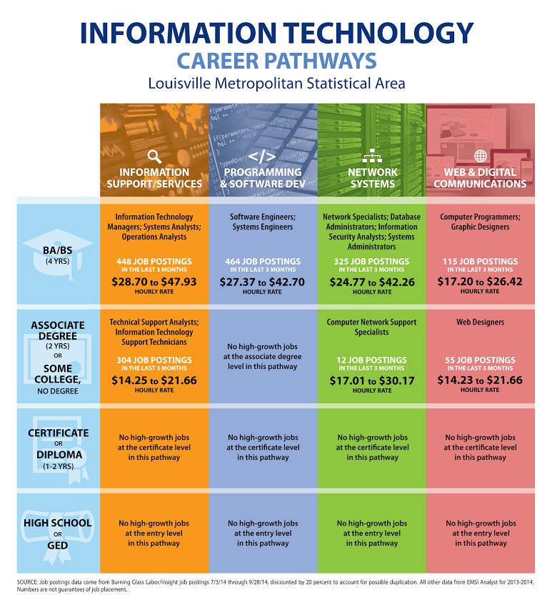
✔
✔
✔

Slide 59


✔
✔
✔
✔
✔

Slide 60


✔
✔
✔
✔
✔

Slide 61
QUESTIONS?
ERIC.BURNETTE@KENTUCKIANAWORKS.ORG
OR
CINDY.READ@KENTUCKIANAWORKS.ORG
502.574.2500

Slide 62

Save the Date… Upcoming Events
Supporting Sector Strategies: Boston Convening
April 14-15, 2015 | Federal Reserve Plaza |
600 Atlantic Ave, Boston, MA 02210
Information & Registration at: http://businessengagement.workforce3one.org/
Supporting Sector Strategies: San Francisco Convening - Resources Available
This convening, which was on held January 8-9, 2015, in Oakland, CA, was the second in a national series offered through the Department of Labor’s Employment and Training Administration's Supporting Sector Strategies Initiative.
Resources available at: http://businessengagement.workforce3one.org/

Slide 63
Save the Date… Upcoming Events
Peer Learning Groups The Sector Strategies Peer-Learning Groups are topic-specific groups (Labor Market Information/Data Solutions, Work-Based Learning, and Industry Engagement )for those interested in pursuing sector strategies work to engage one another and learn from experts in facilitated one-hour phone discussions.
For more information visit: http://businessengagement.workforce3one.org/
Webinar: ETA Real-Time Labor Market Information: Environmental Scan of Vendors and Workforce Development Users
February 10, 2015 2:00 p.m. Eastern
For more information visit: https://www.workforce3one.org/page/webinars

Slide 64

Please Enter your Questions in the Chat Room!

Slide 65

Speakers’ Contact Information
Speaker: Diane Walton
Title: Project Lead
Organization: U. S. Department of Labor/ETA (San Francisco)
Email: Walton.diane@dol.gov
Telephone: 415-625-7924
Speaker: Mary Wright
Title: Senior Program Director, Demand Side
Engagement and Analytics
Organization: Jobs for the Future
Email: mwright@jff.org
Speaker: Cindy Read
Title: Deputy Director
Organization: KentuckianaWorks
(the Greater Louisville Workforce Investment Board)
Email: cindy.read@kentuckianaworks.org

Slide 66
Thank You!
Find resources for workforce system success at:
www.workforce3one.org

