Slide 1
Developing a Sustainable Employer-based Mentoring Program for Youth
Webinar Date: February 10, 2015
2:00PM EST
Presenters: Division of Youth Services
U.S. Department of Labor
Employment and Training Administration

Slide 2
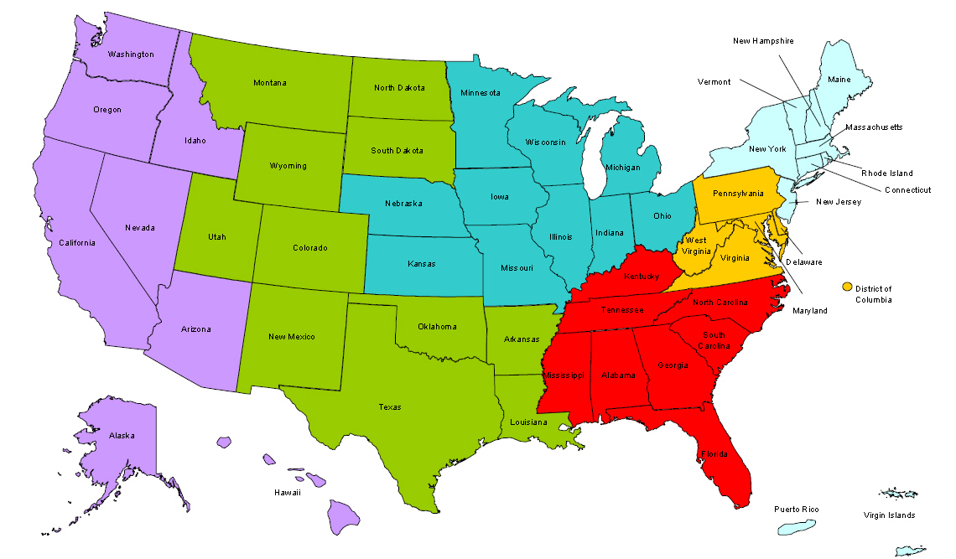
Where are you?
Enter your location in the Chat window – lower left of screen

Slide 3
Moderator
Maisha Meminger
Division of Youth Services
U.S. Department of Labor
Employment and Training Administration

Slide 4
Here’s what you can expect to get out of this webinar!
Review the definition of mentoring in the Participant Tracking System (PTS) to understand what counts as mentoring
Learn strategies for developing an industry-related, employer-based mentoring program
Learn strategies for identifying mentors to assist participants in achieving their goals
Learn methods for cultivating existing resources and building sustainable partnerships
Learn techniques for recognizing and encouraging long term mentoring relationships
Participate in peer-to-peer learning with YCC Grantees who will share promising practices for setting up a successful mentoring program

Slide 5
Agenda
YCC Mentoring Description
Types of Mentoring
Work-based Mentoring vs. Internship
Reporting Mentoring in the PTS
Mentor Recruitment
YCC Grantee Presentation
Mentor Training
Participant Engagement
Follow Up
Retention

Slide 6
Subject Matter Expert
Tressa Dorsey
Dorsey Consulting Services

Slide 7
Mentoring Description
One-on-One and Group
Ongoing, regular contact for a long period of time
Mentors guide, support and encourage participants to be successful in education, work and life
Mentoring can be designed around goals, educational achievement, improved decision making or professional behavior, career objectives or other training activities
Employer or Career based mentoring should role model a professional relationship

Slide 8
Types of Mentoring
Group
One-on-One
Phone
Web

Slide 9
Work-based Mentoring vs. Internships
Mentoring relationships tend to last longer than internships
An internship, even though it includes actual operation in the facilities of the employer, is similar to training which would be given in an educational environment
An internship experience, like a mentoring relationship, is for the benefit of the student
The intern works under close supervision of existing staff; however they may have one person designated to work on soft skills and other additional items
The Intern’s supervisor should not be the mentor

Slide 10
Reporting mentoring
Participant Tracking System
Evan Rosenberg
Division of Youth Services
U.S. Department of Labor
Employment and Training Administration

Slide 11
PTS Mentoring Definition
Mentoring includes one-on-one, group, and/or service-based mentoring in which program participants are matched with adult mentors, preferably in the selected high-growth H-1B industry(ies) or occupation(s).
Mentors should have frequent contact with program participants over a prolonged period of at least one year and should provide guidance in navigating their identified career pathway.
While group mentoring is an acceptable type of mentoring service, all participants that receive formal mentoring must be assigned a mentor and also receive one-on-one mentoring.
One-on-one mentoring means a participant has an assigned adult mentor that they meet with on a one-on-one basis
Mentors must be adults other than staff working on the grant (i.e., teachers, case managers, etc.)

Slide 12
Mentoring Targets
We have heard that some grantees had a different understanding of what would be counted as mentoring in the PTS when grantees provided mentoring targets in their performance matrix.
Grantees will now have the opportunity to work with their FPO to provide an updated mentoring target if they believe their original target is not realistic given the clarification in the mentoring definition.
In order to update the mentoring target, grantees will need to work with their FPO to submit the updated target as a modification to their statement of work.
If grantees are planning to submit any other modifications in the near future, we encourage grantees to submit them at one time.
Grantees have until March 31, 2015 to submit an updated mentoring target.

Slide 13
Please enter your questions in the Chat Room!

Slide 14
Recruitment
Who: Supervisors, CEO’s, CFO’s, Human Resources Staff, Training and Development Personnel
Why: Looks good on resume, investing in future co-workers, employees and bosses
Where: Chamber of Commerce, industry leaders, professionals in the field
How: Time commitment, guidelines (“rules”), reporting

Slide 15
Employer Informed Mentoring Design
YCC Grantee
Karla Spangler
Director of Career Preparation and Readiness
Pathways to Prosperity
Toledo, Ohio

Slide 16
Partnerships That Work
Student
Industry
Educators
One Goal:
Our students will graduate with the tools needed to be successful in life.

Slide 17
Strong Business Advisory Council
Heavy with industry personnel
Working in the field today

Slide 18
Listening….. And Learning….. Educators should not assume they know what an employer needs. Ex. Soft Skills

Slide 19
Peer to Peer Collaboration
Industry Model of collaboration and team building Projects suggested by industry Completed with accuracy

Slide 20
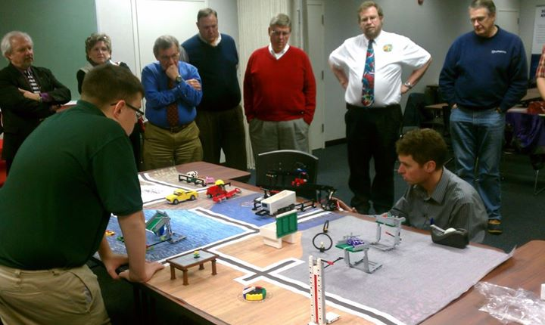
Mentoring
Industry personnel and educators “learn”
from the students.
Industry personnel:
Give suggestions
Offer support
Spend time in the classroom
Continue support in the workplace

Slide 21
Mentoring Continues At the Workplace
Shared and understood expectations Student: Follow business expectations
Employer: Mentor and evaluate

Slide 22
Monthly Advisory Council Meetings
What is working? What needs to be “tweaked”? New members vs. tenured members

Slide 23
Recruitment Strategies
YCC Grantee
Leslye Long
Mentoring Coordinator
Manufacturing Renaissance
Chicago, Illinois

Slide 24
Mentor Recruitment Strategies
Locate Mentors
Approach
Mentor Variety
US2020
Standard Training

Slide 25
Where should I look for mentors and why?
Businesses – Local STEM companies with a travel time under 30 minutes.
Ready to share
Group mentoring on/offsite facilitates employee satisfaction and strengthens company culture
Colleges – Local College students
Fluid schedules
Recall high school anxiety
Ready to share
Familiar Resources
People you know
Professional/Social Media Sites: LinkedIn, Facebook

Slide 26
Where should I look for mentors and why?
The Approach:
Find a win-win for the mentees and the mentors
Club Mission & Service Learning Hours
Some Missions statements require volunteering
Some schools offer service learning credits through their school

Slide 27
Three Mentoring Pools
1. Collegiate: Making Connections
Call and email club presidents
Speak with club sponsors/professors
STEM Programs
NSBE, SHPE, etc.
Lunch and Learns
Attend club meetings
2. Business
Marketing Manager,
CEO
Community Development
Personal Relationships

Slide 28
Three Mentoring Pools
3. Mentor demographic
All ethnicities
Target both sexes although women are usually available
Think: what works for your program?
Ages 18-55 to start; youth can demonstrate ageism
Mentor should live and work within 30 minutes of program location

Slide 29
Reach Out US 2020
List your organization on their site
Provide a point person: Mentoring Specialist for your specific needs
They will recruit mentors from the professional community for you
Main Contact: Shalanda Holmes
sholmes12@cps.edu
http://us2020.org/about-us

Slide 30
Training Mentors
One Standard Training
The basic principals of the program should be consistent: safety, managing mentor expectations, program rules, your program’s perspective/curriculum, support, identifying program location, etc.
Group training at familiar location: company, school or program site

Slide 31
Training
Application
Guidelines
Expectations
Objectives

Slide 32
Participant Engagement
Benefits
Attraction
Acknowledgement
Incentives

Slide 33
Follow Up
When
How
Who
Documentation

Slide 34
Retention
Begins on day one
Follow up with both mentor and mentee
Events
Recognition

Slide 35
Resources
Grads of Life Mentoring Guide
Find Youth Info
Mentor Youth
Sample Mentoring Documents-Dorsey Consulting Services
Paving the Way to Work: A Guide to Career-Focused Mentoring for Youth with Disabilities
Youth Mentoring -Benefits of Worksite Mentoring

Slide 36
For More Information on Internships
Call 1-866-4US-WAGE
Visit www.dol.gov/whd, or
Click the link to view
Fact Sheet on the Employment Relationship

Slide 37
Please enter your questions in the Chat Room!

Slide 38
CONTACT US
U.S. Department of Labor
Employment and Training Administration
200 Constitution Avenue, NW, Room N-4456
Washington, DC 20210
Email: ycc@dol.gov
Tressa A. Dorsey
Dorsey Consulting Services
P: (916) 899-0038
tressadorsey@att.net
www.dorseyconsultingservices.com

Slide 39
Thank you!
Find resources for workforce system success at:
www.workforce3one.org

