Slide 1
TAACCCT Quick Start Webinar:
Get your grant off to a good start
Jennifer Freeman, Program Director, TAACCCT Learning Network
John Heemstra, TAACCCT Grant Manager, Mitchell Technical Institute, South Dakota
February 12, 2015 3:00 – 4:00 p.m. EST

Slide 2
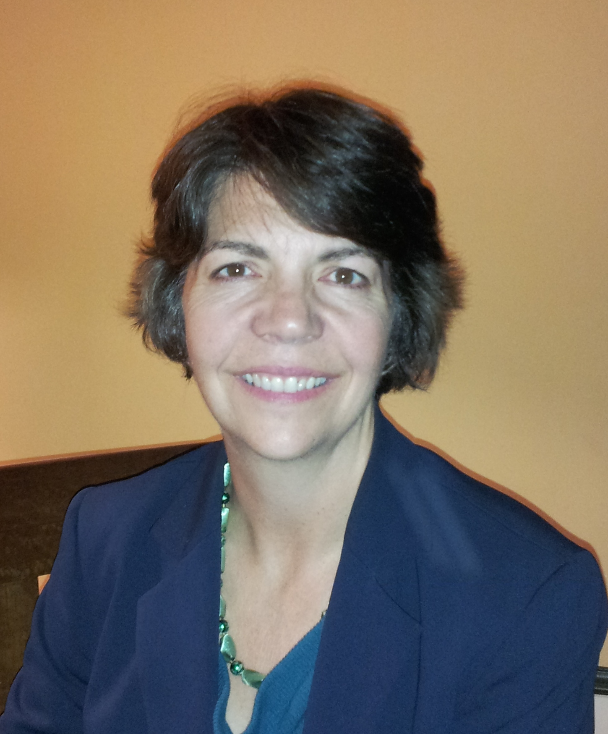
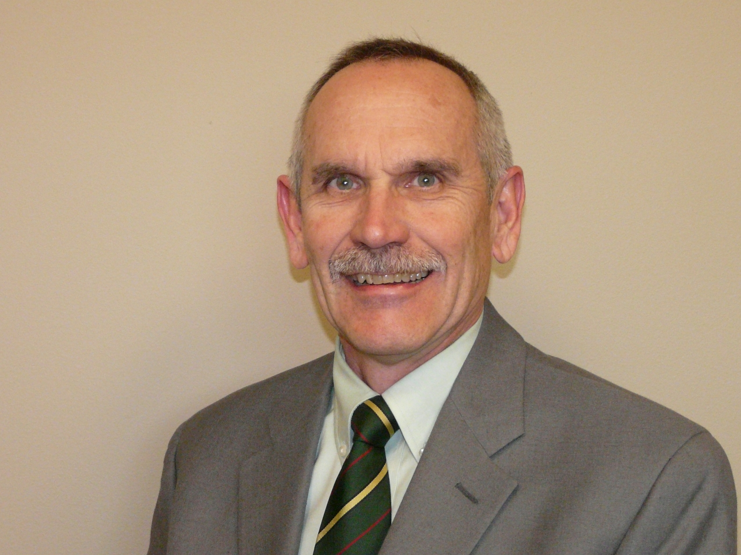
Presenters
Jennifer Freeman, Program Director
TAACCCT Learning Network
Jobs for the Future
John Heemstra, TAACCCT Grant Manager
Mitchell Technical Institute, South Dakota

Slide 3
Agenda
Purpose: To learn about the essential early steps for successful grant implementation
Welcome & Introduction
TAACCCT Learning Network
Understanding TAACCCT Goals
Common Hazards & Elements of Success
Workplans & Reporting Systems
Leadership, Management and Decision-Making Structures
Communications within the college and across the consortium
Stakeholder Engagement
The Open Educational Resources requirement and the CCBY license
Data Collection & Evaluation
Q &A

Slide 4
Participant Poll
Which do you represent?
Single college grantee
Consortium grantee
What is your TAACCCT experience?
This is my first time managing a TAACCCT grant
I have managed one or more previous rounds of TAACCCT

Slide 5
About The TAACCCT Learning Network
U.S. Department of Labor
(National)
Jobs for the Future
CalState/Merlot
Maher&Maher and AACC
The TAACCCT Learning Network helps TAACCCT grantees achieve their greatest success. It is led by Jobs for the Future and supported by the U.S. DOL.
The TLN expands on the technical assistance that is currently provided by Creative Commons, CAST, and CalState/Merlot and adds new services and support provided by JFF with its partners Maher & Maher and the American Association of Community College, and the National Science Foundation advanced Technological Education Centers.
Other Providers of TA to TAACCCT Grantees:
Creative Commons
CAST
NSF/ATE Centers

Slide 6
Multiple Goals Of The TAACCCT Grant
Redesign Education & Training Delivery
Participant Outcomes
Student Attainment and Jobs
Ultimate Impact
Structural, systemic change within colleges and across systems
Program Deliverables

Slide 7
Don’t get Tripped Up by These
Five top challenges that hinder TAACCCT Grant Success:
Lack of Leadership Buy-In: Limited/unclear support from high level college leadership
Slow Start-Up: Significant lags in implementation due to slow staffing, program approval, etc.
Process and Procedural Hurdles: Lengthy challenges in completing procurement, securing course/program approval
Weak Consortium Management: Limited processes for sharing information with consortium members, and supporting their collaboration
Lagging Expenditures: Grants are significantly underspent well into the period of performance
Honorable Mentions include:
Participant Job Placement: Colleges struggle helping students secure employment
Fear: Grantees are hesitant to initiate grant activities because of the complexity of the grant, its size, importance to ETA, etc.

Slide 8
Elements for Success: First Steps
Management Procedures
Leadership and Decision-Making
Communications
Read and understand Your Statement of Work (SOW)
Get staff on board
Secure subagreements ASAP
Establish data collection and reporting systems
Develop agreement for wage-record matching
Develop a spending plan
Ensure leadership buy-in and visible support
Establish structures for decision-making
Make sure everyone understands the goals and activities -- faculty, administrators, workforce stakeholders
Set up team meetings, email updates and other regular systems for communication
Stakeholder Engagement
Build strong partnerships with workforce system
Engage employers

Slide 9
Management Procedures: Workplans and Reporting
DOL Quarterly and Annual Reports are aligned with SOW
If consortium, each college needs a work plan that is aligned with consortium SOW
Develop systems to track deliverables (products) and outcomes (participants)
Report on outcomes and deliverables to all stakeholders regularly

Slide 10
Management Procedures: A Spending Plan
Establish quarterly goals for spending. Consortium/college members and the leadership need to keep an eye on expenditures.
Use reporting process as a tool to engage leadership and grant team

Slide 11
Management Procedures: Meeting the Open Educational Resources Requirement
Be sure all involved faculty understand the OER requirement
Hold meetings with faculty early
Explain the OER requirements of the grant
Train them to find TAACCCT and other OER (don’t reinvent the wheel!)
Train them regarding the CCBY license requirement
April 20, 2 p.m. Orientation to OER and Creative Commons
The Creative Commons and OPEN (Open Professionals Education Network) team can help!
www.Open4Us.org

Slide 12
Management Procedures:
Date Collection & Evaluation
For Job Placement Verification
Set up a system for wage-record matching with the Unemployment Insurance agency in your state
For help with wage-record matching email TAACCCT@dol.gov
For 3rd Party Evaluation
Note May 15th deadline for submitting your grant evaluation plan.
For help with 3rd party evaluation: Urban Institute at TAACCCTEVAL@urban.org

Slide 13
Polling question
Think about your current practices and assess your capacity in Management Procedures on a scale of 1-4;
1 = Just getting started 2 = In the process of establishing practices
3 = Have some practices in place 4 = Have strong practices in place

Slide 14
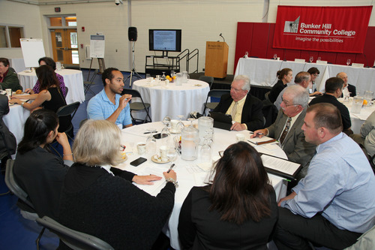
Communications: Information Sharing and Cross-College/System Engagement
Build systems for sharing grant information…
Newsletters, Email Blasts
Presentations (in-person and by webinar)
Kick-off event
… and peer sharing and planning
College-wide implementation team
College lead meetings (w/in a consortium)
Consortium or college-wide
Industry Teams
Faculty Working Groups
Community College/Job Center Convenings
Virtual Peer Sharing via Online Tool (e.g. Basecamp, Dropbox, or GroupSite)

Slide 15
Polling question
Think about your current practices and assess your capacity in Communications on a scale of 1-4;
1 = Just getting started 2 = In the process of establishing practices
3 = Have some practices in place 4 = Have strong practices in place

Slide 16
Leadership and Decision-Making
Project Lead
Leadership Team
Management Team
Implementation Team
For strategic decisions, high-level support/oversight of implementation
To oversee implementation: lead grant staff, finance staff, data collection staff, lead faculty
Cross-Silo Team to include:
management team plus: key faculty, advisors, financial aid staff, career center staff, navigators, academic and workforce deans

Slide 17
Polling question
Think about your current practices and assess your capacity in Leaderships & Decision Making on a scale of 1-4;
1 = Just getting started 2 = In the process of establishing practices
3 = Have some practices in place 4 = Have strong practices in place

Slide 18
Common Goals and Shared Commitment Shared Blueprint Strong Outcomes
Stakeholder Engagement

Slide 19
Stakeholder Engagement: The Public Workforce System
Engage the system early in the grant – explore areas of collaboration
NOW
Focus on developing a true partnership – what TAACCCT services
and activities can benefit the PWS? What can PWS services and
activities can benefit the TAACCCT grant?
Explore how the TAACCCT grant can support PWS outcomes, such
as employment of PWS participants
Leverage your respective core competencies – in what areas is the
PWS particularly effective? Where does the college excel?
Utilize common stakeholders – shared board members, employers
Identify a PWS partner to serve as a champion with their peers

Slide 20
Polling question
Q. What is the status of your working relationship with your WIB and/or One-Stop Career Center/American Job Center?
Signed on to the grant but no defined
Role
Defined role (on paper) but limited
Active engagement
Clearly defined role and we
are actively working together

Slide 21
Stakeholder Engagement: Employers
Approach Employers Early
Build Work-Based Learning Components
internships
Early and deep employer engagement leads to JOBS for your graduates
clinical education
on-the-job training
Identify skill needs
Build aligned curriculum

Slide 22
Polling question
Q. How many have employer partners who are involved in any of the following ways? (select all that apply)
Employer as faculty
Equipment donation
Curriculum development
Internships
Guaranteed interviews for graduates
Other? ___________________

Slide 23
Wrap-up Reminders
Maintain regular communication with your Federal Project Officer.
Check out TAACCCT related resources on www.Workforce3One.org
Reach out to the TAACCCT Learning Network with questions and to connect with peers and resources at TAACCCT@dol.gov

Slide 24
Questions & Answers

Slide 25
Jennifer Freeman, Program Director, TAACCCT Learning Network
Jfreeman@jff.org
John Heemstra, TAACCCT Grant Manager, Mitchell Technical Institute, South Dakota
John.Heemstra@mitchelltech.edu
TAACCCT Learning Network, TAACCCT@dol.gov
Find resources for workforce system success at:
www.workforce3one.org

Slide 26
Thank You!
Find resources for workforce system success at:
www.workforce3one.org

