Slide 1
Enough is Known For Action
Preparing to Deliver Expanded Services to Out-of-School Youth

Slide 2
Today’s Presenters
Lori Crockett Harris, Moderator
Office of Workforce Investment
Employment and Training Administration
U.S. Department of Labor
Evan Rosenberg
Office of Workforce Investment
Employment and Training Administration
U.S. Department of Labor
Expert Peer Presenters
Sean Kelly and Jill Walters, Portland, Oregon
Andrea Robins, Kansas City, Missouri
Portland
Kansas City

Slide 3
Webinar Context
Enough is Known For Action:
Preparing to Deliver Expanded Services to Out-of-School Youth
First of 3-part webinar series
We heard your needs in our WIOA Consultations!
Title builds on Brandeis Enough Is Known For Action Conference
Materials available at http://cyc.brandeis.edu/Employ-educate-support-youth/EnoughisKnownforAction.html

Slide 4
Setting the Stage for Today
Policy & Considerations
Identifying Essential Partners
Recruiting Quality OSY Providers
Recruiting Eligible OSY
Serving Eligible OSY

Slide 5
WIOA Provisions for OSY
WIOA requires 75% of state and local Youth funding be used for out-of-school youth
State and Local calculations
Exception
75% for
Out-of-School
Youth
State & Local
Youth Funding

Slide 6
OSY Eligibility Requirements
To be eligible youth must be:
Not attending any school (as defined under State law)
Aged 16 to 24
Meet one or more additional conditions

Slide 7
OSY Eligibility Requirements
Additional Conditions (Must Meet 1)
School dropout
Within the age of compulsory school attendance, but has not attended school for at least the most recent complete school year calendar quarter
Recipient of a secondary school diploma or its recognized equivalent who is low-income and either basic skills deficient or an English language learner
Subject to the juvenile or adult justice system
A homeless individual defined in sec. 41403(6), Violence Against Women Act (42 U.S.C. 14043e–2(6)), a homeless child or youth, a runaway, in foster care or has aged out of the foster care system, a child eligible for assistance under section 477, Social Security Act (42 U.S.C. 677), or in an out-of-home placement
Pregnant or parenting
An individual with a disability
Low-income individual who requires additional assistance to enter or complete an educational program or to secure or hold employment

Slide 8
OSY Eligibility and Income
Low income is not required for all OSY
Low income is only required if use “condition” III or VIII
III. Recipient of a secondary school diploma or its recognized equivalent who is low-income and either basic skills deficient or an English language learner
VIII. Low-income individual who requires additional assistance to enter or complete an educational program or to secure or hold employment

Slide 9
OSY Expenditure Rates in PY12
0%
75% Goal
100%
Average OSY expenditure rate nationally is 57%
Ranges from a low of 37% to a high of 84%
2 states already above 75%
22 states at 60% or above

Slide 10
Checking In: Polling Question
Considering what you know now, how ready are you to Implement the 75% OSY Expenditure Requirement?
Confident and ready-to-roll!
Expect to increase OSY expenditures but getting to 75% may be difficult
Very concerned; seeking more guidance & technical assistance
Invitation
to Chat
What % of your funds were spent on OSY last Program Year?

Slide 11
Considerations
Your Hot Issues = Our Key Considerations
Collaboration with Education and Health and Human Services partners
Implementing OSY with minimal negative impact to ISY
Funds Allocation & Carry Over
Tracking & Reporting
Upcoming TEGL addressing many of these transition issues

Slide 12
Enough is Known for Action
Three areas we can plan for NOW
Identifying Essential Partners
Recruiting Quality OSY Providers
Expanding Services to OSY

Slide 13
Who Are Your Essential Partners?

Slide 14
Are Your Partners Lined Up?
Key Partners for Successful WIOA OSY Implementation
Adult Education, Community Colleges, K-12, and Alternative Schools
Job Corps and YouthBuild
HHS/TANF agency
Juvenile Court; Juvenile Probation
Group Homes, Homeless shelters and other transitional residential agencies
Vocational Rehabilitation
Veteran’s Hospitals and other readjustment services for returning Armed Services members
Community and Faith Based Organizations
Apprenticeship and Pre-Apprenticeship

Slide 15
Recruiting/Contracting for Quality OSY Providers
Identifying Possible Providers
Based on Program Design decisions
Role of Youth Council (soon to be Committee)
Exploration of CBOs
Developing the RFP
Consider Scope
Determine contract length & timing
Flexible terms and language
Invitation
to Chat
Chat to share YOUR ideas!

Slide 16
Recruiting and Serving Eligible OSY Participants
Peer Presentations!

Slide 17
Recruiting and Serving Eligible OSY Participants
Sean Kelly
Senior Project Manager
Worksystems, Inc.
Portland, Oregon
Jill Walters
Executive Director
Portland YouthBuilders
Portland, Oregon
pybpdx.org
worksystems.org

Slide 18
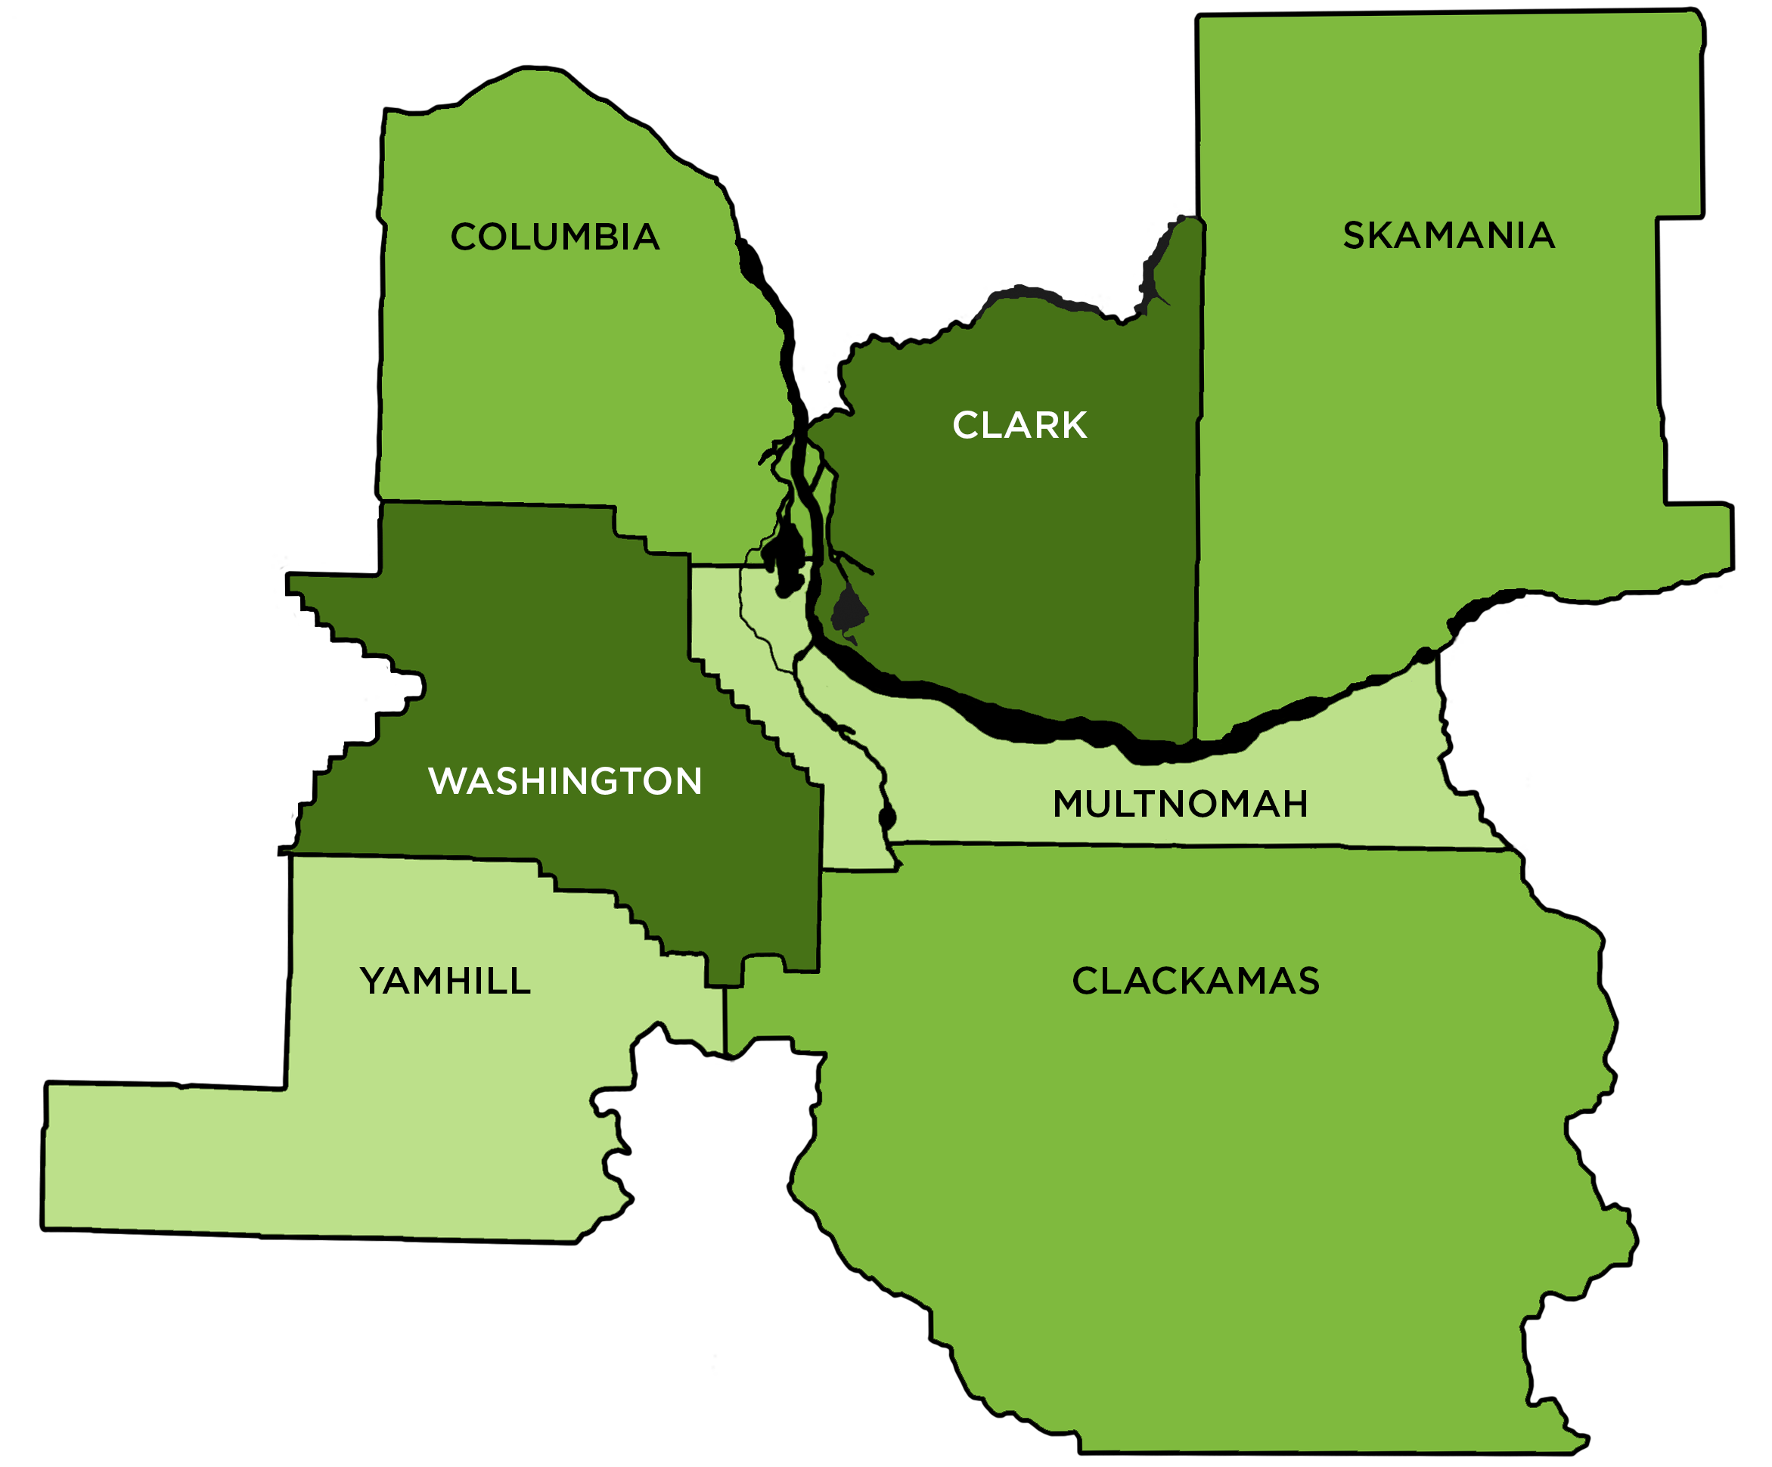
Worksystems, Inc.

Slide 19
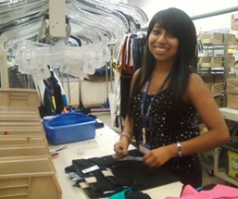
The Career Connect Network
Aligns WIA, CDBG, and Portland general funds
Network of college and career preparation programs
Goal for all youth:
Prepare youth for successful careers through continued education and work-based learning

Slide 20
Key Partners Culturally and Population Specific Service Providers

Slide 21
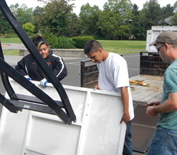
Emphasis on Work Experience

Slide 22
Work Readiness is Critical
Created College and Career Readiness Competency Matrix
5 Competency Areas
Proactive Communication and Collaboration
Reliability
Self-Management
Taking Initiative
Academic/Technical Skills
4 Levels of Readiness

Slide 23
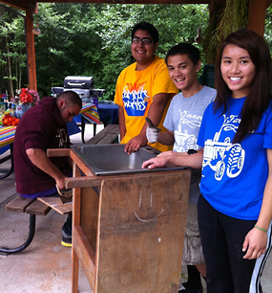
Youth Profile
Aged 16-21 years; limited capacity to serve 22-24 year olds
Low-income
Legal to work
Multnomah or Washington Counties
Experience barriers like juvenile justice involvement, homelessness, human services involvement, pregnant or parenting, etc.

Slide 24
Approach
Multi-year services
Culturally competent and/or population specialization
Industry or career pathway specialization
Career coaching
Orientation & enrollment

Slide 25
What’s Next
Sector Bridge Pathways:
Healthcare
IT/Software
Advanced Manufacturing
Construction

Slide 26
A Key Partner: YouthBuild
Exceptional out of school youth provider
Great alignment and leverage opportunity for WIBs to partner with local YouthBuild program
Long-term – 20 year relationship in Portland

Slide 27
Effective Outreach, Recruitment, and Engagement Strategies for OSY at Portland YouthBuilders

Slide 28
Portland YouthBuilders
Serving OSY for 20 years in DOL-funded YouthBuild Program
Eligible OSY are enrolled in WIA and YouthBuild
Ages 17-24
Multi-year program
High school completion and post secondary readiness
Construction and technology training for credentials
Leadership development
AmeriCorps/Community service
Structured long-term post-placement programming

Slide 29
Outreach and Recruitment
Cast a Wide Net
Maximize referral network
OSY help develop and execute strategies
Social media
Regularly scheduled admissions events
Careful Selection of Applicants
Cross-referral network with other OSY providers for best-fit system

Slide 30
Engagement Strategies
Immediate Connection to Future Success
For relevance and inspiration
Real world work/career experiences
Leadership and Community Service
Opportunities are integrated throughout all program components
Building affordable housing
Refurbishing computers and completing multi-media projects for non-profits, schools, and low-income community members
Builds participant confidence, civic responsibility, and attachment to program
Relationships are Key
With staff, peers, and mentors
Create community
Invitation
to Chat
How do you keep OSY engaged?

Slide 31
Engagement Strategies
High Standards Coupled with High Support
Reflect what is required for post-secondary and career success
Partnerships are Essential for Opportunities
Program consultation, employment, internships, career exposures, volunteers, referrals, funding, etc.
Accelerate Learning and Student Progress
Outside responsibilities may result in shorter program tenure than desired
Individualization and Flexibility
To accommodate individual goals and outside responsibilities

Slide 32
Engagement Strategies
Integrate Across Program Elements
Consistent messaging, targeted skills, and standards
Comprehensive Support
Barriers must be addressed for stabilization and progression
Prioritize Post-Placement Support
Resource and structure with the same care as other services

Slide 33
Recruiting and Serving Eligible OSY Participants
Thank You
Jill & Heather
Q A
&
In Portland

Slide 34
Recruiting and Serving Eligible OSY Participants
Andrea Robbins
Director, Career Services
Full Employment Council, Inc.
1740 Paseo, Kansas City, MO 64108
Office: 816-691-2255
arobins@feckc.org
www.feckc.org

Slide 35
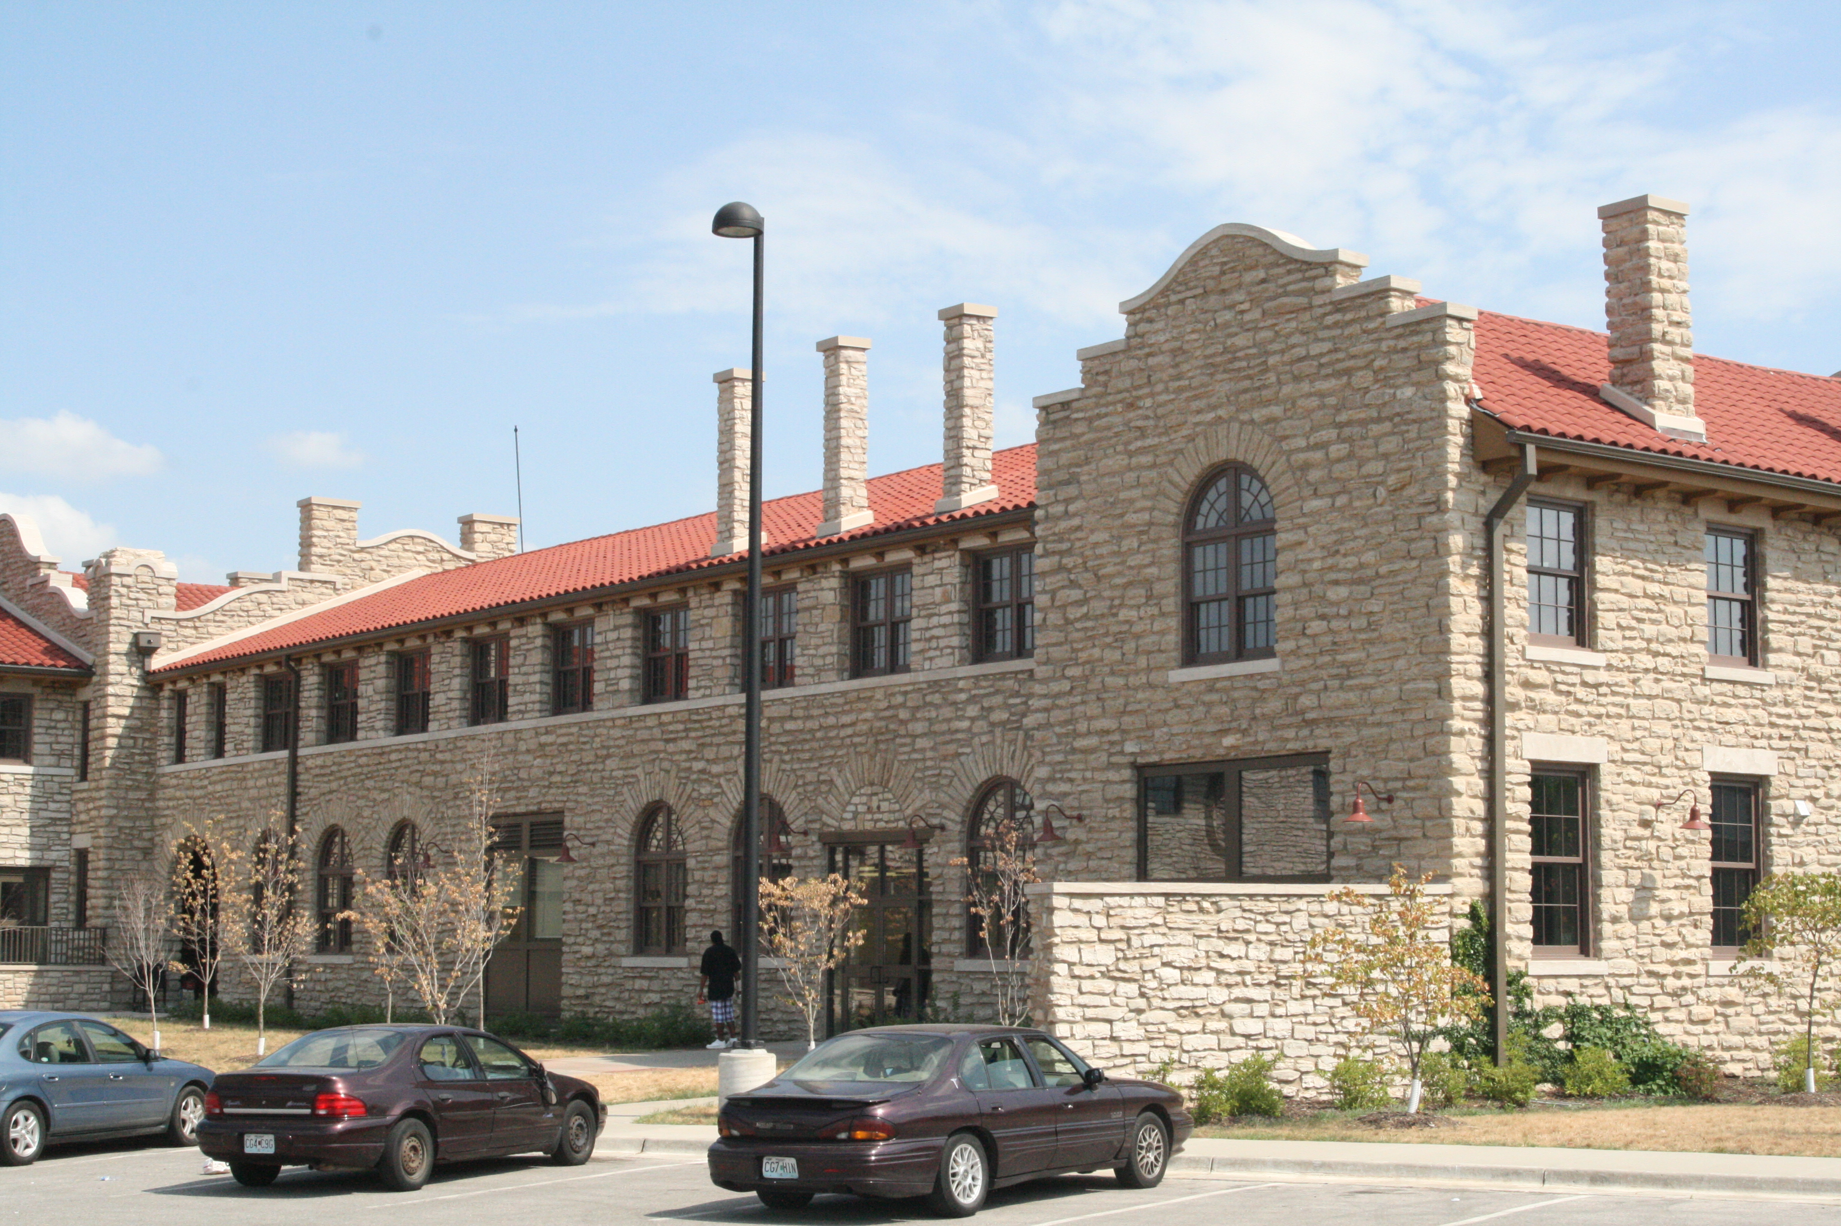
Full Employment Council, Inc. (FEC)
28 Years of Experience
One-Stop Operator and Fiscal Agent of the Missouri Career Centers for two Workforce Investment Board (WIB) Regions
Covering more than 2,700 square miles
Kansas City & Vicinity and Eastern Jackson County
Full Employment Council, Inc.
“Our Job is Your Career.”™
1740 Paseo Boulevard, Kansas City, MO 64108
816-471-2330

Slide 36
Youth Profile
WIA Youth Formula Grants serve 85% out of School Youth who are economically disadvantaged with at least 1 barrier to employment
Project RISE targets disconnected young adults who are unemployed and not attending school
62% not engaged with work or school in last two years or more
75% suspended or expelled from a formal school setting
63% homeless, living with a friend or relative
41% have children
83% function at or below the eighth grade level

Slide 37
Outreach and Recruitment
Street Recruitment
Staff person who is comfortable in the neighborhood
Has “street credibility”
Friend & Family Referral
Prescreened and “Vouched For Referral” from community agencies with whom we have an MOU
Electronic referral (e.g., email)
Commitment to provide feedback on client
Social media
Invitation
to Chat
How do you recruit OSY?

Slide 38
OSY Service Flow
4
5
6
3
Outreach and Recruitment
Orientation and Career Pathway Reinforcement
1
2
Admissions Committee Review
Is youth ready and committed? If 'yes,' then...
Career Exploration, Assessment, and Planning
Youth and Skill Development
Service Learning, Mentoring, Customer Service, Participant Council, Alumni Club
Legal Service, GED/Diploma, Classroom Training, Internship, Work Experience, OJT
Job Advocacy and Placement

Slide 39
Engagement & Retention Strategies
Immediate immersion in career planning
Career Pathways Reinforcement
Essential for screening and effective training and placement
Supportive Services
Employment opportunities
Go beyond what youth would normally have
In-demand occupations only
Livable wage
Tied to career pathways

Slide 40
Career Pathways Reinforcement
1-2 week intensive workshop series
Designed to engage any young adult interested in getting their life on track through education and/or employment
Provides career and educational assessment
Immediate engagement with a positive peer-group coupled with labor market information and specific career guidance
Addresses up front things that would hinder success

Slide 41
Supportive Services Menu
Similar budget for each participant
Prioritized according to the needs of the participant
Focused on a set of approved support services
Transportation
Legal Aid Assistance
Work and School related clothing
Training Related Supplies
Testing Fees
Utilities, etc.
All activities vouchered

Slide 42
Project Rise
12-Month Program
1-2 Week Career Pathway Reinforcement
Eligibility determination
Program compatibility
4-6 week Pre-Internship Phase
Job Readiness - Group Project
Academic Tutoring
Paid internship
Conditional on concurrent attendance in an educational activity
Transition to unsubsidized employment
At least 6 months of continued education post-internship
Case management for the full 12-months of the program
All cohort-based

Slide 43
Summer Jobs Program Training & Internship Program (T.I.P.)
Combining Classroom Training with Paid Internships
Classroom Training
Participants enrolled in Occupational Skill Training courses through area 2- or 4-year colleges designed provide exposure to in-demand occupations
Internships
Participants who successfully completed classroom training eligible to participate in a paid internship at a local business, in areas comparable with the training they received

Slide 44
HiSet & Occupational Skill Training
Combines HS equivalency and nationally-recognized credential issued by a college
Blends three distinct and separate education needs (adult basic education, occupational job skills and work experience) into one synchronous education program
Uses instructor-led, short term, on demand, flex place, flex time, non-semester based training
Provides basic skill development and occupational skill specific training for in-demand occupations, followed by employment related activity or training on the back end

Slide 45
Diverse Work Experience and Intensive Job Placement
Information Technology
Financial Services
Healthcare
Bioscience
Business Services
Customer Service
Advanced Manufacturing
Full Employment Council, Inc.
“Our Job is Your Career.”™
1740 Paseo Boulevard, Kansas City, MO 64108
816-471-2330

Slide 46
Recruiting and Serving Eligible OSY Participants
Thank You
Andrea
Q A
&
In Kansas City

Slide 47
Out-of-School Youth Resources
Department of Labor WIOA Resource Page
http://www.doleta.gov/WIOA/
Department of Education WIOA Resource Page
http://www2.ed.gov/about/offices/list/ovae/pi/AdultEd/wioa-reauthorization.html
TEGL 33-12: WIA Youth Program Guidance for PY 2013
http://wdr.doleta.gov/directives/attach/TEGL/TEGL_33_12_Acc.pdf
TEGL 13-09: Contracting Strategies that Facilitate Serving the Youth Most in Need
http://wdr.doleta.gov/directives/corr_doc.cfm?DOCN=2854
Workforce³one Youth Connections Community of Practice – Peer Resources
https://youth.workforce3one.org/page/resources

Slide 48
Out-of-School Youth Resources
Brandeis Enough Is Known For Action Conference Materials
http://cyc.brandeis.edu/Employ-educate-support-youth/EnoughisKnownforAction.html
Portland’s Career Connect Network Guide
http://www.worksystems.org/sites/default/files/Career%20Connect%20Network%20Providers_0.pdf
Whatever It Takes: How Twelve Communities are Reconnecting Out-of-School Youth
http://www.aypf.org/resources/whatever-it-takes-2006/
Focused Futures: Serving Out-of-School Youth
http://jfs.ohio.gov/owd/WorkforceProf/Youth/Docs/OutofSchoolYouth.pdf
Engaging Out-of-School Youth
http://www.schoolandmain.org/storage/smi-materials/engaging%20out%20of%20school%20youth1203.pdf

Slide 49
Out-of-School Youth Resources
NGA Policy Brief: State Policies to Reengage Dropouts
http://www.nga.org/files/live/sites/NGA/files/pdf/1107REENGAGEDROPOUTS.PDF
Building Roads to Success: Key Considerations for Communities and States Reconnecting Youth to Education
http://nyec.org/content/documents/Building%20Roads%20cover-FINAL.pdf
DoE Guide: Bringing Students Back to the Center: A Resource Guide for Implementing and Enhancing Re-Engagement Centers for Out-of-School Youth
http://www2.ed.gov/programs/dropout/re-engagement-guide121914.pdf
Building a Skilled and Educated Workforce: Exploring Multiple Pathways to Community College for Out-of-School Youth
https://www.workforce3one.org/command/view.aspx?look=5000723343405970074&mode=info&pparams=
Improving Services and Performance: Toolkit for Effective Front-Line Services to Youth
http://www.doleta.gov/youth_services/Toolkit-improve.cfm

Slide 50
What Else?! What Else?!
Two More Webinars in the Series
Work Based Learning March 25
Credentialing/Outcomes April 29

Slide 51
Enough is Known For Action: Preparing to Deliver Expanded Services to Out-of-School Youth
Q A
A Few More
Questions?
&

