Slide 1
From Exploration to Launch: Registered Apprenticeship Quick-Start Toolkit
Webinar Date: February 26, 2015
Presented by:
Office of Apprenticeship
U.S. Department of Labor
Employment and Training Administration

Slide 2
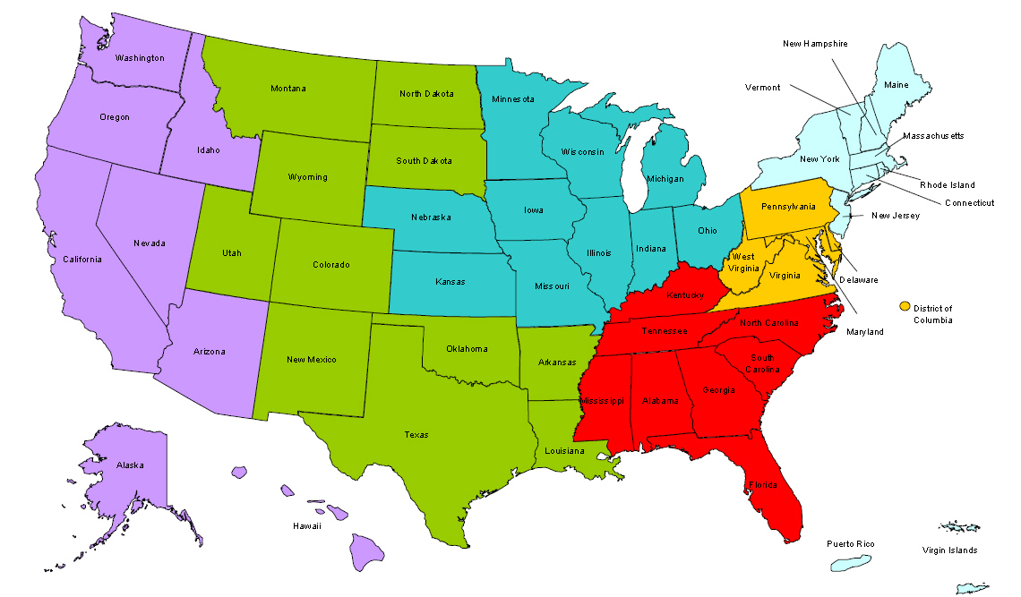
Where are you?
Enter your location in the Chat window – lower left of screen

Slide 3
Here’s what you can expect to get out of today’s webinar!
Moderator: Chad Aleshire
Program Analyst, Office of Apprenticeship
Employment and Training Administration
✓ Learn about a new tool that provides step-by-step actions to build Registered Apprenticeship programs
✓ Learn from practitioners how they built successful partnerships and launched new programs

Slide 4
Polling Question
What organization do you represent?
Business/Industry
State Workforce Agency or State Workforce Board
Local Workforce Agency or Local Workforce Board
American Job Center
Educational Institution
State Registered Apprenticeship
Other (please enter in the chat)

Slide 5
Speakers
John Ladd
Administrator, Office of Apprenticeship
Employment and Training Administration
Grace Waddell
Dean, Agape University
Agape Senior Care
Brad Neese
Director
Apprenticeship Carolina

Slide 6
Registered Apprenticeship
Quick-Start Toolkit
http://www.doleta.gov/oa/employers/apprenticeship_toolkit.pdf

Slide 7
The Registered Apprenticeship Quick-Start Tool Kit features five steps to go from “exploring” to “launching” an RA program.
Step-by-Step
“Action” Guide

Slide 8
Each “step” includes details on aspects of Registered Apprenticeship, links to other resources, and real-world examples.
Information
Resources
Inspiration

Slide 9
Step 1 focuses on Exploring Apprenticeship as a strategy to meet the need for skilled workers.
Apprenticeship is an employer-driven model, combining on-the-job learning with classroom instruction
The apprenticeship strategy can be customized to meet the specific workforce needs of every business
This is an “earn and learn” model – apprentices receive a paycheck from Day 1

Slide 10
Exploring Registered Apprenticeship as a strategy entails identifying an employer’s workforce challenges.
Difficulty in finding workers with the right skills?
Positions with high turnover?
Skilled workers retiring?
Helping workers keep pace with technology changes?
◻
❑


Apprenticeship can help overcome these challenges!

Slide 11
Discussion on Step 1

Slide 12
Step 2 focuses on Partnerships in Developing Registered Apprenticeship Programs and roles for potential partners.

Slide 13
Each type of partner can play an important role in a Registered Apprenticeship program.
Business Partners
Identify skills & knowledge apprentices must learn
Provide on-the-job training
Select experienced mentor for apprentices
Inventory existing training efforts
Workforce Intermediaries
Provide expertise for specific industry sector
May serve as a “sponsor,” administering program for employer
“Aggregate demand” across employers within an industry, that may not have capacity to develop their own program
Workforce intermediaries can be industry associations, joint labor-management organizations, community-based organization, etc.

Slide 14
Each type of partner can play an important role in a Registered Apprenticeship program.
Educational Institutions
Develop curriculum and deliver related instruction to apprentices
Can provide college credit for courses successfully completed
Public Workforce System
Recruit and screen candidates to be apprentices
Provide pre-apprenticeship/basic skills preparation
Provide tools, uniforms, equipment, books
Contribute funds for on-the-job training or related instruction
Apprenticeship System
Provide technical assistance and support
Connect businesses with training providers & partners
Guide sponsors through the registration process

Slide 15
Discussion on Step 2

Slide 16
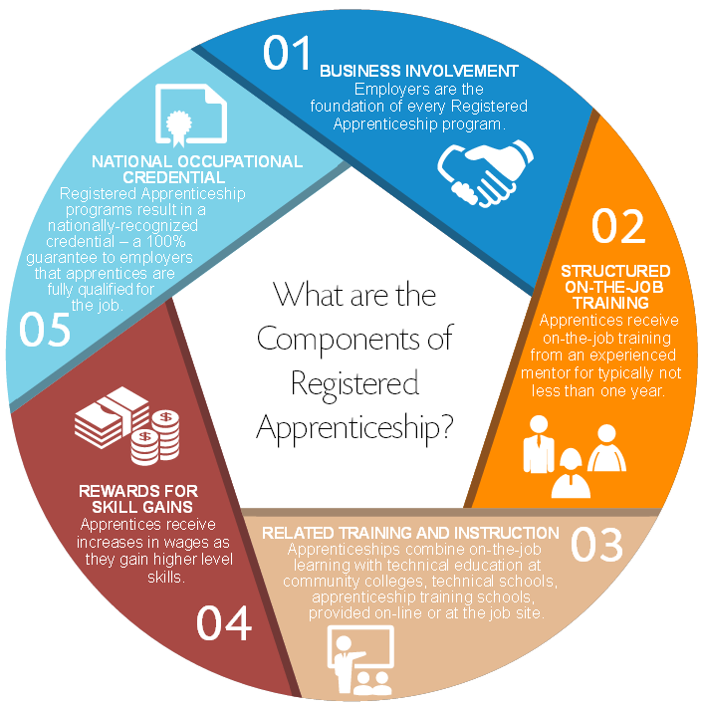
Step 3 focuses on Building the Core Components of your apprenticeship Program.
Business
Involvement
National
Occupational
Credential
Structured
On-the-job
Training
Rewards
for
Skill
Gains
Related Training
and Instruction

Slide 17
There are five core components to apprenticeship programs.
Business involvement
Employers are the foundation of every apprenticeship program
They must be involved in every step of designing the apprenticeship
Structured on-the-job training
Hands-on training with experienced mentor (usually one year or more)
Involves all necessary skills and knowledge for full proficiency on the job
Related training and instruction
Delivers technical, workforce and academic knowledge needed for the job
Education partners collaborate with business to develop curriculum to ensure success

Slide 18
There are five core components to apprenticeship programs.
Rewards for skill gains
Programs are designed to ensure apprentices master all necessary skills/ knowledge to be fully proficient in the occupation
Registered Apprenticeship graduates receive a nationally-recognized credential
National Occupational Credential
Progressive wage increases as skill benchmarks are met
Pay increases as skills/knowledge increase

Slide 19
Businesses already have many – or even all – of the core components in place.
For example, businesses already…
Provide on-the-job training to new employees.
Supplement on-the-job training with other educational opportunities.
Assign supervisors or mentors to support and train new employees.
Provide raises as employee’s advance and skills increase.
Registered Apprenticeship can be integrated into existing training and human resource strategies.

Slide 20
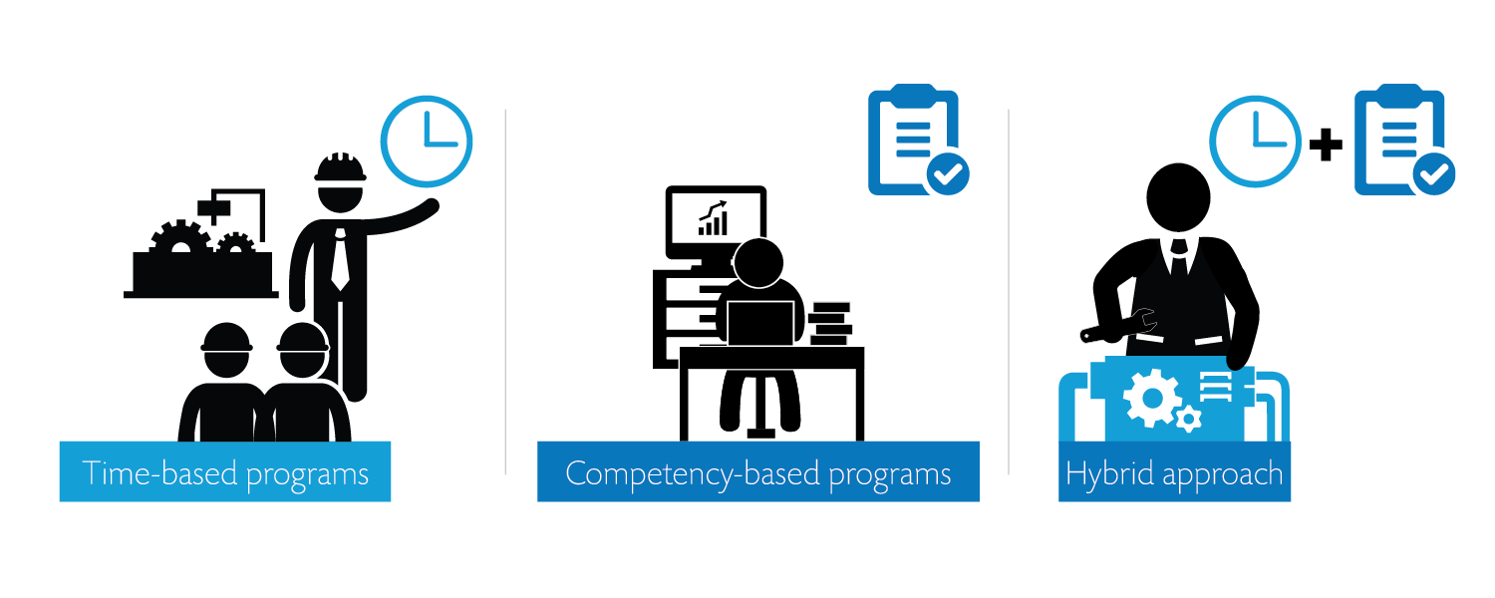
Step 3 also involves deciding which type of Apprenticeship program design to use.

Slide 21
Registered Apprenticeship also offers flexibility in the type of training model selected.
Traditional model
Apprentices receive on-the-job training and classroom instruction concurrently
“Front-loaded” model
Apprentices complete some classroom instruction BEFORE starting on the job.
“Segmented” model
Apprentices alternate between on-the-job training and classroom instruction
The employer chooses which model works best!

Slide 22
Pre-Apprenticeship activities can also be built into a Registered Apprenticeship model.
Pre-Apprenticeship
Individuals are accepted into a Registered Apprenticeship program
Essential basic skills are learned
Ensures direct entry into apprenticeship program and credit for learning already attained

Slide 23
Discussion on Step 3

Slide 24
Step 4 focuses on Registering your Program.
Register with your State Apprenticeship Agency
or
– if there is no state agency –
with the Federal Office of Apprenticeship

Slide 25
Join leading companies across the country…
…using Registered Apprenticeship as a proven solution to recruit, train, and retain highly skilled workers.

Slide 26
Why is it important to register an apprenticeship program?
Access to nationwide network of technical assistance & support – at no charge
A “seal of approval” that the program meets independent standards for quality and rigor
Potential for tax credits
Funding and other resources from federal programs, including the workforce system
Ensure apprentices receive national, industry-recognized credential

Slide 27
Discussion on Step 4

Slide 28
Step 5 focuses on Launching a new Registered Apprenticeship program.
Steps to Success
Conduct marketing and outreach
Will help you attract high-quality apprentices and involve additional partners
Keep in contact with your state apprenticeship office
Your apprenticeship representatives are there to help you!

Slide 29
Step 5 focuses on Launching a new Registered Apprenticeship program.
Steps to Success
Recruit candidates
Screen for minimum skills required and hire your apprentices
Begin training apprentices
Track your apprentices’ progress as they advance through the program and increase skills
Assess and continuously improve program
Evaluate the program’s performance and retool the model as needed to meet changing workforce needs
Share your success!
Share your best practices and tell your story.

Slide 30
Discussion on Step 5

Slide 31
Please enter your questions in the Chat Room!

Slide 32
Resources
Building Apprenticeship Programs:
A Quick-Start Toolkit
http://www.doleta.gov/oa/employers/apprenticeship_toolkit.pdf
U.S. Department of Labor – Apprenticeship Program Website
http://www.doleta.gov/oa/
21st Century Apprenticeship Community of Practice
https://21stcenturyapprenticeship.workforce3one.org
Federal Resources Playbook for Registered Apprenticeship
http://www.doleta.gov/oa/federalresources/playbook.pdf
Agape Senior Care – Video on Youth Apprenticeship
http://www.apprenticeshipcarolina.com/testimonials/agape-senior- intro-to-youth-apprenticeship-in-healthcare.html

Slide 33
Speakers’ Contact Information
Stephen Tucker
John Ladd
Title: Administrator, Office of Apprenticeship
Organization: Employment and Training Administration
Email: OA.Administrator@dol.gov
Grace Waddell
Title: Dean, Agape University
Organization: Agape Senior Care
Email: GWaddell@agapesenior.com
Brad Neese
Title: Director
Organization: Apprenticeship Carolina
Email: Neese@sctechsystem.edu Ro

Slide 34
Thank You!
Find resources for workforce system success at:
www.workforce3one.org

