Slide 1
Engaging Employers for Opportunity Youth
Webinar Date: January 14, 2015
Presented by: Office of Workforce Investment, Division of Youth Services
U.S. Department of Labor
Employment and Training Administration

Slide 2
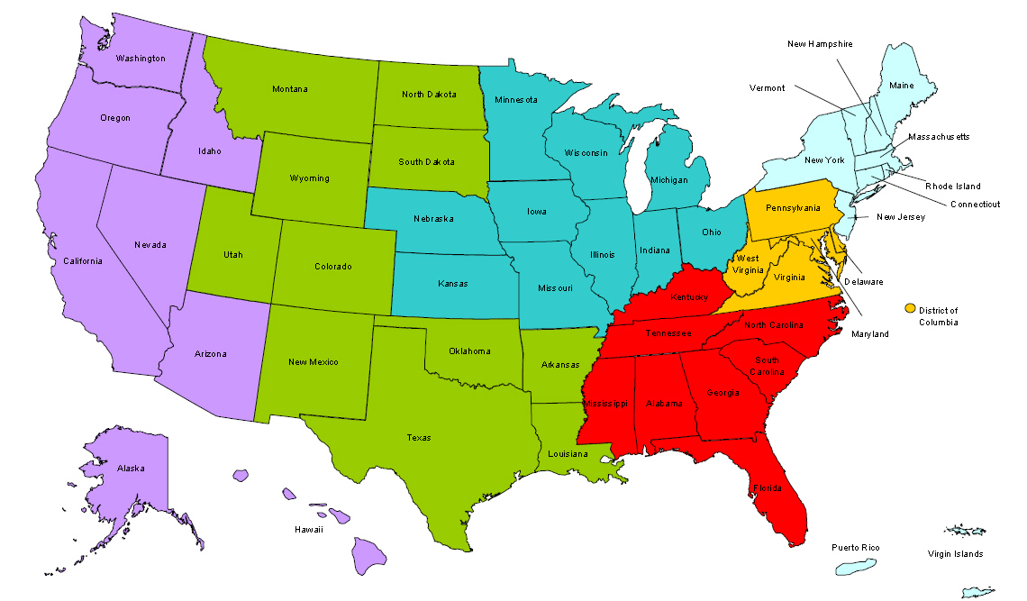
Where are you?
Enter your location in the Chat window – lower left of screen

Slide 3
Moderator
Moderator: Maisha Meminger
Organization: Office of Workforce Investment

Slide 4
Here’s what you can expect to get out of this webinar!
An understanding of the importance of employer engagement to serve out of school youth (OSY) and current efforts underway.
An introduction to Grads of Life, a new campaign aimed at employers.
Tools youth providers can use to engage employers to meet employment-related program goals.

Slide 5
Agenda
Our collective efforts to advance employer demand
Grads of Life campaign history and overview
Maximizing the implementation of WIOA - a unique opportunity to elevate demand-driven solutions
Leading by example: The Administration’s role
Partnership opportunities

Slide 6
Major Changes to WIOA

Slide 7
Changes to Youth Eligibility
Out-of-School Youth
To be eligible youth must be:
Aged 16 to 24
Meet one or more additional conditions

Slide 8
Changes to Youth Eligibility
Out-of-School Youth – Additional Conditions
School dropout
Within the age of compulsory school attendance, but has not attended school for at least the most recent complete school year calendar quarter
Recipient of a secondary school diploma or its recognized equivalent who is low-income and basic skills deficient or an English language learner
Subject to the juvenile or adult justice system
A homeless individual defined in sec. 41403(6), Violence Against Women Act (42 U.S.C. 14043e–2(6))), a homeless child or youth, a runaway, in foster care or has aged out of the foster care system, a child eligible for assistance under section 477, Social Security Act (42 U.S.C. 677), or in an out-of-home placement
Pregnant or parenting
An individual with a disability
Low-income individual who requires additional assistance to enter or complete an educational program or to secure or hold employment

Slide 9
Changes to Youth Eligibility
In-School Youth
To be eligible youth must be:
Aged 14 to 21
Low-income*
And one or more additional conditions
* Youth receiving or eligible to receive a free or reduced price school lunch are considered
“low income” under WIOA

Slide 10
Changes to Youth Eligibility
In-School Youth – Additional Conditions
Basic skills deficient
English language learner
An offender
Homeless, a runaway, in foster care or has aged out of the foster care system
Pregnant or parenting
Disabled
Requires additional assistance to enter or complete an educational program or to secure or hold employment

Slide 11
New Youth Program Elements
Five New Elements (total of 14 program elements)
Financial literacy
Entrepreneurial skills training
Services that provide labor market and employment information in the local area
Activities that help youth transition to postsecondary education and training
Education offered concurrently with and in the same context as workforce preparation activities and training for a specific occupation or occupational cluster

Slide 12
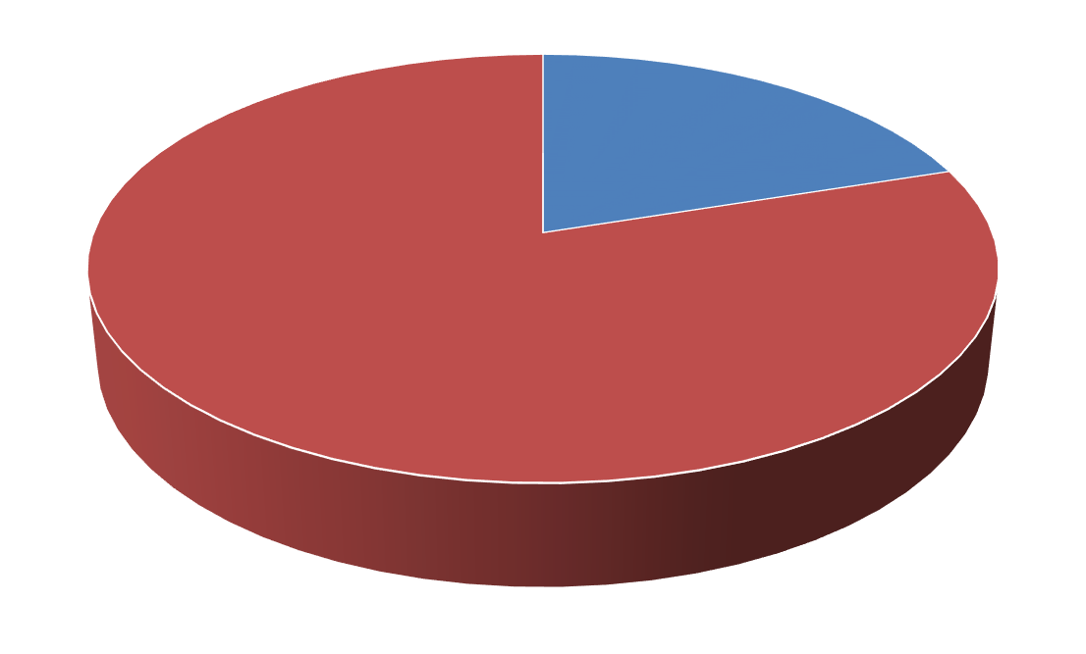
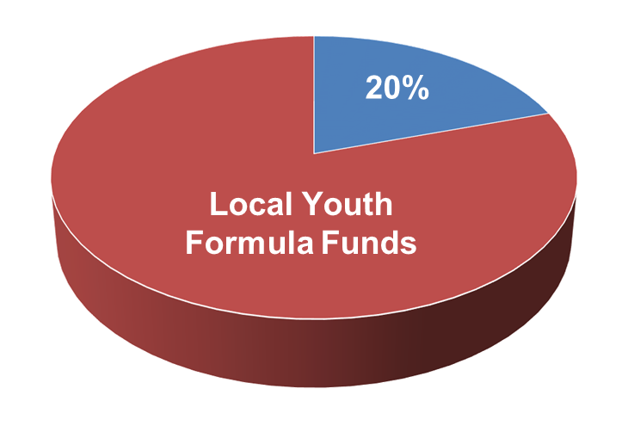
Emphasis on Work-based Learning
Funding Work Experiences
At least 20% of local Youth formula funds must be used for work activities such as:
Summer jobs
Pre-apprenticeship
On-the-job training
Internships
20%
Local Youth Formula Funds

Slide 13
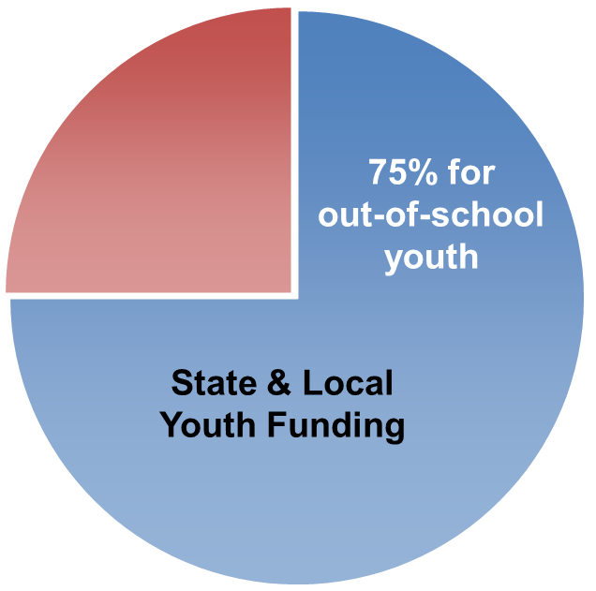
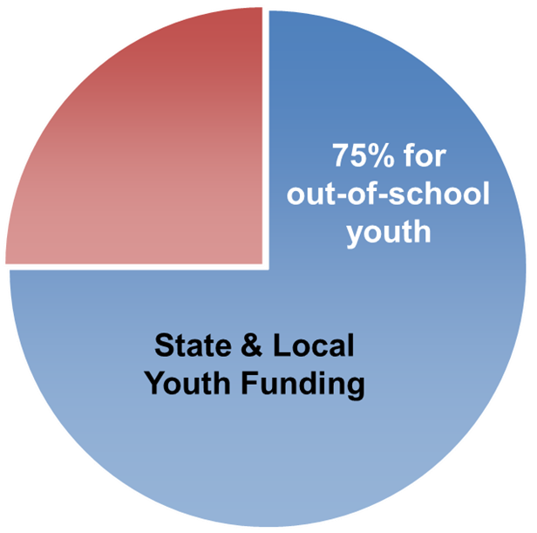
Other Key Provisions
WIOA requires 75% of state and local Youth funding be used for out-of-school youth.
50% exception for states that receive a minimum allotment.
Under WIOA, Youth Councils are no longer required; however, Standing Youth Committees are encouraged.

Slide 14
Presenter
Presenter: Elyse Rosenblum
Title: Executive Director
Organization: Employment Pathways Project

Slide 15
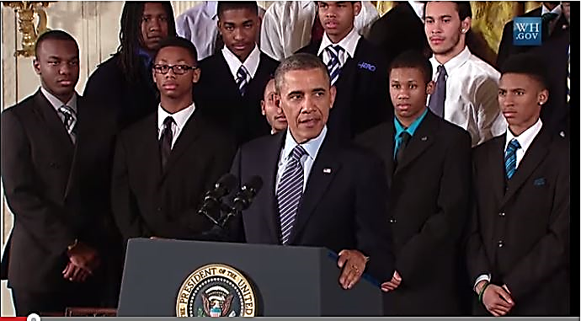
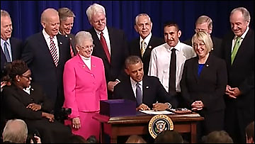
Our Collective Efforts to Advance Employer Demand

Slide 16
Our Collective Efforts to Advance Employer Demand
EMPLOYMENT PATHWAYS
6 MILLION
OPPORTUNITY YOUTH
4 MILLION
OPEN JOB VACANCIES
Employment pathways such as mentoring, internships, school-to-work training, and innovative hiring practices provide skills for young adults and a pipeline of talent for employers.

Slide 17
Campaign History and Partners

Slide 18
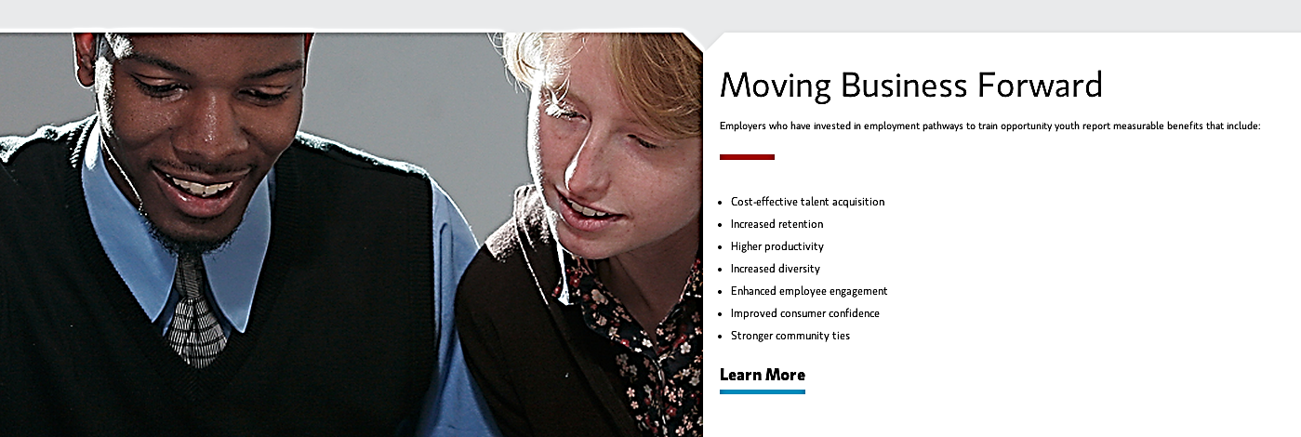
Grads of Life Campaign Overview

Slide 19
The “What and Why” of the Campaign

Slide 20
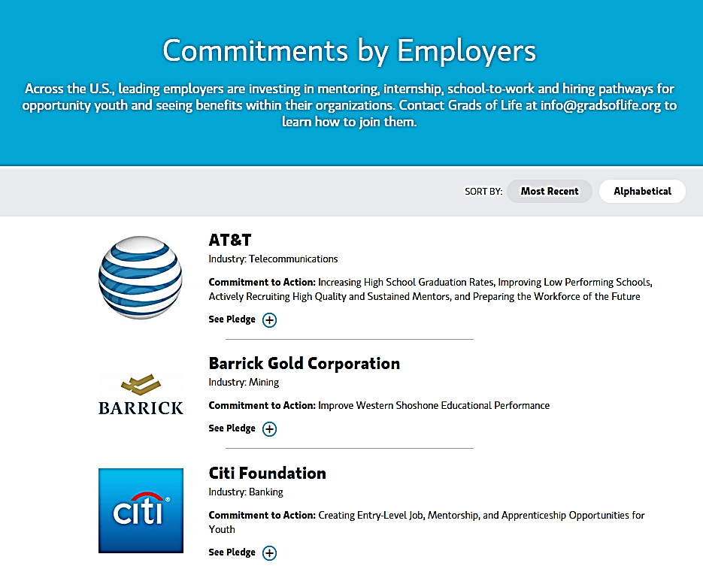
Commitments

Slide 21
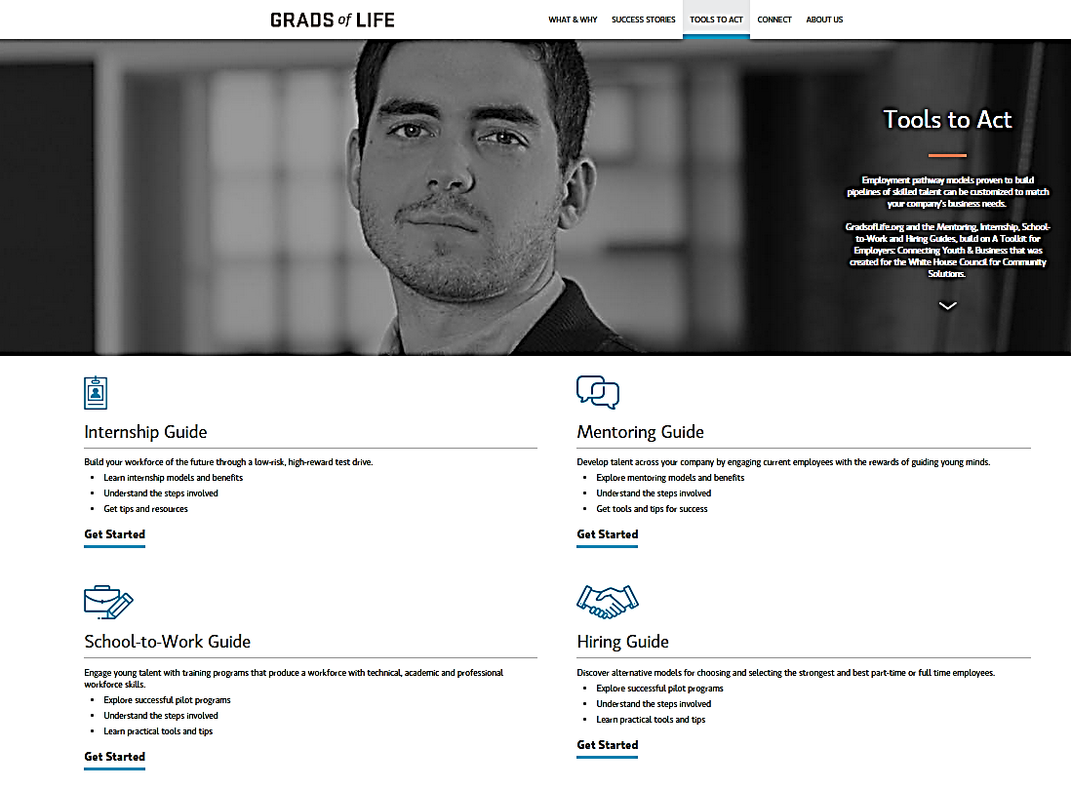
Tools to Act

Slide 22
Success Stories

Slide 23
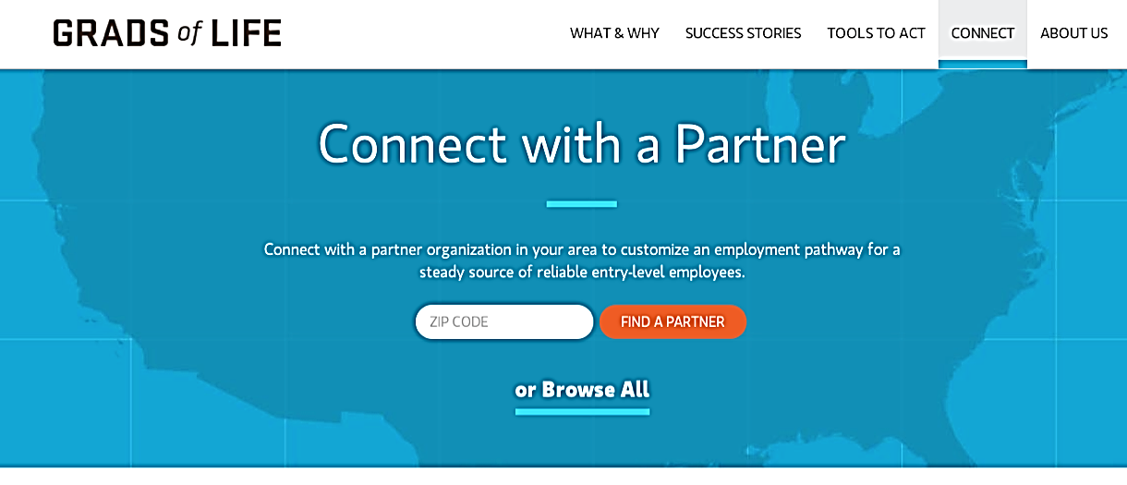
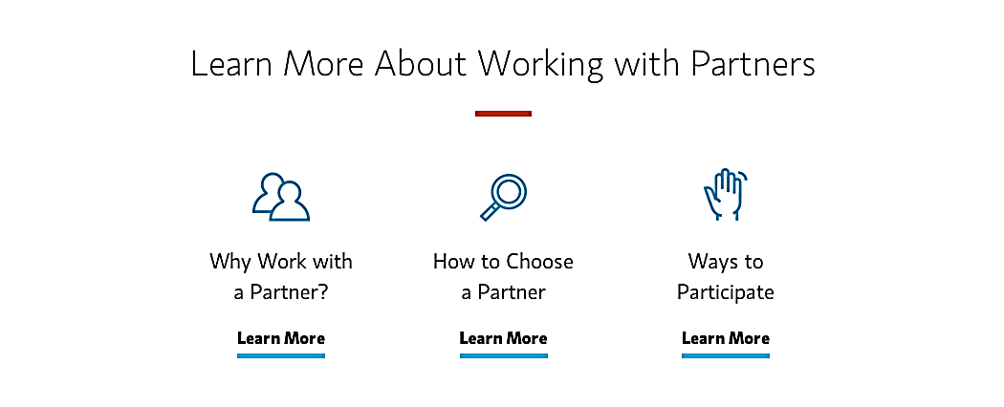
Partner Directory

Slide 24
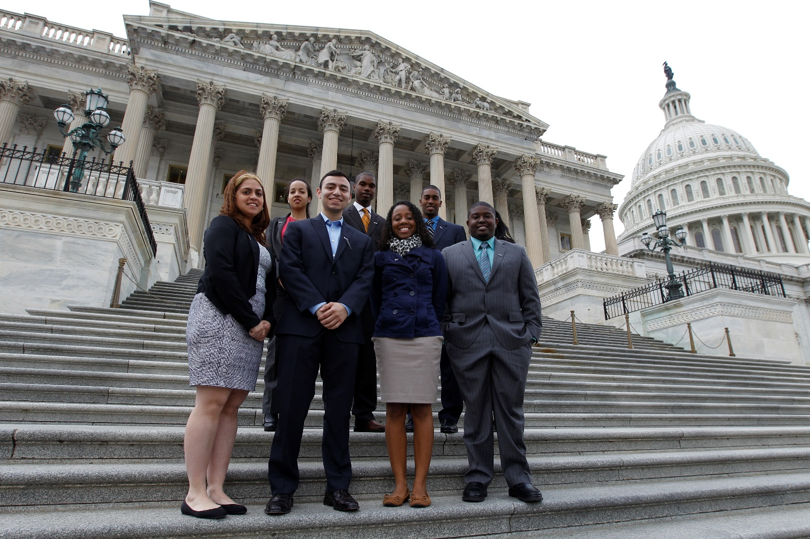
The implementation of WIOA is a unique opportunity to elevate demand-driven solutions

Slide 25
We can partner together for our young adults
Send in Success Stories with business partners/champions.
Get in the Partner Directory and share with other youth programs.
Ensure your youth council/committee and other key stakeholders are aware of the Grads of Life campaign and are able to use it in conversations.
If you are convening employers – share platform and PSA with them. We can help with this.

Slide 26
Resources
Halve the Gap by 2030
http://ssrc-static.s3.amazonaws.com/moa/MOA-Halve-the-Gap-ALL-10.25.13.pdf
U.S. Bureau of Labor Statistic’s Job Openings and Labor Turnover Survey (JOLTS)
http://www.bls.gov/jlt/

Slide 27
Please enter your questions in the Chat Room!

Slide 28
Speakers’ Contact Information
Speaker: Elyse Rosenblum
Title: Executive Director
Organization: Employment Pathways Project
Email: elyse.rosenblum@gmail.com
Telephone: (617) 417-0868
Speaker: Jillian Moskovitz*
Title: Influence Specialist
Organization: Year Up
Email: jmoskovitz@yearup.org
Telephone: (617) 542-1533 ext. 1060
*for Success Story and Partner Directory inquiries.

Slide 29
Thank You!
Find resources for workforce system success at:
www.workforce3one.org

