Slide 1
January 20, 2015
3:30 – 4:30 p.m. EST
The BILT Model: Meaningful Employer Engagement to Secure Jobs for Graduates

Slide 2
ABOUT TLN
U.S. Department of Labor
(National)
Jobs for the Future
CalState/Merlot
Maher & Maher and AACC
The TAACCCT Learning Network is led by Jobs for the Future and supported by the U.S. DOL.
The TLN expands on the technical assistance that is currently provided by Creative Commons, CAST, and CalState/Merlot and adds new services and support provided by JFF with its partners Maher & Maher and the American Association of Community College, and the National Science Foundation advanced Technological Education Centers.
Other Providers of TA to TAACCCT Grantees:
Creative Commons
CAST
NSF/ATE Centers

Slide 3
AGENDA
Purpose: Learn about a unique employer engagement model that goes beyond the annual curriculum review.
Welcome & Introduction
Employer Engagement Overview
Business & Industry Leadership Team (BILT) Model
The Business Perspective
The Community College Perspective
Q &A

Slide 4
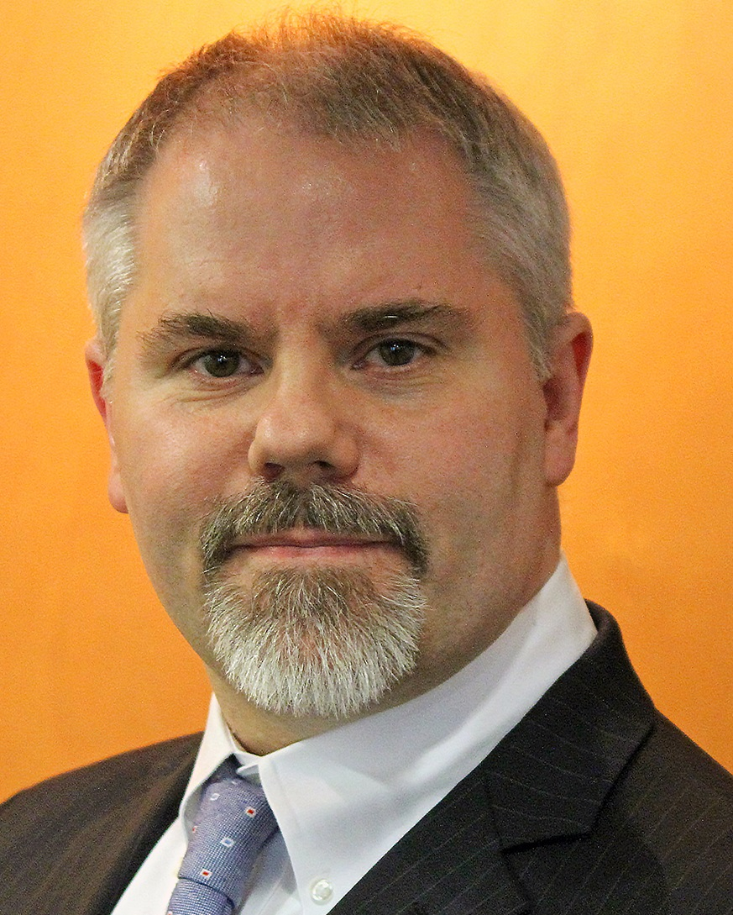
EMPLOYER ENGAGEMENT
Speaker: John Colborn – Director, Skills for America’s Future, Aspen Institute

Slide 5
Percent of employers having difficulty finding the skills they need (various surveys 2013-14)

Slide 6
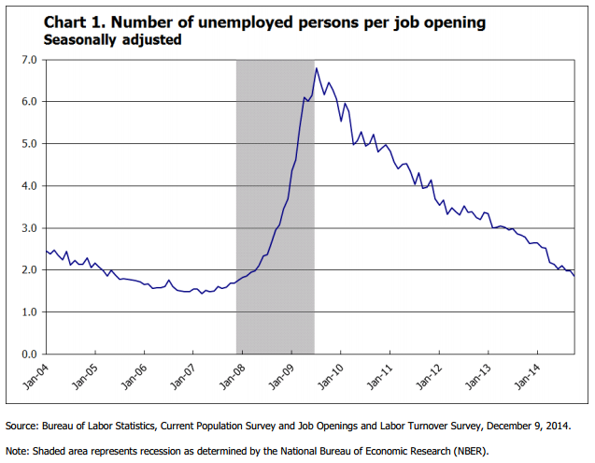
Business cycle impact: A war for talent

Slide 7
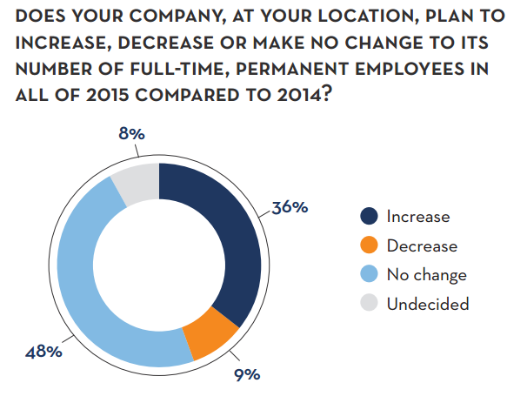
Career Builder 2015 Hiring Forecast
http://careerbuildercommunications.com/pdf/careerbuilder-q1-2015-forecast.pdf

Slide 8
Education/business mismatch
96 percent of college and university chief academic officers said they are extremely or somewhat confident in their institution's ability to prepare students for success in the workforce
just 11 percent of business leaders strongly agree today's college graduates have the skills and competencies that their business needs.
John M. Eger, “Business and Education Executives Just Don't See Eye to Eye”, Huffington Post, 04/12/2014

Slide 9
Ways employers connect & support community colleges
Education and Training Support
Contract for training for incumbent workers
Participation in curriculum advisory committees; participation in skills assessment/needs processes
Participation in student selection or program qualification-setting processes
Guest instruction
Contest/capstone project judging
Donation/loans of materials or equipment; advising on equipment purchases
Organization Leadership and Development
Participation and leadership in program planning and development activities
Taking leadership roles within college governance
Support for policy advocacy and stakeholder outreach efforts
Supporting processes for assessing student, firm, and industry impact for continuous improvement
Financial Support
Labor Market Information/Connections
Employment forecasting
Advising on career pathways
Support for outreach to other employers
Work Experience and Hiring
Workplace visits for students
Internships, summer jobs, co-ops, apprenticeship or other work experience opportunities
Hiring graduates
Recognizing community college credentials in hiring and promotion
Student Support
Participation in career fairs
Participation in mock interviews
Provision of career counseling
Supporting or assisting with employment retention services for student placements
Scholarship support
Faculty Support
Support for adjunct instruction
Faculty development activities, including work experiences or externships

Slide 10

Polling question
Q. How many in audience have employer partners who are involved in any of the following ways? (select all that apply)
Employer as faculty
Equipment donation
Curriculum development
Internships
Guaranteed interviews for graduates
Other? ___________________

Slide 11
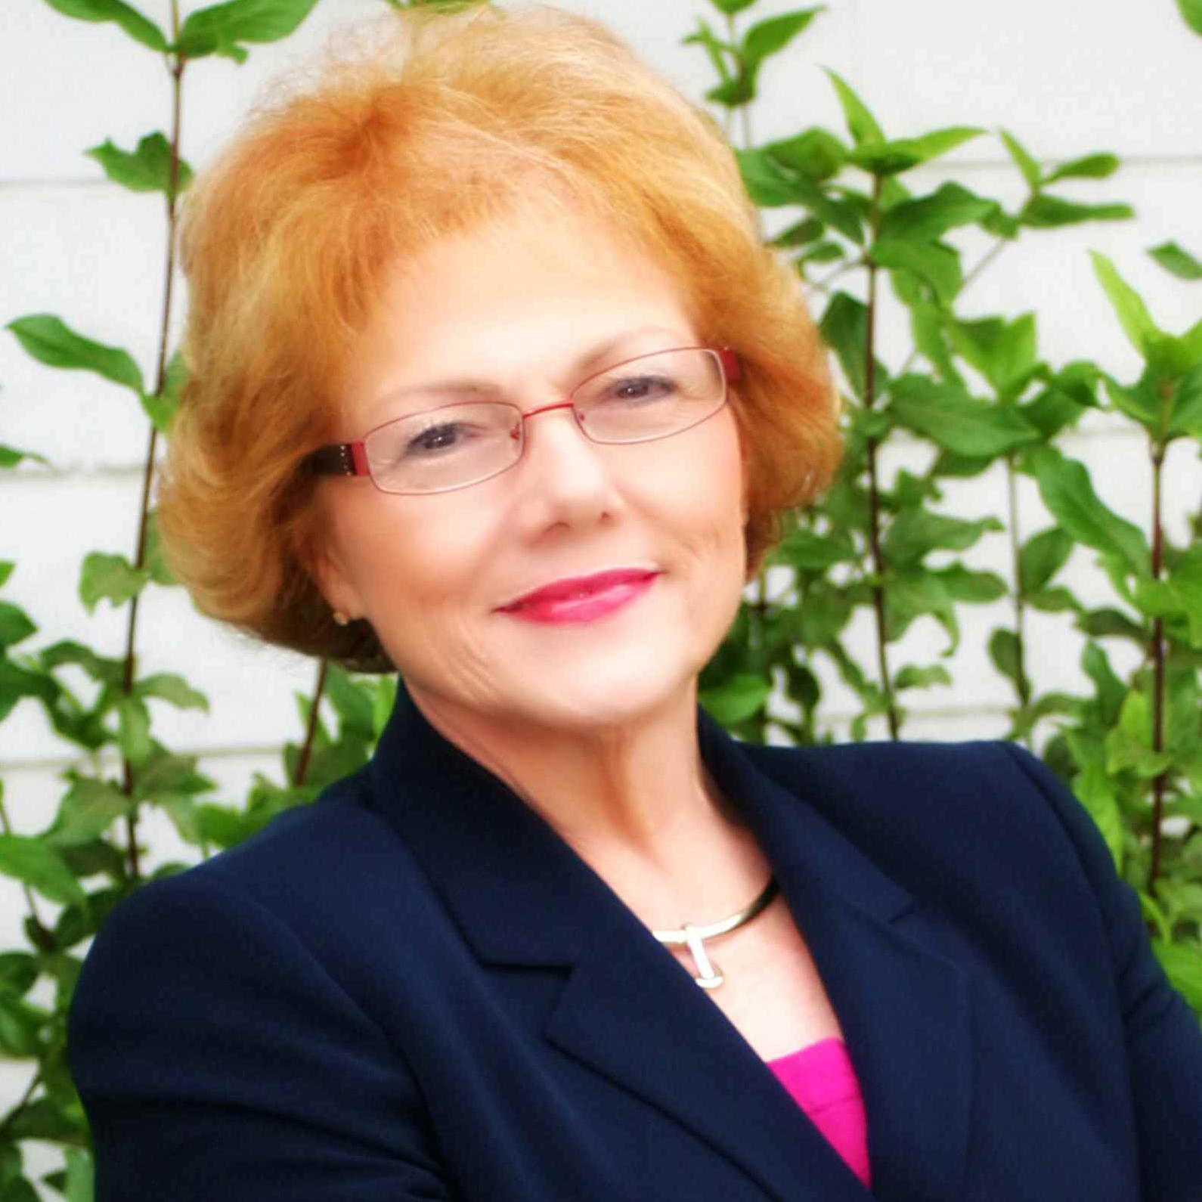

Business & Industry Leadership Team (BILT)
Speaker: Ann Beheler, Ph. D. – Executive Director, NISGTC, a National TAACCCT IT consortium (Round 1)
Principal Investigator, NSF ATE National Convergence Technology Center

Slide 12


BUSINESS & INDUSTRY LEADERSHIP TEAM
(BILT): SETTING THE CONTEXT
Developed by National Convergence Technology Center National Science Foundation (NSF) Advanced
Technological Education (ATE) Center
  Led by Collin College, Frisco, TX
  2004 forward
  Consortium with 40+ college and university partners
  Primarily in the area of networking infrastructure/mobility/data communications
  Developed to address the downturn in IT in
  the early 2000’s
  Designed with lock-step cooperation with
  regional and now national business to ensure employment for graduates

Slide 13

BUSINESS & INDUSTRY LEADERSHIP TEAM TRULY LEADS
BILT Processes developed under the NSF grant spread throughout the National Information Security and Geospatial Technologies DOL TAACCCT consortium (Round 1)
Four IT specialties:
  Programming/Mobile App Development
  Networking/Data Communications
  Cyber security
  Geospatial Technologies
Approach with businesses applies to creating/maintaining/reinvigorating any technology program

Slide 14
THE TYPICAL BUSINESS ADVISORY COUNCIL
Meets 1 or 2 times per year, sometimes the only time the reps are on campus
Mixed level of knowledge in membership
Advises regarding a program, sometimes just reviewing rather than leading
BAC members often find their time split between colleges because each college has its own council

Slide 15
TYPICAL RESULTS FOR BUSINESSES
May be more of a “rubber stamp” relationship
May or may not be truly engaged
May or may not be people at the right level to really help with your program
May result in programs that produce graduates that are not tightly aligned with business need

Slide 16
SUGGESTED ENGAGED BILT MODEL
Business and Industry Leadership Team (BILT)
Regional Council (ours is both national and local) advising multiple colleges
Meets quarterly, not 1-2 times per year
Right people on the council
  High-level technical executives
  First line managers
  Technicians
  HR representatives as long as they are not the sole reps for a company

Slide 17
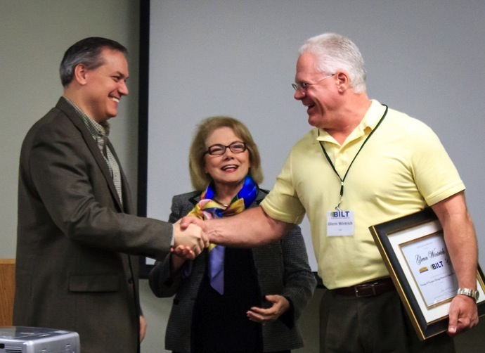
MORE THAN AN ADVISORY COUNCIL
Businesses LEAD the work and are part of the leadership team
Appropriate name is Business & Industry Leadership Team
(BILT) – Leadership, not Advisory

Slide 18
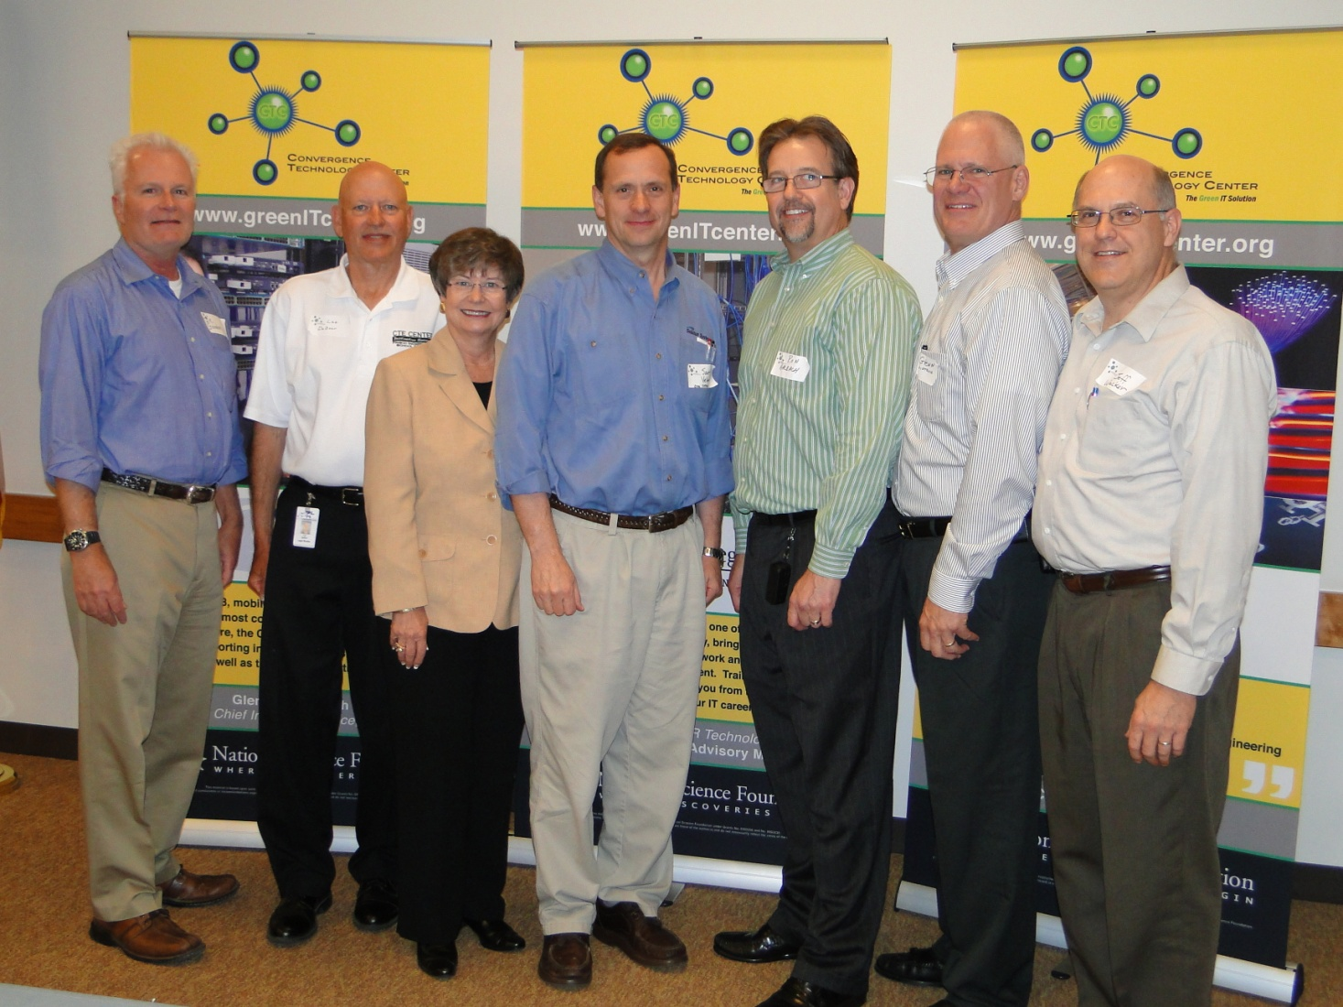
BASIC MODEL FOR BILT MEETINGS
Meets 4 x per year, 1 face to face, 3 x via webinar
Less than quarterly can mean “out of sight, out of mind”

Slide 19
ONE FACE-TO-FACE MEETING ANNUALLY
Curriculum aligned based on solid business-driven process originated in the U. S. Air Force
  Modified DACUM to identify Knowledge, Skills, and Abilities needed from graduates (6 hr. process)
  Faculty determine how to address KSAs through curriculum
  Requirements updated annually
  Will be explained in later webinar

Slide 20
THREE VIRTUAL MEETINGS ANNUALLY
Trends identified to get ahead of curricular changes
Informal forecast of future employee need
Program review (certificates/degrees)
Review/approval of major grant activities/progress
Other topics as appropriate

Slide 21
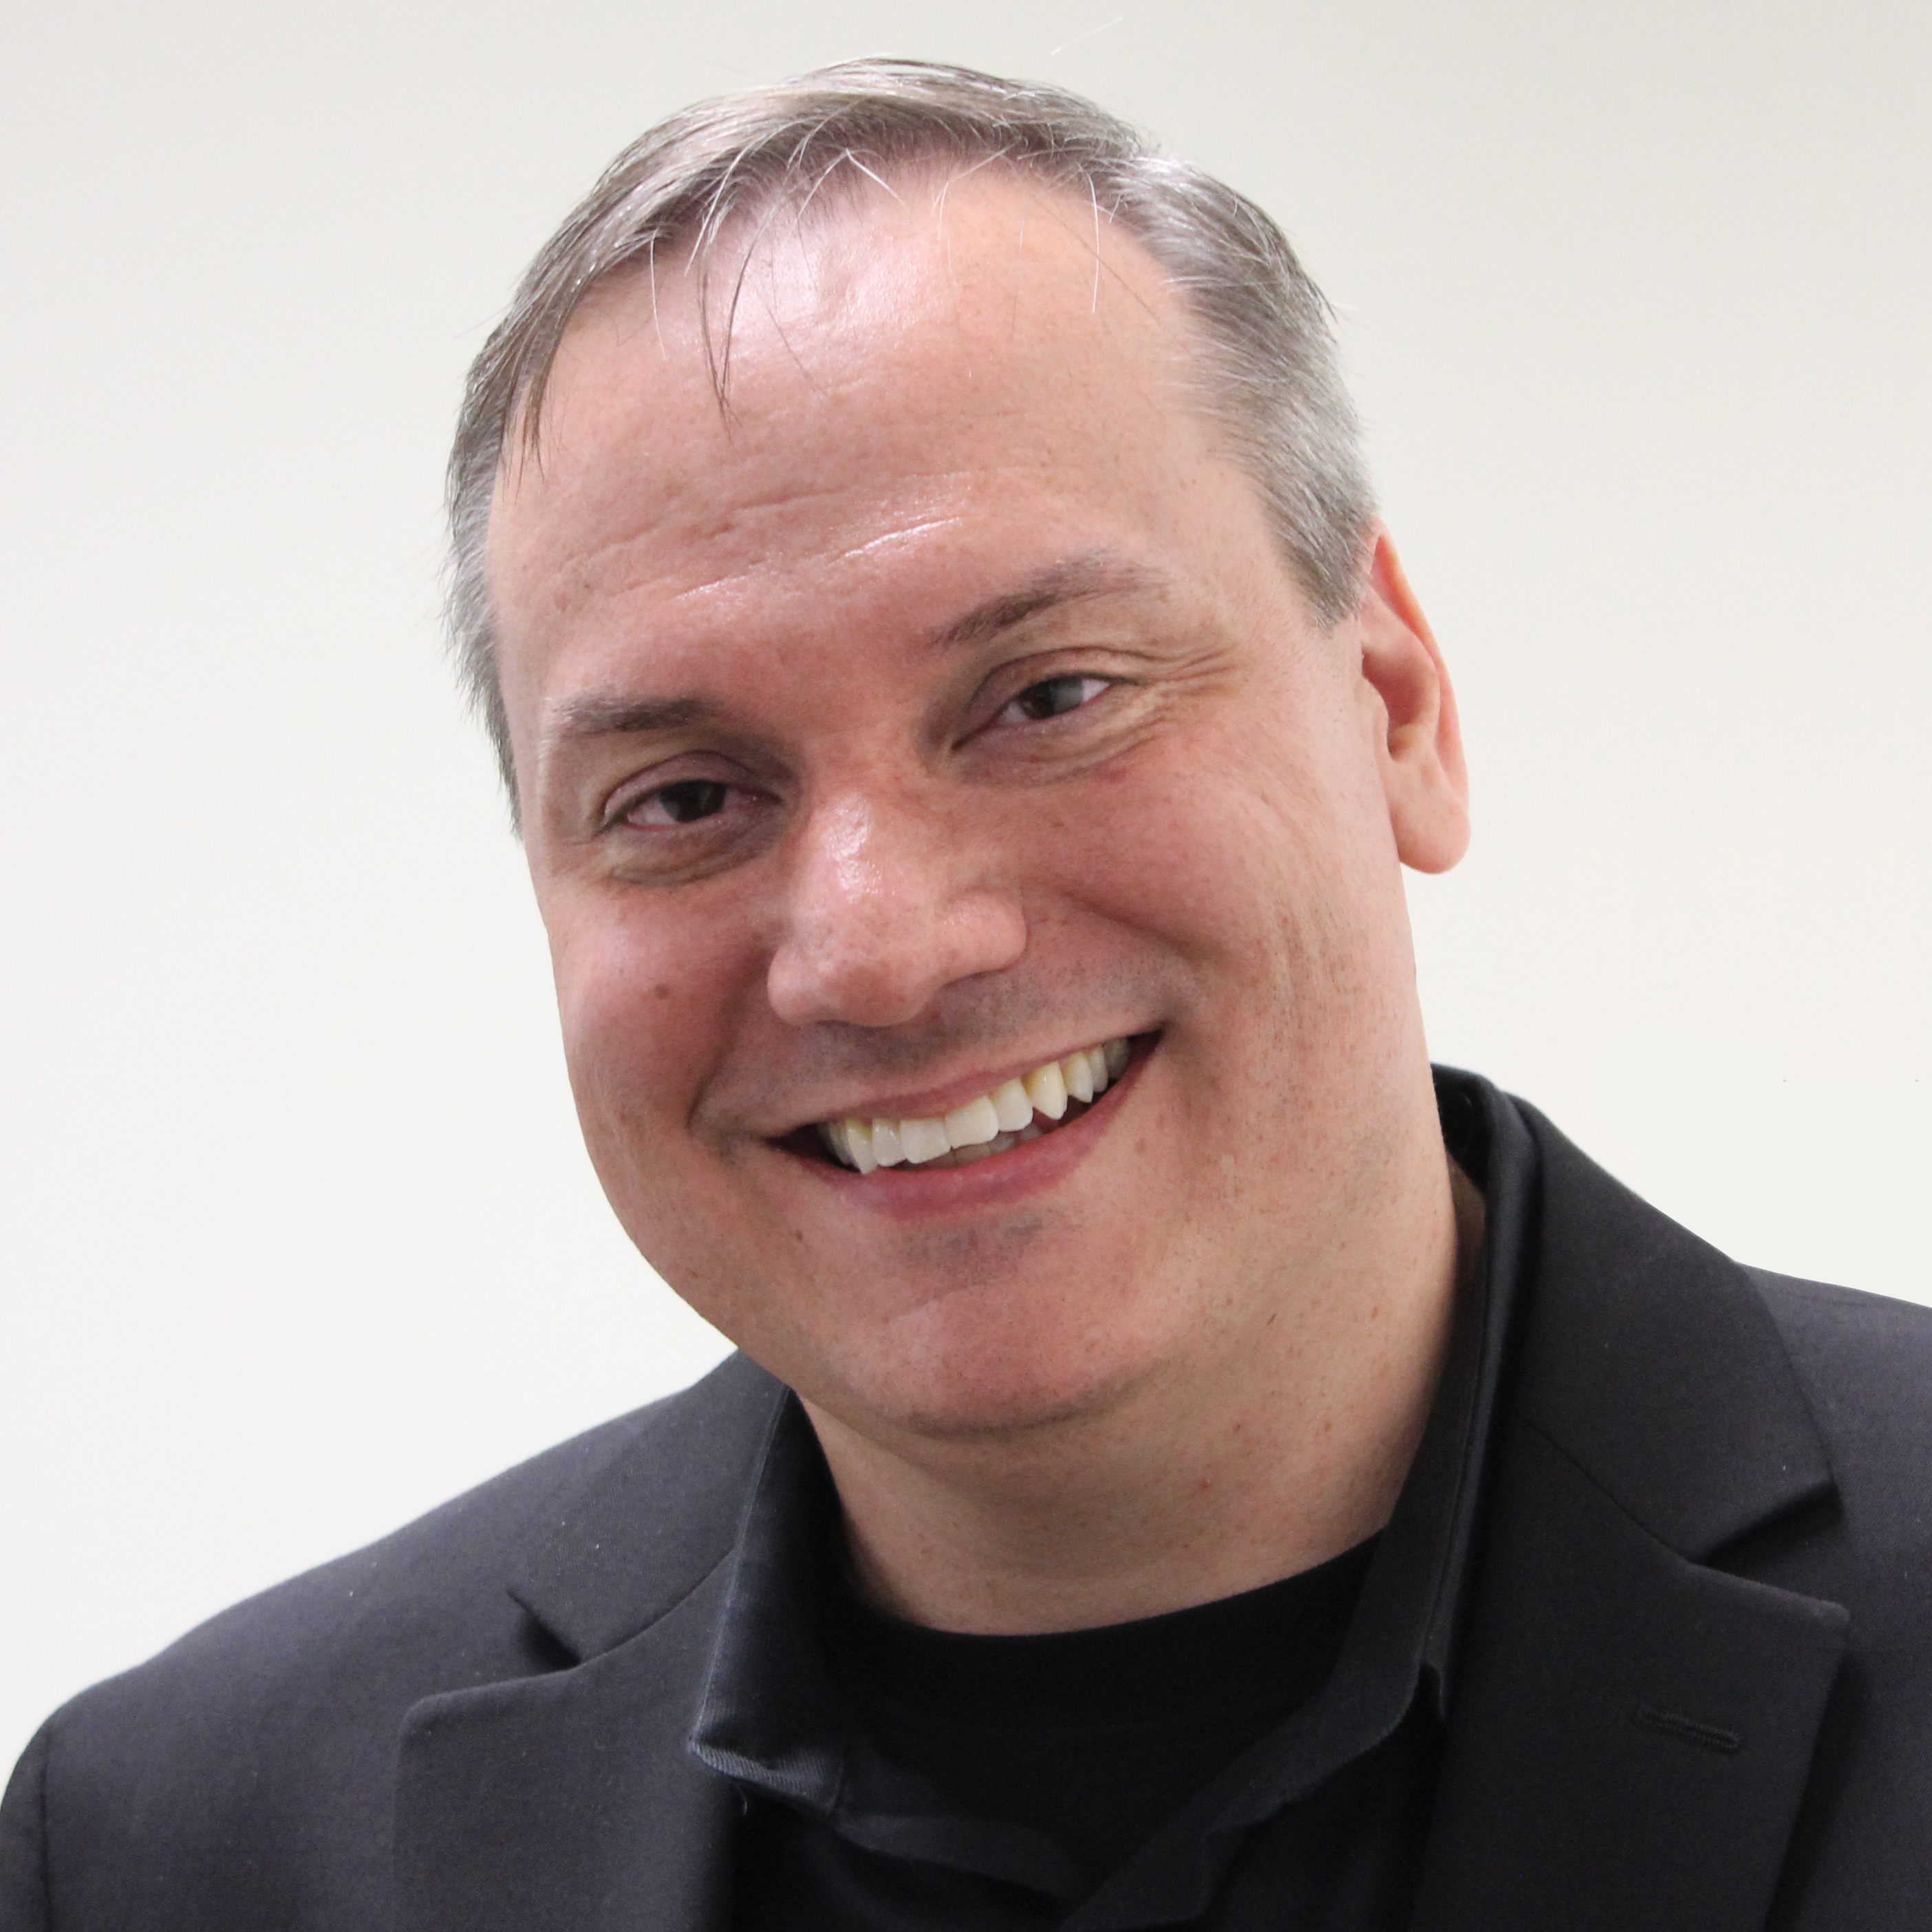
PRESENTER
Speaker: Matt Glover– Senior Director, of Global Information Technology, Harman International
Chair of the National BILT for Networking and Data Communication for NISGTC/CTC

Slide 22


THE BILT FROM THE CHAIRMAN’S PERSPECTIVE
ADVISORY
BUSINESS LED
Differentiators between a business advisory council vs. leadership team
Industry Advised
Suggested KSA
Business is suggesting enhancements to curriculum
Business is not vested in long-term success of programs
Ignored advice erodes business commitment
Industry Led
Required KSA
Curriculum must be recognized by the BILT
Business has “skin-in-the-game”
Business has the opportunity to reduce OJT (On-the-Job-Training)
Business has the ability to “Give Back” to the community in a multi-generational life changing way

Slide 23


SERVING ON BILT – DRIVING REAL VALUE
We are in the business of employing the future of America.
STUDENT
EMPLOYEE
BILT - What is in it for me?
Delivering relevant, industry sought after skills
Students more prepared to enter the workforce
Early business engagement exposes students with business perspective & taxonomy (Mentoring, internships, externships and business graded capstone courses)
Entry-level employees with “hit-the-ground-running” skills
Ability to tangibly give back to the community
Ability to tap eager talent in transitioning to the workforce
Time value realized and appreciated
PROFESSOR
BUSINESS LEADER
“If opportunity doesn’t knock, build a door.” ~ Milton Berle

Slide 24
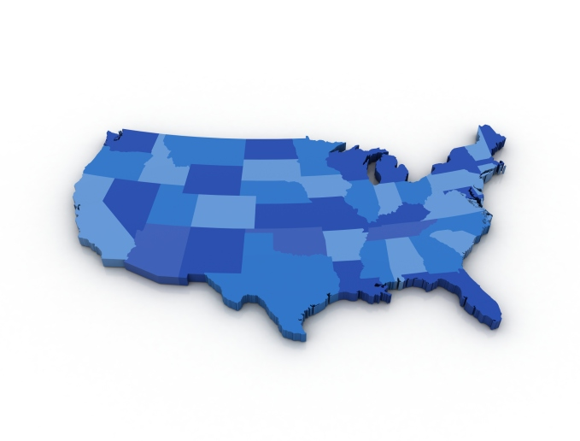

NATIONAL BILT SETS STAGE FOR CONSORTIUM
National BILT – Laying the foundation
Guide Knowledge, Skills, and Abilities (KSAs) for mapping curriculum
Maps KSAs based on Industry and National needs
Members participate virtually & annually in person
  Mentoring students / Participating in Capstone courses
  Leading virtual internships / externships
  Speaking at conferences
Provides a framework for New Regional BILTs to leverage
Regional BILT – Crafting education to critical markets
Focused on regional industry needs (similar regions share)
Curriculum mapping transferred to local/regional BILT constructed similarly for validation/modification
Members participate virtually
  Mentoring students
  Participating in Capstone courses
  Leading virtual internships / externships

Slide 25
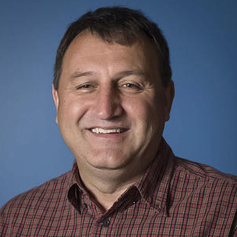
Presenter
Speaker: John Sands, Ph.D. – Academic Director, NISGTC and Dept. Chair of Computer Integrated Technology for Moraine Valley Community College
Principal Investigator, NSF ATE Center for Systems Security and Information Assurance

Slide 26

MORAINE VALLEY COMMUNITY COLLEGE
CSSIA at Moraine Valley Community College – Lead for Cyber Security BILT
NSF ATE National Resource Center
Extensive work on Virtualization
Creation of lab library for virtual teaching and learning environment.
Cyber Security BILT – Leverage National Standards
Incorporate National Security Agency (NSA) and the Department of Homeland Security (DHS)
National Centers of Academic Excellence in Information Assurance/Cyber Defense for Two-Year Education (CAE2Y)
Program Criteria for Measurement
National Institute for Standards and Technology (NIST) National Cybersecurity Workforce Framework NICE

Slide 27

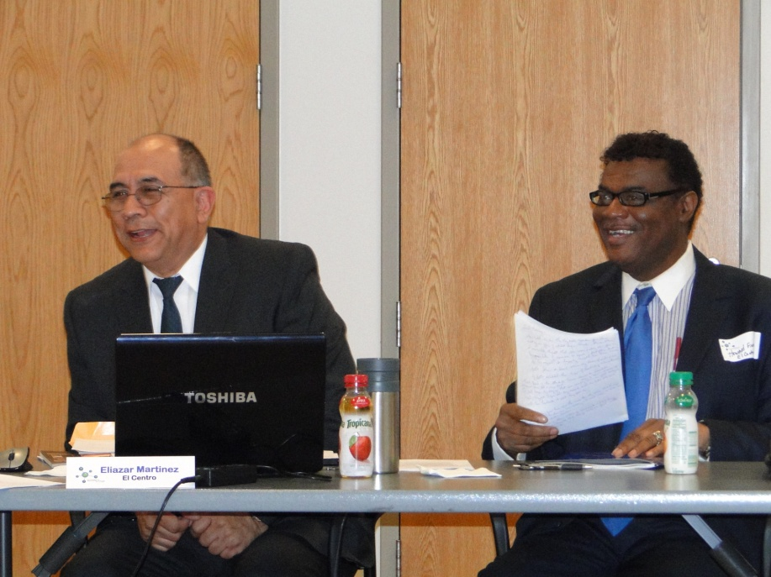
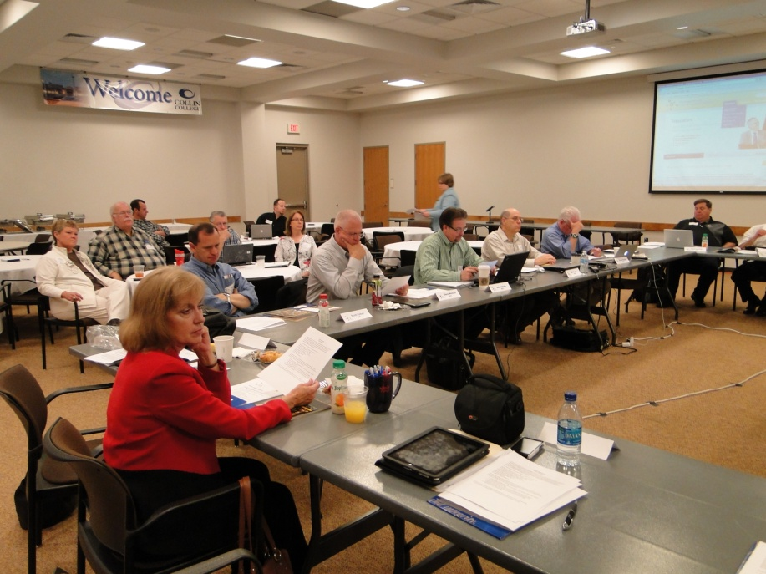
FROM THE LOCAL PERSPECTIVE
Diversity of BILT Members
Government sector
Health care sector
Finance Sector
Manufacturing
How Local BILT Functions
In person/virtual
Local perspective versus national
Approach to prioritizing KSAs
Directly address workforce need while leveraging prior work
Focus on comprehensive approach
Students interaction and engagement
Competitions
Internships
Placement

Slide 28


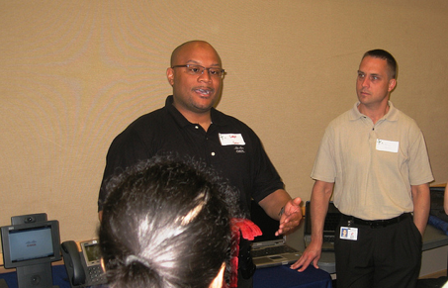
STUDENTS BENEFIT
Level of engagement (student centric approach)
Employment readiness activities
Classroom support (adjuncts, speakers)
Internships, residencies and hiring
Access to a broader employment network
Co-ownership of courses, certificates, and degrees

Slide 29
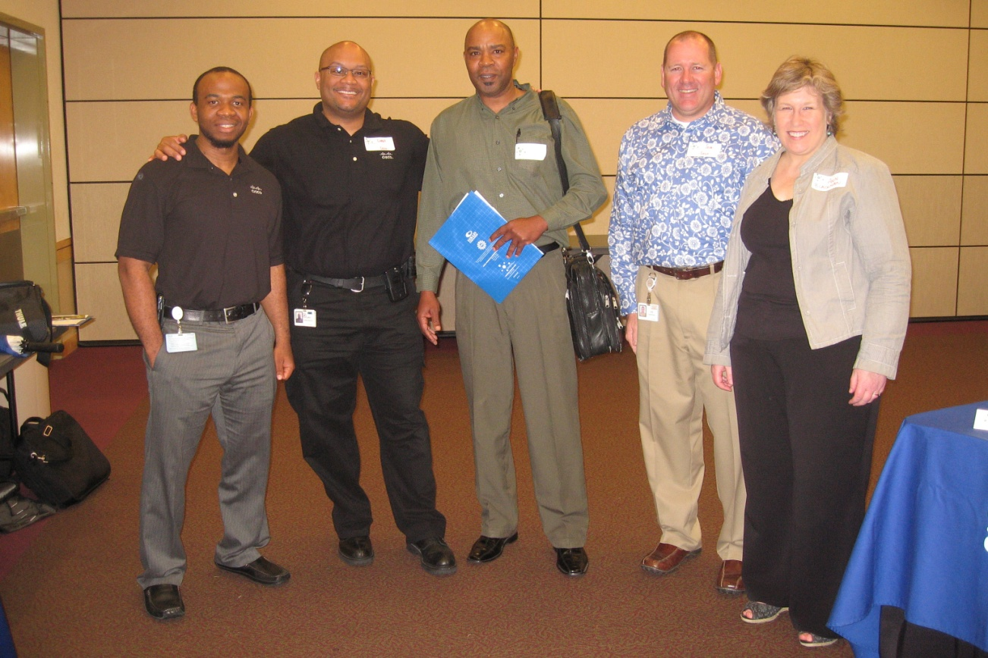
TO BUILD AN ENGAGED BILT
Determine your expectations of the members to bound time commitment
Target specific businesses for membership
Send printed letter and phone (not email)
Use a script that specifies what you
want from the businesses you contact
SHARE YOUR VISION
Emphasize WIN-WIN for the business
member

Slide 30
BILT MODEL – Follow-up Conference Call
Follow-up Conference Call
Friday, Feb. 20, 3 – 4 p.m.
Dial-in Info (617) 603-4430, Passcode: 124
Join this call for deeper discussion and peer-sharing on employer engagement strategies and the BILT Model.

Slide 31

Questions & Answers

Slide 32

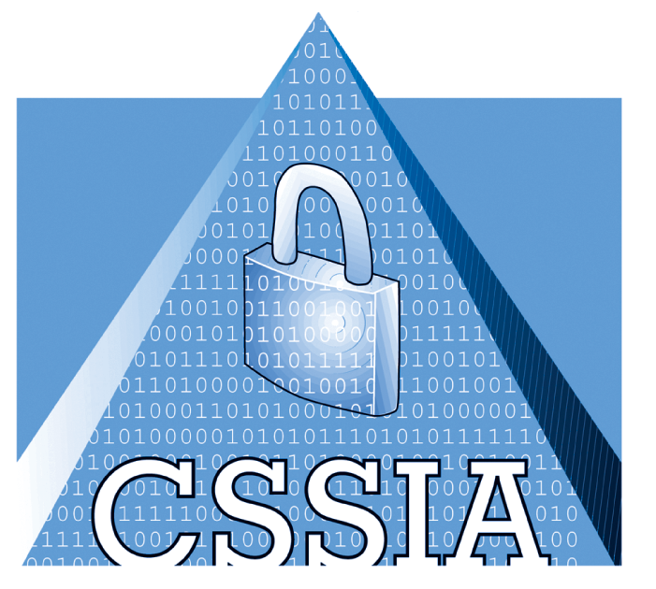

ANN BEHELER
abeheler@collin.edu
JOHN SANDS
sands@morainevalley.edu
WWW.NISGTC.ORG
TEL 617.728.4446 FAX 617.728.4857 info@jff.org
88 Broad Street, 8th Floor, Boston, MA 02110
122 C Street, NW, Suite 650, Washington, DC 20001
WWW.JFF.ORG

