Slide 1
Collaborating with Enrollment Assisters
January 23, 2015

Slide 2
Agenda
The Role of American Job Centers
Importance of the Affordable Care Act (ACA)
ACA Enrollment Update
Examples of Outreach
Q&A

Slide 3
Moderator
Name: Robert Kight
Title: Director, WIA Adult Services & Workforce System
Organization: Employment and Training Administration, DOL

Slide 4
AJCs Connect Job Seekers to Job Opportunities
American Job Centers (AJC) are the nation’s one-stop shops for employment-related services
In 2014, 10 million people served in AJCs
2,500 locations - centers in every state
600 employer-led workforce investment board oversees AJC operations
To find your nearest AJC or WIB, visit www.servicelocator.org

Slide 5
Preparing the Workforce System for Open Enrollment
1st ACA training webinar for AJC staff is available to view here
Training & Employment Notice (TEN) 13-14 -- 2015 Health Insurance Marketplace Open Enrollment Period – posted on doleta.gov
EDUCATE: TEN emphasizes the availability of affordable coverage options in the Marketplace during intake
ENGAGE: TEN encourages connecting with HHS regional office for education/outreach events in your community and using navigators as a resource
ENROLL: TEN recommends hosting enrollment signup events at AJC and establishing office hours for navigators

Slide 6
ACA Outreach in the Workforce System
Sacramento Employment and Training Agency (SETA): $1 million grant from the CA marketplace to conduct outreach and education activities.
Aroostook County Action Program (Maine) – a Workforce Investment Act service provider: directed all full-time job counselors to become certified ACA navigators.
Philadelphia, Springfield, Missouri, and many other cities invite enrollment assisters to American Job Centers to assist customers with the application process.

Slide 7
Presenter
Name Sharon Block
Title: Senior Counselor to the Secretary
Organization: Department of Labor

Slide 8
Importance of the ACA
High priority for Secretary Perez and the Department of Labor
Goal: 9.1 million by February 15
Great partnerships
Reach out if you haven’t already

Slide 9
Presenter
Name Lina Rashid
Title: Acting Director, Transparency and Disclosure Division
Organization: Consumer Information and Insurance Oversight, Centers for Medicare & Medicaid

Slide 10
The Affordable Care Act: The Basics
Signed on March 2010
Expanded Medicaid in some states
Expanded coverage for many people
Created the Marketplaces (state and federal)
Offers Qualified Health Plans
Tax credits available to those who qualify based on income

Slide 11
ACA by the Numbers
Marketplace Enrollment:
Last year, 6.7 people enrolled in a health plan
This year, more than 7.1 million consumers have already selected a plan or were re-enrolled
For the 2015 the proportion who selected a plan with financial assistance is 87 percent compared with 80 percent in the early months of the 2014 Open Enrollment period

Slide 12
ACA by the Numbers (cont)
Medicaid Enrollment:
Since October 2013, more than 9.7 million more Americans have enrolled in Medicaid and CHIP
Reducing the Uninsured:
In one year, the number of uninsured has fallen by 10 million people

Slide 13
What You Need to Know
Open Enrollment Ends February 15
400,000 people signed up just before the February 1 deadline
Some people may qualify for Special Enrollment Periods – birth of a child, loss of job, marriage, etc.
Encourage consumers to look at their options
Connect them with Navigators and Enrollment Assisters
Visit HealthCare.gov to shop!

Slide 14
4 Ways to Get Marketplace Coverage

Slide 15
In-Person Assistance
Marketplace in-person help is available
Navigators, certified application counselors, agents and brokers, etc.
To find help in your area, go to Localhelp.HealthCare.gov

Slide 16
Presenter
Name: Suzanne Coleman-Tolbert
Title: President, CEO
Organization: Central Ohio Workforce Investment Corporation

Slide 17
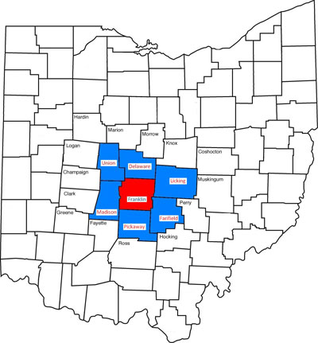
About COWIC- American Job Center (Area 11)
Our mission is to meet the employment needs of businesses and job seekers to support economic development in Central Ohio.
Service
COWIC has provided job center services to central Ohio residents for the past 10 years
Customers
We serve an average of 800 customers a month/10,000 customers a year
Employers
Our Business Solutions Team works with an estimated 400 employers a year.

Slide 18
Building Partnerships with Local Health Centers
COWIC- Area 11has an ongoing relationship with local health agencies, including Columbus Public Health and our Federally Qualified Health Center (FQHC), Columbus Neighborhood Health Center (CNHC).
Through these relationships, job seekers in central Ohio’s American Job Center have ongoing access to health screenings and assessments.
Between the 21-week period (January 2013-June 2014), CNHC met with approximately 350 people in our job center.

Slide 19
ACA Outreach Efforts
Since January 2013, COWIC & CNHC forged a partnership where CNHC counselors and healthcare navigators were in the AJC once a week to deliver information about the ACA in job seeker orientation sessions & begin the application and approval process for those interested.
The Partnership has included the following outreach efforts:
Attend “New Member” WIA Orientations
Counselors attended State information sessions to those receiving unemployment compensation
Counselors assisted interested job seekers with completing online application at healthcare.gov & visible presence at information table in the center
Printed ACA materials available throughout the Job Center
Ongoing education for AJC customers about their healthcare options through the federal Healthcare Marketplace
Mass enrollment event is being planned before the next enrollment deadline

Slide 20
Thank You!

Slide 21
Presenter
Name: Janice Parker
Title: Illinois Relationship Manager, Certified Consumer Credit Educator
Organization: Navicore Solutions

Slide 22
Outreach to Workforce System Partners
Navicore Solutions was previously Novadebt
Background on Novadebt
Worked with IL Department of Commerce and Economic Opportunity on Rapid Response teams
Received Navigator grant
Introduction to partnership with Career Link Centers
Relationship
Types of events

Slide 23
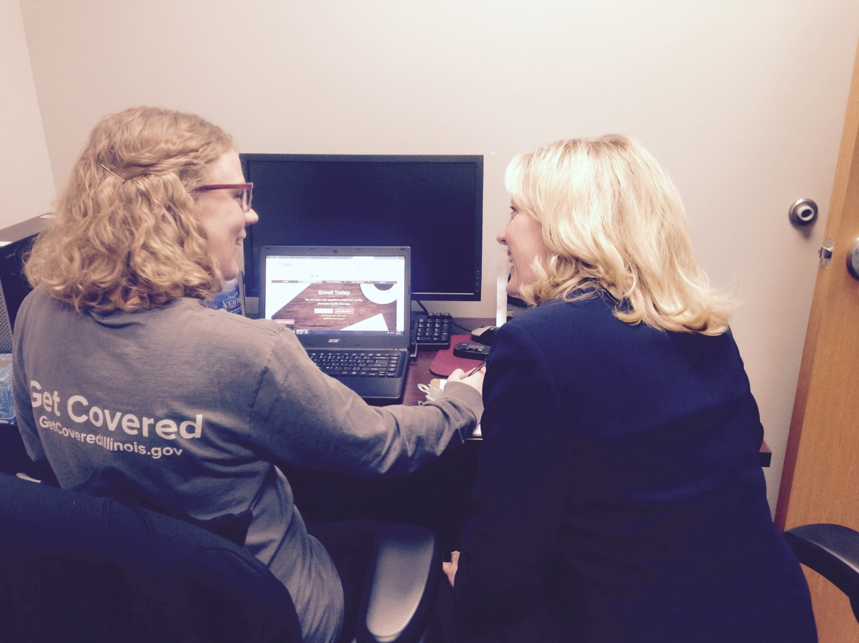
Enrollment Assistance

Slide 24
Contact Information
Janice Parker
IL Relationship Manager
Navicore Solutions
Jparker@navicoresolutions.org
800-772-4557 ext. 80588

Slide 25
Questions and Answers: Please enter your questions in the chat window!

Slide 26
Thank You!
Find resources for workforce system success at:
www.workforce3one.org

