Slide 1
The Importance of the Workforce Innovation and Opportunity Act (WIOA) for Family and Youth Services Bureau Grantees
Webinar Date: January 26, 2015,
2:00 PM EST
Presented by: Office of Workforce Investment, Division of Youth Services
U.S. Department of Labor
Employment and Training Administration

Slide 2
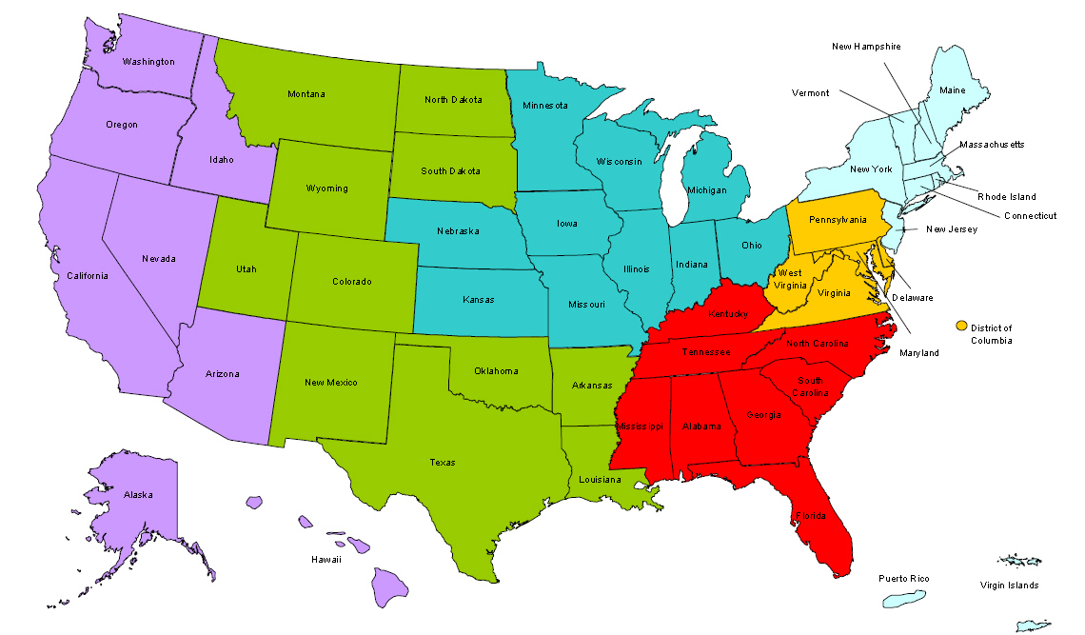
Where are you?
Enter your location in the Chat window – lower left of screen

Slide 3
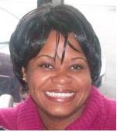
Moderator
Maisha Meminger
Division of Youth Services, U.S. Department of Labor, Employment and Training Administration

Slide 4
Here’s what you can expect to get out of this webinar!
What WIOA states about the Runaway and Homeless Youth and other vulnerable FYSB populations (e.g., domestic violence survivors)
How FYSB grantees should access employment services and supports from local American Job Centers?
What WIOA Workforce Investment Boards, Youth Committees and other efforts should FYSB grantees join?
The expected WIOA benefits for FYSB grantees, stakeholders and service populations?
What has happened well under WIOA?

Slide 5
Agenda
Welcome
WIOA Youth Formula Program
FYSB Grantee Workforce Highlights
Discussion on FYSB/WIOA Connection

Slide 6
Welcome

Slide 7
Debbie Powell
Deputy Associate Commissioner,
Family and Youth Services Bureau
Jennifer Kemp
Unit Chief, Youth Policy and Performance
Division of Youth Services, Employment and Training Administration

Slide 8
WIOA
Evan Rosenberg
Youth Policy and Performance, Division of Youth Services, U.S. Department of Labor, Employment and Training Administration

Slide 9
Vision
To achieve and maintain an integrated, job-driven workforce system that links our diverse, talented workforce to our nation’s businesses and improves the quality of life for our citizens.
Based on three key pillars of our system:
One-Stop career centers provide first-rate customer service to jobseekers, workers, and businesses.
The demands of businesses and workers drive workforce solutions.
The workforce system supports strong regional economies.
WIOA

Slide 10
Six Broad Goals of WIOA
Increase access to education, training, and employment--particularly for people with barriers to employment.

Slide 11
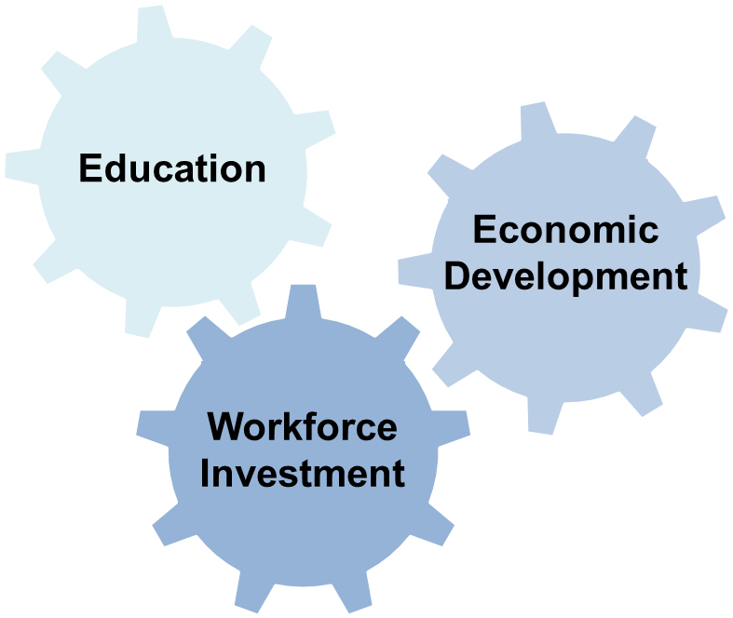
Six Broad Goals of WIOA
Create a comprehensive, high-quality workforce development system by aligning workforce investment, education, and economic development.

Slide 12
Six Broad Goals of WIOA
Improve the quality and labor market relevance of workforce investment, education, and economic development efforts.
Promote improvement in the structure and delivery of services.

Slide 13
Six Broad Goals of WIOA
Increase the prosperity of workers and employers.
Reduce welfare dependency, increase economic self-sufficiency, meet employer needs, and enhance the productivity and competitiveness of the nation.

Slide 14
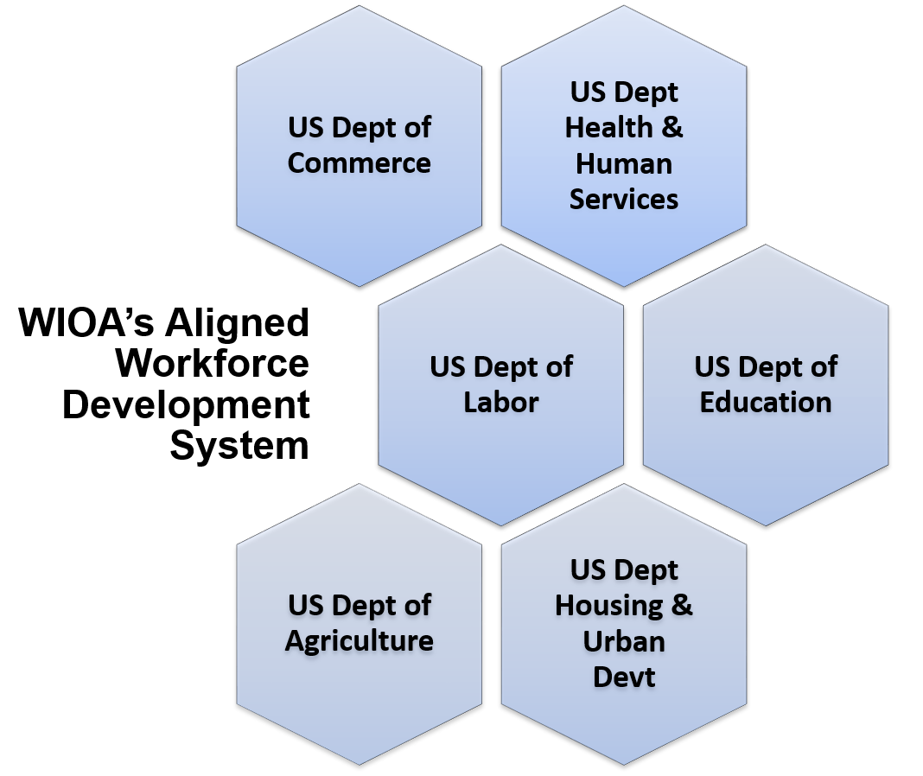
Program Alignment

Slide 15
WIOA Titles
Title I Programs
Title I is the primary source of federal workforce development funding to prepare low-income adults, youth, and dislocated workers for employment, and to help them continue to build skills once they are employed.

Slide 16
WIOA Titles
Title II & Title III Programs
Title II is the main source of federal adult education and literacy funding, including English language services.
Title III funds the Wagner-Peyser Employment Services program, which provides labor exchange services that match employers with qualified job seekers.

Slide 17
WIOA Titles
Title IV Programs
Title IV funds Vocational Rehabilitation which supports a wide range of services designed to help individuals with disabilities prepare for and engage in gainful employment, and secure financial and personal independence through rehabilitative services.

Slide 18
Youth Program

Slide 19
Changes to Youth Eligibility
Out-of-School Youth
To be eligible youth must be:
Aged 16 to 24
Meet one or more additional conditions

Slide 20
Changes to Youth Eligibility
Out-of-School Youth – Additional Conditions
School dropout
Within the age of compulsory school attendance, but has not attended school for at least the most recent complete school year calendar quarter
Recipient of a secondary school diploma or its recognized equivalent who is low-income and basic skills deficient or an English language learner
Subject to the juvenile or adult justice system
A homeless individual defined in sec. 41403(6), Violence Against Women Act (42 U.S.C. 14043e–2(6))), a homeless child or youth, a runaway, in foster care or has aged out of the foster care system, a child eligible for assistance under section 477, Social Security Act (42 U.S.C. 677), or in an out-of-home placement
Pregnant or parenting
An individual with a disability
Low-income individual who requires additional assistance to enter or complete an educational program or to secure or hold employment

Slide 21
Changes to Youth Eligibility
In-School Youth
To be eligible youth must be:
Aged 14 to 21
Low-income*
And one or more additional conditions
* Youth receiving or eligible to receive a free or reduced price school lunch are considered
“low income” under WIOA

Slide 22
Changes to Youth Eligibility
In-School Youth – Additional Conditions
Basic skills deficient
English language learner
An offender
Homeless, a runaway, in foster care or has aged out of the foster care system
Pregnant or parenting
Disabled
Requires additional assistance to enter or complete an educational program or to secure or hold employment

Slide 23
New Youth Program Elements
Five New Elements (total of 14 program elements)
Financial literacy
Entrepreneurial skills training
Services that provide labor market and employment information in the local area
Activities that help youth transition to postsecondary education and training
Education offered concurrently with and in the same context as workforce preparation activities and training for a specific occupation or occupational cluster

Slide 24
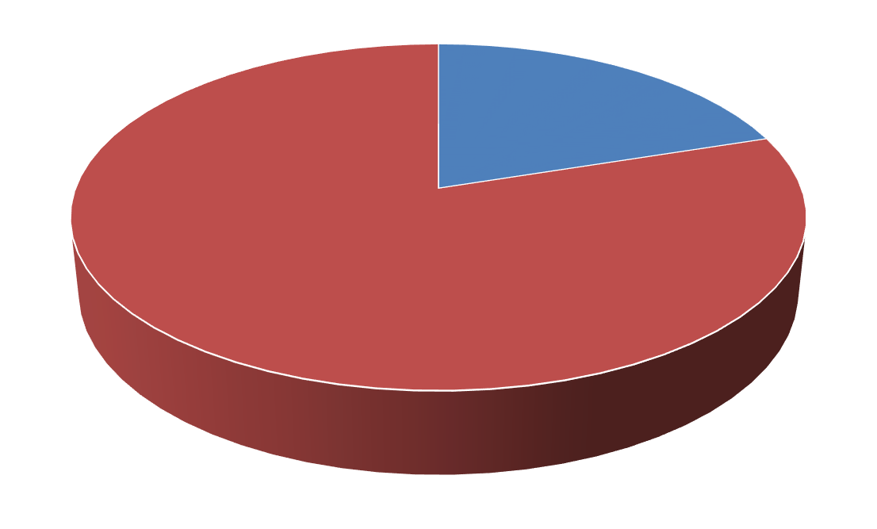
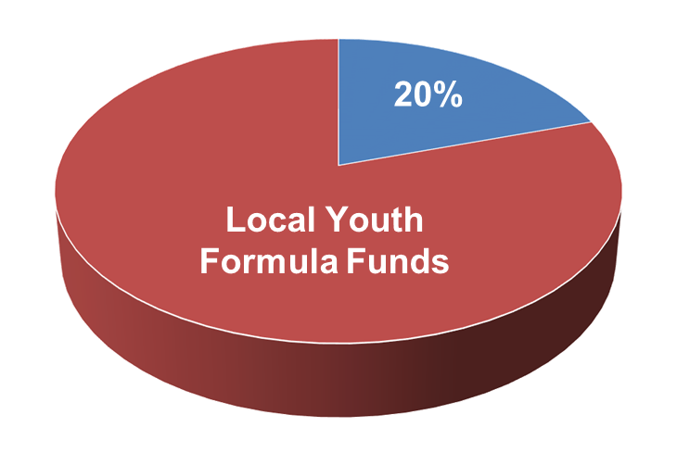
Emphasis on Work-based Learning
Funding Work Experiences
At least 20% of local Youth formula funds must be used for work activities such as:
Summer jobs
Pre-apprenticeship
On-the-job training
Internships
20%
Local Youth Formula Funds

Slide 25
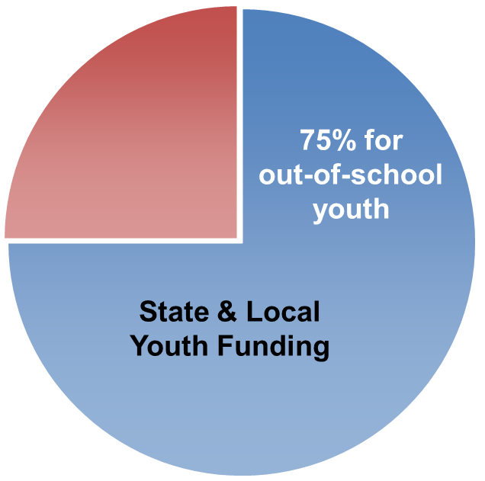
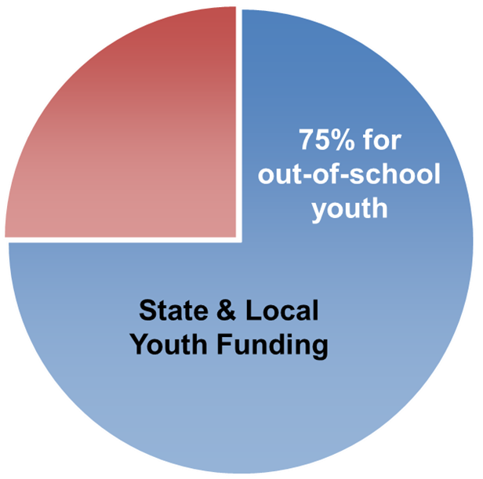
Other Key Provisions
WIOA requires 75% of state and local Youth funding be used for out-of-school youth.
50% exception for states that receive a minimum allotment.
Under WIOA, Youth Councils are no longer required; however, Standing Youth Committees are encouraged.

Slide 26
Introductions
FYSB Grantee Workforce Highlights

Slide 27
Betsy Vidlak, Director of Youth Programs, Community Action Partnership of Western Nebraska

Slide 28
Community Action Partnership of Western Nebraska (CAPWYN) – An RHY Program Perspective www.capwn.org
Our Services:
Teen Outreach Program
Group Home
Youth Shelter
Housing Programs
Transitional Supportive Housing
Permanent Supportive Housing
Supportive Services

Slide 29
Building Relationships with Local Partners
How do we get started?
Where can we work together?
What resources are available?

Slide 30
Youth Success
Youth utilizing Vocational Rehabilitation
Services received
On the Job Training
Collaborative Approach

Slide 31
Success in Youth Programming
What’s next?
What opportunities are there to move forward?
Social Enterprise

Slide 32
Kristen Pavlik, Social Change and Prevention Initiative Coordinator, Florida Coalition Against Domestic Violence

Slide 33
Florida Coalition Against Domestic Violence: Economic Justice Initiatives
FCADV Economic Justice Workgroup: 2013 Needs Assessment
Findings and Recommendations
Florida Department of Economic Opportunity (DEO)
Partnership
Career Source
Regional Trainings
Action Steps to Collaborate Further
Frequently Asked Questions (FAQ) Document
Support to Build Local Level Relationships

Slide 34
Justin Beene, Youth Services Department Manager, Bethany Christian Services

Slide 35
Bethany Christian Services
Getting Started…..
Social Enterprise, Building Bridges Professional Services
Joined the local Workforce Development Board’s Youth Council
Applied to be a youth contractor
Integrated TPP via TOP (16 week program)
DOL YouthBuild program (7 months)

Slide 36
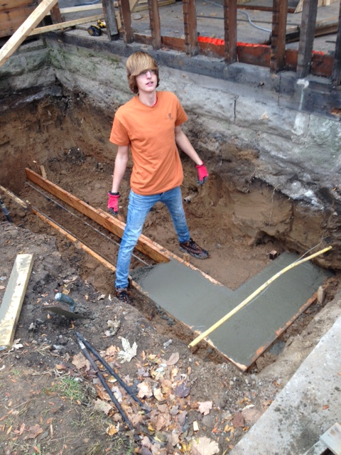
Bethany Christian Services
Lessons Learned/Success Realized….
Immediate celebration of success (i.e student of the week)
Concepts can be applied in real life and then reflected on (i.e trauma triggers in the workplace)
Youth come to us!
Youth hired by the organization

Slide 37
Bethany Christian Services
Moving Forward……
Connect with local Workforce Development Board and Youth Contractors
Listen and provide added-value without creating more work for them
Think outside the box (i.e youth facilitating classes)
CSL focused on employment skills

Slide 38
FYSB-WIOA Connection

Slide 39
What WIOA states about the Runaway and Homeless Youth and other vulnerable FYSB populations (e.g., domestic violence survivors)
How FYSB grantees should access employment services and supports from local American Job Centers
What WIOA Workforce Investment Boards, Youth Standing Committees and other efforts should FYSB grantees join
Expected WIOA benefits for FYSB grantees, stakeholders and service populations

Slide 40
Resources
WIOA Website: www.doleta.gov/wioa
The WIOA Resource Page will provide information and resources for States, local areas, non-profits and other grantees, and other stakeholders to assist with implementation of the Act. This page will be updated to reflect newly developed materials, including responses to frequently asked questions.
Workforce3One.org
WIOA 101

Slide 41
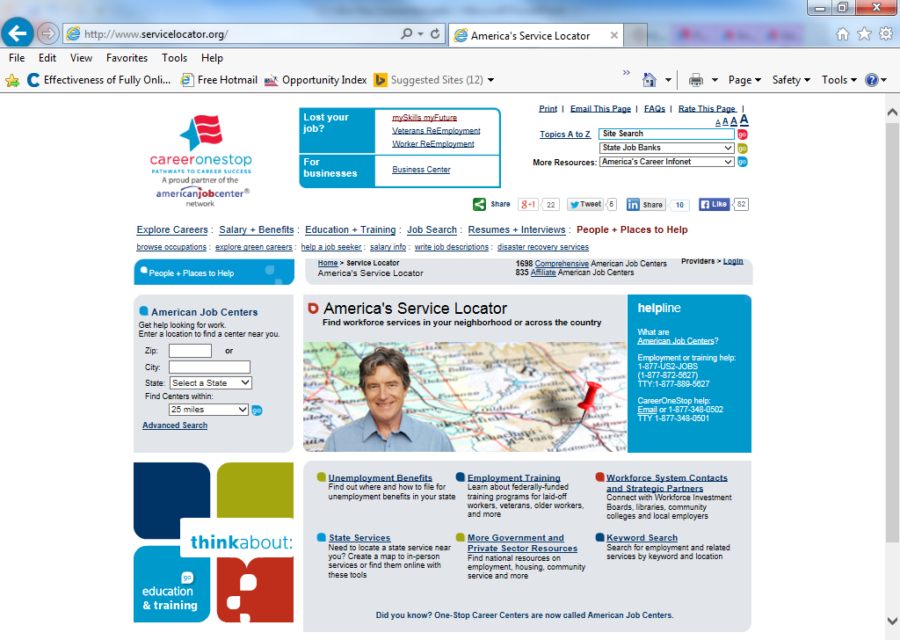

Slide 42
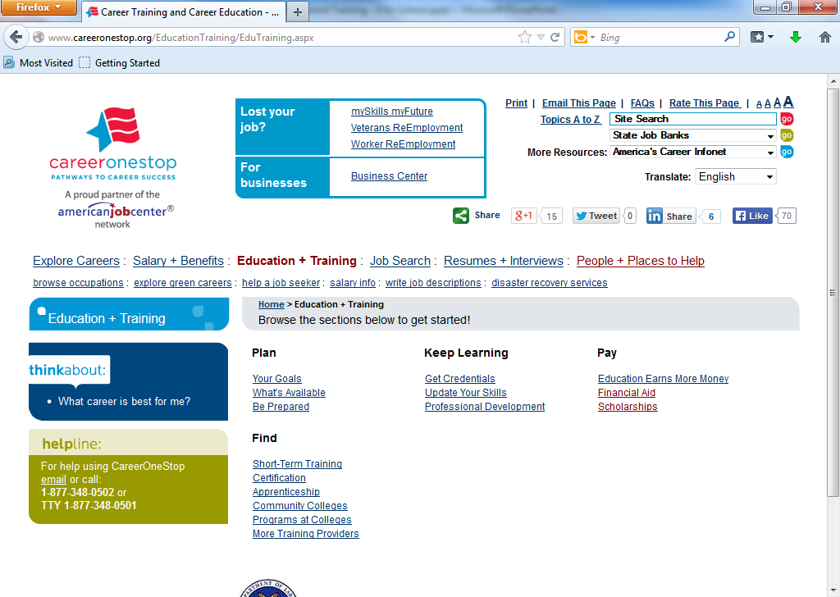
Arrow to Scholarship

Slide 43
FOR MORE INFORMATION
To view America’s Service Locator’s Financial Aid information, visit:
http://www.careeronestop.org/EducationTraining/Pay/FinancialAid.aspx

Slide 44
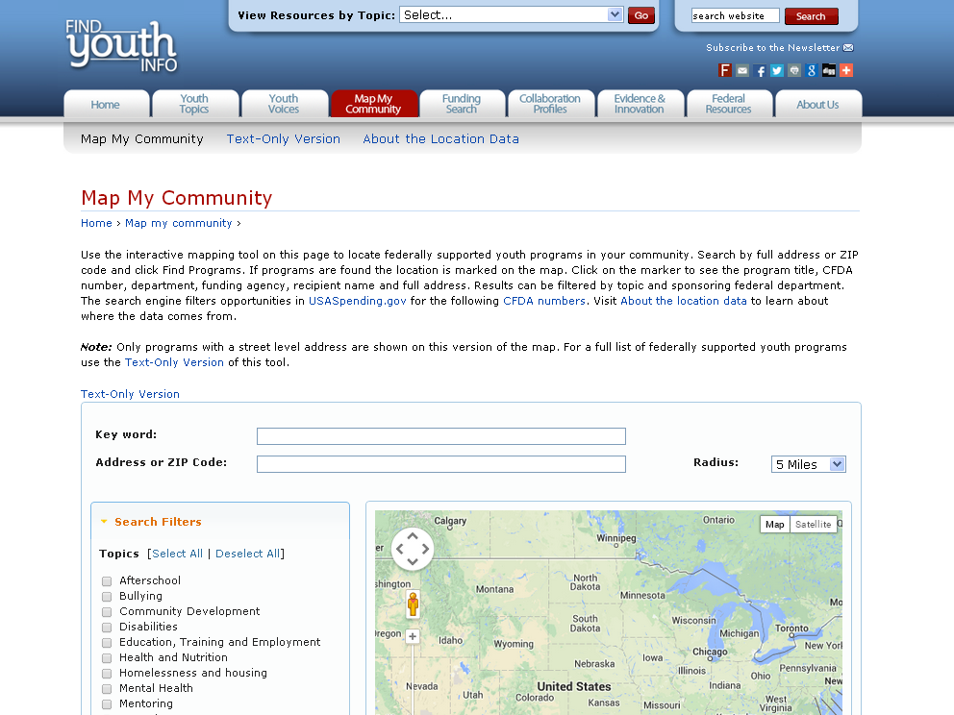
Map My Community enables you to enter a keyword or your zip code and find federally-funded youth programs in your area

Slide 46
FOR MORE INFORMATION
Visit FindYouthInfo.gov
Find funding opportunities related to youth
Read cross-cutting content on youth issues
Sign up for the newsletter
And more!
Email us at FindYouthInfo@air.org

Slide 47
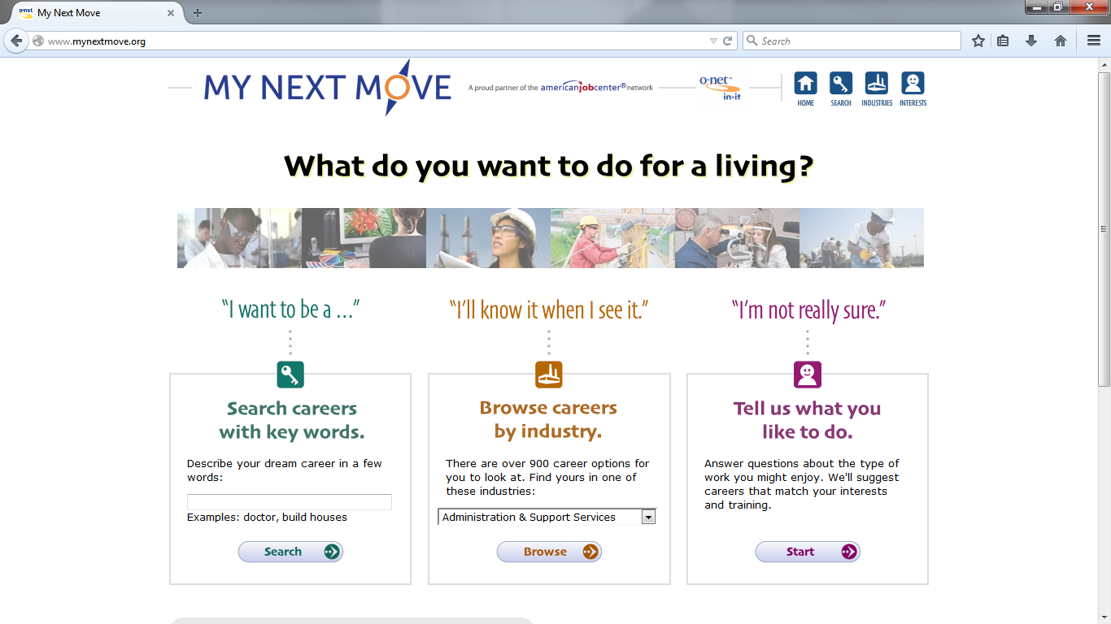
http://www.mynextmove.org/

Slide 48
Please enter your questions in the Chat Room!

Slide 49
Speakers’ and General Contact Information
E-mail
DOL.WIOA@dol.gov
With your questions and ideas on WIOA implementation
Speaker: Linda Reese-Smith
Title: Special Assistant
Organization: Family and Youth Services Bureau
Email: linda.reesesmith@acf.hhs.gov
Speaker: Evan Rosenberg
Organization: Youth Policy & Performance, Division of Youth Services, U.S. Department of Labor, Employment and Training Administration
Email: rosenberg.evan@dol.gov
Speaker: Betsy Vidlak
Title: Director of Youth Programs
Organization: Community Action Partnership of Western Nebraska
Email: bvidlak@capwn.org
Speaker: Kristen Pavlik
Title: Social Change and Prevention Initiative Coordinator
Organization: Florida Coalition Against Domestic Violence
Email: Pavlik_Kristen@fcadv.org
Speaker: Justin Beene
Title: Youth Services Department Manager
Organization: Bethany Christian Services
Email: jbeene@bethany.org

Slide 50
Thank You!
Find resources for workforce system success at:
www.workforce3one.org

