Slide 1
ACT NOW Series:
Partnerships in Action
Implementing WIOA
July 1, 2015
U.S. Department of Labor

Slide 2
The Moderator
Joseph Barela
Senior Advisor
Employment and Training Administration, U.S. Department of Labor
Have a question or comment about WIOA? E-mail DOL.WIOA@dol.gov

Slide 3
Webinar Agenda
Federal Perspective on Partnerships
Best Practice Presentations
Question & Answer Session
Upcoming TA and the Innovation & Opportunity Network

Slide 4
TODAY’S PRESENTERS
Amanda Ahlstrand
Administrator
Office of Workforce Investment,
U.S. Department of Labor
Senior Advisor | Moderator
Employment and Training Administration,
U.S. Department of Labor
Joseph Barela
Special Assistant to the Commissioner
Rehabilitation Services Administration
U.S. Department of Education
Mary Lovley

Slide 5
Amanda Ahlstrand
Administrator
Office of Workforce Investment, U.S. Department of Labor
Have a question or comment about WIOA? E-mail DOL.WIOA@dol.gov

Slide 6
WIOA VISION
The needs of business and workers drive our workforce solutions
One-Stop Centers provide excellent customer service to both our jobseekers and employers
Our workforce system supports a strong regional economy and that we play an active role in community and economic development.

Slide 7
PARTNERSHIP VISION: STATE AND LOCAL LEVEL
From TEGL 19-14: Vision for the Workforce System and Initial Implementation of WIOA:
“States align programs and ensure integrated services through a unified strategic plan and shared governance...”
“Every state collaborates across the core programs (Adult, Dislocated Worker and Youth, Wagner-Peyser, Adult Education and Vocational Rehabilitation)…”
“States and local areas align workforce programs with regional economic development strategies…”
“The One-Stop Center network and partner programs are organized to provide high-quality services…”

Slide 8
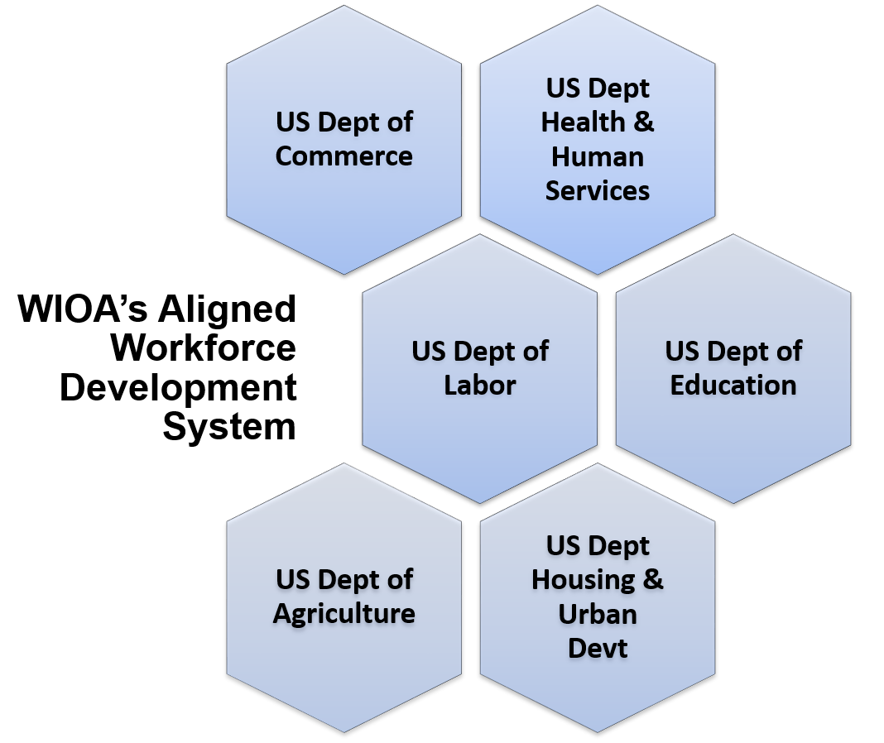
PARTNERSHIP VISION: FEDERAL LEVEL

Slide 9
Mary Lovley
Special Assistant to the Commissioner
Rehabilitation Services Administration U.S. Department of Education

Slide 10
WIOA Title IV Effective Date
Effective Date
WIOA Section 506(d) – Disability Provisions – Except as otherwise provided in title IV of this Act, title IV, and the amendments made by title IV take effect on the date of enactment of the Act. (Rehabilitation Act) (July 22, 2014).

Slide 11
Partnerships are Key
Partnerships across the workforce system and with education will be key to successful implementation of WIOA.
ED expects the VR agencies to partner with:
The various workforce partners in the state, including the One-Stop partners.
Education partners, including LEAs, special education, nontraditional schools, institutions of higher education (colleges, universities, community colleges, technical colleges, etc.), training programs, etc.
Employers, businesses, industries.
Local service providers, including community rehabilitation programs.
State Rehabilitation Councils and other advisory committees.
Other appropriate partners.

Slide 12
Partnerships at the Federal and State Levels
RSA envisions that under WIOA new and enhanced partnerships will occur at the Federal and State levels. Some examples of such partnerships that go beyond the six core WIOA programs include:
SSA/Ticket to Work
TANF
Small Business Administration
Career and Technical Education (Perkins)
Job Corps
Supplemental Nutrition Assistance Program (SNAP)
HUD Employment and Training Programs
Veterans Programs
Other appropriate federal, state or local employment, education, or training programs

Slide 13
Best Practice discussion
Chief of Customized Training & Adult Literacy Services
New Jersey Department of Labor & Workforce Development
Howard Miller
Executive Director
North Tennessee Workforce Board
Marla Rye
Executive Director
Northwest Tennessee Workforce Board
Margaret Prater

Slide 14
New Jersey Adult education
and
workforce partnerships
Howard Miller

Slide 15
Partnership opportunities abound but they need to be sought out
WIOA creates opportunities for partnerships but in
reality they were always there.
The key to WIOA is “alignment” not “consolidation”.
When focusing on alignment groups can work together
When focusing on consolidation people hear “picking winners and losers”
In buildup to WIOA implementation we have not seen folks who oppose WIOA; rather we have been asked “what do you want us to do?”

Slide 16
New jersey adult ed (title II) background
State Department of Education operated grant until 2004
Since 2004, Title II funding operated out of Labor but siloes within
2012: Labor begins reorganizing internal units to consolidate activity
Title II program is moved under Incumbent Worker and Dislocated Worker Grant management.
Now: common providers of service/common users
Beginning of sequencing

Slide 17
Culture class workforce vs adult ed
Just because it is all under one roof does not make it any easier to implement WIOA
Workforce System needs, TANF needs, and Adult Education needs collide rather than compliment
Workforce focus: quick service, movement back to workforce
Adult Ed focus: longer term outcomes
TANF: in need of both services but feels pulled in two separate directions

Slide 18
Pre-wioa
New Jersey Title II was an under performing program (bottom quartile nationally)
Adult Ed services delivered separate from Workforce System needs but yet often have common clients
Things we started:
Adult Ed Program directors meetings
By focusing on performance began to reveal gaps that could be filled by partnering
Give them the North Star (in our case end game was an industry sector strategy outcomes
Make them part of the change movement rather than impose change

Slide 19
Wioa and going forward
Career Pathways
As we further outline career pathway connections the lead on content delivery discussion has been Adult Ed
Pointing out the obvious (show them how they already connect)
Most providers already deliver multiple services (bridge programs, occupational skills)
Build on existing relationships as you introduce new concepts
As we introduced sector strategy information Adult Ed asks what are the common skills needed
Don’t leave them hanging out there on their own. Be in it with them
Building trust with siloes groups
Adult Ed still feels as though they could be forgotten and swallowed up

Slide 20
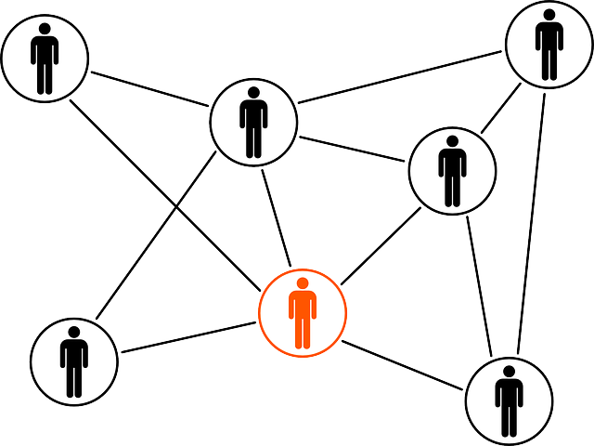
Take away
Adult Ed need to understand customer flow of local workforce system
Who is typically coming in the doors?
What do they need?
Flow should not dictate service delivery but rather inform it
Adult Ed needs to know they are viewed as understanding content delivery and the best way information should be imparted.
Connecting to Developmental Ed provides opportunity and max

Slide 21
WIOA
TANF
Adult Education
Coordination in Tennessee
Marla Rye
Margaret Prater

Slide 22
Adult education
Overview Of AE program
Program results (graduates)
AE coordination with LWDA/AJC system

Slide 23
Ae and the tn career centers/ajc
How do they fit together?

Slide 24
Middle Tennessee adult education
South Central TN Workforce Board, LWDA 10 AE Provider Marshall, Maury & Williamson Counties
North Tennessee Workforce Board, LWDA 8 AE Provider Cheatham & Robertson Counties

Slide 25
Advantages of integration with ajc/tn career center System
WIA Support Services to encourage completion of HiSet
Career Centers serve as GED/HiSet Testing Site
Financial Savings to Local School System
Seamless Transition/Continuation of Education Process at TCAT/Community College

Slide 26
Advantages of integration with ajc/tn career center System
Referrals between Career Center Partners for Agency Services
WIOA
Wagner Peyser
Department Vocational Rehabilitation
Department of Human Services
Work with DHS to serve Families First students
Immediate identification of High School Dropouts for WIOA
AE staff translates for career center customers
AE provide TABE testing for workforce development partners if needed
Various agencies assist with HSE testing fees
Business Services collaborates with AE on employment opportunities
DEI tests learning disabled students

Slide 27
Program results
Model Success

Slide 28
Middle tn results
GED/HSE-2005 to present
1,914
WIA/WIOA core services provided to Adult Education Students
Over 450
American Job Centers serve as Adult Education Testing Sites
Dickson, Montgomery and Robertson Counties
Tested 250 Applicants
58% Pass Rate

Slide 29
Seamless parnterships
Successful Customer Pathway

Slide 30
Ae students & graduates feed seamlessly into ajc/tn career center system
Career Center staff provides information about services at new student registration monthly
AE students are made aware of job fairs and career readiness workshops at the Career Center
Assistance with:
Resume
Interview
Jobs4tn.gov
Assessments (basic skills, interest/aptitude, workplace skills)
National Career Readiness Certificate
InterviewStream
Consult with Career Specialist on training opportunities
Career Center computer lab to learn basic computer skills

Slide 31
Hse/career center success
Patrick Garrett received his HSE diploma in January 2014 and entered the Career Pathway pilot program and obtained employment at a local call center.
“This program has been a really great way for me to get my foot in the door,” stated Garrett.
At the completion of his training, Patrick was offered a full-time position and has since been able to purchase his first vehicle.
“I feel really good about my future now. I want to move up within the company and exceed any expectations I may have previously had for myself.”

Slide 32
Hse/career center success
Offender Classes taught at local jails with coordination with Career Center upon release.
“Without the encouragement of the Career Center staff, I wouldn’t have been able to achieve my goal! “ stated Savage.
Steven McDougal obtained his GED at the Career Center. Upon Completion, he enrolled in WIA Training at Walter’s State and is now a Police Officer!

Slide 33
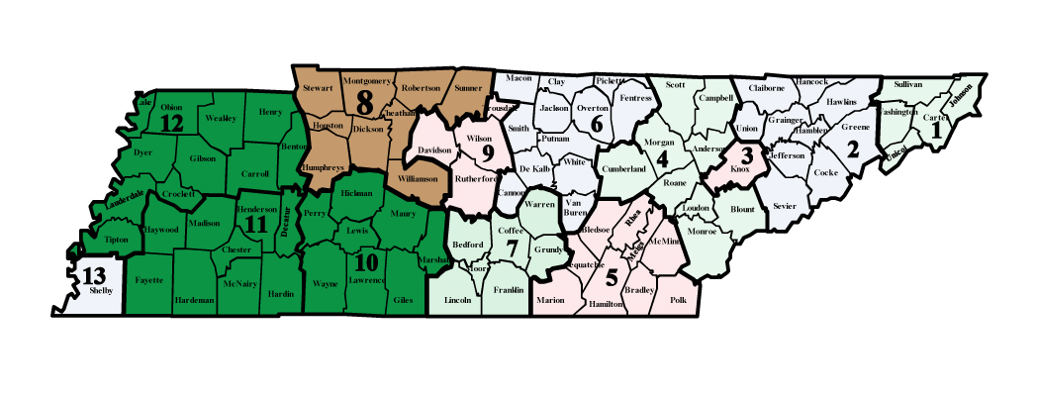
Tanf coordination in tennessee

Slide 34
Tanf coordination benefits
TO AJC
Increased AJC traffic
Diversified the customer base
Provided additional staff/services
Resulted in substantial cost savings
TO TANF
Access to Career Services
WIOA Training Enrollments
Professional Environment-Interaction with Job Seekers and Employers at AJC

Slide 35
Increased ajc traffic
Partners in 1 comprehensive and 9 affiliate sites
Monthly traffic increase -1,250 TANF customers
Annual traffic increase – 15,000 TANF Customers
Expanding to include additional comprehensive center July 1

Slide 36
Expanded customer base
Interaction between customers
Professional environment

Slide 37
Additional staff/services
Welcome Function
Staff
Participant
Workshops
Security

Slide 38
Cost savings
TANF Contribution to Infrastructure
44% of current cost of operations
Rent
Utilities
Security
Internet/technology
Annual Savings estimated at $110,000 for 10 centers.

Slide 39
Partner successes

Slide 40
Question & Answer

Slide 41
Vocational Rehabilitation WIOA Implementation
Activities RSA advised the VR agencies to engage in with respect to partnering with the education and workforce systems prior to final regulations:
Pro-actively engage with the workforce partners in your State in the strategic planning process to develop the Unified Plan, including the strategic vision and goals for preparing and educating the skilled workforce and for meeting the needs of employers.
Review your MOUs with One-Stop partners and assess your presence and participation in One-Stops.
Coordinate with education partners, including LEAs, on the provision of pre-employment transition services to students with disabilities and other transition services with disabilities under the 15 percent reserve.

Slide 42
Vocational Rehabilitation WIOA Implementation (cont.)
Partner with employers to improve and expand employment opportunities for individuals with disabilities, including work-based learning experiences such as internships and apprenticeships.
Partner with local providers to increase resources for extended services for individuals with the most significant disabilities in Supported Employment, including youth with the most significant disabilities.
Dialogue with your State Rehabilitation Council around implementation plans.

Slide 43
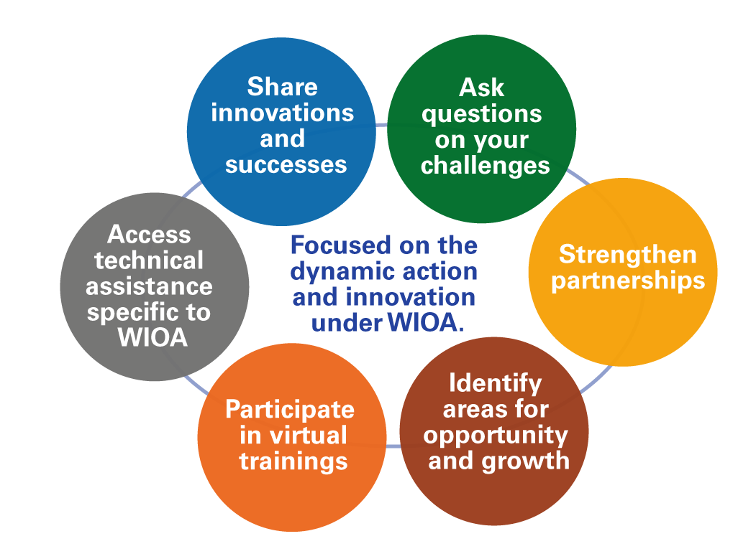
Innovation & Opportunity Network (ION)
Join the ION Community of Practice

Slide 44
Roadmap to Transformational Change
9

Slide 45
ION Technical Assistance
Thank you for participating in today’s webinar!
Reminder: Access existing technical assistance at: wioa.workforce3one.org
Including:
Quick Start Action Planners
WIOA Action Plan Template
Variety of Resources by Topical Area
Voices of Experience
1

