Slide 1
July 9, 2015
Preparing Your Deliverables –
Creative Commons CC BY and SkillsCommons.org:
Tips for Ensuring Submission of Your Deliverables Go Well

Slide 2
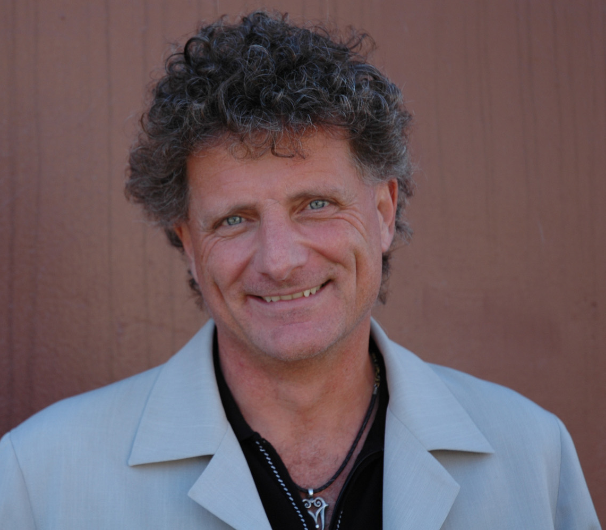
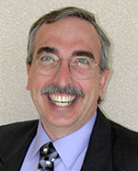
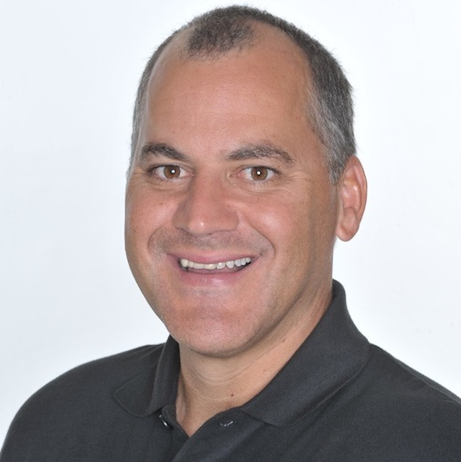
Presenters
Paul Stacey
Associate Director of Global Learning, Creative Commons
Gerry Hanley
Director, Skillscommons.org
Rick Lumadue
Program Manager, Skillscommons.org

Slide 3
Agenda
Review SGA Requirement for
  CC-BY Licensing
  DOL Disclaimer Statement
  Accessibility
  Quality Assurance: Subject Matter Expert Review, UDL, Online/Hybrid
  Grant Deliverables
Tools and Guidelines to Help Your Move Go Well
Moving Your Home: Metaphor for Uploading to SkillsCommons
Demonstrate the submission process of material to SkillsCommons.org
  Learning Resources Collection
  Program Support Materials Collection

Slide 4

CC-BY Licensing
1.1 Creative Commons License
“To ensure that the Federal investment of these funds has as broad an impact as possible and to encourage innovation in the development of new learning materials, as a condition of the receipt of a TAACCCT grant, the grantee will be required to license to the public all work (except for computer software source code, discussed below) created with the support of the grant under a Creative Commons Attribution 4.0 (CC BY) license. Work that must be licensed under the CC BY includes both new content created with the grant funds and modifications made to pre-existing, grantee-owned content using grant funds.”
Retrieved 12/5/2014 from: http://www.doleta.gov/grants/pdf/SGA-DFA-PY-13-10.pdf. pg. 37.

Slide 5
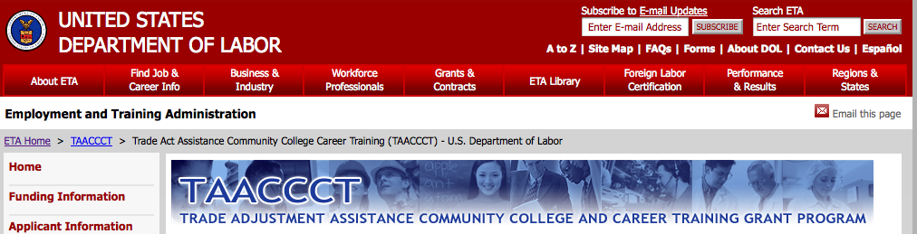
CC-BY Licensing
What is the CC BY requirement in the TAACCCT grant?

Slide 6
CC-BY Licensing
“The purpose of the CC BY licensing requirement is to ensure that materials developed with funds provided by these grants result in Work that can be freely reused and improved by others.”

Slide 7
CC-BY Licensing
Applies to:
Only work that is developed by the grantee with the grant funds.

Slide 8
CC-BY Licensing
Does not apply to:
Pre-existing copyrighted materials licensed to, or purchased by the grantee from third parties, including modifications of such materials.
Works created without grant funds.

Slide 9
CC-BY Licensing
“This license allows subsequent users to copy, distribute, transmit and adapt the copyrighted Work and requires such users to attribute the Work in the manner specified by the grantee. Notice of the license shall be affixed to the Work. For general information on CC BY, please visit http://creativecommons.org/licenses/by/4.0.”

Slide 10
CC-BY Licensing
“From a public policy perspective, the Department is a better steward of public funds by giving the public access to those things created using public funds, and ensuring that these products have as wide spread a use as possible.”

Slide 11
DOL Disclaimer Statement
1.2 Disclaimer of the U.S. Department of Labor as the Funder of the Project
If applicable, the following needs to be on all products developed in whole or in part with grant funds,
“This workforce product was funded by a grant awarded by the U.S. Department of Labor’s Employment and Training Administration. The product was created by the grantee and does not necessarily reflect the official position of the U.S. Department of Labor. The U.S. Department of Labor makes no guarantees, warranties, or assurances of any kind, express or implied, with respect to such information, including any information on linked sites and including, but not limited to, accuracy of the information or its completeness, timeliness, usefulness, adequacy, continued availability, or ownership.”
Retrieved 12/5/2014 from: http://www.doleta.gov/grants/pdf/SGA-DFA-PY-13-10.pdf. pg. 38.

Slide 12
Accessibility
“All online and technology-enabled content and courses developed under this SGA must incorporate the principles of universal design (see http://www.cast.org/udl/) in order to ensure that they are readily accessible to qualified individuals with disabilities. The content and courses must be in full compliance with the Americans with Disabilities Act and Sections 504 and 508 of the Rehabilitation Act of 1973, as amended, and the Web Content Accessibility Guidelines 2.0, Level AA (http://www.w3.org/TR/WCAG/).”
Retrieved 12/5/2014 from: http://www.doleta.gov/grants/pdf/SGA-DFA-PY-13-10.pdf. pg. 35.

Slide 13
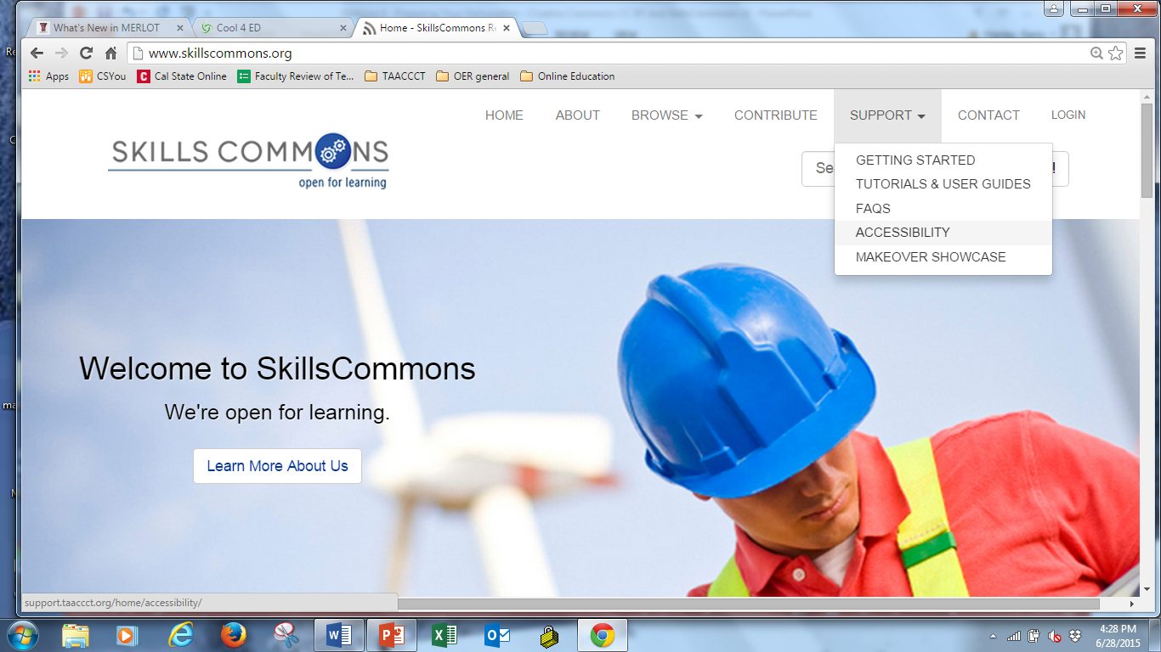
Support Center: Help With Accessibility

Slide 14
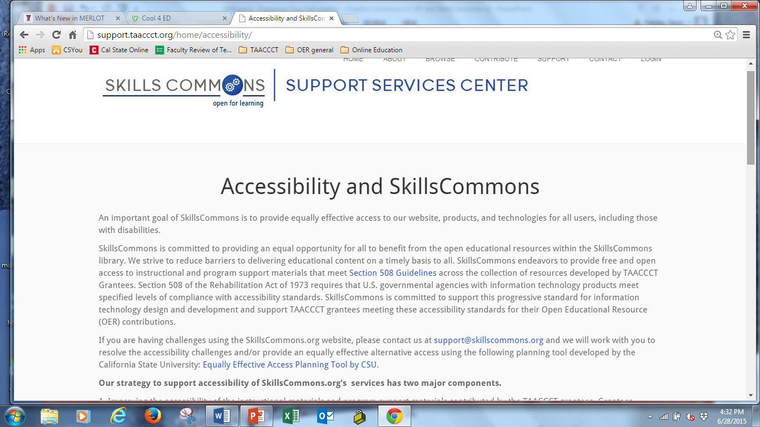
Support Center: Help With Accessibility

Slide 15
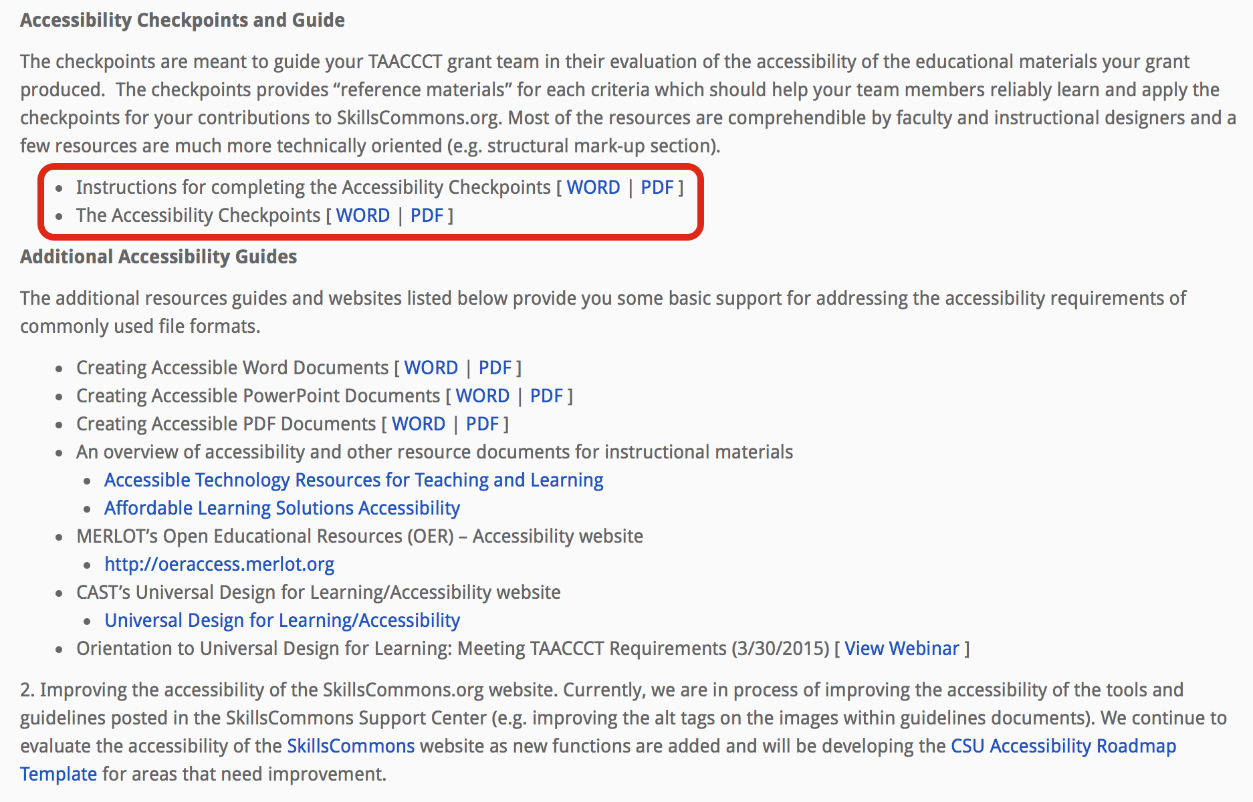
Support Center: Help With Accessibility

Slide 16
Support Center: Help With Accessibility
To Summarize: Suggested Accessibility Strategy:
  Provide an statement of support for accessibility, describe the steps taken to improve accessibility, and explain how you will respond to anyone who needs support to make your materials accessible to them.
  Use a rubric to guide your accessibility evaluation of your materials
  Document and upload your evaluation.
We are working on a VOLUNTARY procedure which will provide you a simple template summarizing the methods you used to improve accessibility and a statement verifying you have satisfied the SGA requirements on accessibility.

Slide 17
Subject Matter Expert Review
1.4 Review of Grant Deliverables - SME Report
“Grantees will be required to identify third-party subject matter experts to conduct reviews of the deliverables produced through the grant. Applicants should allot funds in their budgets for the independent review of their deliverables by appropriate subject matter experts. Subject matter experts are individuals with demonstrated experience in developing and/or implementing similar deliverables. These experts could include applicants’ peers, such as representatives from neighboring education and training providers. The applicant must provide the Department with the results of the review and the qualifications of the reviewer(s) at the time the deliverables are provided to the Department.”
Retrieved 12/5/2014 from: http://www.doleta.gov/grants/pdf/SGA-DFA-
PY-13-10.pdf. pg. 35.

Slide 18
Quality Assurance
TAACCCT wants to provide users CONFIDENCE that the materials produced by grantees are of high quality and aligned with skills and knowledge for the jobs available
  Documents describing how Subject Matter Experts in industry reviewed and approved your learning materials are essential.
  Universal Design for Learning (UDL)
  Quality designs for online and hybrid instruction

Slide 19
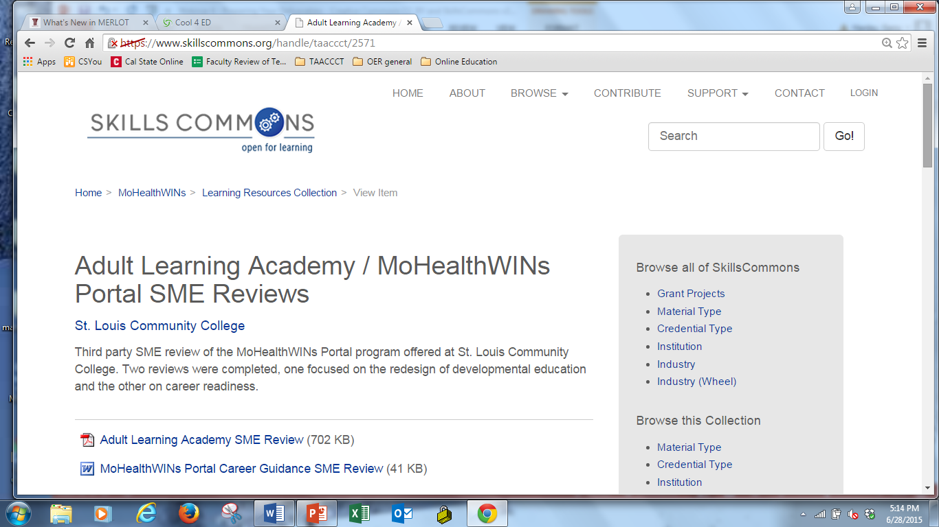
Sample SME Report

Slide 20
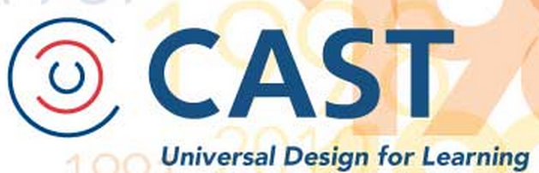
UDL Implementation
UDL GUIDES ALL ELEMENTS OF CURRICULUM
Goals
Materials
Methods
Assessment
udloncampus@cast.org

Slide 21
Support Center: Help With Quality Assurance

Slide 22
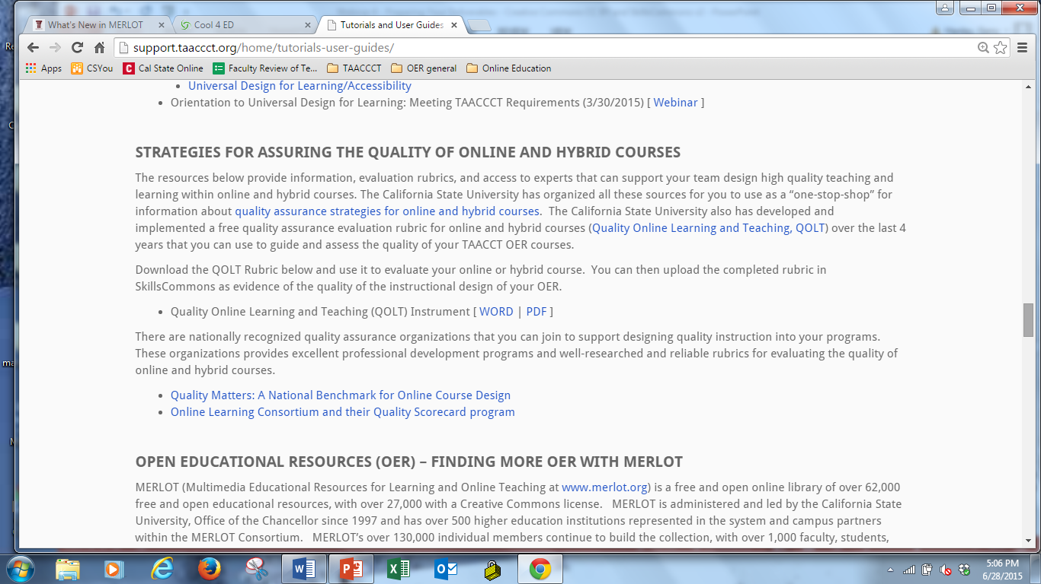
Quality Assurance for Online and Hybrid Courses

Slide 23
With good planning, It’s easy
UPLOADING

Slide 24
Uploading is like moving to a new home
Moving | Uploading | Comments & Advice
Find Your New Home | Get an Account from SkillsCommons | Any Questions??? Ask support@skillscommons.org
Clean out the things you don’t want to bring to your new home | Do “Spring Cleaning” on the materials you might have already uploaded – improve descriptions and repack | Deleting some “test materials” and starting fresh is best. Industry partner and descriptions are ones we believe need the most improvement
Packing up your belongings- not too big and not too small. Label your boxes well | Organizing your grant deliverables to be packaged for uploading. Add accurate and detailed descriptions in metadata | Think about how other people will want to use your materials. A zipped 500MB file will be too big for others to download. Organize submissions into “usable” instructional packages
Movers transport your belongings | Your staff uploads the digital packages to SkillsCommons | Recommend 1 or a few people to upload the materials for reliability in the descriptions/submissions

Slide 25
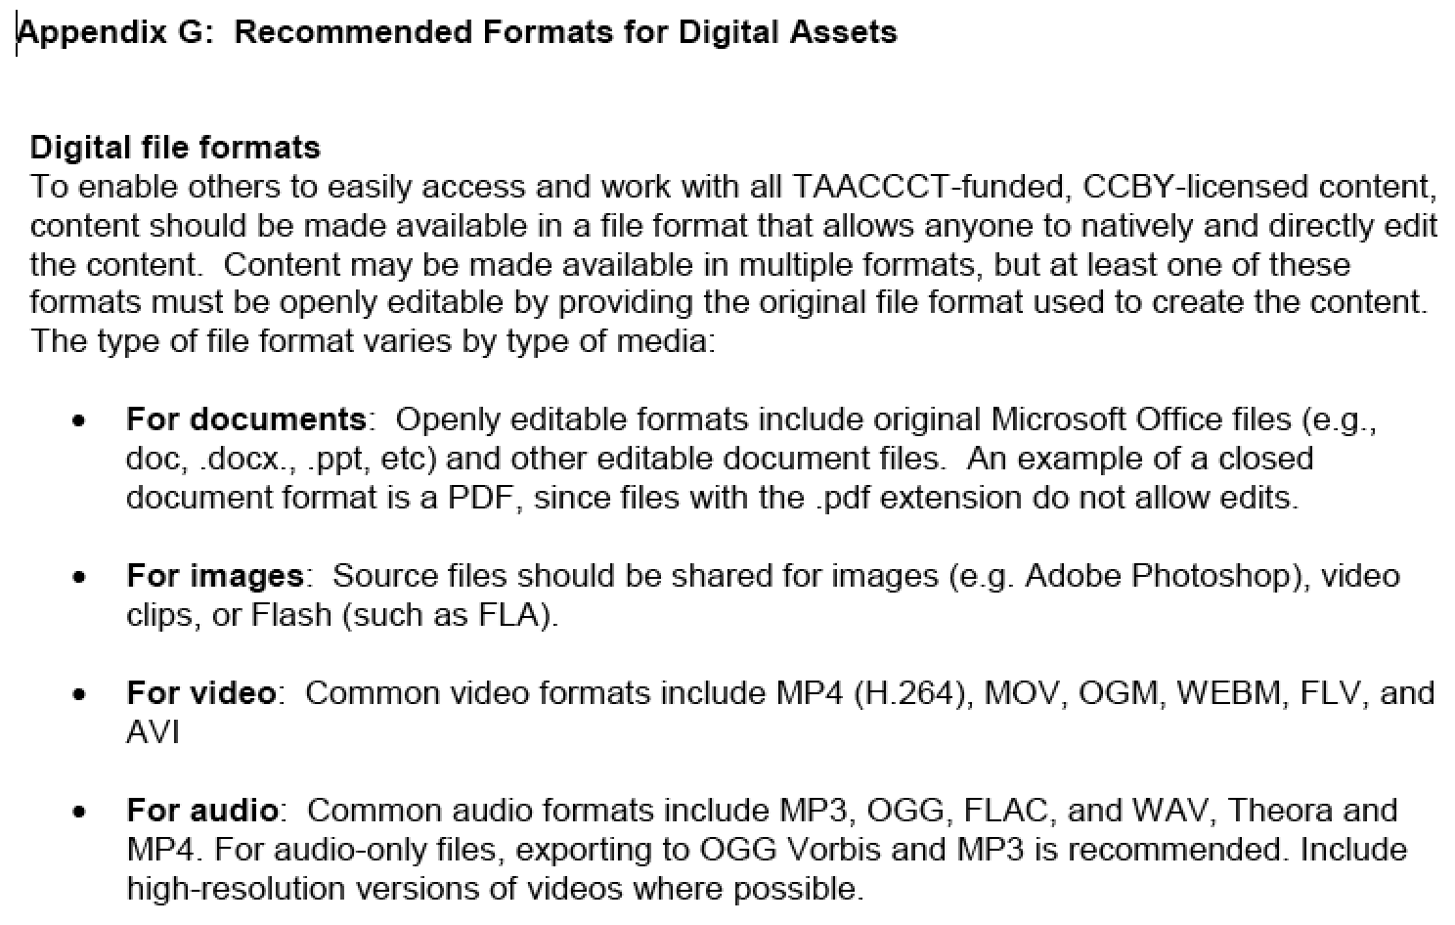
File Formats for Digital Assets
SGA

Slide 26
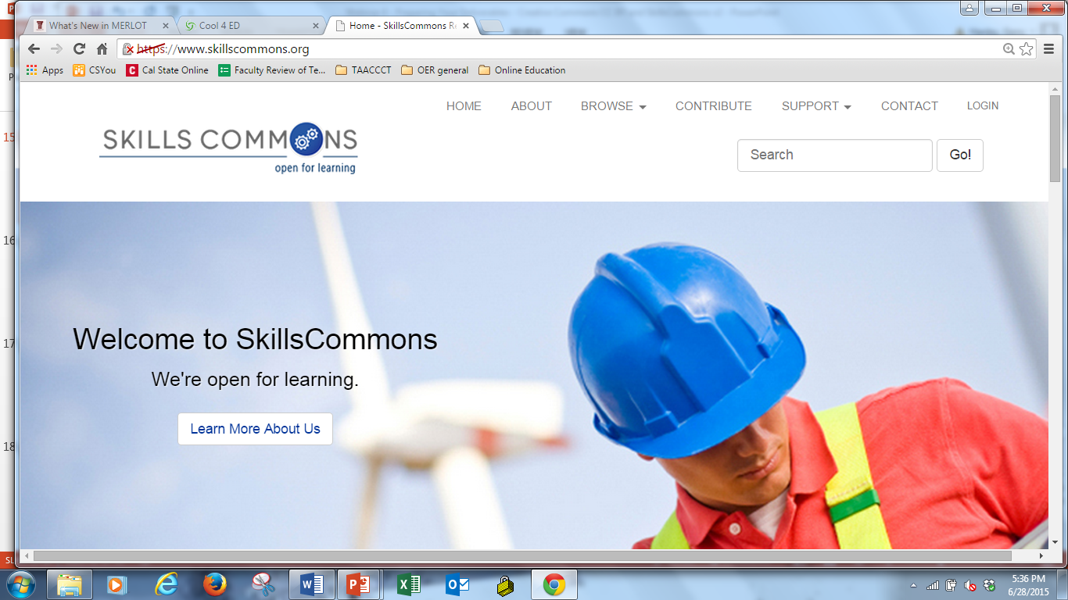
Demonstrating Uploading
http://skillscommons.org

Slide 27
Support Center: Help With Quality Assurance

Slide 28
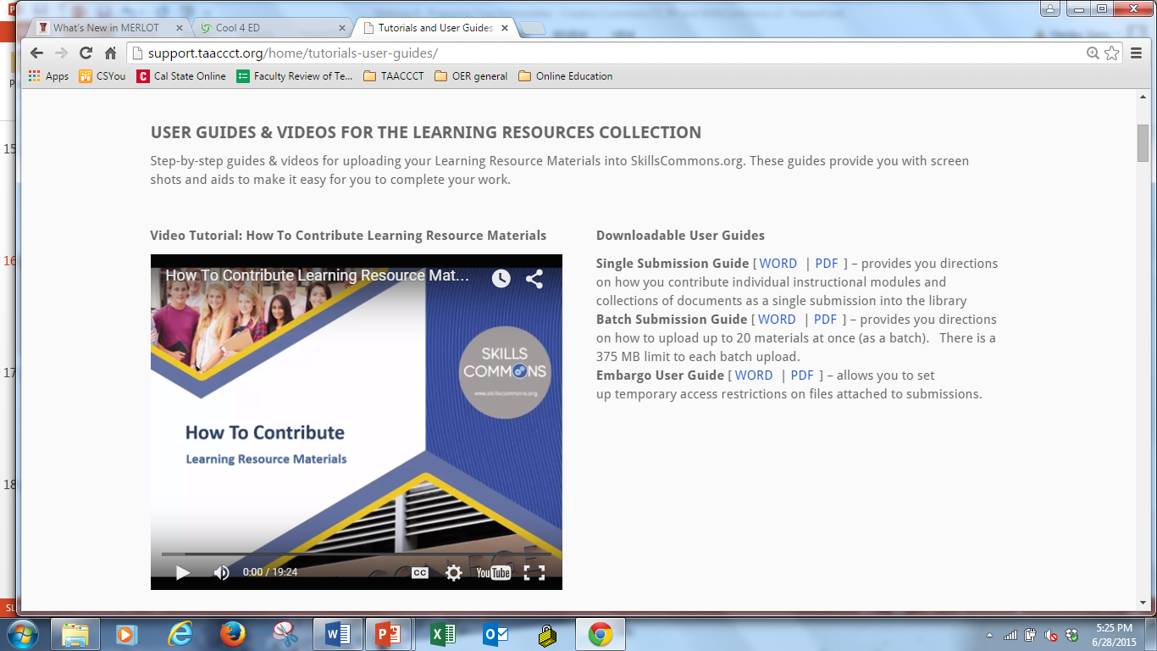
Support Center: Help with Uploading Process

Slide 29
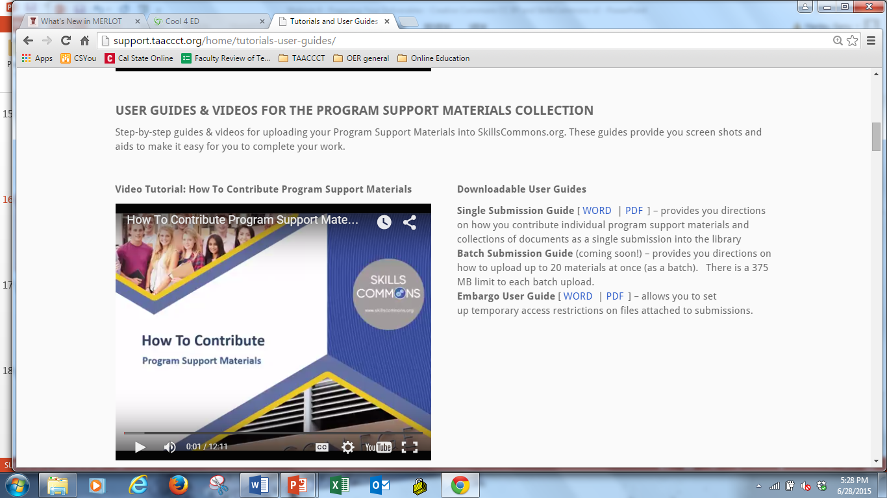
Support Center: Help with Uploading Process

Slide 30
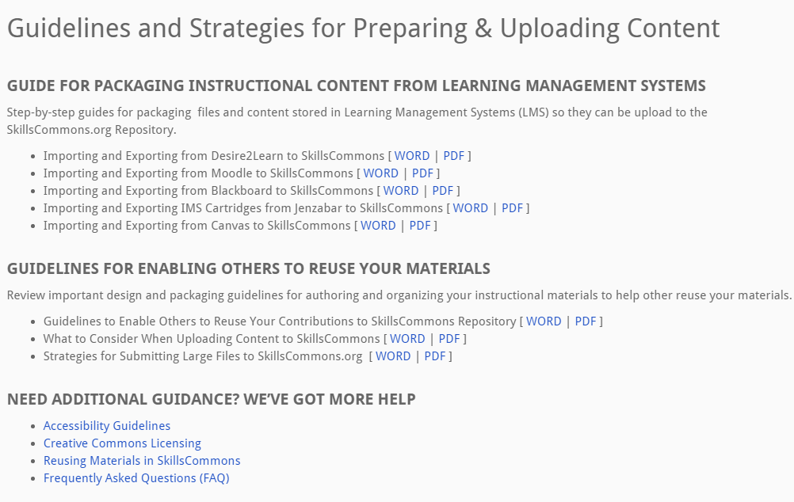
Support Center: Help with Uploading Process

Slide 31

Guidance for Grant Project Managers to Assess TAACCCT Grantee Contributions

Slide 32
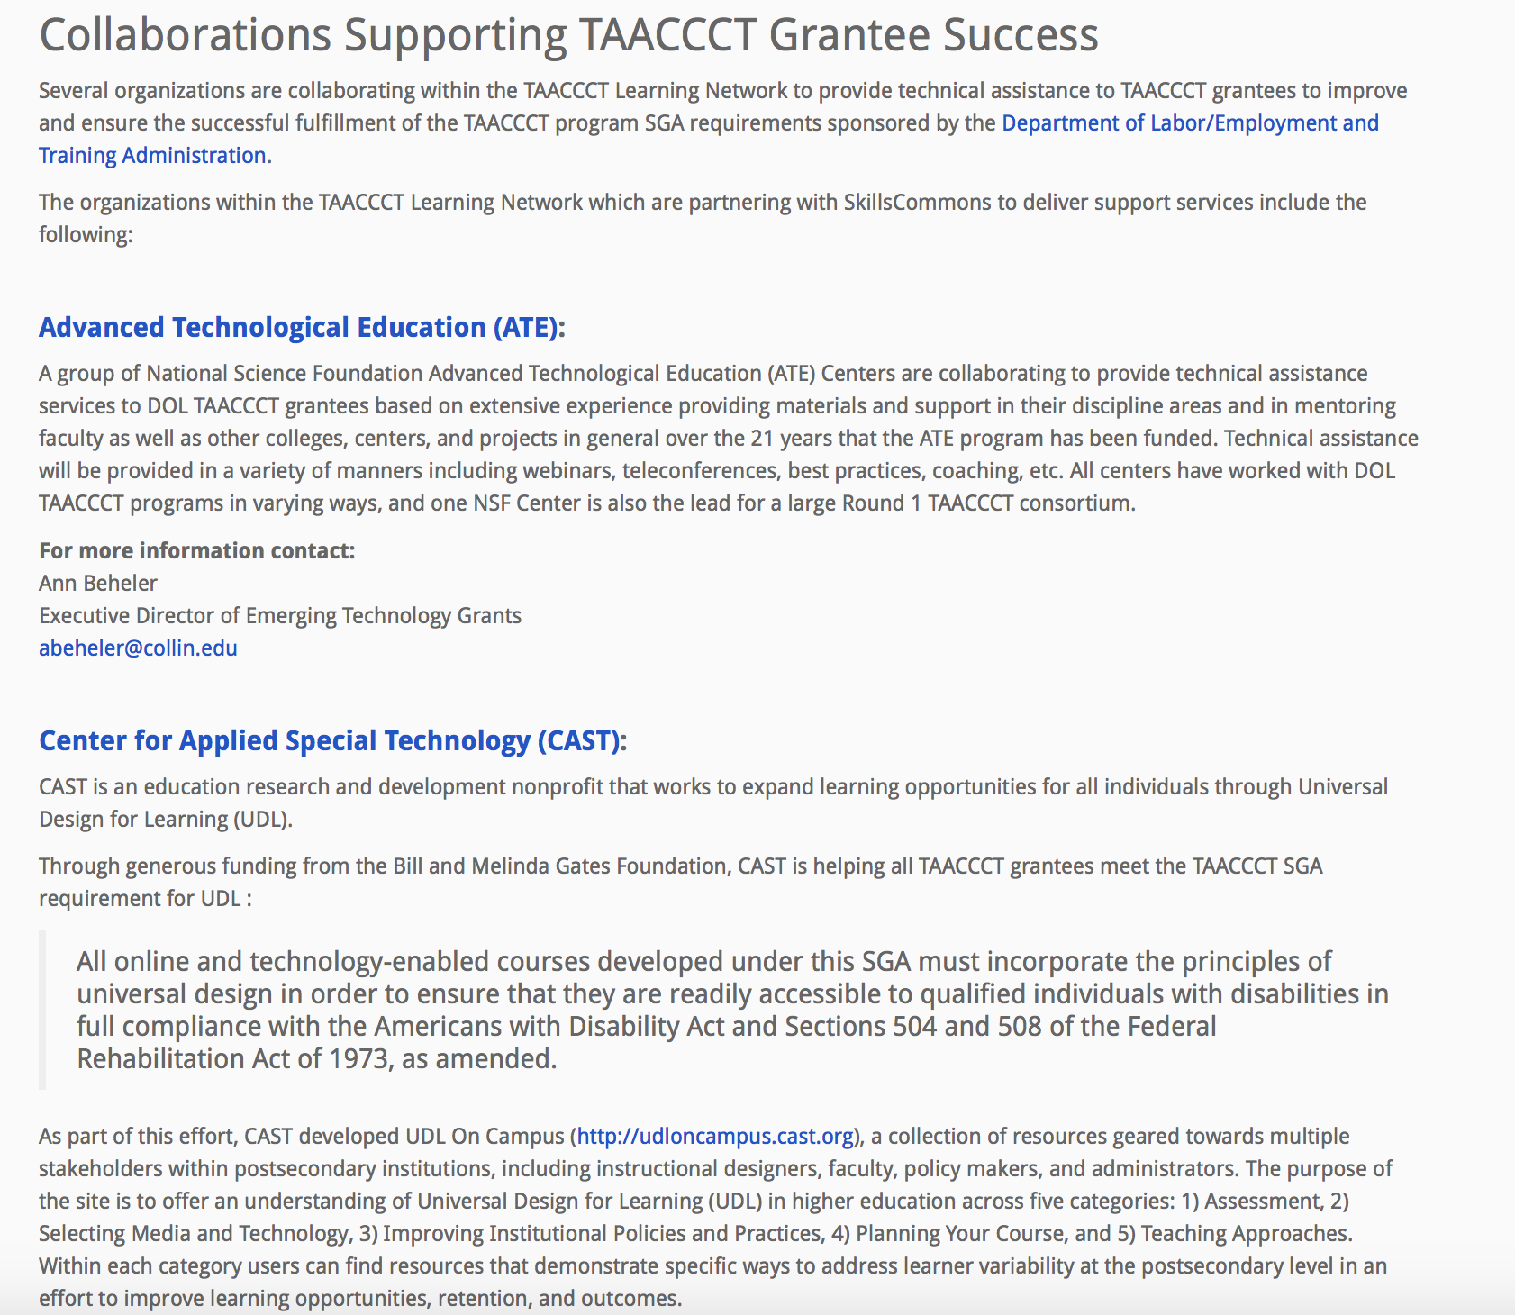
SkillsCommons Collaborations Supporting TAACCCT Grantee Success
Partners
Advanced Technological Education (ATE)
Center for Applied Special Technology (CAST)
Creative Commons
Jobs for the Future (JFF)

Slide 33
Questions
Explore the support services available from Creative Commons & Skills Commons
  SkillsCommons.org Support Services Center:
  http://support.taaccct.org/home/getting-started/
  Creative Commons: https://open4us.org
Ask questions:
Skills Commons support@skillscommons.org
Creative Commons taa@creativecommons.org

