Slide 1
Best Practices in Pre-Apprenticeship Training for Nontraditional Occupations
Webinar Date: July 14th, 2015
Presented by:
U.S. Department of Labor
Employment and Training Administration

Slide 2
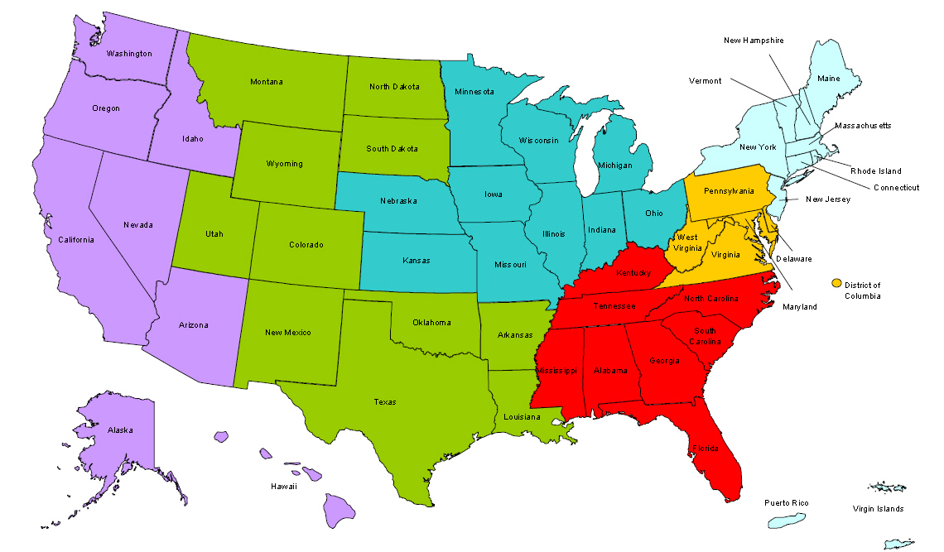
Where are you?
Enter your location in the Chat window – lower left of screen

Slide 3
Moderator
Felecia Hart
Team Leader & WANTO Project Officer
U.S. Department of Labor, Employment and Training Administration

Slide 4
WANTO OVERVIEW
The Women in Apprenticeship and Nontraditional Occupations (WANTO) Act of 1992 authorized the U.S. Department of Labor to award grants to Community-based Organizations to assist employers and labor unions in promoting the recruitment, training, employment and retention of women in apprenticeship and nontraditional occupations.
The U.S. Department of Labor funded a total of $1,938,182 in grants to help women through the WANTO program, an initiative designed to recruit, train and retain women in high-skill occupations in advanced manufacturing, transportation, energy, construction, information technology and other industries.

Slide 5
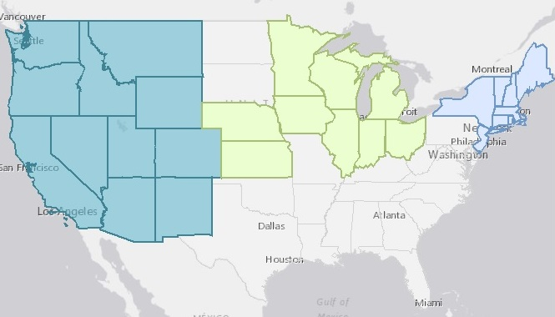
WANTO Grantee Service Areas
Nontraditional Employment for Women (NEW NYC)
Chicago Women in Trades
Western WANTO Consortium
Oregon Tradeswomen, Inc.
Tradeswomen, Inc. (CA)
Apprenticeship and Nontraditional Employment for Women (ANEW – WA)

Slide 6
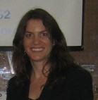
Presenters
Presenter: Meg Vasey
Title: Executive Director
Organization: Tradeswomen Inc.
Presenter: Kathleen Culhane
Title: Executive Director
Organization: NEW NYC

Slide 7
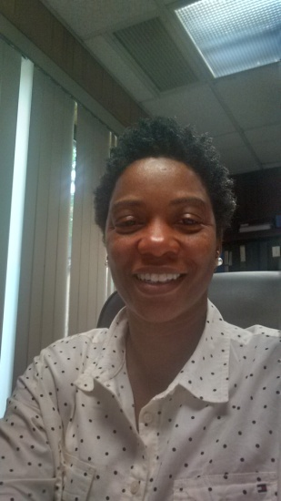
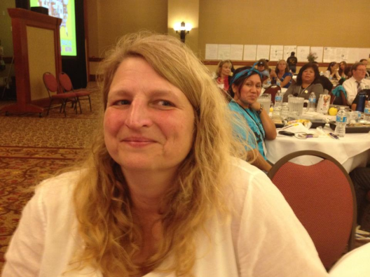
Presenters
Presenter: Leah Rambo
Title: Training Director
Organization: Sheet Metal Workers, Local 28
Presenter: Jayne Vellinga
Title: Executive Director
Organization: Chicago Women in Trades

Slide 8
Polling Question
What type of industry stakeholder are you?
1. Registered Apprenticeship Program
2. Employer
3. WIOA / American Jobs Center
4. Community College
5. Community-based service program
6. Government
7. Other

Slide 9
TRADESWOMEN INC
Tradeswomen Inc. (TWI)
Outreach, recruitment, retention and leadership development for women in the trades since 1979.
All photos :Vicky Hamlin for Tradeswomen Inc.

Slide 10
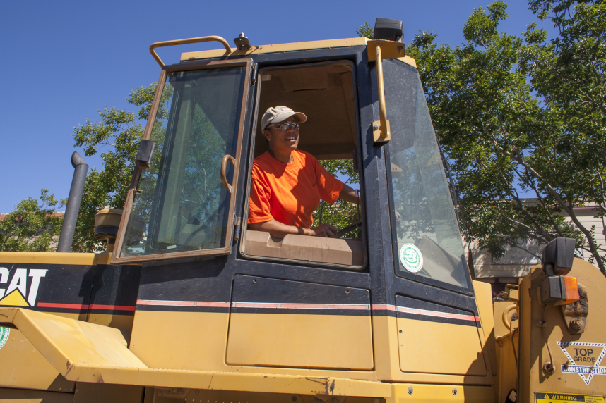
Bringing in More Women
Entry to Apprenticeship for
Women Workshops
We Cover Construction
Career Basics:
What are the trades?
What is apprenticeship?
What is a union?
Safe and informed environment for women to ask questions
All photos :Vicky Hamlin for Tradeswomen Inc.

Slide 11
GENERAL APPRENTICESHIP READINESS
THE CHECK LIST
Stable living situation
HS/GED
Driver’s license
Access to reliable transportation
Physical ability and fitness
English and math proficiency
Legal to work
Drug free

Slide 12
CO-ED PRE-APPRENTICESHIP TRAINING PROGRAMS (PAT)
MULTIPLE PAT PROGRAM MODELS
Single Craft Union sponsored
Multi-Craft Union endorsed
CBOs, Local Agencies
Statewide & National
PAT BENEFITS
BEYOND PREPARATION
Facilitated Entry into JATC
Formal agreements
All photos :Vicky Hamlin for Tradeswomen Inc.

Slide 13
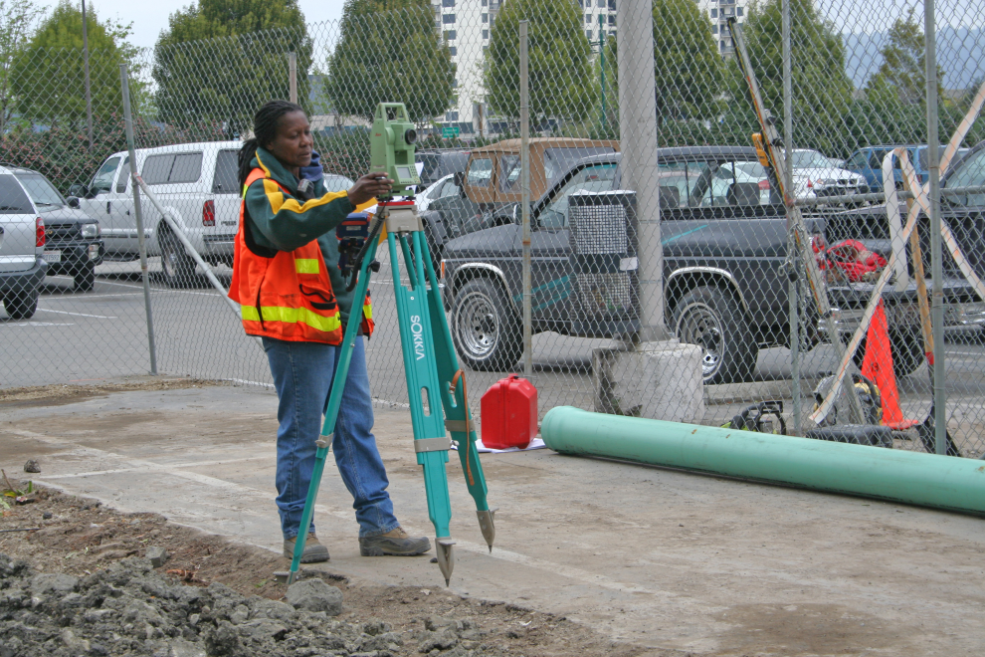
CHALLENGES for CO-ED PATs
Many PAT programs have 0-5% women
Co-Ed PATs require focus to increase #’s of women
Have women do the outreach
Feature women in all promotional materials
Employ female instructors and case managers
Remember diversity
Provide Critical Mass
Retention and placement
Also require strategies
All photos :Vicky Hamlin for Tradeswomen Inc.

Slide 14
STRATEGIES and VALUE-ADDS
TWI speaks women in all male industry
Outreach and recruitment targeted to women
Women well prepared for construction culture
Women Building California/Nation Conferences
Successful Co-Ed TWI Models
All photos :Vicky Hamlin for Tradeswomen Inc.

Slide 15
IMPACTS
Co-Ed PATs can expand the pathway for women into well-paid blue collar jobs
New focus and resources are key
Tradeswomen’s organizations are important partners
All photos :Vicky Hamlin for Tradeswomen Inc.

Slide 16
CONTACT INFORMATION
Meg Vasey
Executive Director
meg@tradeswomen.org
Tradeswomen, Inc.
1433 Webster St. Suite 100
Oakland, CA 94612
510-891-8773 x315
www.tradeswomen.org

Slide 17
Northeast Regional Technical Assistance Center
Hard Hats. Strong Women. Building the Future.

Slide 18
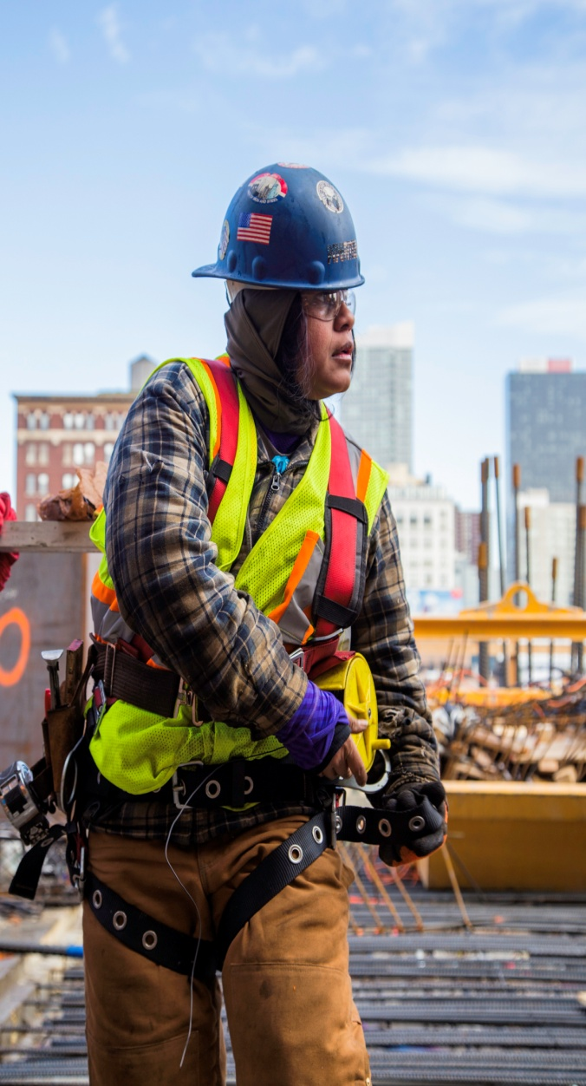
Strong Women
NEW’s Best Practices in Pre-Apprenticeship
Ongoing Recruitment
Consistent Training Cycle
Training Mirrors the Jobsite
Social Services Support
Pre-screening for Employers
Continued Retention of Tradeswomen

Slide 19
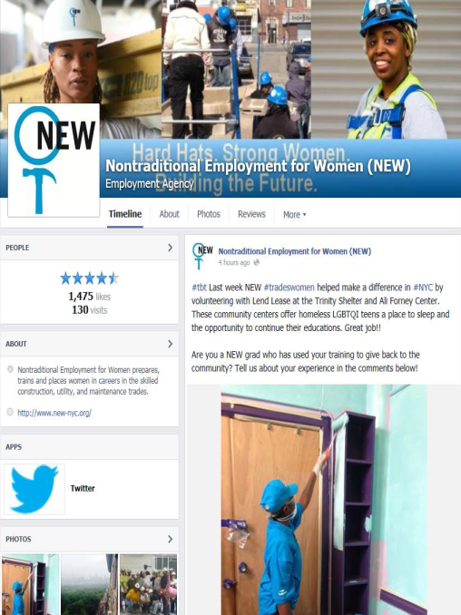
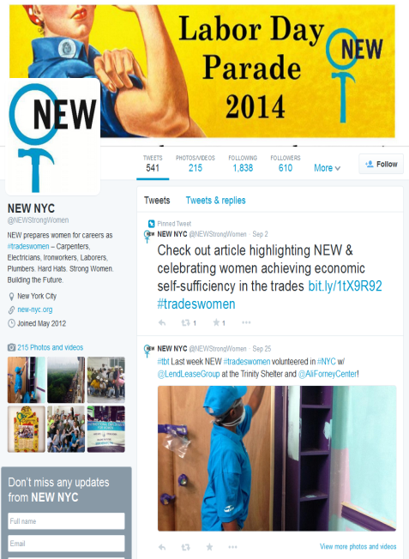
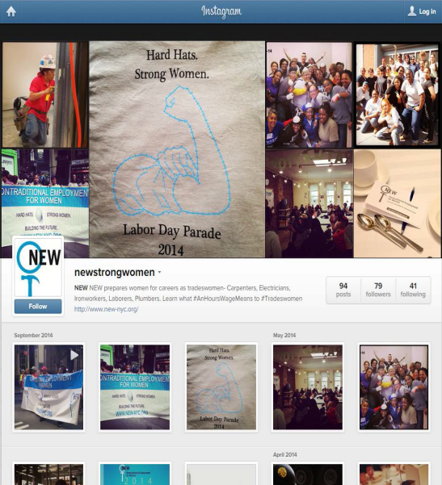
Social Media & Resources
www.facebook.com/nontraditionalemploymentforwomen
@NEWStrongWomen
Social Media Presence
Facebook – 1,673 likes
Each post viewed by 780 users (on average)
Highest reach this past month for one post is 1,007
Twitter – 665 followers
Reach over 2.6K Twitter users (on average) each month
Instagram (100 followers), LinkedIn (125 followers), YouTube (5,000+ views)
NEW’s Website
www.new-nyc.org
New Page for Apprentice Programs
Host Webinars
@NEWStrongWomen

Slide 20
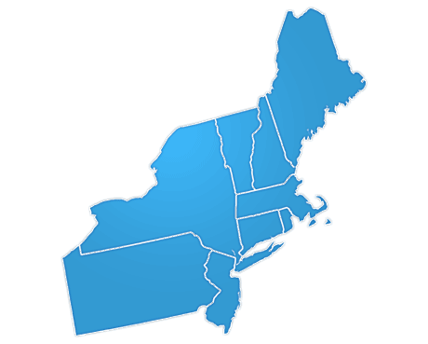
NEW Employers
Carpenters NYC District Council
Carpenters Dock Builders Local 1556
Carpenters Floor Coverers Local 2287
Carpenters Millwrights Local 740
Cement and Concrete Workers District Council
Electricians IBEW Local 3
Heat and Frost Insulators, Local 12
Ironworkers Local 40 & 361, Structural Ironworkers
Ironworkers Local 46, Metallic Lathers and Reinforcing Ironworkers
Ornamental Ironworkers Local 580
Laborers Local No. 78 Hazardous Materials
Laborers Local No. 79 Construction and General Building
Operating Engineers, Local 15
Painters and Allied Trades DC9 – Painters
Painters and Allied Trades DC9 – Bridge Painters Local 806
Painters and Allied Trades DC9 – Drywall Tapers Local 1974
Plasterers, Local 262
Plumbers Local Union No. 1
Sheet Metal Workers Local 28
Steamfitters Local 638
Tile, Marble and Terrazzo Local 7

Slide 21
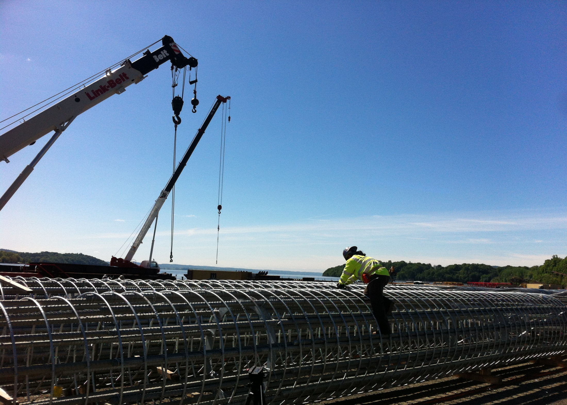
Building the Future
NEW Signature Projects Program
‒ Nani Noverita
NEW graduate, July 2012
Metal Lather, Local 46
40 NEW Signature Projects Citywide

Slide 22
Leah Rambo, JATC Administrator SMART Local 28 Training Center
Why Partner with a Pre-apprenticeship Training Program?
Pool of Qualified Candidates
Support throughout Training
Successful Apprentices → Successful Mechanics
Current Recruitment Seeing Record # of Applicants

Slide 23
CONTACT INFORMATION
Kathleen Culhane
Executive Director
kculhane@new-ncy.org
NEW NYC 243 W 20th St, New York, NY 10011 (212) 627-6252
www.new-nyc.org

Slide 24
Chicago Women in Trades
Founded by tradeswomen in 1981
Mission: to improve women’s economic equity by increasing their participation in high-wage blue collar occupations
Began operating the Technical Opportunities Program (TOP) in 1987
Serve an average of 75 women per year, 70% graduation rate, 70% placement rate, placed 65 women into apprenticeship programs or nontraditional occupations in FY ‘14
Everyone wins – success stories
Hard Hats. Strong Women. Building the Future.

Slide 25
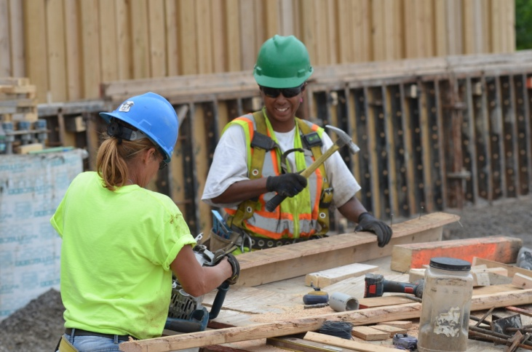
Best Practices - Curriculum
Create a supportive environment that builds confidence, encourages participants to overcome challenges and does not tolerate divisive behavior based on race, sexual orientation etc.
Acclimate students to the expectations and culture of the industry,
but support them in meeting those requirements
Promote peer support
Schedule classes to accommodate
working women
Comprehensive curriculum that
addresses all the barriers women face
in competing for and succeeding in apprenticeship

Slide 26
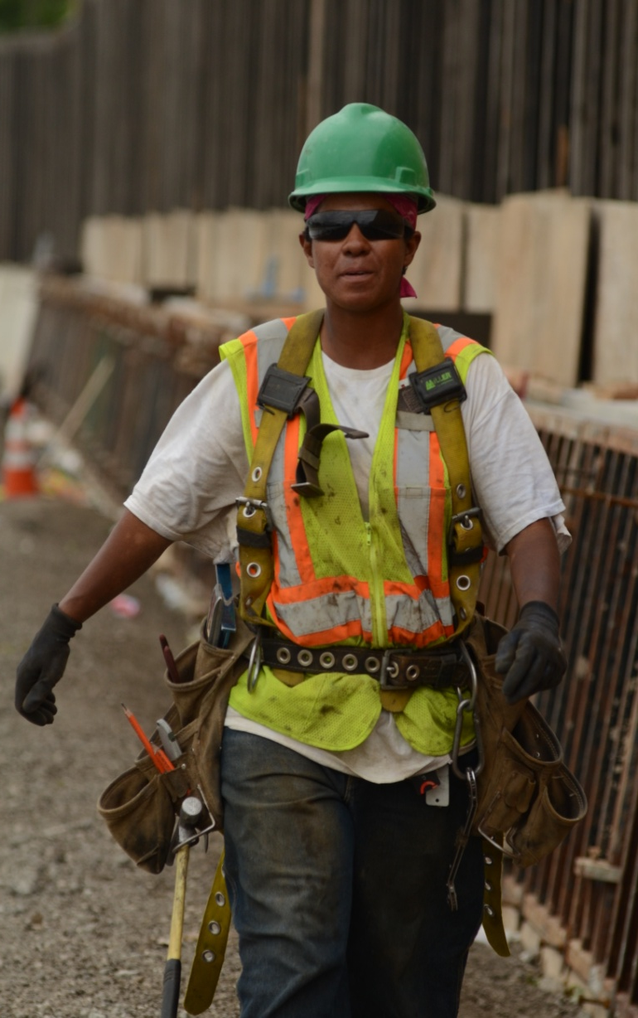
Best Practices - Curriculum
Math and test preparation
build in frequent assessment
organize study groups and have tutors available
Physical fitness
Upper body strength, flexibility and endurance
Material handling

Slide 27
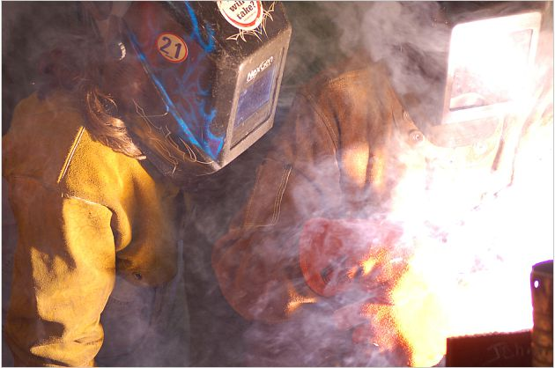
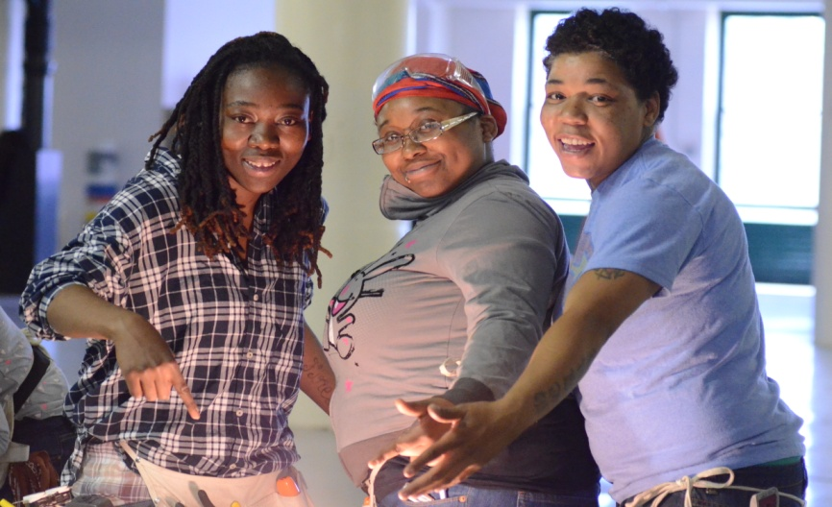
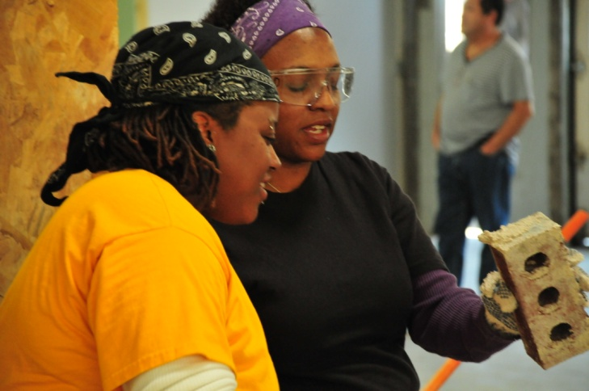
Best Practices - Curriculum
Basic construction skills and hands-on experience
Career exploration
Tradeswomen involvement
Incorporation of basic skills and math
Hands on field trips to apprenticeship programs

Slide 28
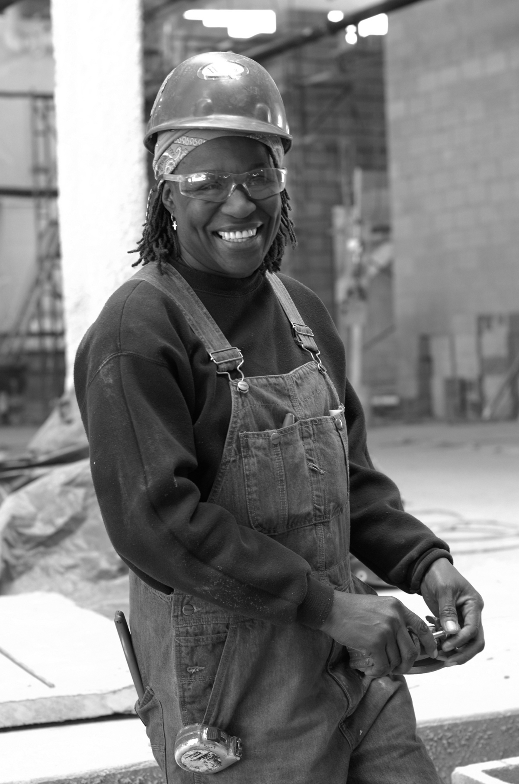
Best Practices - Curriculum
Workplace Readiness
Sexual Harassment Prevention
Mock interviews with
apprenticeship program and
employers
Q and A with tradeswomen, interview with a tradeswoman
Book Club

Slide 29
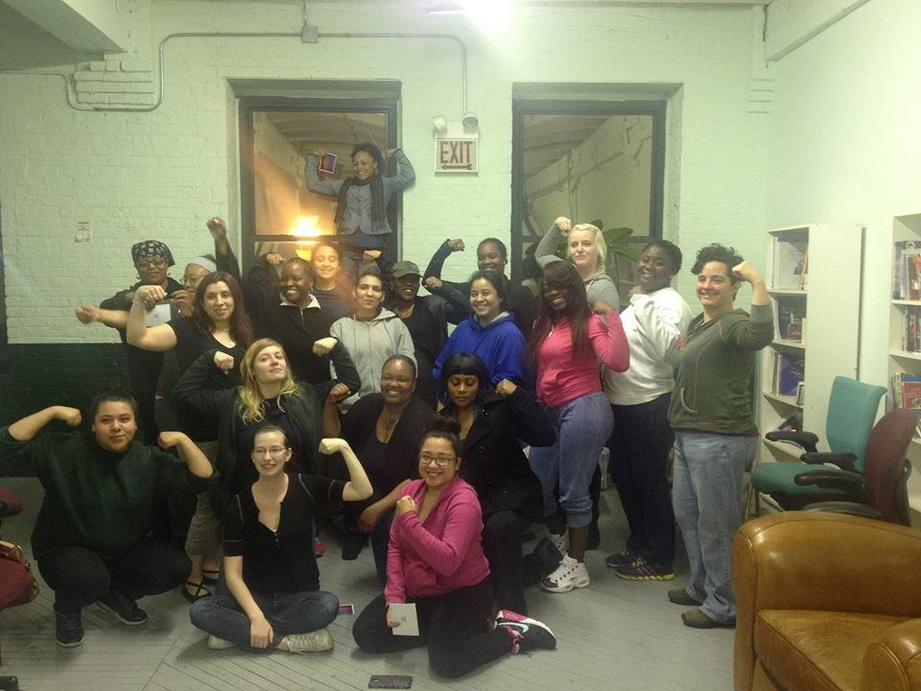
Resources
www.chicagowomenintrades2.org

Slide 30
CONTACT INFORMATION
Jayne Vellinga
Executive Director
jvelling@cwit2.org
Chicago Women in Trades
2444 W.16th Street Suite 3E
Chicago, IL 60608
312-942-1444
www.cwit2.org

Slide 31
Please enter your questions in the Chat Room!

Slide 32
Look for upcoming Webinars in this series!
Employment Supports & Placement
October 2015
Retention & Supportive Services
January 2016
Creating Equitable Jobsites & Classrooms
Sexual Harassment Prevention
March 2016
Best Practices in Mentoring for Nontraditional Occupations
June 2016

Slide 33
For More Information
For more information on the WANTO grant, please contact the
U.S. Department of Labor:
Felecia Hart, Project Officer
U.S. Department of Labor
Employment & Training Administration
202-693-3792
Hart.Felecia@dol.gov

Slide 34
www.workforce3one.org

