Slide 1
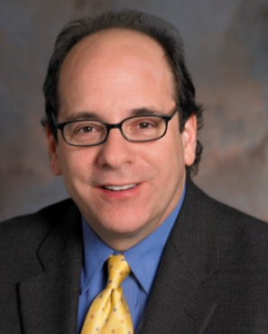
LTU Subject Matter Expert Series: Focus on Mental Health
Supporting Our Clients for the Long-Haul
Date: July 14, 2015; 2:00 p.m. EST
Presented by: Dr. David Blustein, Professor, Boston College, Department of Counseling, Developmental, and Educational Psychology

Slide 2
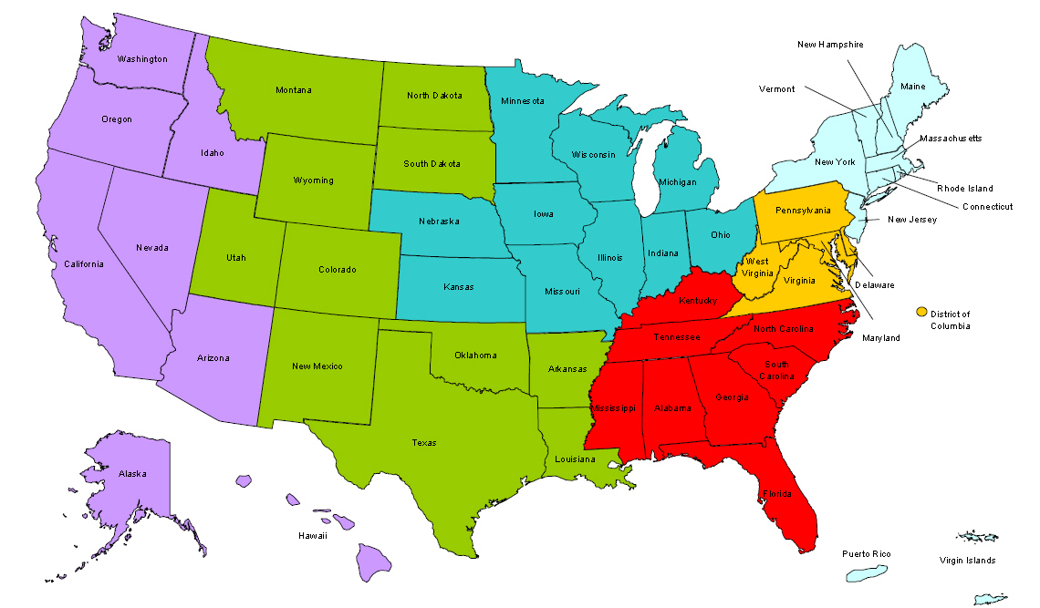
Where are you?
Enter your location in the Chat window – lower left of screen
Notes:
In the Chat Room, please type the name of the your organization, your location, and how many people are attending with you today.

Slide 3
Polling Questions
Polling Question # 1
Let’s get to know who is on the call today. Using the poll, select the role that you play in your H-1B RTW grant.
For this grant initiative I am the:
Authorized Representative
Program Director/Manager
IT/Data Manager or staff
Training Partner
Employer Partner
Service Provider

Slide 4
Welcome & Introductions
Moderator and Facilitator:
Megan Baird, RTW Policy Lead, DOL Division of Strategic Investments
Jen Swidler, RTW Technical Assistance Coach
Guest Speaker:
Dr. David Blustein, Professor, Boston College, Department of Counseling, Developmental, and Educational Psychology
Notes:
MEGAN: Hi everyone, welcome to today’s webinar on the Long-Term Unemployed Subject Matter Expert Series, called Focus on Mental Health: Supporting our Clients for the Long Haul for the H-1B Ready to Work Grants.
I’m Megan Baird from the Department of Labor, Division of Strategic Investments. Joining me today is Ayreen Calimquim and Jen Swidler with High-Impact Partners, our TA providers for the RTW grants.
We hope you are just as exited as we are to hear from our subject matter expert on the long-term unemployed. I will turn it over now to Jen who will talk more about the purpose of these webinars and introduce our special guest speaker.

Slide 5
Agenda: Enhancing Connections
Setting the stage:
Enhancing our empathic connection to our unemployed clients
Exploring the connection between unemployment and mental health
What does research tell us?
What do unemployed folks tell us?
Notes:
David:

Slide 6
Agenda: Enhancing Connections
Getting the Ready-to-Work Back to Work
What can counselors do to connect unemployed clients to sources of health and resilience?
Questions and comments

Slide 7
Setting the stage
Getting the Ready-to-Work Back to Work
Imagine…
You are laid off from your job…at the beginning, it seems like an opportunity to remake your work life.
You look for work…after 6 months, you start to become discouraged
Your relationships start to suffer
You have trouble sleeping
Your appetite increases or decreases dramatically
You have trouble getting out of bed some days

Slide 8
Questions
Getting the Ready-to-Work Back to Work
Does unemployment cause mental health problems or are those with mental health problems more likely to become unemployed?
What can research tell us about the relationships between unemployment and mental health that can improve our work with our clients?
What are the most effective counseling interventions that would help shore up our clients for the long-haul of getting back to work and restoring their mental health?

Slide 9
Where can we find answers?
Getting the Ready-to-Work Back to Work
Narratives and memoirs of the unemployed:
Staying in touch with the real lived experience
Research:
Creating the foundation for evidence-based practice

Slide 10
Where can we find answers?
Getting the Ready-to-Work Back to Work
Our counseling experience
I would like to ask you to write down some ideas that have worked for you in supporting the mental health of your clients.
We can share your experiences in the Follow-Up Roundtable Discussion next week.

Slide 11
Vignettes from the Unemployed:
Getting the Ready-to-Work Back to Work
“Everything gets touched,” said Colleen Klemm, 51, of North Lake, Wis., who lost her job as a manager at a landscaping company last November. “All your relationships are touched by it. You’re never your normal happy-go-lucky person. Your countenance, your self-esteem goes. You think, ‘I’m not employable.’”
- New York Times, 12/14/09

Slide 12
Vignettes from the Unemployed
Getting the Ready-to-Work Back to Work
“Every time I think about money, I shut down because there is none. I get major panic attacks. I just don’t know what we’re going to do.”
“After struggling and struggling and not being able to pay my house payments or my other bills, I finally sucked up my pride; I got food stamps just to help feed my daughter.”
New York Times, 12/14/09

Slide 13
Vignettes from the Unemployed
Getting the Ready-to-Work Back to Work
“I would say the part I’ve reached now is my career’s over, that’s the part I feel I’ve reached now; and now, you know, it’s over so I just take whatever is around really. You know, I’ve had my chances in employment, I’ve done as well as anyone could, anyhow in what I’ve had to face.”
- Narrative from Gabriel et al. (Organizational Studies)

Slide 14
The Unemployed: Real People with Real Problems
Getting the Ready-to-Work Back to Work

Slide 15
The Unemployed: Real People with Real Problems
Getting the Ready-to-Work Back to Work

Slide 16
The Unemployed: Real People with Real Problems
Getting the Ready-to-Work Back to Work

Slide 17
Unemployment and Mental Health: What does the research tell us?
Getting the Ready-to-Work Back to Work
Marie Jahoda proposed that work provides us with five important life needs:
Time structure
Social contact
Collective purpose
Status
Activity

Slide 18
Paul and Moser’s Meta-Analysis
The meta-analysis:
Integrated results of 237 studies with nearly half a million participants.
Results included the following:
People who lost their jobs experienced an increase in mental health problems
Once people became reemployed, their mental health improved
Journal of Vocational Behavior, 2009

Slide 19
Paul and Moser’s Meta-Analysis
Getting the Ready-to-Work Back to Work
Mental health problems exist in 16% of the general population and 34% of the unemployed.

Slide 20
Paul and Moser’s Meta-Analysis
Getting the Ready-to-Work Back to Work
Mental health problems are more pronounced among
Men
blue-collar workers
long-term unemployed

Slide 21
William Julius Wilson: When Work Disappears
Getting the Ready-to-Work Back to Work
Wilson studied urban Chicago to understand the impact of the loss of employment.
The loss of work was associated with increases in family problems, the breakdown of communities (increased crime, substance abuse, etc.)
Work creates the link to the greater social community.
People suffer individually without work.
Communities suffer as well, creating a cycle of poverty and despair

Slide 22
Wilson’s Conclusion
Getting the Ready-to-Work Back to Work
“In the absence of regular employment, a person lacks not only a place in which to work and the receipt of regular income but also a coherent organization of the present – that is a concrete system of expectations and goals. Regular employment provides the anchor for the spatial and temporal aspects of daily life.”

Slide 23
Wilson’s Conclusion
Getting the Ready-to-Work Back to Work
“It determines where you are going to be and when you are going to be there. In the absence of regular employment, life, including family life, becomes less coherent. Persistent unemployment, and irregular employment hinder rational planning in daily life, a necessary condition of adaptation to an industrial economy.”

Slide 24
The Jobs Program: An Intervention Project
Getting the Ready-to-Work Back to Work
Price and Vinokur designed a structured reemployment program that combined social support and specific job search strategies.
Research evidence indicates the following:
The social support of the group is a critical ingredient.
The program worked better than self-help efforts (clients following a printed reemployment guidebook).
In sum, people benefited from both instrumental and emotional support
The groups helped people to find work and to reduce mental health problems.

Slide 25
Unpacking the Jobs Club Results
Getting the Ready-to-Work Back to Work
What seemed to help?
Social support
The experience of telling one’s story to an empathic and concerned group.
Learning practical job search skills

Slide 26
The Power of Shared Experience
Getting the Ready-to-Work Back to Work

Slide 27
The Power of Shared Experience
Getting the Ready-to-Work Back to Work
“Even when someone couldn’t help me out financially or otherwise, just being a sounding board; being someone who can give you psychological help. That has been the biggest help that I have had. Knowing that you’re in the same boat with a lot of other people. Um, but that is, probably the most of what I’ve gotten. Along with that, I know that if my back is to the wall, that I know if they can they will, will help me out.”
(Boston College Unemployment Study Participant)

Slide 28
Supporting our Clients: An Intervention Strategy
Getting the Ready-to-Work Back to Work
Assess
Intervene
Access
Evaluate

Slide 29
Supporting our Clients: Assess
Getting the Ready-to-Work Back to Work
Assess the mental status of your clients.
Normalize the inclusion of a mental health history and assessment of current functioning in your initial sessions.
Normalize the fact that feelings of sadness, hopelessness, and anger are natural and understandable.

Slide 30
Assess
Getting the Ready-to-Work Back to Work
At times, the best intervention is a referral…
Recall the ethical commitment to practice within one’s areas of competence
That said, many mental health counselors and many career counselors have skills in both work and non-work contexts.

Slide 31
Assess
Getting the Ready-to-Work Back to Work
Recall the results from Paul and Moser
Unemployment of more than 6 months is associated with marked increases in mental health problems.
The loss of work is often akin to bereavement.

Slide 32
Assess
Getting the Ready-to-Work Back to Work
Assess for serious mental health problems
Risk of self-injury
Risk of assaultive behavior
Unemployment (particularly long-term unemployment) is a major stressor and can severely exacerbate underlying mental health problems.

Slide 33
Intervene
Getting the Ready-to-Work Back to Work
Ensure that clients have access to both career interventions and mental health interventions.
A conceptual framework—Inclusive psychological practice (summarized in the Psychology of Working-Routledge).
Dignify issues in both the work and non-work domains
Build on areas of strength and resilience.

Slide 34
Intervene
Getting the Ready-to-Work Back to Work
Evidence-based practice
The working alliance
Social support starts in the counseling relationship
Conveying support
Experience-near empathy
Help client feel understood
Affirm clients’ need for connection

Slide 35
Intervene
Getting the Ready-to-Work Back to Work
Help clients identify support in their communities.
Work with clients on finding adaptive ways to ask for support.
Learn about and nurture support groups in your community

Slide 36
Intervene
Getting the Ready-to-Work Back to Work
Stress management
Mindfulness to manage the ongoing anxiety and ruminations about the loss of work
Letting thoughts and feeling flow through us
Develop a compassionate relationship to ourselves and others
Meditation
Exercise
Other adaptive forms of distraction

Slide 37
Intervene
Getting the Ready-to-Work Back to Work
Helping clients construct narratives of their work lives and transition to unemployment.
The process of creating the narrative is therapeutic.
The narrative also gives the counselor an opportunity to fully connect the dots.
While the events are often experienced in a deeply individualistic way, the real story needs to include the context.
This can form a powerful reframe as well as a story that is ultimately affirming.

Slide 38
Intervene
Getting the Ready-to-Work Back to Work
Recall Jahoda’s findings:
Help clients structure their days with job search activities, skill building, stress reduction, and social connections.
Provide clients with means of experiencing new accomplishments and internalizing previous accomplishments.
Helping clients to actively engage in their lives, which can help to reduce depressive symptoms.

Slide 39
Intervene
Getting the Ready-to-Work Back to Work
The best predictor of a return to pre-unemployment levels of mental health is…
A new job!
Your skills as a service provider/career counselor are essential for fully integrative counseling.

Slide 40
Intervene
Getting the Ready-to-Work Back to Work
Supporting an active, engaged, and creative job search
Review latest approaches that are working
Networking
Assess transferable skills
Skills development…Critical for the 21st century

Slide 41
Access
Getting the Ready-to-Work Back to Work
We cannot do this hard work alone.
Help clients locate support groups, job clubs, and the like.
Connect clients to One-Stop Career Centers and other career service agencies in your area.
Connect clients to sources of training and skills development.

Slide 42
Access
Getting the Ready-to-Work Back to Work
Social support…
Social support…
Social support!

Slide 43
Evaluate
Getting the Ready-to-Work Back to Work
We cannot control the job market and we should not take the blame for clients’ ongoing struggles to find work.
We need to be careful about vicarious traumatization.

Slide 44
Evaluate
Getting the Ready-to-Work Back to Work
Consider…
What seemed to help with a given client?
Continue to explore the literature to learn about evidence-based practices.
Share your wisdom and insights with the career counseling community.

Slide 45
Closing Comments
Getting the Ready-to-Work Back to Work
Let’s give an unemployed person an opportunity to conclude:
“I never thought I’d be at this stage now because I, I thought I’d throw in the towel, but I’ve always been a fighter. I come from a strong family. I know strong people and I can’t let myself down. Society has let me down but I can’t let society define me. I can’t let unemployment define me.”
Boston College Unemployment Project participant

Slide 46
Please enter questions in the Chat Room!
Notes:
Please enter your questions into the Chat Room!

Slide 47
Follow-Up Roundtable Discussion
Getting the Ready-to-Work Back to Work
LTU Subject Matter Deep Dive!
Follow-Up Roundtable Discussion with Dr. Blustein
July 22, 2015 at 3:00 p.m. Eastern.
Bring your questions and comments in a lively follow-up discussion on the information presented during today’s webinar.
Hear from fellow grantees with robust mental health programs.
Anne Arundel Workforce Development Corporation
Jewish Vocational Services
Notes:
Jen:

Slide 48
DOL Contacts
Dr. David Blustein
David.Blustein@bc.edu
Your Federal Project Officer, DOL National Office and Technical Assistance Providers
Ready to Work Grantee Mailbox
RTW@dol.gov
Notes:
Megan Baird:
Closing Remarks
- Thank Dr. David Blustein for an interesting/relevant/useful presentation
- Thank grantees for attending, encourage them to attend Roundtable Discussion (Jen will have already mentioned the details)

