Slide 1
Tips and Tools for New Project Managers
July 14, 2015
Jennifer Freeman, Program Director, TAACCCT Learning Network
Maria Fieth, Project Director, Consortium for Healthcare Education Online

Slide 2
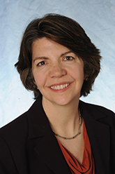
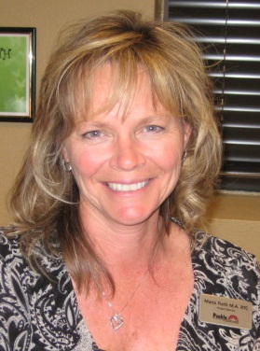
Presenters
Jennifer Freeman, Program Director
TAACCCT Learning Network
Jobs for the Future
Maria Fieth, Project Director, CHEO
Pueblo Community College

Slide 3
TAACCCT LEARNING NETWORK AT A GLANCE
U.S. Department of Labor, Employment & Training Administration
(National)
Jobs for the Future
CalState/Merlot
Maher & Maher
American Association of Community Colleges
U.S. National Science Foundation
ATE Centers
Other Non-Federal Providers of TA and Resources for TAACCCT Grantees:
Creative Commons
CAST
The Transformative Change Initiative

Slide 4
Agenda Items
Welcome & Introductions
Understanding TAACCCT Goals
Elements of Success
Workplans & Reporting Systems
Communications within the college and across the consortium
Stakeholder Engagement
Summing it all Up – Keys to Success

Slide 5
Participant Poll
Which do you represent?
Single college grantee
Consortium grantee
What is your TAACCCT experience?
This is my first time managing a TAACCCT grant
I have managed one or more previous rounds of TAACCCT

Slide 6
Multiple Goals Of The TAACCCT Grant
Redesign Education & Training Delivery
Ultimate Impact
Structural, systemic change within colleges and across systems
Program Deliverables
Participant Outcomes
Student Attainment and Jobs

Slide 7
Elements for Success
Management Procedures
Stakeholder Engagement
Communications
Read and understand Your Statement of Work (SOW)
Get staff on board and trained
Secure subagreements ASAP
Establish data collection and reporting systems
Establish other policies and procedures
Develop agreement for wage-record matching
Develop a spending plan
Build strong partnerships with workforce system
Engage employers
Make sure everyone understands the goals and activities -- faculty, administrators, workforce stakeholders
Set up team meetings, email updates and other regular systems for communication
Student Supports
Curriculum/Program Design
Hire, train and develop systems to support your navigators
Develop plans to support student recruitment, retention and job placement
Leadership and Decision-Making
Educate faculty and staff about the OER and CCBY requirements
Educate faculty and staff regarding ADA 504/508 requirements
Ensure leadership buy-in and visible support
Establish structures for decision-making

Slide 8
Consortium for Healthcare Education Online

Slide 9
Date Collection & Reporting
Wage Data Collection

Slide 10
Participant Poll
Do you have a wage record-matching
agreement in place with your
state’s unemployment insurance
agency?
Yes
No
Not yet, but it’s in process

Slide 11
Date Collection & Reporting
Establish a plan early for the collection of all data – who’s responsible? Enrollment data, completion/progress, job placements
For Job Placement Verification
Frontload the set up of a system for wage-record matching with the Unemployment Insurance agency in your state
Triangulate Data if necessary
Work backward from annual reports and Q reports

Slide 12
Reporting in a Consortia
College work plans need to align with consortium SOW
Reports from each college should mirror required DOL
Quarterly and Annual Reports
Each college should know their progress vs. the consortium’s progress

Slide 13
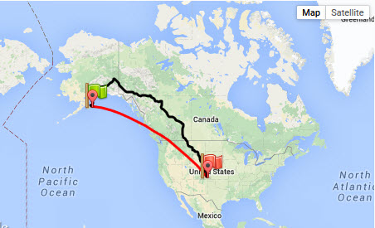
Reporting at Individual Colleges
For single-site grants, regular status reports to the president and others helps to keep team on-track

Slide 15
Keep an Eye on Spending
Consortium members and leadership need to keep an eye on expenditures.

Slide 16
Focus on Spending, Single-Site
Single-site grant managers should also share budget numbers with team members and leadership.

Slide 17
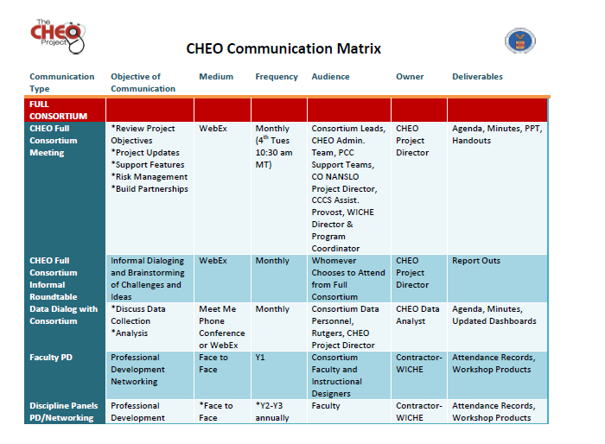
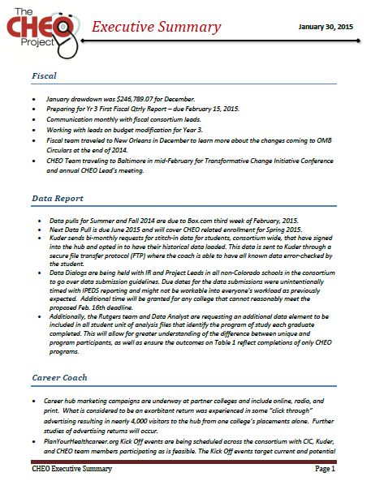
Reporting to Leadership
Regular status reports (college vs. consortium performance) to each college president helps to keep each consortium member on-track

Slide 18
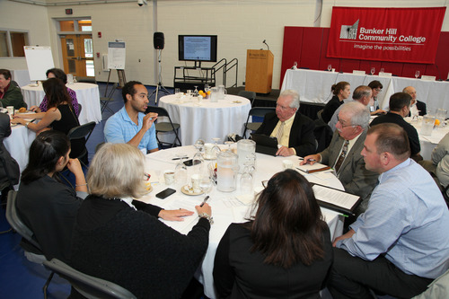
Peer-Sharing and Momentum Building
Build systems for sharing grant information…
In-Person and virtual events
Newsletters, Email Blasts
Presentations (in-person and by webinar)
… and peer sharing and planning
College and consortium implementation teams
Consortium or college-wide
Industry Teams
Faculty Working Groups
Community College/Job Center Convenings
Virtual Peer Sharing via Online Tool (e.g. Basecamp, Dropbox, or GroupSite)

Slide 19
Employer Engagement
Approach Employers Early
Build Work-Based Learning Components
internships
Early and deep employer engagement leads to JOBS for your graduates
clinical education
on-the-job training
Identify skill needs
Build aligned curriculum
www.planyourhealthcareer.org

Slide 20
Public Workforce System Engagement
Successful collaboration with the Public Workforce System (PWS) can significantly enhance the success of your TAACCCT grant
PWS includes State Workforce Agencies, Workforce Investment Boards, and American Job Centers
Collaboration can lead to stronger employer engagement, enhanced services for participants, and increased participant outcomes

Slide 21
Discussion question
Q. What is the status of your working relationship with your WIB and/or One-Stop Career Center/American Job Center?
Signed on to the grant but no defined
Role
Defined role (on paper) but limited
Active engagement
Clearly defined role and we
are actively working together

Slide 22
Stakeholder Engagement: The Public Workforce System
Engage the system early in the grant – explore areas of collaboration
NOW
Focus on developing a true partnership – what TAACCCT services
and activities can benefit the PWS? What can PWS services and
activities can benefit the TAACCCT grant?
Explore how the TAACCCT grant can support PWS outcomes, such
as employment of PWS participants
Leverage your respective core competencies – in what areas is the
PWS particularly effective? Where does the college excel?
Utilize common stakeholders – shared board members, employers
Identify a PWS partner to serve as a champion with their peers

Slide 23
Summing it all up:
Key Tips for Successful Grant Implementation
Secure buy-in from top leadership, and leadership demonstrate support for grant to college staff
Complete subagreements with consortium members as quickly as possible
Develop systems and processes for engaging members, from con calls to software
Implement strong systems for tracking deliverable progress as well as participant outcomes
Develop an agreement for wage-record matching with state agency to track job placements
Focus on spending, early and often – develop a spending plan and check-in with consortium regularly
Engage employers, early and often - focus on deep, comprehensive partnerships

Slide 24
Tracking Tools for Managers
Samples of Today’s Tools:
CHEO Project Dashboard
Another sample dashboard and other tools – MoWINs
http://mccatoday.org/programmatic-documents/
CHEO Newsletter
Health-e Workforce newsletter: http://eepurl.com/bo9uXL
http://planyourhealthcareer.org/pathways

Slide 25
Thank You!
Find a handy and frequently updated list of available TAACCCT webinars in the TLN Catalog:
https://etagrantees.workforce3one.org/view/2001510061517561311/info
Find other materials for TAACCCT success at:
https://etagrantees.workforce3one.org
Ask questions and to connect with peers and resources at TAACCCT@dol.gov

