Slide 1
ACT NOW Series:
Governance, Leadership and Building a Strategic Board
July 15, 2015
U.S. Department of Labor

Slide 2
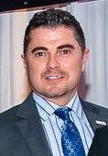
Joseph Barela
Senior Advisor
Employment and Training Administration, U.S. Department of Labor
Have a question or comment about WIOA? E-mail DOL.WIOA@dol.gov

Slide 3
Webinar Agenda
Federal Perspective on Strategic Boards
Governance and Leadership Panel
Question & Answer Session
Upcoming TA and the Innovation & Opportunity Network

Slide 4
TODAY’S PRESENTERS
Deputy Administrator
Employment and Training Administration,
U.S. Department of Labor
Kathy Tran
Senior Advisor | Moderator
Employment and Training Administration,
U.S. Department of Labor
Joseph Barela

Slide 5
Voices of Experience Video

Slide 6
Kathy Tran
Deputy Administrator
Employment and Training Administration, U.S. Department of Labor
Have a question or comment about WIOA? E-mail DOL.WIOA@dol.gov

Slide 7
Vision for WIOA GOVERNANCE & Leadership
Workforce boards as:
System Builders: WIOA expands the strategic roles of state and local workforce development boards
Regional Backbones: WIOA positions boards to better meet the workforce needs of local and regional employers

Slide 8
Key Governance Provisions within WIOA
Reduces size of state, local boards
Streamlines board membership
Retains business majorities/leadership role (w/ focus on high-growth employers)
Voc. Rehab., Adult Ed, and Registered Apprenticeship as required members
Enhances local control over the mix of services
More flexibility

Slide 9
Expected Outcomes
More talent development strategies:
Enhanced sector strategies
Coordinated career pathways
Strengthening connections between core programs
Fresh operational approaches:
Implementing evidence-based promising practices
Use of technology to connect intake, case management systems
Customer flow/service (e.g. customer-centered service design)

Slide 10
For More Info…
Review the Governance Training and Employment Guidance Letter No. 27-14
http://www.doleta.gov/wioa/

Slide 11
For More Info…
Review the Local Leadership and Governance QSAP:
http://qsap.workforce3one.org/page/planner

Slide 12
Panelist discussion
Executive Director
Centralina Workforce Development Board, Charlotte, NC
David Hollars
Deputy Secretary
Kentucky Education and Workforce Development Cabinet
Beth Brinly
Executive Director
Lane Workforce Partnership, Eugene, OR
Kristina Payne

Slide 13
VIDEO PANEL DISCUSSION

Slide 14
Questions & Answers

Slide 15
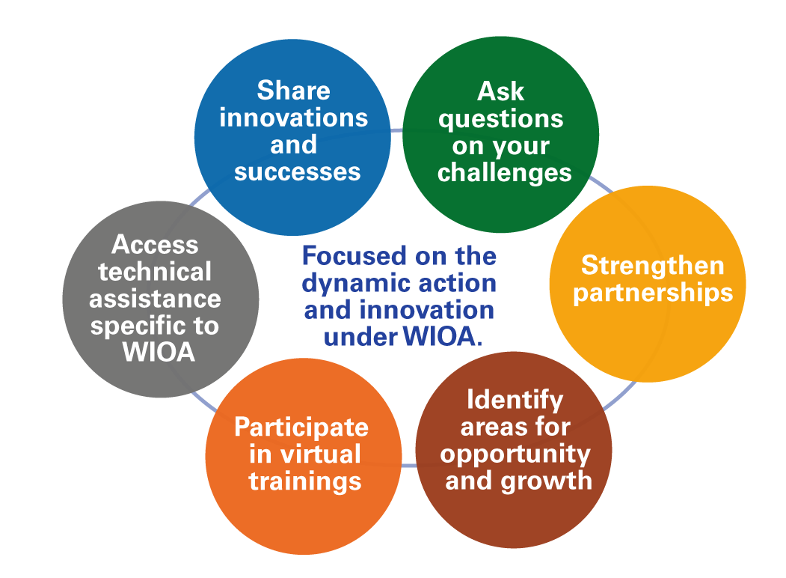
Innovation & Opportunity Network (ION)
Join the ION Community of Practice

Slide 16
Roadmap to Transformational Change
9

Slide 17
ION Technical Assistance: UP NEXT
How might we improve the customer experience and outcomes for our shared one-stop customers?
Webinar: Customer Centered Design
July 29th
12:00pm—1:30pm et
https://ion.workforce3one.org

