Slide 1
Budget Controls for Program Effectiveness
Webinar Date: Thursday, July 16, 2015
Presented by:
Office of Grants Management
U.S. Department of Labor
Employment and Training Administration

Slide 2
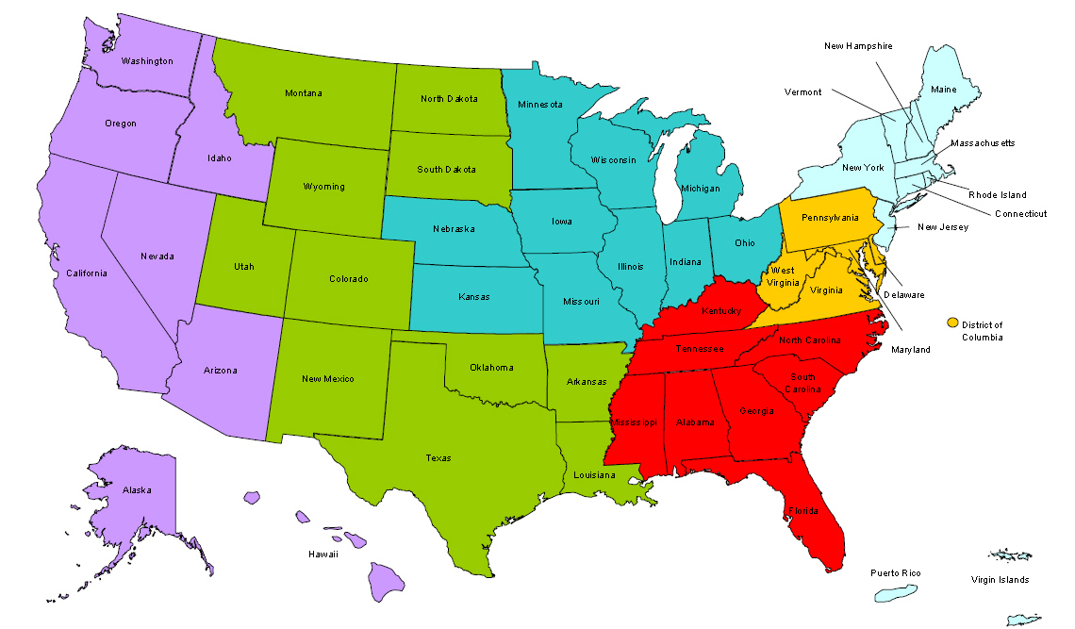
Where are you?
Enter your location in the Chat window – lower left of screen

Slide 3
Why This Session Is Needed
Uniform Guidance changes the process of budget modifications
Budgets provide a blueprint for managing your grant to achieve maximum effectiveness
Budget controls are a necessary and vital tool for an entity's management to control costs and help management anticipate potential problems on a timely basis.
There are tools that you can use to manage your costs in compliance with requirements

Slide 4
Module Objectives
• Understand the processing of budget modifications for discretionary DOL-ETA grants
• Describe how accounting information is tracked and compared against budget
• Explain what kind of grant actions can arise from budget analysis
• Understand the link between budget controls and program effectiveness
• Identify common mistakes

Slide 5
Knowledge Check
On a scale of 1 (lowest) to 5 (highest), rate your knowledge and understanding of the following by circling the appropriate number in the middle column of the sheet, labeled Pre-Training, for each of the statements.
I am fully aware of the requirements for budget controls
I know the format of the federally required budget and how to obtain data
I understand the various methods for budget analysis
I know the grant actions that may result from budget analysis
I am aware of the consequences that arise from failure to comply

Slide 6
BASIC PRINCIPLES AND UNIFORM GUIDANCE CHANGES

Slide 7
What are Budget Controls?
Internal control system
Designed to provide methods to ensure costs are in line with projections
“planned vs. actual” analysis
Require approval from Federal agency for certain items of cost
Identify potential performance issues

Slide 8
Key Uniform Guidance Changes
2 CFR 200.302 Financial management.
Financial Standards 200.302(b)(5)
Comparison of expenditures with budget amounts
200.308 Revision of budget and program plans
200.308(e) Authority to restrict transfer of funds

Slide 9
Discretionary Recipients
IMPORTANT CHANGE - BUDGET MODIFICATION & PRIOR APPROVAL PROCESS
For funds awarded after December 26, 2014, requests for budget modifications must be submitted in writing at least 30 days before the effective date of any change
For grants that exceed the Simplified Acquisition Threshold ($150,000), ETA has the option to require prior approval if budget changes exceed 10% of the total grant award
See 200.308(e), 2900.9, and 2900.10
Replaces previous requirement that all changes in salaries and fringe benefits required Grant Officer approval

Slide 10
Uniform Guidance-DOL Exception
Several DOL exceptions at 2 CFR 2900.9-12
2900.9 Revision of budget and program plans.
Award does not constitute prior approval of those items requiring prior approval
2900.10 Prior approval requests.
Must request prior approval actions at least 30 days prior to the effective date of the requested action

Slide 11
Uniform Guidance-DOL Exception (2)
2900.11 Revision of budget and program plans including extension of the period of performance
Must request prior approval for an extension to the period of performance
2900.12 Revision of budget and program plans approval from Grant Officers.
Unless otherwise noted in the Grant Agreement, prior written approval must come from the Grant Officer (See 200.308(d))

Slide 12
Standard Form 424A
(SF-424A)
Required budget format
As contained in the grant agreement
Assists to ensure budget controls in place
By object class as linked to recipient expenditure records

Slide 13
Budget Narrative
Clearly written narrative
Links appropriate resources to meet project objectives
Budget in line with resources requested
Qualifications of key staff sufficient to assure proper direction, management and completion of the project

Slide 14
BUDGET PURPOSE AND PREPARATION

Slide 15
Budget Purposes
Quantify planned actions & activities
Facilitate communication
Including program and fiscal staff and management
Allocate resources
Benchmark in comparing actual results
Basis for evaluating and improving performance
Basis for course correction

Slide 16
SF-424A Budget Categories

Slide 17
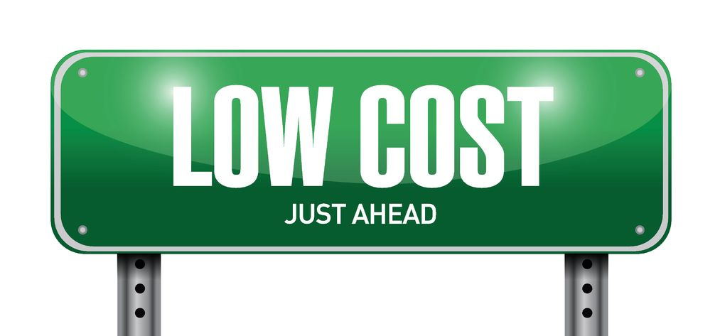
Additional Items to Track
Administrative costs
Program costs
Cost limitations
E.g., support costs
Match requirements
Direct costs
Cost allocation plan

Slide 18
Budget Controls
Accounting records need to track to budget categories
Linking spreadsheets or chart of accounts
Spending according to quarterly budget estimates
Spending within approved line items
Awardee level
Subawardee level

Slide 19
Budget Controls (2)
Monitor costs and make adjustments
Pass-through entity level
Subrecipient levels
Indication of potential modification needs
To redirect unused funds for more effective utilization
To make administrative adjustments for unanticipated changes

Slide 20
BUDGET ANALYSIS AND USE

Slide 21
Components of Budget Analysis
Compare actual results with budget plan
All budget categories
At least quarterly but more often if red flags
Identify significant variances
Analyze cause(s) of variances
Identify and take appropriate corrective action
Conduct trend analysis over time
Compare results from one period to the next
Track impact of corrective actions
Combine the analysis of financial and program performance indicators

Slide 22
Budget Analysis Worksheet

Slide 23
Total Expenditure Analysis

Slide 24
Tracking Overall Expenditures
Overall expenditures
Is the grant “on-track”?
Spending too fast or too slow?
Are costs proportionate to outcomes?
Where does data come from?
Grant books of account as reported

Slide 25
Administrative Costs Analysis

Slide 26
Tracking Administrative Expenditures
Administrative expenditures
Are costs appropriately reported?
Are your costs within limitation?
Is your expenditure rate “too fast” or “too slow”?
Where does data come from?
Grant books of account
ETA 9130

Slide 27
Match Expenditures

Slide 28
Tracking Match Expenditures
Match expenditures (if required)
Are you reporting required match?
Is match generated at an appropriate rate?
Where does the data come from?
SF-424A, Section C, Line 8e (Requirement)
Books of account as reported on ETA 9130
Not applicable to formula or most discretionary programs

Slide 29
Performance Analysis

Slide 30
Tracking Outcomes
Enrollment or performance outcomes
“On-track” to meet service outcomes of grant?
Phased training transitions?
Curriculum development?
Performance standards?
Where does the data come from?
Data provided on quarterly narrative reports
Data provided on the quarterly performance reports

Slide 31
Combined Analysis
Combined analysis of financial and program results at the end of the 5th quarter of a 12 quarter period of performance
41.67% of grant time elapsed
27.66% of total award expended
51.54% of allowable admin costs expended
34.68% of required match expended
42.75% of total planned enrollments
39.06% of planned training enrollments

Slide 32
Analyze the Results
Are expenditures consistent with the budget?
Have you exceeded any budget line item(s)?
How??
Planned vs. actual analysis
Trend analysis over time

Slide 33
Analyze the Results (2)
Grant start-up
Too slow or too fast
Single large item purchases
Look for trends over time
Continued under or over spending
Comparisons with performance data
Analysis should be performed quarterly

Slide 34
What do you do with results?
Determine compliance with budget control requirements
Identify if budget modification may be needed:
Is there a need to move funds between categories?
Review requirements of 200.308 and 2900.12 to determine if Grant Officer approval is required prior to moving funds among line items

Slide 35
Common Mistakes
Consequences of Lack of Budget Controls
Primarily: failure to compare planned expenditures to actual expenditures
Failure to have link between budget categories and chart of accounts
Failure to control expenditures
Modifications not requested timely
Over-expenditure or under-expenditure
Failure to link financial and program performance
Failure to communicate

Slide 36
Knowledge Check
On a scale of 1 (lowest) to 5 (highest), rate your knowledge and understanding of the following by circling the appropriate number in the final column of the sheet, labeled Post-Training, for each of the statements.
I am fully aware of the requirements for budget controls
I know the format of the federally required budget and how to obtain data
I understand the various methods for budget analysis
I know the grant actions that may result from budget analysis
I am aware of the consequences that arise from failure to comply

Slide 37
Key Concepts
You should know and understand the components of the budget and how this is used to monitor program and financial activity
The requirements for budget controls and analysis are contained in the Uniform Guidance
There are a number of tools available for use in performing budget analysis
All financial activity should also be compared to performance activity to achieve effectiveness

Slide 38
Administrative costs

Slide 39
Administrative Costs
Not every program uses same definition
Not all grants have same limits
Includes Direct and Indirect Administrative Cost
Reporting on 9130 Line 10f

Slide 40
Administrative v. Program: Administrative Costs
Costs associated with carrying out administrative and general management functions
Accounting, Budgeting, Payroll, Procurement, Cash Management
Facilities, Property Management, Insurance, Personnel
Monitoring, Audit, Investigations, Incident Reports, Resolution activities
General legal, Human Resources
Automated systems, maintenance, equipment
Any contract or sub-award that is “administrative” in function

Slide 41
Administrative v. Program: Administrative Costs
Costs associated with carrying out administrative and general management functions
Accounting, Budgeting, Payroll, Procurement, Cash Management
Facilities, Property Management, Insurance, Personnel
Monitoring, Audit, Investigations, Incident Reports, Resolution activities
General legal, Human Resources
Automated systems, maintenance, equipment
Any contract or sub-award that is “administrative” in function

Slide 42
Administrative v. Program: Program Costs
Costs directly associated with the functions dealing with participants and training are program costs
Costs not considered administrative in definition or nature
Costs related to participants; direction, supervision, management, tracking
Costs related to training, providers, LMI, performance
Cost directly associated with a program activity or participant

Slide 43
Match

Slide 44
Basic Criteria for Match
200.306(b) provides the following criteria:
Verifiable in recipient records
Not used to support another Federally funded program
Necessary and reasonable
Allowable cost under Cost Principles
Not paid with Federal funds
Provided for in approved budget
Conform to other applicable Uniform Guidance provisions
DOL exception at 2900.8
Contributions are accounted for as funds are expended

Slide 45
Basic Criteria for Match
200.306(b) provides the following criteria:
Verifiable in recipient records
Not used to support another Federally funded program
Necessary and reasonable
Allowable cost under Cost Principles
Not paid with Federal funds
Provided for in approved budget
Conform to other applicable Uniform Guidance provisions
DOL exception at 2900.8
Contributions are accounted for as funds are expended

Slide 46
Two Types of Match Expenditures
Non-Federal Cash expenditures
Funds or services provided and paid for by recipient or subrecipient from non-Federal funds
Payment for services that are allowable under the grant
3rd party cash contributions to recipient that are spent by the recipient on allowable costs
In-kind contributions
Products, space or services provided by a third party organization and not paid for by recipient or subrecipient
Both cash and in-kind contributions must be for activities that are allowable under the grant

Slide 47
Match Examples
Personnel services not paid for with grant funds or other Federal funds
Grantee/subrecipient staff
3rd party services not paid for with grant funds
Equipment & supplies expended by the grant but not paid for with grant funds
Unrecovered or unclaimed indirect costs
Donated Space
Other recipient/subrecipient resources used to support the grant but not charged to the grant
Meets the standards for allowable costs to the grant but are not charged to grant funds

Slide 48
Match Exclusions
Costs
Paid for with Federal funds
Used as match for another Federal program
Construction/purchase of facilities (WIA)
Except YouthBuild
Expenditure of program income

Slide 49
In-Kind Contribution Examples
Personnel services
Volunteers or paid non-recipient staff
Services provided by a third party
Equipment & supplies donated for grant use
Space donated for grant use
Valuation standards in prior Circulars
29 CFR Part 97.24(b)(7) governments
29 CFR Part 95.23(c-h) non-profits
Valuation standards in Uniform Guidance
2 CFR 200.306 and .434

Slide 50
Valuation of In-Kind
200.306 and 200.434
Personnel Services
Individual performing regular job activity
Regular rate of pay + allocable fringe benefits
Individual performing other volunteer services
Rates consistent with recipient pay for like work or
Rates of pay for similar work in the local area
Include reasonable amount for fringe benefits

Slide 51
Valuation of In-Kind (2)
Loaned equipment: Fair rental value
Donated Supplies
Fair market value at time of donation
Donated equipment or supplies
Fair market value at time of donation or
Depreciation [when item has long term value]
Donated space use
Fair rental value of comparable space
Depreciation
Donated buildings and land
Depreciation

Slide 52
Documentation
Source documentation 200.306(b)
Recorded in books of account
Included in audit scope & review
Support for 3rd party contributions
Verifiable from subrecipient records or
Maintained by recipient
Methods used to value in-kind
If not expended and not in the financial records, it does not qualify as match
Same type of financial records needed for match as for grant expenditures

Slide 53
Common Errors
Do not verify 3rd party records to support claimed match
Need to monitor
3rd parties do not retain match records
Need to collect records or ensure their proper storage
Rely on letters of intent and undocumented assurances
Not acceptable documentation
Staff costs as match not supported
Need time records to support
Value of in-kind contributions not documented or supported
Apply same standard as with direct grant expenditures
Use valuation methods cited in this training
Cannot be counted as BOTH match/leveraged resource and allowable grant cost

Slide 54
Closeout
If required match is not met:
Determination whether required by statute or regulation
If required under statute or regulation, federal share is proportionally reduced
Shortfall may affect future award potential
Remember that required match must be reported on the ETA 9130 under line 10.j., Total recipient share required
When leveraged resources are not met:
No formal penalty
May affect future funding

Slide 55
Recipient Share
10j. Total Recipient Share Required: = Required Match
10k. Recipient Share of Expenditures
10l. Recipient Share of Unliquidated Obligations
10m. Total Recipient Share [Calculated]
10n. Remaining Recipient Share to be Provided [Calculated]

Slide 56
Recipient Share (2)
10l. - Unliquidated Obligations
10m. - Total Recipient Share (Calculated)
10n. - Remaining Recipient Share to be Provided Balance of Match not yet provided. (Calculated)

Slide 57
“Get your facts first, then you can distort them as you please.”
-Mark Twain
THANK YOU!
PLEASE COMPLETE YOUR EVALUATIONS

Slide 58
Please enter your questions in the Chat Room!

Slide 59
www.workforce3one.org

