Slide 1
Internal Controls: Establishing an Effective Control Environment
Webinar Date: Thursday, July 16, 2015
Presented by:
Office of Grants Management
U.S. Department of Labor
Employment and Training Administration

Slide 2
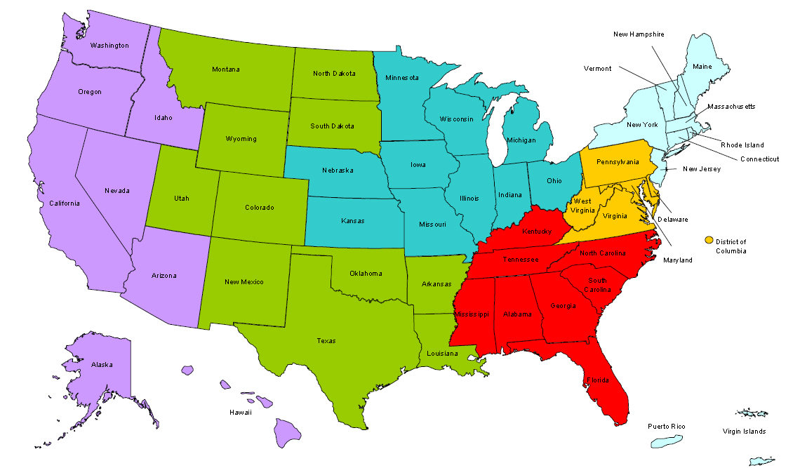
Where are you?
Enter your location in the Chat window – lower left of screen

Slide 3

Why This Session Is Needed
Both recipients and subrecipients are responsible for ensuring funds are used properly
Internal Controls impact every aspect of an organization:
  Are effective only when people and environment work together
  Help prevent fraud, waste
  and abuse
^{Internal Controls}

Slide 4
Module Objectives
Describe the Uniform Guidance requirements for financial management systems
Discuss the definitions and requirements of internal controls as outlined in the Uniform Guidance
Describe the components of an effective internal control framework
Identify and describe key internal control activities
Identify consequences of ineffective controls
^{Internal Controls}

Slide 5
Knowledge Check
On a scale of 1 (lowest) to 5 (highest), rate your knowledge and understanding of the following by circling the appropriate number in the middle column of the sheet, labeled Pre-Training, for each of the statements.
I am knowledgeable of the Financial Management standards in the
Uniform Guidance
I understand the new Internal Control definitions and requirements in the Uniform Guidance.
I am familiar with the five integrated components of Internal Control
per the COSO* Framework
I understand the difference between reasonable and absolute assurance
I am knowledgeable of effective Internal Control practices
* - Committee of Sponsoring Organizations of the Treadway Commission

Slide 6
What’s New?
Increased focus on internal controls in the Uniform Guidance
Subpart D—Post Federal Award Requirements, Standards for Financial and Program Management
  200.303 Internal Controls
    The guidance from Audit Requirements to Standards for Financial and Program Management is moved to this section.
^{Internal Controls}

Slide 7
Resources for Internal Control Guidance
Uniform Guidance identifies two documents
  “Standards for Internal Control in the Federal Government,“ also known as the “Green Book,” issued by the Comptroller General of the United States
  http://www.gao.gov/assets/670/665712.pdf
  “Internal Control Integrated Framework“ issued by the Committee of Sponsoring Organizations of the Treadway Commission (COSO)
  http://www.coso.org/documents/990025P_Executive_Summary_final_may20_e.pdf
^{Internal Controls}

Slide 8
FINANCIAL MANAGEMENT SYSTEMS

Slide 9
Financial Management
Systems
200.302 Financial management
States must follow state laws and procedures
Non-federal entities must have systems, policies, and procedures in place by which they manage funds and activities to provide assurance that Federal funding will be used for the purpose intended in compliance with the requirements of the Federal award.
^{Internal Controls}

Slide 10
Seven Financial
Management Standards
Identification of all Federal receipts and expenditures by:
  CFDA Title and Number
  Award ID and year
  Federal agency name
  Name of pass-through entity, if any
Accurate, current, and complete disclosure
Records that identify source and application of funds
Effective control over and accountability for assets
Comparison of expenditures to budgets
Written procedures for payments
Written procedures for allowable costs
^{Internal Controls}

Slide 11
Seven Financial
Management Standards
Identification of all Federal receipts and expenditures by:
  CFDA Title and Number
  Award ID and year
  Federal agency name
  Name of pass-through entity, if any
Accurate, current, and complete disclosure
Records that identify source and application of funds
Effective control over and accountability for assets
Comparison of expenditures to budgets
Written procedures for payments
Written procedures for allowable costs
^{Internal Controls}

Slide 12

Effective
Management Systems
Effective financial management systems include:
  Clear delineation of roles and responsibilities
  Written policies and procedures
  Training
  Internal controls
  Effective oversight
  Effective communication and information sharing
Financial systems that provide reliable and current information
  Accounting controls
  Accurate, timely reports
  Budget controls
  Asset management
  Record retention/access controls
^{Internal Controls}

Slide 13
Internal Controls Defined
200.61 Internal controls
A process designed to provide reasonable assurance regarding the achievement of objectives in the following categories:
  Effectiveness and efficiency of operations
  Reliability of internal and external reporting
  Compliance with laws and regulations
^{Internal Controls}

Slide 14
Internal Control over
Compliance Requirements
200.62 Internal Control over compliance requirements for Federal Awards
A process to provide reasonable assurance that
(a) Transactions properly recorded/accounted to:
  Permit the preparation of financial statements and reports;
  Maintain accountability over assets
  Demonstrate compliance with Federal statutes, regulations, and terms and conditions of the Federal award
^{Internal Controls}

Slide 15
Internal Control over
Compliance Requirements (2)
(b) Determine that transactions executed in compliance with:
  Federal statutes, regulations, the terms and conditions of Federal award
  Any other Federal statutes and regulations identified in the Compliance Supplement
(c) Ensure funds, property, and other assets are safeguarded.
^{Internal Controls}

Slide 16
Uniform Guidance
Requirements
200.303 Internal controls
The non-Federal entity must:
  a) Have effective internal controls over Federal awards that provide reasonable assurance
  b) Comply with Federal statutes, regulations, and the terms and conditions
  c) Evaluate and monitor compliance
  d) Take prompt action when instances of noncompliance are identified
  e) Safeguard protected personally identifiable information (PII) and other sensitive data.
^{Internal Controls}

Slide 17
Uniform Guidance
Requirements (2)
200.303 Internal controls
The non-Federal entity must:
  a) Have effective internal controls over Federal awards that provide reasonable assurance
  b) Comply with Federal statutes, regulations, and the terms and conditions
  c) Evaluate and monitor compliance
  d) Take prompt action when instances of noncompliance are identified
  e) Safeguard protected personally identifiable information (PII) and other sensitive data.
^{Internal Controls}

Slide 18
INTERNAL CONTROL FRAMEWORK

Slide 19
The COSO*
View of Internal Control
Internal control is a process:
Effected by an entity’s board of directors, management, other personnel
Designed to provide reasonable assurance regarding the achievement of objectives relating to operations, reporting and compliance.
* Committee of Sponsoring Organizations of the Treadway Commission
^{Internal Controls}

Slide 20
Internal Control Framework…
Five Inter-Related Components
Risk
Assessment
Control
Activities
Information &
Communication
Monitoring
Control Environment
^{Internal Controls}

Slide 21
(1) Control Environment
Foundation for all other standards of internal control.
Pervasive influence on all the decisions and activities of an organization.
Effective organizations set a positive “tone at
the top”.
Factors include the integrity, ethical values and competence of employees, and, management’s philosophy & operating style.
^{Internal Controls}

Slide 22
(2) Risk Assessment
Risks are internal and external events that threaten the accomplishment of objectives.
Risk assessment is the process of identifying, evaluating, and deciding how to mitigate them…
  What is the likelihood of the event occurring?
  What would be the impact if it were to occur?
  What can we do to prevent or reduce the risk?
  What is the vulnerability or likelihood of loss?
^{Internal Controls}

Slide 23
(2) Risk Assessment
Risks are internal and external events that threaten the accomplishment of objectives.
Risk assessment is the process of identifying, evaluating, and deciding how to mitigate them…
  What is the likelihood of the event occurring?
  What would be the impact if it were to occur?
  What can we do to prevent or reduce the risk?
  What is the vulnerability or likelihood of loss?
^{Internal Controls}

Slide 24
(2) Risk Assessment for Equipment
200.313 Equipment
Secure and restrict access to equipment to reduce the risk of loss or unauthorized use.
Perform periodic physical inventories to verify existence, quantities, location, condition, and utilization.
Base the level of security on the vulnerability of items being secured, the likelihood of loss, and the potential impact should a loss occur.
  These principles apply to other assets as well: cash, credit cards, laptops, supplies, etc.
^{Internal Controls}

Slide 25
(3) Control Activities
Tools: Policies, Procedures, and Processes
Designed and implemented to help ensure that management directives are carried out.
Help prevent or reduce the risks that can impede the accomplishment of objectives.
Occur throughout the organization, at all levels, and in all functions.
Includes approvals, authorizations, verifications, reconciliations, security of assets, reviews of operating performance, and adequate separation of duties.
^{Internal Controls}

Slide 26
(3) Control Activities:
Separation of Responsibilities
To the extent possible, separation should be employed for the following responsibilities:
Custodian – A separate person holds or has custody of the asset
Authorization – A separate person authorizes the transaction
Record – A separate person records the transaction
Reconcile – A separate person reconciles the transaction
^{Internal Controls}

Slide 27

(4) Communication and Information
Pertinent information must be captured, identified and communicated on a timely basis.
Effective information and communication systems enable the organization’s people to exchange the information needed to conduct, manage, and control its operations.
Records and information systems must be sufficient to provide reliable reporting and demonstrate compliance with the federal award.
^{Internal Controls}

Slide 28
(5) Monitoring
Internal control systems must be monitored to assess their effectiveness… Are they operating as intended?
Ongoing monitoring is necessary to react to changing conditions…Have controls become outdated, redundant, or obsolete?
Monitoring occurs in the course of everyday operations; it includes regular management & supervisory activities and other actions personnel take in performing their duties.
It also includes the process of monitoring subrecipients for compliance with requirements and taking appropriate actions to correct deficiencies.
^{Internal Controls}

Slide 29
KEY INTERNAL CONTROL ACTIVITIES

Slide 30
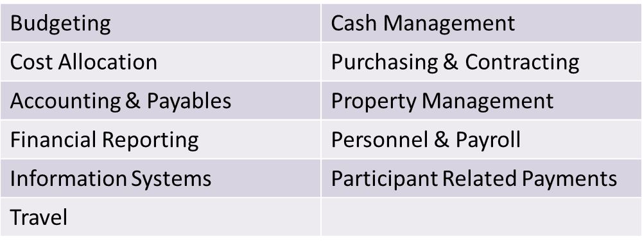
Key Areas
Strong internal controls along with adequate separation of duties are needed in the following key financial and program areas:
^{Internal Controls}

Slide 31
Effective Internal Controls
Benefits rather than encumber management
Are cost-effective
Safeguards assets
Encourages adherence to company’s polices and procedures
Promotes operational efficiency
^{Internal Controls}

Slide 32
Effective Control
for Small Entities
Same standards as large entities but different implementation
Small entities have some advantages
  Management more involved in operations
  Direct interaction with staff
  Easier lines of communication
  Use compensating controls
    Add levels of review, random transaction reviews
^{Internal Controls}

Slide 33
Internal Control Limitations
Cost Considerations / Cost v. Benefit
Judgment
Breakdowns
Management Overrides
Risk of Collusion
^{Internal Controls}

Slide 34
Do we really need internal controls?

Slide 35
Weak Internal Controls
Increase Risk Through …
Business Interruption
System breakdowns or catastrophes, excessive
re-work to correct for errors.
^{Internal Controls}

Slide 36
Weak Internal Controls
Increase Risk Through …
Erroneous Management Decisions
Based on erroneous, inadequate or misleading information.
^{Internal Controls}

Slide 37
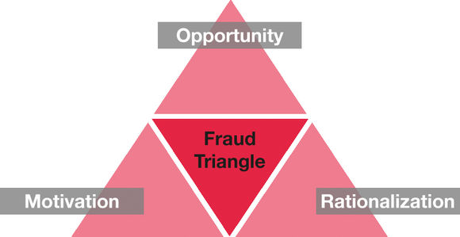
Weak Internal Controls
Increase Risk Through …
Fraud, Embezzlement and Theft
By management, employees, customers, vendors, or the public-at-large.
Loss, Misuse or Destruction of Assets
Unintentional loss of physical assets such as cash, inventory, and equipment.
^{Internal Controls}

Slide 38

Common Contributors to Compliance Deficiencies
Inadequate resources
Lack of understanding of roles and responsibilities of institutional staff
Inadequate staff and subrecipient training and education
Outdated or nonexistent policies and procedures
Inadequate management
systems
^{Internal Controls}

Slide 39
Common Contributors to Compliance Deficiencies
Inadequate resources
Lack of understanding of roles and responsibilities of institutional staff
Inadequate staff and subrecipient training and education
Outdated or nonexistent policies and procedures
Inadequate management
systems
^{Internal Controls}

Slide 40
Helpful Tips
Hire competent, reliable and ethical staff
Set the control environment including compensating controls
Formalize internal control policies and staff responsibilities in writing
Entire staff, including the board, can be incorporated into the process
^{Internal Controls}

Slide 41
EXERCISE – INTERNAL CONTROL QUIZ

Slide 42
Knowledge Check
On a scale of 1 (lowest) to 5 (highest), rate your knowledge and understanding of the following by circling the appropriate number in the final column of the sheet, labeled Post-Training, for each of the statements.
I am knowledgeable of the Financial Management standards in the
Uniform Guidance
I understand the new Internal Control definitions and requirements in the Uniform Guidance.
I am familiar with the five integrated components of Internal Control
per the COSO* Framework
I understand the difference between reasonable and absolute assurance
I am knowledgeable of effective Internal Control practices
* - Committee of Sponsoring Organizations of the Treadway Commission

Slide 43
“If everything seems under control,
you’re just not going fast enough.”
~ Mario Andretti
Thank You!
Please Complete Your Evaluations

Slide 44

Please enter your questions in the Chat Room!

Slide 45



www.workforce3one.org

